Slide 1
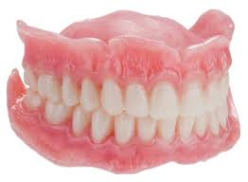
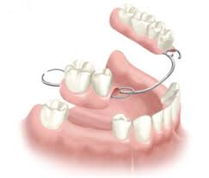
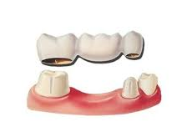
Introduction in prosthodontics
Bushra Mohammed Ali Al-Ameen
B,D,S,. M,Sc.(Pros)

Slide 2
Definitions
Prosthetic: The art and science of supplying artificial replacements for missing parts of the human body.
Prosthodontics (Prosthetic dentistry): It is the branch of dental art and science that deals with the replacement of missing teeth and oral tissues to restore and maintain oral form, function, appearance, and health.
Prosthesis: An artificial replacement of an absent part of the human body.

Slide 3
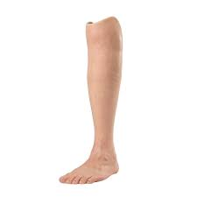
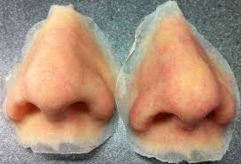
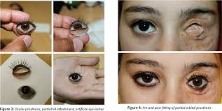
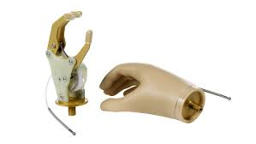
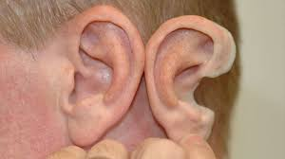
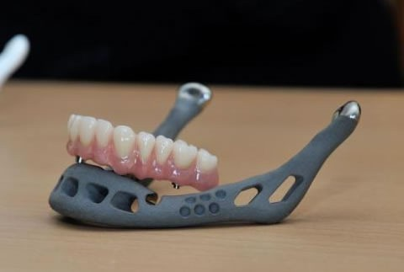
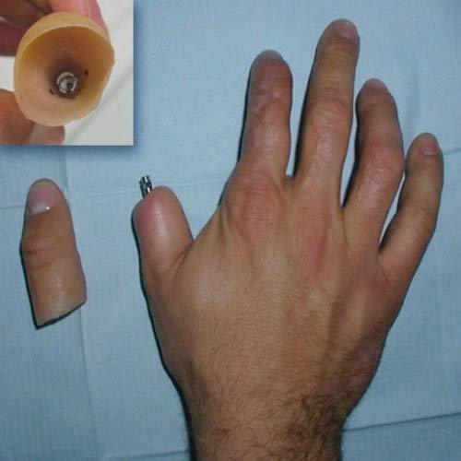
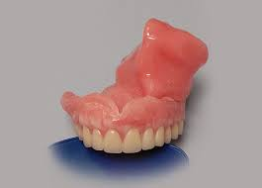

Slide 4
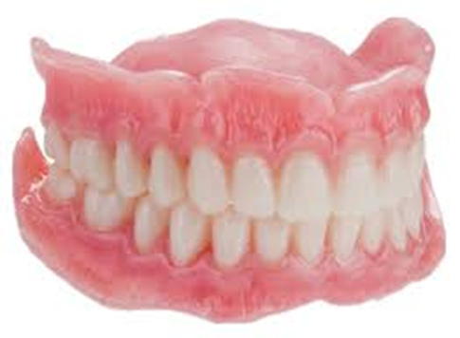

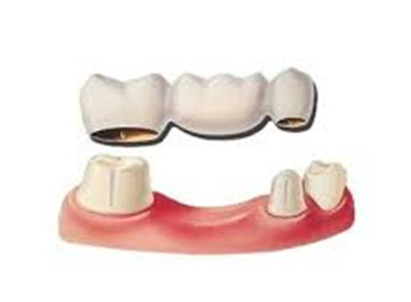
Definitions
Dental prosthesis: An artificial replacement of one or more teeth (up to the entire dentition in the arch) and associated dental and/or alveolar structures.

Slide 5
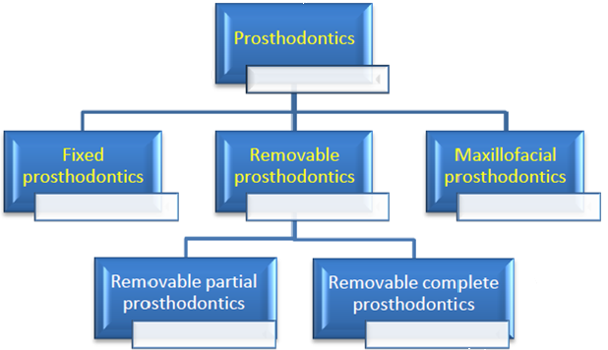

Slide 6
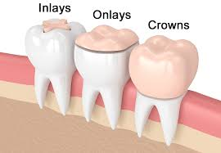
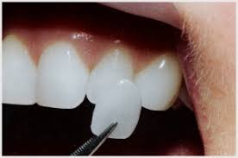
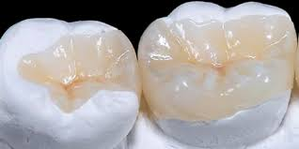
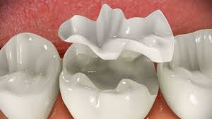
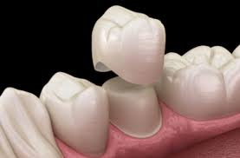
Definitions
Fixed prosthodontics: is the area of prosthodontics focused on permanently attached (fixed) dental restoration, Such as indirect dental restorations, crowns, bridges (fixed dentures), inlays , Onlays, and veneers.

Slide 7


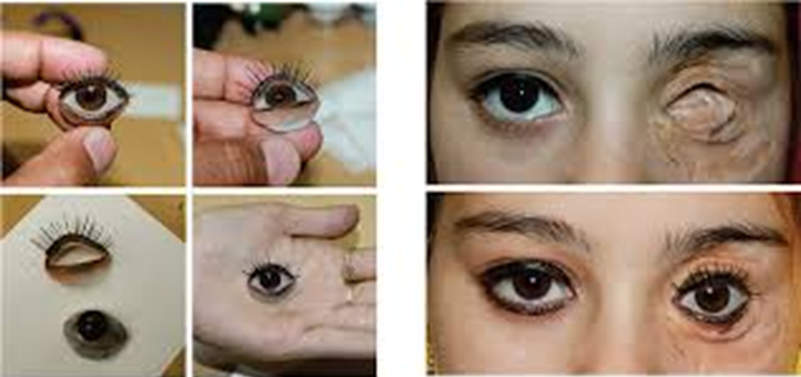
Definitions
Maxillofacial prosthodontics: Maxillofacial prosthodontics is a specialty of dentistry which deals with the rehabilitation of patients with acquired and congenital defects of the head and neck region.

Slide 8
Definitions
Removable dental prosthesis: Any dental prosthesis that replaces some or all teeth in a partially dentate arch (removable partial dental prosthesis) or edentate arch (removable complete dental prosthesis), and can be removed from the mouth and replaced at will.
A removable partial denture (RPD): is a denture for a partially edentulous patient who desires to have replacement teeth for functional or aesthetic reasons and who cannot have a bridge (a fixed partial denture) for any reason, such as a lack of required teeth to serve as support for a bridge (i.e. distal abutments) or financial limitations.
Complete denture: A removable dental prosthesis which replaces the entire dentition and associated structures of the maxilla and mandible.

Slide 9
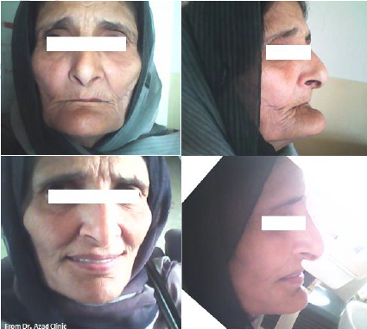
Complete denture
Objective of complete denture:
1) Preservation of the remaining tissues in health state.
2) Restoration of the function of mastication.
3) Restoration of the disturbed facial dimension and contour (esthetic).
4) Correction of speech due to the loss of natural teeth.
5) Satisfaction, pleasing and comfort of the patient.

Slide 10
Complete denture is composed of:
Basal surface (impression surface or tissue surface): the part of a denture that rests on the foundation tissues (the oral structures available to support a denture) and to which the teeth are attached.
Denture occlusal surface: the portion of the surface of a denture that makes contact with its antagonist.
Denture polished surface: the portion of the surface of a denture that extends in an occlusal direction from the border of the denture and includes the palatal surface. It is the part of the denture base that is usually polished, and it includes the buccal and lingual surfaces of the teeth

Slide 11
Complete denture is composed of:
Denture border: the margin of the denture base at the junction of the polished surface and the basal surface.
Denture flange: the part of the denture base that extends from the cervical ends of the teeth to the denture border.

Slide 12
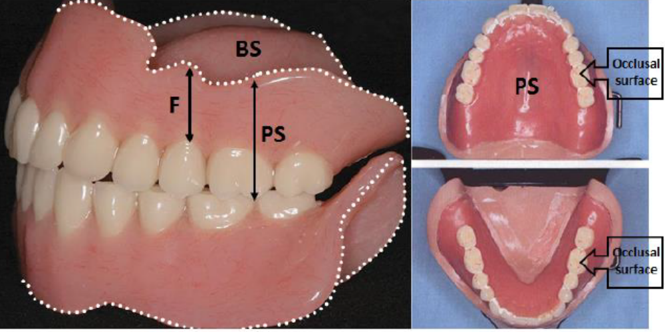
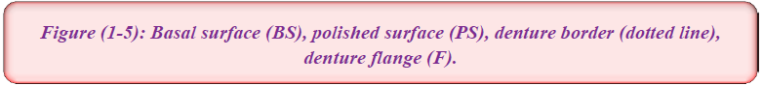

Slide 13
Extra Oral Landmarks

Slide 14
Extra-oral landmarks
The following extra-oral anatomical features should be noted:
Philtrum: is a midline shallow depression of the upper lip, which starts at the labial tubercle and ends at the nose.
Labial tubercle: is a little swelling in the mid portion of the vermillion border of the upper lip.
Vermillion borders: the lip is covered by the skin at its facial surface and the mucous membrane at its inner surface. The transitional area between the skin and the mucous membrane of the upper and lower lips is a pink or red zone of thinner epithelium, which is called the vermillion border.

Slide 15
Extra-oral landmarks
The following extra-oral anatomical features should be noted:
Naso-labial groove: is a furrow of variable depth that extends from the wing (ala) of nose to end at some distance from the corner of the mouth.
Labio-mental groove: is a sharp or deep groove that lies between the lower lip and the chin.

Slide 16
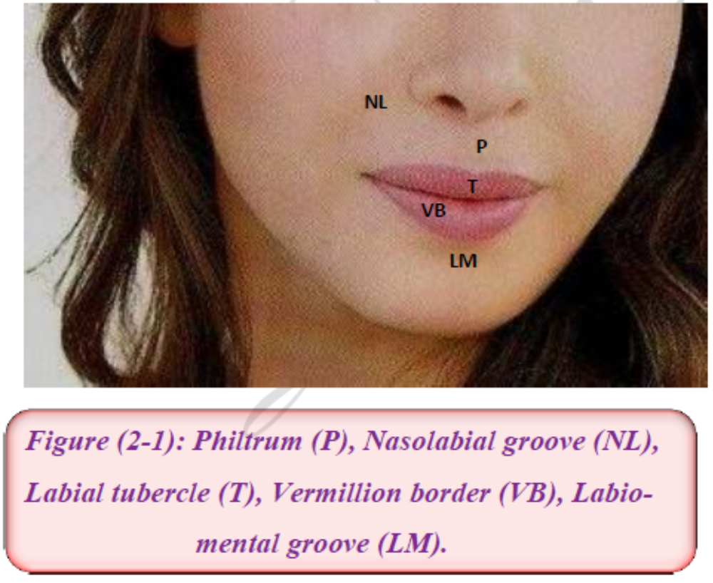
Extra-oral landmarks

Slide 17
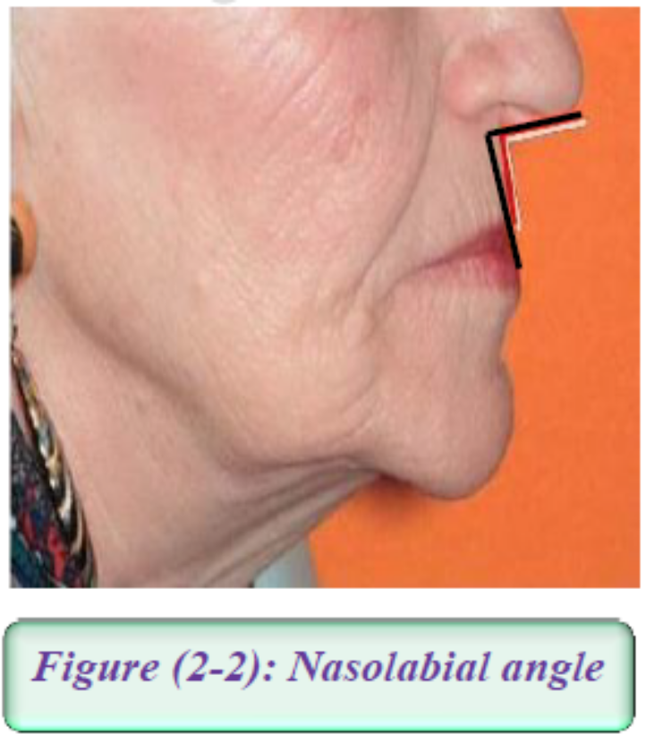
Extra-oral landmarks
The following extra-oral anatomical features should be noted:
Naso-labial Angle: is an angle between columella of nose and philtrum of lip, normally, approximately 90° as viewed in profile.

Slide 18
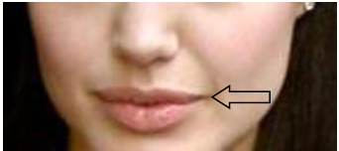
Extra-oral landmarks
The following extra-oral anatomical features should be noted:
Angle of the mouth and Labial commissure: Angle of the mouth is the lateral limit of the oral fissure. Labial commissure is a junction of upper and lower lips lateral to the angle of the mouth.

Slide 19
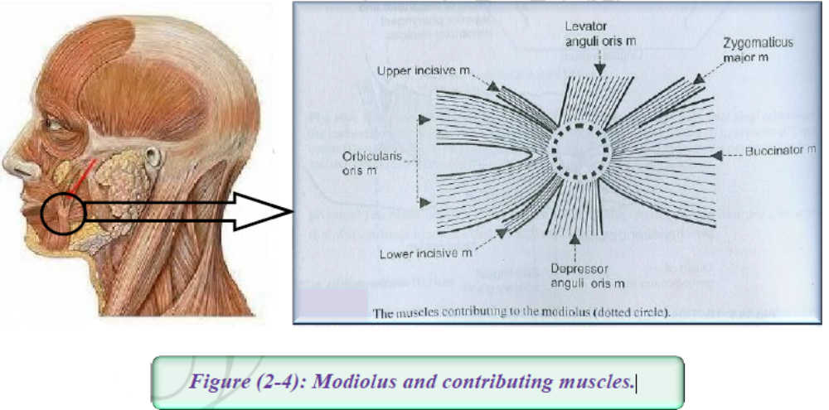
Extra-oral landmarks
The following extra-oral anatomical features should be noted:
Modiolus: This muscular knot is at the angles of the mouth.
Modiolus may lie laterally to the lower premolars so it will displace a lower denture if those teeth are set too far buccally.

Slide 20

THANK YOU

