Slide 1
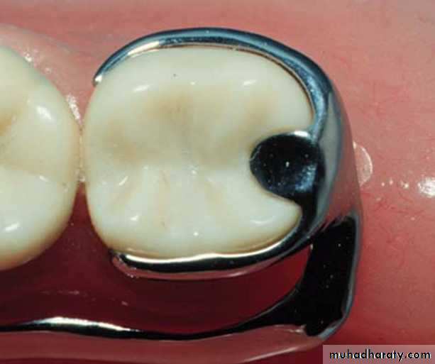
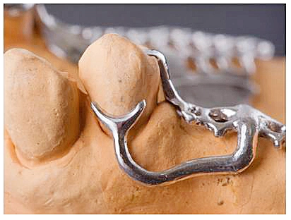
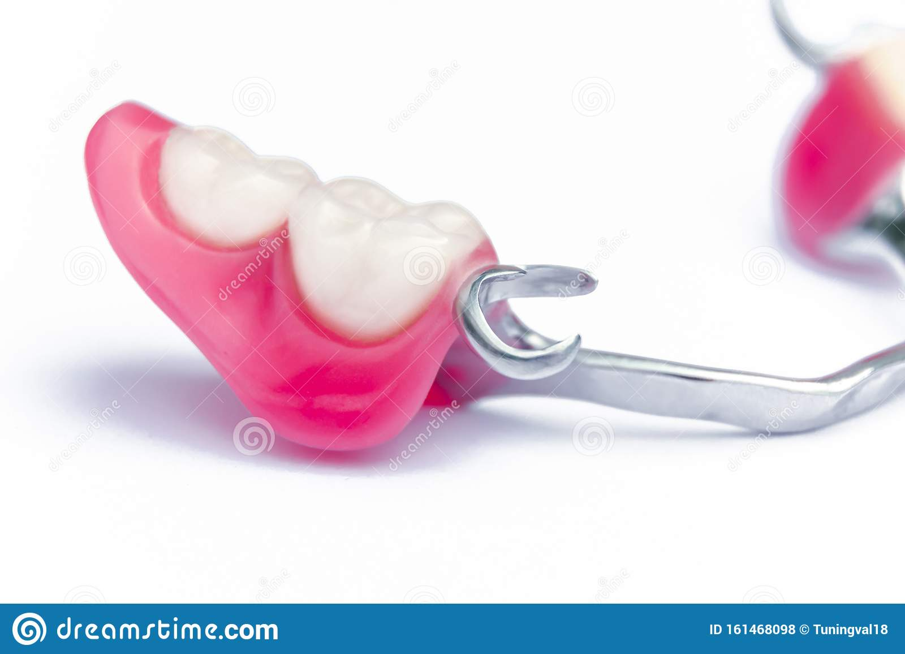
Retainers
Bushra Mohammed Ali Al-Ameen
B,D,S,. M,Sc.(Pros)

Slide 2
In general a removable partial denture should have these requirements:
1-Support: The support derived from the abutment teeth through the use of rests and from the residual ridge through the use of well fitting bases.
2-Stability: Removable partial denture must be stable against horizontal movement through the use of rigid components like reciprocal arm of circumferential clasp and minor connector. Removable partial denture must also be stable against rotational movements through the use of rigid connector and indirect retainers.
3-Retention: Sufficient retention is provided by two means: Primary retention for removable partial denture is accomplished mechanically by placing retaining elements (direct retainers) on the abutment teeth. Secondary retention is provided by the intimate relationship of the minor connector contact with the guiding planes ,denture bases, and major connectors (maxillary) with the underlying tissue .The latter (secondary retention) is similar to the retention of complete denture. It is proportionate to the accuracy of the impression registration, the accuracy of the fit of the denture bases, and the total involved area of contact.

Slide 3
Retainers can be divided into:
I. Direct retainers.
II. Indirect retainers.
Direct retainers
A direct retainer is any unit of a removable dental prosthesis that engages an abutment tooth to resist displacement of the prosthesis away from basal seat tissue.
The direct retainer's ability to resist this movement is greatly influenced by the stability and support of the prosthesis provided by major and minor connectors, rests, and tissue bases.

Slide 4
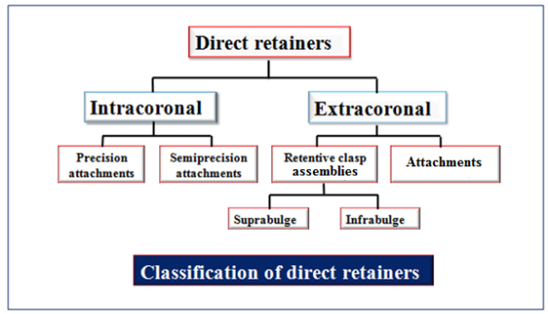
Classification of direct retaners:

Slide 5
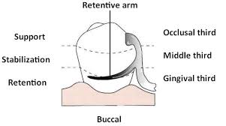
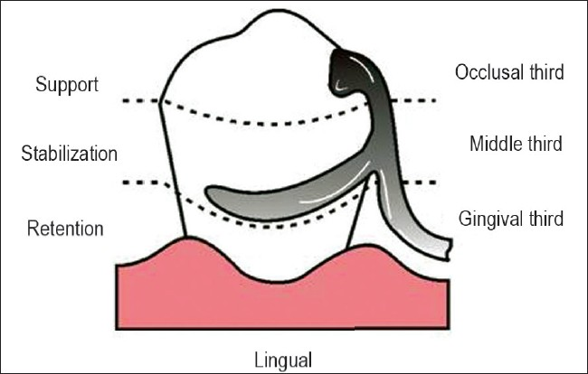
The extracoronal retainer (Clasp type)
The extracoronal retainer is the most commonly used retainer for removable partial dentures, which uses mechanical resistance to displacement through components placed on the external surfaces of an abutment tooth in an area cervical to survey line or in a depression created for this purpose. Usually a flexible arm is forced to deform, so there will be resistance to removal.

Slide 6
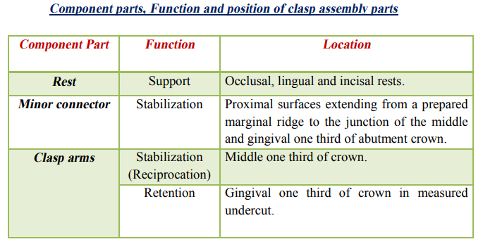
Components of clasp assembly:

Slide 7
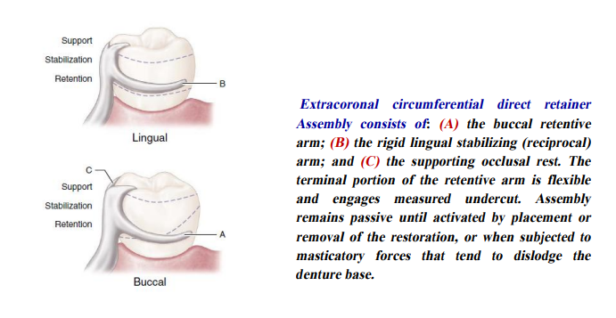


Slide 8
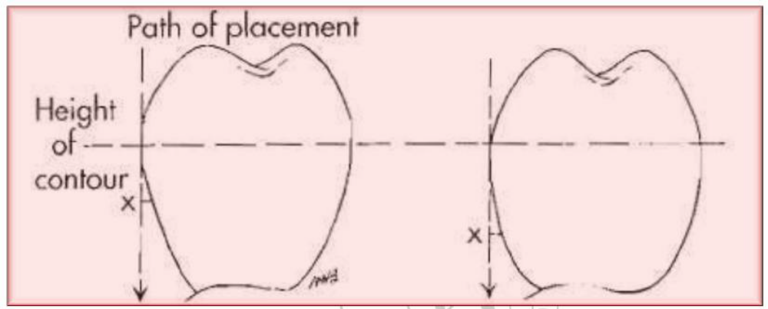
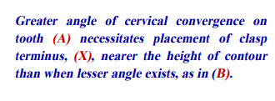
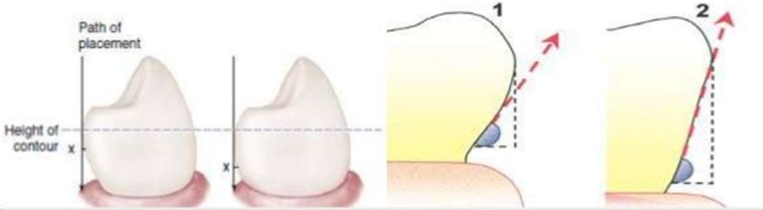
Factors affecting the magnitude of retention
Size of and distance into the angle of cervical (gingival) convergence and how far into the angle of convergence the clasp terminal is placed
To be retentive, a tooth must have an angle of convergence cervical to the height of contour.
When the angle of convergence between two abutments differs, uniformity of retention can be obtained by placing the clasp arms into the same degree of undercut (i.e. both 0.01").A guiding principle of partial denture design is that retention should be uniform in magnitude and bilaterally opposed amongst abutments.

Slide 9
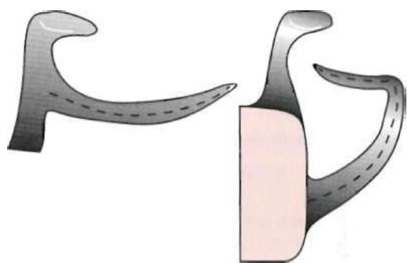
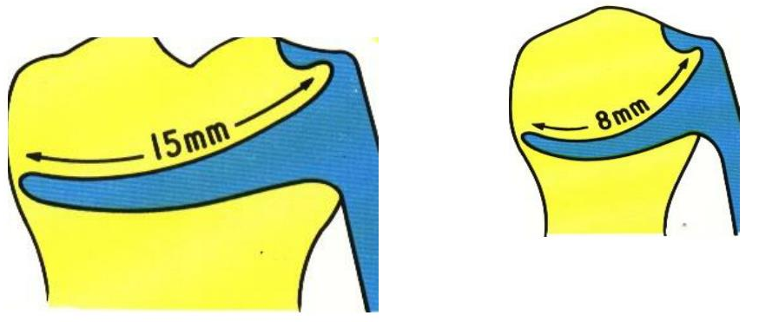
Factors affecting the magnitude of retention
Flexibility of the clasp arm
This is influenced by the following factors:
1. Length of clasp arm
Increase length of clasp arm increase the flexibility of it (increasing clasp curvature increases length).
Length of clasp arm is measured from the point where the taper begins.
Length of clasp arm may be increased by using curving rather than straight retentive arms.

Slide 10
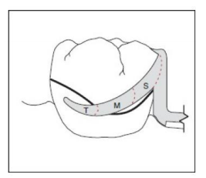
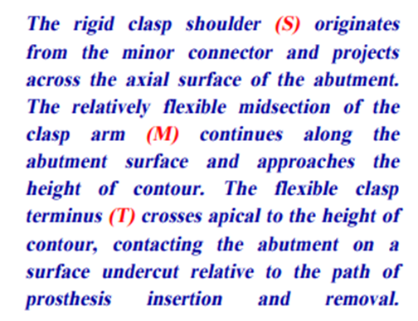
Factors affecting the magnitude of retention
Flexibility of the clasp arm
This is influenced by the following factors:
2. Diameter of clasp
The greater the average diameter of a clasp arm the less flexible it will be.
If it’s taper is absolutely uniform, the average diameter will be at a point midway between its origin and its terminal end. If its taper is not uniform, a point of flexure and therefore a point of weakness will exist.
The clasp should always taper from the body to the tip, being thicker where the body is attached to the denture base metal or acrylic and thinnest at the end of the arm.

Slide 11
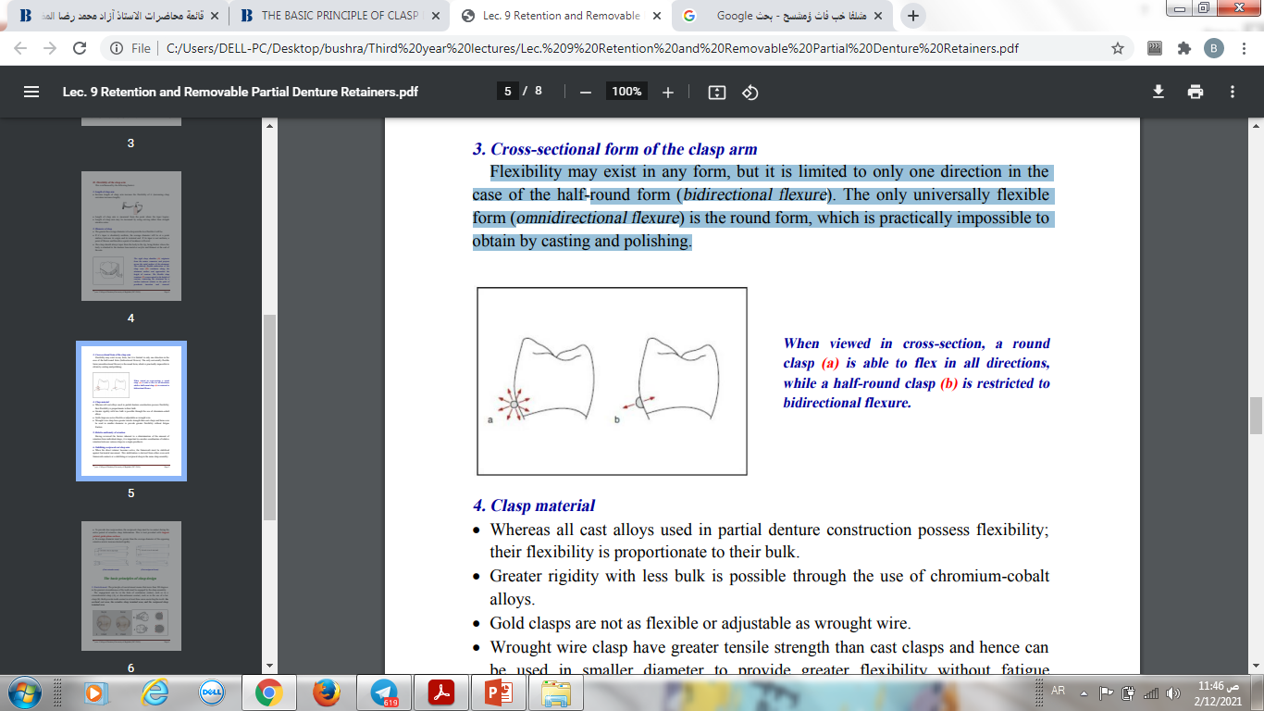
Factors affecting the magnitude of retention
Flexibility of the clasp arm
This is influenced by the following factors:
3. Cross-sectional form of the clasp arm
Flexibility may exist in any form, but it is limited to only one direction in the case of the half-round form (bidirectional flexure). The only universally flexible form (omnidirectional flexure) is the round form, which is practically impossible to obtain by casting and polishing.

Slide 12
Factors affecting the magnitude of retention
Flexibility of the clasp arm
This is influenced by the following factors:
4. Clasp material
Whereas all cast alloys used in partial denture construction possess flexibility; their flexibility is proportionate to their bulk.
Greater rigidity with less bulk is possible through the use of chromium-cobalt alloys.
Gold clasps are bulky and have a high cost.
Wrought wire clasp have greater tensile strength than cast clasps and hence can be used in smaller diameter to provide greater flexibility without fatigue fracture.

Slide 13
Factors affecting the magnitude of retention
Flexibility of the clasp arm
This is influenced by the following factors:
5. Relative uniformity of retention
Having reviewed the factors inherent to a determination of the amount of retention from individual clasps, it is important to consider coordination of relative retention between various clasps in a single prosthesis.

Slide 14
Factors affecting the magnitude of retention
Flexibility of the clasp arm
This is influenced by the following factors:
6. Stabilizing-reciprocal cast clasp arm
When the direct retainer becomes active, the framework must be stabilized against horizontal movement. This stabilization is derived from either cross-arch framework contacts or a stabilizing or reciprocal clasp in the same clasp assembly.

Slide 15
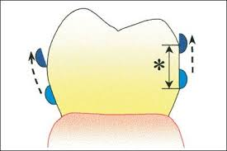
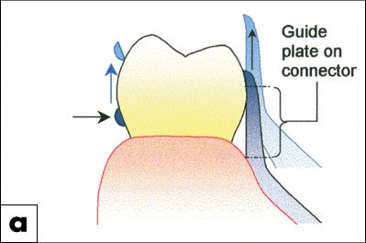
Factors affecting the magnitude of retention
Flexibility of the clasp arm
This is influenced by the following factors:
6. Stabilizing-reciprocal cast clasp arm
To provide true reciprocation, the reciprocal clasp must be in contact during the entire period of retentive clasp deformation. This is best provided with lingual palatal, guide-plane surfaces.
Its average diameter must be greater than the average diameter of the opposing retentive arm to increase desired rigidity.

Slide 16
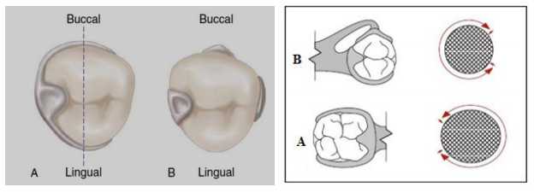
The basic principles of clasp design
Encirclement:
The principle of encirclement means that more than 180 degrees in the greatest circumference of the tooth must be engaged by the clasp assembly.
The engagement can be in the form of continuous contact, such as in a circumferential clasp (A), or discontinuous contact, such as in the use of a bar clasp (B). Both provide tooth contact in at least three areas encircling the tooth: the occlusal rest area, the retentive clasp terminal area, and the reciprocal clasp terminal area.

Slide 17
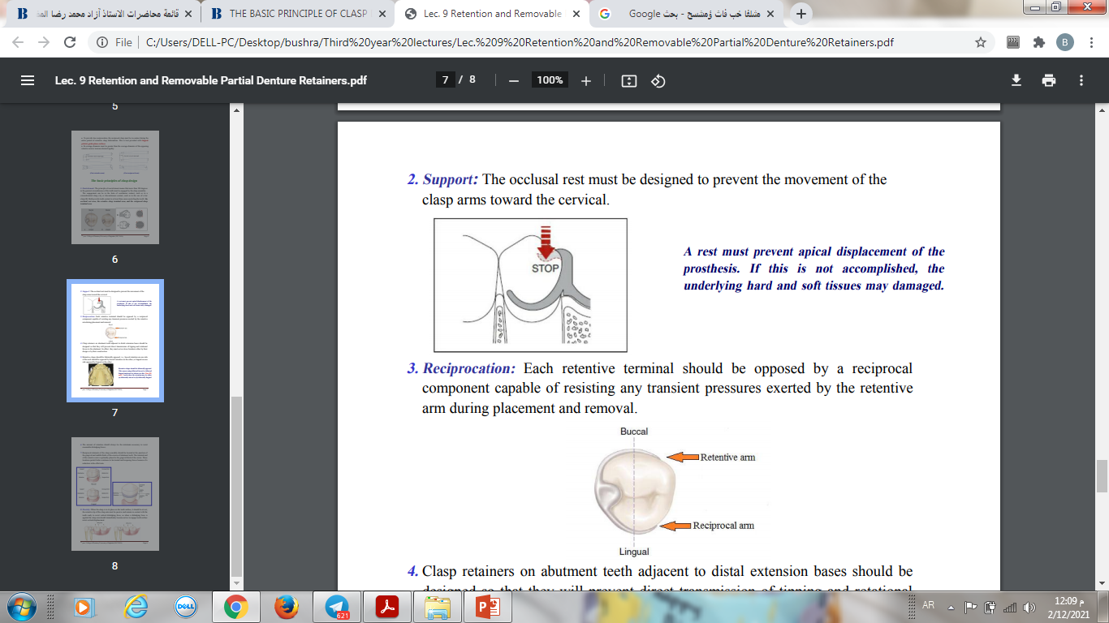
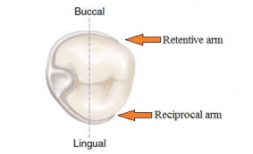
The basic principles of clasp design
2. Support:
The occlusal rest must be designed to prevent the movement of the clasp arms toward the cervical.
3. Reciprocation:
Each retentive terminal should be opposed by a reciprocal component capable of resisting any transient pressures exerted by the retentive arm during placement and removal.

Slide 18
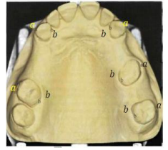
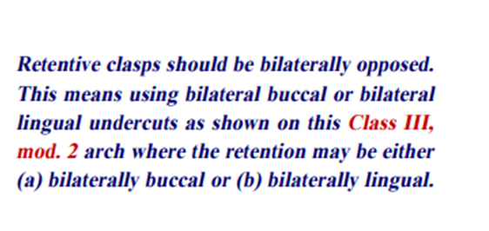
The basic principles of clasp design
4. Clasp retainers on abutment teeth adjacent to distal extension bases should be designed so that they will prevent direct transmission of tipping and rotational forces to the abutment. In effect, they must act as stress breakers either by their design or by their construction.
5. Retentive clasps should be bilaterally opposed, i.e., buccal retention on one side of the arch should be opposed by buccal retention on the other, or lingual on one side opposed by lingual on the other.

Slide 19
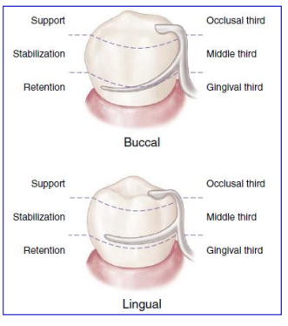
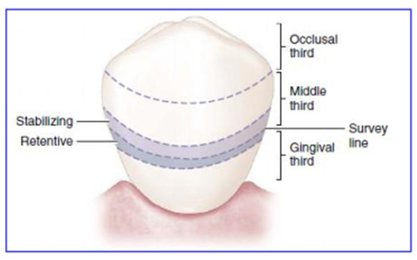
The basic principles of clasp design
6. The amount of retention should always be the minimum necessary to resist reasonable dislodging forces.
7. Reciprocal elements of the clasp assembly should be located at the junction of the gingival and middle thirds of the crowns of abutment teeth. The terminal end of the retentive arm is optimally placed in the gingival third of the crown. These locations permit better resistance to horizontal and torqueing forces because of a reduction in the effort arm.

Slide 20
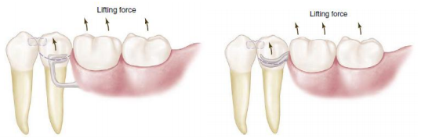
The basic principles of clasp design
8. Passivity:
When the clasp is in its place on the tooth surface, it should be at rest, the retentive tip of the clasp arm must be passive and remain in contact with the tooth ready to resist vertical dislodging force, so when a dislodging force is applied the clasp arm should immediately become active to engage tooth surface resist vertical displacement.

Slide 21
The key to selecting a successful clasp design for any given situation is to choose one that will:
1- Avoid direct transmission of tipping or torquing forces to the abutment.
2- Accommodate the basic principles of clasp design by definitive location of component parts correctly positioned on abutment tooth surfaces.
3- Provide retention against reasonable dislodging forces (with consideration for indirect retention).
4- Be compatible with undercut location, tissue contour, and esthetic desires of the patient.

Slide 22

Thank you

