Slide 1
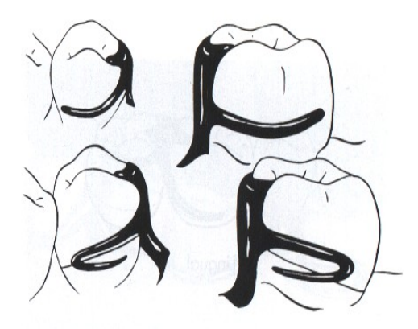
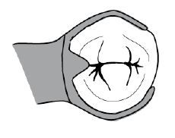
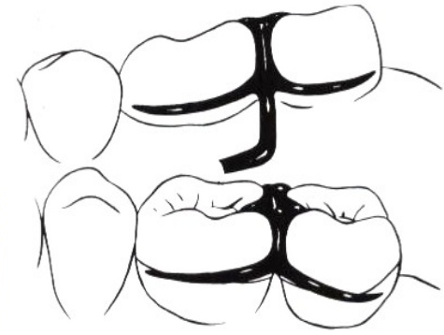
Types of Clasp Assemblies (1)
Bushra Mohammed Ali Al-Ameen
B,D,S,. M,Sc.(Pros)

Slide 2
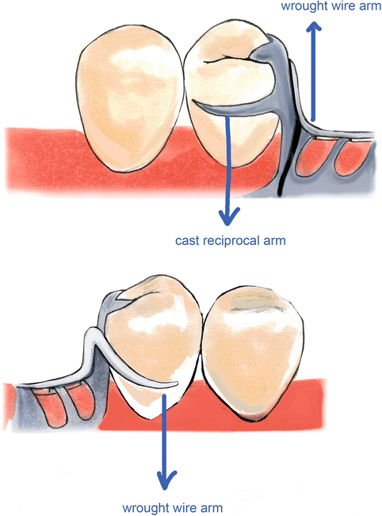
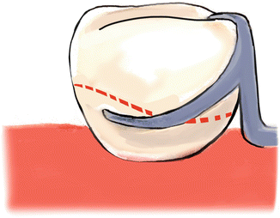
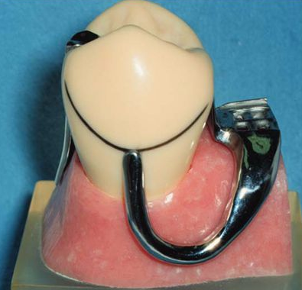
There are 4 principal forms of extracoronal retainers:
Circumferential clasp.
RPI system.
Bar clasp.
Combination clasp.

Slide 3
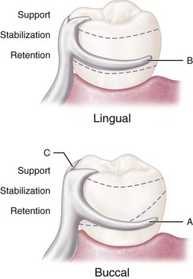
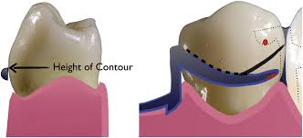
A- Circumferential clasp
It approach the undercut area from occlusal direction, it is called (occlusally approaching clasp), since it is coming to the undercut area above the height of contour so called supra-bulge clasp and since it is pulling the tooth during action so called pull clasp.
Circumferential clasp assembly consists of:
Buccal retentive arm: The terminal portion of retentive arm is flexible and engages measured undercut.
Rigid lingual stabilizing (reciprocal) arm.
Supporting occlusal rest.
Assembly remains passive until activated by placement or removal of restoration or when subjected to masticatory forces that tend to dislodge the denture base.

Slide 4
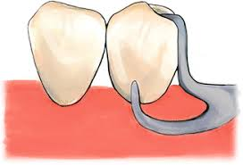
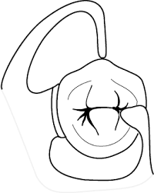
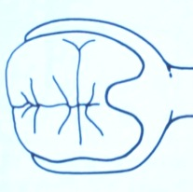
A- Circumferential clasp
Disadvantages:
More tooth surface is covered than with a bar clasp arm.
It may increase the width of the occlusal surface of the tooth.
More metal may be displayed than with the bar clasp arm.
As with all cast clasps, true adjustment is impossible.

Slide 5
Types of circumferential clasps
Basic form of circumferential clasp
Ring Clasp
Embrasure clasp (Butterfly clasp)
Multiple clasp
Half-and-half clasp
Reverse-action clasp (hairpin)
Back-action clasp

Slide 6
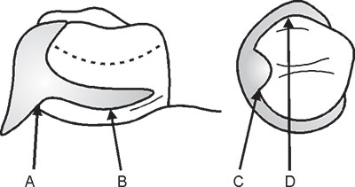
Types of circumferential clasps
Basic form of circumferential clasp:
It is a buccal and lingual arm originating from a common body.
This clasp is used properly when two clasp arms originate from the body and occlusal rest areas and approach bilateral retentive and nonretentive areas on the sides of the tooth away from the point of origin.
It is the clasp of choice for tooth-supported removable partial denture.

Slide 7
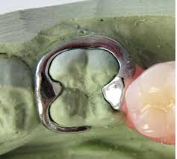
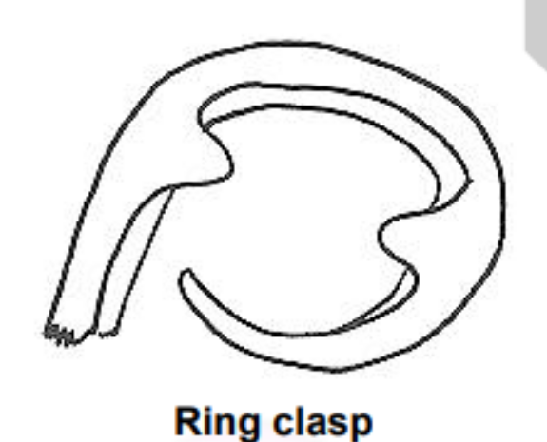
Types of circumferential clasps
Ring Clasp:
It is indicated with isolated mandibular molar abutment.
It encircles nearly all of a tooth from its point of origin.
It is used when a proximal undercut cannot be approached by other means. For example, when a mesiolingual undercut on a lower molar abutment cannot be approached directly because of its proximity to the occlusal rest area and cannot be approached with a bar clasp arm because of lingual inclination of the tooth, the ring clasp encircling the tooth allows the undercut to be approached from the distal aspect of the tooth.
The clasp should never be used as an unsupported ring, because if it is free to open and close as a ring, it cannot provide either reciprocation or stabilization.

Slide 8
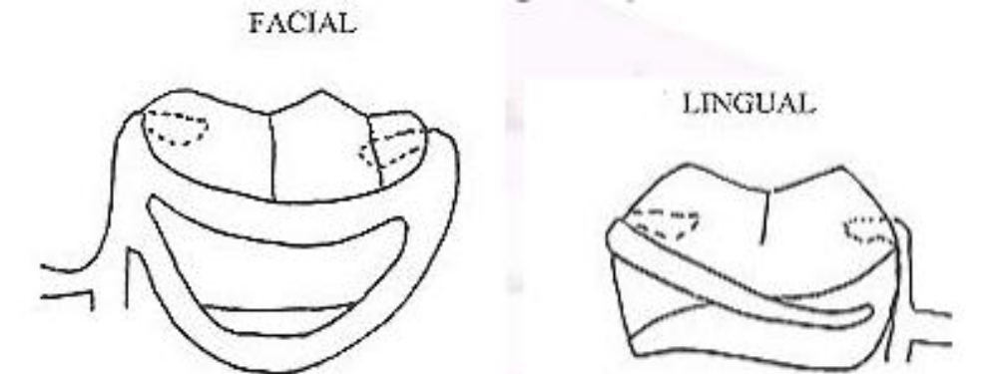
Types of circumferential clasps
Ring Clasp:
It should always be used with a supporting strut on the non-retentive side, with or without an auxiliary occlusal rest on the opposite marginal ridge.

Slide 9
Types of circumferential clasps
Ring Clasp:
Advantages:
Provides adequate encirclement.
Excellent retention with adequate flexibility due to increased length of clasp arm.
The advantage of an auxiliary rest is that further movement of a mesially inclined tooth is prevented by the presence of a distal rest.
Disadvantages:
Decalcification of teeth.
Increased occlusal table.
Poor esthetics, Esthetics need not be considered on such a posteriorly located tooth.

Slide 10
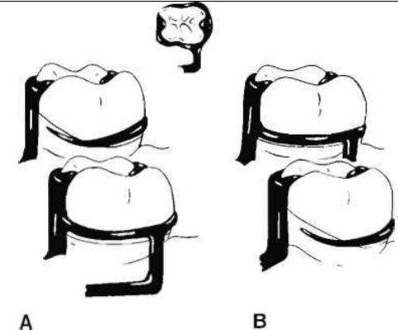
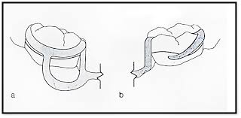
Types of circumferential clasps
Ring Clasp:
Ring clasp encircling nearly all of tooth from its point of origin. A, Clasp originates on mesiobuccal surface and encircles tooth to engage mesiolingual undercut. B, Clasp originates on mesiolingual surface and encircles tooth to engage mesiobuccal undercut. In either example, supporting strut is used on non-retentive side.
A ring-type clasp may be used in reverse on an abutment located anterior to a tooth bounded edentulous space. The only justification for its use is when a distobuccal or distolingual undercut cannot be approached directly from the occlusal rest area and/or tissue undercuts prevent its approach from a gingival direction with a bar clasp arm.

Slide 11
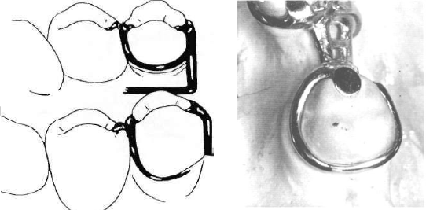
Types of circumferential clasps
Ring Clasp:
Improperly designed ring clasp lacking necessary support. Such a clasp lacks any reciprocating or stabilizing action because entire circumference of clasp is free to open and close.

Slide 12
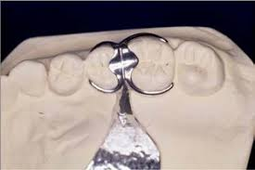
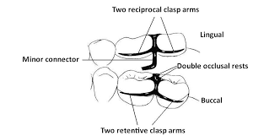
Types of circumferential clasps
Embrasure clasp (Butterfly clasp) (bonwill clasp):
Embrasure clasp two opposing circumferential clasps joined at their bodies. Embrasure clasps should have two retentive clasp arms and two reciprocal clasp arms, either bilaterally or diagonally opposed.
It always should be used with double occlusal rests. This is done to avoid interproximal wedging by the prosthesis, which could cause separation of the abutment teeth and result in food impaction and clasp displacement. In addition to providing support, occlusal rests also serve to shunt food away from contact areas.
It is used on the side of the arch where there is no edentulous space( unmodified class II or class III).

Slide 13
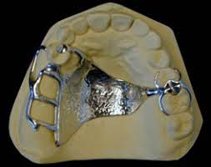
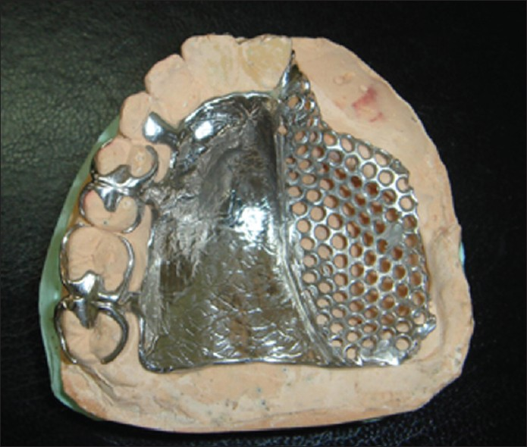
Types of circumferential clasps
Embrasure clasp (Butterfly clasp):
Example of use of embrasure clasp for a Class II partially edentulous arch. Embrasure clasp on two left molar abutments was used in the absence of posterior modification space.

Slide 14
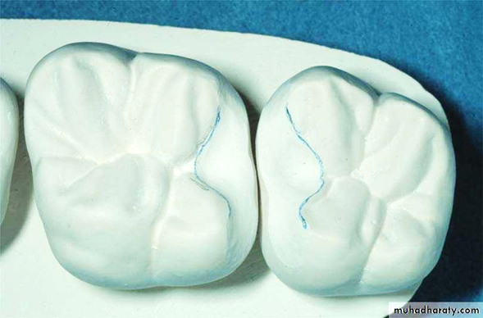
Types of circumferential clasps
Embrasure clasp (Butterfly clasp):
Disadvantages:
Improper clearance can give rise thin section of clasp leading to breakage.
Occlusal and proximal surfaces of adjacent molar and premolar prepared for embrasure clasp.
Note that rest seat preparations are extended both buccally and lingually to accommodate retentive and reciprocal clasp arms.

Slide 15
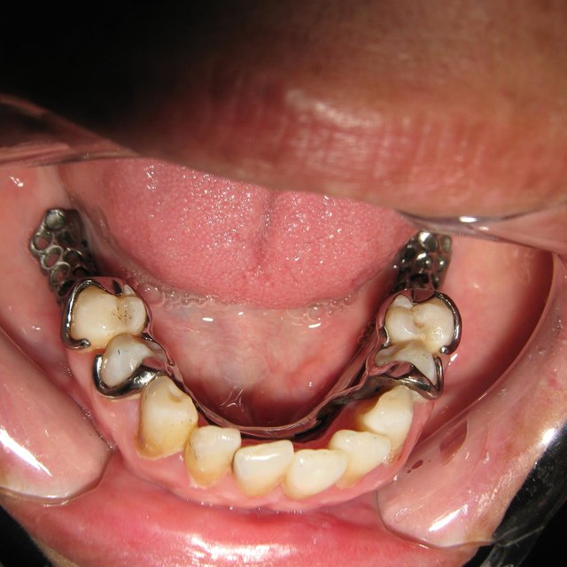
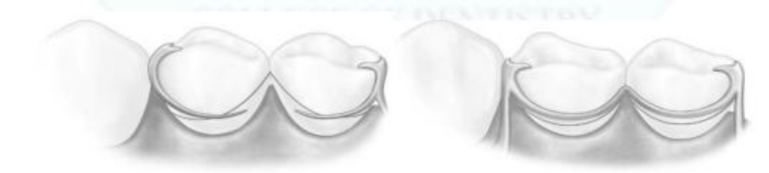
Types of circumferential clasps
Multiple clasp:
The multiple clasp is simply two opposing circumferential clasps joined at the terminal end of the two reciprocal arms. It is used when additional retention and stabilization are needed, usually when the principal abutment tooth is periodontally compromised and stresses originating from prosthesis retention can be distributed between multiple abutment teeth. It may be used for multiple clasping in instances in which the partial denture replaces an entire half of the dental arch. It may be used rather than an embrasure clasp when the only available retentive areas are adjacent to each other. Its disadvantage is that two embrasure approaches are necessary rather than a single common embrasure for both clasps.

Slide 16
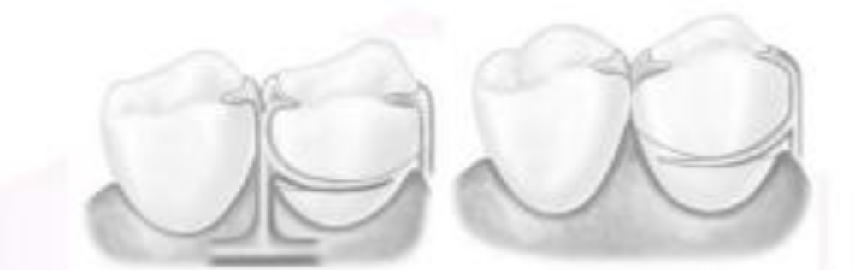
Types of circumferential clasps
Half-and-half clasp:
The half-and-half clasp consists of a circumferential retentive arm arising from one direction and a reciprocal arm arising from another.
The second arm must arise from a second minor connector, and this arm is used with or without an auxiliary occlusal rest. Reciprocation arising from a second minor connector can usually be accomplished with a short bar or with an auxiliary occlusal rest, thereby avoiding so much tooth coverage. There is little justification for the use of the half-and-half clasp in bilateral extension base partial dentures.

Slide 17
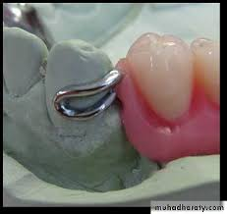
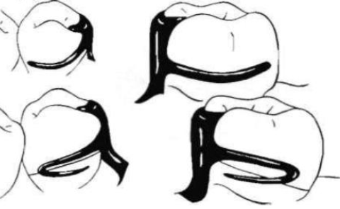
Types of circumferential clasps
Reverse-action clasp (hairpin)(fish hook):
The reverse-action clasp arm is designed to permit engaging a proximal undercut from an occlusal approach by looping back the retentive arm to engage an undercut apical to the point of origin.
Retentive arm has two horizontal components:
The occlusal portion which acts as a minor connector.
The apical portion which pass over the height of contour to engage the desired undercuts.
Properly designed, the reverse-action clasp should make a hairpin turn to engage an undercut below the point of origin.

Slide 18
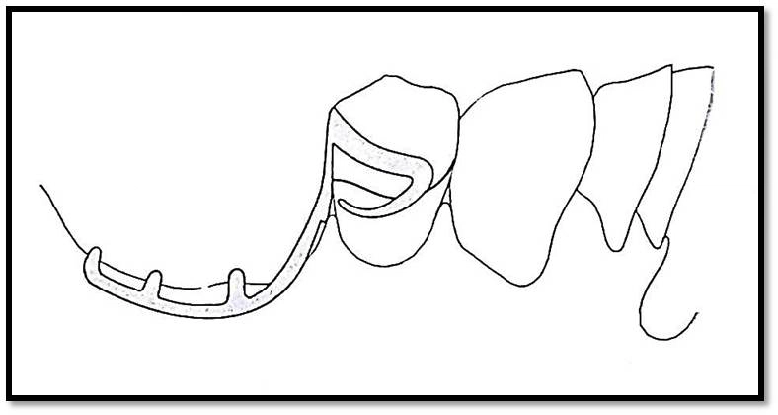
Types of circumferential clasps
Reverse-action clasp (hairpin):
The upper part of the arm of this clasp should be considered a minor connector and must be rigid, giving rise to the tapered lower part of the arm. Therefore only the lower part of the arm should be flexible. With the retentive portion beginning beyond the turn, only the lower part of the arm should flex over the height of contour to engage a retentive undercut. The bend that connects the upper and lower parts of the arm should be rounded to prevent stress accumulation and fracture of the arm at the bend.

Slide 19
Types of circumferential clasps
Reverse-action clasp (hairpin)(fish hook):
Other methods of accomplishing the same result are with a ring clasp originating on the opposite side of the tooth or with a bar clasp arm originating from a gingival direction. However, when a proximal undercut must be used on a posterior abutment and when tissue undercuts, tilted teeth, or high tissue attachments prevent the use of a bar clasp arm, the reverse-action clasp may be used successfully.

Slide 20
Types of circumferential clasps
Reverse-action clasp (hairpin):
Although the ring clasp may be preferable, lingual undercuts may prevent the placement of a supporting strut without tongue interference. In this limited situation, the hairpin clasp arm serves adequately, despite its several disadvantages.
The clasp covers considerable tooth surface and may trap debris; its occlusal origin may increase the functional load on the tooth, and its flexibility is limited.
Esthetics usually need not be considered when the clasp is used on a posterior abutment, but the hairpin clasp arm does have the additional disadvantage of displaying too much metal for use on an anterior abutment.
To use this type of clasp, there should be sufficient clinical crown height to provide space between occlusal and apical arms.

Slide 21
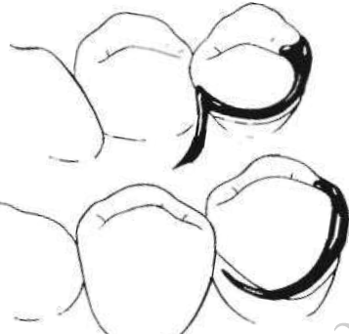
Types of circumferential clasps
Back-action clasp:
The back-action clasp is a modification of the ring clasp. Back-action circumferential clasp is used on premolar abutment anterior to edentulous space. The undercut can usually be approached just as well using a conventional circumferential clasp, with less tooth coverage and less display of metal. With the circumferential clasp, the proximal tooth surface can be used as a guiding plane as it should be, and the occlusal rest can have the rigid support it requires.
An occlusal rest always should be attached to some rigid minor connector and should never be supported by a clasp arm alone. If the occlusal rest is part of a flexible assembly, it cannot function adequately as an occlusal rest.

Slide 22

Thank you

