Slide 1
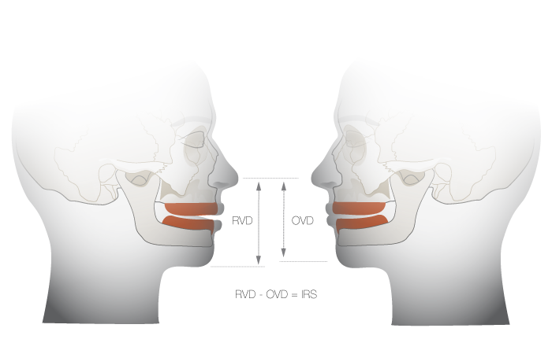
Vertical relation
Bushra Mohammed Ali Al-Ameen
B,D,S,. M,Sc.(Pros)

Slide 2
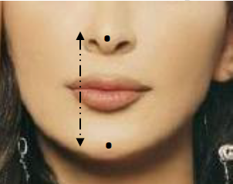
Vertical relation
Vertical relation: It is the amount of separation between the maxilla and
the mandible in a frontal plane.
Vertical dimension: It is the distance between two selected points, one
on a fixed and one on a movable member.
In general, the vertical measurement of face could be recorded between
any two arbitrary selected points which are usually located one above the
mouth (at the tip of nose) and the other below the mouth (at the tip of
chin in the mid line region).

Slide 3
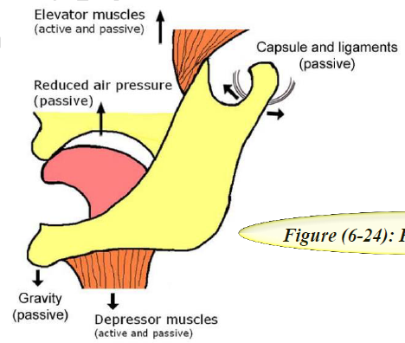
Physiological rest position:
It is the postural position of the mandible when an individual is resting comfortably in an upright position and the associated muscles are in a state of minimal contractual activity.

Slide 4
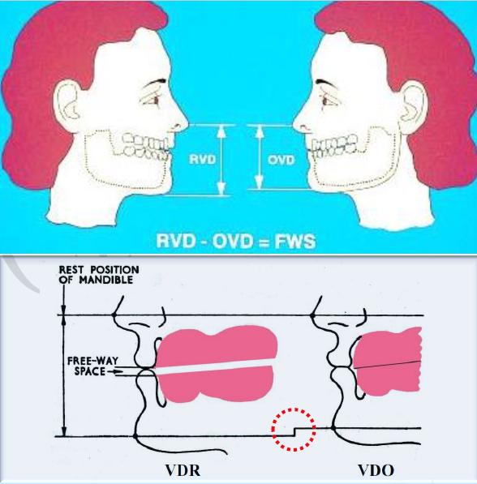
Rest vertical dimension:
It is the distance between two selected points (one at the tip of nose and the other at the tip of chin in the mid line region) measured when the mandible is in the physiologic rest position.

Slide 5
Occlusal vertical dimension:
It is the distance measured between two points when the occluding members (teeth or occlusal rims) are in contact.

Slide 6
Interocclusal distance (interocclusal gap):
It is the distance between the occluding surfaces of the maxillary and mandibular teeth when the mandible is in a specified position.

Slide 7
Interocclusal rest space (freeway space):
It is the distance between the occluding surface of maxillary and mandibular teeth when the mandible is in its physiological rest position. It is the difference between the vertical dimension of rest and the vertical dimension of occlusion.
RVD – OVD = Freeway space
normally ≈ (2-4 mm)

Slide 8
Increased vertical dimension (over openeing)
Increased trauma to the denture bearing area (acceleration of residual ridge resorption).
Inharmonious facial proportion (increased lower facial height).
Difficulty in swallowing and speech.
Pain and clicking in the temporomandibular joint and muscular fatigue.
Stretching of the facial muscles and skin.
Increase space of the oral cavity.
Loss of biting power.
Increase nasolabial angle.
Sensation of bulky denture.
Premature contact of upper and lower teeth.
Instability of dentures due to their excessive height.
Clicking of teeth in speech and mastication.
Separated upper and lower lip with poor esthetic and difficulty in bilabial sound (/p/b/m/).
Seem unable to open the mouth widely.
Excessive display of artificial teeth and gum.

Slide 9
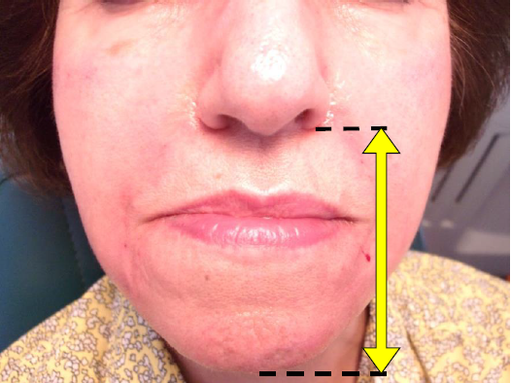

Slide 10
Decreased vertical dimension (over closure)
Comparatively lesser trauma to the denture bearing area.
Inharmonious facial proportion (decreased lower facial height).
Difficulty in swallowing and speech.
Pain and clicking in the temporomandibular joint and muscular fatigue.
Loss of muscle tone and presence of wrinkles and folds that is not due to age.
Decreased space of the oral cavity, and pushing the tongue backward.
Loss of biting power.
Nasolabial angle is less than 90°.
Angular chelitis due to folding of the corner of the mouth.
Cheek biting.
Thinning of the vermilion borders of the lip.
Prominence of lower jaw and chin.
Obstruction of the opening of the Eustachian tube due to elevation of the soft palate due to elevation of the tongue and mandible.

Slide 11
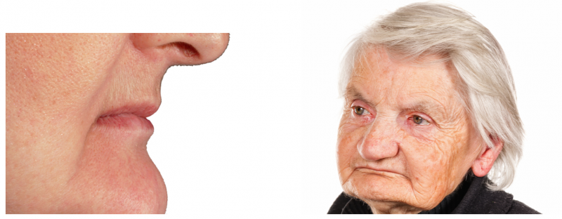

Slide 12
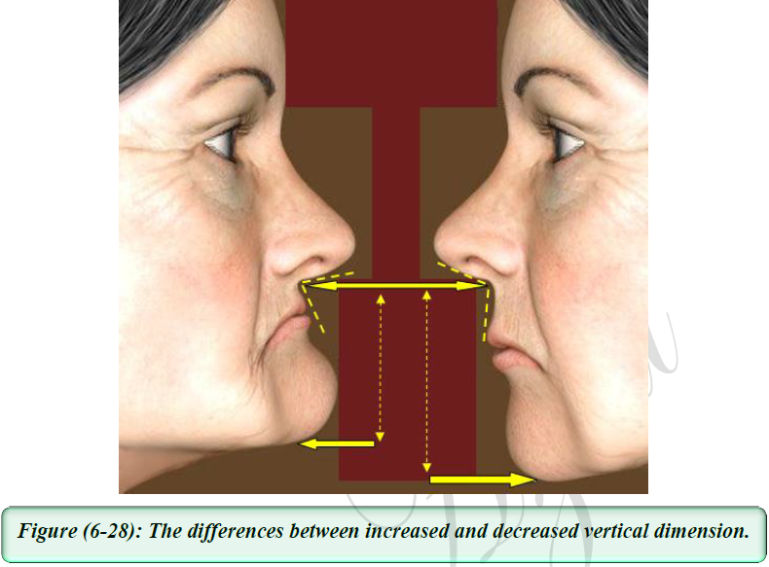

Slide 13
Importance of vertical dimension
Functional roles; include:
a- Mastication.
b- Deglutition.
c- Phonetics.
d- Respiration.
Physiological roles:
by maintenance health of tissue (mucosa, bone, muscles, and temporomandibular joint); also called comfortable role.
Esthetic role
Psychological role

Slide 14
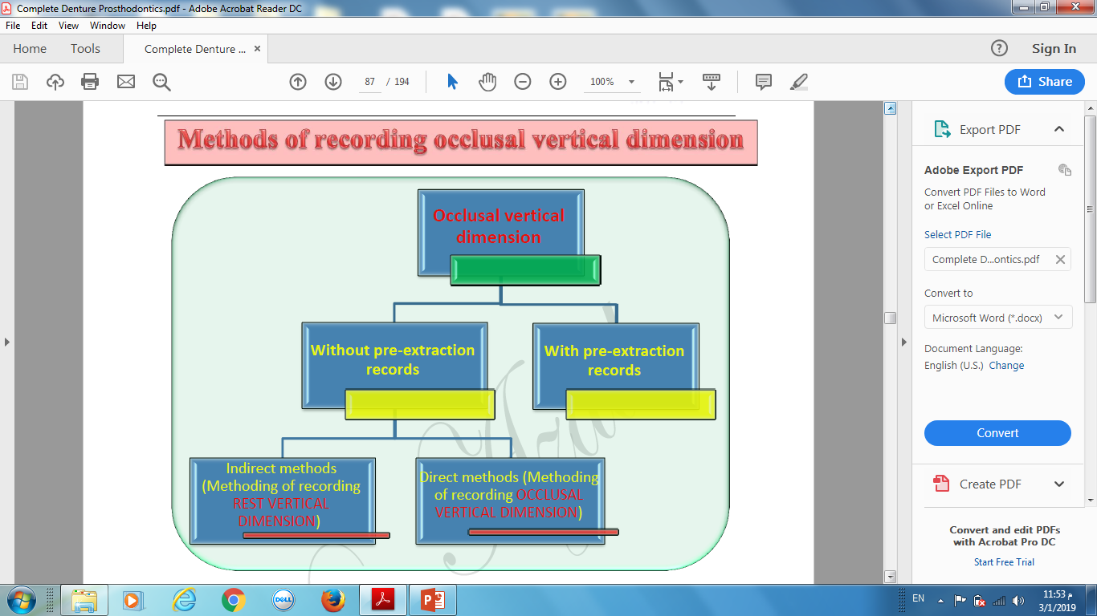

Slide 15
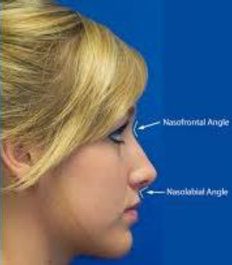
Methods of recording occlusal vertical dimension
1- Pre-extracion records
These records are made before the patient extracts all teeth and loses his occlusal vertical dimension; these records are:
1- Profile photographs :
They are made and enlarged to life size. Measurements of anatomic landmarks on the photograph are compared with measurements using the same anatomic landmarks on the face.
These measurements can be compared when the records are made and again when the artificial teeth are tried in.
The photographs should be made with the teeth in maximum occlusion, as this position can be maintained accurately for photographic procedures.

Slide 16
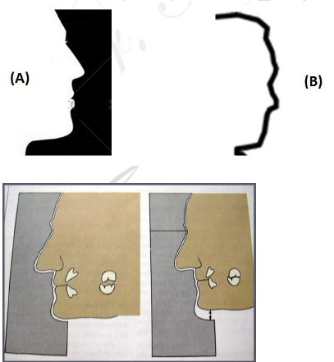
Methods of recording occlusal vertical dimension
1- Pre-extracion records
2- Profile silhouettes:
An accurate reproduction of the profile silhouettes can be cut out in cardboard or contoured in wire.
The silhouettes can be repositioned to the face after the vertical dimension has been established at the initial recording and/or when the artificial teeth are tried in.

Slide 17
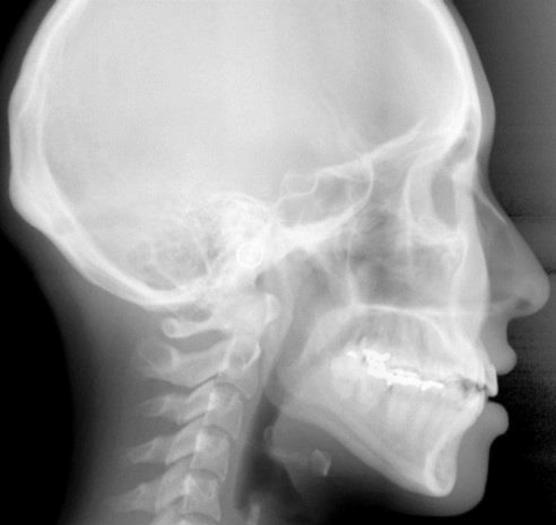
Methods of recording occlusal vertical dimension
1- Pre-extracion records
3- Profile radiographs:
They have been much used in researches of vertical dimension of occlusion rather than routine clinical use in prosthodontic treatment for edentulous patients.
The two types of radiographs advocated are the cephalometric profile radiograph and radiograph of the condyles in the fossae.
The inaccuracies that exist in either the technique or the method of comparing measurements make this method unreliable.
Cephalometric radiograph.

Slide 18
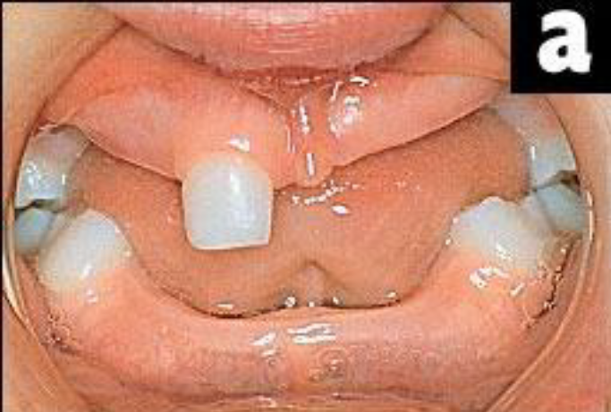
Methods of recording occlusal vertical dimension
1- Pre-extracion records
4- Articulated casts
This method is valuable with patients whose ridges are not sacrificed during the removal of the teeth or resorbed during a long waiting period for denture construction.
Dentulous patient.

Slide 19
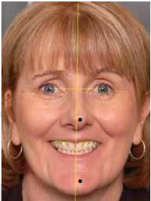
Methods of recording occlusal vertical dimension
1- Pre-extracion records
5- Facial measurements
Before extraction, the patient is instructed to close the jaws into maximum occlusion, then two tattoo points have been marked, one on the upper half of the face and the other on the lower half.
The distance is measured, after extraction these measurements are compared with measurements made between these points when the artificial teeth are tried in.
Facial measurements (tattoo).

Slide 20
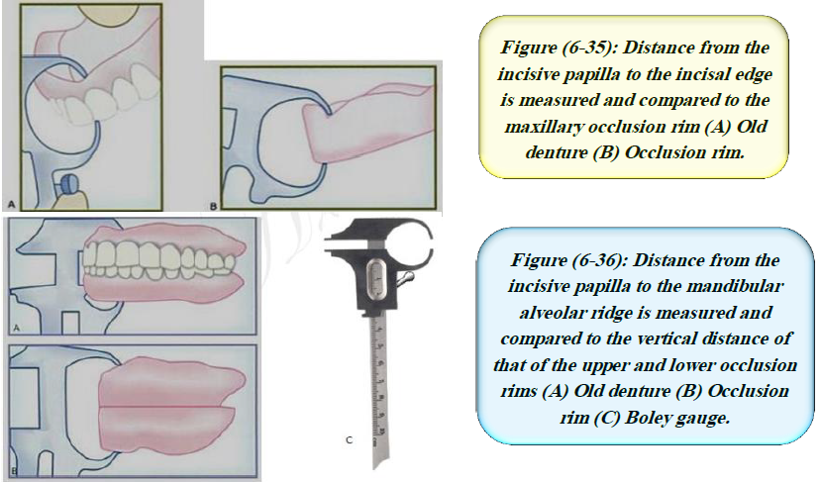
Measurements from former dentures
Dentures that the patient has been wearing can be measured, and measurements can be correlated with observations of the patient's face to determine the amount of change required. These measurements are made between the ridge crests in the maxillary and mandibular dentures with a Boley gauge.

Slide 21

Methods of recording occlusal vertical dimension
1- Without Pre-extracion records
A-Direct methods to find occlusal vertical dimension:
Boos power point method:
A metal plate (central bearing plate) is attached to the maxillary record base.
A bimeter (an oral meter that measures pressure) is attached to the mandibular record base.
This bimeter has a dial, which shows the amount of pressure acting on it.
The record bases are inserted into the patient's mouth and the patient is asked to bite on the record bases at different degrees of jaw separation.
The biting forces are transferred from the central bearing point to the bimeter. The highest value is called the power point which represents the occlusal vertical dimension.

Slide 22
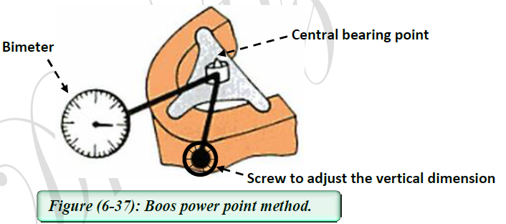
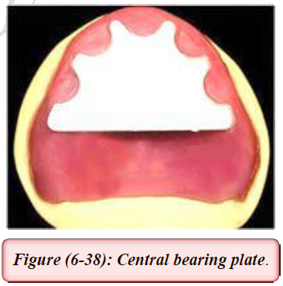

Slide 23
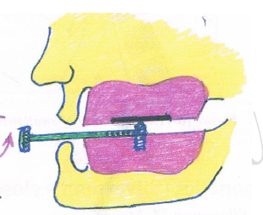
Methods of recording occlusal vertical dimension
1- Without Pre-extracion records
A-Direct methods to find occlusal vertical dimension:
2. Tactile sense or neuromuscular perception:
A central bearing screw/central bearing plate apparatus is used and attached to accurately adapt record bases permits the patient to experience through neuromuscular perception the different vertical relations.
The central bearing screw is adjusted downward and upward until the height of contact feels right to the patient and this represents the occlusal vertical dimension.

Slide 24
Methods of recording occlusal vertical dimension
1- Without Pre-extracion records
A-Direct methods to find occlusal vertical dimension:
3. Swallowing threshold:
The theory behind this method is that at the beginning of swallowing cycle, the teeth of the upper and lower jaws almost come together with a very light contact. This factor can be used as a guide to determine the occlusal vertical dimension.
The technique involves fabrication of cones of soft wax on the mandibular record base. The maxillary and mandibular record bases are inserted in the patient mouth. Salivation is stimulated and the patient is asked to swallow. The repeated action of swallowing the saliva will gradually reduce the height of the wax cones to allow the mandible to reach the level of occlusal vertical dimension.

Slide 25
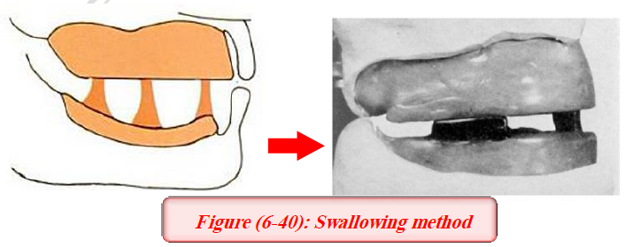
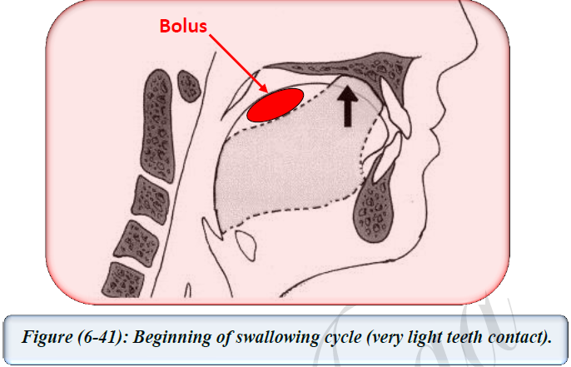

Slide 26
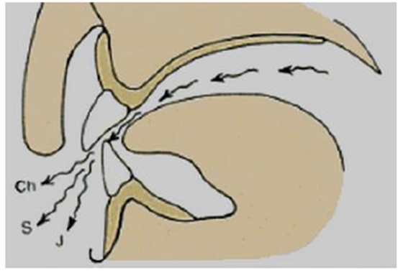
Methods of recording occlusal vertical dimension
1- Without Pre-extracion records
A-Direct methods to find occlusal vertical dimension:
4. Phonetics (silversman closest speaking space):
Silverman's closest speaking space: It is the minimal amount of interocclusal space between the upper and lower teeth when sounds like ch, s, and j are pronounced.
There is 1-2 mm clearance between teeth when observed from the profile and frontal view.
Phonetic tests of the vertical dimension include listening to speech sound production and observing the relationships of teeth during speech.
The production of ch, s, and j sounds brings the anterior teeth closest together without contact. If the distance is too large, it means that too small a vertical dimension of occlusion may have been established. If the anterior teeth touch when these sounds are made, the vertical dimension is probably too great.

Slide 27
Methods of recording occlusal vertical dimension
1- Without Pre-extracion records
B- In-Direct methods to find occlusal vertical dimension (methods of recording rest vertical dimension) :
Facial measurements:
Instruct the patient to stand or sit comfortably upright with eyes looking straight ahead at some object which is on the same level.
Insert the maxillary record base with the attached contoured occlusion rim.
With an indelible marker, place a point of reference on the end of the patient's nose and another on the point of the chin. The patient is asked to perform functional movements like wetting his lips and swallowing, and to relax his shoulders (this is done to relax the supra- and infrahyoid muscles).
When the mandible drops to the rest position, the distance between the points of reference is measured. Repeat this procedure until the measurements are consistent. Such measurements are helpful but cannot be considered as absolute.

Slide 28
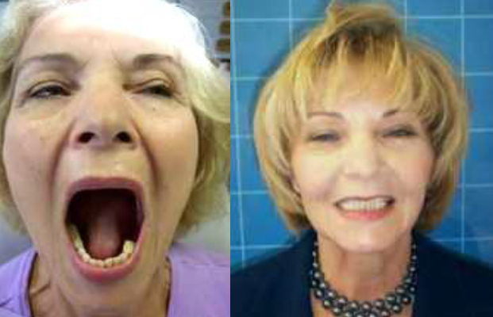
Methods of recording occlusal vertical dimension
1- Without Pre-extracion records
B- In-Direct methods to find occlusal vertical dimension (methods of recording rest vertical dimension) :
2. Tactile sense:
Instruct the patient to stand or sit erect and open the jaws wide until strain is felt in the muscles.
When this opening becomes uncomfortable, ask them to close slowly until the jaws reach a comfortable, relaxed position.
Measure the distance between the points of reference.

Slide 29
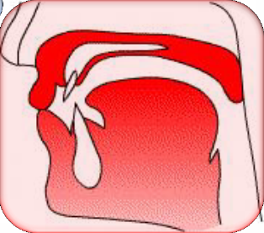
Methods of recording occlusal vertical dimension
1- Without Pre-extracion records
B- In-Direct methods to find occlusal vertical dimension (methods of recording rest vertical dimension) :
3. Phonetics:
Ask the patient to repeat pronounce the letter m a certain numbers of times, like repeat the name Emma until they are aware of the contacting of the lips as the first syllabus em is pronounced.
When patient have rehearsed this procedure, ask that they stop all jaw movement when the lips touch. At this time measure between the two points of reference.

Slide 30
Methods of recording occlusal vertical dimension
1- Without Pre-extracion records
B- In-Direct methods to find occlusal vertical dimension (methods of recording rest vertical dimension) :
4. Facial expression :
The experienced dentist may notice the relaxed facial expression when the patient's jaws are at rest.
The following facial features indicate that the jaw is in its physiological rest position: The upper and lower lips should be even anteroposteriorly and in slight contact in a single plane. The skin around the eyes and over the chin should be relaxed; it should not be stretched, shiny, or excessively wrinkled. The nostrils are relaxed and breathing should be unobstructed. These evidences of rest position of the maxillomandibular musculature are the indications for recording a measurement of the vertical dimension of rest.

Slide 31
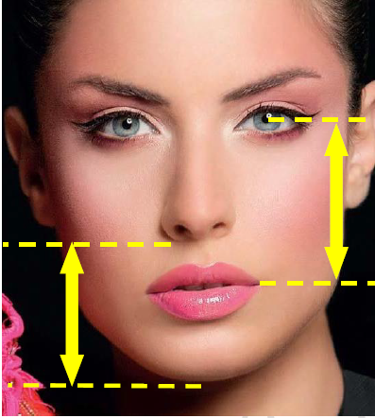
Methods of recording occlusal vertical dimension
1- Without Pre-extracion records
B- In-Direct methods to find occlusal vertical dimension (methods of recording rest vertical dimension) :
5. Anatomical landmarks (Willis method) :
The Willis guide is designed to measure the distance from the pupils of the eyes to the corner of the mouth and the distance from the anterior nasal spine to the lower border of the mandible.
When these measurements are equal, the jaws are considered at rest. Its accuracy is questionable in patients with facial asymmetry.

Slide 32
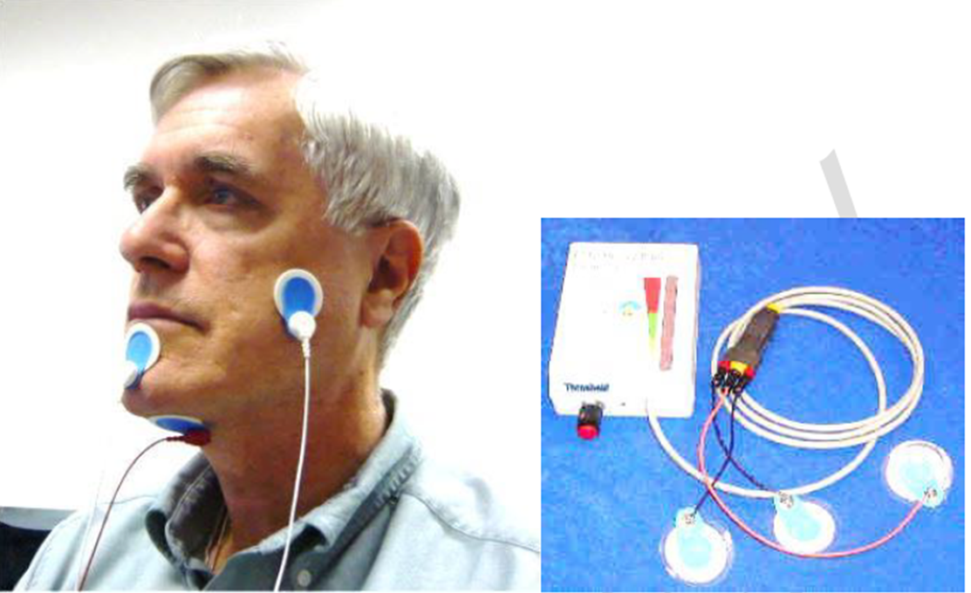
Methods of recording occlusal vertical dimension
1- Without Pre-extracion records
B- In-Direct methods to find occlusal vertical dimension (methods of recording rest vertical dimension) :
6. Electromyographic method (EMG)
By using a special device that measures the tone of masticatory muscles, when the tone is at its least, this means these muscles are in rest position and the jaws are at rest position.

Slide 33


