Slide 1
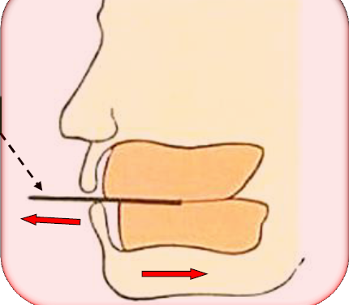
Horizontal relations
Bushra Mohammed Ali Al-Ameen
B,D,S,. M,Sc.(Pros)

Slide 2
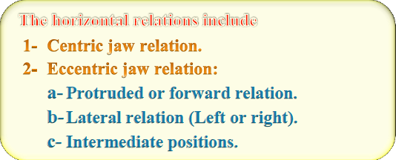
Horizontal jaw relations:
The relationship of mandible to maxilla in a horizontal plane (in anteroposterior and side to side direction).

Slide 3
Centric jaw relation:
It is the maxillomandibular relationship in which both condyles articulate with the thinnest avascular portion of their respective disks with the complex in the anterior-superior position against the shapes of the articular eminencies.
This position is independent of tooth contact.
It is restricted to a purely rotary movement about the transverse horizontal axis .
it is bone-to-bone relationship

Slide 4
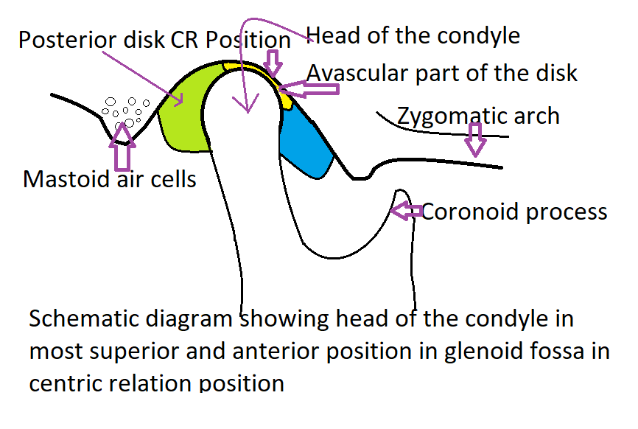
Centric jaw relation:

Slide 5
Centric occlusion:
The occlusion of opposing teeth when the mandible is in centric relation.
This may or may not coincide with the maximal intercuspal position (it is tooth-to-tooth relationship dictated by bone to bone relationship).
Maximal intercuspal position:
The most complete interdigitation of the teeth independent of condylar position.
Hence maximal intercuspation is a maxillomandibular relationship determined by tooth-to-tooth relationship.

Slide 6
Importance of centric jaw relation (Significance):
It is learnable, repeatable, and recordable position which remains constant throughout life.
It is a reference position from which the mandible can move to any eccentric position and return back involuntarily.
It is the start point for developing occlusion.
Functional movements like chewing and swallowing are performed in this position, because it is the most unstrained position.
It is a reliable jaw relation, because it is bone to bone relation.

Slide 7
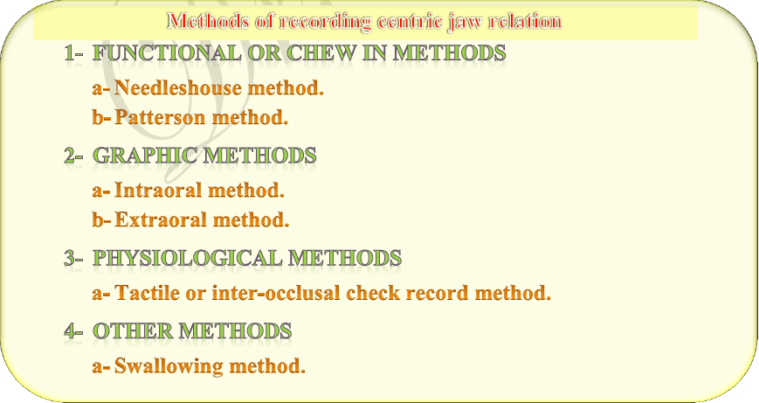

Slide 8
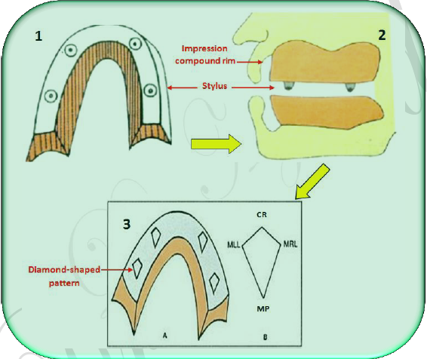
Needleshouse methods
In this method used impression compound occlusion rims with four metal styli placed in the maxillary rim. When the patient moves his mandible, the styli on the maxillary rim will create a marking on the mandibular rim, after all mandibular movements are made, and a diamond-shaped pattern is formed. The anterior most point of this diamond pattern indicates the centric jaw relation.

Slide 9

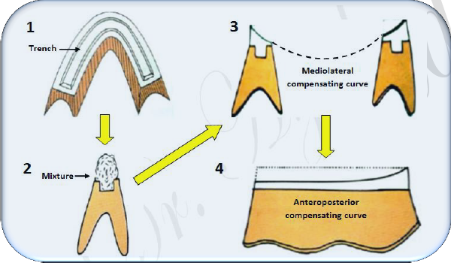
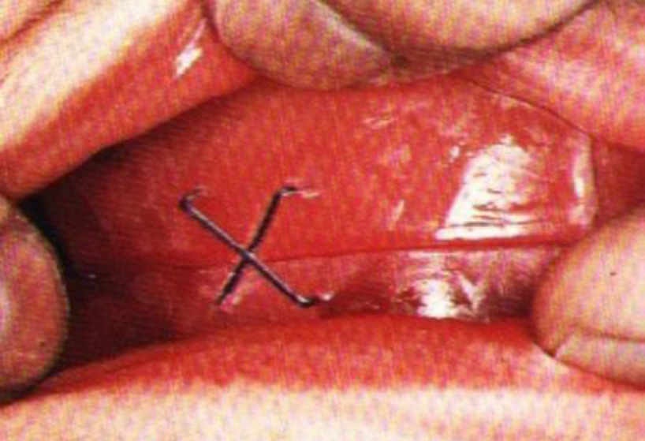
Patterson method
In this method used wax occlusion rims. A trench is made along the length of mandibular rim.
A 1:1 mixture of pumice and dental plaster is loaded into the trench. When the patient moves his mandible, compensating curves on the mixture will produced, and the height of the mixture is also reduced.
The patient is asked to continue these movements till a predetermined vertical dimension is obtained.
Finally the patient is asked to retruded his jaw and the occlusal rims are fixed in this position with metal staples

Slide 10
The disadvantages of functional methods involve lateral and anteroposterior displacement of the recording bases in relation to the supporting bone while the record is being made.

Slide 11
Graphic method
These methods are called so because they use graphs or tracing to record the centric relation.
The general concept of this technique is that a pen-like pointer is attached to one occlusal rim and a recording plate is placed on the other rim, the plate coated with carbon or wax on which the needle point can make the tracing, when the mandible moves in horizontal plane, the pointer draws characteristic patterns on the recording plate.
The characteristic patterns created on the recording plate is called arrow point tracing, also known as Gothic arch tracing.
The apex of the arrow point tracing gives the centric relation, with the two sides of the tracing originating at that point being the limits of the lateral movements.
The apex of the arrow head should be sharp else the tracing is incorrect.

Slide 12
Graphic method
The graphic methods are either intraoral or extraoral depending upon the placement of the recording device.
The extraoral is preferable to the intraoral tracing, because the extraoral is more accurate, more visible, and larger in comparing with the intraoral tracing.

Slide 13
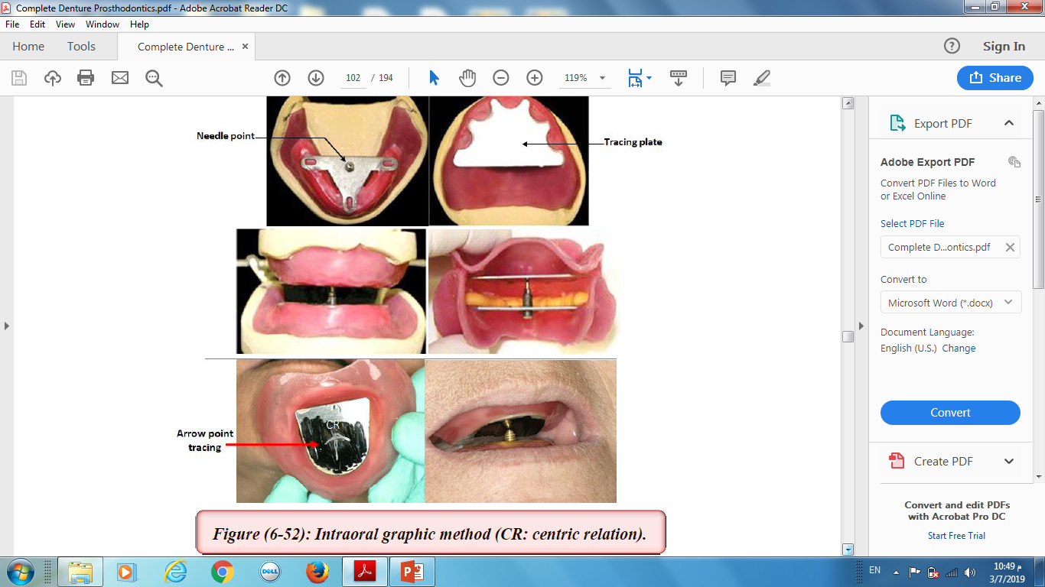
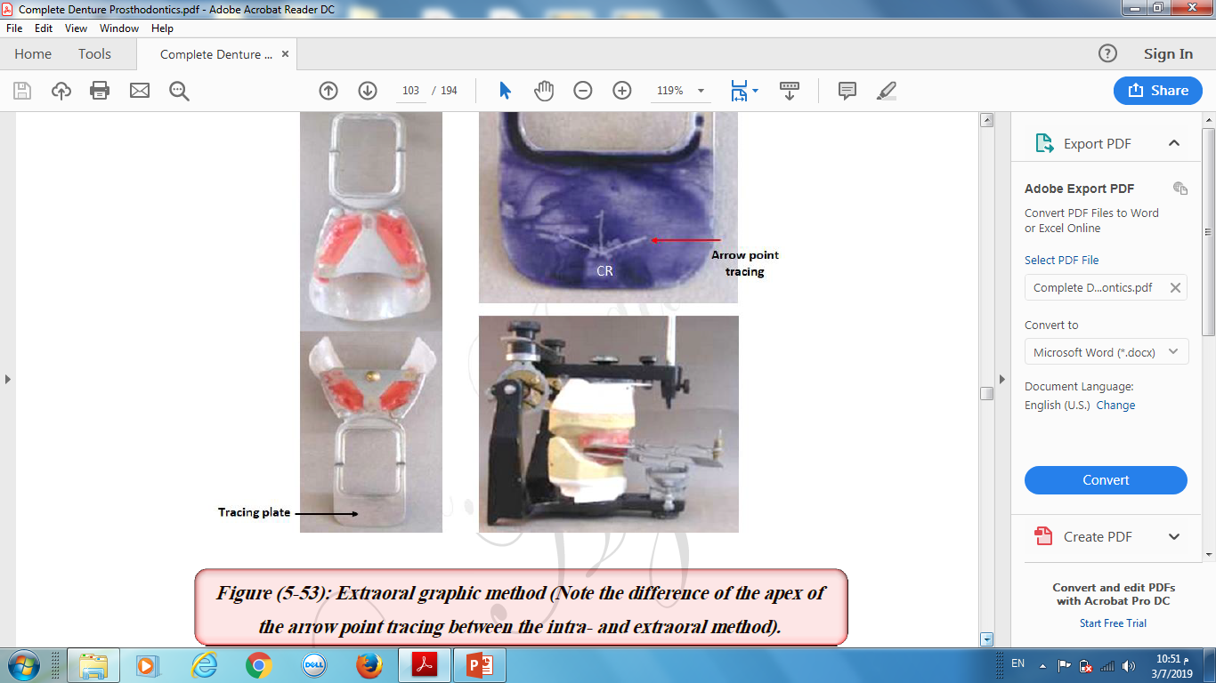
Graphic method

Slide 14
Tactile or interocclusal check record method
In this method the centric relation is recorded by placing a record medium between the record bases when the jaws positioned at centric relation.
The patient closes into the recording medium with the lower jaw in its most retruded unstrained position and stops the closure at predetermined vertical dimension.
Advantages:
This method is simple, because mechanical devices are not used in the patient mouth and are not attached to the occlusion rims.
This method has advantage of causing minimal displacement of the recording bases in relation to the supporting bone.
This method is essential in making an accurate record, the visual acuity and the sense of touch of the dentist also inter in making of centric relation record, this phase is developed with experience and it is difficult to teach to another individual.

Slide 15
Materials that are commonly used for interocclusal record are:
Wax.
Impression compound.
Silicon and polyether impression material.
Zinc oxide eugenol paste.
Cold cure acrylic.
Rapid setting dental plaster.

Slide 16
Indications of interocclusal check record
Abnormally related jaws.
Displaceable, flabby tissues.
Large tongue.
Uncontrollable mandibular movements.
It can also be done for patient already using a complete denture.

Slide 17
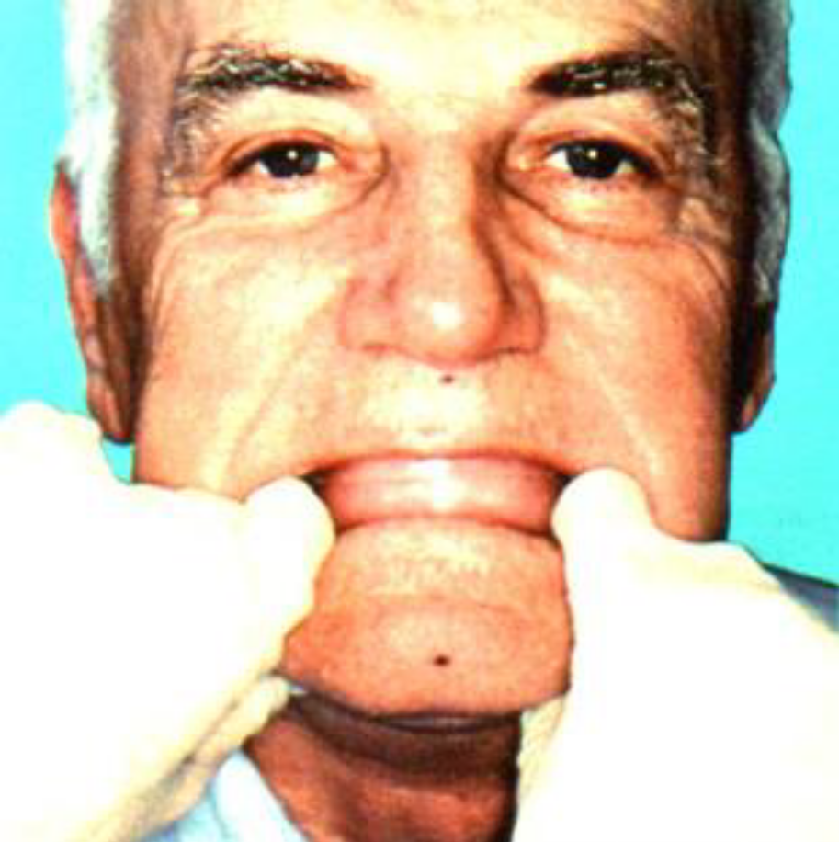
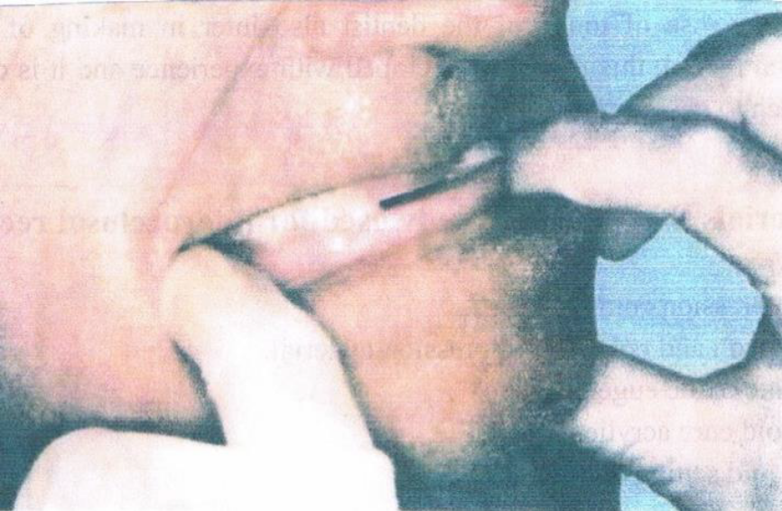
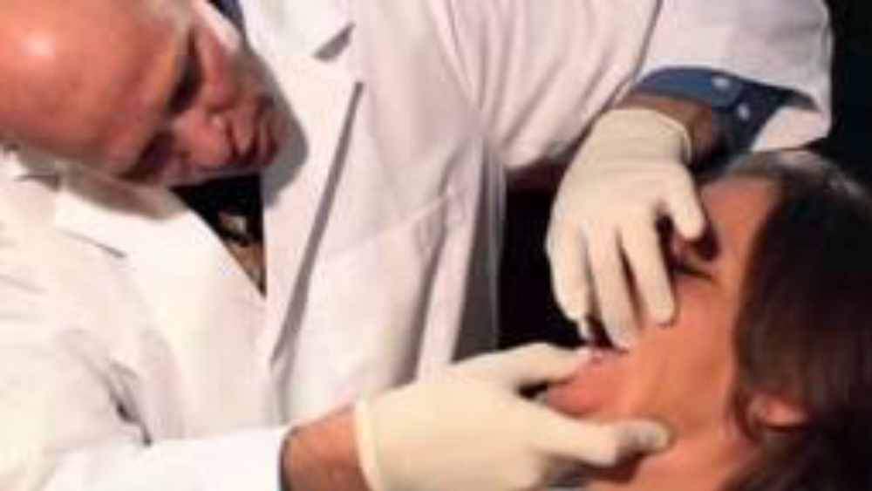

Slide 18
Methods of assisting patient to move the mandible to the centric relation
The dentist must guide the mandible of patient to the centric relation not force it
The patient is instructed to let his jaw relax (palpate the temporalis and masseter muscles to relax them), pull it back and close slowly on the back teeth.
The patient is instructed to get the feeling of pushing his upper jaw out and then close the mouth with back teeth in contact.
Assist the patient to protrude and retrude the mandible repeatedly with the operator holding the finger lightly against the chin.
Boo's series of stretch exercise: The patient is instructed to:
a- Open the mouth wide and relax.
b- Move the jaw to the left and relax.
c- Move the jaw to the right and relax.
d- Move the jaw forward and relax, in series of movements.
The results to be expected are for the patient to be able to follow the dentist's directions in moving the jaw to centric relation and the desired eccentric positions.

Slide 19
Methods of assisting patient to move the mandible to the centric relation
5. The patient can be instructed to turn the tongue towards the posterior border of the upper record base and close the rims together until they meet. The disadvantage with this method is the likelihood of displacing the mandibular record base by the action of the elevated tongue.
6. Tilt the patient head back, the tension of muscles under chin make protrusion more difficult.
7. Exert pressure in molars in both sides and ask the patient to close (molar reflex method).
8. Celluloid strip is placed between the rims and pulled out. Ask the patient to restrain the strip from slipping away; the mandible involuntarily goes to centric relation.

Slide 20
Pulling a strip of celluloid interposed between the occlusal rims will automatically retrude the mandible to centric relation.

Slide 21
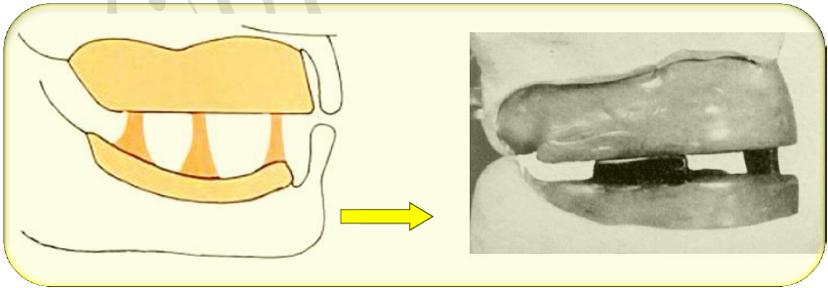
Swallowing method
In this method, soft cones of wax are placed on the lower record base. The wax cones contact the upper occlusion rim when the patient swallows. This procedure is supposed to establish both proper vertical and horizontal relation of mandible to maxilla.

Slide 22
Eccentric jaw relations
It is defined as any relation-ship of the mandible to the maxilla other than the centric relation.
It includes protrusive and lateral relations.
The main reason in making an eccentric jaw relation record is to adjust the horizontal and lateral condylar inclination in the adjustable articulator, and to establish the balanced occlusion.
The protrusive and left and right lateral movements records are made in the same manner as for centric relation record and these include:
Functional or chew in methods.
Graphic methods.
Physiological methods (tactile or inter-occlusal check record method).

Slide 23
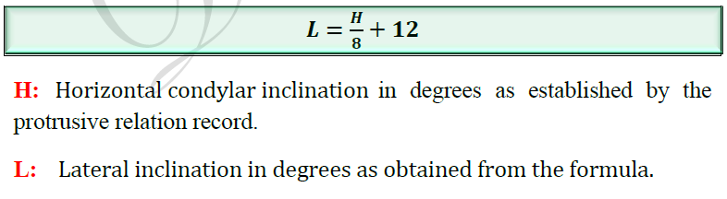
Eccentric jaw relations
The interocclusal eccentric records may be made either on the occlusion rim before the teeth are set up or on the posterior teeth at the try-in appointment.
When the protrusive eccentric record is made on Hanau articulator, the following formula is used to obtain an acceptable lateral inclination.

Slide 24


