Slide 1
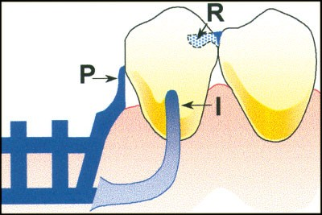
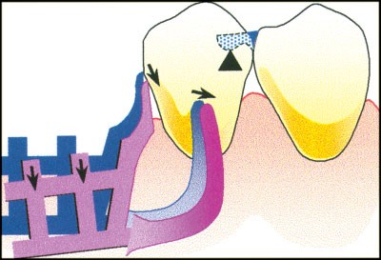
Types of Clasp Assemblies (2)
Bushra Mohammed Ali Al-Ameen
B,D,S,. M,Sc.(Pros)

Slide 2
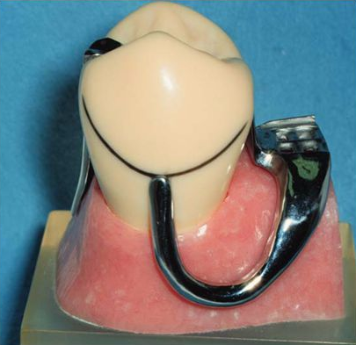
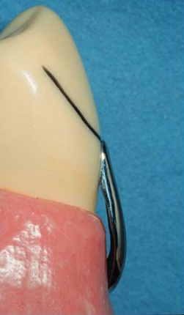
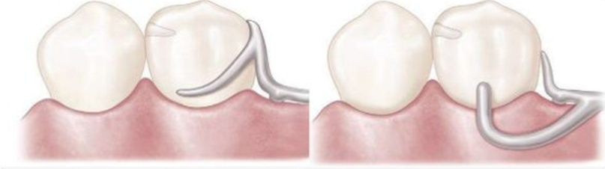
Bar clasp
It approaches the undercut area from gingival direction, it is called gingivally approaching clasp, since it is coming to the undercut area under the height of contour, so called infrabulge clasp, and since it is pushing the tooth during action so called push clasp.
The I bar should be located in the gingival third of the buccal or labial surface of the abutment. The whole arm of the I-bar should be tapered to its terminus, with no more than 2 mm of its tip contacting the abutment, the retentive tip contacts the tooth from the undercut to the height of contour.

Slide 3
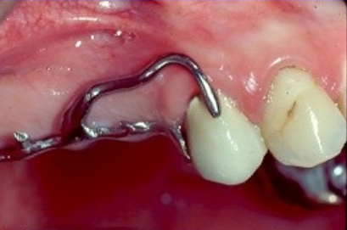
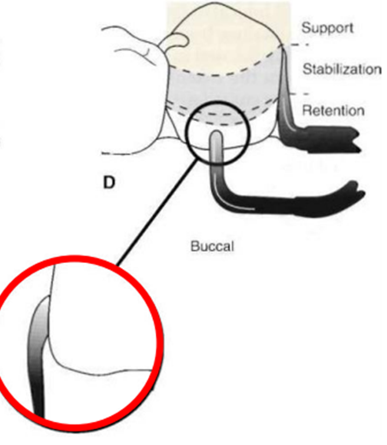
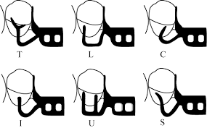
Bar clasp
The horizontal portion of the approach arm must be located at least 4 mm from the gingival margin and even farther if possible.
The term bar clasp is generally preferred over the less descriptive term Roach clasp arm. The bar clasp arm arises from the denture framework or a metal base and approaches the retentive undercut from a gingival direction.
The bar clasp arm has been classified by the shape of the retentive terminal. Thus it has been identified as a T, modified T, I,Y or U…etc.

Slide 4
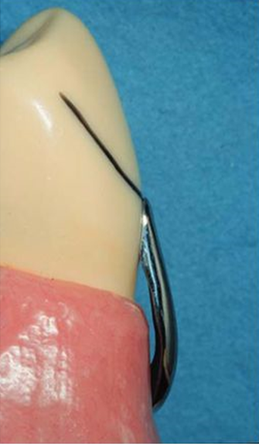
Bar clasp
Buccal retentive arm (I-bar ) engaging measured undercut (with slight occlusal extension for stabilization.
The approach arm of an infra-bulge clasp must not impinge on the soft tissues adjacent to the abutment.
The approach arm should cross perpendicular to the free gingival margin.
It should not be used in area of tissue undercut.
Uniform length and adequate taper should be given for sufficient flexibility
The clasp terminus tip should be placed as apical as possible on the abutment teeth.

Slide 5

Indications:
When a small degree of undercut (0.25 mm) exists in the cervical third of the abutment tooth, which may be approached from a gingival direction.
On abutment teeth for tooth-supported partial dentures or tooth-supported modification areas, and on abutments teeth of tooth-tissue supported as a part of the RPI system.
In situations in which esthetic considerations must be accommodated and a cast clasp is indicated.

Slide 6
Contraindications:
When a deep cervical undercut exists or when a severe tooth and/or tissue undercut exist, either of which must be bridged by excessive block-out. When severe tooth and tissue undercuts exist, a bar clasp arm usually is an annoyance to the tongue and cheek and also traps food debris.
Shallow vestibule (less than 4 mm) or an excessive buccal or lingual tilt of the abutment tooth.

Slide 7
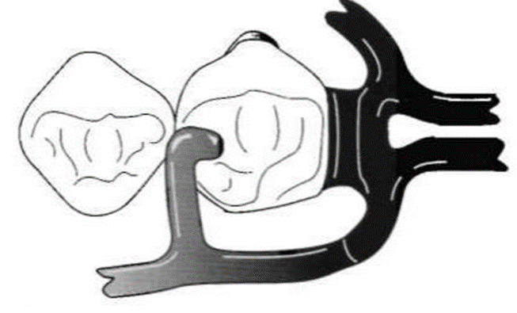
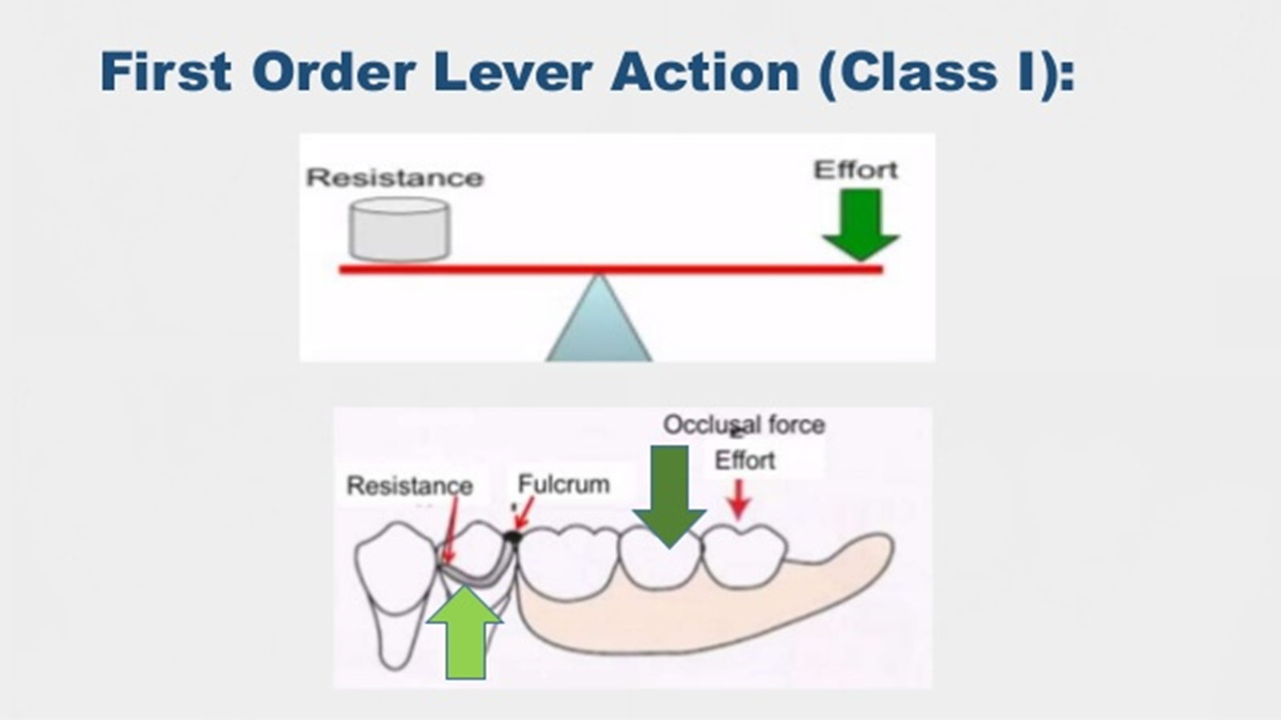
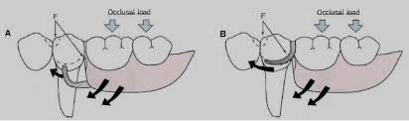
RPI system
Clasp assemblies that accommodate functional prosthesis movement are designed to address the concern of a Class I lever.
The concern is that the distal extension acts as a long "effort arm" across the distal rest "fulcrum“ to cause the clasp tip "resistance arm" to engage the tooth undercut.
This results in a harmful tipping or torqueing of the tooth and is greater with stiff clasps and more denture base movement.

Slide 8
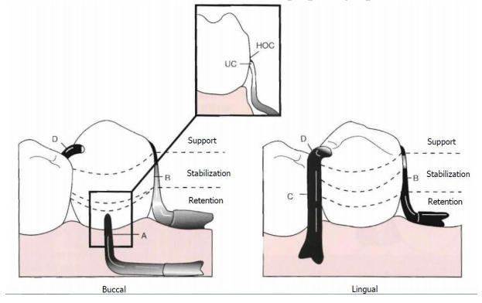
RpI system consists of:
Buccal retentive arm (I-bar) engaging measured undercut.
Stabilizing (reciprocal) elements , the area of bar contact along with the rest and its minor connector and proximal plate contact provides stabilization through encirclement.
Proximal plate minor connector on distal.
Lingually placed mesial minor connector for occlusal rest, which also serves as a stabilizing (reciprocal) component.
Mesially placed supporting occlusal rest. Assembly remains passive until activated.

Slide 9
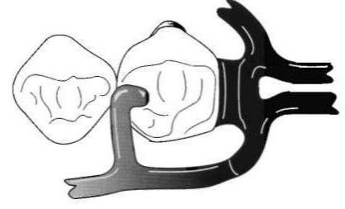
RPI system
In case of free end extension denture two strategies are adopted to either change the fulcrum location and subsequently the "resistance arm" engaging effect (mesial rest concept clasp assemblies), or to minimize the effect of the lever by use of a flexible arm (wrought-wire retentive arm) which is called combination clasp.
Mesial rest concept clasps are proposed to accomplish movement accommodation by changing the fulcrum location. This concept includes the RPI clasps. The RPI is a current concept of bar clasp design, and refers to the rest, proximal plate, and I-bar component parts of the clasp assembly.
Basically, this clasp assembly consists of a mesioocclusal rest with the minor connector placed into the mesiolingual embrasure, but not contacting the adjacent tooth.

Slide 10
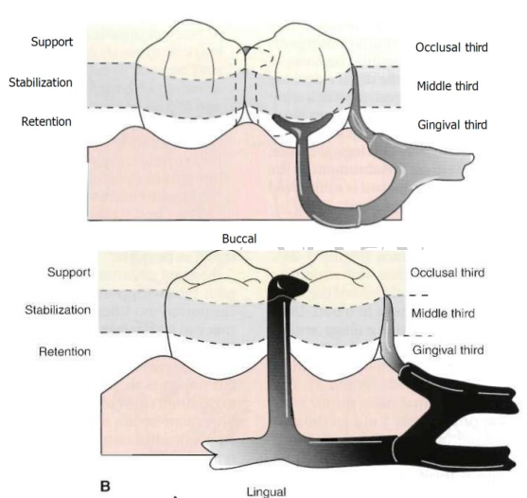
A distal guiding plane, extending from the marginal ridge to the junction of the middle and gingival thirds of the abutment tooth, is prepared to receive a proximal plate.
The buccolingual width of the guiding plane is determined by the proximal contour of the tooth.

Slide 11
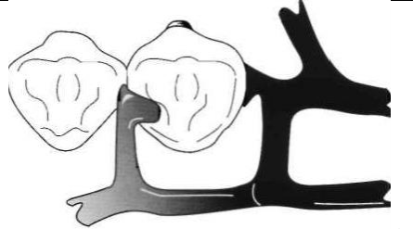
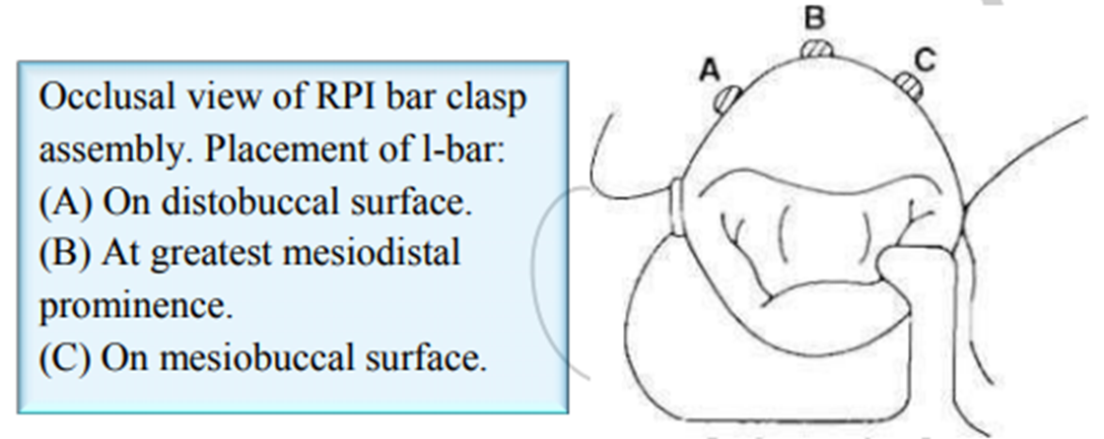
The proximal plate, in conjunction with the minor connector supporting the rest, provides the stabilizing and reciprocal aspects of the clasp assembly.

Slide 12
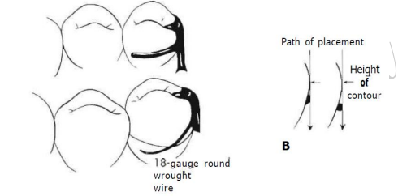
Combination clasp
Another strategy to reduce the effect of the Class I lever in distal extension situations is to use a flexible component in the (resistance arm) which is the strategy employed in the combination clasp.
The combination clasp consists of a wrought-wire retentive clasp arm and a cast reciprocal clasp arm, the wrought-wire retentive clasp arm is either cast to, or soldered to, a cast framework.

Slide 13
Combination clasp
Indication:
On an abutment tooth adjacent to a distal extension base where only a mesial undercut exists on the abutment or where a large tissue undercut contraindicates a bar-type retainer, to minimize the effects of first-class lever system.
When maximum flexibility is desirable, such as on an abutment tooth adjacent to a distal extension base or on a weak abutment when a bar-type direct retainer is contraindicated.
Its adjustability when precise retentive requirements are unpredictable and later adjustment to increase or decrease retention may be necessary.
Its esthetic advantage over cast clasps.

Slide 14
Combination clasp
Advantages:
Flexibility, adjustability, and appearance of the wrought-wire retentive arm.
Wrought-wire retentive arm makes only line contact with abutment tooth, rather than broader contact of cast clasp.
Wrought in structure, it may be used in smaller diameters than a cast clasp, with less danger of fracture.
Because it is round, light is reflected in such a manner that the display of metal is less noticeable than with the broader surfaces of a cast clasp.
A less likely occurrence of fatigue failures in service with the tapered wrought-wire retentive arm versus the cast.
Tapered, round wrought wire clasp arm may act somewhat as a stress breaker between denture base and the abutment teeth.

Slide 15
Combination clasp
Disadvantages:
It involves extra steps in fabrication, particularly when high-fusing chromium alloys are used.
It may be distorted by careless handling on the part of the patient.
Because it is bent by hand, it may be less accurately adapted to the tooth and therefore provide less stabilization in the suprabulge portion.
It may distort with function and not engage the tooth.
Fracture at joining point because of recrystallization of soldering metal.

Slide 16


