Slide 1
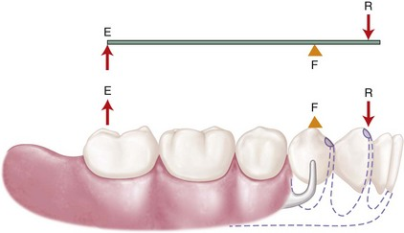
Indirect Retainer
Bushra Mohammed Ali Al-Ameen
B,D,S,. M,Sc.(Pros)

Slide 2
Indirect Retainer
It is that part of removable partial denture which assists the direct retainers in preventing displacement of distal extension denture bases by resisting lever action from the opposite side of the fulcrum line, when the denture moves away from tissue in pure rotation around the fulcrum line.

Slide 3
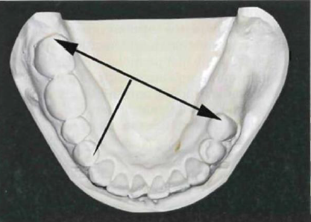
Fulcrum Line:
It is an imaginary axis passing through the most posterior abutments (through occlusal rests or any other rigid portion of a direct retainer assembly located occlusally or incisally to the height of contour of the primary abutments), around which the denture rotates slightly when subjected to various forces directed toward or away from residual ridge.

Slide 4
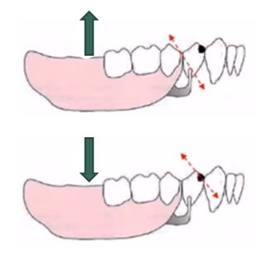

Fulcrum Line:
Types of fulcrum line:
1- Retentive fulcrum line:
An imaginary line connecting retentive points of clasp arms, around which denture tend to rotate when subjected to forces such as the pull of sticky foods.
2- stabilizing fulcrum line:
An imaginary line connecting occlusal rests, around which denture tend to rotate when subjected to masticatory forces.

Slide 5
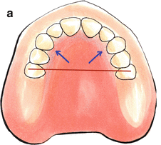
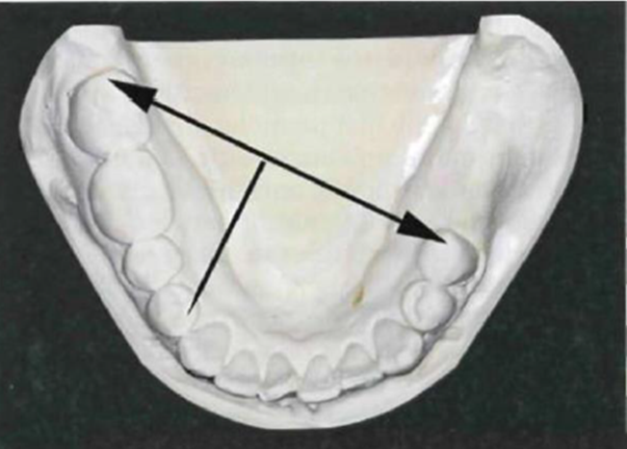
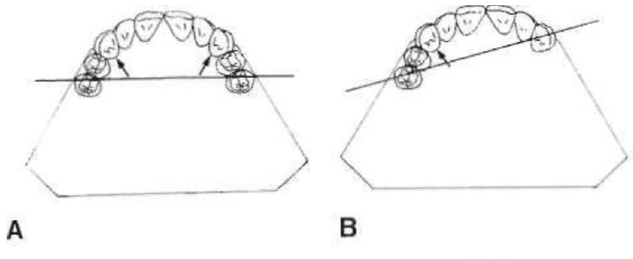
Fulcrum Line:
Location of fulcrum line for different classes of removable partial denture:
The best location for the indirect retainer at 90 degrees to the fulcrum line and provides an efficient resistance to denture base lift.
In Class I arch: Fulcrum line passes through the most posterior abutments, provided some rigid component of framework is occlusal to abutment's heights of contour.

Slide 6
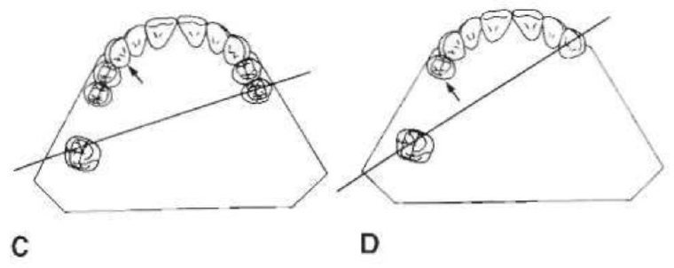
Fulcrum Line:
Location of fulcrum line for different classes of removable partial denture:
In Class II arch: Fulcrum line is diagonal, passing through abutment on distal extension side and the most posterior abutment on opposite side.
If abutment tooth anterior to modification space lies far enough from fulcrum line, it may be used effectively for support of indirect retainer.

Slide 7
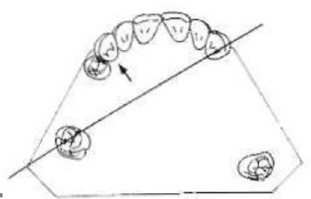
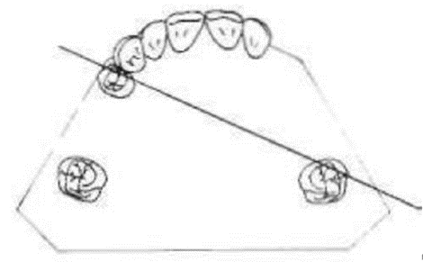
Fulcrum Line:
Location of fulcrum line for different classes of removable partial denture:
In Class III arch with posterior tooth on right side, which has a poor prognosis and will eventually be lost, fulcrum line is considered the same as though posterior tooth were not present. Thus its future loss may not necessitate altering original design of the removable partial denture framework.
In Class III arch with non-supporting anterior teeth, adjacent edentulous area is considered to be tissue-supported end, with diagonal fulcrum line passing through two principal abutments as in Class II arch.

Slide 8
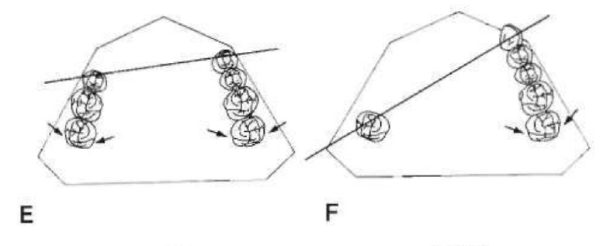
Fulcrum Line:
Location of fulcrum line for different classes of removable partial denture:
In Class IV arch: Fulcrum line passes through two abutments adjacent to single edentulous space.

Slide 9
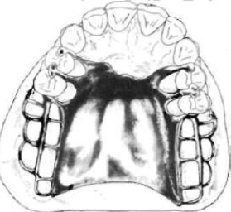
Forms of indirect retainers:
1- Auxiliary occlusal rest:
The most commonly used indirect retainer is an auxiliary occlusal rest located on an occlusal surface and as far away from the distal extension base as possible.
In a Class I arch, this location is usually on the mesial marginal ridge of the first premolar on each side of the arch. The ideal position for the indirect retainer perpendicular to the fulcrum line would be in the vicinity of the central incisors, which are too weak and have lingual surfaces that are too perpendicular to support a rest. Bilateral rests on the first premolars are quite effective, even though they are located closer to the axis of rotation.

Slide 10
Forms of indirect retainers:
1- Auxiliary occlusal rest:
Indirect retainers for Class II partial dentures are usually placed on the marginal ridge of the first premolar tooth on the opposite side of the arch from the distal extension base.
Bilateral rests (indirect retainer) are seldom indicated except when an auxiliary occlusal rest is needed for support of the major connector or when the prognosis of the distal abutment is poor and provision is being considered for later conversion to a Class I partial denture.

Slide 11
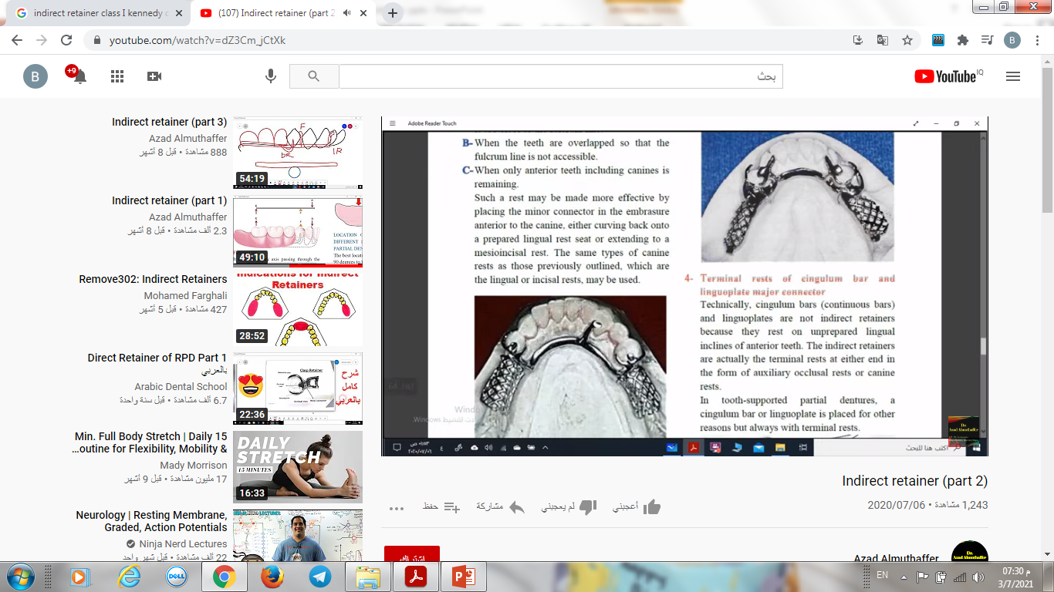
Forms of indirect retainers:
2- Canine rest:
A. The mesial marginal ridge of the first premolar is too close to the fulcrum line.
B. When the teeth are overlapped so that the fulcrum line is not accessible.
C. When only anterior teeth including canines is remaining.
Such a rest may be made more effective by placing the minor connector in the embrasure anterior to the canine, either curving back onto a prepared lingual rest seat or extending to a mesioincisal rest.
The same types of canine rests as those previously outlined, which are the lingual or incisal rests, may be used.

Slide 12
Forms of indirect retainers:
3- Canine extensions from occlusal rests:
Finger extension from a premolar rest is placed on the prepared lingual slope of the adjacent canine tooth. Such an extension is used to increase the effect of indirect retention by increasing the distance of a resisting element from the fulcrum line. This method is particularly applicable when a first premolar must serve as a primary abutment. The distance anterior to the fulcrum line is only the distance between the mesioocclusal rest and the anterior terminal of the finger extension.
Even when they are not used as indirect retainers, canine extensions, continuous bar retainers, and linguoplates should never be used without terminal rests because of the resultant forces effective when they are placed on inclined planes alone.

Slide 13
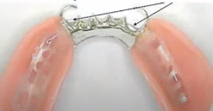
Forms of indirect retainers:
4- Terminal rest of cingulum bar and linguoplate major connector:
Technically, cingulum bars (continuous bars) and linguoplates are not indirect retainers because they rest on unprepared lingual inclines of anterior teeth.
The indirect retainers are actually the terminal rests at either end in the form of auxiliary occlusal rests or canine rests.
In toothsupported partial dentures, a cingulum bar or linguoplate is placed for other reasons but always with terminal rests.

Slide 14
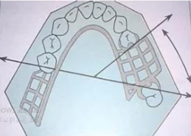
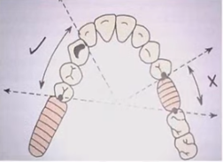
Forms of indirect retainers:
5- Modification areas:
The occlusal rest on a secondary abutment in a Class II partial denture may serve as an indirect retainer. This use will depend on how far from the fulcrum line the secondary abutment is located.
Direct retainer of a modification space located anterior to the terminal abutment axis may also act as indirect retainers provided they are far enough from the fulcrum line.
If the secondary abutment is present farther away from the fulcrum line than the direct retainers of the modification space, it will be more efficient as an indirect retainer.

Slide 15
Forms of indirect retainers:
5- Modification areas:
Note: The primary abutments in a Class II, modification 1 partial denture are the abutment adjacent to the distal extension base and the most distal abutment on the tooth-supported side.
Class II mod. 1 removable partial denture framework. Fulcrum line, when denture base is displaced toward residual ridge, runs from left second premolar to right second molar. When forces tend to displace denture away from its basal seat, supportive element (distal occlusal rest) of direct retainer assembly on right first premolar serves as indirect retainer.

Slide 16
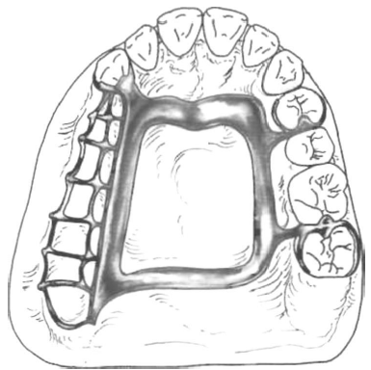
Forms of indirect retainers:
5- Modification areas:
The anterior abutment on the tooth-supported side is a secondary abutment, serving to support and retain one end of the tooth-supported segment and adding horizontal stabilization to the denture.
If the occlusal rest on the secondary abutment lies far enough from the fulcrum line, it may serve adequately as an indirect retainer (dual function) (tooth support for one end of the modification area and support for an indirect retainer).
If the modification space were not present, as in an unmodified Class II arch, auxiliary occlusal rests and stabilizing components in the same position would still be essential to the design of the denture.

Slide 17
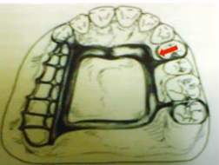
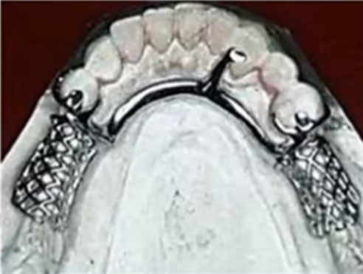
Forms of indirect retainers:
6- direct indirect retention :
Reciprocal arm of a direct retainer located anterior to fulcrum line may act as indirect retainer.
7- Incisal rest :
On mandibular canines when mesial fossa of first premolar is close to fulcrum line.

Slide 18
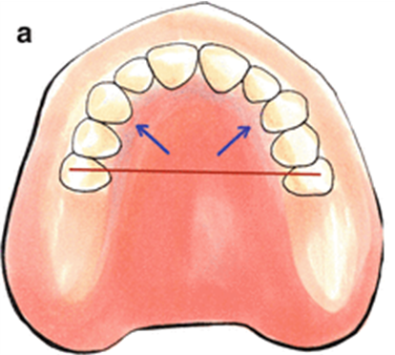
Forms of indirect retainers:
8- Rugae support the major connector :
Some clinicians consider coverage of the rugae area of the maxillary arch as a means of indirect retention because the rugae area is firm and usually well situated to provide indirect retention for a Class I removable partial denture.
Although it is true that broad coverage over the rugae area can conceivably provide some support, the facts remain that tissue support is less effective than positive tooth support and that rugae coverage is undesirable if it can be avoided.

Slide 19
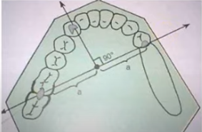
Factors influencing the effectiveness of indirect retainers:
1. The effectiveness of the direct retainers:
The principal occlusal rests on the primary abutment teeth must be reasonably held in their seats by the retentive arms of the direct retainers.
2. Distance from the fulcrum line:
The following three areas must be considered:
A. Length of the distal extension base.
B. Location of the fulcrum line, ideally indirect retainer should be located at a point perpendicular to the midpoint of the fulcrum line.
C. How far beyond the fulcrum line the indirect retainer is placed.

Slide 20
Factors influencing the effectiveness of indirect retainers:
3. Rigidity of the connectors supporting the indirect retainer:
All connectors must be rigid if the indirect retainer is to function as intended.
4. Effectiveness of the supporting tooth surface:
The indirect retainer must be placed on a definite rest seat on which slippage or tooth movement will not occur. Tooth inclines and weak teeth should never be used to support indirect retainers.

Slide 21
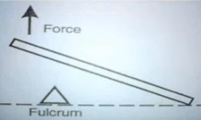
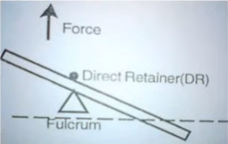
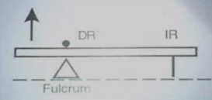
Direct retainer – indirect retainer interaction:
1- Indirect retainer without direct retainer:
2- Direct retainer without indirect retainer:
3- Direct retainer with indirect retainer:

Slide 22
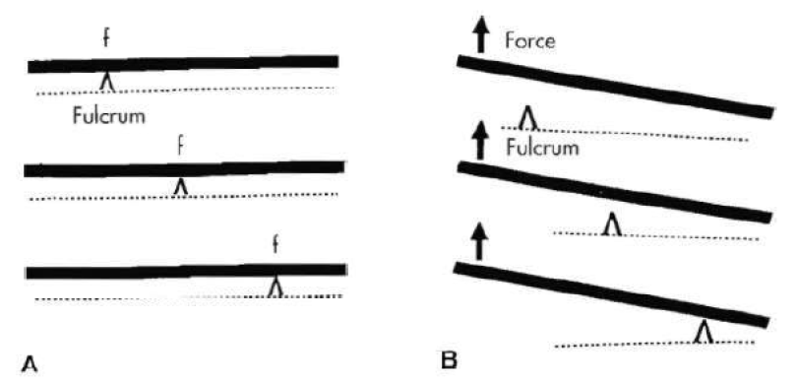
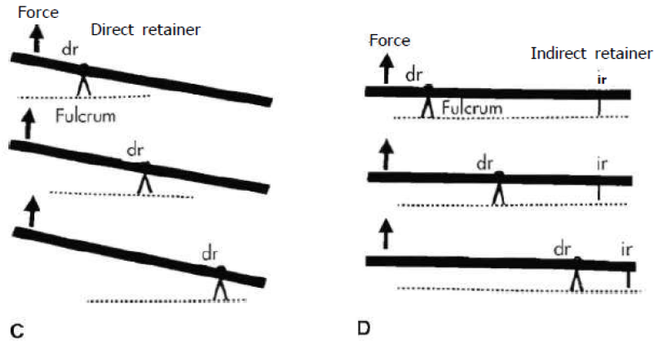

Slide 23
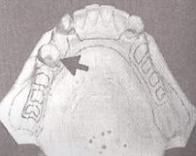
Auxiliary functions of indirect retainers:
It tends to reduce anteroposterior-tilting leverages on the principal abutments. This is particularly important when an isolated tooth is being used as an abutment.
Contact of its minor connector with axial tooth surfaces aids in stabilization against horizontal movement of the denture.
Anterior teeth supporting indirect retainers are stabilized against lingual movement.
Act as an auxiliary guiding plane.
It may support a portion of the major connector facilitating stress distribution.
It may provide the first visual indications for the need to reline an extension base partial denture.
It act as a third point of contacting the tooth structure to ensure accurate repositioning of the frame work on the tooth during rebasing and relining.

Slide 24
Indirect retainer principle
Beams are supported at various points.
Lifting force will displace entire beam in absence of retainers.
With direct retainers (dr) at fulcrum, lifting force will depress one end of beam and elevate other end.
With both direct and indirect retainers (ir) functioning, lifting force will not displace beam. The farther the indirect retainer is from the fulcrum, the more efficiently it should control movement.

Slide 25

Thank you

