Slide 1
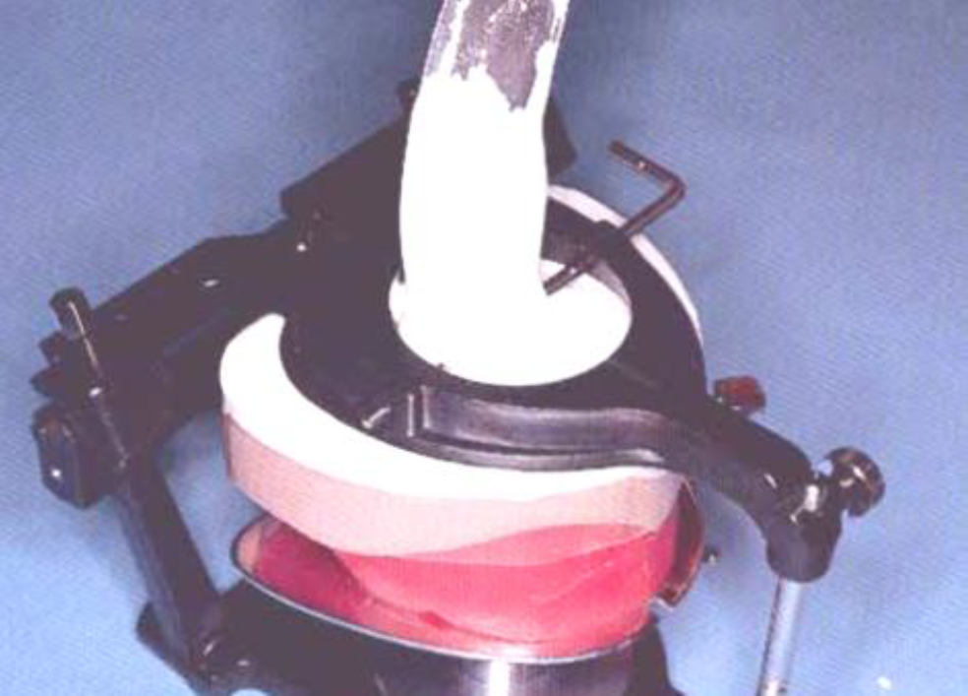
Lab Procedure Prior to Try-in
Mounting
Bushra Mohammed Ali Al-Ameen
B,D,S,. M,Sc.(Pros)

Slide 2
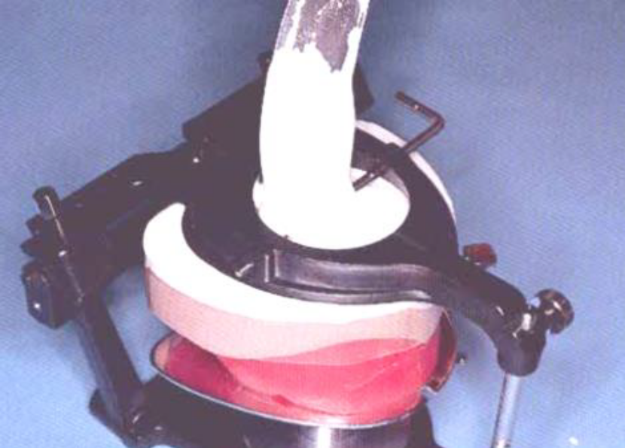
Mounting
It is the procedure of attaching the maxillary and mandibular casts to the articulator in their recorded jaw relation.
It is also called articulation.
The maxillary cast is first articulated, and then the mandibular cast is articulated after recording the vertical and centric jaw relations.

Slide 3
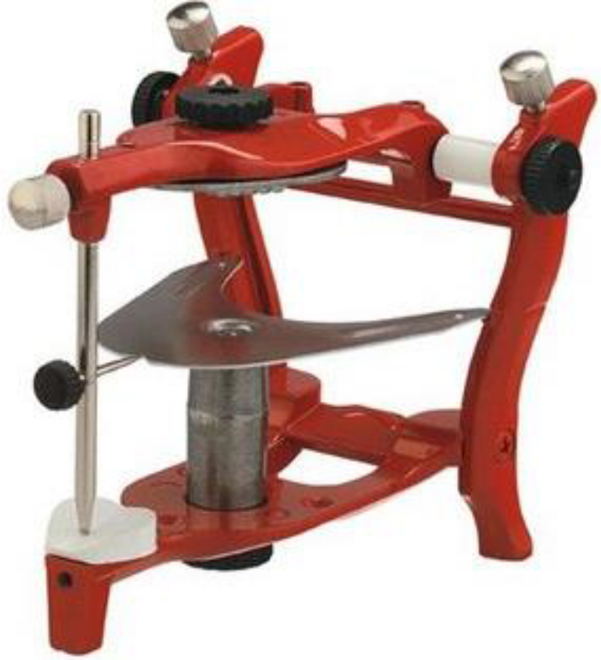
Zeroing or resetting the articulator before mounting
In mean value articulator (Class II articulator):
The articulator should be clean from any remnant of previous plaster.
The movable surfaces of the articulator should move freely without any hindrance.
The incisal pin should be flushed with the top of upper member of articulator to give zero reading.
The mounting table should be properly fixed to the articulator.

Slide 4
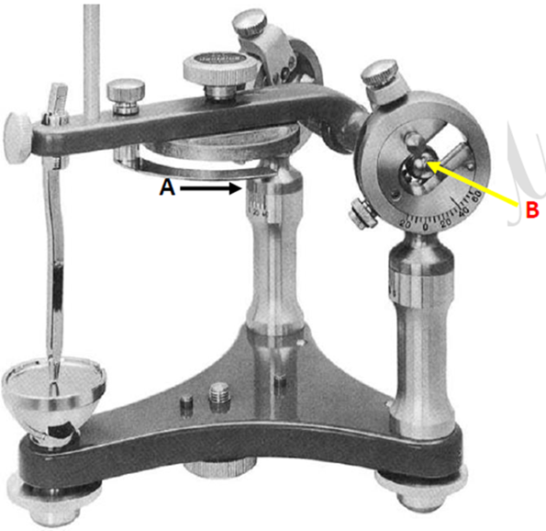
Zeroing or resetting the articulator before mounting
In semiadjustable articulator (Class III articulator):
The articulator should be clean from any remnant of previous plaster.
The movable surfaces of the articulator should move freely without any hindrance.
The incisal pin should be flushed with the top of upper member of articulator to give zero reading.

Slide 5
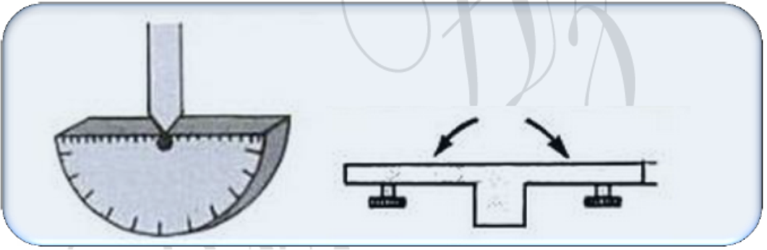
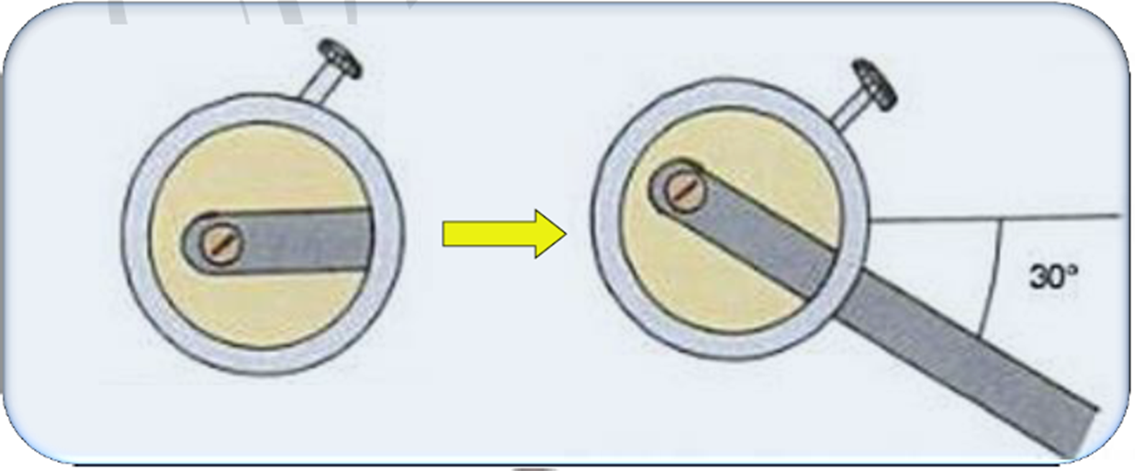
Zeroing or resetting the articulator before mounting
In semiadjustable articulator (Class III articulator):
4. Set the incisal guide table at 0° anteroposteriorly and laterally.
5. Set the condylar track in the horizontal condylar guidance at 30° bilaterally.

Slide 6

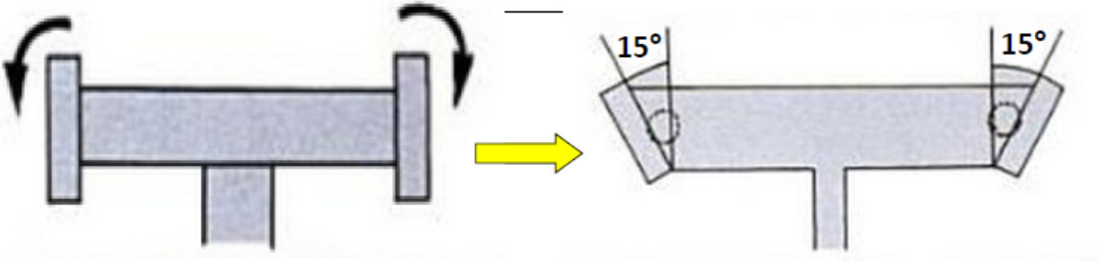

Zeroing or resetting the articulator before mounting
In semiadjustable articulator (Class III articulator):
6. Set the Bennett angle at 30°.
7. Set the lateral condylar guidance at 15°;(A).
8. Lock the opening axis (hinge axis) of the articulator into centric position by placing the condylar ball element all the way forward and turning up the locking pin;(B).

Slide 7
Preparation of the casts for mounting
Determine the midline of the cast according to the midline of incisive papilla and continue this line posteriorly all around the cast.
The casts should be placed in slurry water for better adhesion of the casts to the mounting plaster.
With wax knife, V-shape cuts on the base of upper and lower casts, so as to facilitate the laboratory remounting.
The cut should be approximately 1/4 inch depth and 1/2 inch width.
Lightly coated the base of the casts with Vaseline or any separating medium.
The base plate with occlusion rim should be sealed to the cast by wax.

Slide 8
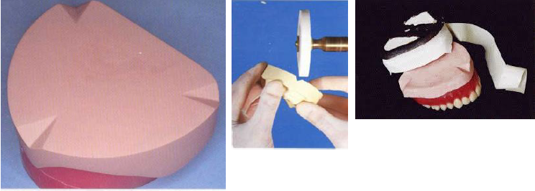

Slide 9
Mounting the maxillary cast
The maxillary cast is first attached to the upper member of the articulator after orientation jaw relation by using the face-bow with adjustable type of articulators.
while for the mean value articulator use the mounting table to support the maxillary occlusion rim in its position during mounting.
The mandibular cast is articulated after recording the vertical and centric jaw relations.

Slide 10
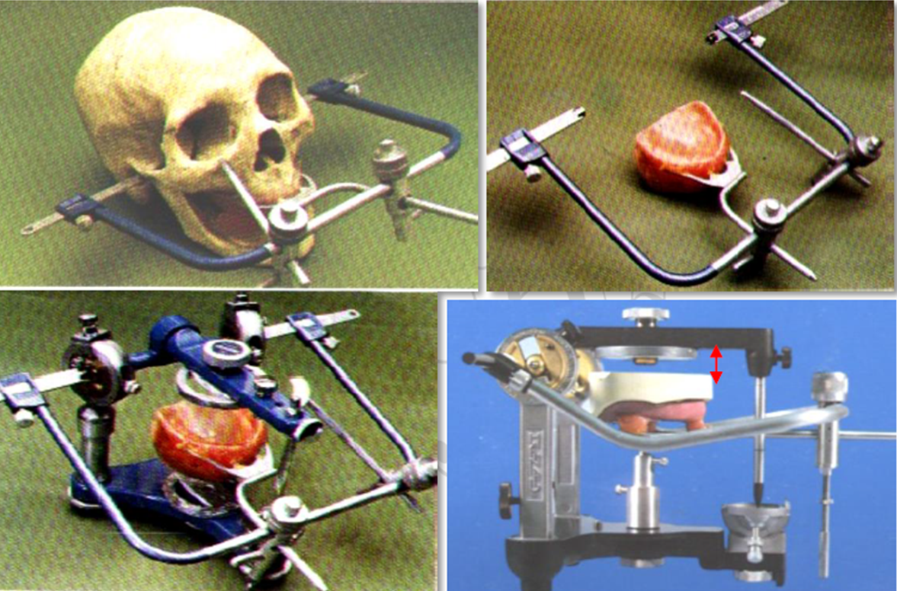
Face-bow transfer supports the maxillary occlusion rim in its position during mounting in semi-adjustable articulator.

Slide 11
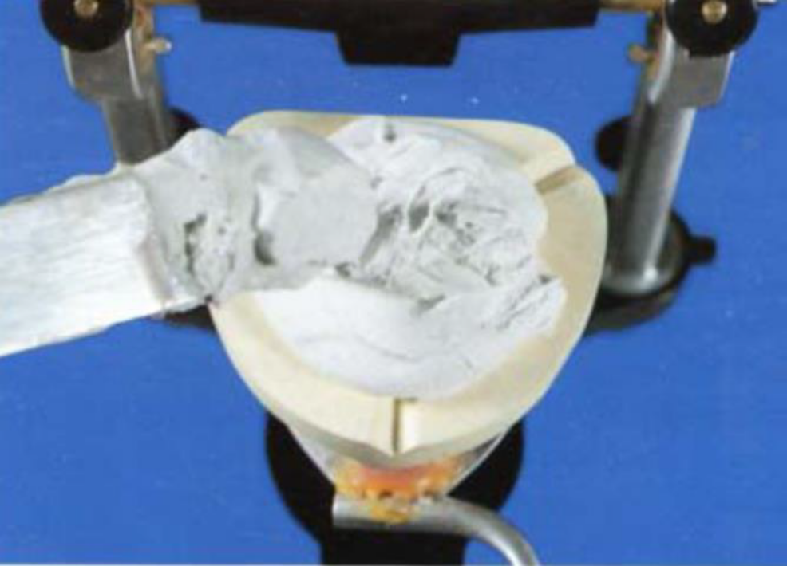
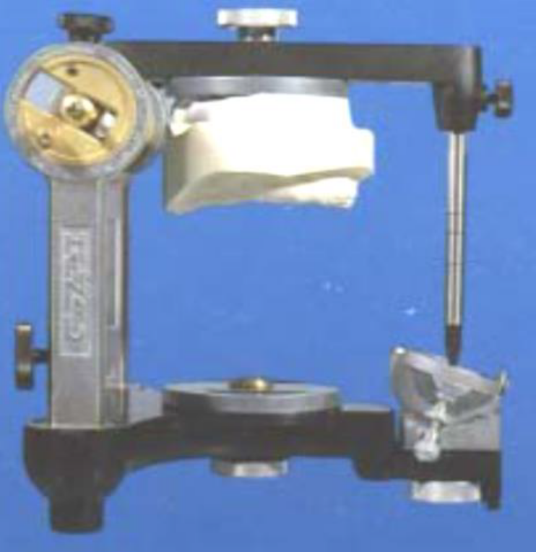
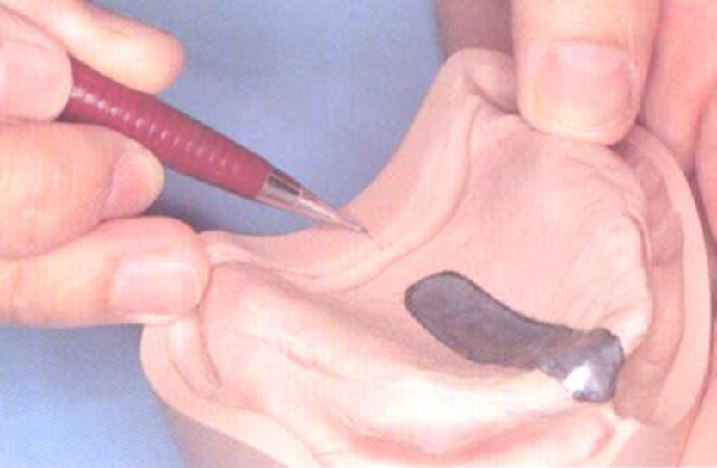
Face-bow transfer supports the maxillary occlusion rim in its position during mounting in semi-adjustable articulator.

Slide 12
After recording the orientation jaw relation, the following steps are carried out
Enough space should be present between the base of the cast and the upper member of the articulator to accommodate for the plaster material over the cast. If there is not enough space trimming should be done to the base of the cast.
Alignment of the midline of the maxillary occlusion rim to the center of the cross midline which found on the mounting table anteriorly and posteriorly, so that the cast will be centralized to the mounting table and the occlusal rim fixed to the mounting table by wax.

Slide 13
After recording the orientation jaw relation, the following steps are carried out
Plaster is mixed according to the manufacturer instruction then the plaster is poured over the base of the cast and the upper member is closed until the incisal pin touches the incisal table.
Smoothing and polishing of the plaster is done.
The mounting should be cleaned and any debris removed from the articulator and mounting table.

Slide 14
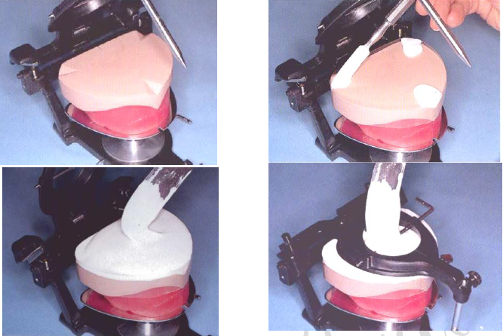
Mounting table supports the maxillary occlusion rim in its position during mounting in mean value articulator.

Slide 15
Mounting the mandibular cast
The mandibular cast is mounted after recording the tentative vertical and centric jaw relations.
The mandibular occlusion rim should be well secured to the mandibular cast with it record base by using wax, also sealing should be done between the maxillary and mandibular rims after making tentative centric jaw relation.
Care should be taken that there is no posterior interference between the maxillary and mandibular casts (Heel area).
The articulator with the mounted maxillary cast is inverted to aid in the mounting the mandibular cast.

Slide 16
Mounting the mandibular cast
The maxillary occlusal rim with mandibular occlusal rim (centric record) placed on the maxillary cast.
The mandibular cast is placed on the mandibular occlusal rim (It should be soaked in slurry water before mounting).
The plaster is mixed and poured over the base of the mandibular cast and the articulator is closed until the incisal table touch the incisal pin, then the plaster should be smoothed and polished.

Slide 17
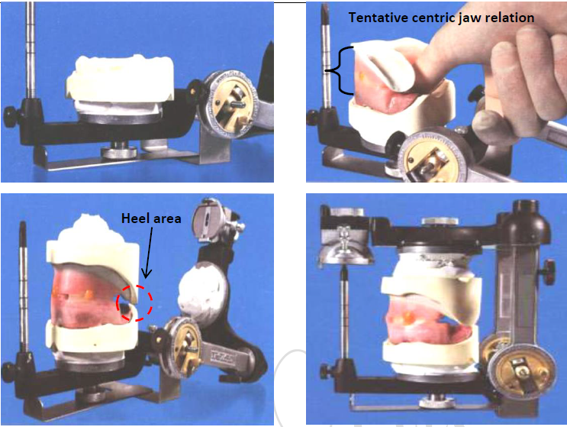
Mounting the mandibular cast in semiadjustable articulator.

Slide 18
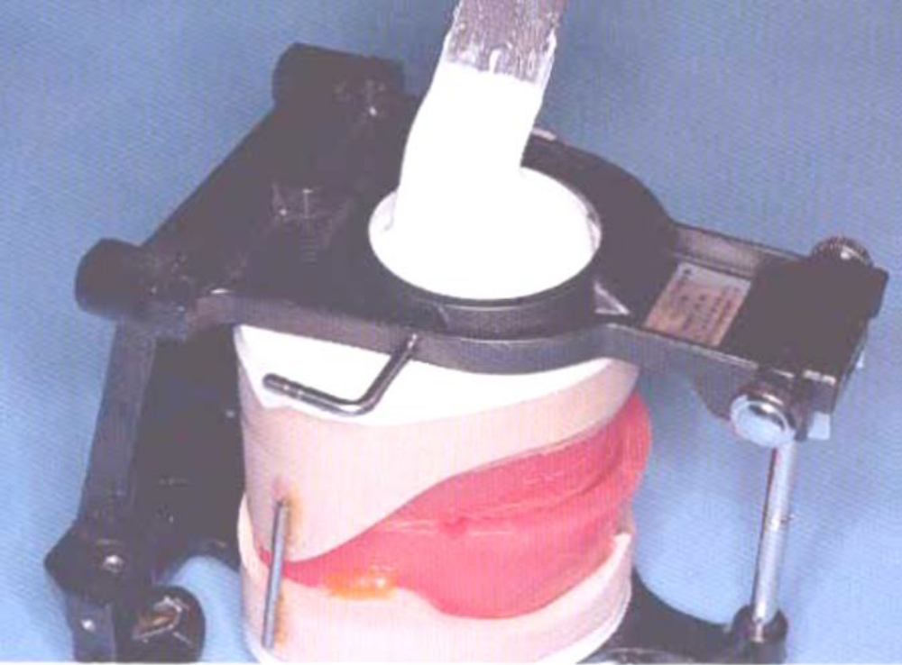
Mounting the mandibular cast in mean value articulator.

Slide 19
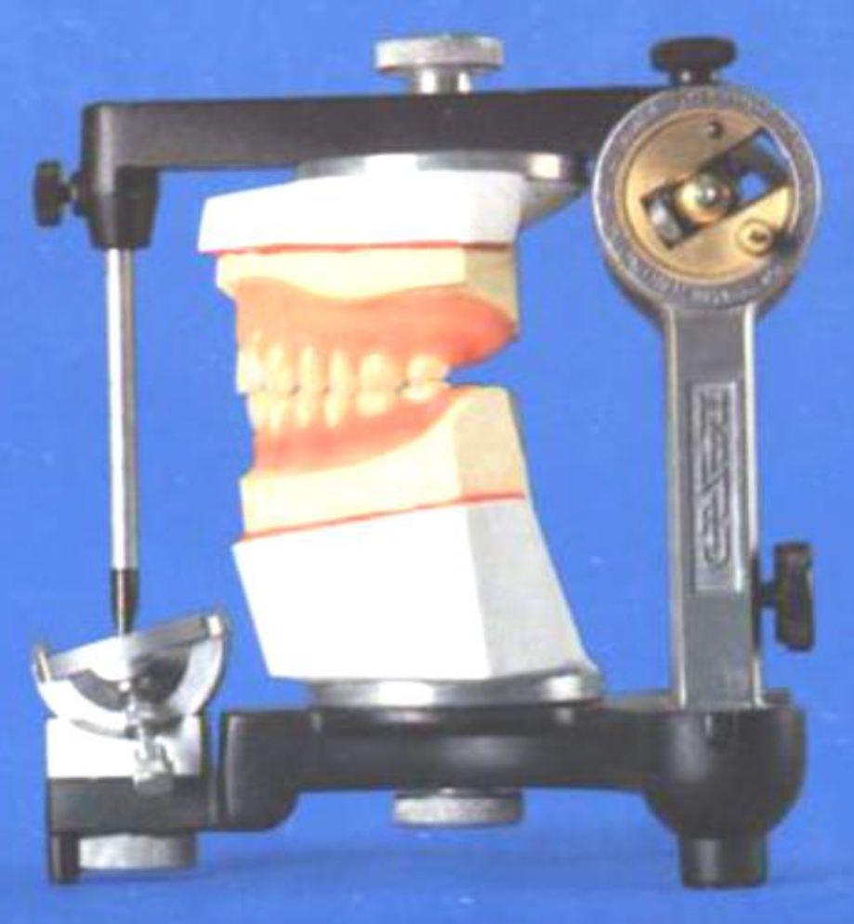
Checking the mounting
The midline of maxillary cast should be coincided with the midline of mandibular cast and midline of articulator.
Centralization of maxillary cast with upper member of articulator then the centralization of lower cast which depend on accuracy of the maxillary cast.
Incisal pin checked if it does not touch the incisal table.
Heel area checked if there is any contact between the maxillary and mandibular casts.

Slide 20
Possible errors might occur during mounting
The record base is not properly secured to the cast.
Interference of the casts posteriorly.
The incisal pin does not touch the incisal table.
The incisal pin is not properly screwed.
Wrong transference of the midline of the articulator with that of the casts (shifting of the midline).
Movement of the casts during mounting.
Maxillary and mandibular rims are not properly fixed after making centric record.
Dimensional changes in the plaster material.

Slide 21


