Slide 1
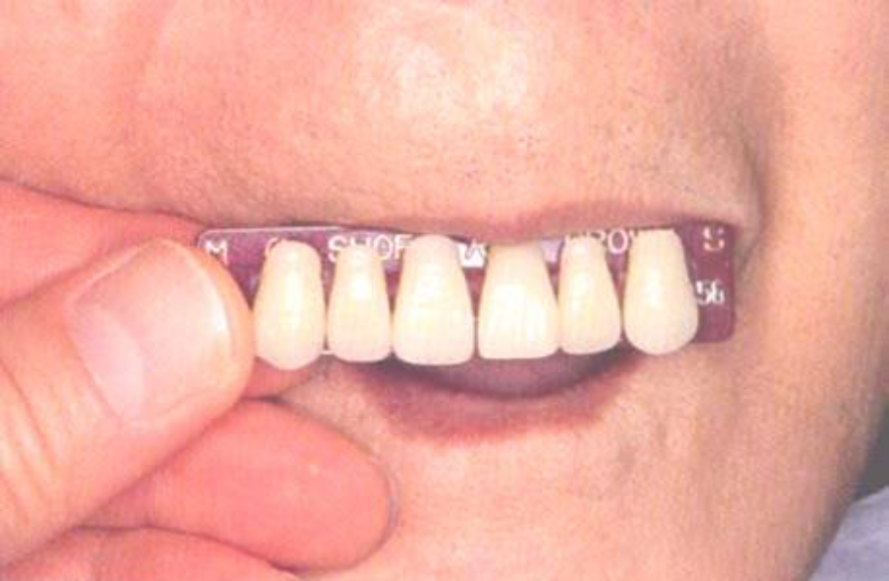
Selection of artificial teeth
Bushra Mohammed Ali Al-Ameen
B,D,S,. M,Sc.(Pros)

Slide 2
Teeth selection is very important as the selection of the appropriate shade, size, and form of the artificial teeth determines the esthetic and function of the denture.
Objectives in teeth selection:
The teeth should be in harmony with the surrounding tissues.
They should maintain the vertical dimension.
They should be efficient for mastication.
Anterior teeth are selected predominantly based on esthetic.
The posterior teeth should be selected based on the function.

Slide 3
Selection of artificial teeth
1. Selection of anterior teeth.
2. Selection of posterior teeth.

Slide 4
Selection of anterior teeth
Anterior teeth are primarily selected to satisfy esthetic requirements, so the dentist's professional obligation is to give the patient adequate information, guidance, and opportunity to choose their teeth.
Anterior teeth selection is the area of prosthodontic care in which the patient should be given a primary responsibility to determine the esthetic outcome.

Slide 5
Records of shade, size, and form of teeth could be obtained from pre-extraction records which include
1- preserved extracted teeth.
2- previous diagnostic casts with natural teeth.
3- pre-extraction radiograph.
4- pre-extraction photograph.
5- observation of teeth of close relatives.
6- The old denture might help in teeth selection by ask the patient, if (like or dislike) the teeth and decide to change or not.

Slide 6
Factors to be considered when pre-extraction records are not available
Shade
Size
form

Slide 7
Shade
It is the degree of darkness of the color.
There are two basic shades, the yellow and grey, and the other shades vary in between.
Many patients will ask for very light shade, tell them that the proper shade gives more natural appearance, never force the patient to accept a shade that they do not want, they will never be satisfied with the denture.

Slide 8
Factors of shade selection
1- Age.
2- Gender.
3- Complexion.
4- Patient Preference.

Slide 9
Factors of shade selection
1- Age:
The younger the patient, the lighter the shade is preferred.
The shade of natural teeth will be darkening with age because of
deposition of secondary dentin.
Consequent reduction in size of the pulp chamber.
Wearing a way of enamel.
External staining of the exposed dentin from oral fluids, foods, or tobacco.

Slide 10
Factors of shade selection
2- Gender:
The gender may affect the shade; it seems that females are given lighter and brighter teeth than males.
3- Complexion:
The color of the face should harmonize the shade of the teeth. Lighter teeth are suitable for lighter skin, while darker teeth are suitable for darker skin. Although people with dark skin seemed to have very light teeth, this is because of contrast in the skin and teeth color.

Slide 11
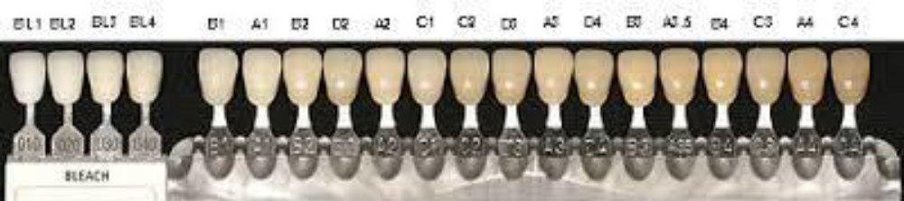
Factors of shade selection
4- Patient Preferance:
Show the patient a complete shade guide and select the two tabs that are the lightest and the darkest, hold them against the patient lip and ask them to point to the one that they prefer this method called (method of pair comparison).
More than two or three shades should be selected and comparison between them would help in final right selection.

Slide 12
Size
To select the size of anterior teeth, we have to consider the following:
Length
Width
Patient Preference

Slide 13
Size
1- Length:
The length of anterior teeth is controlled by:
A- length of upper lip.
In short lip more than 2 mm seen from the maxillary central incisors.
In medium lip length 1.5-2 mm seen from the maxillary central incisors.
In long lip nothing can be seen from the maxillary central incisors.
B- level of the lower lip.
Length of mandibular anterior teeth should be with the level of lower lip.
C- Inter-ridge distance.
When the space is available, it is more esthetically acceptable to use a tooth long enough to eliminate the display of the denture base (teeth are more attractive in appearance than denture base materials).

Slide 14
Size
2- Width:
A-The width from the tip of left canine to the tip of right canine is almost equal to the width of the nose (interalar width) when measured by the caliper.
(Width of six anterior teeth = interalar width + 7 mm).
B- The width of maxillary central incisor equals approximately to 1/16 of bizygomatic width, and the width of maxillary anterior teeth equals to 1/3.36 of bizygomatic width.
C- Width of the anterior teeth can be measured on maxillary occlusal rim depending on the intraoral anatomical landmarks like: (buccal frenum, corner of the mouth, and canine eminence).

Slide 15
Size
3- Patient Preference:
Use the method of pair comparison to assist a patient to decide what size of tooth they prefer.
Set two different sizes of teeth on a piece of wax rope, place them under the upper lip, and find out which one the patient prefers.

Slide 16
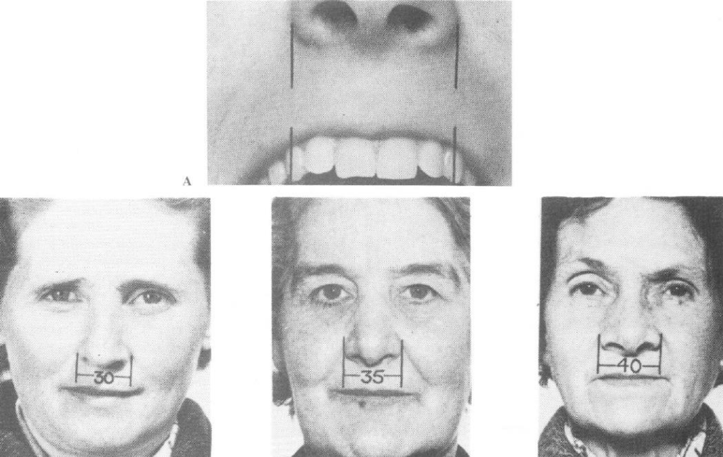

Slide 17
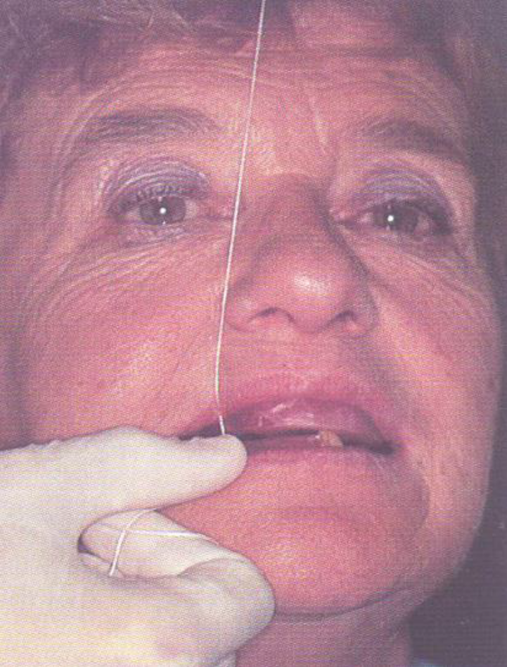
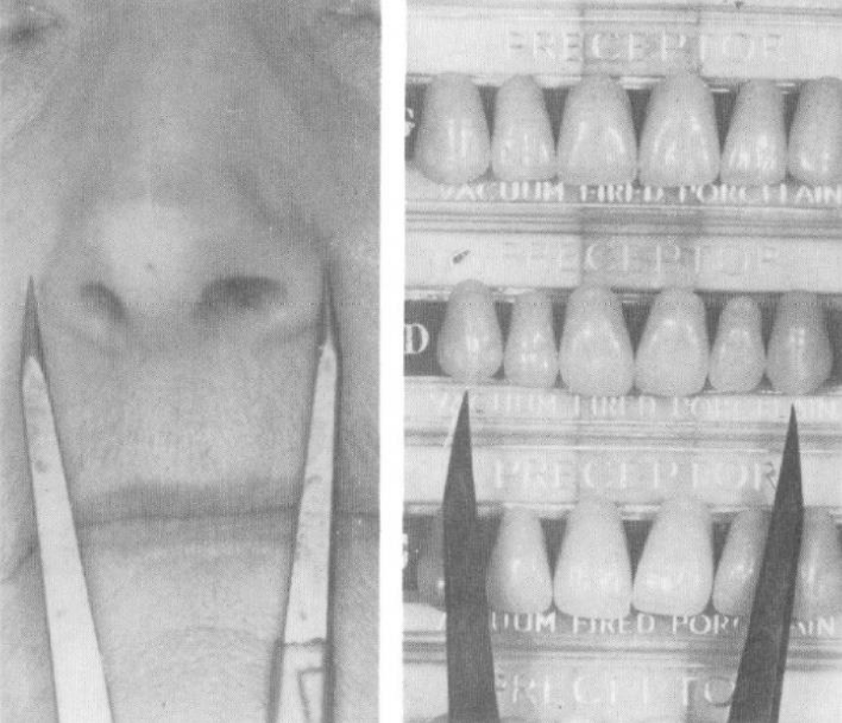

Slide 18
Form
The form or outline of anterior teeth depends on:
Facial form.
Gender.
Age.
Personality.
Patient preference.

Slide 19
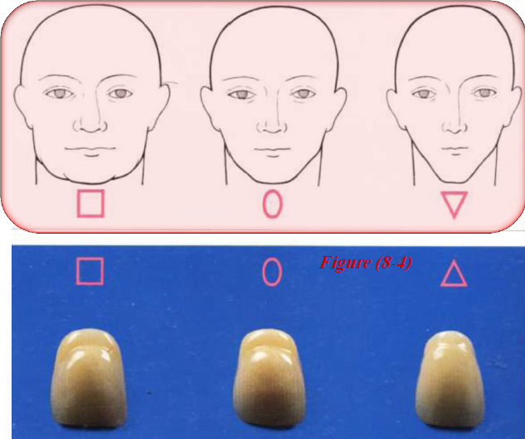
Form
The form or outline of anterior teeth depends on:
Facial form:
According to frontal outline:
the face could be classified into square, ovoid and tapering .
the maxillary central incisor form should be in harmony with patient face.

Slide 20
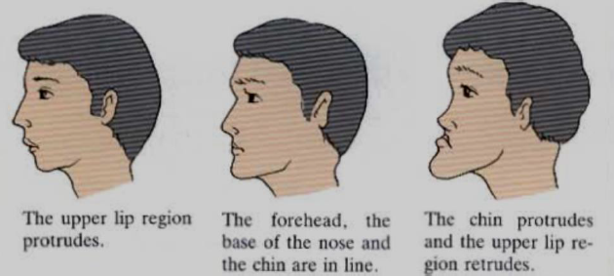
Form
The form or outline of anterior teeth depends on:
Facial form:
According to profile:
The face could be classified into: straight, convex and concave.
The labial surface of maxillary central incisor viewed from mesial aspect should be in harmony with profile of face.

Slide 21
Form
The form or outline of anterior teeth depends on:
2. Gender:
Masculine form:
Is associated with square, cuboidal, and angular Form.
Feminine form:
Is associated with more rounded, ovoid, and tapering features.
3. Age:
In old patients the teeth tend to have square form due to attrition, more Round features disappear and line angle quite seen in those patients.

Slide 22
Form
The form or outline of anterior teeth depends on:
4. Personality:
It seems reasonable that a large vigorous type of persons have teeth of more square, large teeth with prominent markings, different from those of delicate appearing persons.
5. Patient preference:
Allow the patient to select between the same size teeth but different Forms. Set two different forms of teeth on the right and left sides of a Piece of wax rope, and ask the patients which they prefer.

Slide 23
Materials of artificial teeth
Porcelain | Acrylic
We have vacuum fired and air fired, the vacuum fired is better because they are harder and have luster. | They are made from acrylic resin.
They are brittle and thus susceptible to fracture, more resistance to abrasion. | They are not brittle, but poor abrasion resistance, so they might become worn down with consequent loss of vertical dimension.
Excellent esthetic, does not stained, and maintain luster for long time. | Esthetic very good, but cannot maintain luster for long time.
Mechanical bonding by pins or undercut holes. | Chemical bonding with denture base Easily ground and polished.
Difficult to grind and polish. | Easily ground and polished.
There is clicking during contact. | There is no clicking during contact.

Slide 24
Materials of artificial teeth
Porcelain | Acrylic
More forces transmit to the mucosa. | Transmit less force to mucosa because they have greater resilience, so they cushion the underlying supporting tissue from occlusal load.
Thermal expansion is much lower than acrylic causes stresses in acrylic denture base and crazing may appear around teeth. | Thermal expansion same as that of acrylic denture base.

Slide 25
Selection of posterior teeth
Posterior teeth are selected for:
1. Shade
2. Mold (Size + Occlusal form)

Slide 26
Shade
Shade of posterior teeth should be harmonized to the shade on anterior teeth.
Maxillary first premolars are sometimes used for esthetic more than function, so it is advisable to select premolar teeth with lighter color than the other posterior teeth, but not lighter than anterior teeth.
Generally the shades of posterior teeth are slightly darker than anterior teeth.

Slide 27
Size
Occlusogingival height:
It is determined by the available interarch distance.
The occlusal plane should be located at the midpoint of the interocclusal distance.
The length of the maxillary first premolar should be comparable to that of maxillary canine to have the proper esthetic effect.
The height of posterior teeth usually divided into long, medium, and short. Long posterior teeth are generally more esthetic in appearance than are shorter teeth.

Slide 28
Size
Buccolingual width:
The buccolingual width of posterior teeth should be slightly narrower than natural teeth, because the broader occlusal surfaces which direct more stress during function to supporting tissue, leading to increase in the rate of ridge resorption.
Broader teeth encroach into the tongue space leading to instability of the denture. Also, the teeth should not encroach into the buccal corridor space to avoid cheek biting.

Slide 29
Size
Mesiodistal length:
The combined mesiodistal lengths of all maxillary posterior teeth in that side of the arch should be equal to the distance between canine line, and anterior border of maxillary tuberosity.
For mandibular posterior teeth, the mesiodistal lengths should be equal to distance between the canine line and anterior border of retromolar pad.
Placing a tooth on an inclined plane (steep anteroposterior ridge slope) should be avoided, otherwise this would lead to forward displacement of the denture and dislodgment of denture occurs.
Similarly the teeth should not be placed over displaceable tissues like the retromolar pad as it will cause tipping of the denture during function.
In case with inadequate mesiodistal length, the premolar can be omitted.

Slide 30
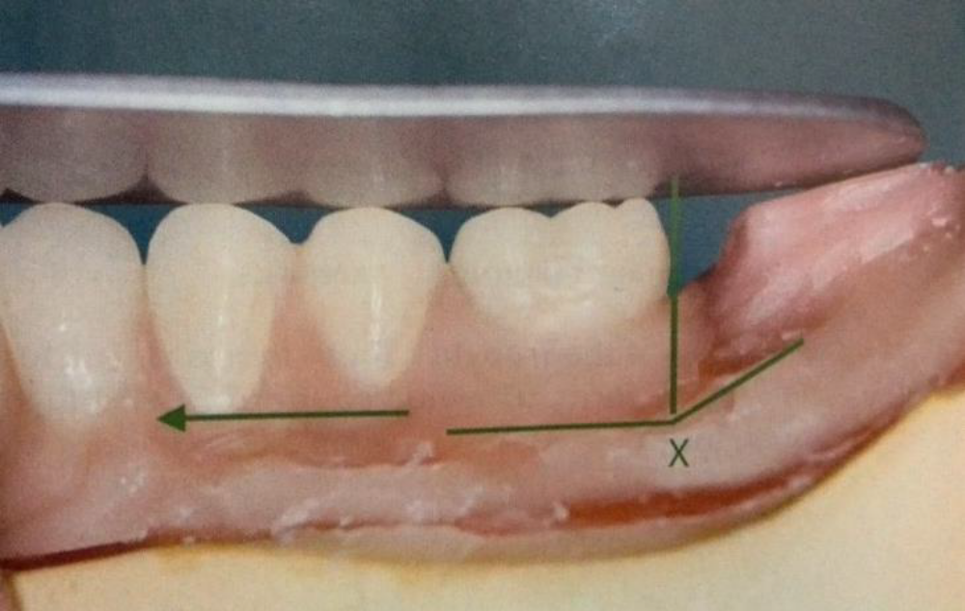
X indicates the beginning of the steep slope. The arrow indicates the potential movement of the denture during the function if the second molar were placed on the slope.

Slide 31
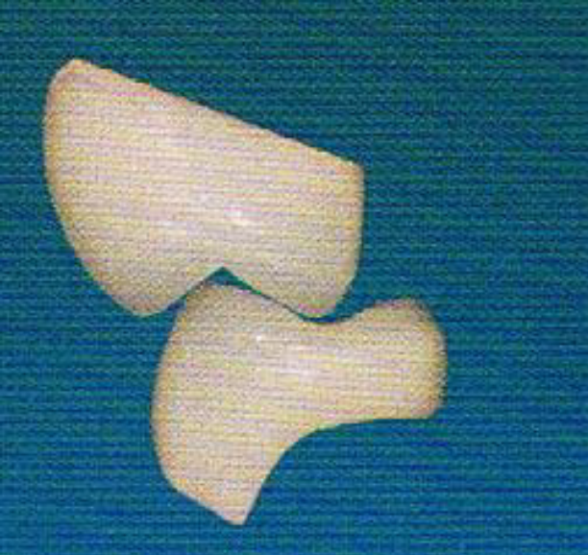
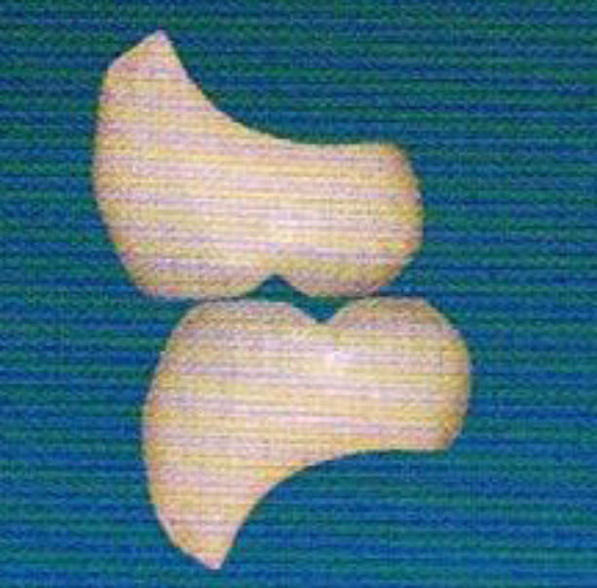
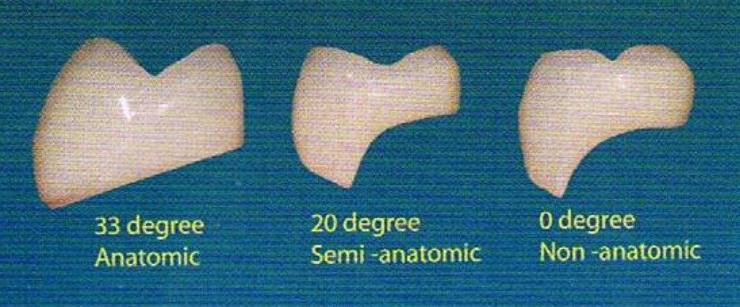
Occlusal form
There are two forms :
A- Cusp form (anatomical teeth):
Anatomical teeth have cusp angles 33; 20; 5
B- Non-cusp from ( non-anatomical or cuspless teeth):
They are also called monoplane, flat plane, or zero degree.

Slide 32
Advantages of cusp form teeth
More efficient in chewing.
They can be arranged in balanced occlusion in eccentric position.
The cusp fossa relationship between the maxillary and mandibular posterior teeth forms a definite point for return to centric occlusion.
More acceptable esthetically.
More compatible with surrounding oral environment.

Slide 33
Advantages of non-cusp form teeth
Offer less resistance in non-masticatory movement like (bruxism); therefore less damaging to the supporting structure.
More comfortable.
Offer less resistance to lateral forces therefore, they are indicated in excessively resorbed ridges.
Allow greater range of movement which is necessary in patient with malrelated jaws.
They can be used with less damaging effect than cusp form teeth in patient with uncoordinated neuromuscular control which jaw relation records are not repeatable.

Slide 34
