Slide 1
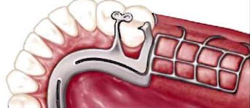
Stress breaker –Stress equalizer
Bushra Mohammed Ali Al-Ameen
B,D,S,. M,Sc.(Pros)

Slide 2
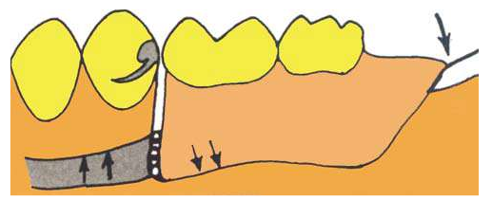
STRESS BREAKER
In the distal extension RPD, Support is derived from both the residual ridge and abutment teeth.
The variation in consistency providing this support allows some rotational movements of the free end base towards the soft tissues.
Harmful tissue –ward movements of distal extension under occlusal load are transmitted to the abutment teeth resulting in loosening of these teeth.
Dentures with a stress breaker are also called as a broken stress partial dentures or articulated prostheses

Slide 3
STRESS BREAKER
STRESS BREAKER :
It is A device which relieves the abutment teeth of all or part of the occlusal forces” Or, "is a device that allows movement between the denture base and the direct retainer which may be intracoronal or extracoronal”.
Or, It is a device that permits some hinge or rotational movement between the denture base or its supporting framework and the direct retainers (whether they are intra coronal or extracoronal retainer), this device separate the action of the direct retainers from the base movement, so it was used to minimize strain on the abutment teeth to which the partial denture is attached and transfer them to the denture bearing areas. It is indicated in a distal extension restoration.
All vertical and horizontal forces applied to the artificial teeth are distributed throughout the supporting portions of the dental arch. Broad distribution of the force is obtained through the rigid major, minor connectors and stabilizing components.

Slide 4
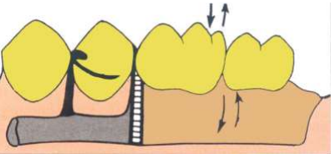
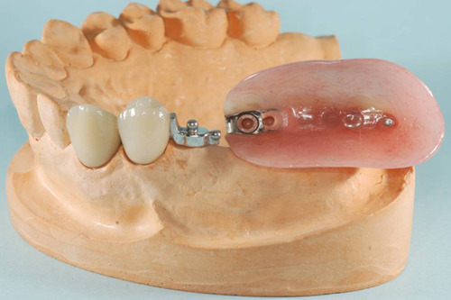
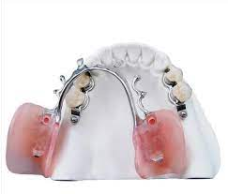
Types of stress breaker
1-First group (non rigid attachments): RPD having a movable joint between the direct retainer and the denture base. include hinge , sleeve and cylinder, ball and socket device.
These types have a movable joint between the direct retainer and the denture base and permit vertical movement and hinge action of the distal extension denture base.

Slide 5
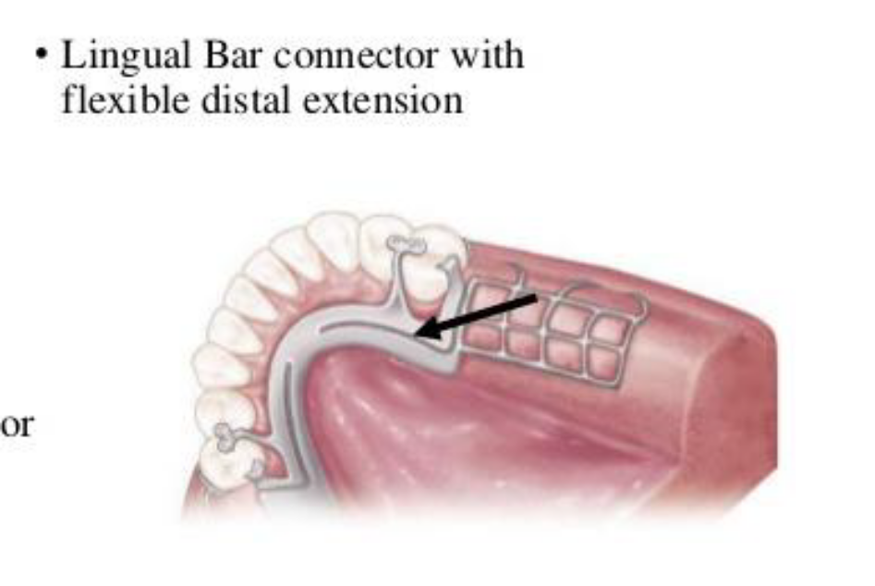
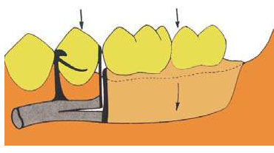
Types of stress breaker
2-second group: include design having a flexible connection between the direct retainer and the denture base (articulated partial denture) this group include the use of:
A-Divided major connector (split bar):
by using this type of stress breakers, the vertical forces applied on distal extension base must pass anteriorly along the lower bar and then back along more rigid upper bar to reach abutment tooth therefore the tipping forces that would otherwise be transmitted directly to abutment teeth are dissipated by flexibility of lower bar and distance traveled .

Slide 6
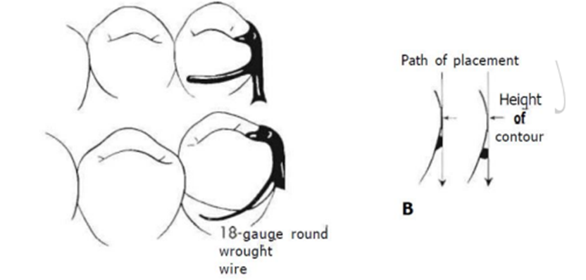
Types of stress breaker
2-second group: include design having a flexible connection between the direct retainer and the denture base (articulated partial denture) this group include the use of:
B-Wrought wire clasp (combination clasp)
C-clasps having stress breaking effect:
1-RPI system
2-Reverse Aker clasp
3-RPA system
R=rest mesially located, P=proximal plate, A= Aker clasp

Slide 7
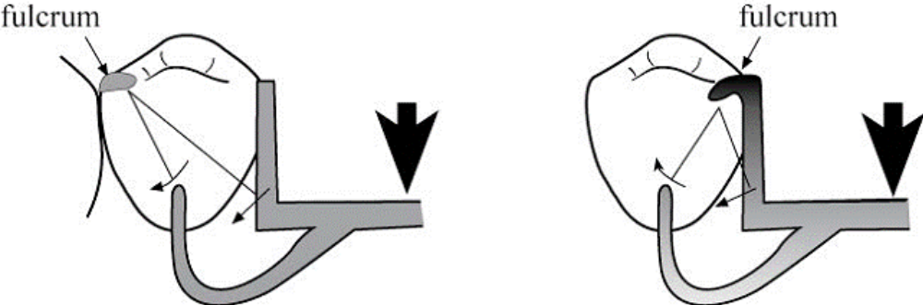
Types of stress breaker
2-second group: include design having a flexible connection between the direct retainer and the denture base (articulated partial denture) this group include the use of:
B-Wrought wire clasp (combination clasp)
C-clasps having stress breaking effect:
1-RPI system
2-Reverse Aker clasp
3-RPA system
R=rest mesially located, P=proximal plate, A= Aker clasp

Slide 8
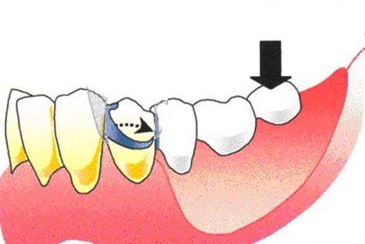
Types of stress breaker
2-second group: include design having a flexible connection between the direct retainer and the denture base (articulated partial denture) this group include the use of:
B-Wrought wire clasp (combination clasp)
C-clasps having stress breaking effect:
1-RPI system
2-Reverse Aker clasp
3-RPA system
R=rest mesially located, P=proximal plate, A= Aker clasp

Slide 9
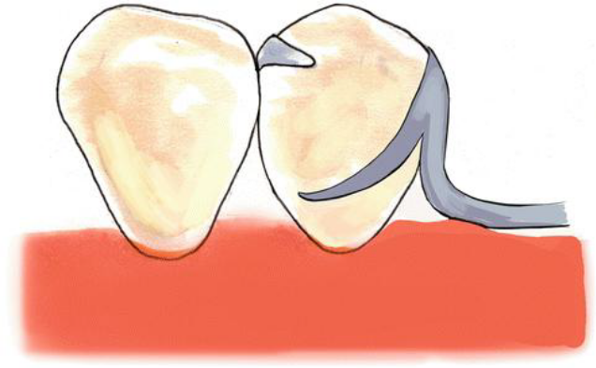
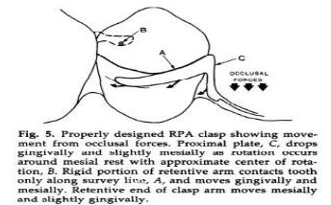
Types of stress breaker
2-second group: include design having a flexible connection between the direct retainer and the denture base (articulated partial denture) this group include the use of:
B-Wrought wire clasp (combination clasp)
C-clasps having stress breaking effect:
1-RPI system
2-Reverse Aker clasp
3-RPA system
R=rest mesially located, P=proximal plate, A= Aker clasp

Slide 10
Advantages Of Stress Breakers:
Preservation of alveolar support of abutment teeth by minimizing the horizontal forces acting on the teeth.
The flexible type of stress breaker creates a balance of stress between the abutment teeth and the residual ridge
Movement of the denture base result in the physiologic stimulation to the mucosa
If relining is needed and but not done, the abutment teeth are not damaged quickly.
The flexible attachment (non-rigid attachment) of the distal extension base to the major connector makes splinting of weak teeth by the denture framework is possible.

Slide 11
Disadvantages Of Stress Breakers:
Lack of occlusal stability.
Not provide bracing for lateral forces
Improper control of forces distribution between the dentate and edentulous areas.
The denture is more difficult to fabricate and therefore more costly.
If relining is not done when needed excessive resorption of the residual ridge may result
Flexible connectors may be bent and fractured by careless handling and by repeated flexing.
Repair and maintenance of any stress breaker are difficult, costly, and frequently required.
All mechanical devices those are free to move in the mouth in collect debris and become unclean.
some split connector is used as stress breaker pinch the underlying soft tissue or the tongue as they open and close under function.

Slide 12

Thank You

