Slide 1
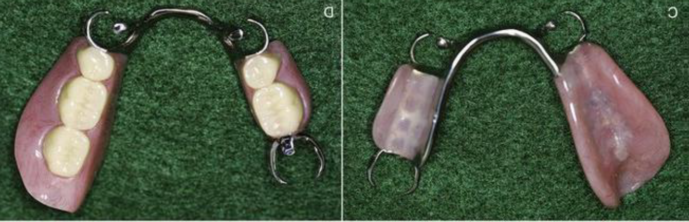
Partial Denture Base
Bushra Mohammed Ali Al-Ameen
B,D,S,. M,Sc.(Pros)

Slide 2
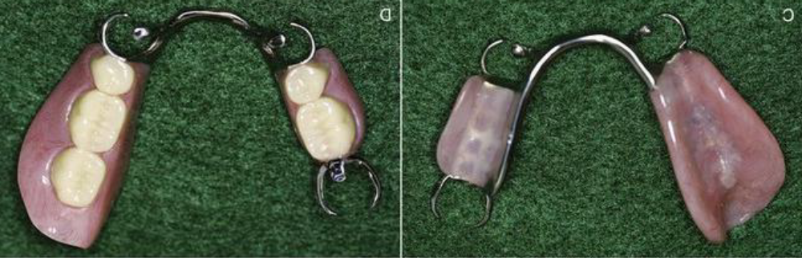
Partial Denture Base
It is that part of partial denture that supports the artificial teeth, and rest on the foundation tissues, and transfers the occlusal force to the supporting structures.

Slide 3
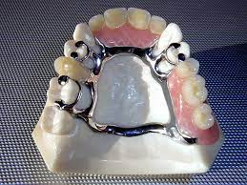
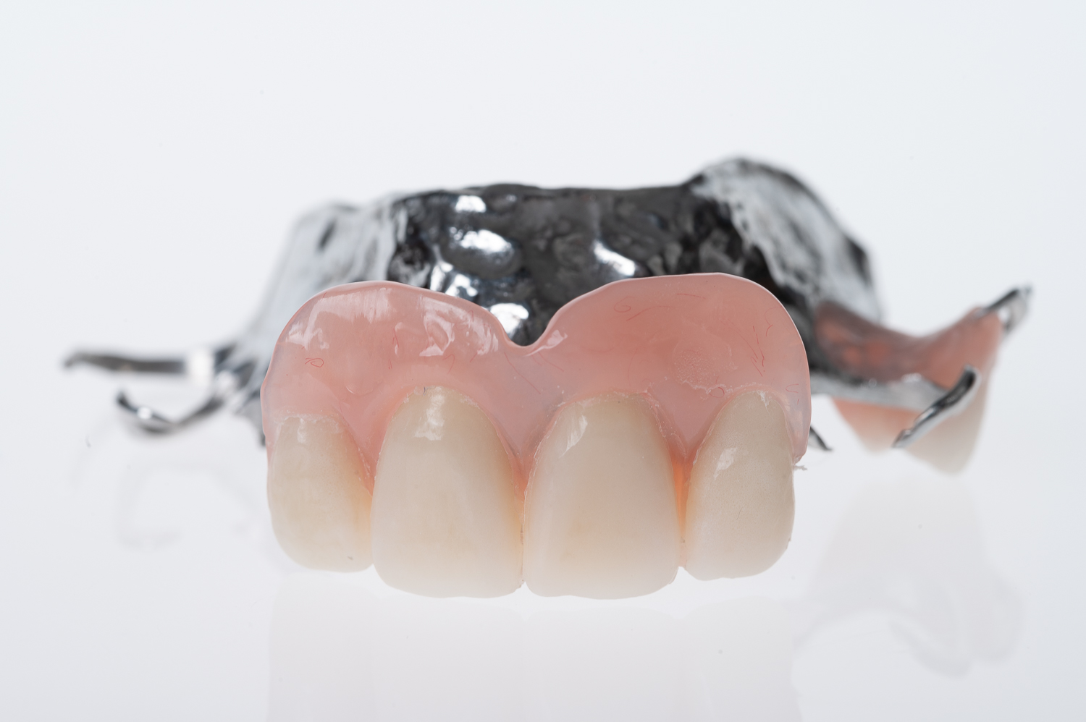
Functions Of Denture Base
Masticatory function: It supports the artificial teeth and consequently receives the functional forces from occlusion and transfers functional forces to supporting oral structures.
Cosmetic function: this is related to reproducing natural-looking contours.
Physiological function: The stimulation of the underlying tissue of the residual ridge, by massaging action during movement of the denture base under functional stress (within physiological tolerance) maintain their form and tone better than similar tissues suffering from disuse (disuse atrophy).

Slide 4
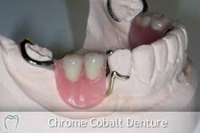
Functions Of Denture Base
Prevent vertical and horizontal migration of remaining natural teeth.
Oral cleanliness: eliminate undesirable food traps.
The denture bases must contribute to the support of the denture and improving prosthesis stability
Secondary retention is provided by the intimate relationship of denture bases.

Slide 5

Type Of Denture Base According To Support:
1- Tooth supported partial denture base.
In a tooth-supported prosthesis, the denture base is primarily a span between two abutments supporting artificial teeth. Thus occlusal forces are transferred directly to the abutments through rests.
Also, the denture base and the supplied teeth serve to prevent horizontal migration of all of the abutment teeth in the partially edentulous arch and vertical migration of teeth in the opposing arch.
When anterior teeth are replaced, esthetics may be of primary importance.
Future relining or rebasing may not be necessary to reestablish support. Relining is necessary only when tissue changes have occurred beneath the tooth-supported base to the point that poor esthetics or accumulation of debris result.

Slide 6
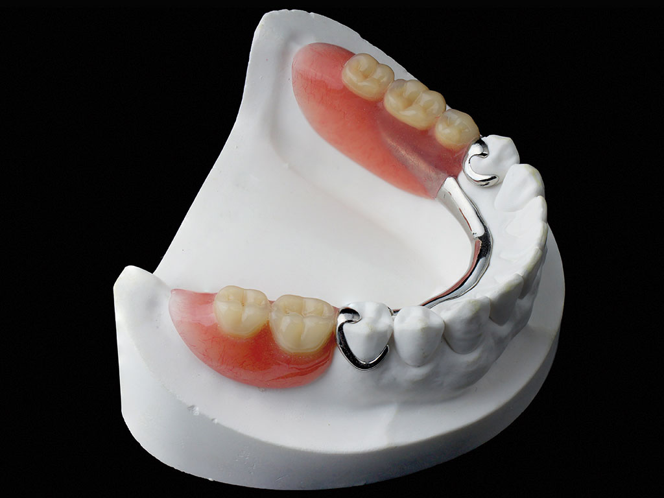
Type Of Denture Base According To Support:
2- Distal Extension partial denture base.
In a distal extension partial denture, the denture bases must contribute to the support of the denture and improving prosthesis stability. Maximum support from the residual ridge may be obtained by using broad, accurate denture bases, which spread the occlusal load equitably over the entire area available for such support (snowshoe principle).
Therefore support should be the primary consideration in selecting, designing, and fabricating a distal extension partial denture base. It must be made of a material that can be relined or rebased when it becomes necessary to reestablish tissue support for the distal extension base.

Slide 7
Type Of Denture Base According To Support:
2- Distal Extension partial denture base.
Secondary retention is provided by the intimate relationship of denture bases, Retention of denture bases has been described as the result of the following forces:
a) Adhesion.
b) Cohesion.
c) Atmospheric pressure.
d) Physiological molding of the tissue around the polished surfaces of the denture.
e) Effect of gravity on the mandibular denture.

Slide 8
Type Of Denture Base According To Support:
2- Distal Extension partial denture base.
Management of distal extension cases:
Using mesial rest on the last abutments.
Using indirect retainers.
Using special type of direct retainers, such as R.P.I system and combination clasp.
Using special kind of impression technique called altered cast technique.
Using implant to support the denture base.
Using a stress breaker if indicated.

Slide 9
Types Of Denture Base According To Material:
Resin Type Denture Base
Metal Type Denture Base

Slide 10
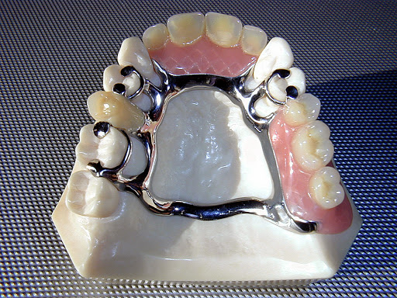
Types Of Denture Base According To Material:
Resin Type Denture Base:
It is most widely used type of denture base because of easy fabrication and easy of attachment to metal framework.
Indications :
A- Distal extension ridge
B- Long span ridge
C- In cases of immediate partial denture

Slide 11
Types Of Denture Base According To Material:
Resin Type Denture Base:
Indications :
A- Distal extension ridge:
The resin denture base is indicated for distal extension cases (class I and class II) because of the support of the denture by tissue and ridge and denture base, so there will be need for relining.

Slide 12
Types Of Denture Base According To Material:
Resin Type Denture Base:
Indications :
B- Long span ridge:
In class III and class IV edentulous cases because of possibility of tissue changes underneath the denture base and there will be need for future relining.

Slide 13
Types Of Denture Base According To Material:
Resin Type Denture Base:
Indications :
C- In cases of immediate partial denture:
Since after healing period there will be need for relining so that resin denture base will be needed for such cases.

Slide 14
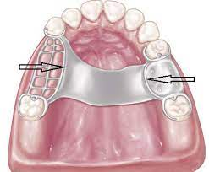
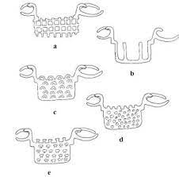
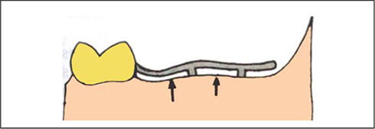
Mechanical attachment of plastic denture base materials to the metal framework
Acrylic resin bases are attached to the partial denture framework by means of minor connector; the method of attachment is mainly mechanical by undercuts or holes.
Relief over the basal seat areas of the master cast is used; after casting, the portion of the retentive framework to which the acrylic resin base will be attached will stand away from the tissue surface sufficiently to permit a flow of acrylic resin base material beneath its surface and provide mechanical retention.
Relief under the mesh should not be started immediately adjacent to the abutment tooth but should begin 1.5-2 mm from the abutment tooth. This will create a metal to tissue contact immediately adjacent to the tooth.

Slide 15
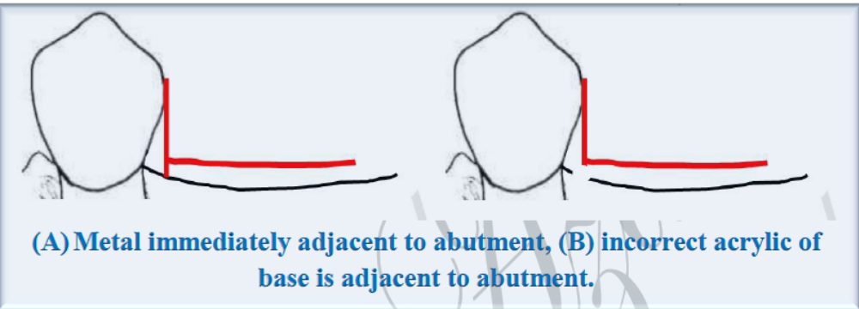

Slide 16

Mechanical attachment of plastic denture base materials to the metal framework
The retentive framework for the base should be embedded in the base material with sufficient thickness of resin (1.5 mm) this becomes necessary during the denture adjustment period or during relining procedures.
Thickness is also necessary to prevent weakness and fracture of the acrylic resin base material surrounding the metal framework.

Slide 17
Mechanical attachment of plastic denture base materials to the metal framework may has several DISADVANTAGES:
Oral fluids and microorganisms seep between the metal and plastic surface and eventually stain, resulting in an objectionable black line at the metal-plastic interface.
To provide mechanical retention; the denture base must be designed with considerable bulk.
The flexing of the plastic denture base at the finish lines weakens the plastic resulting in fracture.
The technique of bonding plastic to metal surface is being introduced into removable partial denture fabrication. These recently developed adhesive techniques and materials, and future developments, will eliminate the disadvantages of mechanical retention of plastic only and may alter the design and fabrication of removable partial denture base retention minor connector in the near future.

Slide 18
Types Of Denture Base According To Material:
Resin Type Denture Base:
Advantages:
1. Can be easily relined.
2. Easy to fabricate, adjust, finish, polish, and repair.
3. Resin is more esthetic than metal.
Disadvantages:
1. More porous than metal and therefore more difficult to clean.
2. Requires more bulk for rigidity than metal.
3. Easily abraded.
4. Easily fractured.
5. Plastic is a poor thermal conductor.
6. Has the potential to be dimensionally unstable.

Slide 19
Types Of Denture Base According To Material:
II. Metal Type Denture Base:
It is made of either:
1- Gold and platinum: but these materials are so expensive.
2- Cobalt chromium: this is more being in use nowadays.
3- Recently, the titanium being used as a denture base and in oral implant because of its excellent properties.
The metal type denture base has the ability to stimulate the underlying tissues that will maintain the integrity of the bone by preventing bone resorption.

Slide 20
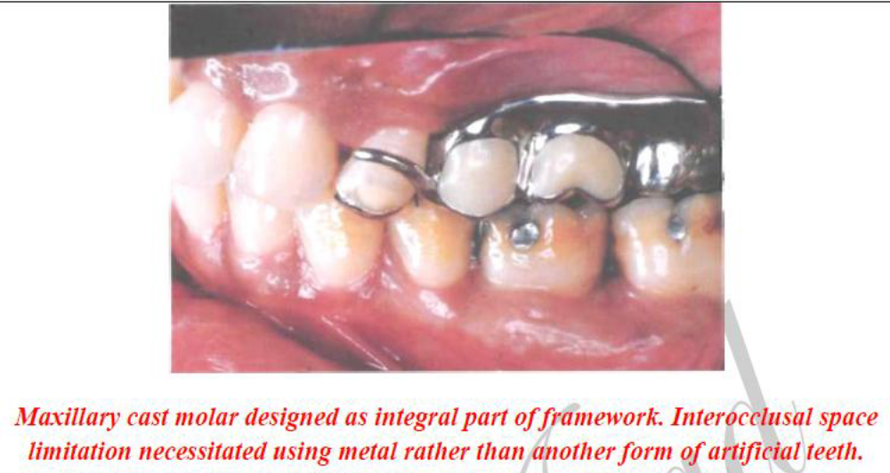
Types Of Denture Base According To Material:
II. Metal Type Denture Base:
Indications:
1- Short span (tooth borne removable partial denture).
2- When there is no enough inter-ridge space for artificial teeth (inadequate intermaxillary space) because of over eruption of opposing teeth.

Slide 21
Types Of Denture Base According To Material:
Metal Type Denture Base:
Advantages:
1- Accuracy and Permanence of Form.
Cast metal bases not only more accurately than denture resins but also can maintain their accuracy of form without change in the mouth.
Because of its accuracy, the metal base provides an intimate contact that contributes considerably to the retention of denture prosthesis. Permanence of form of the cast base is also ensured because of its resistance to abrasion from denture cleaning.

Slide 22
Types Of Denture Base According To Material:
Metal Type Denture Base:
Advantages:
2- Comparative Tissue Response
The inherent cleanliness of the cast metal base contributes to the health of oral tissue when compared with an acrylic resin base. The reasons for this are the greater density and the bacteriostatic activity contributed by ionization and oxidation of the metal base. Acrylic resin bases tend to accumulate mucinous deposits containing food particles.

Slide 23
Types Of Denture Base According To Material:
Metal Type Denture Base:
Advantages:
3- Thermal Conductivity
Temperature changes are transmitted through the metal base to the underlying tissue, thereby helping to maintain the health of that tissue. Freedom of interchange of temperature between the tissue covered and the surrounding external influences (temperature of liquid, solid foods, and inspired air) contributes much to the patient's acceptance of a denture and may help prevent the feeling of the presence of a foreign body.

Slide 24
Types Of Denture Base According To Material:
Metal Type Denture Base:
Advantages:
4- Weight and Bulk
Metal alloy may be cast much thinner than acrylic resin and still have adequate strength and rigidity.
Sometimes weight and thickness may be used to advantage in denture bases. In the mandibular arch, the weight of the denture may be an asset in regard to retention.
On the other hand, extreme loss of residual alveolar bone may make it necessary to add fullness to the denture base to restore normal facial contours and to fill out the buccal vestibule to prevent food from being trapped in the vestibule beneath the denture. In such situations an acrylic resin base may be preferable to the thinner metal base.

Slide 25
Types Of Denture Base According To Material:
Metal Type Denture Base:
Disadvantages:
Difficult to reline, adjust, and rebase.
It is expensive.
The errors that occur in posterior palatal seal area cannot be corrected with metal denture base.
Poor esthetic.

Slide 26
Types Of Artificial Teeth:
1- Acrylic teeth:
It has the ability to be attached chemically to the denture base.
2- Porcelain teeth:
It is attached to the denture base by mechanical mean, either by pin that will be processed in denture base and a hole is presenting the base of the tooth allowing its attachment by cementation.
3- Metal Teeth:
Some cases the molar teeth may be processed as part of the denture base by casting procedure this is indicated in cases of limited inter-maxillary spaces.

Slide 27

Thank you

