Slide 1
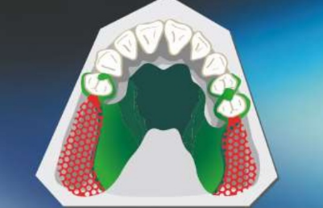
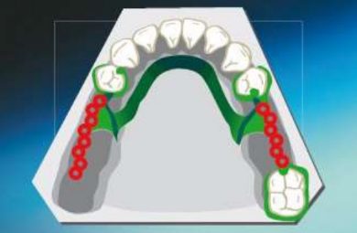
Designing of Partial Denture
Bushra Mohammed Ali Al-Ameen
B,D,S,. M,Sc.(Pros)

Slide 2
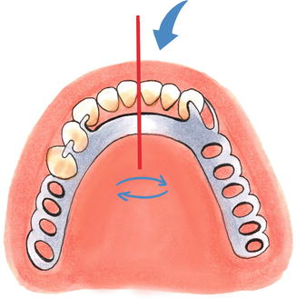
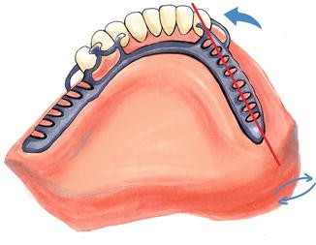
Designing of Partial Denture
The objective of partial denture designing can be thought of as the control of denture movement while not exceeding the physiological tolerance of the oral structures.

Slide 3
Differentiation Between Two Main Types of Removable Partial Dentures
Class III | Class I and II
Derives all of its support from the abutment teeth | Derive their primary support from tissues underlying the base and secondary support from the abutment teeth | The manner in which each is supported

Slide 4
Differentiation Between Two Main Types of Removable Partial Dentures
Class III | Class I and II
Anatomic impression | Dual impression/ functional impression | The method of impression making

Slide 5
Differentiation Between Two Main Types of Removable Partial Dentures
Class III | Class I and II
Not needed | Needed (because it rotates about a fulcrum) | The need for some kind of indirect retention

Slide 6
Differentiation Between Two Main Types of Removable Partial Dentures
Class III | Class I and II
Metal bases are more frequently used in tooth- supported restorations, because relining is not as likely to be necessary. | Acrylic- resin is generally used as a base material for distal extension bases. | The use of a base material that can be relined to compensate for tissue changes

Slide 7
Differentiation Between Two Main Types of Removable Partial Dentures
Class III | Class I and II
Akers, Embrasure, Ring clasp | combination clasp could be used because it is a combination of cast and wrought materials incorporated into one direct retainer, RPI, RPA | Requirements for direct retention

Slide 8
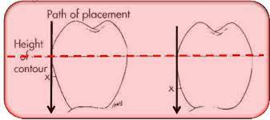
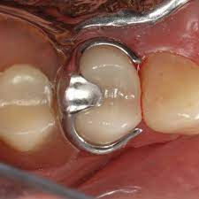
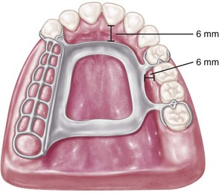
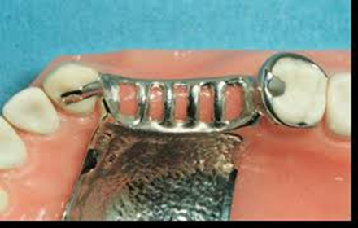
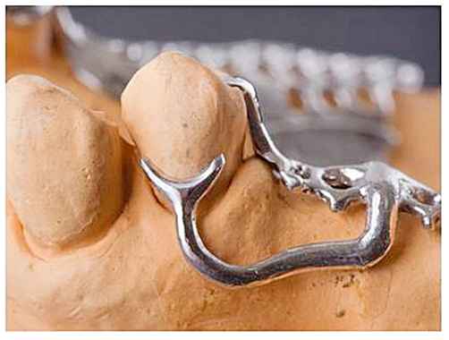
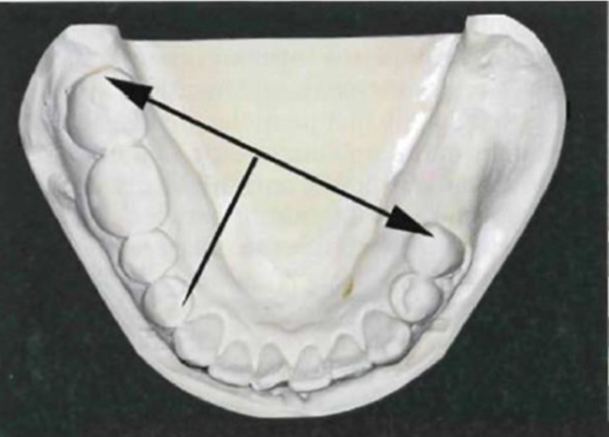
Design Sequence
1. Path of insertion
2. Rests
3. Major connector
4. Minor connectors
5. Direct retainers
6. Indirect retainers

Slide 9
Design Sequence 2-Rest
Kennedy Class III
Place rests adjacent to edentulous space (both ends).
Exceptions:
o Teeth incapable of providing adequate support, poor crown/root ratio, or uncorrectable periodontal disease.
o If abutment tooth has improper anatomy for the indicated rest.

Slide 10
Design Sequence 2-Rest
Kennedy Class I & II
Mesial rest preferred
Distal rest preferred when:
o Abutment is rotated
o Heavy centric contact on mesial
o Large restoration on mesial

Slide 11
Design Sequence 2-Rest
Kennedy Class I & II
If the rest is placed on the distal of the tooth adjacent to the edentulous area, when a posterior force is applied the tooth is tipped towards the edentulous area, which opens the proximal contacts between teeth and moves the tooth causing mobility and bone loss.

Slide 12
Design Sequence 2-Rest
Kennedy Class I & II
When the rest is placed mesially (away from the edentulous area), the force tends to move the tooth towards the adjacent tooth mesially. Thus the adjacent tooth absorbs some of the forces of occlusion.

Slide 13
Design Sequence 2-Rest
Kennedy Class I & II
A tooth is better able to tolerate vertically directed forces than horizontal forces.
If the rest is placed on the distal side of the abutment near the edentulous area, the forces are not vertical but almost horizontal in the region just next to the abutment.

Slide 14
Design Sequence 2-Rest
Kennedy Class I & II
As you move the rest anteriorly, the forces are directed more favorably in a more vertical direction in relation to the edentulous area.

Slide 15
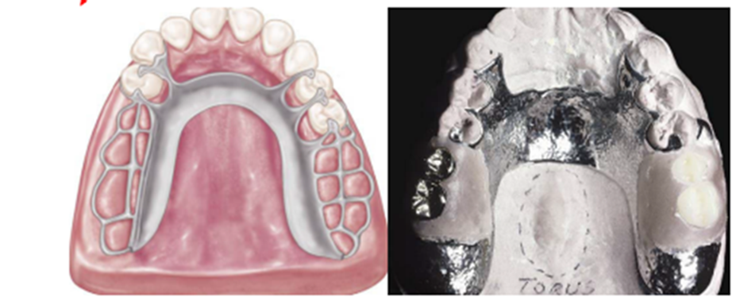
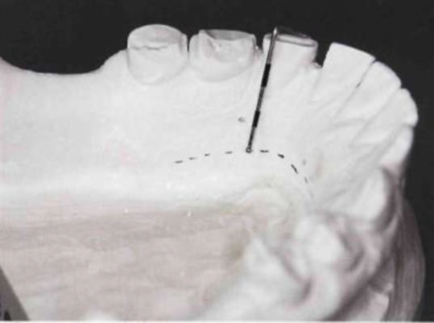
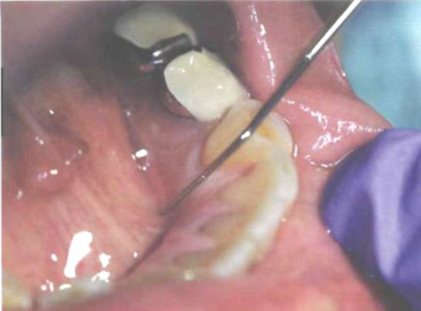
Design Sequence 3- Major Connectors
Assess tori, height of floor of mouth, frenal attachments, which may affect major connector choice.

Slide 16
Mandibular Major connectors
Whenever possible (8 mm space) | Lingual Bar
High frenum, floor of mouth less than 8 mm, resorption of ridges Want to stabilize teeth, May need to add teeth to RPD Want to avoid torus | Linguoplate
When the height of the floor of the mouth in relation to the free gingival margins will be less than 6 mm. | Sublingual bar
When wide diastema exists between mandibular anterior teeth | Mandibular Major Connectors Lingual bar with cingulum bar (Kennedy Bar, Double Lingual Bar)
Excessive block-out of interproximal undercuts (crowding of teeth) | Cingulum bar (continuous bar)
Malpositioned or lingually inclined teeth and Large mandibular tori | Labial bar

Slide 17
Maxillary Major Connector
Bilateral tooth-supported prostheses | Single palatal strap
Class I and II arches, Long edentulous spans in Class II, modification 1 arches, Class IV arches, Inoperable palatal tori | Combination anterior and posterior palatal strap
Some or all anterior teeth remain | Palatal plate
When a large inoperable palatal torus exists, and occasionally when several anterior teeth are to be replaced | U-shaped palatal connector
 | Single palatal bar
 | Anterior– posterior palatal bars

Slide 19
Design Sequence 4- Minor Connectors
Connects components to the major connector:
1. Direct retainer
2. Indirect retainer
3. Denture base
Minor connectors:
Should be rigid
Mostly located in an embrasure
Should taper towards the contact area

Slide 21
Design Sequence 5- Direct Retainers
Direct Retainers in Cl III
Clasp of Choice: Akers.
Embrasure clasp: on dentulous side.
Ring clasp: on single molar or tilted molar.
Direct Retainers Cl I & II
Use stress releasing retainers
More load transferred to residual ridge RPI RPA Combination Clasp

Slide 22
Design Sequence 5- Direct Retainers
Clasp of Choice: RPI
If can’t use I-bar then RPA: in cases of high frenal attachment, soft tissue undercut, shallow vestibule.
If can’t use mesial rest then Combination Clasp: in cases of restoration, heavy occlusion, rotated tooth.

Slide 23
Design Sequence 6- Indirect Retainers
Usually for Class I & II only
Position on the opposite site of fulcrum line
Perpendicular and far from fulcrum line
Canine and premolar usually
Rest at each end of lingual plate

Slide 24

Thank you

