Slide 1
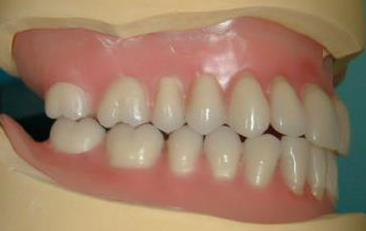
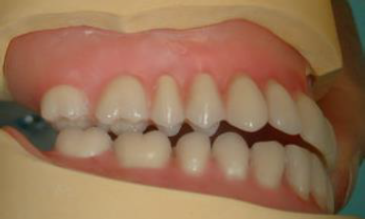
Occlusion
Bushra Mohammed Ali Al-Ameen
B,D,S,. M,Sc.(Pros)

Slide 2
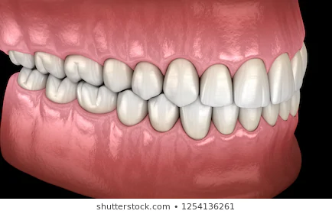
Occlusion
Occlusion:
Any contact between teeth of opposing dental arches; usually, referring to contact between the occlusal surface.
Occlusion of complete denture:
The static relationship between the incising or masticatory surfaces of the maxillary or mandibular teeth or tooth.

Slide 3
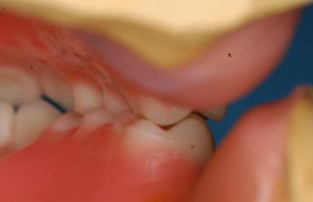
Occlusion
In complete denture reconstruction, it is essential that the maximum intercuspation is in harmony with centric relation even through this condition does not always occur in natural dentition, so the dentist is responsible to record centric relation, and maintain this relationship in the laboratory procedure during mounting and arrangement of teeth in centric occlusion.
In centric occlusion, the facial cusps of the mandibular teeth contact the central fossae of maxillary teeth, while the lingual cusps of maxillary teeth fit into the central fossae of the mandibular teeth. Note how the facial cusps of the maxillary teeth extend beyond the facial surfaces of the mandibular teeth. This overlap prevents cheek-biting when the dentures are completed.

Slide 4
Concepts of occlusion
Concepts of occlusion :
Balanced occlusion.
Monoplane occlusion.
Lingualized occlusion

Slide 5
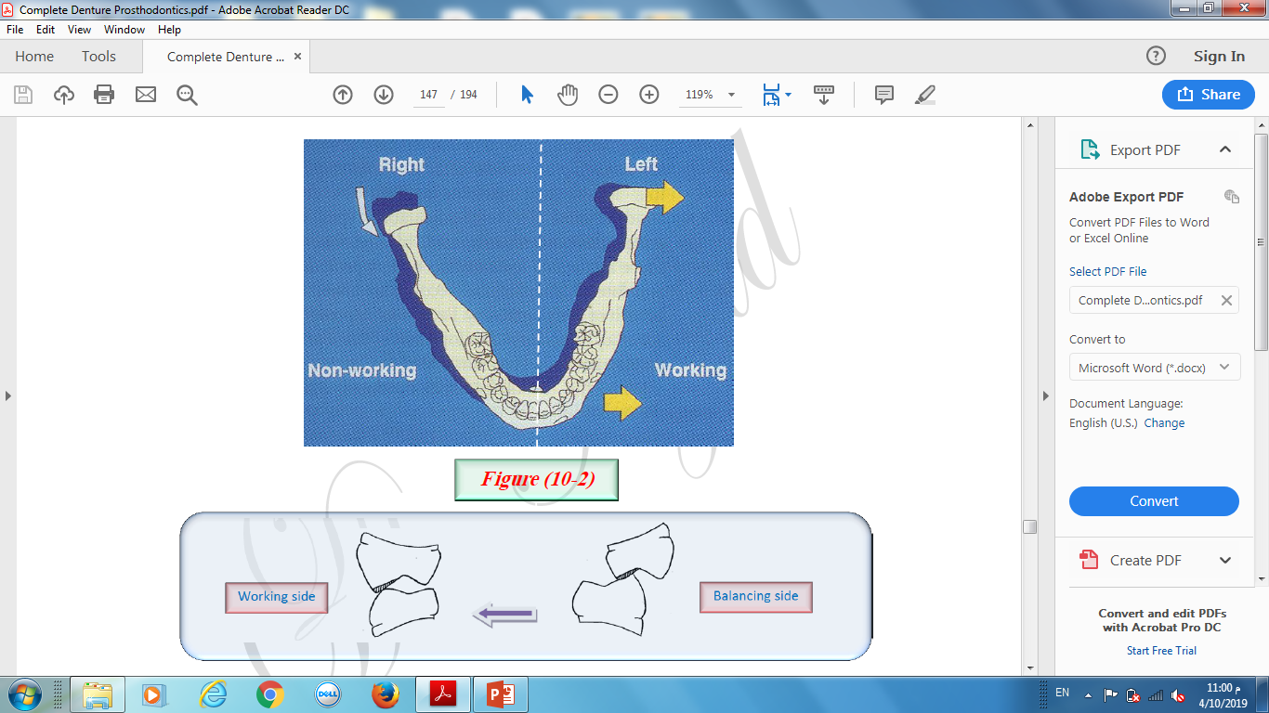
Balanced occlusion
It is the simultaneous contacting of the maxillary and mandibular teeth on the right and left and in the anterior and posterior occlusal areas (working, balancing, and protrusive).
Balanced occlusion is done to obtain stability of denture during parafunctional movement.
Balanced occlusion is achieved by using of anatomical teeth and adjustable articulators.

Slide 6
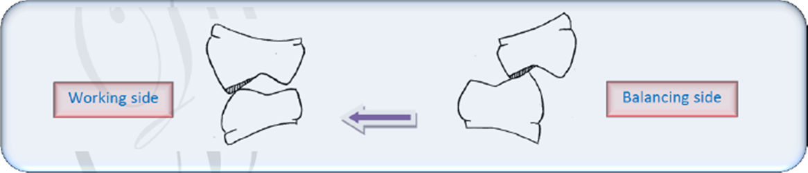
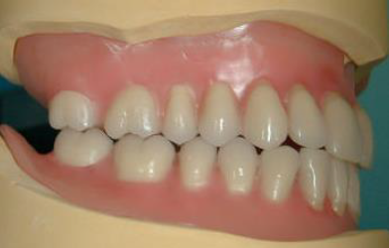
Balanced occlusion
Working side:
It is the side toward which the mandible moves in a lateral excursion.
Working or functional occlusion occurs when the facial cusps of the maxillary teeth meet the facial cusps of the mandibular teeth and the lingual cusps of the maxillary teeth meet the lingual cusps of the mandibular teeth.
The relationship is not cusp tip to cusp tip, but cusp tip into cusp valley with each maxillary cusp distal to the corresponding mandibular cusp.
Working occlusion enable a person to hold and crush food.

Slide 7
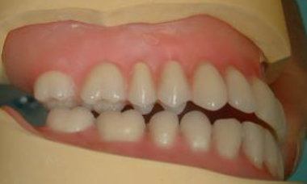
Balanced occlusion
Balancing side (non-working side):
That side of the mandible that moves toward the median line in a lateral excursion (the side opposite the working side).
Balancing occlusion occurs simultaneously on the opposite side from working occlusion.
Balancing occlusion functions to maintain the dentures in position during lateral excursive movements.
In balancing occlusion, the lingual cusps of maxillary teeth contact the facial cusps of the mandibular teeth.
In many techniques, balancing contacts are necessary only on the second molars, to decrease the cuspal interference.

Slide 8
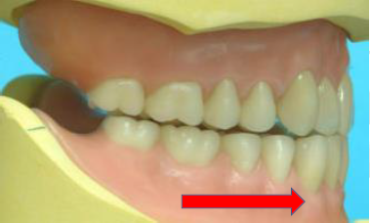
Balanced occlusion
Protrusive occlusion :
It is the relation acquired by the mandible when it moves in protrusive direction from centric position.
The protrusive direction is downward and forward.
When the condyles travel in this direction they bring the anterior teeth into a position favorable for incision.
In protrusive balance, the distal inclines of the maxillary buccal cusps contact the mesial inclines of the mandibular buccal cusps.
Protrusive balancing contact may occur on lingual cusps, this help to maintain denture stability.

Slide 9
Importance of balanced occlusion
It avoids displacement of denture and help in its stability during functional and non-functional movements.
It helps in earlier repositioning of denture which becomes displaced during mastication.
It minimize period required for adaptation of patient to the denture due to its stability.
Prevent trauma to the supporting tissue since the pressure is equally distributed on the teeth.

Slide 10
Factors of balanced occlusion (factors of occlusion in complete denture)
1- Inclination of condylar guidance.
2- Inclination of incisal guidance.
3- Cusp height.
4- Orientation of the occlusal plane.
5- Prominence of the compensating curve.

Slide 11
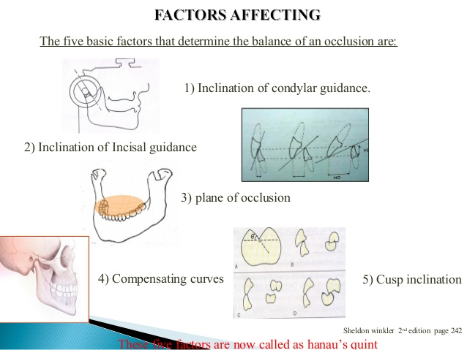

Slide 12
Advantages of balanced occlusion
Penetration of food easily (good chewing efficiency).
Resistance to denture rotation (cusp interdigitation).
Better esthetic.
Act as guide for proper jaw closure.

Slide 13
Disadvantages of balanced occlusion
When there is occlusion disharmony during setting, difficult to correct it by adjusting.
Stable bases and precise jaw closure is required.
Increase horizontal forces.
Difficult to adapt in jaw relation other than skeletal class I.
Need adjustable articulators.

Slide 14
Monoplane (neutrocentric) occlusion:
Monoplane occlusion is characterized by:
Occlusal contacts of maxillary and mandibular teeth initially in maximum intercuspation.
The disocclusion of posterior teeth as result of their arrangement in a single plane.
The contact of the anterior teeth during movement of the mandible (teeth are set in a flat plane with no vertical overlap of the anterior teeth).
Protrusive balance compensation in monoplane denture occlusions needs a second molar slant (ramp).
Monoplane occlusion is achieved by use of cuspless teeth, to obtain occlusal plane flat and parallel to the upper and lower residual ridges.

Slide 15
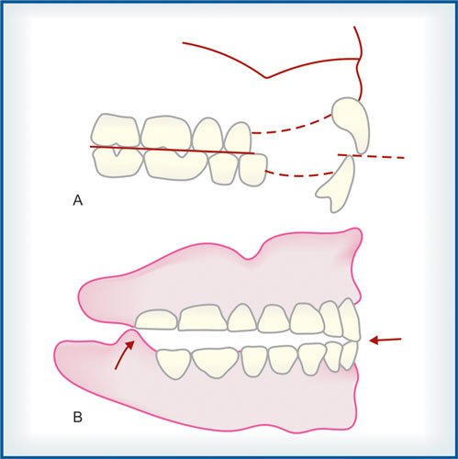
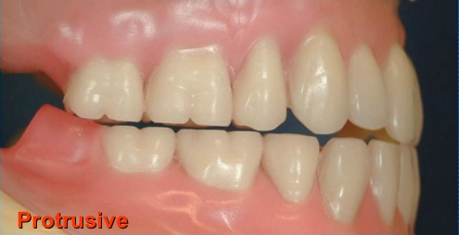

Slide 16
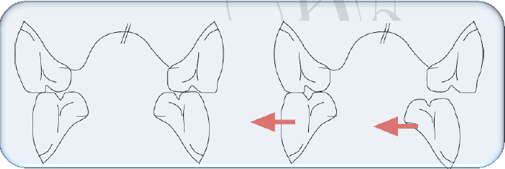
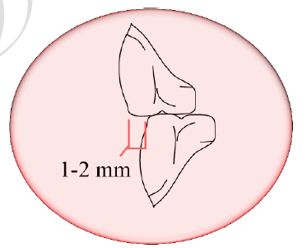
Monoplane (neutrocentric) occlusion:

Slide 17
Advantages of monoplane occlusion:
More denture stability due to absence of lateral force during vertical chewing, less resistance to lateral force and parafunctional movements.
Freedom in centric (mandible is not lock in centric by cuspal interdigitation).
Easier to use in skeletal class II and class III.
Simple articulator may be used.
Less damaging effect in uncontrolled neuromuscular movement.
More comfortable.

Slide 18
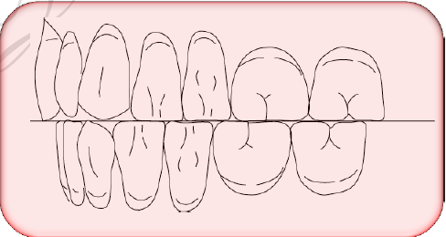
Disadvantages of monoplane occlusion:
Decrease chewing efficiency (no cusp), increased by a metal insert in posterior teeth as cutting tool.
Poor esthetic, in premolar, absence of cusps; in anterior teeth there is edge to edge no overbite, no overjet due to absence of cusps in posterior teeth. This overcomes by using ramp (cusped posterior tooth) to have contact in protrusive movements that permits to set the anterior teeth in overbite and overjet.
Used in :
This concept may be used in aged people
with flat ridge and uncoordinated mandibular
movements.

Slide 19
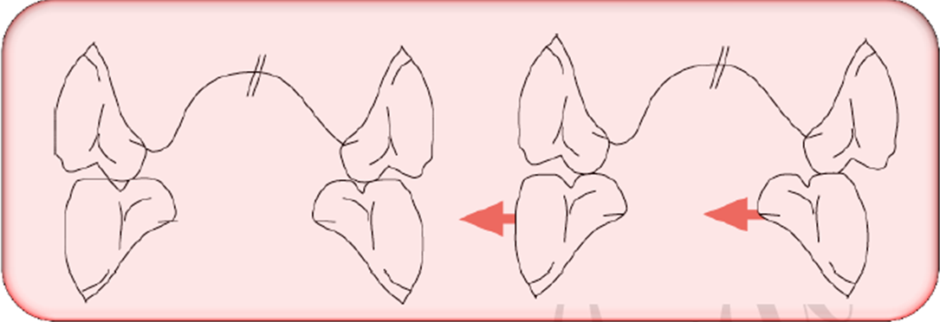
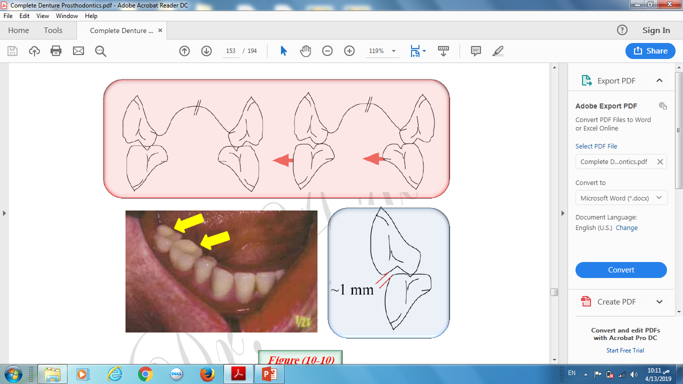
Lingualized occlusion:
The maxillary cusps (prominent lingual cusp) are the main functional occlusal elements.
These may oppose mandibular 0° or shallow cusp teeth in balanced or nonbalanced patterns depending on the needs of the patient.

Slide 20
Lingualized occlusion:
Lingualized occlusion is achieved by using anatomical teeth or semi-anatomical teeth with some modifications:
Reducing and flattening the cusps and cusp slope.
Setting the posterior upper teeth so that the lingual cusps articulate in the middle of the fossae and the buccal cusps is out of occlusion (slight buccal tilt of upper posterior teeth).

Slide 21
Advantages of lingualized occlusion:
The presence of a cusped tooth in the maxillary premolar and first molar regions looks more natural when compared to a 0° tooth.
The use of occlusal curves for purpose of balance allows for incisal overlap of the anterior teeth. This is more similar to the natural tooth overlap than can be provided by non-balanced occlusal schemes without violating the mechanics of complete denture function.
The use of maxillary lingual cusps could be expected to centralize the occlusal forces and reduce the frictional resistance of flat teeth sliding over one another.
Better stability can be gained during parafunctional movements.
This concept fulfill the most of the advantages of anatomical and monoplane concepts.

Slide 22


