Slide 1
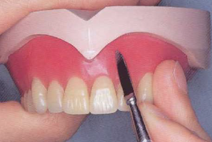
Waxing And Carving
Bushra Mohammed Ali Al-Ameen
B,D,S,. M,Sc.(Pros)

Slide 2
Waxing
It is the contouring of the wax base of trial denture into the desired form.
The polished surface, which will be in contact with the oral tissues developed by contouring the wax.

Slide 3
The form of polished surface of a denture influences its
Retention and stability of the denture.
Esthetic values of the denture: the esthetic of complete denture is not related to arrangement of teeth alone, we attempt to simulate natural anatomy of patient mouth which include size, shape, and contour of missing oral tissues during construction of complete upper and lower dentures.

Slide 4
There are three principal surfaces concerned in functional stability of the denture
The basal or impression surface.
The leverage position and occlusal surfaces of the teeth.
The location and form of the polished surfaces.

Slide 5
The polished surface is determined by
The width of the border of the denture.
The buccolingual position of the teeth.
The fullness given to the wax to obtain convexity or concavity both facially and lingually.

Slide 6
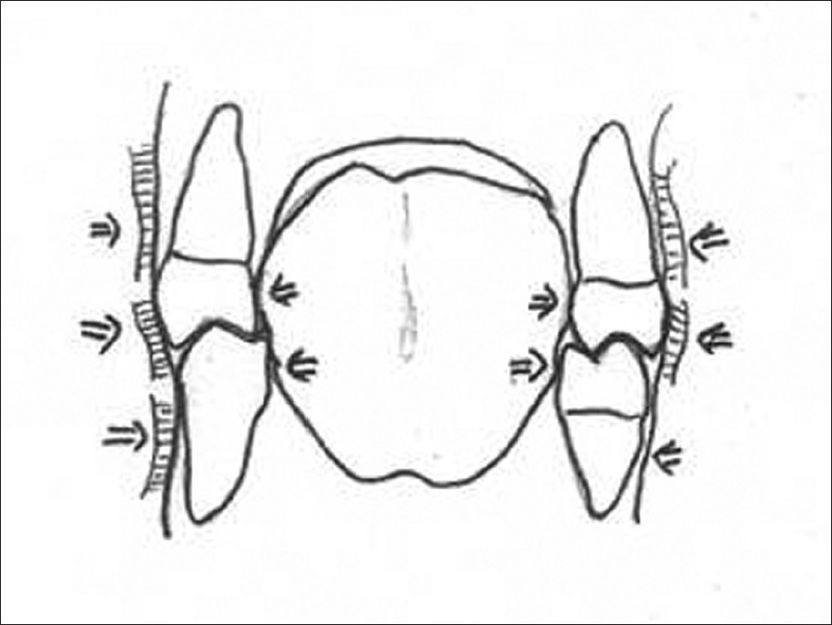
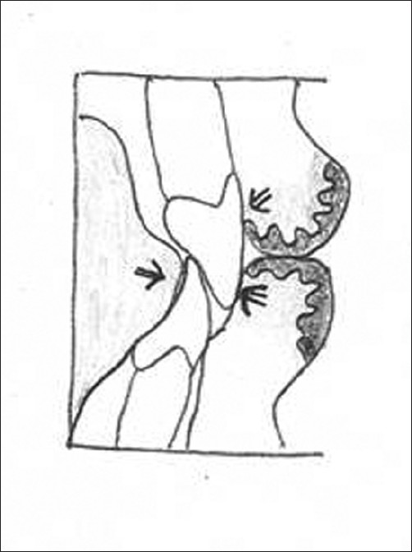
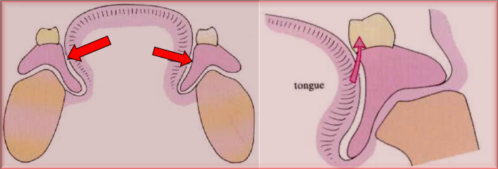
The action of the muscles of the check and tongue, exerts horizontal force in the direction of the occlusal plane by the tongue and cheek can act either a placing or displacing agent, depending on the shape of the polished surface.

Slide 7
When the lingual and buccal borders of a mandibular denture are being shaped, they can be made concave so that the tongue and cheek will grip and tend to seat the denture.
In the opposite case where the lingual and the buccal surfaces are made convex by waxing , the forces resulting from pressures of the tongue and cheeks will tend to unseat the denture.

Slide 8
The buccolingual position of the teeth is important because a buccal position of the teeth would necessity shaping the surface of the denture base in such a manner that the muscle action of the cheeks would tend to unseat the mandibular denture.

Slide 9
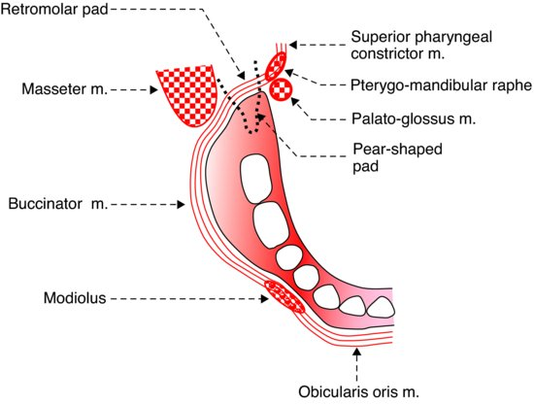
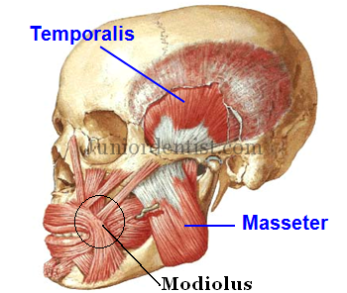
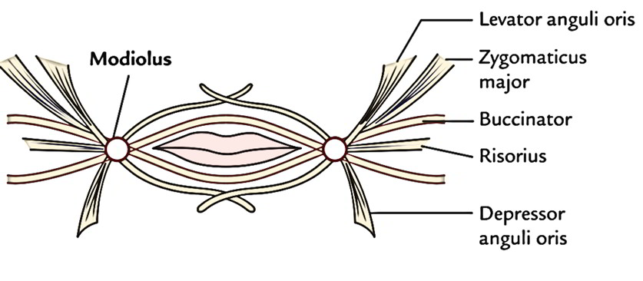
The buccal surface of the mandibular dentures in the first premolar region should be shaped carefully so as not to interfere with the action of the modiolus (connecting the facial muscles with the orbicularis oris).
This connecting point of the muscles can displace the mandibular denture if the polished surface inclines toward the cheek, or if the arch in the premolar region is too wide.

Slide 10
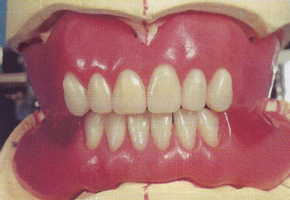
The wax surfaces around the teeth are known as the art portion of the polished surface and should, for esthetic reasons, imitate the form of the tissue around the natural teeth.
The upper part of the polished surface, known as the anatomical portion .
The contours of the polished surface begin at the gingival collars of the prosthetic dentition.

Slide 11
Requirements of waxing the polished surface
They should duplicate the covered soft tissues as accurately as possible realistic, not exaggerated.
The borders, both labial and buccal should full the vestibules.
Notches should be provided to accommodate the mucous membrane attachment (frenum), both in size and direction.
The contour of the facial flanges should be compatible with the cheek and lips.
The contour of the lingual flanges should be compatible with the tongue.
The palatal section of the maxillary denture should be nearly a reproduction of the patient palate and rugae.
Avoid a bulky wax-up. The additional bulk of acrylic resin may contribute to porosity and dimensional processing error.

Slide 12
The procedure of waxing (festooning of complete denture)
Contour the wax carefully to prevent movement of the teeth.
Place strips of base plate wax along the facial surface of the trial denture so that they extend from the gingival third of the teeth to the edge of the cast.
With a hot spatula lute the strips to the underlying wax at 1\4 inch intervals, and melt the wax into contact with the necks of the teeth.
After the wax has cooled, carve the interdental papilla.

Slide 13
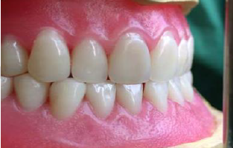
The rules of forming the papilla
The papilla must extend to the point of tooth contact for cleanliness.
The papilla must be of various lengths.
The papilla must be convex in all directions.
The papilla must be shaped according to the age of the patient.

Slide 14

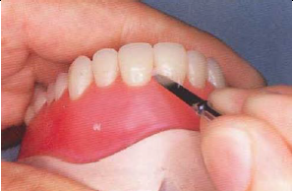
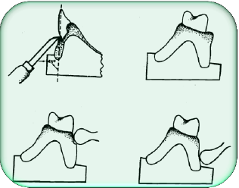
The procedure of waxing (festooning of complete denture)
Developing the margin by carving with an ash no. 5 or Le'Crone carver at 45° angle to the neck of the teeth. The posterior area should have a marked fullness.

Slide 15
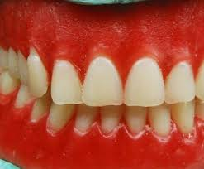
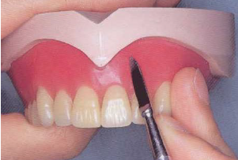
The procedure of waxing (festooning of complete denture)
The ledges around the teeth are not contoured as roots of the teeth other way to wax buccal and labial surfaces to produce shallow grooves in the inter-radicular spaces. These grooves should not extend to the gingival margins which should be slightly raised in the interdental space to form the papilla.

Slide 16
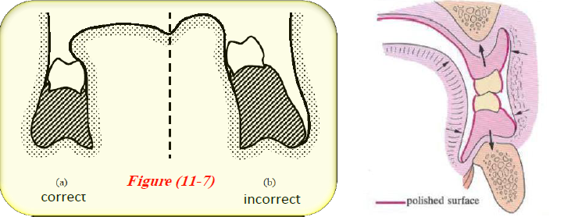
The procedure of waxing (festooning of complete denture)
7. Wax the lingual flange of the mandibular denture thickly enough to full all depressions and to slop down from the necks of the teeth and inward toward the tongue. The slope of the flange should be free from the undercuts and very slightly concave at or near the lower border.

Slide 17
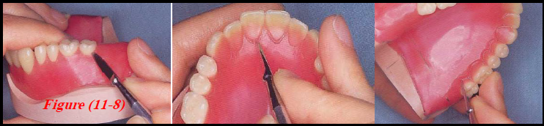
The procedure of waxing (festooning of complete denture)
8. Contour the wax around the necks of the maxillary posterior artificial teeth to form part of clinical crowns and to make these teeth more natural in size and more compatible to the tongue.

Slide 18
The procedure of waxing (festooning of complete denture)
9. The palatal surface of maxillary denture should be waxed to a uniform thickness of 2.5 mm, when the processed resin is smoothed and polished, the palate will be as thin as possible and yet sufficiently thick to provide adequate strength.
10. After the wax has been contoured, smooth it by flaming. Stippling

Slide 19
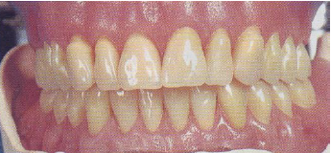

The procedure of waxing (festooning of complete denture)
11. Stippling of the wax: an alternative to gingival contouring some people stipple the wax and this produce a finished denture, whose surface shows an (orange peel) effect, produces a very pleasing result.
This may be produced by tapping the surface of the wax with bristles of a tooth-brush after first warming the surface or by a small burnishing bur rotating in a hand-piece; and then polished it with wet cotton.
Disadvantage: of stippling is that it produces a denture which is more liable to contamination by calculus deposits; if it done it should be confined to the area of the denture which can be seen when the patient grains broadly.

Slide 20
Establishing of posterior palatal seal area
Posterior palatal seal area:
It is the soft tissues along the junction of the hard and soft palates on which pressure within physiological limits of the tissues can be applied by a denture to aid in the retention of the denture.
The posterior border of the denture is determined in the mouth and its location is transferred onto the cast.

Slide 21
Establishing of posterior palatal seal area
Posterior palatal seal area:
The locations of the right and left hamular notches are marked with an indelible pencil.
Then the location of fovea palatinae near the median palatal suture is marked.
The vibrating line (the posterior part of the posterior palatal seal area) normally used as a guide to the ideal posterior border of the denture, it may be slightly anterior to the fovea palatinae.

Slide 22
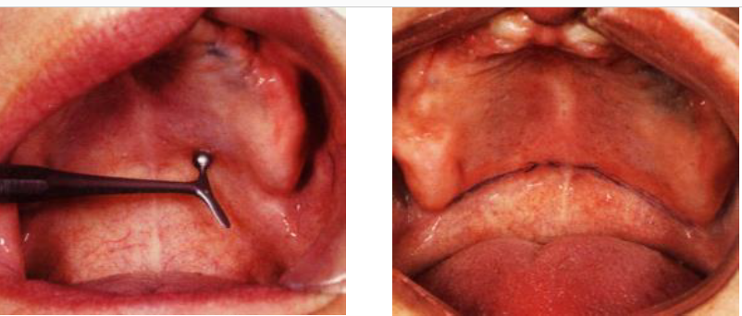
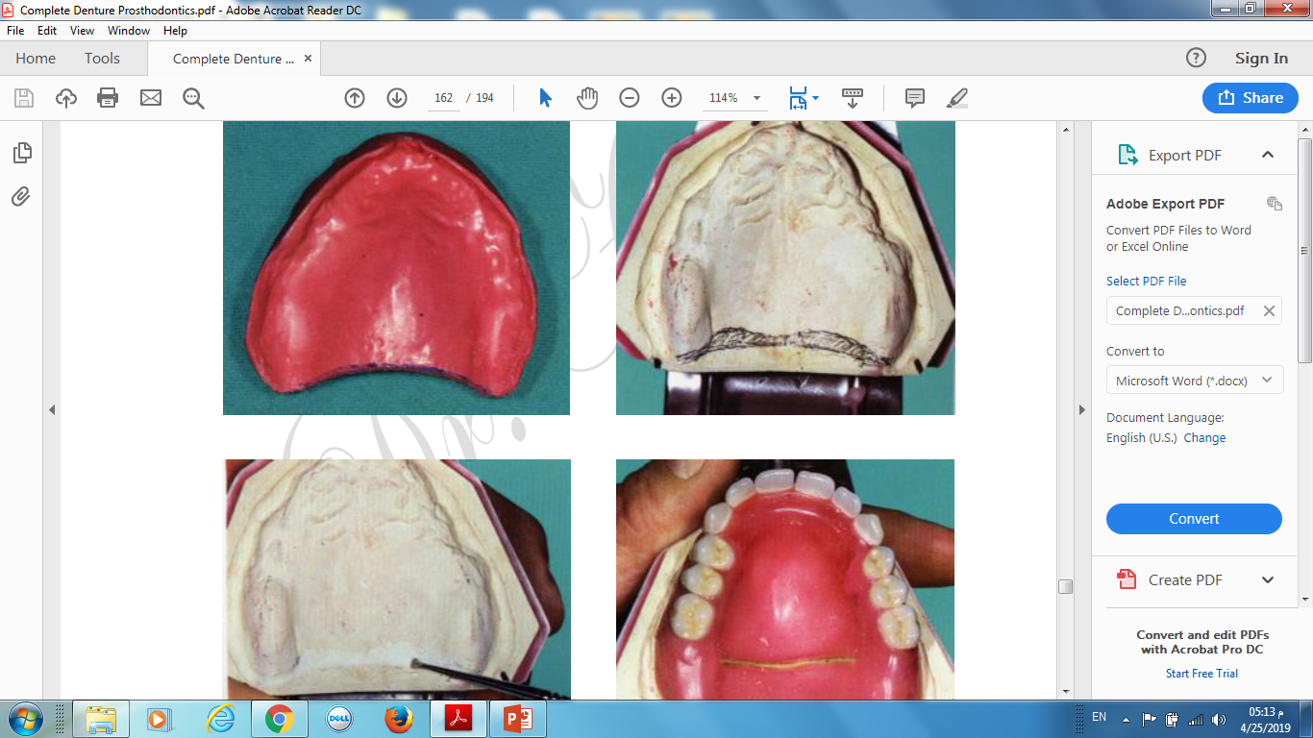
Carving posterior palatal seal

Slide 23
Advantages of posterior palatal seal area
It helps to determine the posterior border of the maxillary denture.
It helps to compensate for the shrinkage of the acrylic resin in this area during processing.
Provide a good seal in the posterior area of the maxillary arch which increase retention.
It prevents food to enter under the maxillary denture.
Reduces the tendency for gag reflex.

Slide 24
Processing of the denture

Slide 25
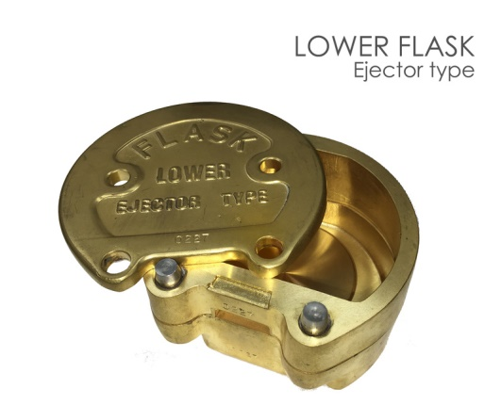
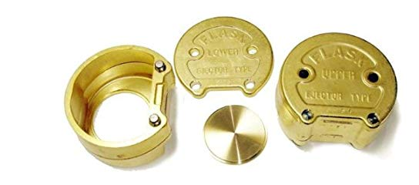
First : Flasking
Flasking : It is the process of investing the cast with its waxed denture in a flask to make a two sectional mold used to form the acrylic resin denture base.
Flask: It is a metal case uses the dental stone to invest the cast and trial wax denture to create the mold within it.

Slide 26
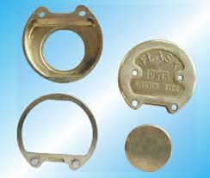
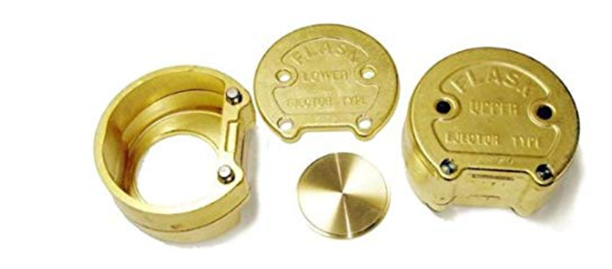
The flask consists of:
Lower half: Drag (bottom), which contains the cast.
Upper half: Cope (ring), which captures the teeth of the denture.
The cover: Cap (lid).

Slide 27
Flasking techniques:
Compression technique (open pack method):
The master cast with the waxed trial denture is invested in the lower half of the flask with gypsum investment material.
Then the upper half of the flask is put in place and gypsum is poured to the occlusal surfaces of the teeth.
The top portion of the flask is poured with another layer of plaster or stone and the cover is placed on the flask.

Slide 28
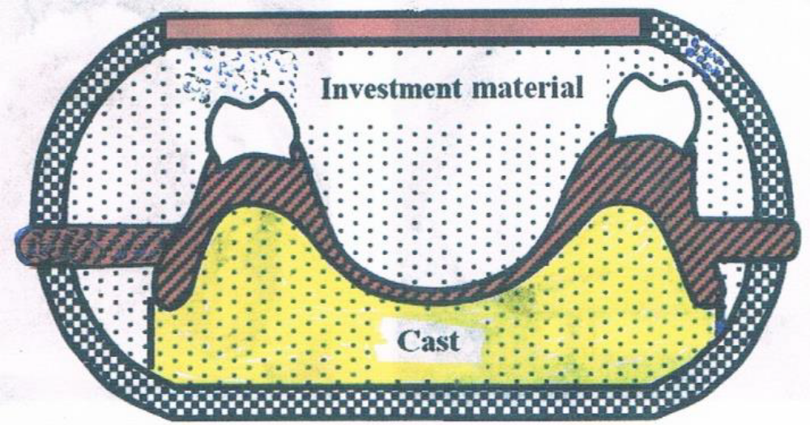
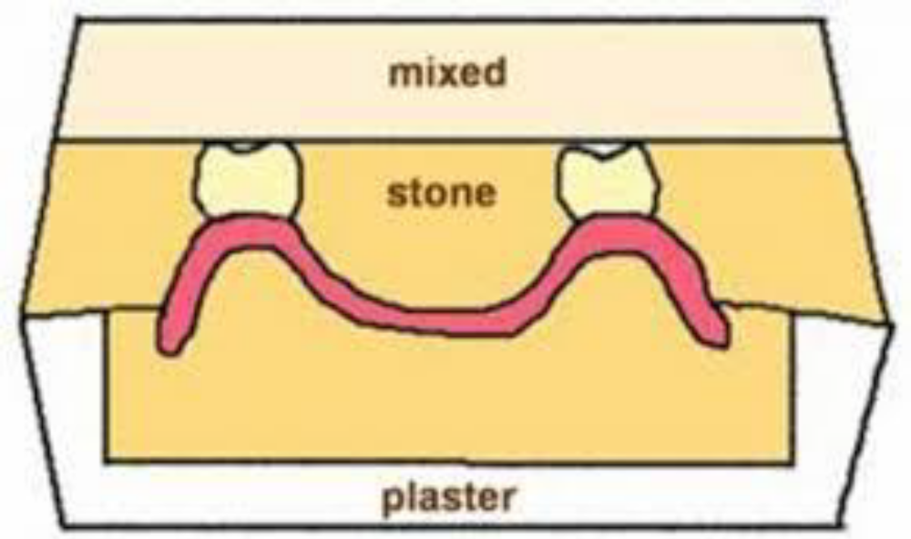

Slide 29
Flasking techniques:
Injection mold technique:
It is a complicated procedure required special flask and equipment. In this technique the wax pattern is sprued and the material is injected into the mold. This process allows injection of further material during processing to compensate for the polymerization shrinkage.

Slide 30
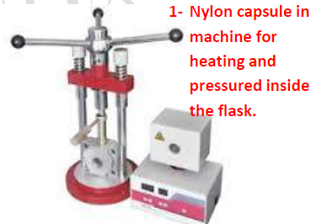
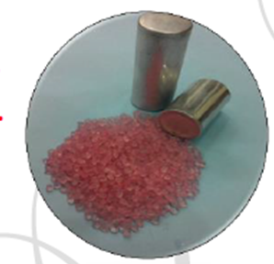
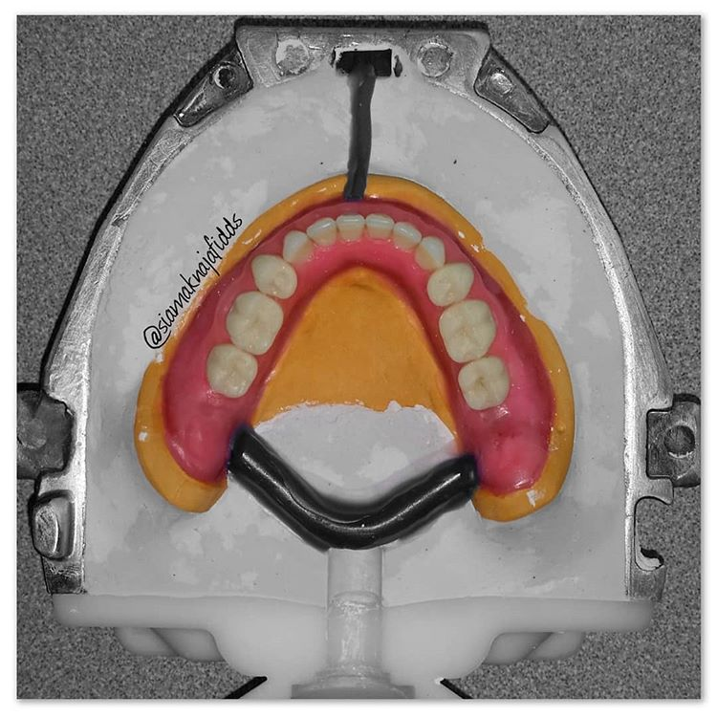
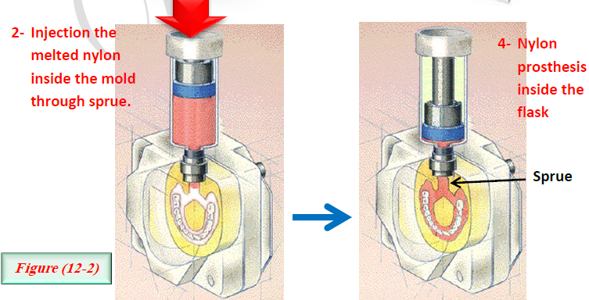

Slide 31

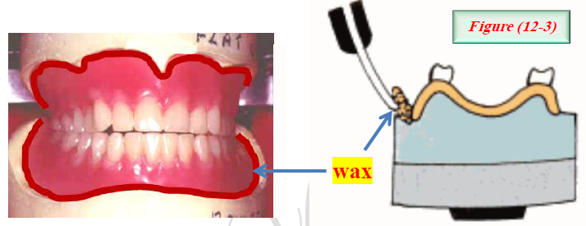
The procedure in processing the denture in compression technique
1. Sealing the upper and lower trial denture all over the border until the margin of the cast while the casts still on the articulator.

Slide 32
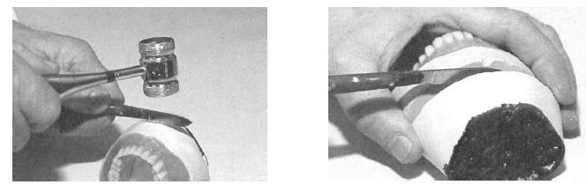
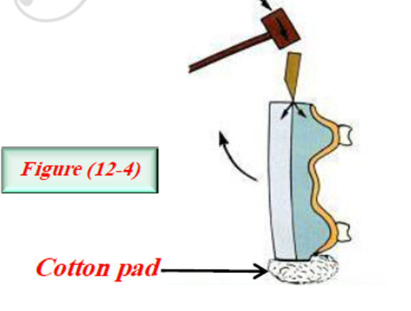
The procedure in processing the denture in compression technique
2. Soak the casts and the mounting plaster in water a few minutes to separate the casts from the mounting plaster, save the plaster mounting as it will be used to reposition the casts on the articulator after the dentures have been processed.

Slide 33
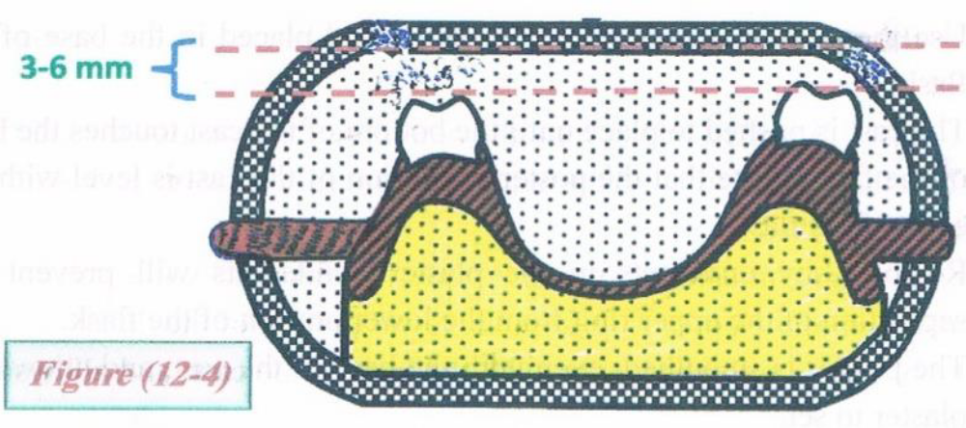
The procedure in processing the denture in compression technique
3. Make sure that there is enough space between the incisal and occlusal surfaces of the teeth and the top of the upper ring about 3-6 mm, if there is no space then the cast base must be reduced in thickness.

Slide 34
The procedure in processing the denture in compression technique
4. Adapt a layer of tinfoil to the base of the casts, slightly overlapping the edges to insure clean removal from the investment, apply separating medium to the casts and flask.
5. Waxed denture painted with surface tension reducing agent to decrease likelihood of bubbles formation.

Slide 35
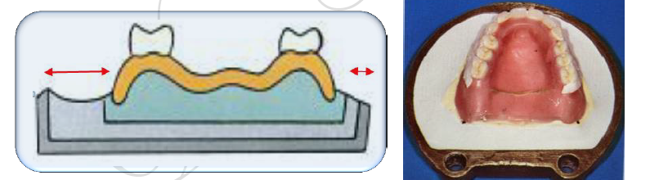
The procedure in processing the denture in compression technique
6. Invest the lower half of the flask first:
A- Use the mixture of the plaster or stone and placed in the bottom of the flask.
B- Center the cast in the lower half of the flask. The cast is pushed down to
place until its rim is nearly level with the top edge of the bottom of the
flask. Note that the posterior portion of the cast is level with the edge of
the flask.

Slide 36
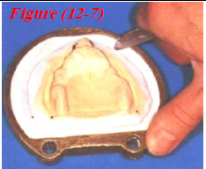

The procedure in processing the denture in compression technique
6. Invest the lower half of the flask first:
C- Remove any undercuts in the stone. Undercuts will prevent the separation
of the upper ring from the lower portion of the flask.
D- The stone is smoothed and leveled between the edge of the cast and the rim of the flask, and then allows the stone to set.
E- After the final setting of stone has occurred,
it will be coated with separating medium.

Slide 37
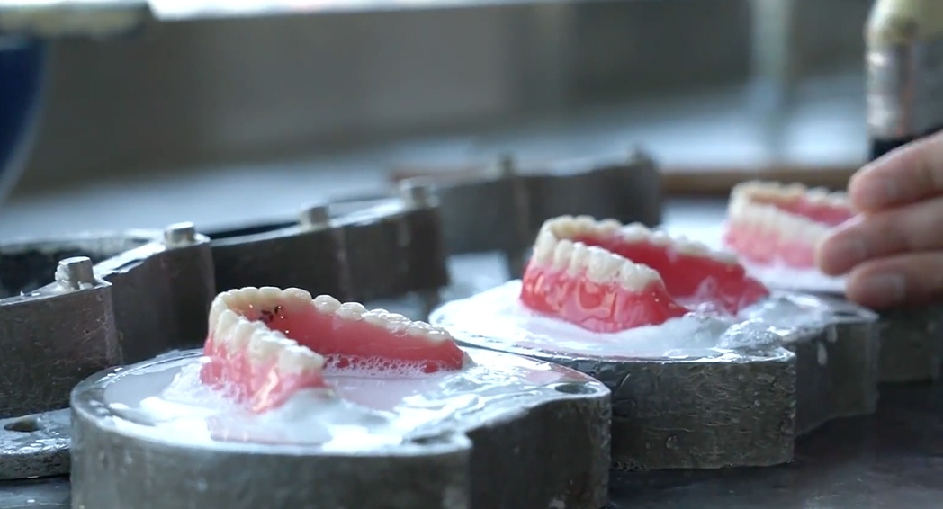

Slide 38
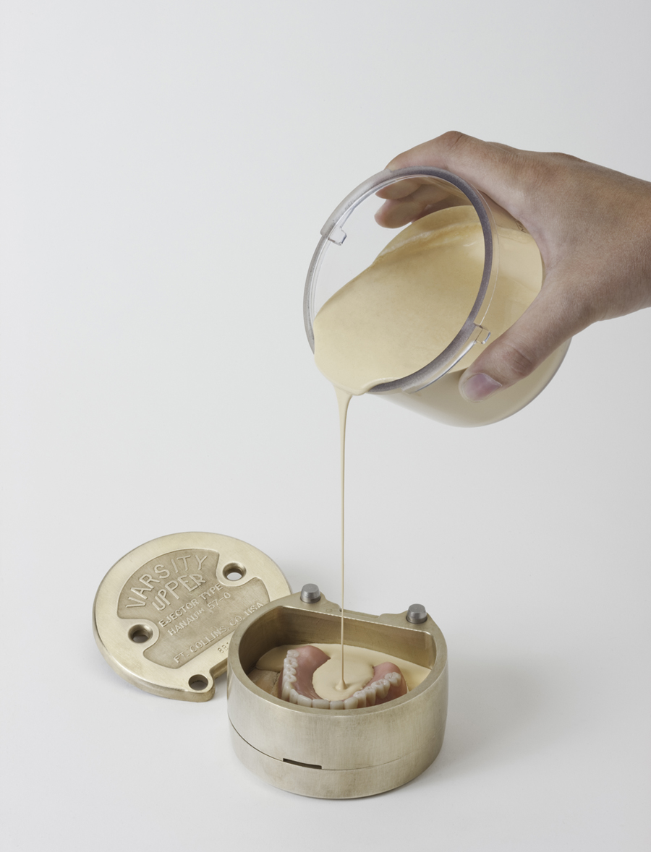
The procedure in processing the denture in compression technique
7. Invest the upper half of the flask first:
A- Position the ring of the flask.
B- Mixing of stone is done, pouring of the mixture to flow and reach all surfaces of teeth without any air bubbles by putting the flask on the vibrator. The investment material must reach the incisal edge and the occlusal surfaces of the teeth

Slide 39
The procedure in processing the denture in compression technique
7. Invest the upper half of the flask first:
C- Separating medium is painted on the second layer of plaster after setting and smoothening of the plaster is done
D- A third mixing of stone is done and pouring it until the flask is filled with plaster and the flask is covered and some plaster enter through the holes in the cover and around the edges, this pour will easily be separated during divesting procedure, and will be aware of the position of the teeth when using any mechanical devices to break away the stone mold.
E- The plaster is left to set completely for about 45 minutes.

Slide 40
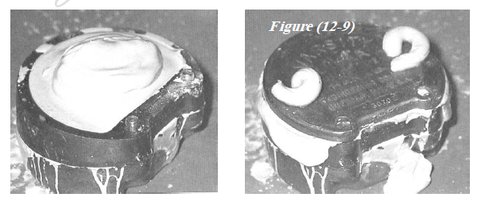

Slide 41
Second : Wax Elimination
After the complete set of the gypsum the flask is ready for the next step which is “wax elimination”
A- Place the flask on the ladle and lower it into boiling water bath for 5 minutes. This will soften the waxed denture base, which can be easily removed from the mold when the flask is opened.
B- After 5 minutes, remove the flask from the boiling water and gently open it, insert a wax knife between the lower and upper halves and gently separate them.

Slide 42
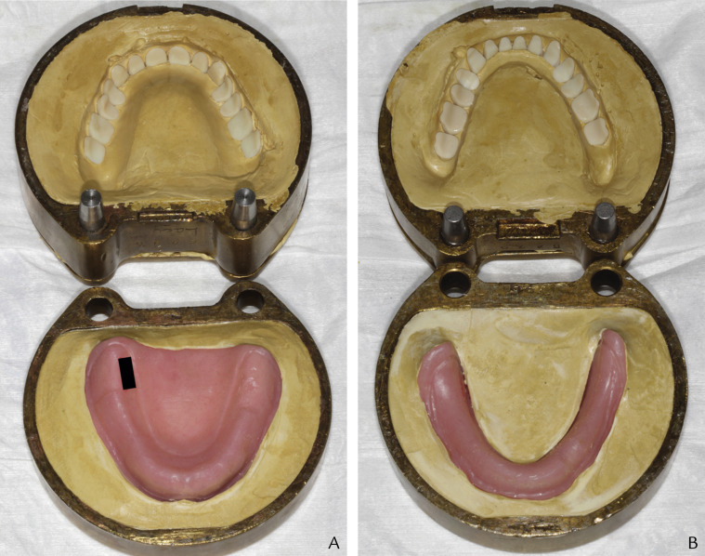

Slide 43
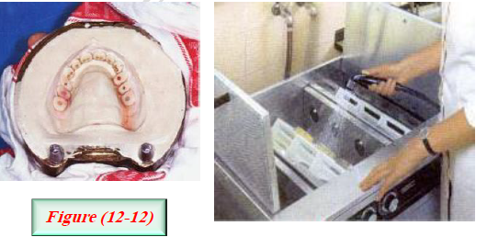
Second : Wax Elimination
C- Remove the semisolid pieces of the waxed denture base. All the teeth should remain in the upper half of the flask, using more hot (boiling) water to flush out all the remnants of the wax.

Slide 44
Second : Wax Elimination
D-Wax solvent can be used with stiff brush to remove any remaining wax on teeth.
E- As soon as possible flush the mold with clean hot water and detergent. The detergent will be flush out the wax residue from area that cannot be reached with the wax solvent. Immediately flush the mold with hot water to remove all traces of the detergent solution.
F- It is essential to remove all wax residues, the acrylic resin will not adhere to a surface coated with wax. (Artificial teeth basal area).
G- Stand the flask on its side and allow it to drain, dry, and cooled.

Slide 45
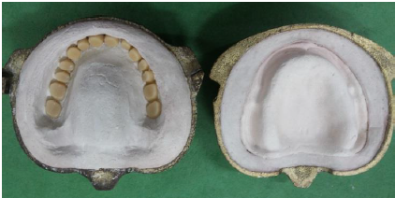

Slide 46
Third :Packing
A- Separating medium is used on plaster or stone, care should be taken not to painting the teeth with separating medium.
B- The mold is left to dry and another coat is painted on the flask and also left to dry.
C- Heat cured acrylic is used polymer/monomer is mixed according to manufacturer instruction. Usually 10 cc of monomer and 30 cc of polymer will be enough to pack an average-sized denture, after mixing of the material on clean jar and reach dough stage, it is ready for packing.

Slide 47
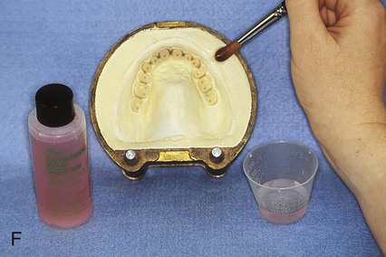
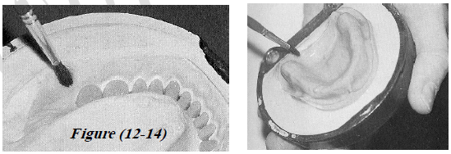
Third :Packing

Slide 48
Third :Packing
D- Packing the material in the upper half of the flask, being sure to press it well into the area around the teeth. Use enough material to insure over packing on the first closure using nylon sheet. At least two trial closure are done and before the final closure a thin layer separating medium is applied on the cast and the nylon sheet is removed and then the two halves of the flask are closed under pressure by bench press of about 100 kg/cm2, then the flask is put in spring clamp and the clamp is closed tightly.

Slide 49
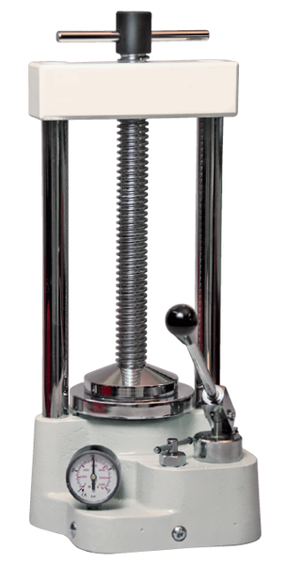
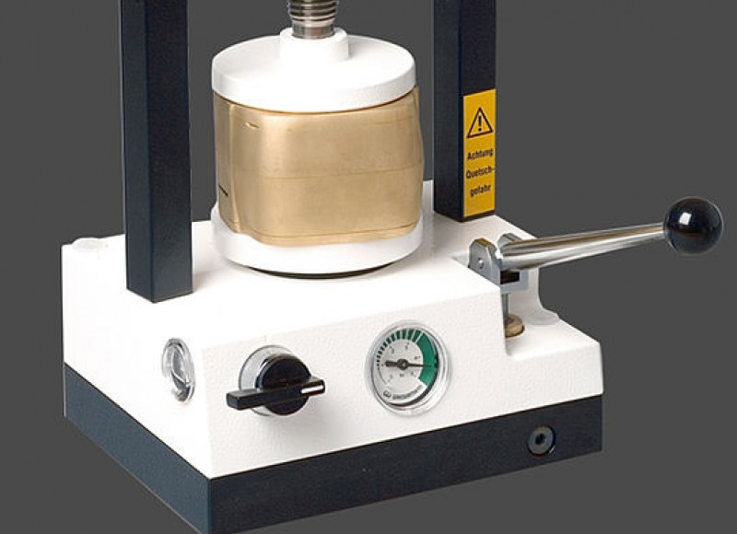
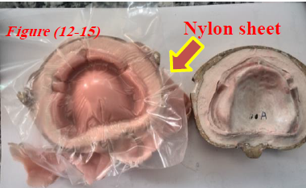

Slide 50
Fourth : Curing
Curing: polymerization of acrylic resin by heat, the amount of heat must be controlled while processing acrylic resin.
Types of curing cycles:
Long cycle (slow): heat the flask in water at 60-70 °C for 9 hours.
Short cycle (rapid) : heat the flask in water at 74 °C for 90 minutes, then boil (100°C) for 1 hour for adequate polymerization of the thinner portions.
The best curing cycle is the slow curing cycle because most of the conversion of monomer to polymer occurs during the period at 70°C and the rapid curing cycle may induce greater dimensional changes in the dentures than slow curing method.

Slide 51
Fourth : Curing
After curing and before deflasking, the flasks must cool slowly to room temperature to allow adequate release of internal stresses and thus minimize the risk of warpage of the bases.

Slide 52
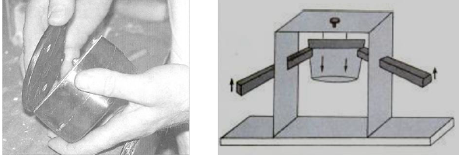
Fifth: Deflasking
It is the removal of the mold from the flask and separates the denture and the cast from the mold (divesting). The flask is removed from the mold using a flask ejector, which is used to separate the flask from the mold after removing of the cover.

Slide 53
Fifth: Deflasking
By using a saw longitudinal and horizontal cuts are carefully made through the plaster or stone and the pieces are gently removed. The cured dentures and their casts have been removed from the mold.

Slide 54
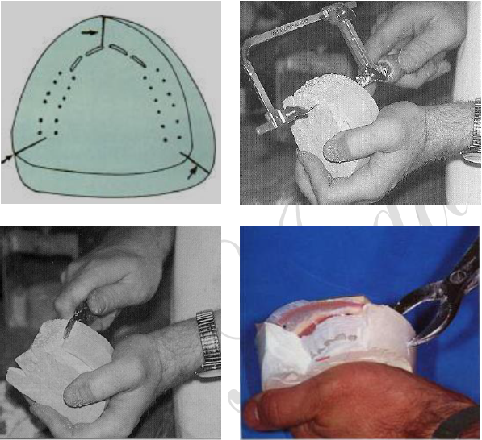
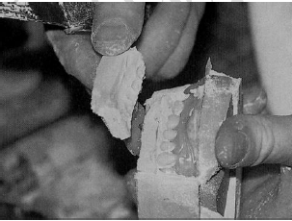

Slide 55


