Slide 1
Occlusal Correction
Bushra Mohammed Ali Al-Ameen
B,D,S,. M,Sc.(Pros)

Slide 2
Occlusal correction
Artificial teeth may move about to a minor degree during waxing and processing of the trial denture to a resin one (wax elimination, packing of acrylic resin, and curing).
This teeth movement is due primarily to dimensional changes in the waxed denture base, the investing material, and in the resin denture base during curing. Occlusal discrepancies caused by these dimensional changes ordinarily are removed before the dentures are polished.

Slide 3
Causes of errors in occlusion
Inaccurate maxillo-mandibular relation record by the dentist.
Errors made in the transfer of maxillo-mandibular relation to the articulator.
Failure to use the face-bow and subsequently changing in the vertical relation on the articulator.
Failure to seat the occlusion rims correctly on the cast (ill-fitting record bases).
Incorrect arrangement of posterior teeth.
Failure to close the flask completely during processing.
Warpage of the dentures by overheating them in polishing stage.
Dimensional changes of the denture base material (acrylic resin).

Slide 4
The errors that are a result of processing changes can be eliminated before insertion of the dentures in the patient’s mouth, correcting occlusal surface of the teeth by selective grinding.
Selective grinding :
It is the modification of the occlusal forms of the teeth by grinding according to a plan.
The modification of the occlusal forms of the teeth by grinding at selected places marked by spots made by articulating paper, or marked by parts of the teeth cutting through a thin layer of occluding wax placed over the teeth.

Slide 5
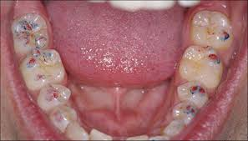
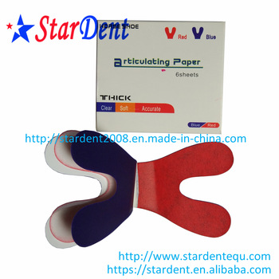
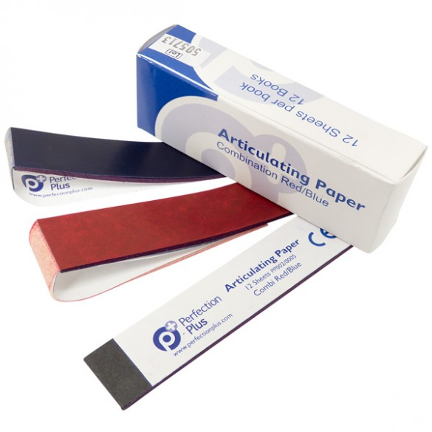
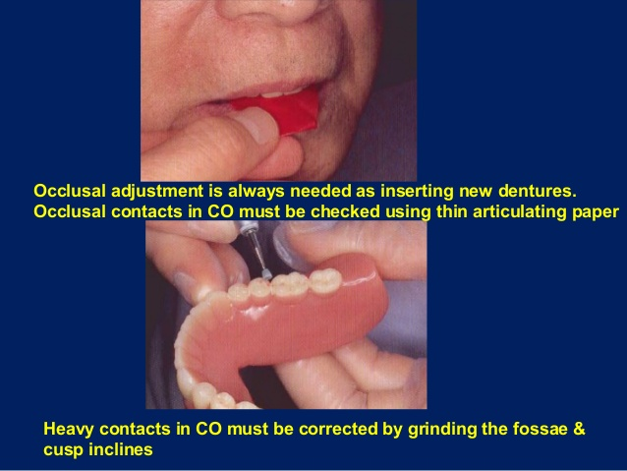
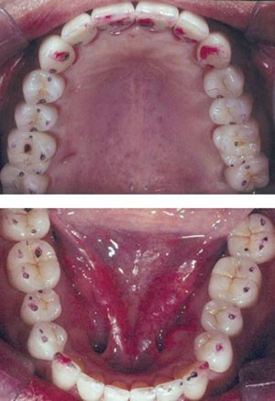
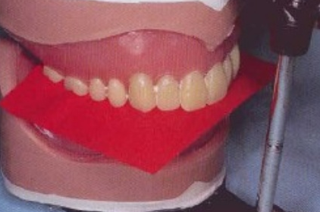

Slide 6
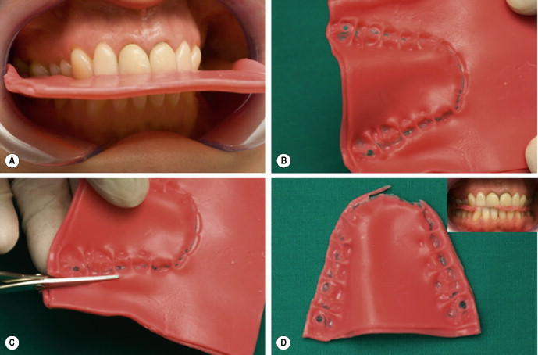

Slide 7
Correction of occlusal records
Two methods are generally used in correcting errors due to processing changes, in both the occlusal surfaces of teeth are altered by selective grinding:
Intraoral (inside patient mouth, clinically).
Extraoral (on the articulator, in the laboratory).

Slide 8
Disadvantages of intraoral correction
It is difficult to see the errors because the soft tissues will be distorted and obscure the errors.
The denture bases will be shift in relation to the underlying bone when there are errors in occlusion due to the resiliency of the soft tissue.
The articulating paper marks are likely to be incorrect due to the presence of the saliva.
The central of jaw position depends entirely on the ability of the patient to place and move jaw correctly.

Slide 9
Advantages of extraoral correction
Easily visible.
Easily located.
Easily corrected by selective grinding.
The articulating paper marks can be quite easily made on dry teeth.
Make the correction away from the patient thus there is a psychological advantage.

Slide 10
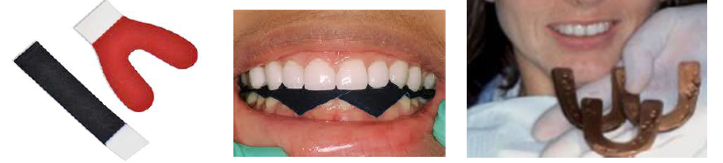
Articulating paper and occluding wax can be used to detect the premature contacts, although it is preferable to use occluding wax because premature contact will cause the cusps to penetrate through the wax indicating heavy contact is present.

Slide 11
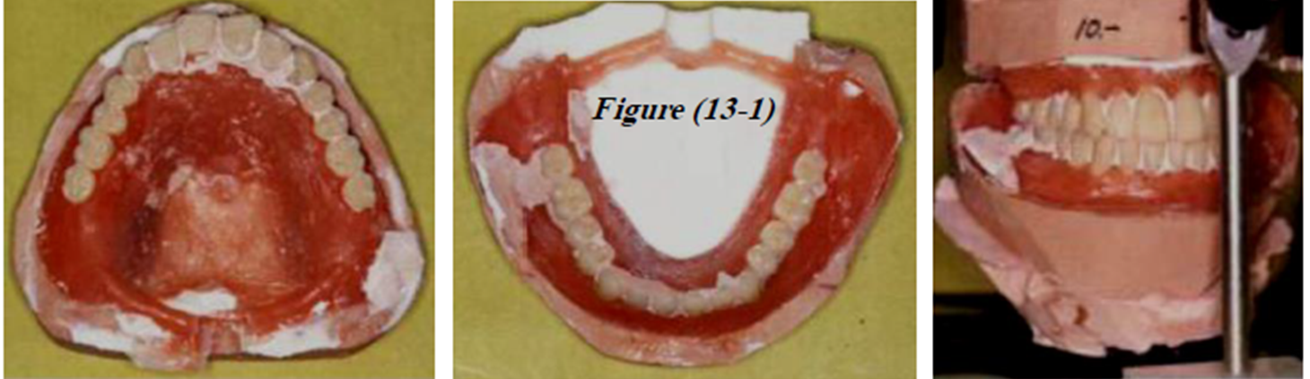
An alternate method to correct the occlusion before removal the dentures from the casts
Replace the upper and lower mounting casts and the dentures on the articulator, If processing changes in occlusion have occurred, they must be corrected.

Slide 12
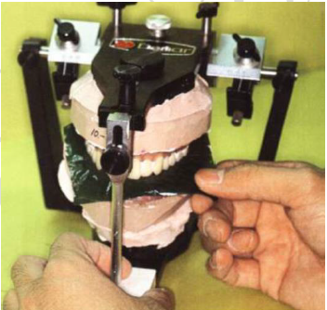
An alternate method to correct the occlusion before removal the dentures from the casts
2. Reestablished the vertical dimension of occlusion at this time, an opening in the vertical dimension can be noted by corresponding opening in the relationship of the incisal pin to the incisal table. The pin should contact the table.

Slide 13
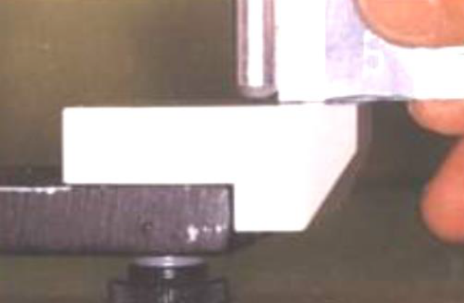
An alternate method to correct the occlusion before removal the dentures from the casts
If excessive opening between incisal pin and incisal table, the flask do not correctly closed.
If the incisal pin prematurely touches the incisal table, the denture may have been under packed.
If there is 1-1.5 mm of incisal pin opening, proper technique have been followed through the investing and packing procedures.

Slide 14
An alternate method to correct the occlusion before removal the dentures from the casts
3. Refine and equalize the centric occlusion.
4. Perfect the working and balancing occlusions.
5. Correct the protrusive occlusion.

Slide 15
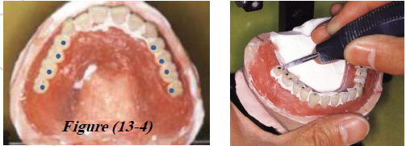
Rules of selective grinding
Never grind a centric cusp tip unless it contacts prematurely in all excursions of the mandible. Always grind the opposing fossa. (i.e. if the cusp is premature contact in centric relation and is also premature in balancing or working, then the cusp should be reduced; if the cusp is in premature contact in centric relation, but is not in working or balancing prematurity, then the opposing fossa or marginal ridge should be reduced).

Slide 16
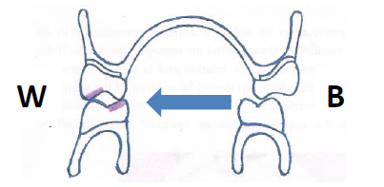
Rules of selective grinding
2. Utilize the (BULL rule) when perfecting working occlusion prematurity,
grind the lingual incline plane of the Buccal cusps of the Upper teeth, or
the buccal incline plane of the Lingual cusps of the Lower teeth.
BULL rule applies working side only.

Slide 17
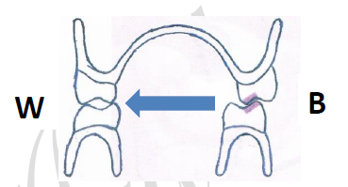
Rules of selective grinding
3. If there is a premature contact on the balancing side, then adjust the buccal incline plane of the lingual cusp of the upper teeth, or the lingual incline plane of the buccal cusp of the lower teeth.
When grinding to perfect balancing occlusion prematurity, never grind the interfering cusp tips but grind the cusp inclines.
Usually this done in the mandibular teeth, do not adjust both maxillary and mandibular teeth.

Slide 18
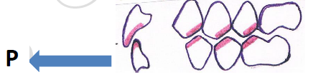
Rules of selective grinding
4. In correcting protrusive interference in the anterior teeth grind the labial portion of the incisal edges of the mandibular teeth and the lingual portion of the maxillary teeth.
For protrusive interference in the posterior teeth, reduce the distal slopes of the upper buccal cusps, or the mesial slopes of the lower lingual cusps.

Slide 19
Finishing And Polishing

Slide 20
Finishing
Finishing: of complete denture is the process of perfecting the final form of the denture by removing any flash, stone remaining around the teeth, and any nodules of acrylic resin on the surfaces of the denture base resulting from processing.
Flash: It is the excess of acrylic resin at the denture border, the acrylic resin that was forced out between the two halves of the flask by the pressure applied during the processing procedure.

Slide 21
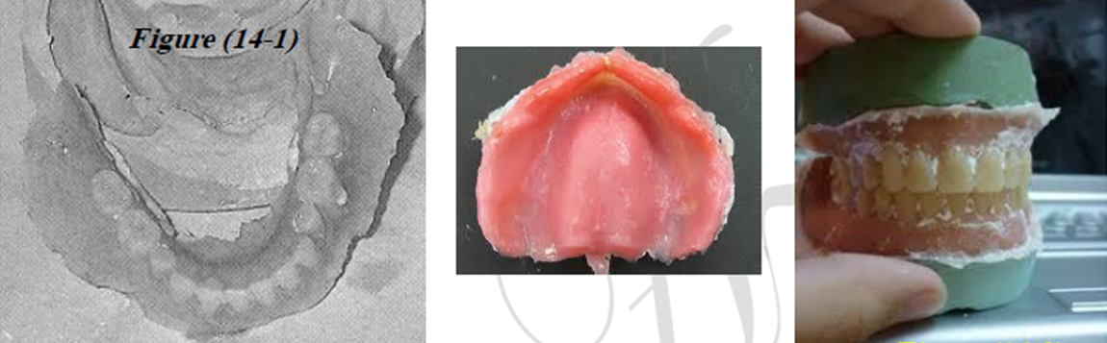
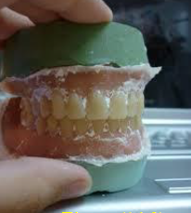
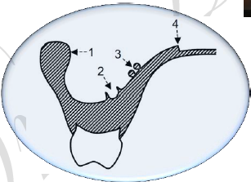

Slide 22
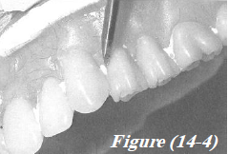
Procedure for finishing
Take care to preserve the border and contour of the denture during the finishing process. If the impression was correcting molded and boxed, and the trial denture was carefully waxed contoured into the form desired in the finished denture, little finishing will be necessary.
Carefully remove remaining stone around the neck of teeth with a small sharp knife.

Slide 23
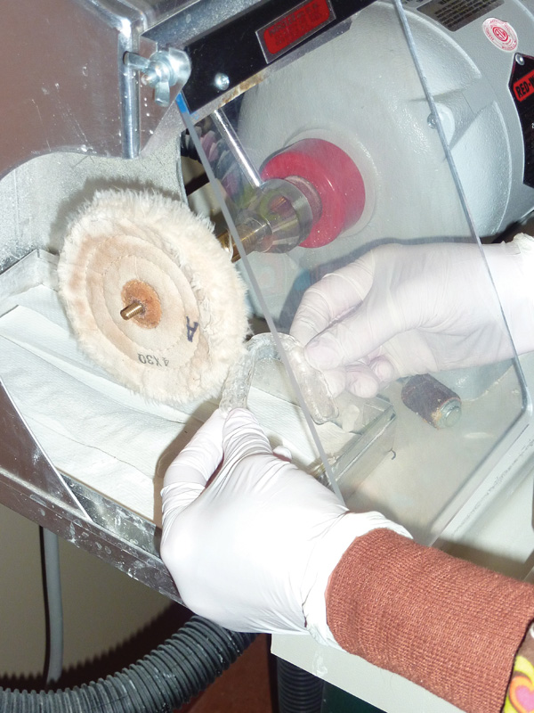
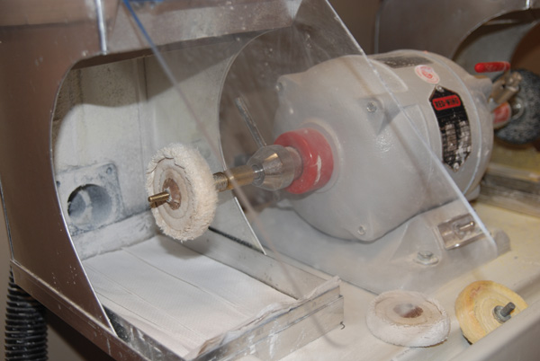
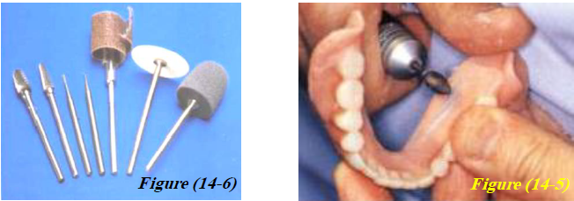
Procedure for finishing
2. To remove the flash of acrylic resin from the denture border, press the denture base lightly against a slowly revolving arbor band mounted on the dental lathe. An alternate but less satisfactory to use a large acrylic bur or stone bur mounted in a straight hand piece to remove the flash. Take care not to change the form of the denture border but only remove the excess resin on the border of denture.

Slide 24
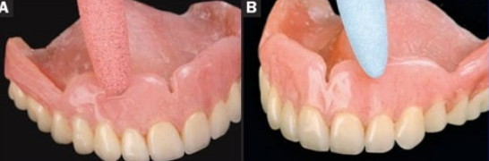
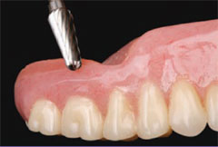
Procedure for finishing
3. Remove nodules of acrylic with small stone or acrylic carbide burs.
4. The posterior area of the palate has been thinned to its proper thickness.

Slide 25
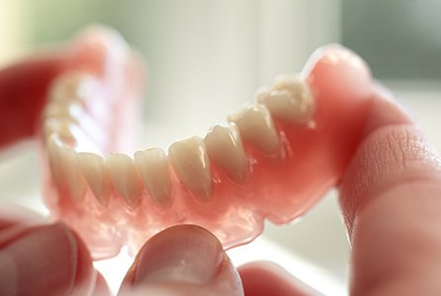
Polishing
Polishing: is a process of removing scratches. Polishing consists of making the dentures smooth and glossy without changing the contours.

Slide 26
Principles of polishing
1- The tissue surface of a denture is never polished as a polishing destroys the details necessary for good fit and retention.
2- The polished surface extends just over the border, but the borders are not reduced in height and width during polishing.
3- Care must be taken when using pumice (it should be used as wet slurry) as this material is very abrasive and may obliterate the details placed on the denture when they were waxes (festooned).
4- Resin teeth have approximately the same hardness as the denture base, so polishing a denture with resin teeth requires some precautions not necessary with porcelain teeth.
5- When polishing, only the denture base and not the teeth are polished.
6- During the finishing and polishing we should minimize the reduction of bulk because this cause warpage.

Slide 27


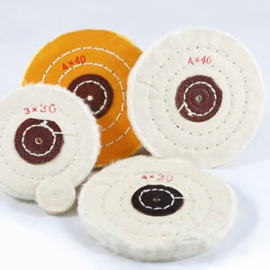
Procedure for polishing
A- smoothening :
1- Polish labial, buccal, lingual, and palatal external surfaces of the denture with wet pumice on rag wheel attached to dental lathe running at slow speed. Keep plenty of pumice on the denture surface and keep the denture moving at all times; press the denture lightly against the wheel.

Slide 28
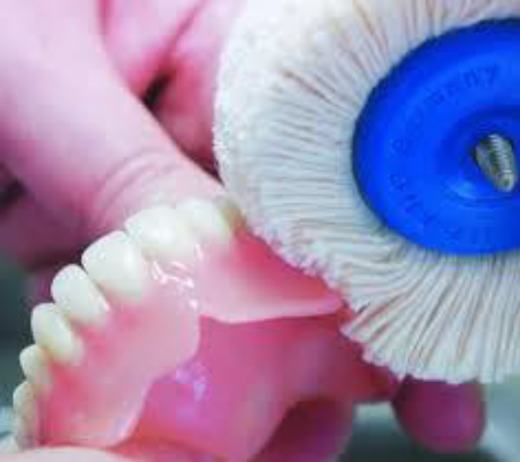
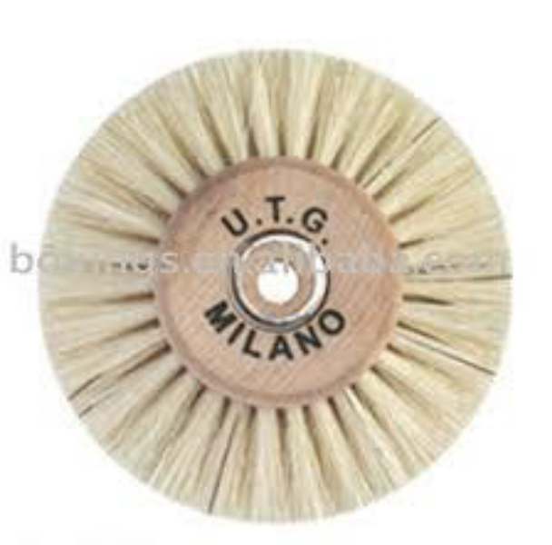
Procedure for polishing
A- smoothening :
2- Polish acrylic around the teeth with wet pumice and a brush wheel attached to dental lathe moving at slow speed. Be careful not remove previously developed contours.

Slide 29
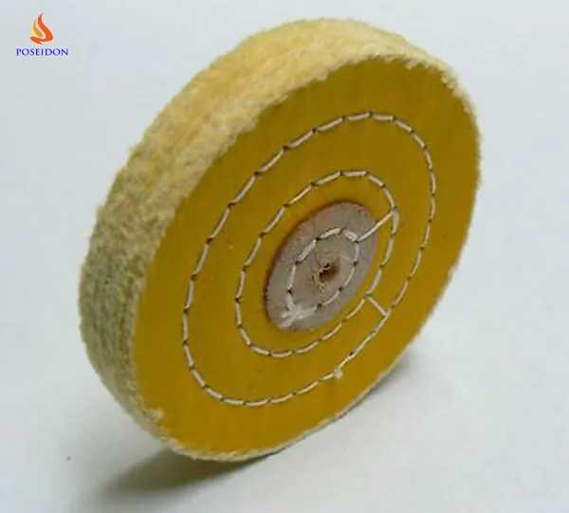
Procedure for polishing
A- smoothening :
3- Polish the border, lateral and palatal surfaces of denture by using wet muslin buffing wheel attached to dental lathe.

Slide 30
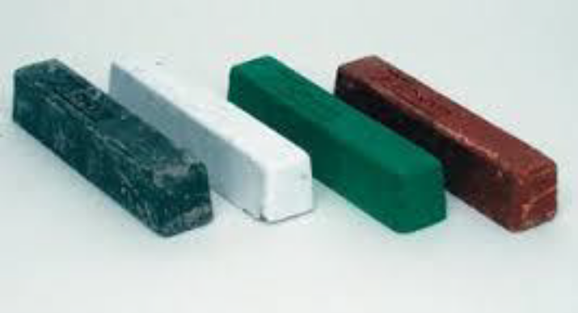
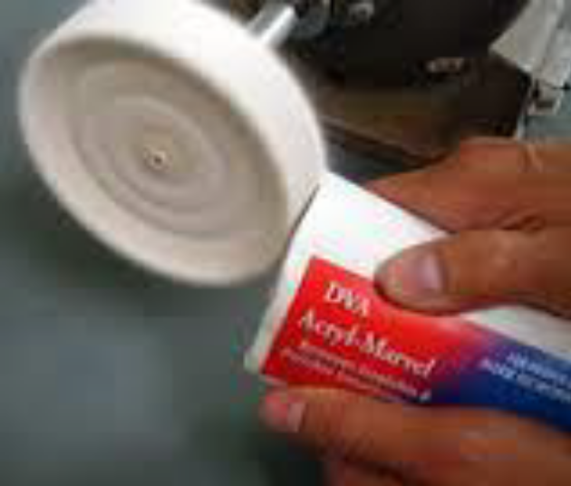
Procedure for polishing
B- making the denture glossy :
1- Use Rouge (greasy material) this material is applied to dry muslin buffing wheel, this differ in that the polishing compound is applied to the wheel not as pumice to the piece of work being polished.

Slide 31
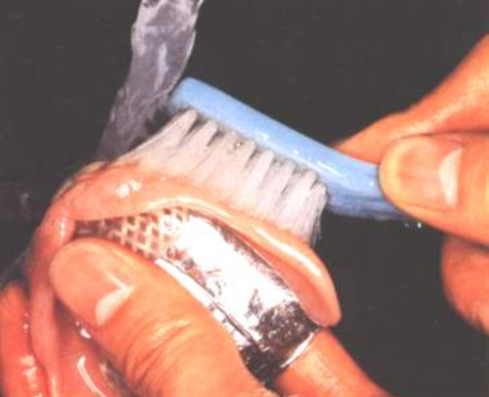
Procedure for polishing
B- making the denture glossy :
2- After the denture completely polished with rouge, it is scrubbed thoroughly.
3- Final polish is obtained by placing high shine material on the denture.

Slide 32
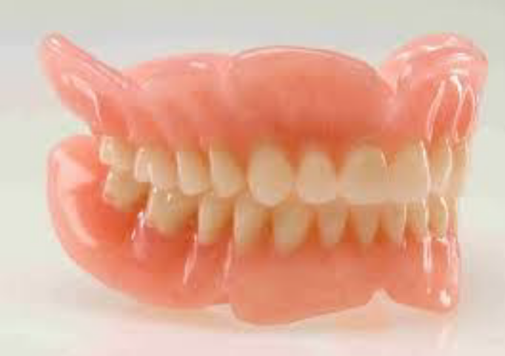
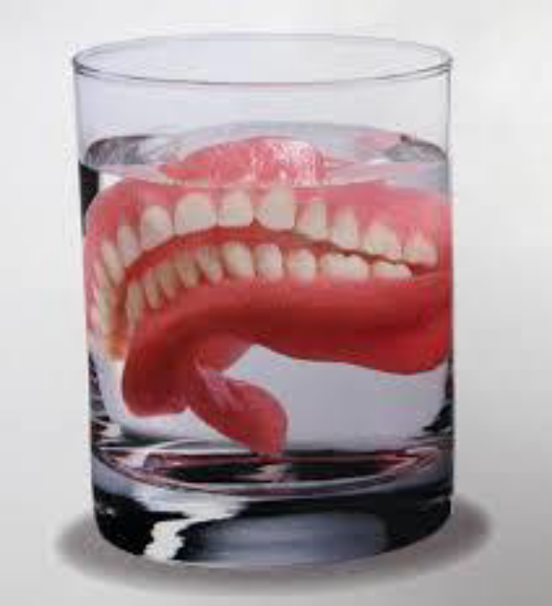
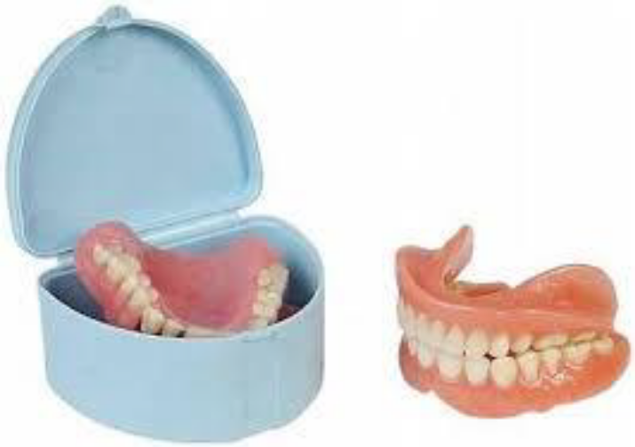
Procedure for polishing
B- making the denture glossy :
4- Store the polished dentures in water until they have been delivered to the patient. Store the dentures in water all the times otherwise they will undergo dimensional changes and shrinkage.

Slide 33
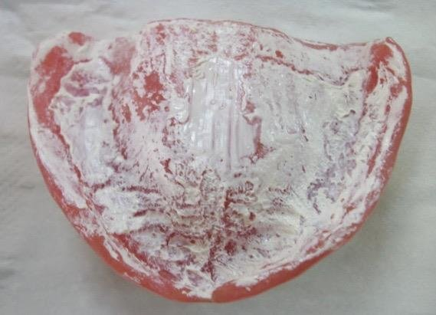
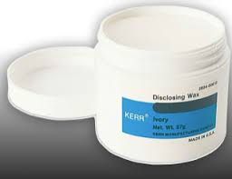
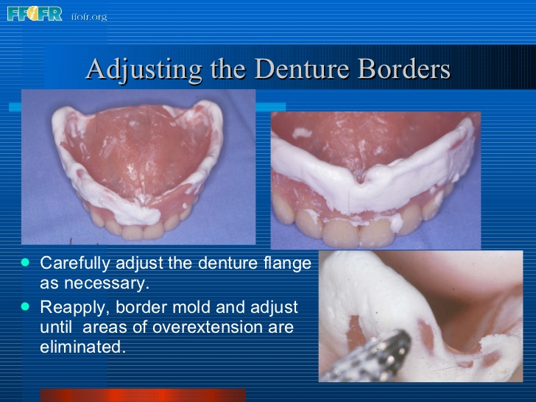
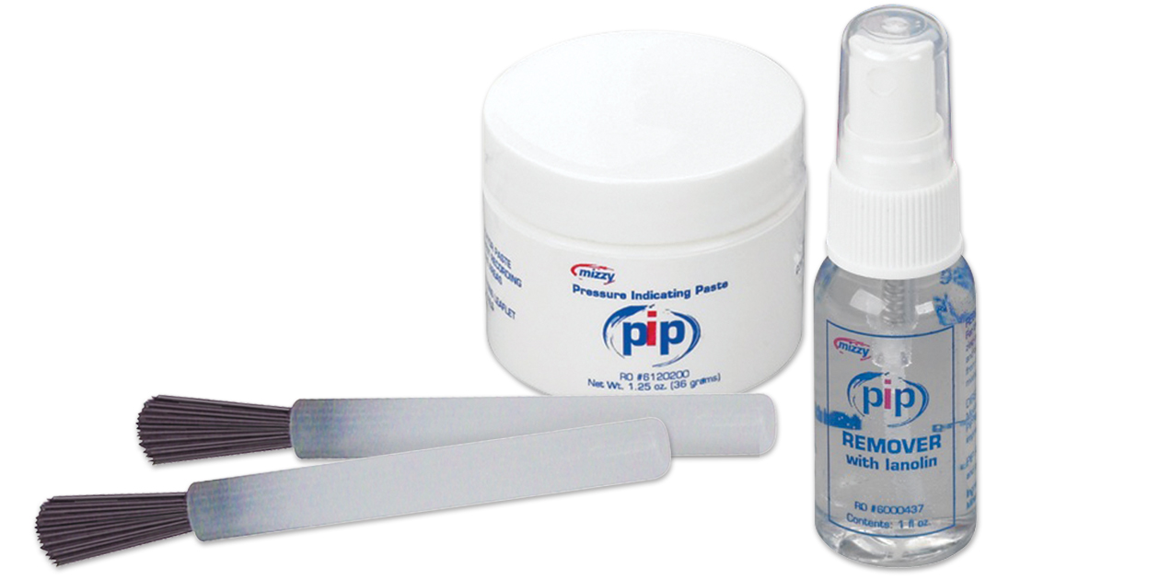
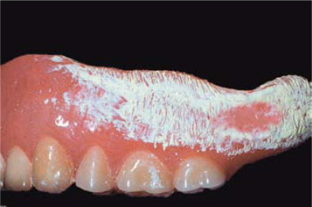
Every new set of complete dentures should be tested in mouth for tissue adaptation and retention and any pressure area should be indicated by using pressure indicating paste, and overextended borders should be indicated by using disclosing wax.

Slide 34


