Slide 1
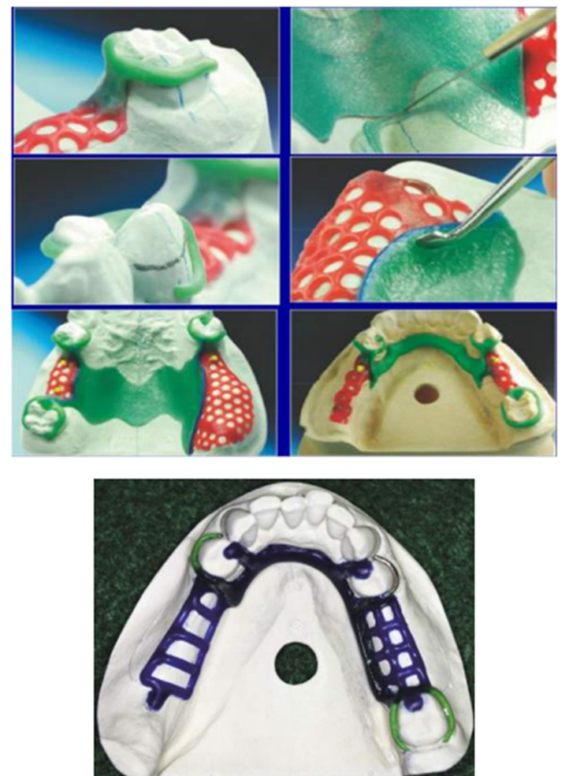
Technical Procedures of RPD Construction
Bushra Mohammed Ali Al-Ameen
B,D,S,. M,Sc.(Pros)

Slide 2
Importance of Knowing Lab. Procedures:
Knowledge of the laboratory phase of partial denture construction is essential for the clinician, who must assume total responsibility for the design and the quality control of all aspects of its construction.
It is important to have an understanding of the laboratory procedures involved:
1. This enables the dentist to design an RPD framework.
2. Complete a laboratory work authorization that tells a technician to design and make the framework.
3. Evaluate the quality of the framework.

Slide 3
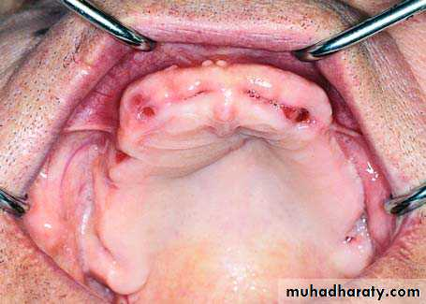
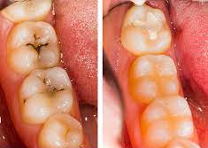
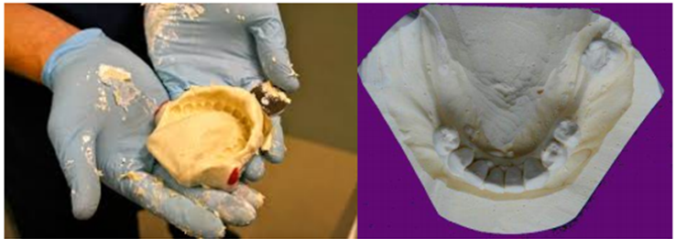
Clinical and Laboratory Steps in fabricating a RPD
1. Introduction to the patient and knowing the chief complain (Clinical steps).
2. Diagnosis and filling a case sheet with preparation and motivation for the patient to the treatment (Clinical)
3. Treatment plan and suggestion of the prognosis after deciding to make an RPD. (Clinical)
4. Pre-prosthetic mouth preparation. (Clinical)
5. Diagnostic impression & study cast. (Clinical)
6. Primary surveying. (Laboratory)
7. Designing the prosthesis. (Clinical & laboratory).

Slide 4
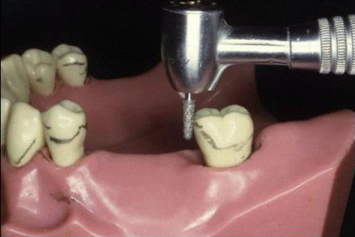
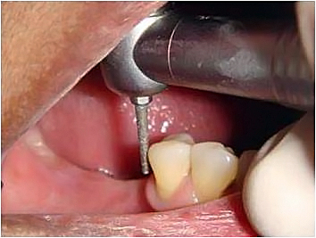
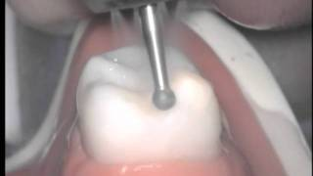
Clinical and Laboratory Steps in fabricating a RPD
8. Secondary surveying. (Laboratory)
9. Model preparation (Laboratory)
10. Prosthetic mouth preparation. (Tooth preparation, cavity preparation). (Clinical)
11. Final impression & master cast. (Clinical)
12. Tertiary surveying to the master cast.
13. Wax-up (relief and block out).
14. Duplication and preparation of refractory casts
15. Wax pattern.
16. Spruing. (Laboratory)
17. Investing
18. Burn out
19. Casting
20. Finishing and polishing.

Slide 5
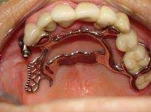
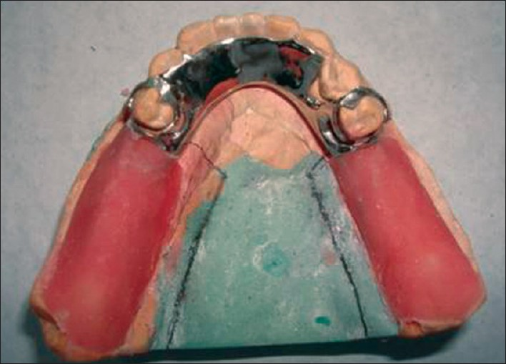
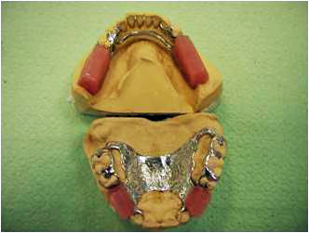
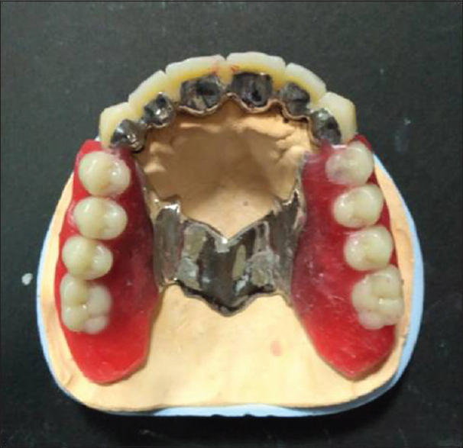
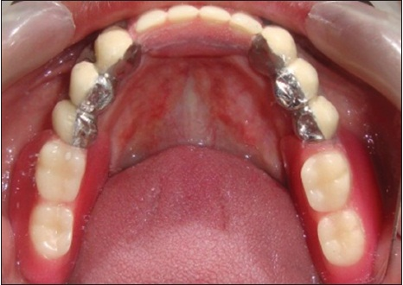
Clinical and Laboratory Steps in fabricating a RPD
21. Framework try-in (Clinical)
22. Bite-rim construction. (Laboratory)
23. Jaw relation registration. (Clinical)
24. Teeth selection and setting. (Laboratory)
25. Denture try-in. (Clinical)
26. Flasking. (Laboratory)
27. Deflasking. (Laboratory)
28. Packing. (Laboratory)
29. Curing. (Laboratory)
30. Finishing and polishing. (Laboratory)
31. Denture insertion. (Clinical)

Slide 6
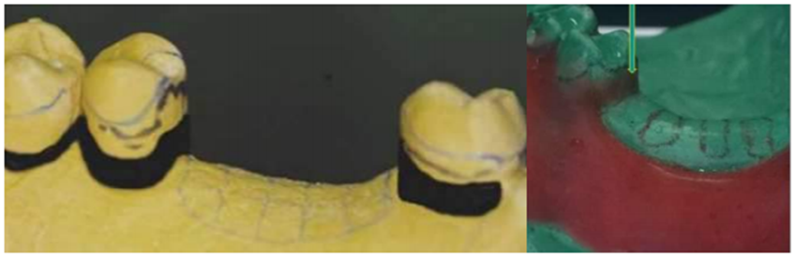
BLOCK OUT
After the master cast has been surveyed and establishment of the path of placement and the location of undercut areas on the master cast, any undercut areas that will be crossed by rigid parts of the denture (which is every part of the denture framework except the retentive clasp terminals) must be eliminated by blockout.
Blockout:
It is act of placing wax into undercut areas that will be crossed by rigid parts of the denture except the retentive clasp terminals; this step was done on the master cast before duplication.

Slide 7
BLOCK OUT
TYPES OF BLOCK OUT
1. Paralleled Blockout.
2. Shaped Blockout
3. Arbitrary Blockout

Slide 8
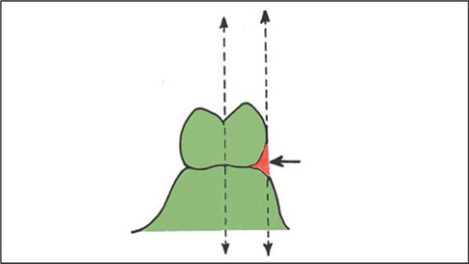
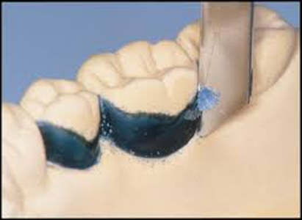
BLOCK OUT
1.Paralleled Blockout:
Parallel blockout is necessary for areas that are cervical to guiding plane surfaces and over all undercut areas that will be crossed by major or minor connectors.
Hard inlay wax may be used satisfactorily as a blockout material. It is easily applied and is easily trimmed with the surveyor blade.
Trimming is facilitated by slightly warming the surveyor blade with an alcohol torch.

Slide 9
BLOCK OUT
1.Paralleled Blockout:
Sites:
Proximal tooth surfaces to be used as guiding planes.
Beneath all minor connectors.
Tissue undercuts to be crossed by rigid connectors (or any rigid part of the denture).
Tissue undercuts to be crossed by origin of bar clasps.
Deep interproximal spaces to be covered by minor connectors or linguoplates.
Beneath bar clasp arms to gingival crevice.

Slide 10
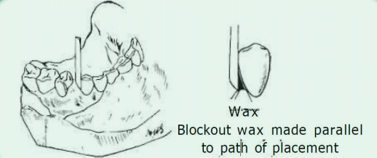
BLOCK OUT
1.Paralleled Blockout:
All guiding plane areas must be parallel to path of placement, and all other areas that will be contacted by rigid parts of denture framework must be made free of undercut by parallel blockout.

Slide 11
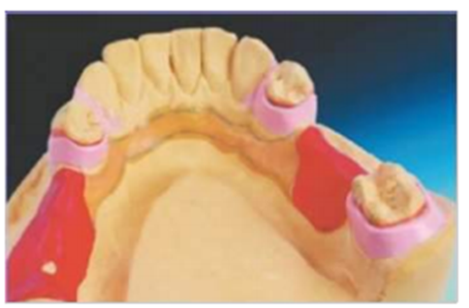
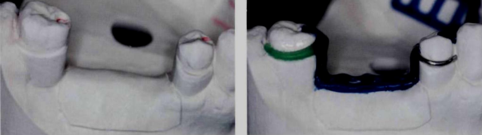
BLOCK OUT
2.Shaped Blockout:
Follow the clasp patterns, may or may not be used.
However, this should not be confused with the actual blocking out of undercut areas that would offer interference to the placement of the denture framework.

Slide 12
BLOCK OUT
2.Shaped Blockout: .
Site:
On buccal and lingual surfaces of the abutment teeth, to locate the wax patterns for clasp arms.
Wax ledge for reciprocal clasp arm as cervical as possible also ledge for location of retentive clasp arm. Wax ledges on buccal surfaces of premolar and molar abutments have been duplicated in refractory the cast for exact placement of clasp molar pattern and the premolar wrought wire clasp.

Slide 13
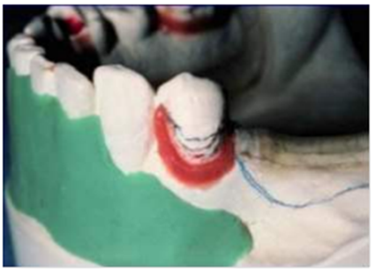
BLOCK OUT
3.Arbitrary Blockout:
Such areas are the labial surfaces and labial undercuts not involved in the denture design and the sublingual and distolingual areas beyond the limits of the denture design. These are blocked out arbitrarily with hard baseplate wax, but because they have no relation to the path of placement, they do not require the use of the surveyor.
Arbitrary block out is done to:
1- Prevent distortion of duplicating mold when the master cast is removed.
2- Facilitate the removal of the refractory cast from the impression during duplication.

Slide 14
BLOCK OUT
3.Arbitrary Blockout:
Sites
All gingival crevices.
Gross tissue undercuts situated below areas involved in design of denture framework.
Tissue undercuts distal to cast framework.
Labial and buccal tooth and tissue undercuts not involved in denture design.

Slide 15
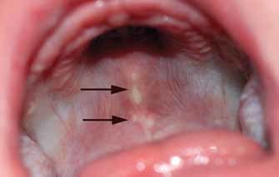
Relief:
Removable partial denture framework usually displays intimate contact with the teeth and soft tissues. However, there are certain areas where contact is not desirable.
In these areas framework is shaped to stand away from the underlying tissues ; this is accomplished by relief which is the procedure of placing wax in certain areas on the master cast before duplication, to create a raised area on the refractory cast.

Slide 16
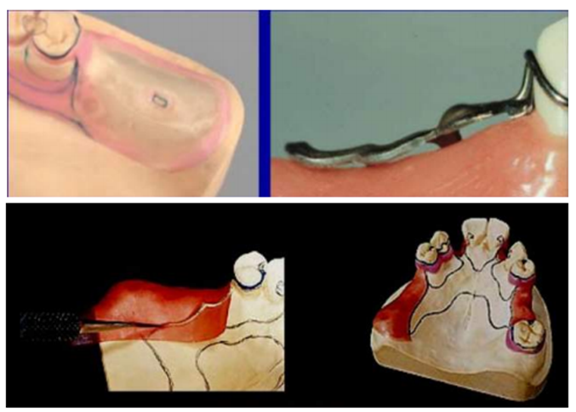
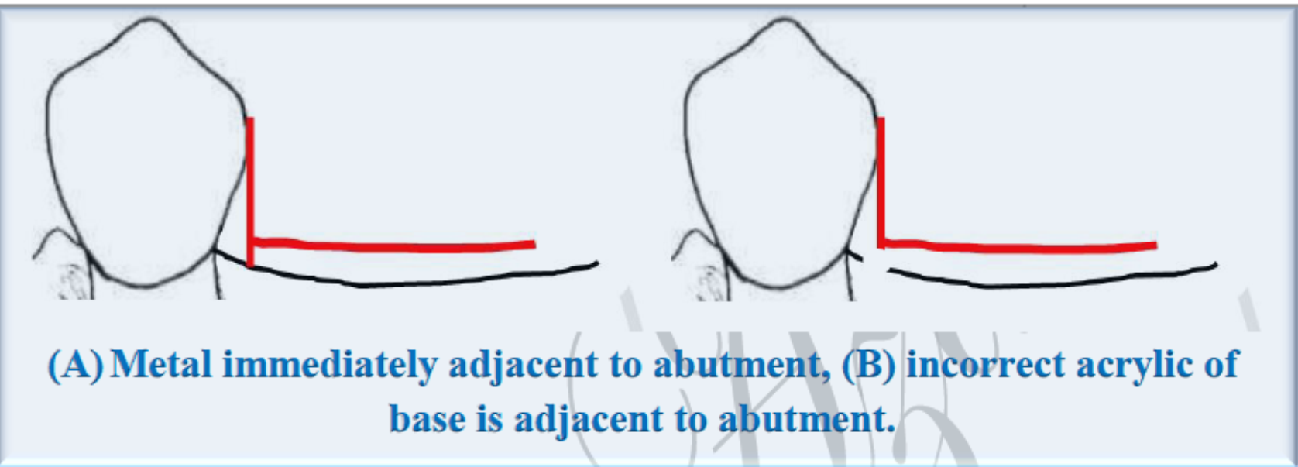
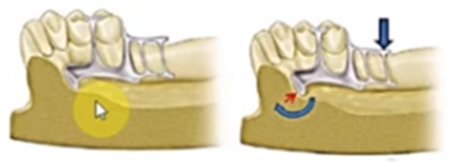
Relief:
Purpose of relief:
To prevent tissue impingement resulting from rotation of the denture framework.
To prevent abrasion of the cast.
To create space for the acrylic resin (beneath the retentive ladder) to be filled.

Slide 17
Relief:
Sites
Beneath lingual bar connectors or the bar portion of the linguoplates concerning the relative slope of the alveolar ridge.
Areas in which major connectors will contact thin tissue, such as hard areas so frequently found on lingual or mandibular ridges and elevated palatal raphes and tori.
Beneath the ladder minor connectors for attachment of resin bases.

Slide 18
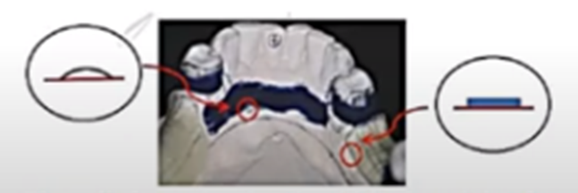
Relief:
The relief wax border should be butt joint for site C, and the wax borders for site A should be blended with contours of the cast.

Slide 19

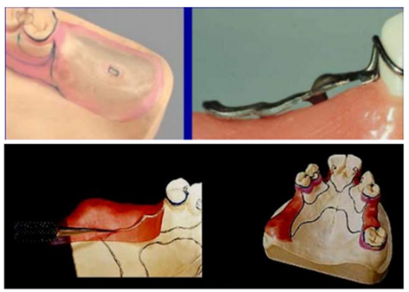
Relief:
Tissue stops
Tissue stops are represented as (2 mm x 2 mm) square cut in the relief wax over the ridge in distal extension areas.
Tissue stops are integral parts of minor connectors designed for retention of acrylic resin bases.
They provide stability to the framework during the stage of transfer and processing. Tissue stops can engage buccal and lingual slopes of the residual ridge for stability.

Slide 20
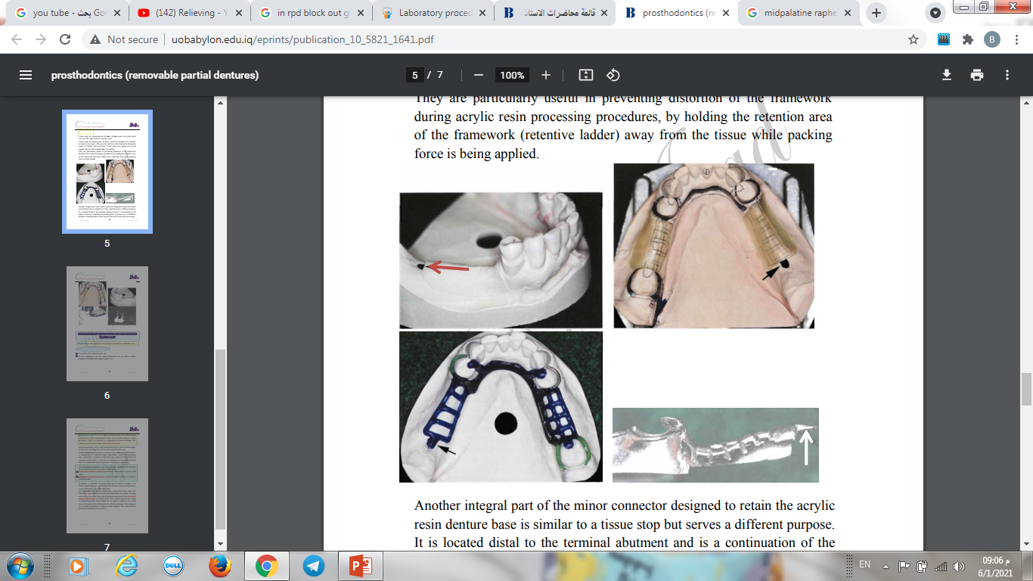
Relief:
Tissue stops
They are particularly useful in preventing distortion of the framework during acrylic resin processing procedures, by holding the retention area of the framework (retentive ladder) away from the tissue while packing force is being applied.

Slide 21
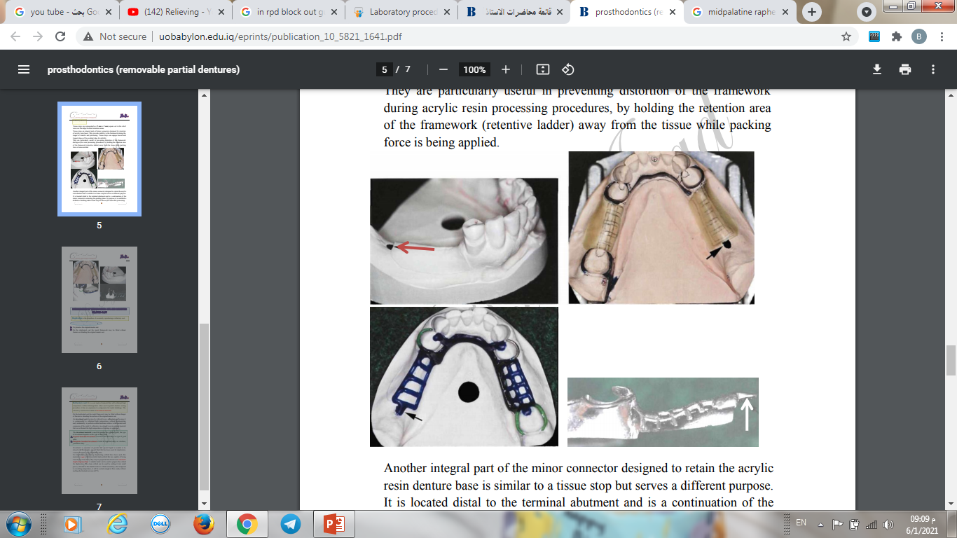
Relief:
Tissue stops

Slide 22
Relief:
Another integral part of the minor connector designed to retain the acrylic resin denture base is similar to a tissue stop but serves a different purpose.
It is located distal to the terminal abutment and is a continuation of the minor connector contacting the guiding plane.
Its purpose is to establish a definitive finishing index tissue stop for the acrylic base after processing.

Slide 23
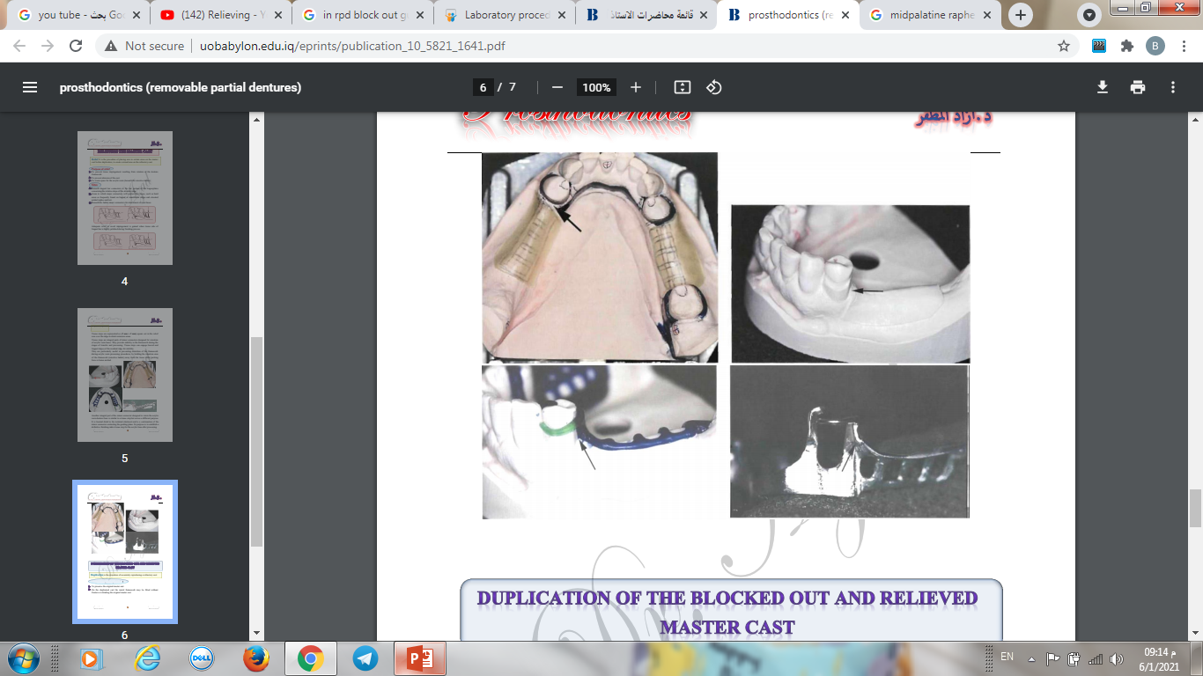
Relief:
Tissue stops

Slide 24
Duplication (tertiary impression):
Duplication is the procedure of accurately reproducing a refractory cast.
Duplication is done for the blocked out and relieved master cast
A stone cast may be duplicated for many reasons:
1. Preservation of original casts.
2. Eliminating the danger of fracture or abrading the surface of the original master cast.
3. Forming the wax or plastic pattern
4. The metal framework is cast against the surface of refractory cast.

Slide 25
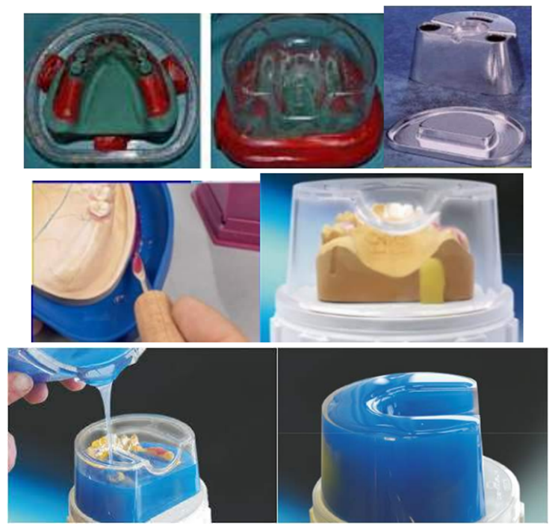
Duplication (tertiary impression):
Duplicating Materials are:
1. Colloidal (agar)
2. Silicon
Colloidal materials are made fluid by heating and return to gel while cooling. The cast to be duplicated must be placed in the bottom of a flask, called a duplicating flask Attach cast to the bottom of the flask so that it does not move.

Slide 26
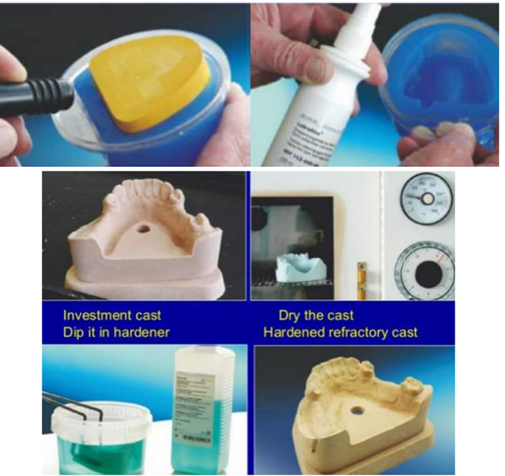
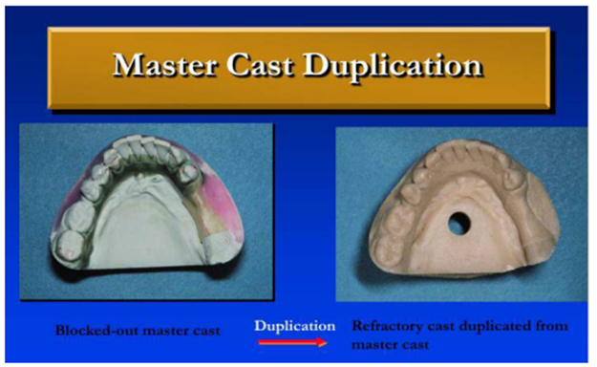
Duplication (tertiary impression):

Slide 27
Duplication (tertiary impression):
Refractory cast:
It is a cast made of material that will withstand high temperature without disintegration when used in partial denture casting procedure; it has an expansion to compensate for metal shrinkage.
The refractory cast has been made of investment material ( investment cast).
The investment material is used for making the refractory cast; the type of investment depends on the type of alloy used:
Gypsum bounded investment is used for low heat alloys as type IV gold alloy.
Phosphate bounded investment is used for high heat alloys as vitallium, palladium alloy.

Slide 28
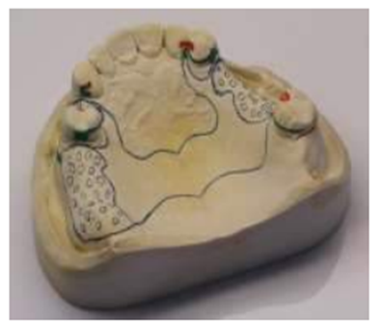
Design Transfer:
Before the actual waxing can begin, the design must be transferred on the refractory cast.

Slide 29

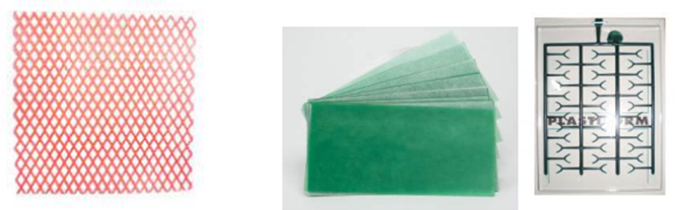
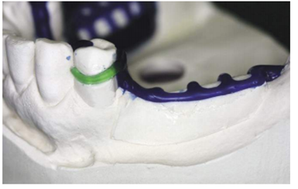
Waxing the RPD Framework
Waxing the RPD Framework: Wax pattern on the duplicate cast according to the establish design.

Slide 30
SPRUING:
• Sprues have the purpose of leading the molten metal from the crucible into the mold cavity.
• For this purpose, they should be:
a. Large enough to accommodate the entering molten metal .
b. Of proper shape to lead the metal into the mold cavity as quickly as possible.
c. They provide a reservoir of molten metal from which the casting may draw during solidification, thus preventing porosity caused by shrinkage.

Slide 31
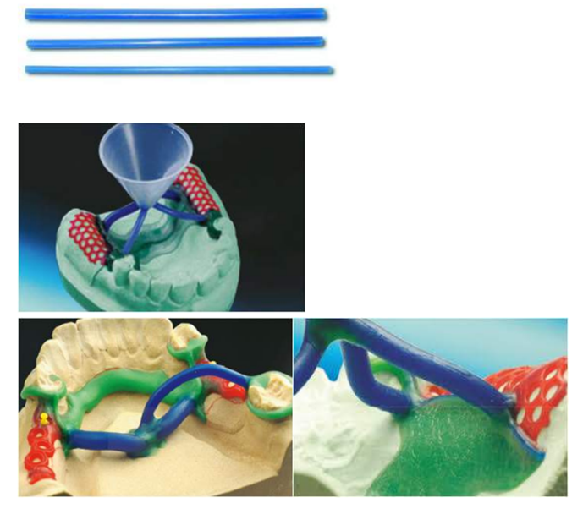
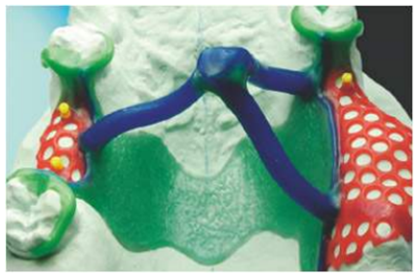
SPRUING:

Slide 32
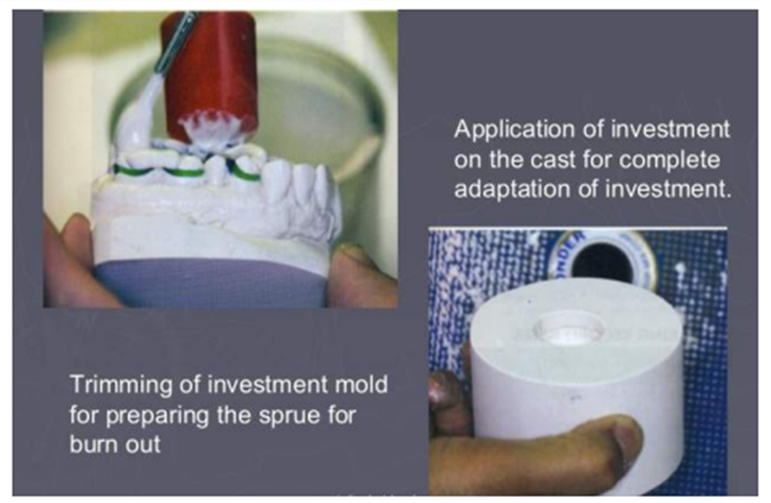
Investing the sprued Pattern:
The investment for an RPD casting consists of two parts:
a. The investment cast on which the wax pattern is made.
b. The outer investment surrounding the cast and pattern.

Slide 33
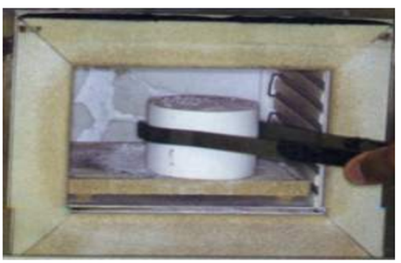
BURN OUT:
The burnout procedure serves three purposes:
1. It drives off moisture in the mold.
2. It vaporizes and thus eliminates the pattern, leaving a cavity in the mold.
3. It expands the mold to compensate for contraction of the metal on cooling.

Slide 34
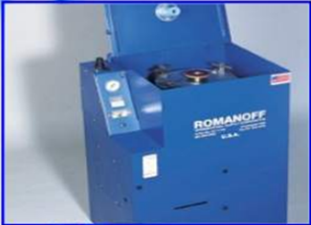
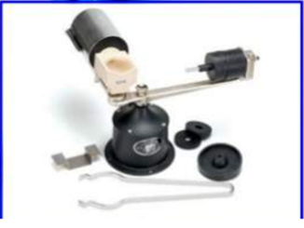
Casting
Casting machines:
1. Air pressure casting machines:
Alloy is melted in situ in crucible hollow of the ring , followed by applied air pressure.
2. centrifugal casting machines:
Alloy is melted in a crucible, and forced into the mold by centrifugal force.

Slide 35
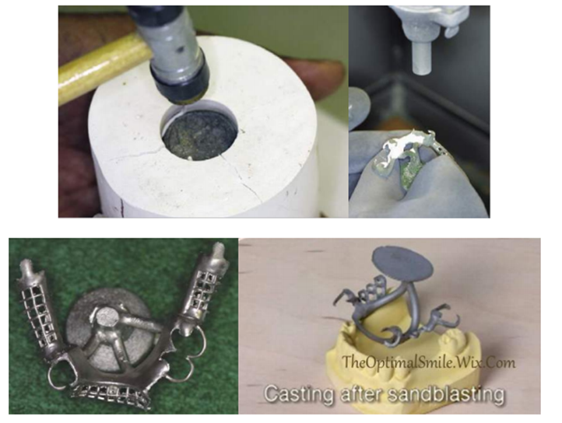
Casting

Slide 36
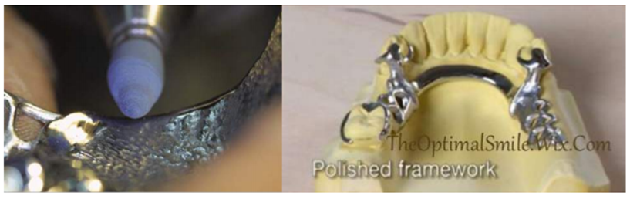
Finishing and Polishing of metal framework:
•The sprue removal and finishing is done with high-speed lathe, large abrasive discs, polishing compounds and wheels.
•The final finishing procedures are similar to those used for gold alloy but the Chromium-cobalt and Nickle-chromium alloys is much harder.
•The major difference is that the Chromium-cobalt and Nicklechromium alloys are also electro-polished, in addition to the usual mechanical lathe polishing, to produce a smooth surface.

Slide 37
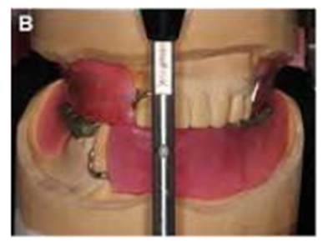
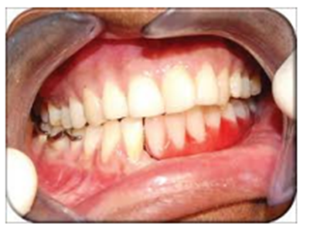
NOTES
• There should be no rocking of the framework on the master cast.
• All of the rests should be seated accurately with the rest seat preparations and the clasp arms contacting the desired locations of the abutment teeth.
• The design should be exactly as you have drawn it on the diagnostic cast and on the laboratory work authorization.
• Mounting the jaw relation on the articulator is done after metal frame work “try in” inside the patient mouth and taking jaw relation, after mounting we can continue with setting of teeth and waxing.
• Try-in stage in the patient mouth for teeth setting and others (Clinical step).

Slide 38
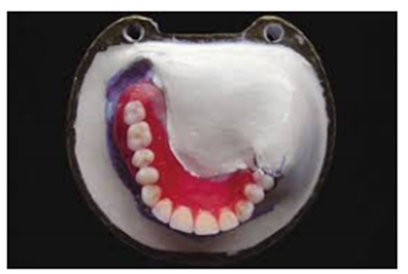
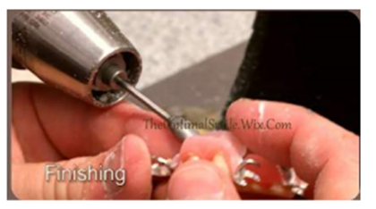
NOTES
• Flasking, wax elimination and packing of acrylic (Laboratory step).
• Deflasking, finishing and polishing of the finished appliance (Laboratory step).
• Insertion in patient's mouth and instructions (Clinical step).

Slide 39

Thank you

