Slide 1
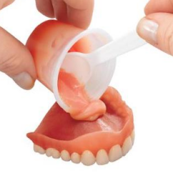
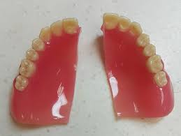
Relining, Rebasing and Repairing of Complete Denture.
Bushra Mohammed Ali Al-Ameen
B,D,S,. M,Sc.(Pros)

Slide 2

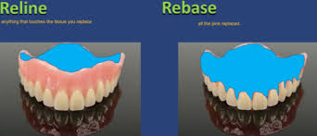
Relining and Rebasing

Slide 3
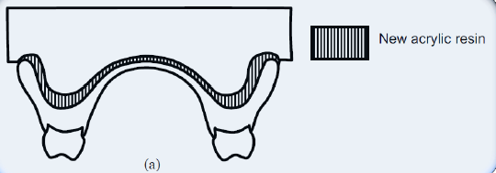
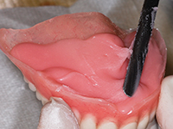
Relining
It is the procedures used to resurface the tissue-side of a denture with new material layer, thus producing an accurate adaptation to the denture foundation area. It is usually carried out when the fitness of the denture has been deteriorated and it is not necessary to construct a new one.

Slide 4
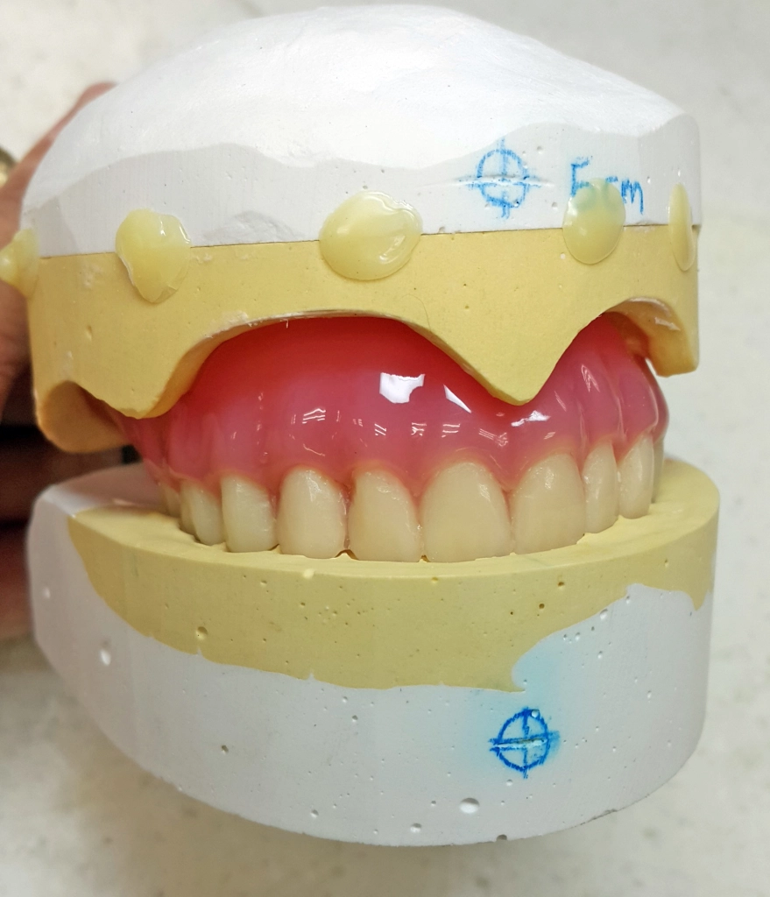
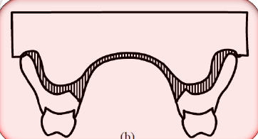
Rebasing
It is the laboratory process of replacing the entire denture base material on an existing prosthesis, without changing the dental arch, and the occlusal relationship.

Slide 5
Indications for relining and rebasing
When observed clinical changes include:
Loss of retention and stability.
Loss of occlusal vertical dimension.
Loss of support for facial tissues.
Horizontal shift of dentures: in correct occlusal relationship.
Reorientation of occlusal plane.

Slide 6
Contraindications for relining and rebasing
When there is increased vertical dimension (insufficient interarch space).
Poor esthetic and incorrect position of teeth.
Unsatisfactory jaw relationship in the denture.
Excessive resorption of residual ridge.
Severe osseous undercuts.
Dentures causing major speech problems.
Temporomandibular joint problems.

Slide 7
Relining can be achieved in one of two ways:
Direct (chair side).
Indirect (laboratory).

Slide 8
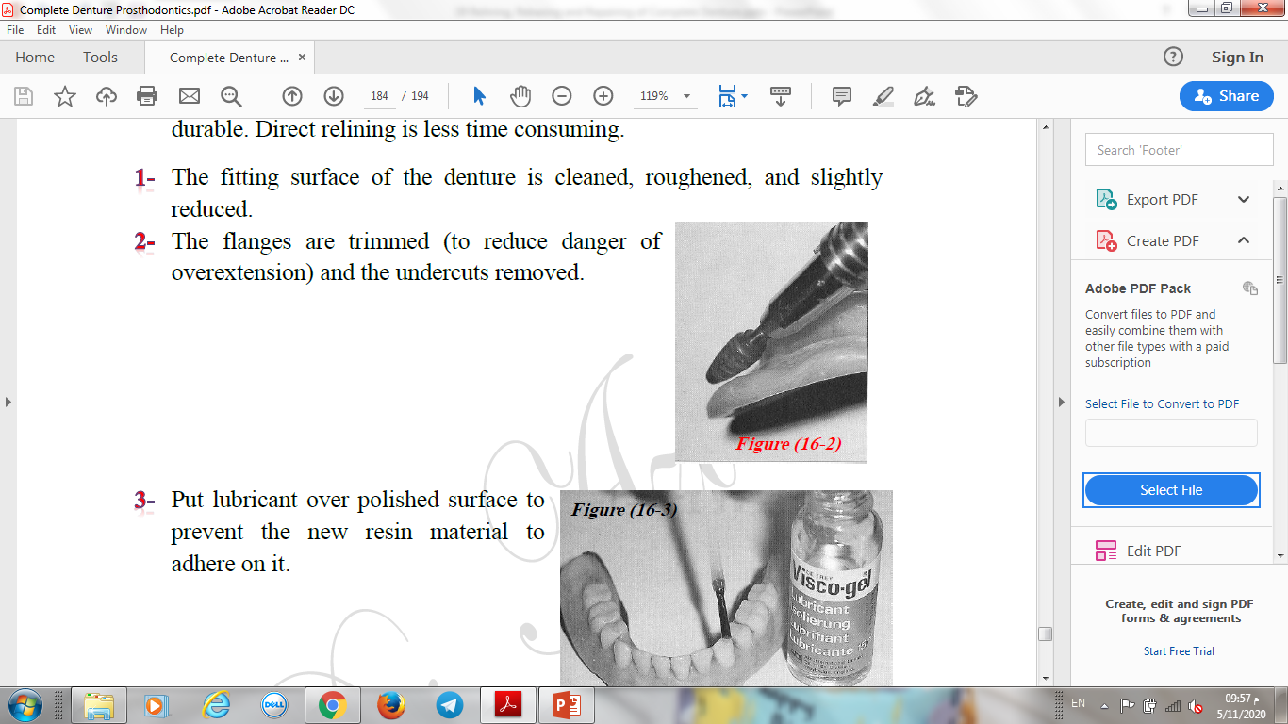
Procedure of Direct Relining
Cold cured acrylic or tissue conditioner material is used.
Direct relining is less time consuming; but are not very durable.
Procedure:
The fitting surface of the denture is cleaned, roughened, and slightly reduced.
The flanges are trimmed (to reduce danger of overextension) and the undercuts removed.
Put lubricant over polished surface to prevent the new resin material to adhere on it.

Slide 9
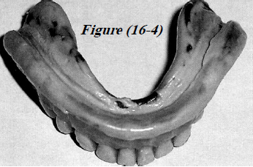
Procedure of Direct Relining
Procedure:
5. The new self-curing relining material is then mixed and applied to the fitting surface.
6. The denture is inserted and the patient asked to bite gently on the denture to ensure that the occlusion is not altered by the procedure.
7. Border molding can then be carried out.
8. The denture is kept in situ for about 5 minutes after which it is removed and carefully examined.

Slide 10
Procedure of Direct Relining
The disadvantages of cold cure acrylic as relining material:
The material has often produced a chemical burn on the mucosa, and from exothermic reaction.
Color stability is very low and bad odor due to porosity of the material, since no flasking procedure is used.
Liability for errors and wrong positioning of the denture is great.
Improvement in the denture requirement is very little and low.
It is a short term solution.

Slide 11
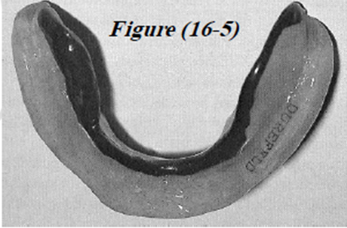
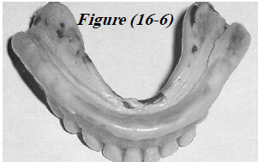
Procedure of In-Direct Relining
Procedure:
The fitting surface is cleaned, the undercuts are removed and the flanges are shortened.
Minor defects and extensions can be corrected.
A wash impression by zinc oxide eugenol is making with the old denture, with the patient in light occlusal contact.

Slide 12
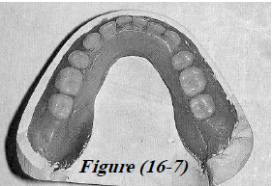
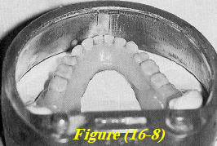
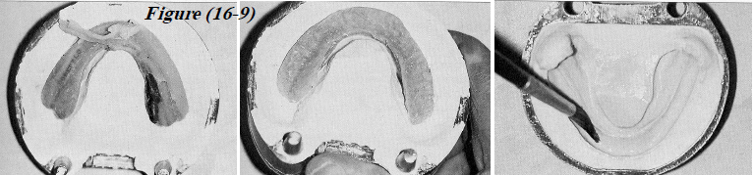
Procedure of In-Direct Relining
Laboratory steps:
Beading and boxing of the impression, then pouring the boxed impression with stone material.
The denture and the cast are not separated, but any excess impression on the teeth or facial surfaces of the base is removed, then the denture flasked in the usual manner.
Zinc oxide eugenol elimination in hot water for 5 minutes; then separated and all the impression material is cleaned from the cast and the denture base.

Slide 13
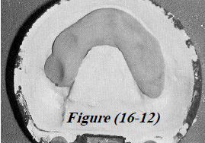
Procedure of In-Direct Relining
Laboratory steps:
4. Painting the cast with a separating medium.
5. Paint the surface of the denture with cotton pellet moistened with monomer.
Mix the acrylic resin and place it in the flask (the new relining material should be compatible with the old denture base material chemically and esthetically).
Curing the heat cured resin.
The denture deflasked and the cast removed from the denture then polish the denture; the relined denture is ready to be inserted in the patient mouth.

Slide 14
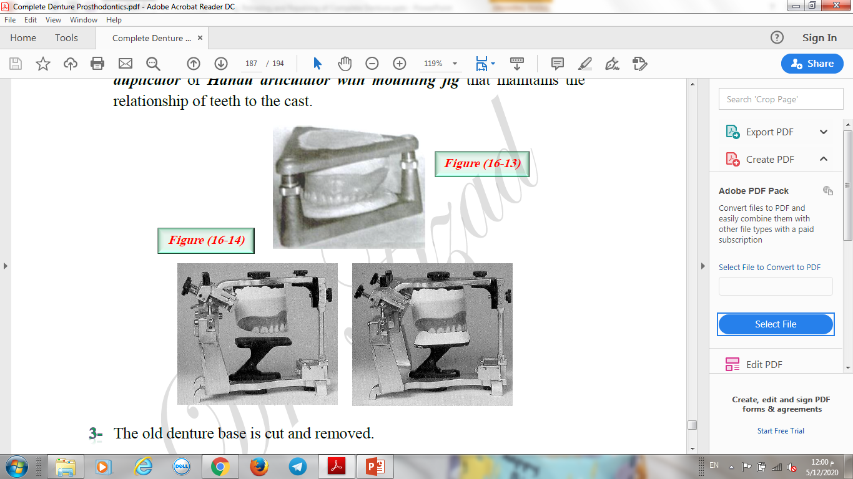
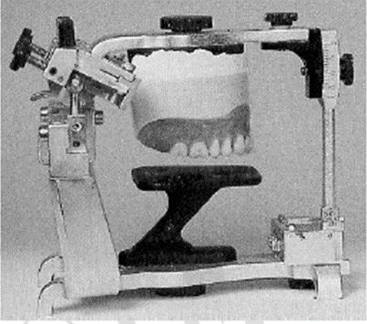
Procedure of Rebasing
Rebasing procedure is the same as those for relining with some differences:
Impression is made and a cast is poured in the denture as in relining procedure.
The denture with the cast is mounted on an instrument as Hooper duplicator or Hanau articulator with mounting jig that maintains the relationship of teeth to the cast.

Slide 16
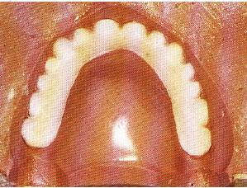
Procedure of Rebasing
Rebasing procedure is the same as those for relining with some differences:
3. The old denture base is cut and removed.
The original teeth are re-waxed in their previous positions on the cast.
The denture is then processed in the laboratory as for relining.

Slide 17
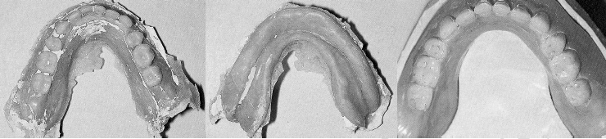
Procedure of Rebasing
Rebasing procedure is the same as those for relining with some differences:
6. The denture deflasked and the cast removed from the denture then finished and polish the denture; the relined denture is ready to be inserted in the patient mouth.

Slide 18
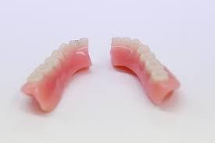
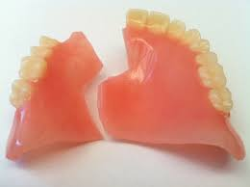
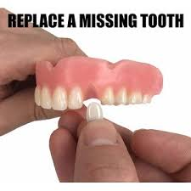
Repairing of complete denture

Slide 19
Repair of complete denture fractures
One of the advantages of using acrylic resin in denture base, it can be easy to repair.
The fractures may occur either:
1. Intraorally (during function).
2. Extraorally (dropping the denture on hard surface).

Slide 20
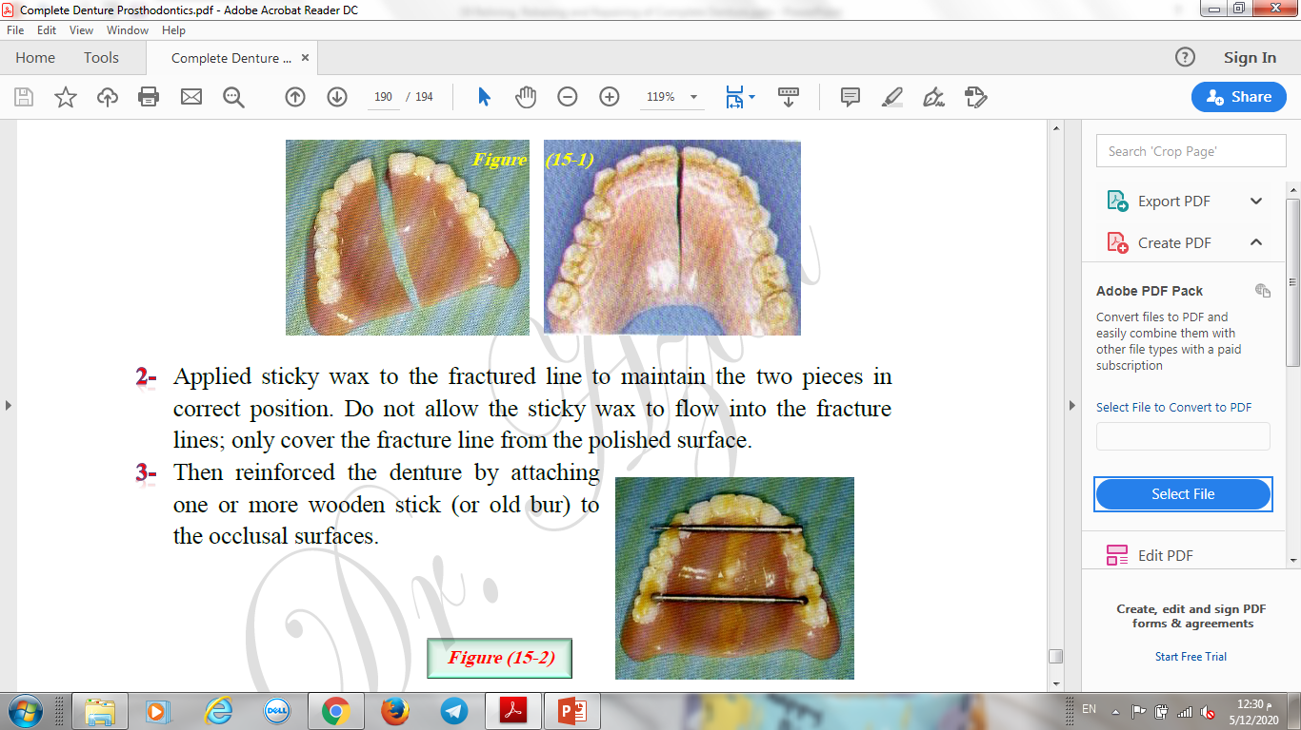
Repairing of complete denture fractures;
A- when all broken parts are available
Clinical and laboratory procedures:
Accurate reassembly of the broken parts, if not, the denture will neither fit nor occlude properly.
Applied sticky wax to the fractured line to maintain the two pieces in correct position. Do not allow the sticky wax to flow into the fracture lines; only cover the fracture line from the polished surface.
Then reinforced the denture by attaching one or more wooden stick (or old bur) to the occlusal surfaces.

Slide 21
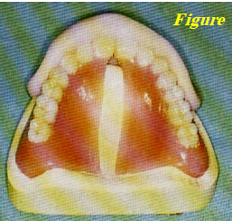
Repairing of complete denture fractures;
A- when all broken parts are available
Clinical and laboratory procedures:
4. Block out any undercuts in the tissue side of the denture and apply separating medium.
A cast is poured into the denture using quick set plaster.
After setting remove the two pieces of the denture gently.
Coat the cast with tinfoil substitute (separating medium), set aside to dry.
The edges of the fracture are beveled toward the polished surface and the polished surface reduced to form a groove of 8-10 mm in width along the fractured line.
The pieces of the denture are reassembled on the cast.

Slide 22
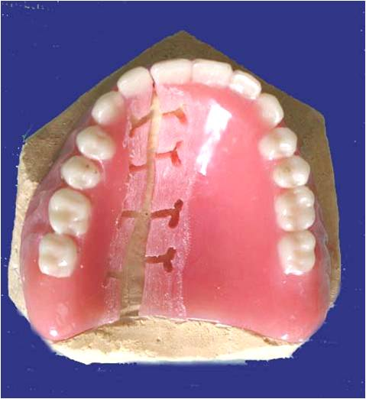
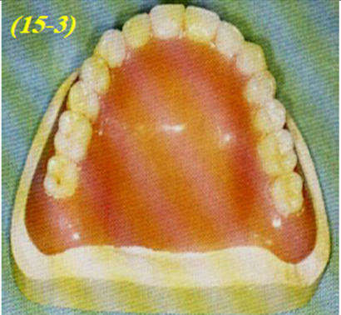
Repairing of complete denture fractures;
A- when all broken parts are available
Clinical and laboratory procedures:
Self-curing resin repair material is used. An alternate application of monomer and polymer are made until the area to b repaired is filled.The area should be slightly overfilled to allow for finishing.
Porosity in the repair material can be prevented by using a pressure curing unit that will produce 30 pounds of pressure will enhance the density of resin as it cures, left in it for a minimum 10 minutes.
The denture is removed from the unit, then from the cast.
Finished and polished in a conventional manner.
Inserted in patient mouth.

Slide 23
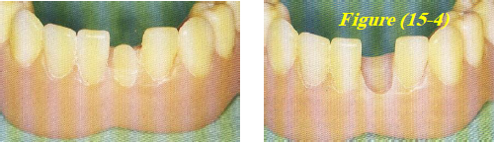
Repairing of complete denture fractures;
B- Replacement of broken or missing teeth
There are many techniques but the one which provides good result is:
The area lingual to the fractured tooth is reduced using a small bur.
The fractured tooth is then heated using flame to soften the area surrounding it then pushed out.
The mold and shade of the tooth is determined and selected.
Remove the denture base material lingual to the socket which must be large enough to accommodate the new tooth without interference. The labial portion of the tooth socket is left intact to aid in repositioning of the new tooth.

Slide 24
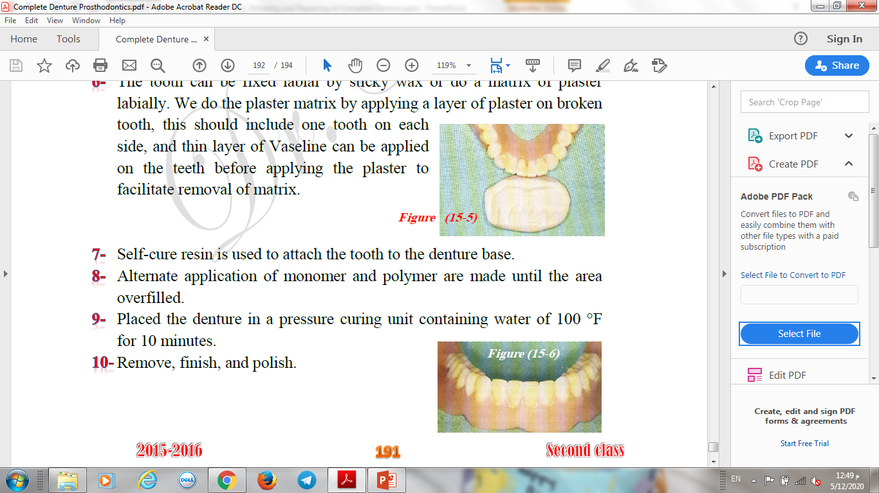
Repairing of complete denture fractures;
B- Replacement of broken or missing teeth
There are many techniques but the one which provides good result is:
Placing the new tooth in position.
The tooth can be fixed labial by sticky wax or do a matrix of plaster labially. We do the plaster matrix by applying a layer of plaster on broken tooth, this should include one tooth on each side, and thin layer of Vaseline can be applied on the teeth before applying the plaster to facilitate removal of matrix.
Self-cure resin is used to attach the tooth to the denture base.

Slide 25
Repairing of complete denture fractures;
B- Replacement of broken or missing teeth
There are many techniques but the one which provides good result is:
Alternate application of monomer and polymer are made until the area overfilled.
Placed the denture in a pressure curing unit containing water of 100 °F for 10 minutes.
Remove, finish, and polish.

Slide 26
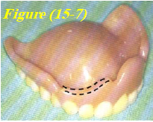
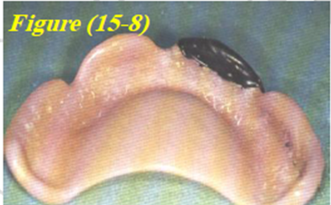
Repairing of complete denture fractures;
C- When there is missing labial or lingual border
Often a piece of a broken denture may be lost or may be impossible to position. For this reason it may be necessary to replace this missing part.
If small piece broken of the border can be fashioned by placing warmed molding plastic on the remaining border and then recontouring the missing area by placement in the patient mouth. After proper recontouring a cast is poured into the denture. The molding plastic is removed and self-cure resin is used to fill the area of the missing border. The resin is then cured and polished.

Slide 27
Repairing of complete denture fractures;
C- When there is missing labial or lingual border
If borders are missing from several areas of the denture or if a large piece is missing, it may be necessary to make an impression over the fractured denture:
An oversized perforated tray is filled with irreversible hydrocolloid impression material and then the broken denture is placed in the patient mouth to make an impression over the denture.
A cast is poured in the impression with the denture by stone. After setting of stone and the impression has been removed, the cast will reveal the area to be added.
Self-cure resin is then used to replace these missing areas.
Recently a visible light cured resin can be used in place of conventional self-cure resin to repair fracture denture.

Slide 28
Repairing of complete denture fractures;
C- When there is missing labial or lingual border
Advantages of visible light curing resin over conventional denture resin:
Visible light cure resin has superior strength and dimensional stability.
Complete polymerization without residual monomer.
Ease of manipulation.
The material well tolerated by patient.
Need minimum of time and effort.

Slide 29


