Slide 1
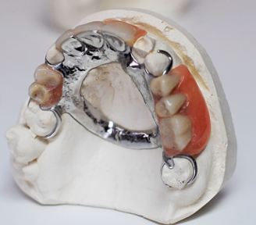
Introduction to removable partial denture
Dr. Mohammed Abdulaziz

Slide 2
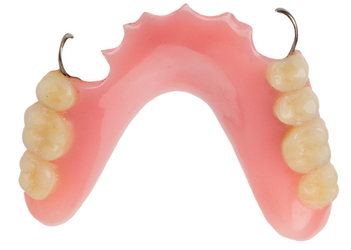
Removable partial denture
is a prosthesis that replaces some teeth in a partially dentate arch, and can be removed from the mouth and replaced at will; it is either acrylic type or metallic type (cobalt/chrome).

Slide 3
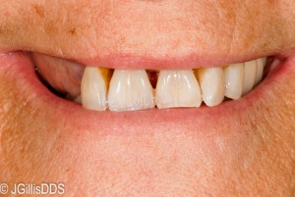
Why do we have to make a removable partial denture?
Deviation from the normal state
Fill the empty space
Esthetic
Proper function and occlusion
prevent extrusion of opposing teeth (super-eruption), and migration or tilting of adjacent teeth.
stimulation for underlying ridge
phonetic
balance of muscular relationship

Slide 4
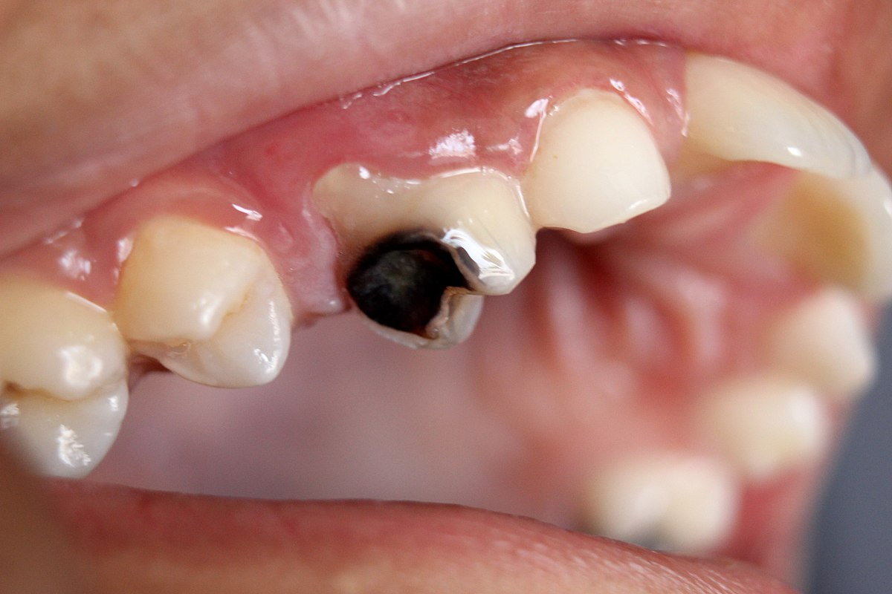
Causes of teeth loss
Caries
Periodontal disease
Accidents and trauma

Slide 5
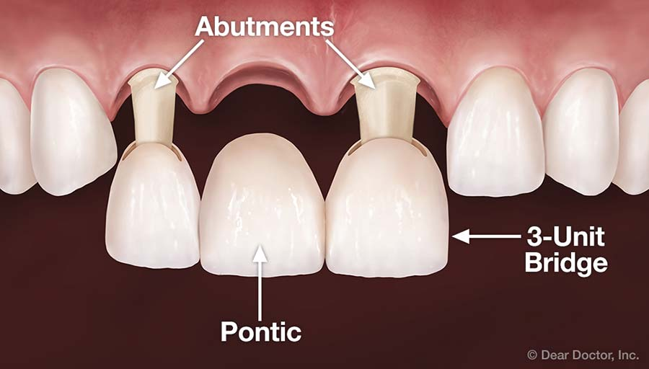
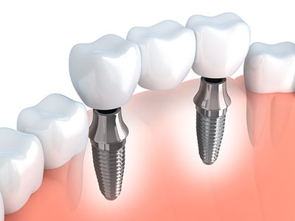
Bridge (fixed partial denture)
A partial denture that is luted or otherwise securely retained to natural teeth, tooth roots, and /or dental implant that furnish the primary support and retention for the prosthesis.

Slide 6
Indications of fixed partial denture
Unilateral bounded edentulous span
Class IV Kennedy with normal loss of bone.
Modification area located anteriorly with class I and class II Kennedy classification for simplify the design of removable partial denture.

Slide 7
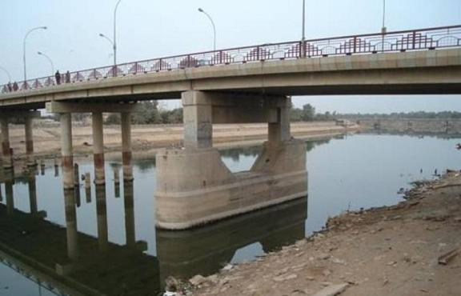
Abutment
is a tooth, a portion of a tooth, or a portion of an implant that serves to support and/or retain removable or fixed prosthesis prosthesis.

Slide 8
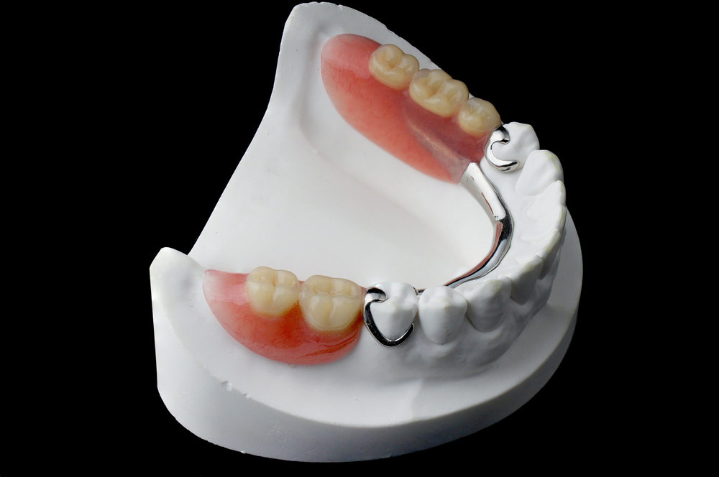

Slide 9
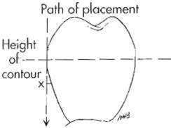
Height of contour
is defined as a line encircling a tooth, designating its greatest circumference at a selected position determined by a dental surveyor.

Slide 10
Undercut
is that portion of a tooth that lies between the height of contour and the gingiva; when it is used in reference to other oral structures, undercut means the contour or cross section of a residual ridge or dental arch that would prevent the placement of a denture.

Slide 11


Slide 12
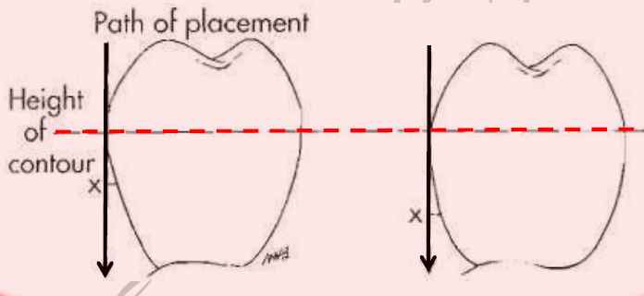
The angle of cervical convergence
is an angle viewed between a vertical rod contacting an abutment tooth and the axial surface of the abutment cervical to the height of contour.

Slide 13
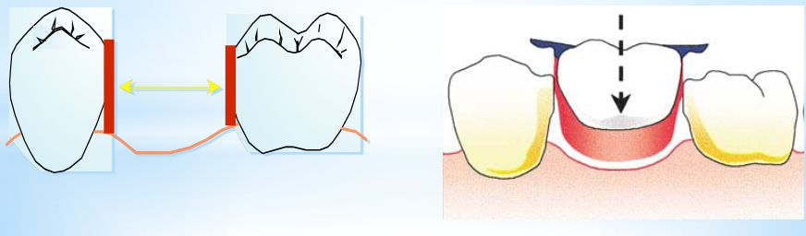
Guiding planes: are two or more vertically parallel surfaces of abutment teeth shaped to direct prosthesis during placement and removal.
Path of insertion (path of placement) is the specific direction in which prosthesis is placed on the abutment teeth.

Slide 14
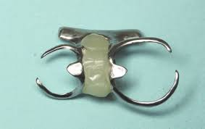
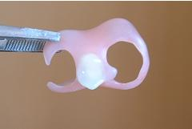
Nesbit denture: is a unilateral removable partial denture design.
Bilateral bracing to achieve good balance with removable denture, the work should extend to the other side of the arch.

Slide 15
Components of removable partial denture
Major connectors
Minor connectors
Rests
Direct retainers
Stabilizing or reciprocal components (as parts of a clasp assembly)
Indirect retainers (if the prosthesis has distal extension bases)
One or more bases each support one to several replacement teeth.

Slide 16
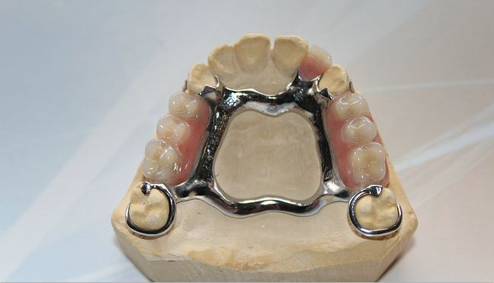
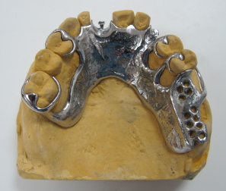

Slide 17
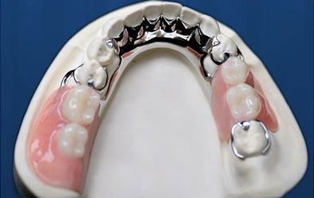
Types of edentulous arches
Bounded saddle: where we have two abutment teeth on either side of the edentulous space, treated by either fixed or removable partial denture.
Free ended saddle: where there is only on abutment tooth at an end of the edentulous space, treated is only by a removable partial denture.

Slide 18
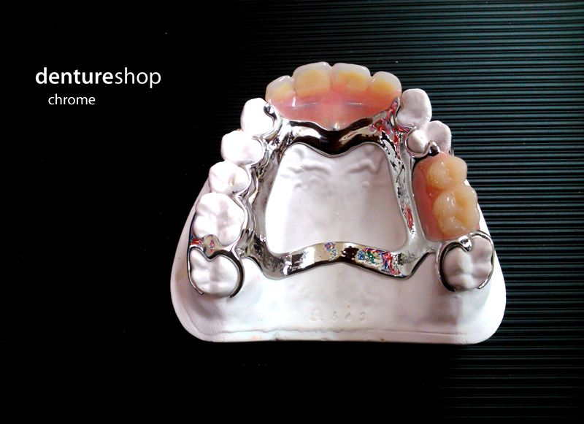

Slide 19
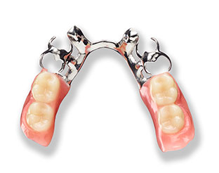

Slide 20
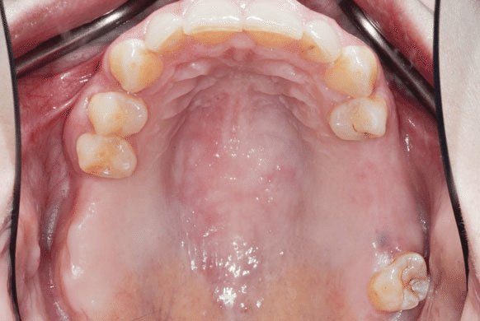

Slide 21
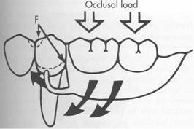
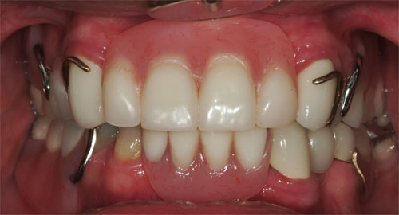
Disadvantages of clasp retained partial denture
Strain on the abutment teeth often is caused by improper tooth preparation, clasp design, and/or loss of tissue support under distal extension partial denture bases.
Clasps can be unesthetic, particularly when they are placed on visible tooth surfaces.
Caries may develop beneath clasp components, especially if the patient fails to keep the prosthesis and the abutments clean.

Slide 22
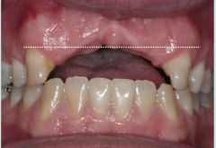
Indications of removable partial dentures
Distal extension situations (free end situation).
Long span tooth- bounded edentulous area.
Need for bilateral stabilization.
Excessive loss of the residual ridge.
Unusually sound abutment teeth.
If the prognosis of remaining teeth are questionable.
After recent extraction.
Economic consideration.

Slide 23

The End
Best Wishes

