Slide 1
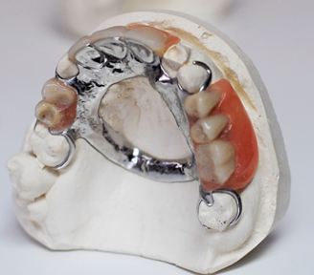
Classification of partially edentulous arches
Dr. Mohammed Abdulaziz

Slide 2
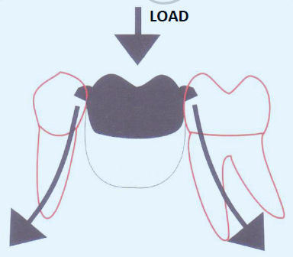
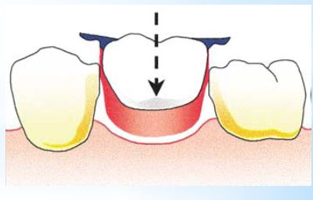
Tooth supported
For partially edentulous patients the prosthetic options available include natural tooth-supported fixed partial dentures, removable partial dentures, and implant-supported fixed partial dentures.

Slide 3
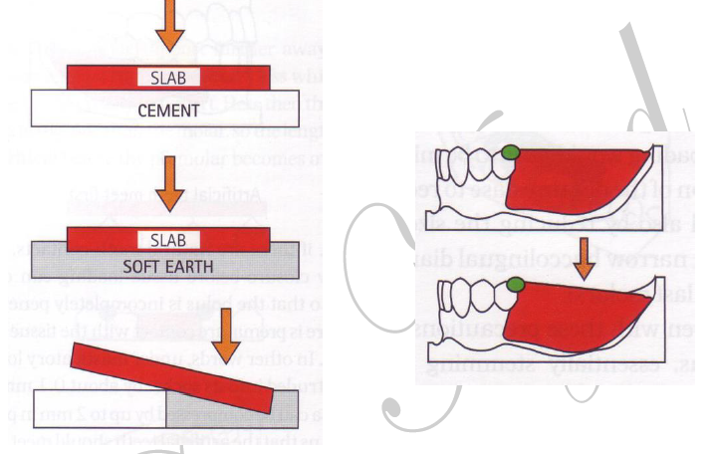
Tooth and tissue supported
For removable partial dentures that do not have the benefit of natural tooth support at each end of the replacement teeth (the extension base removable partial denture), it is necessary that the residual ridge be used to assist in the functional stability of the prosthesis.

Slide 4
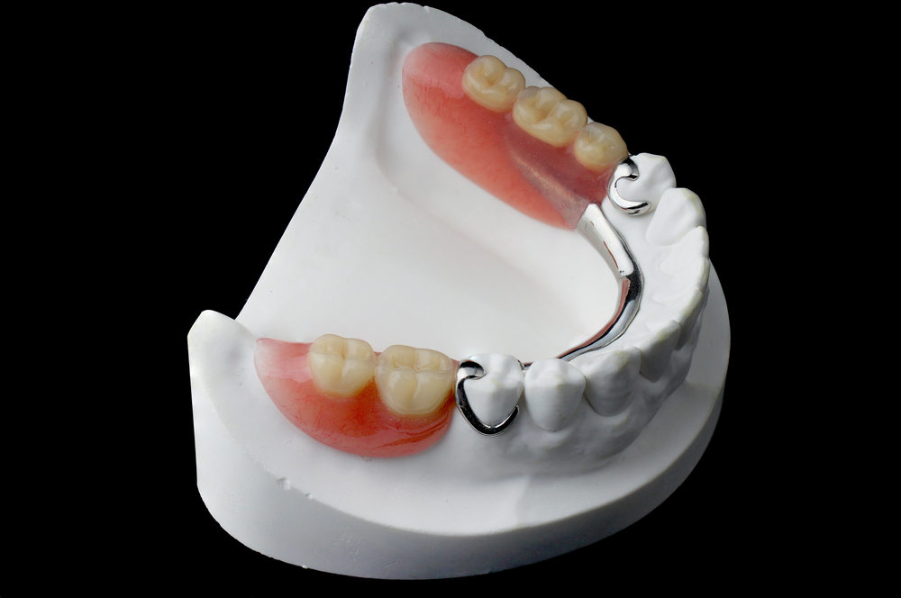

Slide 5
Kennedy classification
The Kennedy method of classification was originally proposed by Dr. Edward Kennedy in 1925.
. Class I: Bilateral edentulous areas located posterior to the natural teeth
Class II: Unilateral edentulous area located posterior to the remaining natural teeth.
Class III: Unilateral edentulous area with natural teeth remaining both anterior and posterior to it.
Class IV: Single, but bilateral (crossing the midline), edentulous area located anterior to the remaining natural teeth.

Slide 6
APPLEGATE'S RULES FOR APPLYING THE KENNEDY CLASSIFICATION
#1: Classification should follow rather than precede any extractions of teeth that might alter the original classification.
#2: If a third molar is missing and not to be replaced, it is not considered in the classification.
#3: If a third molar is present and is to be used as an abutment, it is considered in the classification.
#4:If a second molar is missing and is not to be replaced, it is not considered in the classification (e.g. if the opposing second molar is likewise missing and is not to be replaced).

Slide 7
#5: The most posterior edentulous area (or areas) always determines the classification.
#6: Edentulous areas other than those determining the classification are referred to as modification and are designed by their number.
#7: The extent of the modification is not considered, only the number of additional edentulous areas.
#8:There can be no modification areas in Class IV arches.

Slide 8
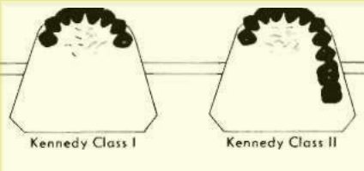

Slide 9


Slide 10
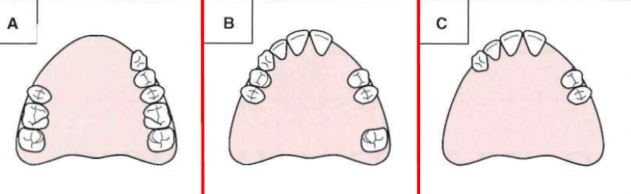

Slide 11
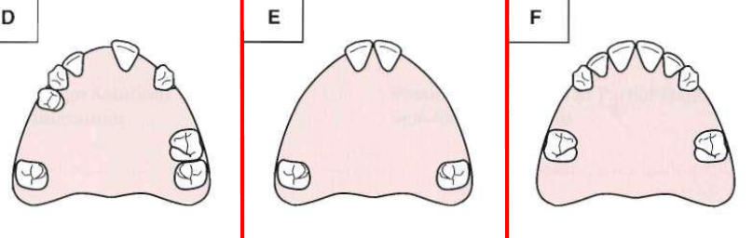

Slide 12
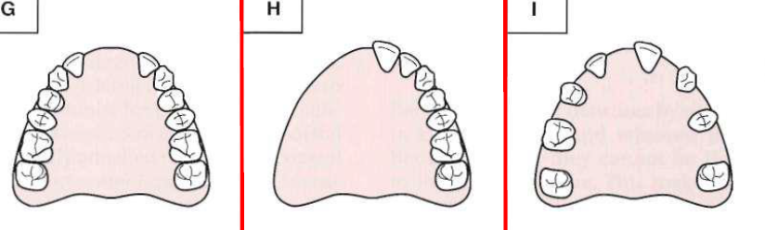

Slide 13
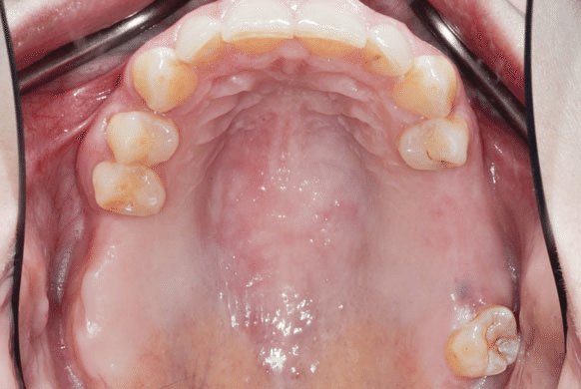

Slide 14

The End
Best Wishes

