Slide 1
Intraoral Landmarks
Bushra Mohammed Ali Al-Ameen
B,D,S,. M,Sc.(Pros)

Slide 2
Intraoral Landmarks
The anatomy of the edentulous ridge in the maxilla and mandible is very important for the design of a complete denture.
The consistency of the mucosa and architecture of the underlying bone is different in various parts of the edentulous ridge.
Hence some parts of the ridge are capable of withstanding more force than other areas.
A thorough knowledge of these landmarks is essential even prior to impression making.

Slide 3
Anatomical landmarks in maxillary arch
Limiting structures.
Relief areas.
Supporting structures.

Slide 4
Anatomical landmarks in maxillary arch
1- limiting structures:
Labial frenum.
Labial sulcus (labial vestibule).
Buccal frenum.
Buccal sulcus (buccal vestibule).
Hamular notch (pterygo-maxillary notch).
Posterior palatal seal area.

Slide 5
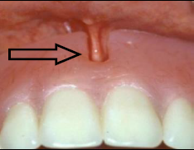
Anatomical landmarks in maxillary arch
1- limiting structures:
1- Labial frenum:
It is a fold of mucous membrane extending from the mucosal lining of the upper lip to the labial surface of the residual ridge at the median line.
The frenum may be single or multiple; narrow or broad.
It contains no muscle fibers, but it is moved with muscles of lip, and inserts in a vertical direction, which creates the maxillary labial notch in the impression or denture.
Labial frenum and labial notch.

Slide 6
Anatomical landmarks in maxillary arch
1- limiting structures:
2- Labial sulcus (labial vestibule):
It is a space extends on both sides of the labial frenum to the buccal frenum bounded externally by the upper lip and internally by the residual ridge.
The reflection of the mucous membrane superiorly determines the height of the vestibule (mucogingival line limits upper border).
In the denture, the area that fills this space is known as labial flange.
It is very important to record adequate depth/width of vestibule, flange overextension causes instability/soreness and proper contouring gives optimal esthetics.

Slide 7
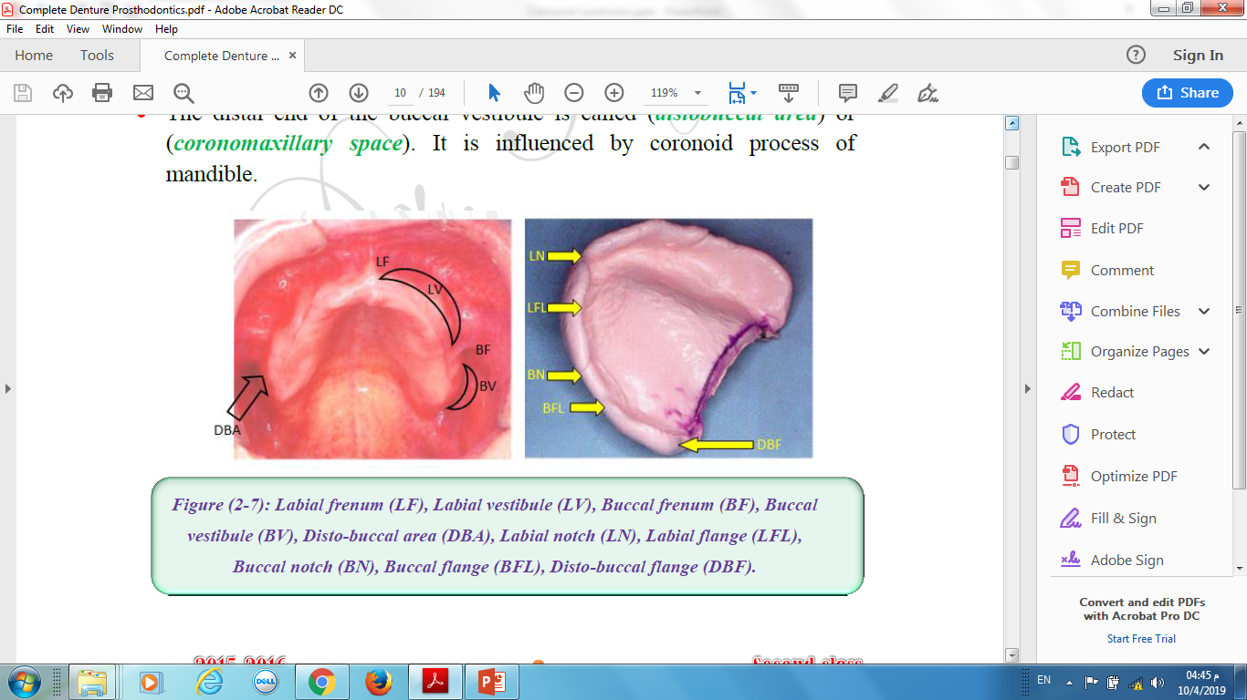

Slide 8
Anatomical landmarks in maxillary arch
1- limiting structures:
3- Buccal frenum:
A fold or folds of mucous membrane varies in size and shape and extends from the buccal mucous membrane reflection area toward the slope or crest of residual ridge.
It contains no muscle fibers and its direction is anteroposterior.
It produces the maxillary buccal notch in the denture which must be broad enough to accommodate the movement of frenum which is affected by some of the facial muscles as the orbicularis oris muscle pull it forward while buccinator muscle pull it backward.

Slide 9
Anatomical landmarks in maxillary arch
1- limiting structures:
4- Buccal sulcus (buccal vestibule) :
It is the space distal to the buccal frenum to the hamular notch.
It is bounded laterally by the cheek and medially by the residual ridge.
The area of the denture which fills this space is known as buccal flange.
The stability and retention of the denture are greatly enhanced if the vestibule is properly filled with the flange distally, so recording adequate depth/width is very important and improper extension causes instability/soreness.
Its size related to the contraction of buccinators muscle, position of mandible and the amount of bone loss from maxilla.
The distal end of the buccal vestibule is called (distobuccal area) or (coronomaxillary space).
It is influenced by coronoid process of mandible.

Slide 11
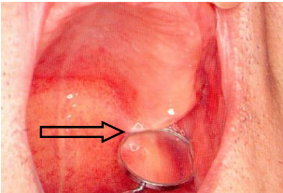
Anatomical landmarks in maxillary arch
1- limiting structures:
5- Hamular notch (pterygo-maxillary notch):
It is a narrow cleft of loose connective tissue between distal surface of tuberosity and the hamular process of the medial pterygoid plate.
The width is approximately (2 mm) anteroposteriorly.
It uses as a boundary of the posterior border of the maxillary denture.
It houses the disto-lateral termination of the denture and aids in achieving posterior palatal seal.
The overextension of the denture base beyond the pterygo-maxillary notch may cause soreness, and underextension may cause poor retention.

Slide 12
Anatomical landmarks in maxillary arch
1- limiting structures:
6-posterior palatal seal area
The soft tissue area beyond the junction of the hard and soft palates on which pressure within physiological limits, can be applied by a complete denture to aid in its retention.
The imaginary line across the posterior part of the palatal seal area marking the division between the movable and immovable tissues of the soft palate called Vibrating line (AH-line).
It extends from one hamular notch to the other about (2 mm) in front of the fovea palatina.
This can be identified when the movable tissues are functioning; when the individual says series of short "AH" sounds.

Slide 13
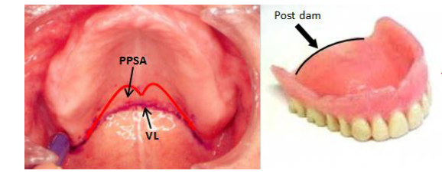
Anatomical landmarks in maxillary arch
1- limiting structures:
6-posterior palatal seal area
It is not well defined as a line, therefore it is better to describe it as an area rather than a line.
In the denture, the posterior border of the denture that lies over vibrating line is known as (post dam) to form posterior seal.

Slide 14
Anatomical landmarks in maxillary arch
2- Relief areas:
Incisive papilla.
Canine eminence (Cuspid eminence).
Zygomatic process (Malar bone).
Fovea palatinae.
Midpalatine raphe.
Torus palatinus.

Slide 15
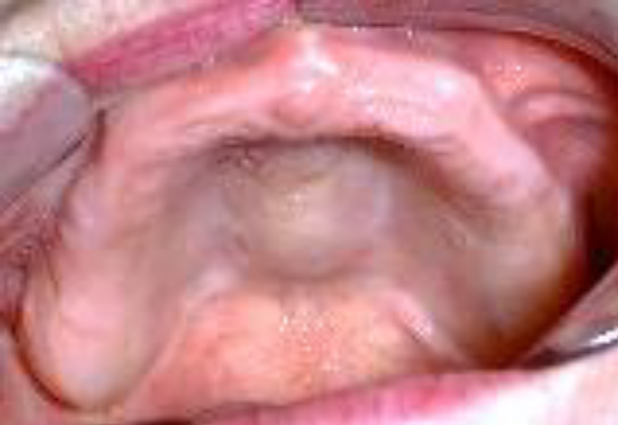
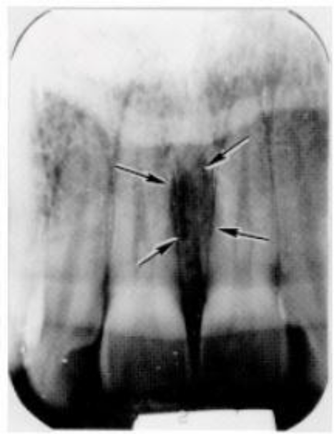
Anatomical landmarks in maxillary arch
2- Relief areas:
1- incisive papilla:
It is a pad of fibrous connective tissue lies between the two central incisors on the palatal side; it overlies the incisive foramen of the nasoplatine duct where the nasoplatine nerve and vessels arises.
In an edentulous mouth, it may lie close to the crest of the residual ridge.
Relief over the incisive papilla should be provided in denture to avoid any interference with blood supply and nerve pathway which causes burning sensation and pain.
It aids in determination of the location of artificial central incisors.
The Location of the incisive papilla gives proper estimation to the amount of alveolar bone loss.

Slide 16
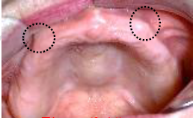
Anatomical landmarks in maxillary arch
2- Relief areas:
2- Canine eminence (Cuspid eminence):
It is a round bony elevation in the corner of the mouth it represents the location of the root of the canine, which is helpful to be used as a guide for selection and arrangement of maxillary anterior teeth.

Slide 17
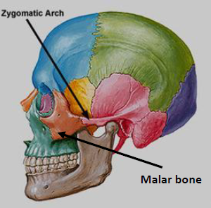
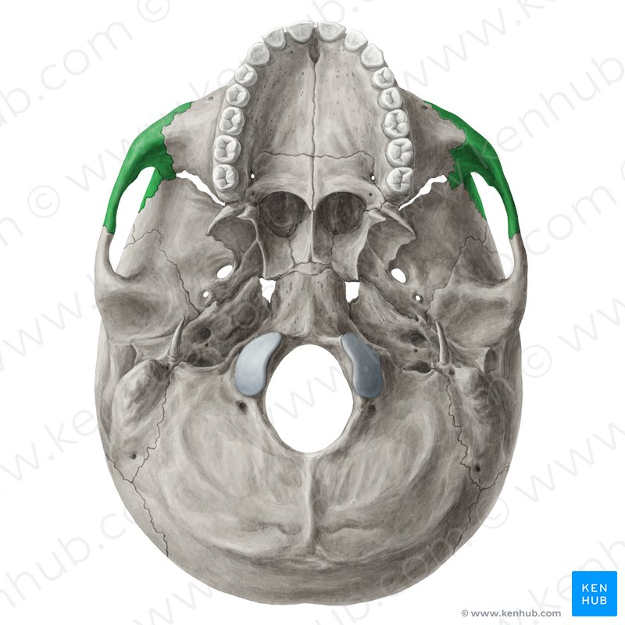
Anatomical landmarks in maxillary arch
2- Relief areas:
3-Zygomatic process (Malar bone):
It is located opposite to the first molar region, hard area found in the mouth that has been edentulous for long time.
Some dentures require relief over this area to prevent soreness of the underlying tissue.

Slide 18
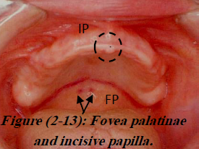
Anatomical landmarks in maxillary arch
2- Relief areas:
4- Fovea palatinae:
These are two indentations on each side of the midline, formed by a coalescence of several mucous gland ducts; they act as a guide for aiding in locating of the vibrating line and posterior border of the denture.

Slide 19
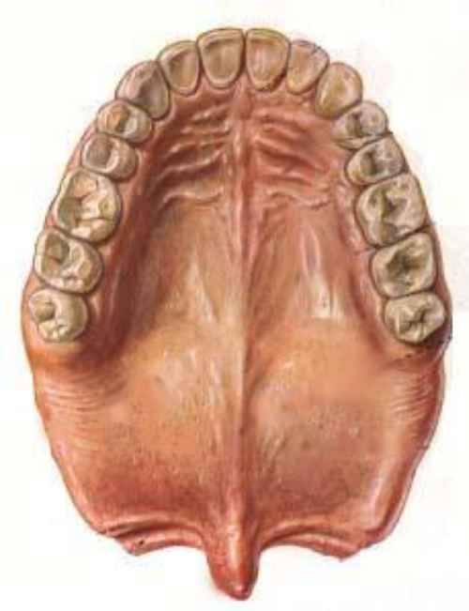
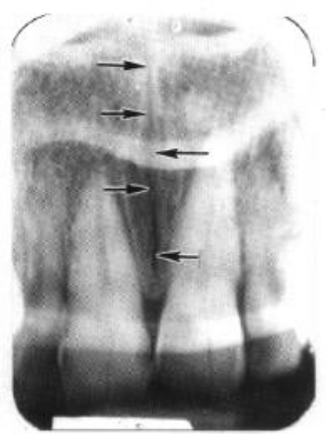
Anatomical landmarks in maxillary arch
2- Relief areas:
5- Midpalatine raphe:
It overlies the medial palatal suture, extended from the incisive papilla to the distal end of the hard palate.
The mucosa over this area is usually tightly attached, thin and non-resilient; the underlying bony union being very dense and often raised, the palatal tori are located here if present.
Relieve adequately to avoid trauma from denture base.

Slide 20
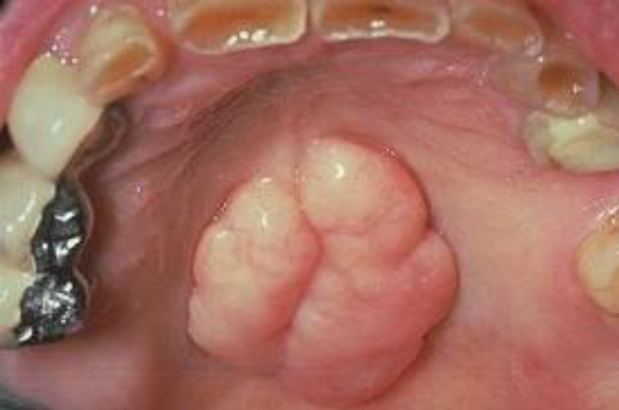
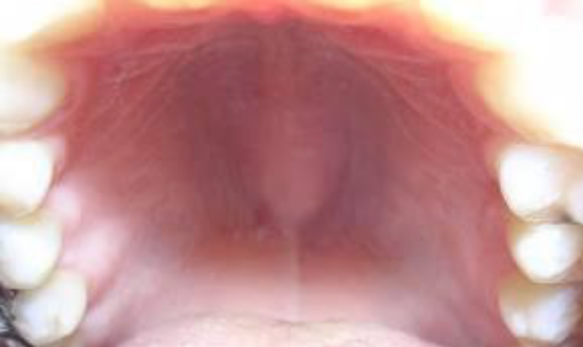
Anatomical landmarks in maxillary arch
2- Relief areas:
6- Torus palatinus :
It is a hard bony enlargement that occurs in the midline of the roof of the mouth (hard palate).
It is found in 20 % of the population, relief done if it is small and surgical correction may be needed if the tori are very large and extends to the vibrating line.
The female: male ratio is 2:1.

Slide 21
Anatomical landmarks in maxillary arch
3- Supporting structures:
A- Primary stress bearing areas:
1. Palatal shelf area.
2. Postero-lateral portion of the residual alveolar ridge.
B- secondary stress bearing areas:
1. Maxillary tuberosity.
2. Rugae area.

Slide 22
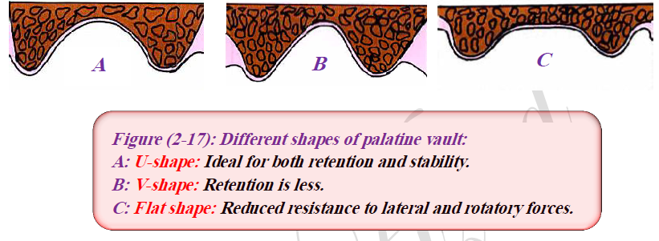
Anatomical landmarks in maxillary arch
3- Supporting structures:
A- Primary stress bearing areas:
1. Palatal shelf area:
The horizontal portion of the hard palate lateral to the midline (Palatine vault)

Slide 23
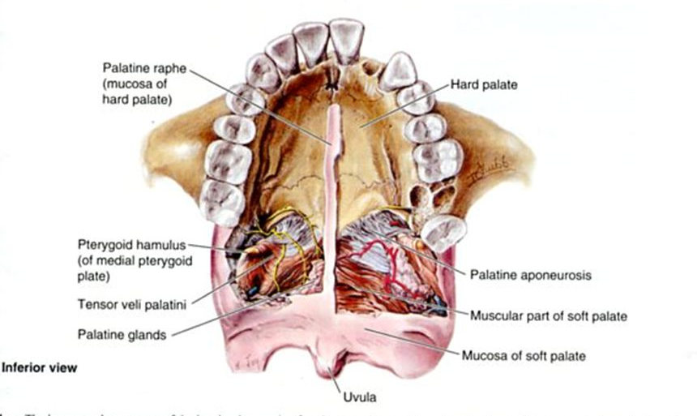

Slide 24
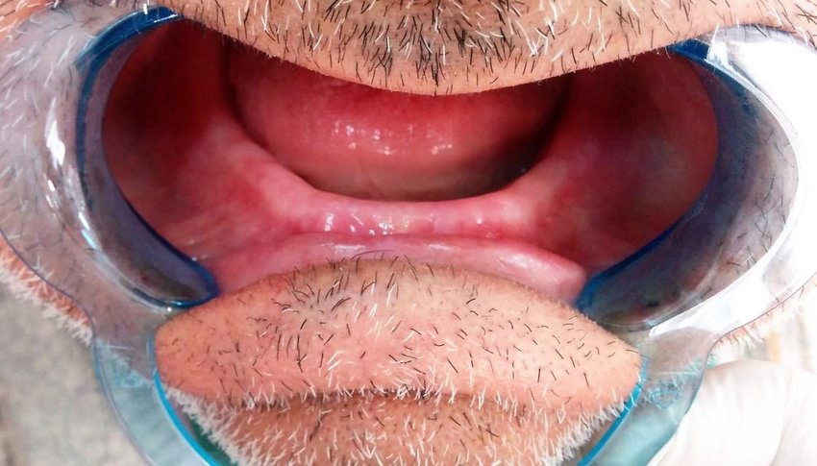
Anatomical landmarks in maxillary arch
3- Supporting structures:
A- Primary stress bearing areas:
2. Postero-lateral portion of the residual alveolar ridge:
Residual ridge: It is the bony process that remains after teeth have been lost, which is covered by mucous membrane.
The residual ridge considered to be the primary stress bearing area.
The residual ridge will produce the ridge fossa or groove in the impression or denture.

Slide 25
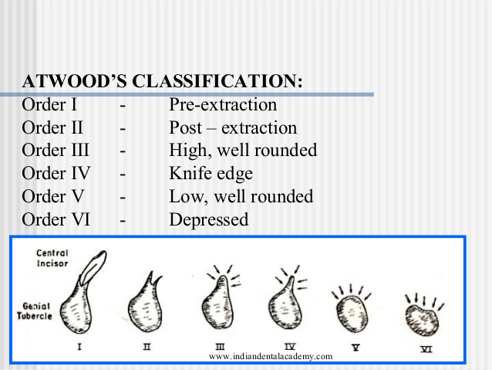
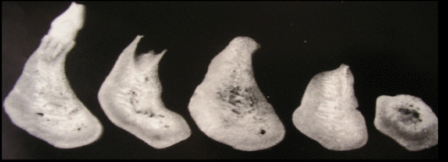

Slide 26
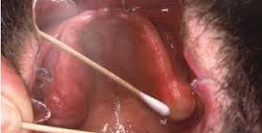
Anatomical landmarks in maxillary arch
3- Supporting structures:
B- secondary stress bearing areas:
1. Maxillary tuberosity:
It is the area of the alveolar ridge that extends distal to the maxillary third molar to the hamular notch.
In some patients it may be very large in size (fibrous or bony) that not allow for proper placement of the denture, so surgical correction may be indicated.

Slide 27
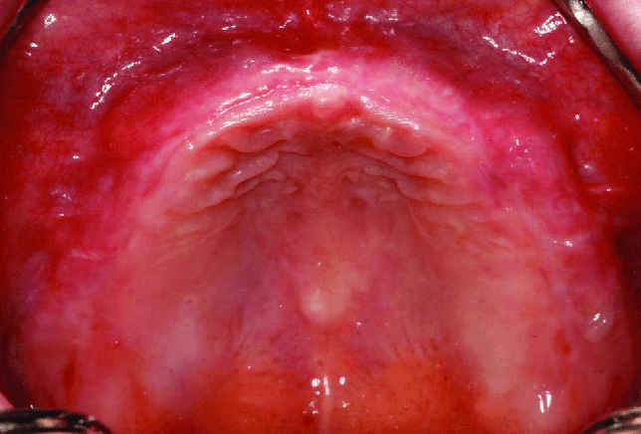
Anatomical landmarks in maxillary arch
3- Supporting structures:
B- secondary stress bearing areas:
2. Rugae area:
These are raised areas of dense connective tissue radiating from the median suture in the anterior third of the palate.
The folds of the mucosa play an important role in speech; also it is regarded as a secondary stress bearing area. It should not be distorted in the impression.

Slide 28
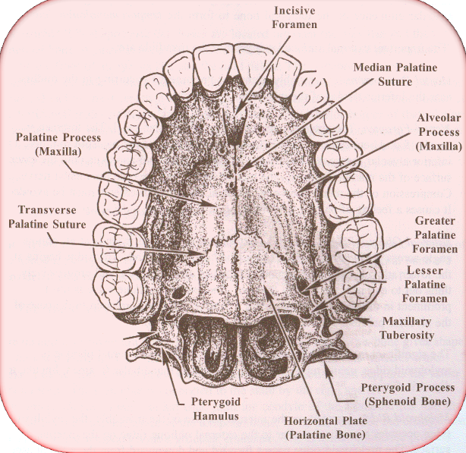

Slide 29
THANK YOU

