Slide 1
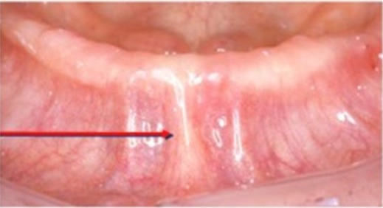
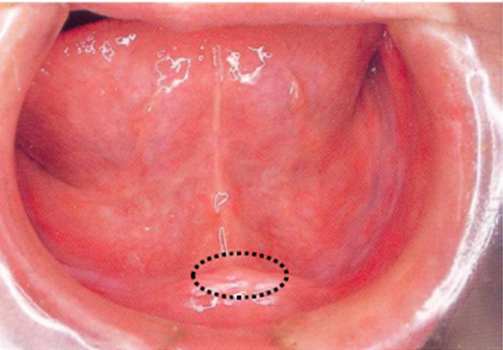
Intraoral landmarks (ii)
Bushra Mohammed Ali Al-Ameen
B,D,S,. M,Sc.(Pros)

Slide 2
Anatomical landmarks in mandibular arch
Limiting structures.
Relief areas.
Supporting structures.

Slide 3
Anatomical landmarks in mandibular arch
1- limiting structures:
Labial frenum.
Labial sulcus (labial vestibule).
Buccal frenum.
Buccal sulcus (buccal vestibule).
Lingual frenum.
Alveolo-lingual sulcus (lingual vestibule):
Retromolar pad.
Pterygomandibular raphe or ligament.
External oblique line.

Slide 4
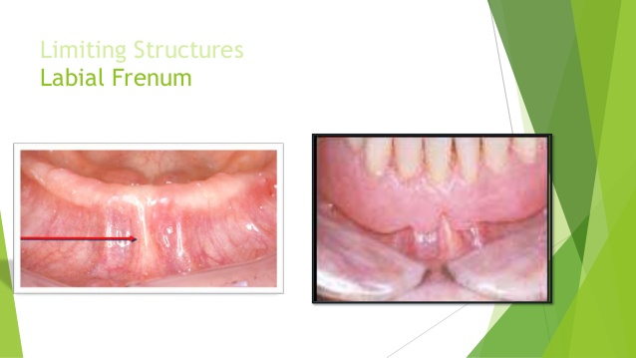
Anatomical landmarks in mandibular arch
1- limiting structures:
Labial frenum:
It is a fold of mucous membrane.
It is not usually as pronounced as the frenum in the maxillary arch, it is shorter and wider than the maxillary frenum, but is histologically and functionally similar.
The frenum may be single or multiple; narrow or broad.
It may contain fibrous band attached to the orbicularis oris muscle, therefore it may be active in mastication.

Slide 5
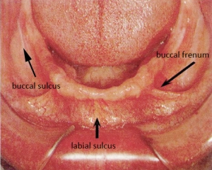
Anatomical landmarks in mandibular arch
1- limiting structures:
2. Labial sulcus:
The labial flange space extending from the labial frenum to the buccal frenum in both sides, it is limited inferiorly by the mucous membrane reflection, internally by the residual ridge, and labially by the lower lip.
It is very important to record adequate depth/width of vestibule, flange overextension causes instability/soreness and proper contouring gives optimal esthetics.

Slide 6
Anatomical landmarks in mandibular arch
1- limiting structures:
3. Buccal frenum:
It is a fold or folds of mucous membrane extending from the buccal mucous membrane reflection to the slope or crest of the residual ridge in the region just distal to the cuspid eminence.
This membrane may be single or double; broad U-shaped or sharp V-shaped, in anteroposterior direction.
It must be molded and have enough space (notch) in the denture to prevent displacement as it may be activated in function by the muscles.

Slide 7

Anatomical landmarks in mandibular arch
1- limiting structures:
4. Buccal sulcus (buccal vestibule):
It is extended from the buccal frenum to the distal end of the arch .
It is bounded externally by the cheek and internally by the residual ridge.

Slide 8
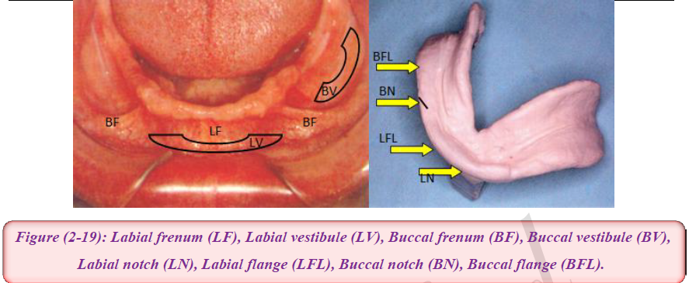

Slide 9
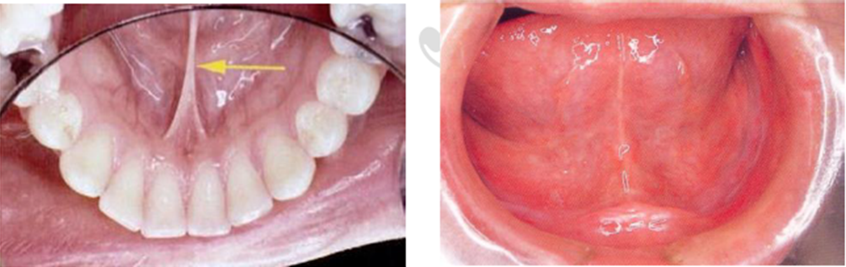
Anatomical landmarks in mandibular arch
1- limiting structures:
5. Lingual frenum:
It is a fold of mucous membrane can be observed when the tip of the tongue is elevated.
This, the lingual frenum, overlies the genioglossus muscle.
This frenum is activated when the tongue is moved; therefore it must be molded well in the impression to prevent displacement of the denture or ulceration of the tissue.

Slide 10
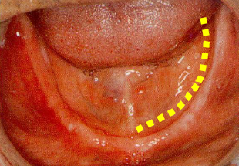
Anatomical landmarks in mandibular arch
1- limiting structures:
6. Alveolo-lingual sulcus (lingual vestibule):
It is extended from the lingual frenum to the retromylohyoid curtain; it is bounded externally by the residual ridge and internally by the tongue.
This space is filled by the lingual flange of the denture and can be divided into three parts:

Slide 11
Anatomical landmarks in mandibular arch
1- limiting structures:
6. Alveolo-lingual sulcus (lingual vestibule):
Anterior region (premylohyoid fossa): It extends from the lingual frenum to the first premolar area which produces premylohyoid eminence in the impression.
Middle region (mylohyoid ridge): It extends from the first premolar area to the distal end of the mylohyoid ridge; here the mylohyoid muscle forms the muscular floor of the mouth. It arises from the mylohyoid ridge, It is important in determining the contour of the lingual flange, lingual flange should extend below the level of the mylohyoid ridge, the tongue rests on the top of flange and aids in stabilizing the lower denture.
Posterior region (retromylohyoid fossa): It extends from the distal end of the mylohyoid ridge to the retromylohyoid curtain. The lingual flange of the denture should extend laterally and fill the retromylohyoid fossa.

Slide 12
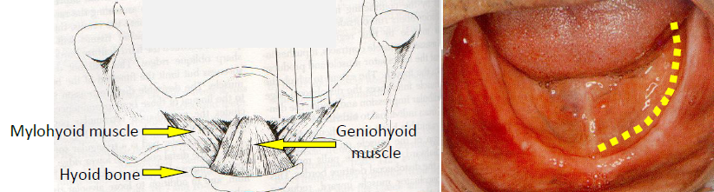
Anatomical landmarks in mandibular arch
1- limiting structures:
6. Alveolo-lingual sulcus (lingual vestibule):
Proper recording of these regions give typical S-form of the lingual flange,

Slide 13
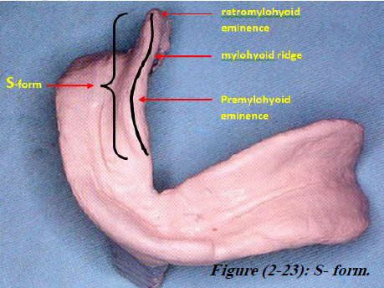
Anatomical landmarks in mandibular arch
1- limiting structures:
6. Alveolo-lingual sulcus (lingual vestibule):
Proper recording of these regions give typical S-form of the lingual flange,

Slide 14
Anatomical landmarks in mandibular arch
1- limiting structures:
7. Retromolar pad:
It is a pear-shaped area at the distal end of the mandibular residual ridge, containing loose connective tissue, glandular tissue, the lower margin of the pterygomandibular raphe (fibers of buccinator and superior constrictor muscles) along with fibers from the temporal tendon.
Two third of pad must be covered by the denture to perfect the border seal of the denture; also it is used as a guide for locating the level of occlusal plane, which must not be higher than half its vertical height.

Slide 15
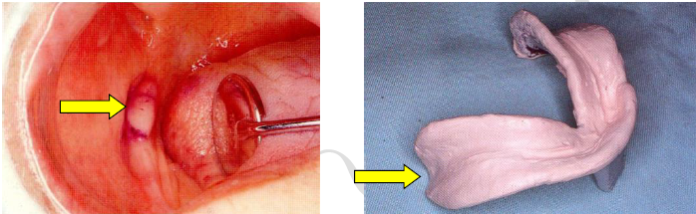
Anatomical landmarks in mandibular arch
1- limiting structures:
7. Retromolar pad:

Slide 16
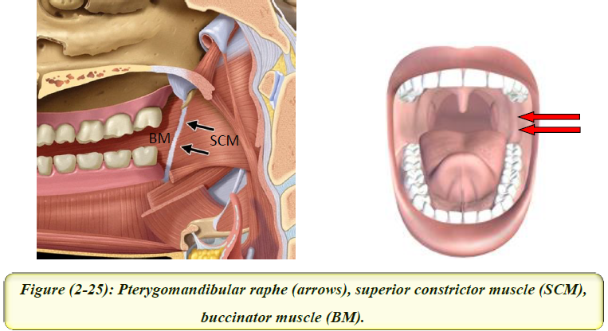
Anatomical landmarks in mandibular arch
1- limiting structures:
8. Pterygomandibular raphe or ligament:
It is union of buccinator and superior constrictor muscles extending from hamular process to retromolar pad, it is stretched during mouth opening.

Slide 17
Anatomical landmarks in mandibular arch
1- limiting structures:
9. External oblique line:
It is a ridge of dense bone outside the buccal shelf extending from just above the mental foramen coursing superiorly and distally, becoming continuous with the anterior border of the ramus.
This line is the attachment site of the buccinator muscle.
It is a guide for lateral termination of mandibular buccal flange.
It shows a groove in impression.

Slide 18
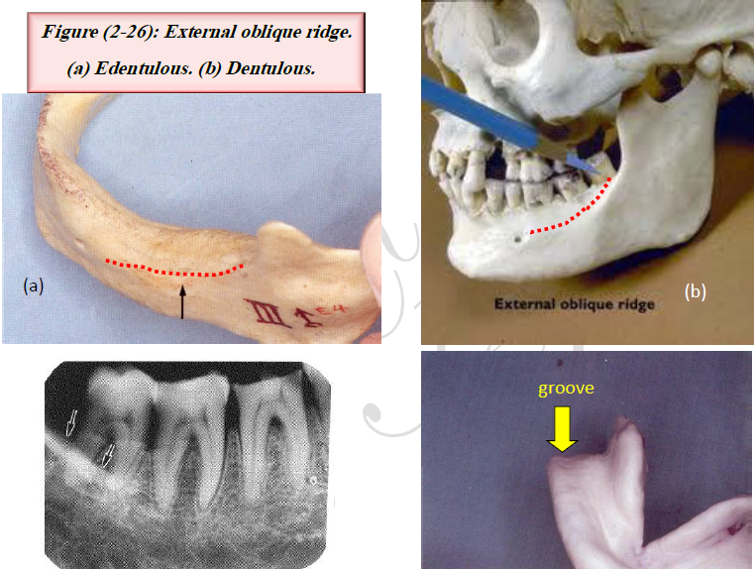
Anatomical landmarks in mandibular arch
1- limiting structures:
9. External oblique line:

Slide 19
Anatomical landmarks in mandibular arch
2- Relief areas:
Mental foramen.
Mylohyoide ridge.
Torus mandibularis.
Genial tubercle.

Slide 20
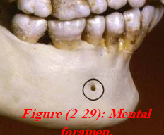
Anatomical landmarks in mandibular arch
2- Relief areas:
Mental foramen:
The anterior exit of the mandibular canal located on the external surface of the mandible between the first and second premolar area.
In case of severe resorption, the foramen occupies a more superior position and the denture base must be relieved to prevent nerve compression and pain.

Slide 21
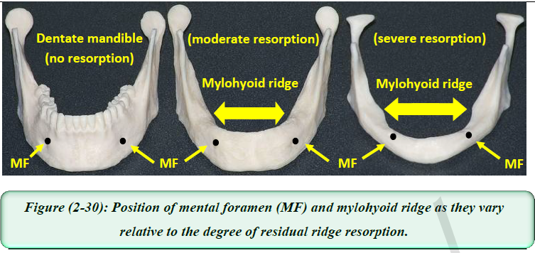
Anatomical landmarks in mandibular arch
2- Relief areas:
Mental foramen:

Slide 22
Anatomical landmarks in mandibular arch
2- Relief areas:
2. Mylohyoide ridge :
It is sharp or irregular covered by the mucous membrane, it runs along the lingual surface of the mandible; anteriorly, the ridge lies close to the inferior border of the mandible; but become progressively higher on the posterior body of the mandible until it terminates just distal to the lingual tuberosity.
The thin mucosa cover the mylohyoid ridge may get traumatized and should be relieved.
The area under this ridge called undercut.

Slide 23
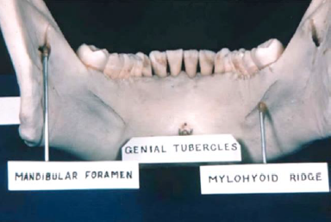
Anatomical landmarks in mandibular arch
2- Relief areas:
2. Mylohyoide ridge :

Slide 24
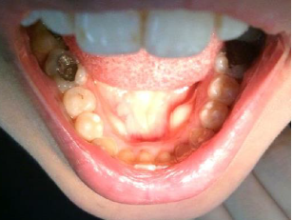
Anatomical landmarks in mandibular arch
2- Relief areas:
3. Torus mandibularis :
It is a bony prominence on the lingual side, near the premolar region.
It is covered by a thin mucosa.
It is found in 6-8% of the population; 80% of these cases found bilaterally.
It has to be relieved or surgically removed as decided by its size and extent.
The female: male ratio is 1:1.

Slide 25
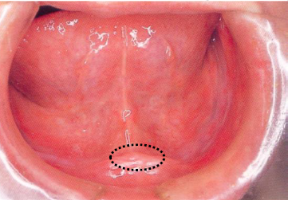
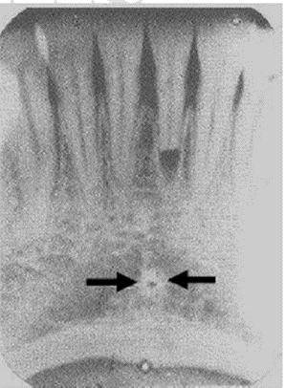
Anatomical landmarks in mandibular arch
2- Relief areas:
4. Genial tubercles (mental spine):
These are a pair of bony structures found anteriorly on the lingual side of the body of the mandible.
In case of severe bone resorption, they may occupy more superior position, surgical correction may be needed.
The superior tubercle gives attachment to the genioglossus muscle and the inferior one gives attachment to the geniohyoid muscle.

Slide 26
Anatomical landmarks in mandibular arch
3- Supporting structures:
A- Primary stress bearing areas:
1. Buccal shelf area.
B- secondary stress bearing areas:
1. Buccal and lingual slopes of residual ridge

Slide 27
Anatomical landmarks in mandibular arch
3- Supporting structures:
A- Primary stress bearing areas:
Buccal shelf area:
The area between the mandibular buccal frenum and the anterior border of the masseter muscle is known as buccal shelf area.
It is bounded medially by the crest of the residual ridge, laterally by the external oblique line, anteriorly by the buccal frenum, distally by the retromolar pad.
It serves as a primary stress bearing area for the mandibular denture because; it is covered by a layer of compact bone, wide and at right angle to the direction of vertical forces.

Slide 28
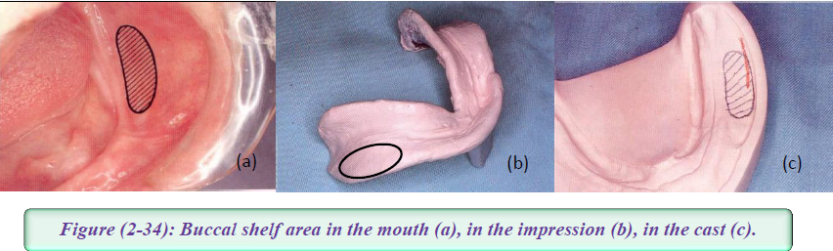
Anatomical landmarks in mandibular arch
3- Supporting structures:
A- Primary stress bearing areas:
Buccal shelf area:

Slide 29
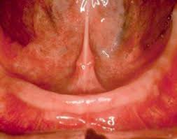
Anatomical landmarks in mandibular arch
3- Supporting structures:
B- secondary stress bearing areas:
1. Buccal and lingual slopes of residual ridge:

Slide 30
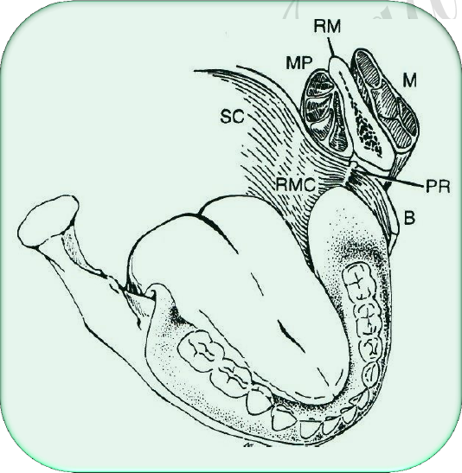

Slide 31

Thank You

