Slide 1
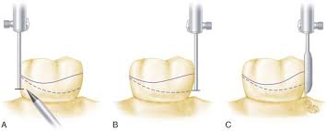
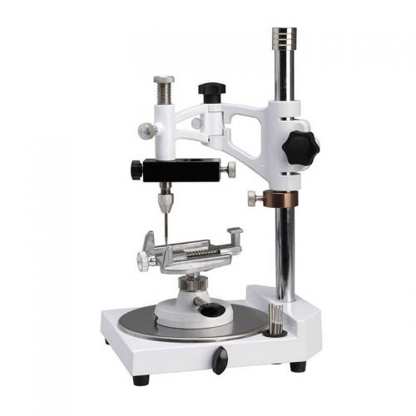
Dental Surveyor
Bushra Mohammed Ali Al-Ameen
B,D,S,. M,Sc.(Pros)

Slide 2
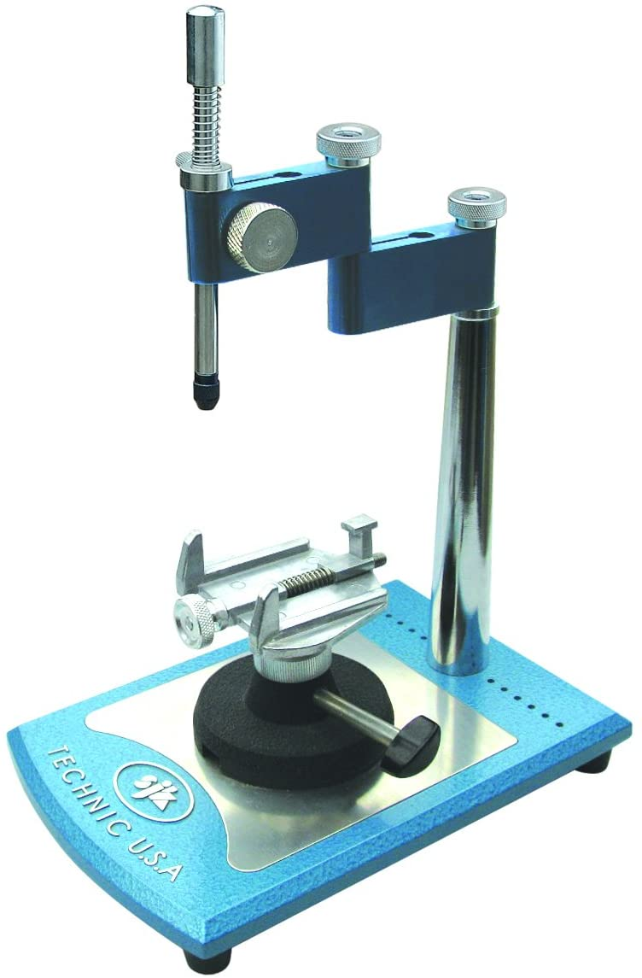
Dental Surveyor
It is an instrument used to determine the relative parallelism of two or more surfaces of the teeth or other parts of the cast of a dental arch.

Slide 3
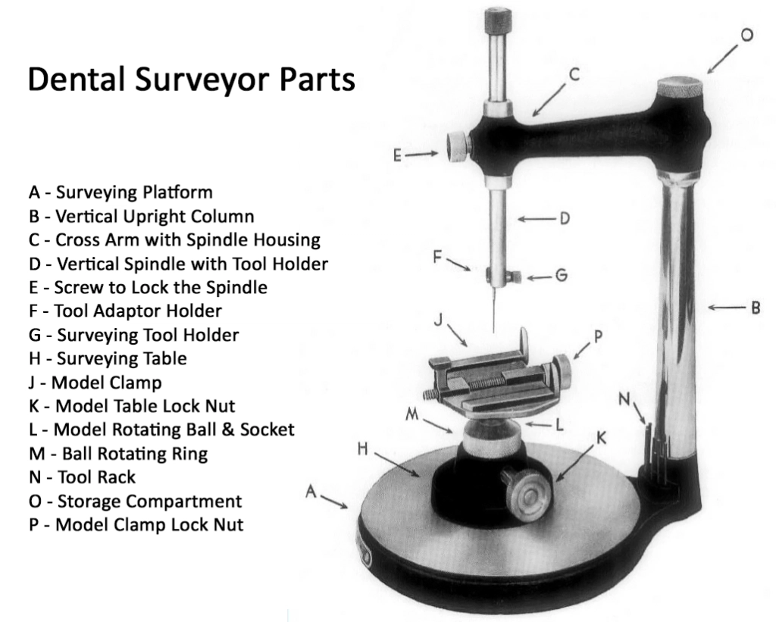
Parts of dental surveyor
1. Platform on which the base is moved.
2. Vertical arm that supports superstructure.
3. Horizontal arm from which surveying tool suspends.
4. Table to which the cast is attached.
5. Base on which the table swivels.
6. Mandrel for holding special tools.
7. Survey tools:
Analyzing rod
Carbon marker
Undercut gauge
Wax trimmer

Slide 4
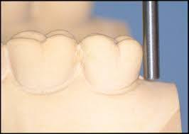
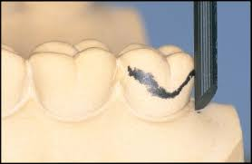
Survey tools:
The tools which are used for surveying are:
Analyzing rod:
It is a rigid metal rod used for diagnostic purposes in the selection of the path of placement and to determine the undercut areas prior to scribing the height of contour with the carbon marker.
Carbon marker:
It is used for the actual marking of the survey line on the cast. A metal
shield is used to protect it from breakage.

Slide 5
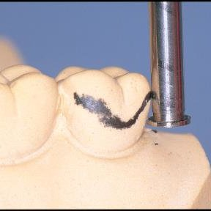
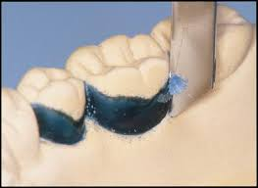
Survey tools:
The tools which are used for surveying are:
Undercut gauge
They are used to measure the extent of the undercut on abutment teeth that are being used for clasp retention.
Wax trimmer
It is used to trim excess wax that may be inserted into those undercut area which are to be obliterated to obtain the proper form of the wax pattern.

Slide 6
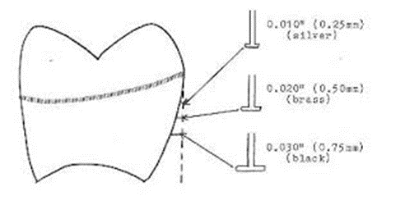
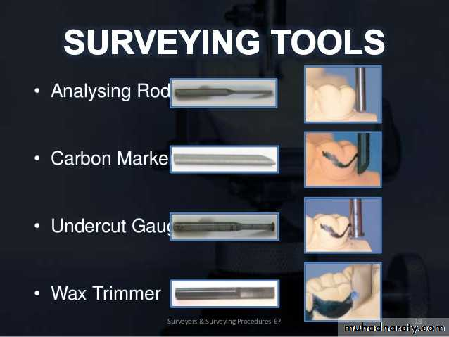
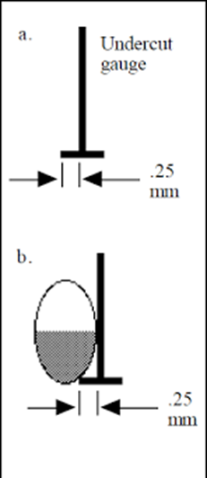

Slide 7
Description of dental surveyor
The most widely used surveyors are the Ney and the Jelenko.
The principal parts of the Jelenko surveyor are essentially the same as those for the Ney surveyor except that the Jelenko arm swivels, whereas the Ney arm is fixed, and by loosening the nut at the top of the vertical arm, the horizontal arm may be made to swivel. The objective of this feature, originally designed to permit freedom of movement of the arm in a horizontal plane rather than to depend entirely on the horizontal movement of the cast.
For those who prefer to move the cast only in a horizontal relationship to a fixed vertical arm, the nut may be tightened and the horizontal arm used in a fixed position.

Slide 8
Description of dental surveyor
Another difference between the Ney and Jelenko surveyors is that the vertical arm on the Ney surveyor is retained by friction within a fixed bearing. The shaft may be moved up or down within this bearing, but it remains in any vertical position until again moved. The shaft may be fixed in any vertical position desired by tightening a setscrew.
In contrast, the vertical arm of the Jelenko surveyor is spring mounted and returns to the top position when it is released. It must be held down against spring tension when it is in use.

Slide 9
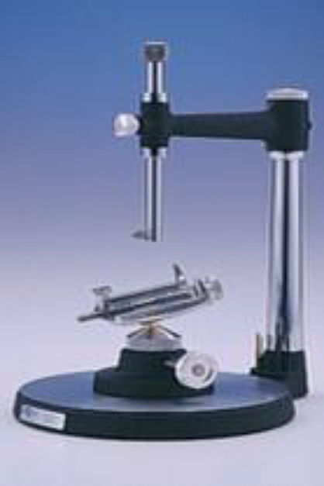
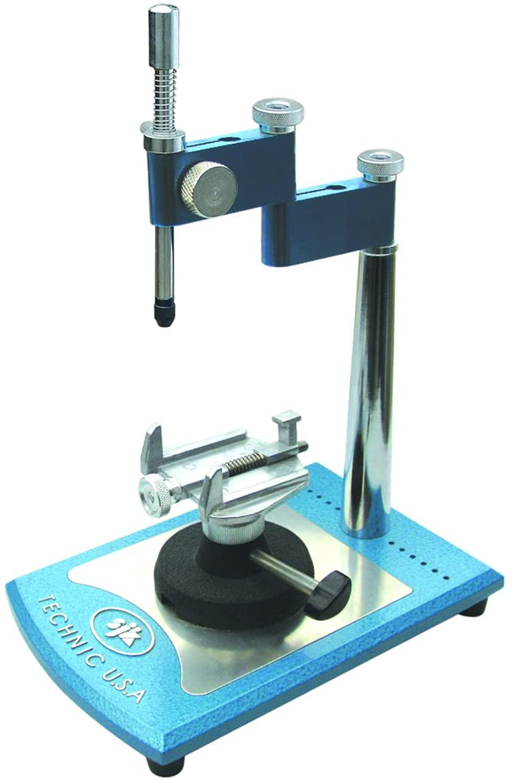
Ney v/s jelenko
Ney
Horizontal arm: fixed.
Vertical arm: retained by friction.
The shaft remains in any vertical position until again it is moved.
Cast table is moved around surveyor platform.
Jelenko
Horizontal arm: movable.
Vertical arm: spring mounted.
Vertical arm when released return to its original position.
Cast table is fixed with the magnet in the surveyor platform.
Ney surveyor is widely used because of its
simplicity and durability.
Jelenko surveyor

Slide 10
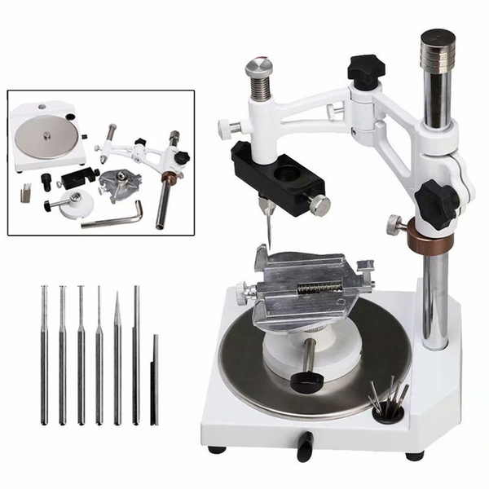

Slide 11
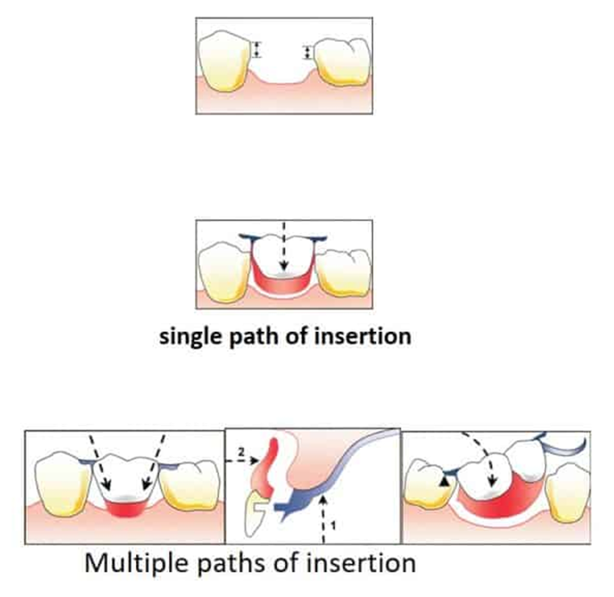
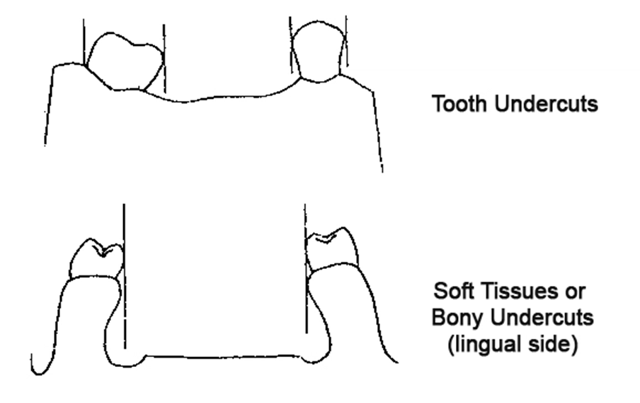
Objectives of surveying
1. To determine the most desirable path of placement that will eliminate or minimize interference to placement and removal.
2. To identify proximal tooth surfaces those are made parallel to act as guiding planes during placement and removal.
3. To locate and measure areas of the teeth that may be used for retention.
4. To determine whether tooth and bony areas of interference will need to be eliminated surgically or by selecting a different path of placement.

Slide 12
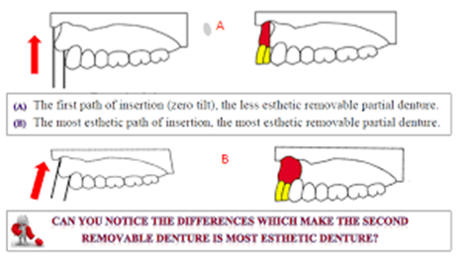
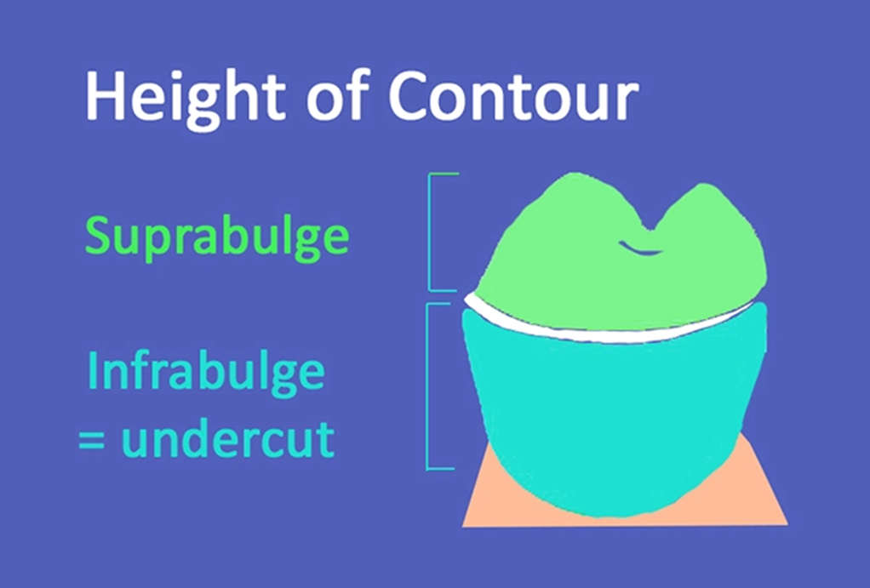
Objectives of surveying
5. To determine the most suitable path of placement that will permit locating retainers and artificial teeth to the best esthetic advantage.
6. To permit an accurate charting of the mouth preparation to be made.
7. To delineate the height of contour on abutment teeth and to locate areas of undesirable tooth undercuts, to be avoided, eliminated, or blocked out.
8. To record the cast position in relation to the selected path of placement for future reference.

Slide 13
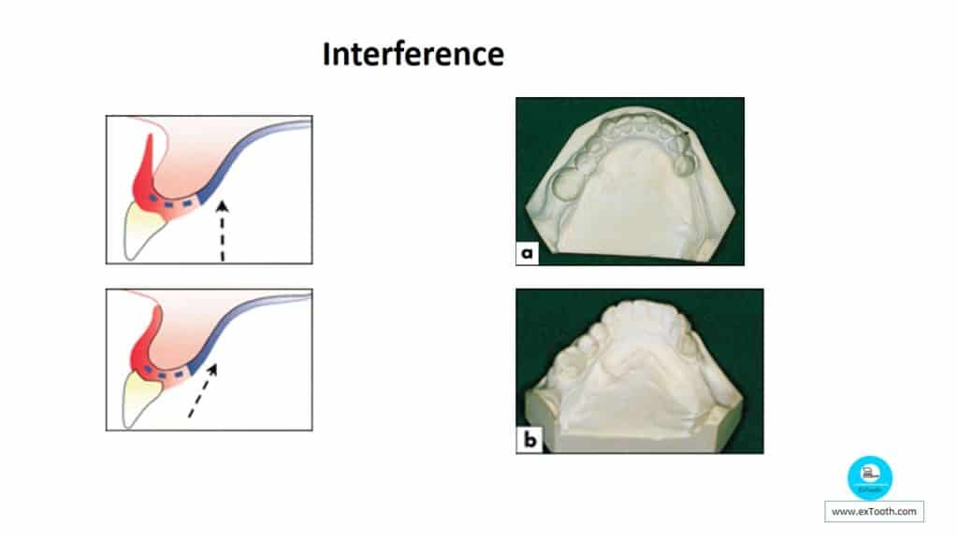

Slide 14
Principles of surveying
Surveying a tooth consisted of locating accurately the height of its maximum contour in relation to the plane in which the cast is positioned.
Whenever possible, cast should be surveyed with the occlusal plane parallel to the base of the surveyor so that the path of insertion is vertical to the occlusal plane.
The fact that the majority of the natural teeth crowns are bulbous in shape (have a suprabulge area); this suprabulge point could occur anywhere between the occlusal surface and the gingival margin. When a vertical arm is brought into contact with the convex surface, they will contact only at one point that is the point of maximum convexity. When this surface is rotated, and is still in contact with the vertical arm, an imaginary line will be traced at the greatest circumference, when we substituted this vertical analyzing rod with a carbon marker then an actual line will be produced at the level of the maximum tooth bulge, this line is called survey line.

Slide 15
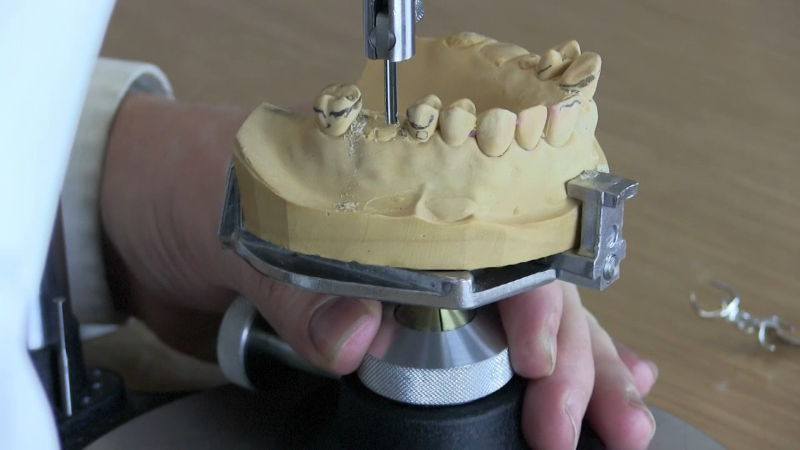

Slide 16
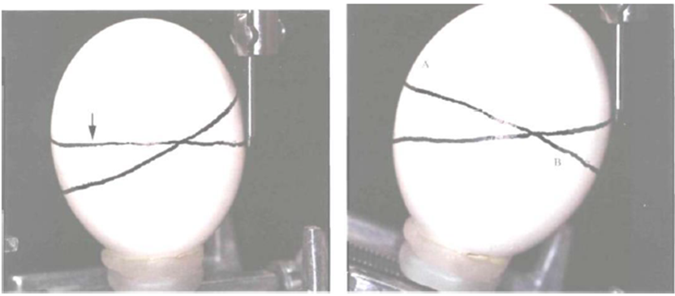
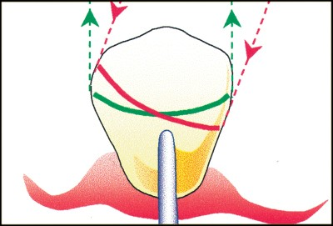
Principles of surveying
The area of a tooth occlusal to the survey line is a non-undercut area, while the area gingival to the survey line is undercut area. When a tooth is tilted or rotated in relation to the analyzing rod, another survey line will be traced, as result, the extent of non-undercut area and the undercut area are consequently changed. That means that the survey line can vary according to the angle formed by contact of the vertical analyzing rod with the tooth surface. Alteration of undercut area can be done by anterior and posterior tilting of dental cast.

Slide 17
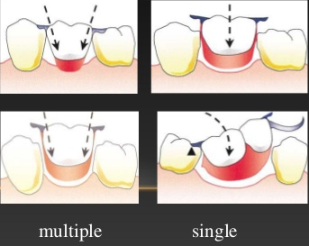
Principles of surveying
The effect of tilting a cast on the surveyor will be:
1. Redistribution of undercuts to the desired areas.
2. Allow more favorable path of insertion.
3. Allow the use of a desired type of clasp for better function and
esthetic.
4. Allow the use of a design to minimize food impaction.

Slide 18
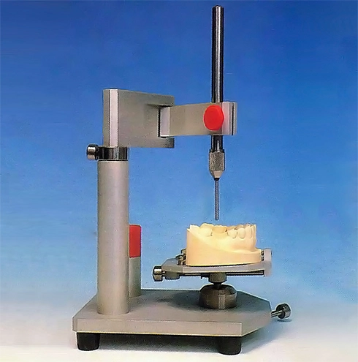
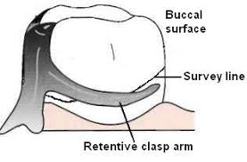
Rules of surveying
1- The undercut areas cannot be created or produced by tilting the cast.
2- All casts are originally surveyed with the occlusal plane is parallel to the base of surveyor; this is what we called zero tilt. Most patients will tend to seat the partial denture under force of occlusion. If the path of insertion is other than vertical to the occlusal plane such seating may deform the clasps.
3- The retentive tip of the clasp must engage the undercut area, which are present when the cast is surveyed in certain position.

Slide 19
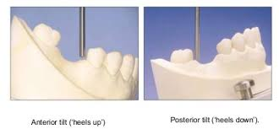
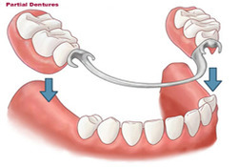
Rules of surveying
4- Wherever possible, the undesirable undercut and area of interference are removed during mouth preparation by recontouring teeth or making necessary restoration.
5- Anteroposterior tilt: anterior tilt will increase the mesial undercut, while the posterior tilt will increase the distal undercut. Such as in free end extension partial denture. Tilting the cast anteriorly will decrease or eliminate the distal undercut where the path of insertion will be changed, thus getting rid of undesirable undercut located distally, therefore the tilting of the cast is to minimize or equalize the undesirable undercut.
6- Lateral tilt: dealing with retentive undercut situated buccally or lingually on posterior teeth.
Note: A partial denture should have a single path of insertion, this is only possible for dentures with bounded saddle, for dentures with free end saddles two or more paths of insertion will be possible.

Slide 20
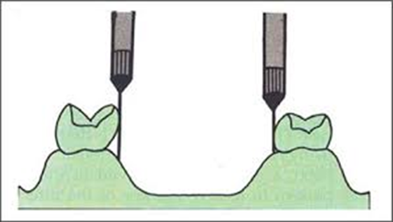
Types of undercuts established by surveyor
1-Contour: due to natural contour of the tooth.
2-Positional: due to tilting of cast on surveyor.
3-Desirable undercut: used for retaining the removable partial denture against the dislodging forces by incorporating retentive flexible clasp arm.
4-Undesirable undercut: undercuts other than those used for retention are considered undesirable and should be eliminated by:
a) Tooth recontouring.
b) Placing properly contoured crown restoration on the tooth.
c) Tilting the cast and change the path of insertion.
d) Blocking out the undercut with wax on the master cast.

Slide 21


