Slide 1
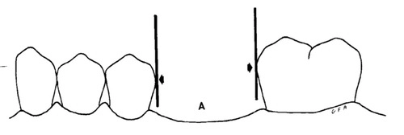
Factors that determine path of placement and removal
Bushra Mohammed Ali Al-Ameen
B,D,S,. M,Sc.(Pros)

Slide 2
Factors That Determine Path Of Placement And Removal:
Guiding planes.
Retentive areas.
Interference.
Esthetics.

Slide 3

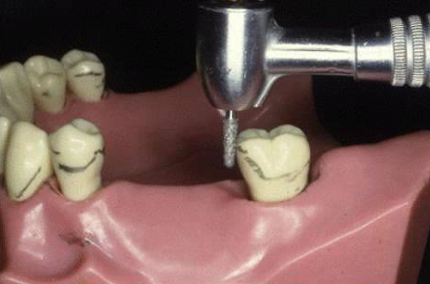
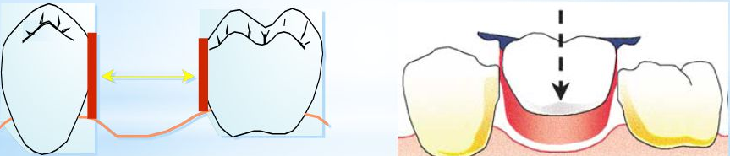
1-Guiding Planes:
proximal tooth surfaces that bear a parallel relationship to one another must either be found or be created to act as guiding planes during placement and removal of the prosthesis.
guiding planes are necessary to ensure the passage of the rigid parts of the prosthesis. thus the denture can be easily placed and removed by the patient without strain on the teeth contacted or on the denture itself and without damage to the underlying soft tissue.

Slide 4
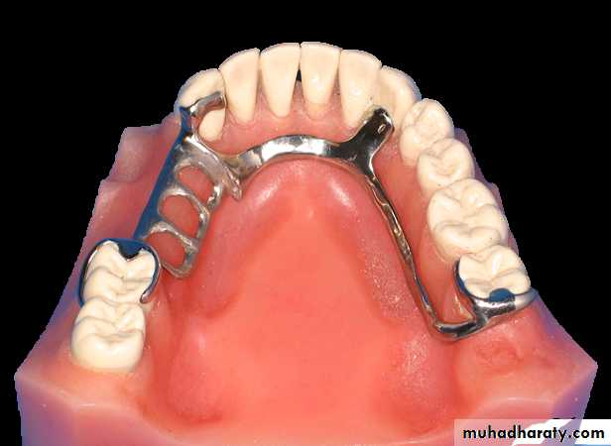
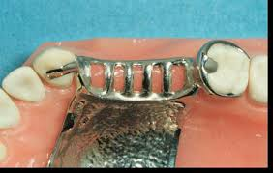
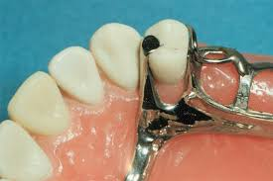
1-Guiding Planes:
The components of the denture that contact the guiding plane during placement of removable partial denture are:
Proximal surface: are the minor connector that joins the occlusal rests and clasp to the saddle, and proximal plates are used with I bar or R.P.I. system.
Axial or lingual tooth surface: are reciprocal clasp arms, lingual plates that act as reciprocal arm, and minor connector that joins the auxiliary rest to the major connector.

Slide 5
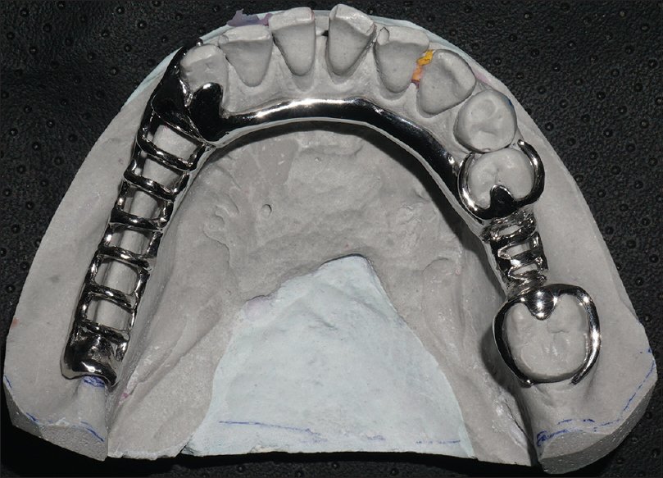
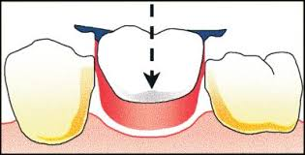
1-Guiding Planes:
Function of guiding plane:
Guide the prosthesis in and out of the mouth without any undesirable forces against remaining teeth (Assure definite path of insertion).
The frictional forces of contact of the prosthesis with the guiding plane wall will contribute significantly to the retention of removable partial denture.
Can provide bracing or stabilization when placed in the axial tooth surfaces.
Insure positive clasp action.

Slide 6
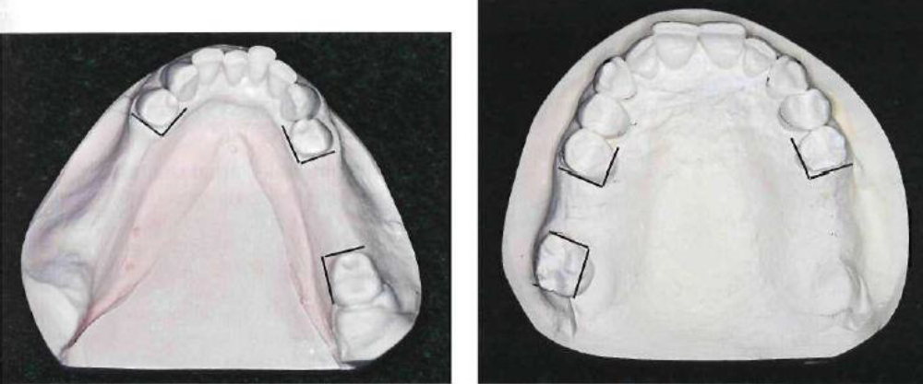
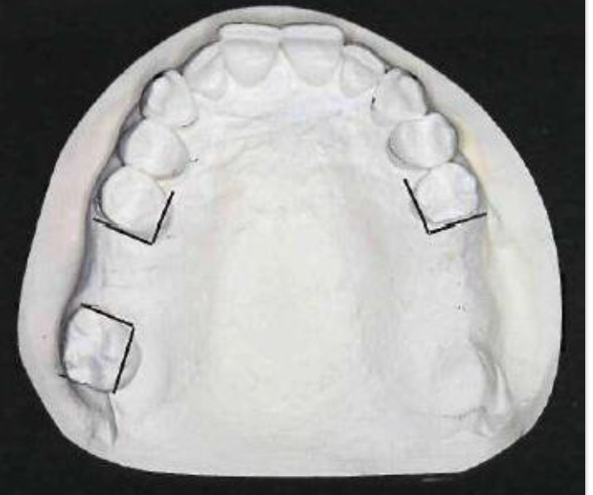
1-Guiding Planes:

Slide 7
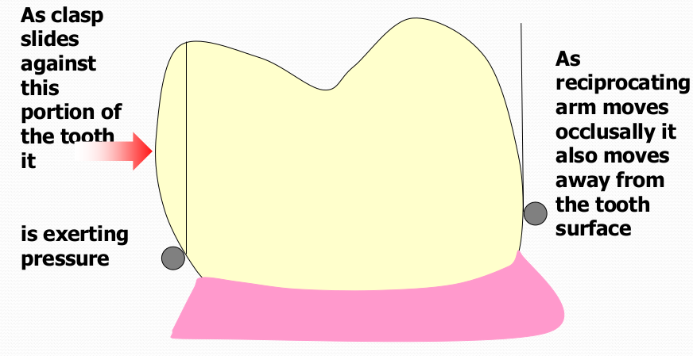
2- Retentive Areas:
Retentive areas must exist for a given path of placement and must be contacted by retentive clasp arms, which are forced to flex over a convex surface during placement and removal. For a clasp to be retentive; its path of escapement must be other than parallel to the path of removal of the denture itself; otherwise, it would not be forced to flex and thereby generate the resistance known as retention. Clasp retention therefore depends on the existence of a definite path of placement and removal.

Slide 8
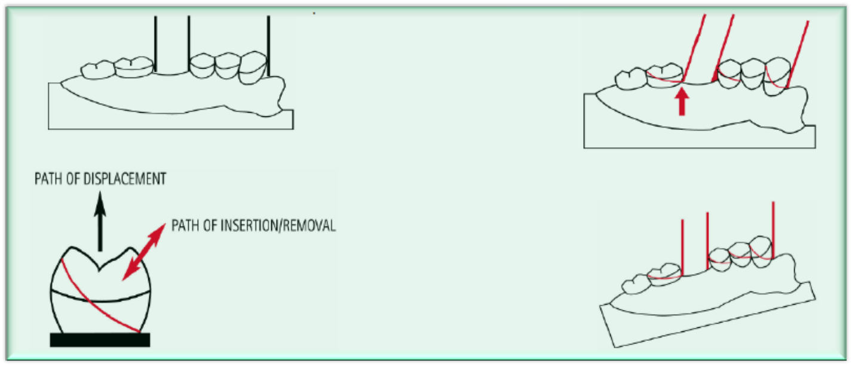
2- Retentive Areas:
Fairly even retention may be obtained by one of two means. One is to change the path of placement to increase or decrease the angle of cervical convergence of opposing retentive surfaces of abutment teeth. The other is to alter the flexibility of the clasp arm by changing its design, its size and length, or the material of which it is made.

Slide 9
3- Interference
The prosthesis must be designed so that it may be placed and removed without encountering tooth or soft tissue interference. A path of placement may be selected that encounters interference only if the interference can be eliminated during mouth preparation or on the master cast by a reasonable amount of block-out.
Interference may be eliminated during mouth preparation by surgery, extraction, modifying interfering tooth surfaces, or altering tooth contours with restorations.

Slide 10
4- Esthetics:
The location of retentive areas may influence the path of placement selected, and therefore retentive areas always should be selected with the most esthetic location of clasps. Generally, less metal will be displayed if the retentive clasp is placed at a more distogingival area of tooth surface made possible either by the path of placement selected or by the contour of the restorations.

Slide 11
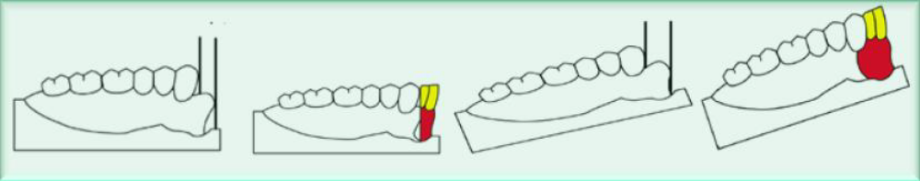
4- Esthetics:
Esthetics also may dictate the choice of path selected when missing anterior teeth must be replaced with the partial denture. In such situations a more vertical path of placement is often necessary so that neither the artificial teeth nor the adjacent natural teeth will have to be modified excessively.

Slide 12
Recording relation of cast to surveyor
1-Tripod method.
2-Analyzing rod method.

Slide 13
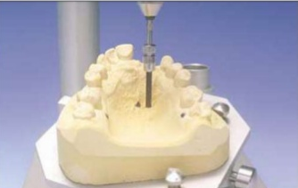
Recording relation of cast to surveyor
1-Tripod method:
Place three widely divergent dots on the tissue surface of the cast using the tip of a carbon marker, with the vertical arm of the surveyor in a locked position. On returning the cast to the surveyor, it may be tilted until the tip of the surveyor blade or diagnostic stylus again contacts the three dots in the same plane. This will produce the original position of the cast and therefore the original path of placement.
This is known as tripoding the cast some dentists prefer to make tiny pits in the cast at the location of the tripoding dots to preserve the orientation of the cast and to transfer this relationship to the refractory cast.

Slide 14
Recording relation of cast to surveyor
2-Analyzing rod method:
Score two sides and the dorsal aspect of the base of the cast with a sharp instrument held against the surveyor blade.
On returning the cast to the surveyor, tilting the cast until all three lines are again parallel to the surveyor blade, the original cast position can be reestablished.

Slide 15
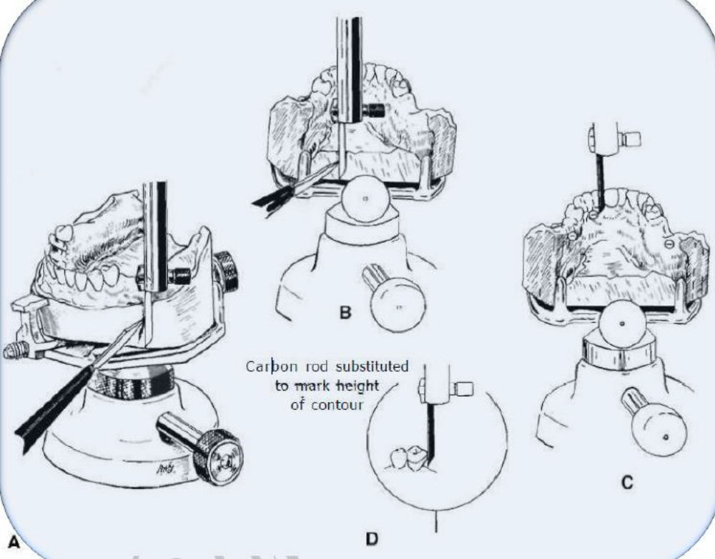

Slide 16


