Slide 1
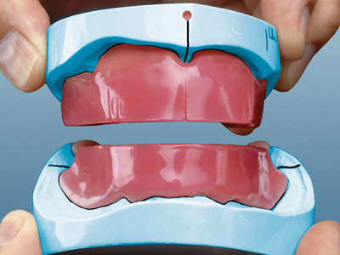
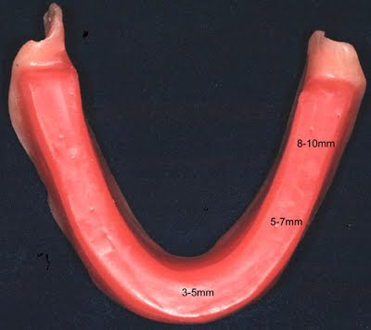
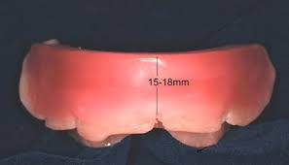
Laboratory Procedures Prior to Jaw Relation Records
RECORD BASE
Bushra Mohammed Ali Al-Ameen
B,D,S,. M,Sc.(Pros)

Slide 2
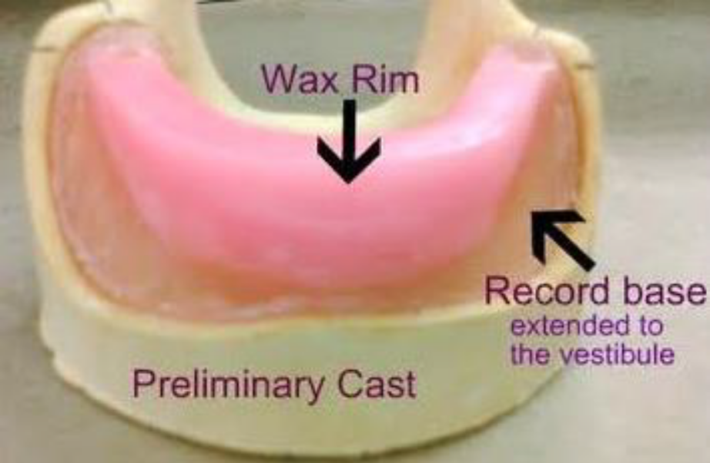
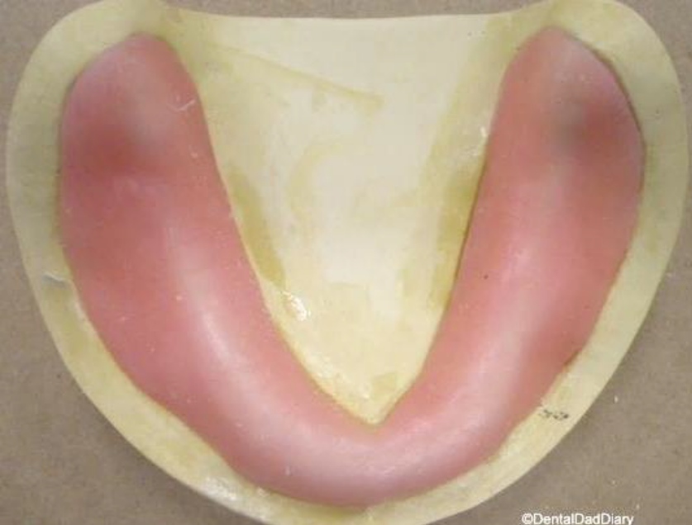
Record Base
It is a temporary form representing the base of a denture. It is used for making maxillomandibular relation records and for arrangement of artificial teeth.
It is also known as base plate, temporary base, trial base.

Slide 3
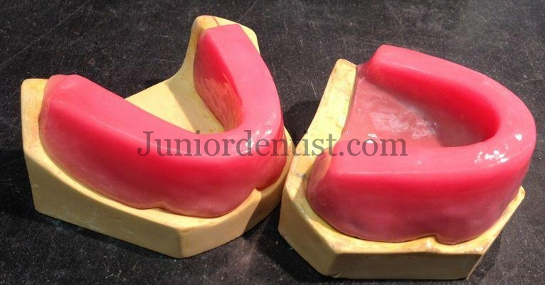
Requirment of record base
1- The record base must have rigidity to withstand occlusal loads.
2- The record base must have accuracy and stability.
3- The extent and the shape of the borders and fitness should resemble a finished denture.
4- All surfaces that contact lips, cheek and tongue should be smooth,
rounded and polished.
5- The crest, labial and/or buccal slopes should be
thinned to provide space for teeth arrangement.

Slide 4
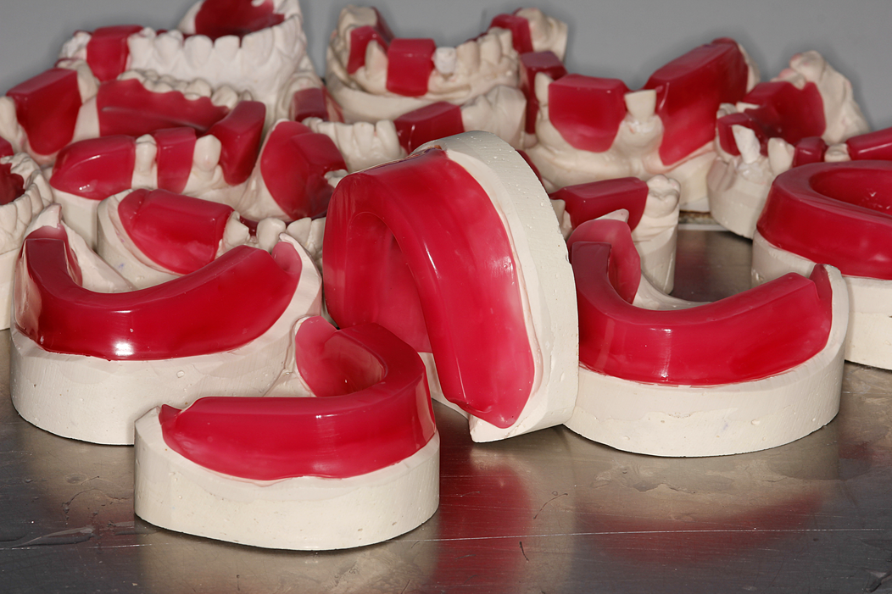
Accuracy of maxilla-mandibular relation record affected by:
1) Rigidity.
2) Stability.
3) Movability of the record bases.

Slide 5
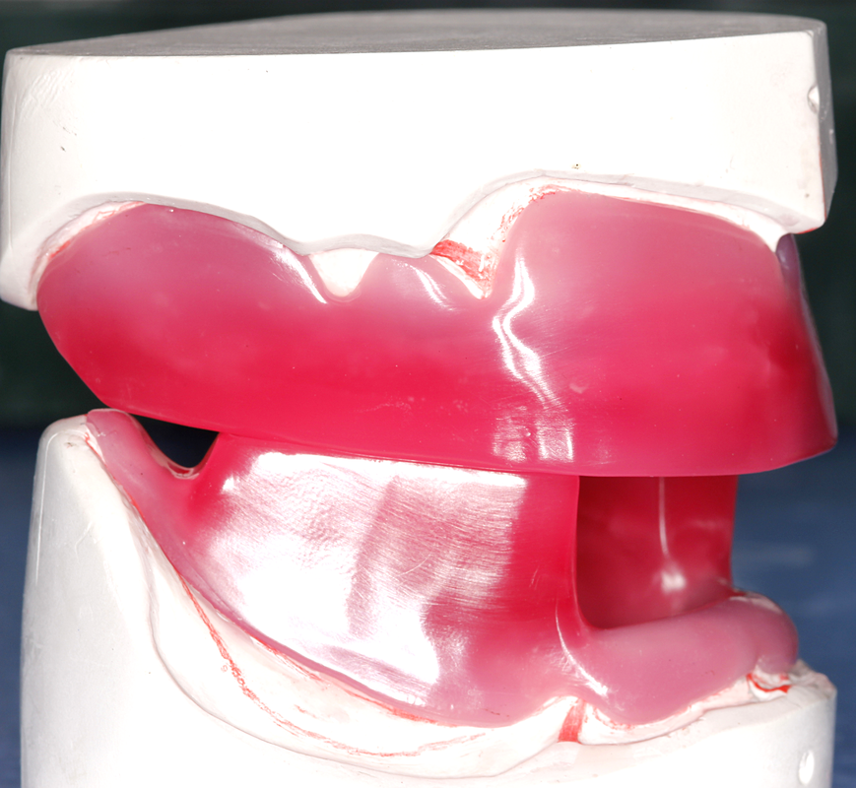
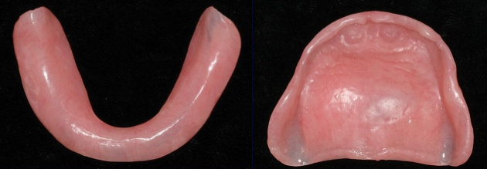
Materials used in construction of record base
1. Shellac record base.
2. Self-curing acrylic resin.
3. Light curing acrylic resin.
4. Thermoplastic resin.

Slide 6
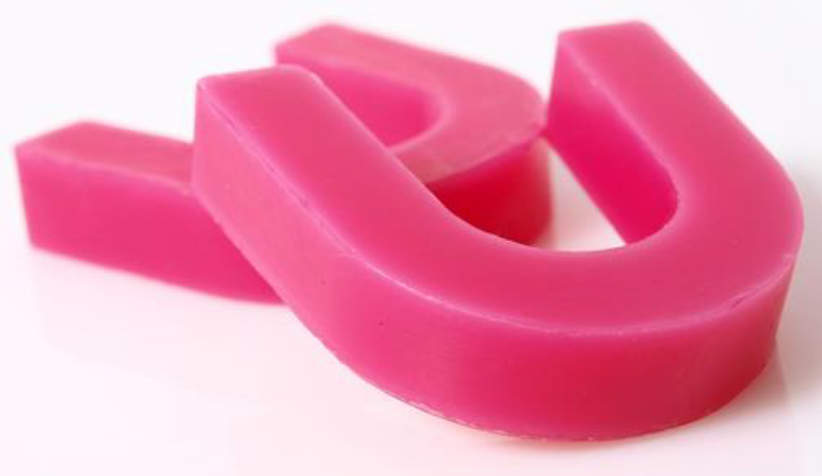
Materials used in construction of occlusion rims
1) Bite block wax.
2) Base plate wax.
3) Modeling compound.
Wax is used more frequently; since it is easier to manage in the registration and in arranging teeth.

Slide 7
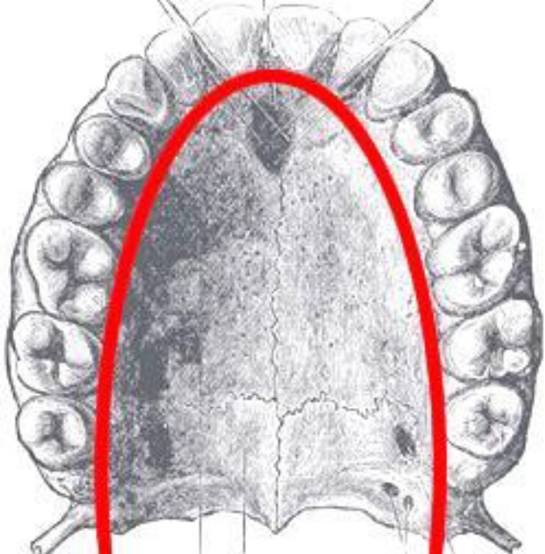
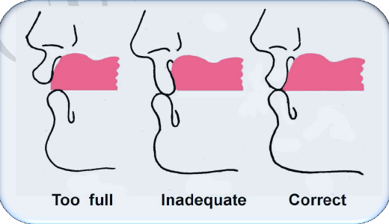
Uses of occlusion rims
1. Establishment of the arch form (neutral zone).
2. Support of the facial musculature.
The position of the lip and cheeks are important in the recording of maxilla-mandibular relations. The proper contouring of the occlusion rims for lip and cheek support allows the muscles of facial expression to act in a normal manner.

Slide 8
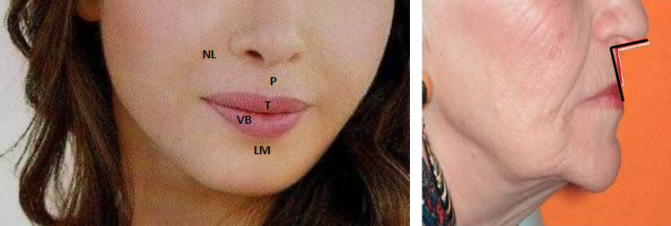
Uses of occlusion rims
2. Support of the facial musculature.
The anatomic guides aid in determining the proper contouring of anterior section of maxillary and mandibular occlusion rims (proper lip contour).
The nasolabial sulcus.
The labiomental sulcus.
The philtrum.
The commissure of the lips.

Slide 9
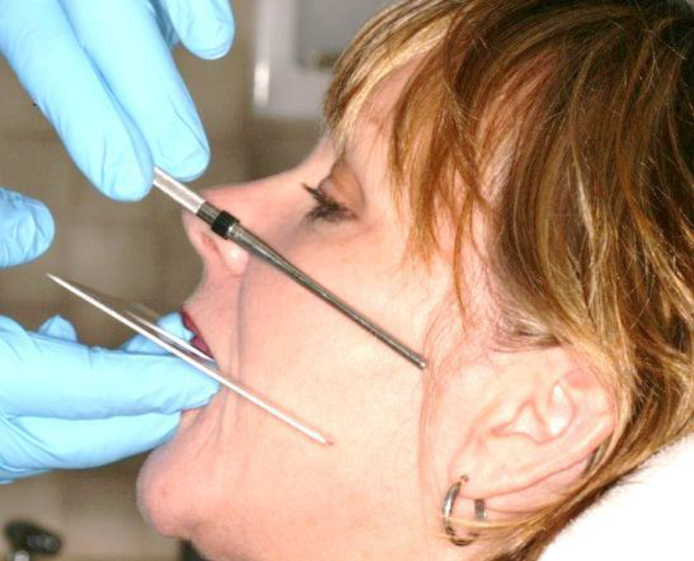
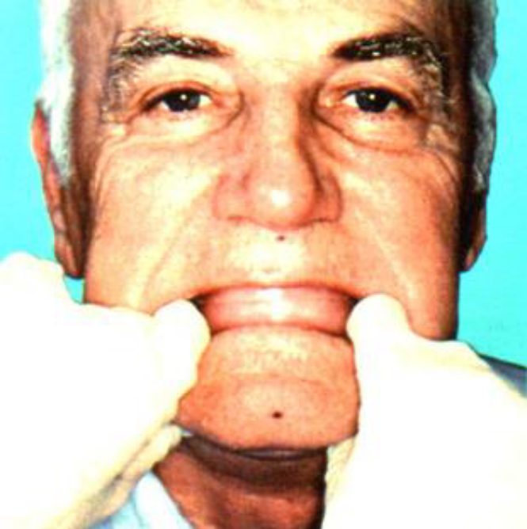
Uses of occlusion rims
3. Establish the level/height of the occlusal plane.
4. In determining of jaw relation which include:
a) Determination of the vertical dimension.
b) Determination of the horizontal (centric and eccentric jaw relations).

Slide 10
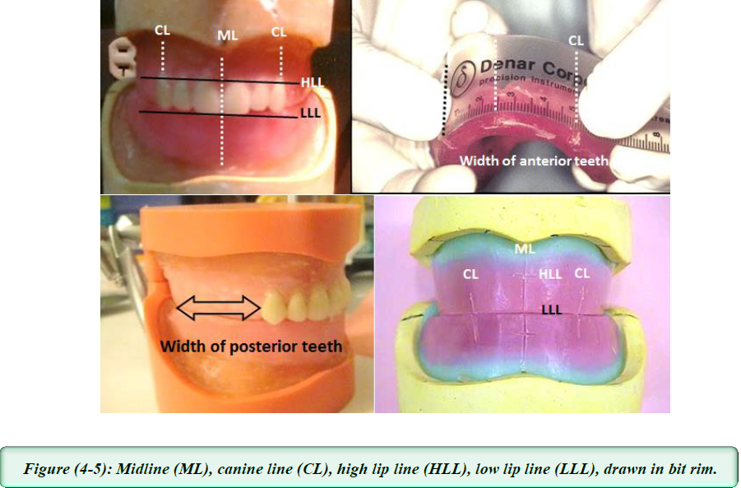
Uses of occlusion rims
5. In selection of teeth:
a) The position of midline can be determine
b) Canine lines (cuspid lines) are drawn at the corner of mouth on each side, width of 6 anterior teeth is equal to the distance between the two canine lines + 7 mm, the width of posterior teeth is equal to the distance between the canine line and the end of wax rim posteriorly.

Slide 11
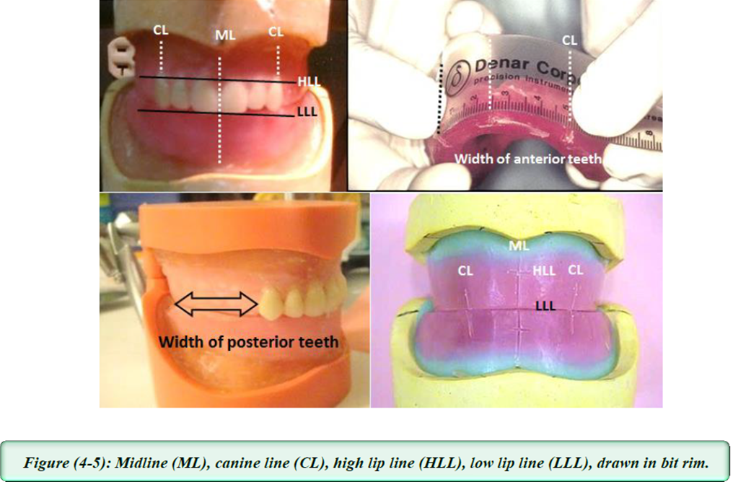
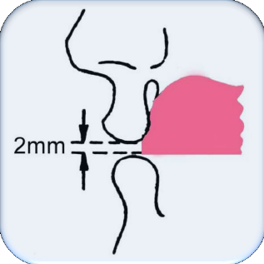
Uses of occlusion rims
5. In selection of teeth:
c) The high length of anterior teeth is determined by drawing high lip line (gum line, smiling line) when patient smiling, the whole of anterior incisors should be seen.
d) The low lip line (speaking line, relaxed lip line) is a line drawn on wax rim when lip is relax, in this case (2 mm) of anterior teeth should be seen.

Slide 12
Uses of occlusion rims
6. Setting up of teeth.

Slide 13
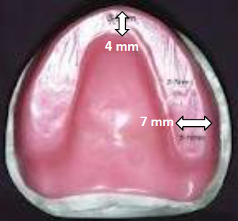
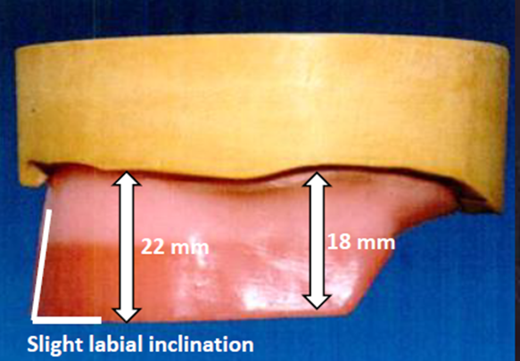
Measurement of maxillary occlusal rim
It should be directly over the crest of the residual ridge.
The anterior edge of the maxillary rim should have a slight labial inclination and the maxillary labial surface should be about (8 mm) anterior to the line bisecting the incisive papillae.
The final wax rim should be (4 mm) width anteriorly and gradually becomes wider posteriorly to measure (7 mm).
The occlusal height of maxillary rim should be (22 mm) high from the depth of the sulcus at the region of canine eminence (lateral to the labial frenum) and (l8 mm) high when measured from the depth of the sulcus in the posterior region (from the buccal flange to the tuberosity area).

Slide 14
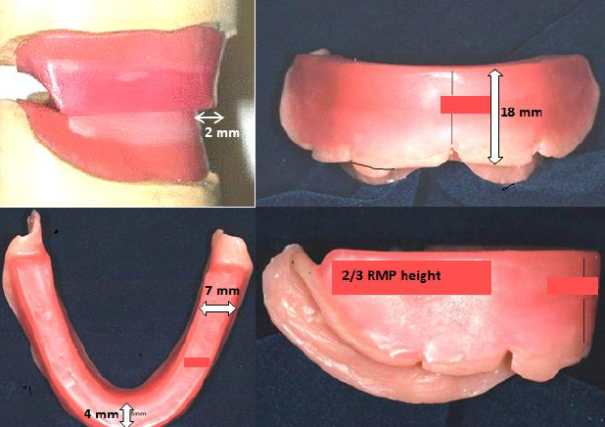
Measurement of mandibular occlusal rim
It should occupy the space over the crest of the residual ridge.
Mandibular incisal edge should be at the level of the lower lip and about (2 mm) behind the maxillary incisal edge.
The final wax rim should be (4 mm) width anteriorly and gradually becomes wider posteriorly to measure (7 mm) in molars area.
The occlusal height of mandibular rim should be (18 mm) high from the depth of the sulcus at the region of canine eminence (lateral to the labial frenum) and the occlusal plane should flush to two-third height of the retromolar pad in the posterior region.

Slide 15
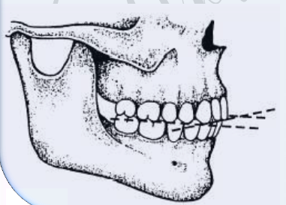
Occlusal plane
The average plane established by the incisal and occlusal surfaces of the teeth. Generally, it is not a plane but represents the planar mean of the curvature of these surfaces.
The height of the occlusal plane should be l-2 mm below the upper lip and this will be different from patient to other and affected by the age of the patient and type of the lip.
Generally, there are l-2 mm of the incisors in the average dentulous patient will be seen, but for best appearance, each case should be considered separately in relation to the height of the lip, age and sex of the patient e.g. for the patient that have long lip the height of the occlusal plane should be with the border of the upper lip, while for the patient with short lip, more than 2 mm of incisors should appear from upper lip.

Slide 16
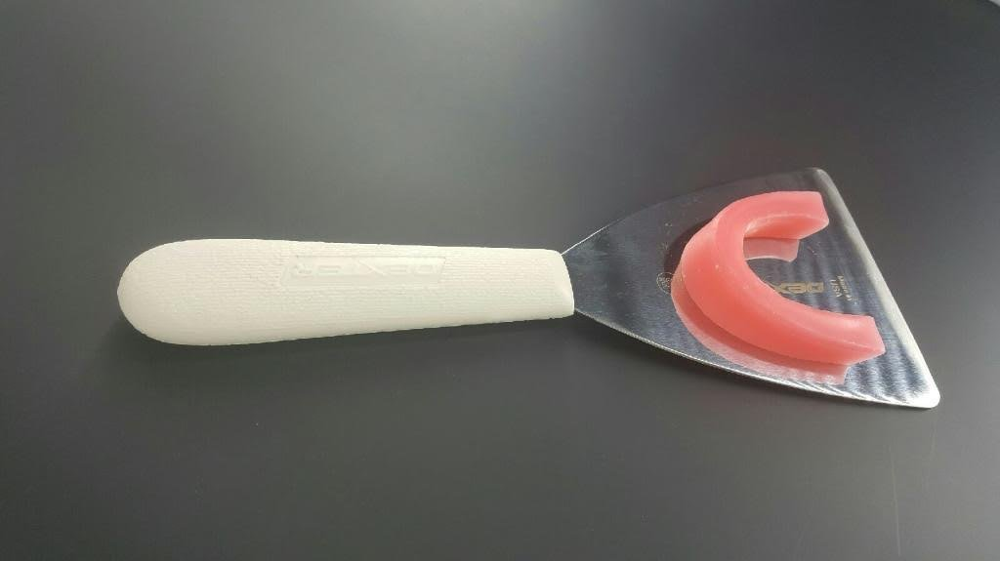
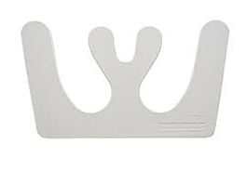
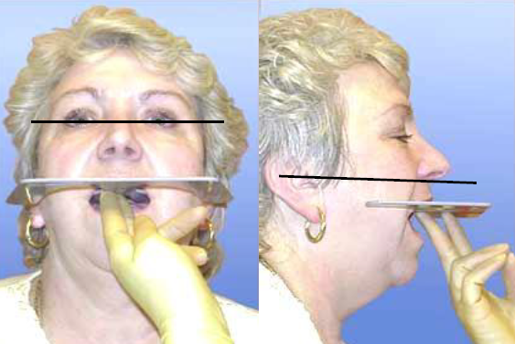
Fox Plane Guide
It is an appliance used to check the parallelism of the wax occlusal rim anteriorly and posteriorly, also known as (occlusal plane plate).
The anterior part of the wax rim : should be parallel to the inter-pupillary line (this is an imaginary line running between the centers of the two pupils of the eye when the patient is looking straight forward).
The posterior part of the wax rim: starting from the canine region backward which should be parallel to the Camper's line, this is a line running from the inferior border of the ala of nose to the superior border of the tragus of the ear also called (ala-tragus line).

Slide 17


