Slide 1
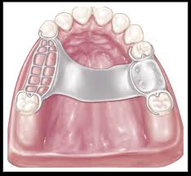
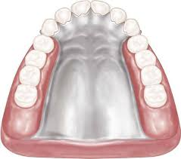
Maxillary Major Connectors
Bushra Mohammed Ali Al-Ameen
B,D,S,. M,Sc.(Pros)

Slide 2
Major Connector
Definition:
It is that unit of the partial denture to which all other parts are directly or indirectly attached.
Or it is the part of a removable partial denture that joins the components on one side of the arch to those on the opposite side.

Slide 3
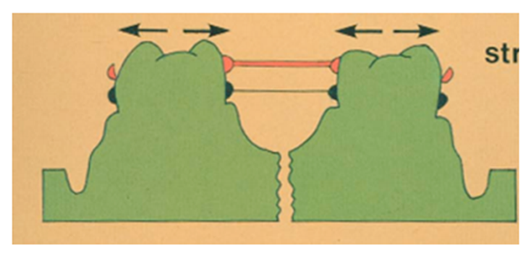
Functions of Major Connectors:
1. Unification of the major parts of the prosthesis.
2. Distribution of the applied force throughout the arch to selected teeth and tissue. (properly designed rigid MC distributes forces throughout the arch and decreases the load to any one area while controlling prosthesis movement).
3. Cross-arch Stability: Cross-arch tooth contact is effective when a rigid major connector joins the portion of the prosthesis receiving the function to selected regions of the arch. A rigid MC will limit movement possibilities by acting as a counteracting lever.

Slide 4
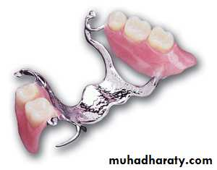
Requirements of Major Connectors:
1. Sufficiently rigid.
2. Must not permit impingement upon the free gingival margins of the remaining teeth.
3. Should not enter undercut areas.
4. Cross abruptly at 90°.
5. Avoid terminating on hard structures or soft tissues.
6. Minimize food impaction.

Slide 5
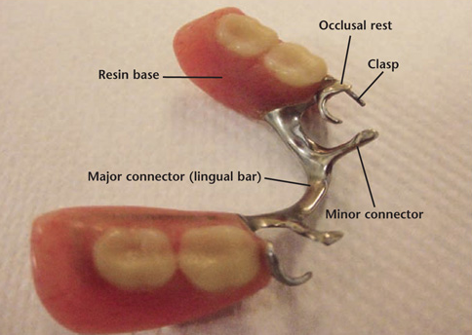
Requirements of Major Connectors:
Sufficiently rigid:
To be able to transmit forces from one side of the arch to the other, to distribute forces to supporting tissues (dento-alveolar & muco-osseous segments).
Other components of RPD (retentive clasps, occlusal rests, and indirect retainers) can be effective only if the MJ is rigid.
If the major connector is flexible: It will lead to concentration of forces that in turn will cause:
• Traumatic damage to periodontal support of the abutment teeth.
• Injury to residual ridges.
• Impingement of underlying tissue.
• Resorption of hard and soft tissues.

Slide 6
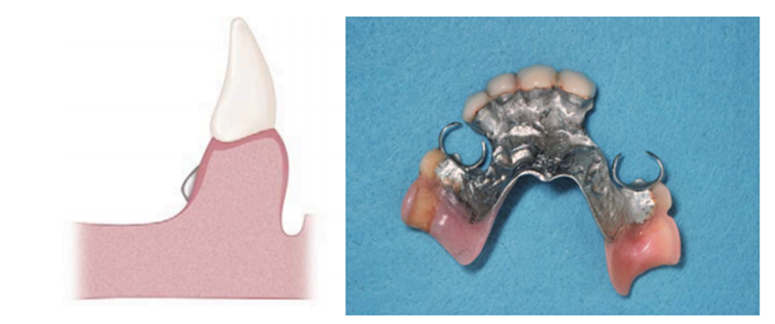
Requirements of Major Connectors:
Sufficiently rigid:
So, in order to increase rigidity, this could be done:
Use a more rigid alloy: Chrome-cobalt has a better rigidity than gold alloys, and cast is better than wrought.
Shape (cross-section): half round and half pear shaped are better than flat bars.
Increase the bulk as the length increases.
Corrugate linguo-plate or rugae areas.

Slide 7
Requirements of Major Connectors:
2. Must not permit impingement upon the free gingival margins of the remaining teeth:
Location:
1. Major connectors should be free of movable tissue.
2. Impingement of gingival tissue should be avoided.
3. Bony and soft tissue prominences should be avoided during placement and removal.
4. Relief should be provided beneath a major connector to prevent its settling into areas of possible interference.
5. They should be located and/or relieved to prevent impingement of tissue because the distal extension denture rotates in function.

Slide 8
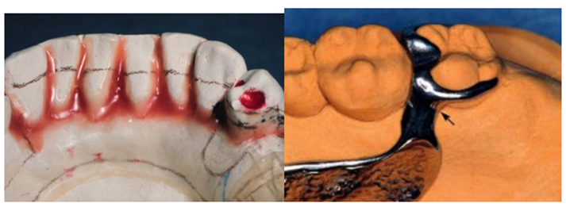
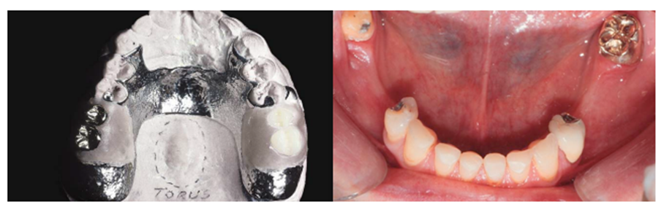
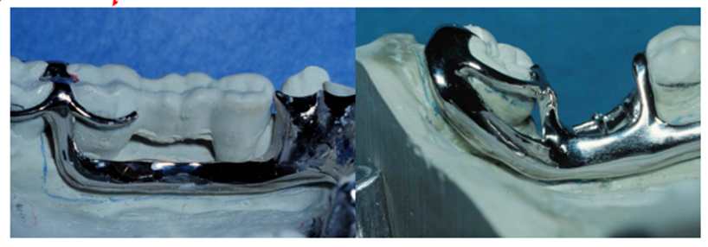
Requirements of Major Connectors:
3. Should not enter undercut areas, and it's avoided by:
• Changing path of insertion or Using blockout.
4. Cross abruptly at 90°:
to avoid creating angles and bends that will concentrate forces.
5.Avoid terminating on:
• Hard structures: ex mid-palatal suture or mandibular tori.
• Soft tissues: ex Lingual frenum & the movable soft palate.
6. Minimize food impaction:
• Locate margins away from the free gingival margin.
• Eliminate "traps" or large concavities where food can collect.

Slide 9
Characteristics Of Major Connectors Contributing To Health And Well-being
1. Made from an alloy compatible with oral tissues.
2. Is rigid and provides cross-arch stability through the principle of broad distribution of stress.
3. Does not interfere with and is not irritating to the tongue.
4. Does not substantially alter the natural contour of the lingual surface of the mandibular alveolar ridge or of the palatal vault.
5. Does not impinge on oral tissue when the restoration is placed, removed, or rotates in function.
6. Covers no more tissue than is necessary.
7. Does not contribute to the trapping of food particles.
8. Has support from other elements of the framework to minimize rotation tendencies in function.
9. Contributes to the support of the prosthesis.

Slide 10
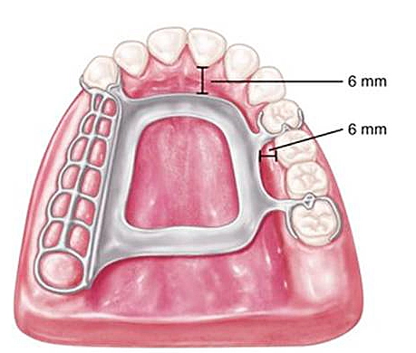
Maxillary Major Connectors Design Specification:
A. Placement of the border:
1. border is at least 6mm from the gingival margin if not so, the metal extends to cover the cingulum of the tooth or the palatal surface of the posterior teeth.
2. Border should be tapered to be less perceptible to the patient and smoothly curved, pass in the valley of the rugae region.
3. Posteriorly the border shouldn't extend to the movable soft palate.

Slide 11
Maxillary Major Connectors Design Specification:
B. Borders should be beaded:
Minor elevations at maxillary major connector borders that contact the palatal soft tissues, they are termed bead lines.
They are intended to:
• Slightly displace the adjacent soft tissues.
• Produce a mechanical seal and prevent food particles from collecting under the major connector.
• Provide excellent visual finish lines for technicians who finish and polish RPD frameworks.
• The groove must fade within 6 mm of the gingival margin to prevent impingement also fade over a hard midline of the palate.

Slide 12
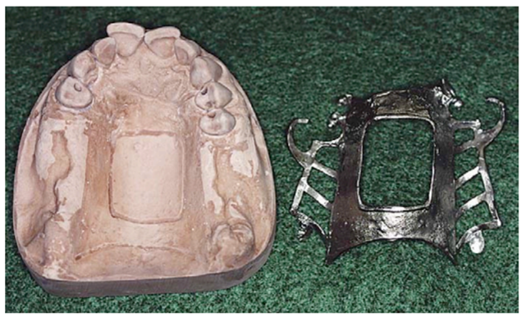
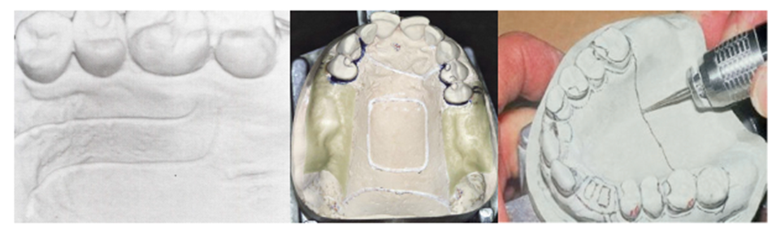
Maxillary Major Connectors Design Specification:
B. Borders should be beaded:
Created by scribing shallow channels on the surface of a cast before duplication in investment material.
Each channel should have a width and depth of 0.5 to 1.0 mm.
The depth of the beading should be reduced in areas of thin tissue coverage such as the midpalatine raphe or a palatal torus.
When the partial denture is not in the mouth, the outline of the beading should be evident in the palatal soft tissues (no evidence of irritation or inflammation).

Slide 13
Maxillary Major Connectors Design Specification:
C. Relief:
Except in the presence of a palatal torus or a prominent median suture line, relief should not be used under a maxillary MC.
The intimate contact between the palatal soft tissues and the metal connector enhances the retention and stability of the denture.
To maintain this intimate metal–soft tissue contacts, the tissue side of the major connector is not brought to a high finish during polishing procedures.

Slide 14
Types Of Maxillary Major Connectors
1. Palatal bar.
2. Palatal strap.
3. Anteroposterior palatal bar.
4. Anteroposterior palatal strap.
5. Complete palate.
6. U-shaped Palatal MC (horse-shoe).

Slide 15
1. Palatal Bar
• A narrow half oval with its thickest point at the center.
• The bar is gently curved and should not form a sharp angle at its junction with the denture base.
Advantages:
For many years, the palatal bar was one of the most widely used. Today, palatal bar major connectors are used primarily in interim applications. The palatal bar has few advantages and should be avoided.

Slide 16
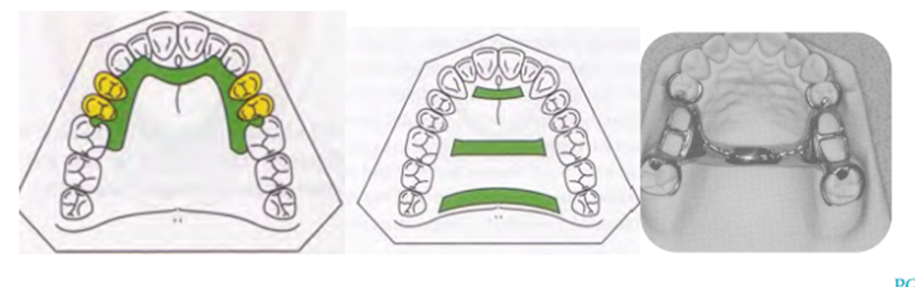
1. Palatal Bar
Disadvantages:
To provide the necessary rigidity, a palatal bar major connector must be bulky. So, patients find the palatal bar uncomfortable.
Palatal bar derives little vertical support from the bony palate. As a result, a palatal bar major connector must derive nearly all its support from rests on the remaining teeth.
should be limited to short-span Class III applications should not be placed anterior to the second premolar position, otherwise its bulk may produce noticeable discomfort and alteration of speech.

Slide 17
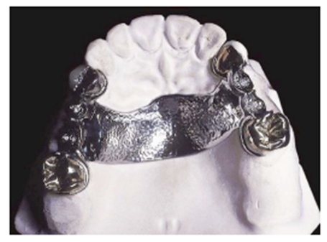
2.Palatal Strap
The palatal strap is the most versatile MC.
Wide band of metal with a thin cross-sectional dimension.
The anteroposterior dimension of a palatal strap should not be less than 8 mm to avoid compromise of its rigidity.
The width of a palatal strap should increase as the edentulous space increases in length. Thus, ensuring rigidity and permitting greater support from the hard palate.
Indication:
Used to connect bilateral tooth-supported prosthesis, even those with short edentulous spaces, particularly when the edentulous areas are located posteriorly. This type of major connector is better suited for the restoration of short span tooth supported bilateral edentulous areas.

Slide 18
2.Palatal Strap
Advantages:
It is in two or more planes great resistance to bending and twisting.
It has little interference with normal tongue action, so it’s well accepted by patients.
The increased tissue coverage helps distribute applied stresses over a larger area.
Disadvantages:
1. Patient may complain of excessive palatal coverage this may be due to improper positioning of the strap borders.
Anterior border positioned posterior to the palatal rugae.
If this is not possible, the anterior border should be terminated on the posterior slopes of prominent rugae.
Posterior border positioned anterior to the junction of the hard and soft palates.
2. May predispose the patient to papillary hyperplasia when the partial denture is worn 24 hours a day.

Slide 19
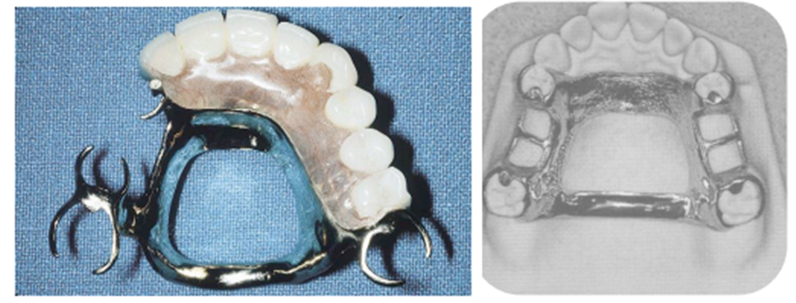
3. Anteroposterior Palatal Bar
Has characteristics of palatal bar and palatal strap MC.:
The anterior bar is relatively flat. Its cross-sectional is similar to palatal strap. Borders of the anterior bar are positioned on the slopes of prominent rugae, to blend with the contours of the anterior palate.
The posterior bar is a half oval, similar to the palatal bar MC.
Two bars joined by flat longitudinal elements on each side of the palate.
This configuration gives the effect of a circle and is more rigid than any of the two individual elements.
The two bars, lying in different planes, produce a structurally strong L-beam effect.

Slide 20
3. Anteroposterior Palatal Bar
Advantages:
Rigid.
Minimizes soft tissue coverage,
Resistant to deformation.
Used when support is not a major consideration.
When the anterior and posterior abutments are widely separated.
Large palatal tori that cannot be removed for health reasons.
Disadvantages:
Uncomfortable & bulky bothers the tongue and interferes with phonetics.
Little support from the bony palate (So, contraindicated in pts. with poor periodontal support)
Shouldn’t be considered the first choice (selected only after other choices have been considered and eliminated).

Slide 21
4. Combination AnteroPosterior Palatal Strap
• The anterior and posterior components are joined together by longitudinal connectors on either side.
• Form a square or rectangular frame. Each component braces the others against possible torque and flexure.
• Flexure is nonexistent in such a design
• A posterior palatal strap should be flat and a minimum of 8 mm wide. located as far posterior as possible to avoid interference with the tongue but anterior to the line of flexure formed by the junction of the hard and soft palates.
• Anterior connector may be extended anteriorly to support anterior tooth replacements.

Slide 22
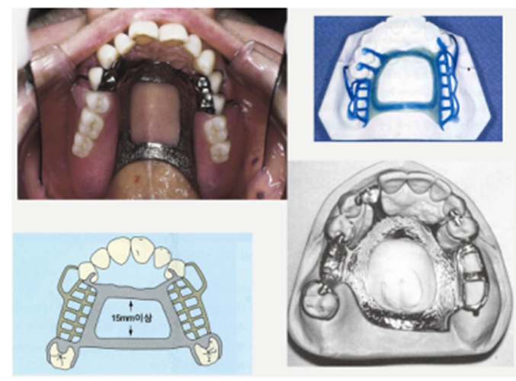
4. Combination AnteroPosterior Palatal Strap
Properties:
• Lying in two different planes increase rigidity.
• Lack of support it covers less of horizontal hard palate.
• Should cross the midline at right angle rather than on a diagonal.
Indication:
For tooth born and tooth mucosa born partial denture cases needing rigidity more than that of an anterior palatal strap.
When torus exists.
Contraindication: Maxillary torus extending posteriorly to soft palate.

Slide 23
5. Palatal Plate (Complete Palate)
Indications:
In Class II arch with large posterior modification space and some missing anterior teeth.
When the last remaining abutment tooth on either side of a Class I arch is the canine or first premolar tooth, especially when the residual ridges have undergone excessive vertical resorption.
In most situations in which only some or all anterior teeth remain.
No interfering tori.
The anatomic contours of the palate will be faithfully reproduced in the finished denture.

Slide 24
5. Palatal Plate (Complete Palate)
Advantages:
Uniformed thickness.
Thermal conductivity of the metal makes the palatal plate acceptable to the tongue and underlying tissues.
Corrugation in the anatomic replica adds strength
Intimate contact, interfacial surface tension between metal and tissue provides the prosthesis with greater retention.

Slide 25
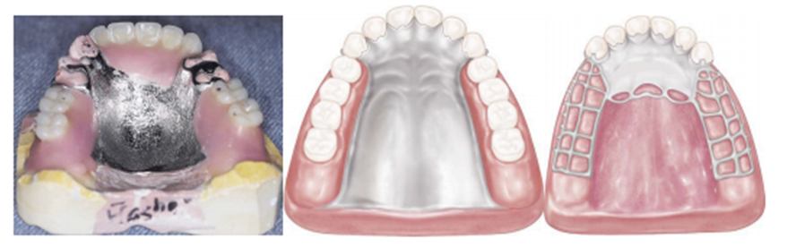
5. Palatal Plate (Complete Palate)
The palatal plate may be used in any one of three ways:
It may be used as a plate of varying width that covers the area between two or more edentulous areas, as a complete.
Partial cast plate that extends posteriorly to the junction of the hard and soft palates.
The form of an anterior palatal connector with a provision for extending an acrylic resin denture base in a posterior direction.

Slide 26
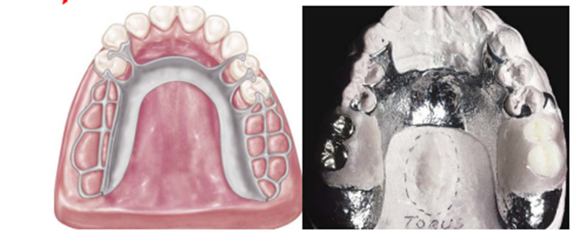
6. U-shaped Palatal MC (horse-shoe)
It is the least desirable of maxillary major connectors
Indications:
1) When a large inoperable palatal torus exists.
2) when several anterior teeth are to be replaced .
Disadvantages:
Its lack of rigidity allows lateral flexure under occlusal force leading to torque or direct lateral force to abutment teeth.
May permit impingement of underlying tissue when subjected to occlusal loading (no good support).
Bulk results in increased thickness in areas that are irritant to the tongue.

Slide 27


