Slide 1
Mandibular Major Connectors
Bushra Mohammed Ali Al-Ameen
B,D,S,. M,Sc.(Pros)

Slide 2
Requirments of major connector.
1. Relief is provided for soft tissue under all portions of the mandibular major connector and at any location where the framework crosses the marginal gingiva.
2. The inferior border of mandibular major connectors should be gently rounded after being cast to eliminate any sharp edge.
3. Not impinging on the movable floor of the mouth → only reaching the “functional depth”
4. Lingual bar major connector should be located at least 4 mm inferior to gingival margins and farther if possible.
5. If less than 8 mm exists between gingival margins and the movable floor of the mouth, a lingual plate, a sublingual bar, or a continuous bar is preferred as a major connector.

Slide 3
Six types of mandibular major connectors are:
Lingual bar.
Linguoplate.
Lingual bar with cingulum bar (continuous bar).
Sublingual bar.
Cingulum bar (continuous bar).
Labial bar.

Slide 4
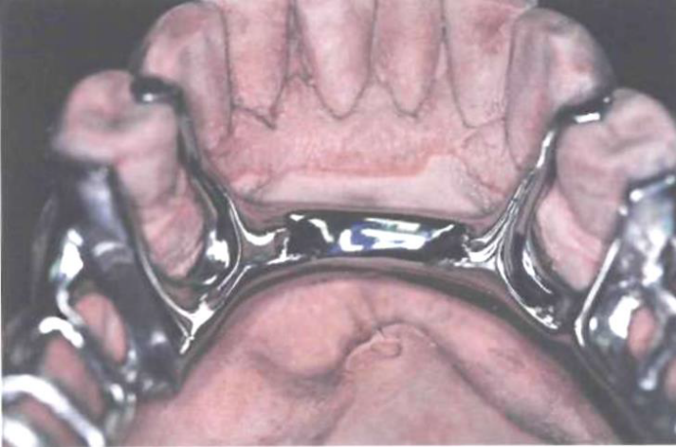
1) Lingual bar major connector.
Indications:
The lingual bar should be used for mandibular removable partial dentures where sufficient space exists between the slightly elevated alveolar lingual sulcus and the lingual gingival tissue (at least 8 mm).
Diastemas or open cervical embrasures of anterior teeth.
Overlapped anterior teeth.
Contraindications:
When the lingual frenum is high or the space available for a lingual bar is limited (less than 8 mm).
Lingually inclined teeth.
An undercut lingual alveolar ridge which would result in an excessive space between the bar and the mucosa.
When the future replacement of one or more incisor teeth.

Slide 5
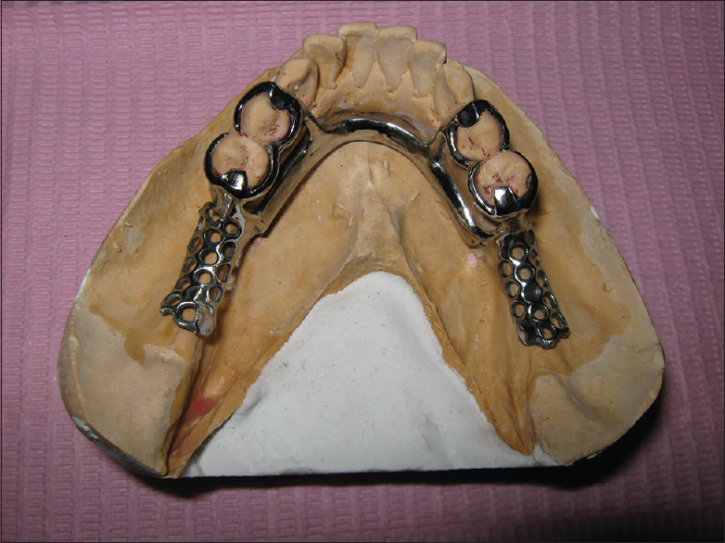
1) Lingual bar major connector.
Advantages:
Covers minimum surface area of teeth and tissue therefore potential for caries, periodontal problems caused by plaque being held in contact with teeth and tissue is minimal.
It is relatively small, inconspicuously located and minimally interfere with functions, so patient prefers lingual bar over linguoplate.

Slide 6
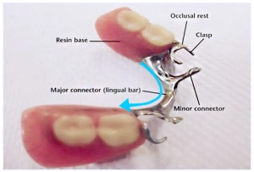
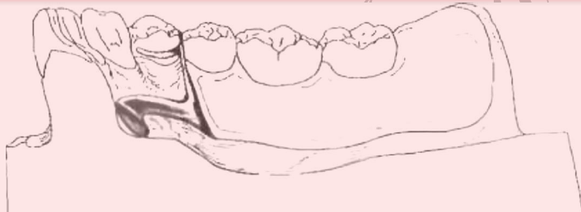
1) Lingual bar major connector.
Characteristics and location:
Half-pear shaped with bulkiest portion inferiorly located.
Superior border tapered to the soft tissues will minimize interference with tongue.
The inferior border of the lingual bar should be slightly rounded. A rounded border will not impinge on the lingual tissue when the denture bases rotate inferiorly under occlusal loads.
Superior border located at least 4 mm inferior to gingival margins.
Inferior border located at the ascertained height of the alveolar lingual sulcus when the patient's tongue is slightly elevated.

Slide 7
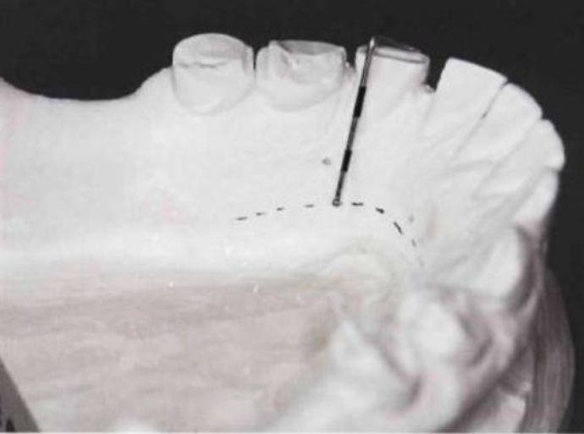
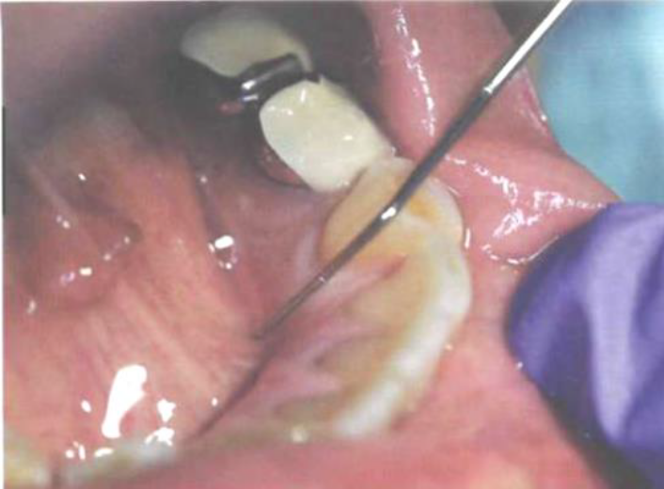
1) Lingual bar major connector.
There are two clinically methods to determine the relative height of the floor of the mouth to locate the inferior border of a lingual mandibular major connector.
Ask the patient to touch the vermilion border of upper lip with the tip of his tongue, and measure the height of the floor of the mouth in relation to the lingual gingival margins of adjacent teeth with a periodontal probe. Recording of these measurements permits their transfer to both diagnostic and master casts.

Slide 8
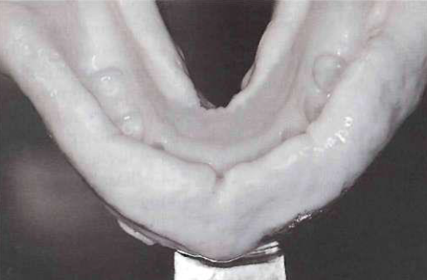
1) Lingual bar major connector.
There are two clinically methods to determine the relative height of the floor of the mouth to locate the inferior border of a lingual mandibular major connector.
2. Use a special tray having its lingual borders 3 mm short of the elevated floor of the mouth and then to use an impression material that will permit the impression to be accurately molded as the patient licks the lips. The inferior border of the planned major connector can then be located at the height of the lingual sulcus of the cast resulting from such impression.

Slide 9
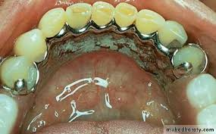
2) Linguoplate major connector.
Indications:
When the lingual frenum is high or the space available for a lingual bar is limited (Where a clinical measurement from the free gingival margins to the slightly elevated floor of the mouth is less than 8 mm, a linguoplate is indicated in lieu of a lingual bar).
When the residual ridges in Class I arch have undergone such vertical resorption that they will offer only minimal resistance to horizontal rotations of the denture through its bases.
For using periodontally weakened teeth in group function to furnish support to the prosthesis and to help resist horizontal rotation of the distal extension type of denture.
When the future replacement of one or more incisor teeth will be facilitated by the addition of retention loops to an existing linguoplate.
Mandibular tori which must be covered by removable partial denture, because they cannot be surgically removed or avoided in the design. Relief is provided between the torus and the framework.
For stabilizing periodontally weakened teeth.

Slide 10
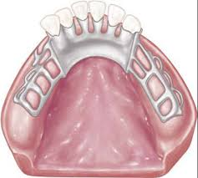
2) Linguoplate major connector.
Contraindications:
Overlapped anterior teeth, that leads to small gaps between the superior edge of the plate and the teeth.
Lingually inclined teeth.
Open cervical embrasures where the plate would be visible, so a lingual bar with continuous bar or labial bar should be considered.
Diastemas, unless the lingual plate can have slots in it to avoid the displayed metal.

Slide 11
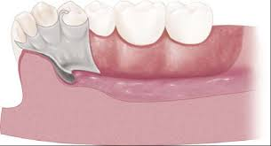
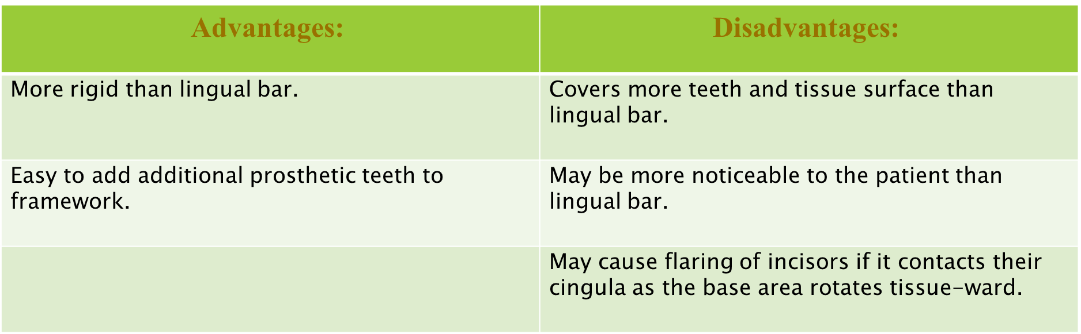
2) Linguoplate major connector.

Slide 12

2) Linguoplate major connector.
Characteristics and location:
Half-pear shaped with bulkiest portion inferiorly located.
Thin metal apron extending superiorly to contact cingula of anterior teeth and lingual surfaces of involved posterior teeth at their height of contour.
Apron extended interproximally to the height of contact points (closing interproximal spaces).
Scalloped contour of apron as dictated by interproximal block out, the straight superior margin can be bulky at the cingulum region, causing tongue discomfort.
Superior border finished to continuous plane with contacted teeth.
Inferior border at the ascertained height of the alveolar lingual sulcus when the patient's tongue is slightly elevated.

Slide 13
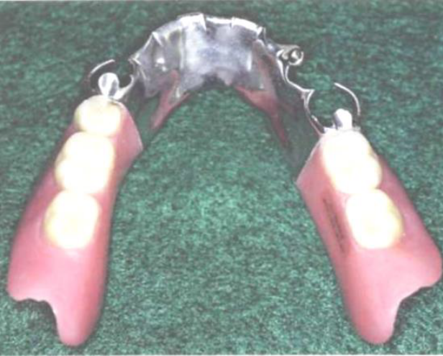
2) Linguoplate major connector.
A linguoplate should be made as thin as is technically feasible and should be contoured to follow the contours of the teeth and the embrasures.
The upper border should follow the natural curvature of the supra-cingular surfaces of the teeth and should not be located above the middle third of the lingual surface.
The linguoplate does not in itself act as an indirect retainer. When indirect retention is required, definite rests must be provided for this purpose.
Both the linguoplate and the cingulum bar should ideally have a terminal rest at each end regardless of the need for indirect retention. However, when indirect retainers are necessary, these rests may also serve as terminal rests for the linguoplate or continuous bar.
In Class I and Class II partial dentures especially, the superior border of the linguoplate or continuous bar retainer should never be placed above the middle third of the teeth so that orthodontic movement is prevented during the rotation of a distal extension denture. This guideline is not as important when the six anterior teeth are in nearly a straight line, but when the arch is narrow and tapering, a cingulum bar or linguoplate on anterior teeth extends well beyond the terminal rests and orthodontic movement of those teeth is more likely.

Slide 14
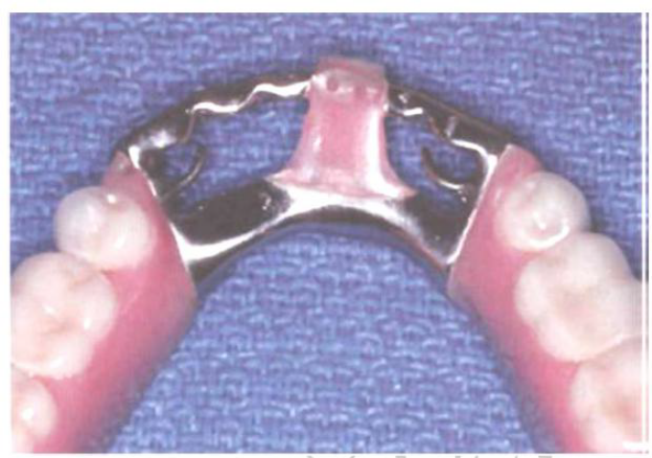
3) Lingual bar with cingulum bar
Indications:
When a linguoplate is otherwise indicated but the open cervical embrasures of anterior teeth and a linguoplate would objectionably display metal in a frontal view.
Contraindications:
Any contraindication for a lingual bar.
Any contraindication for a linguoplate except open cervical embrasures.
Wide diastemas.
Advantages:
More rigid than lingual bar.
Covers less tooth.

Slide 15
3) Lingual bar with cingulum bar
Disadvantages:
Very complex design.
May be objectionable to patient because there are four edges exposed to the tip of the tongue.
Characteristics and location:
Conventionally shaped and located same as lingual bar major connector component when possible.
Thin, narrow (3 mm) metal strap located on cingula of anterior teeth, scalloped to follow interproximal embrasures with inferior and superior borders tapered to tooth surfaces.
Originates bilaterally from incisal, lingual, or occlusal rests of adjacent principal abutments.

Slide 16
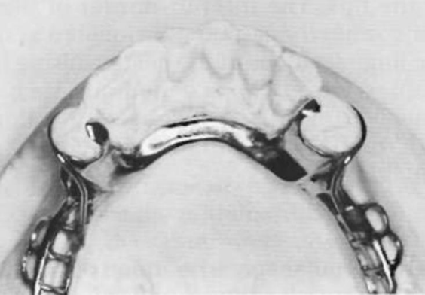
4) sublingual bar major connector.
Indications:
Where the height of the floor of the mouth in relation to the free gingival margins will be less than 6 mm.
Bracing and indirect retention can be provided by clasps and indirect retainers and future additions of prosthetic teeth to the framework are not anticipated.
Severely undercut lingual alveolar ridge.
Diastemas and open cervical embrasures of anterior teeth.
Overlapped anterior teeth.

Slide 17
4) sublingual bar major connector.
Contraindications:
Where a lingual bar or linguoplate will suffice.
Situations where bracing and/or indirect retention must be provided by contact of the major connector with the teeth.
Situations where future additions of prosthetic teeth to the framework are anticipated.
Remaining natural anterior teeth severely tilted toward the lingual.
Interfering lingual tori.
High attachment of a lingual frenum.
Interference with elevation of the floor of the mouth during functional movements.

Slide 18
4) sublingual bar major connector.
Advantages:
Sublingual bar does not contact anterior teeth or lingual alveolus.
More esthetic than other lingual major connectors because of its location.
More rigid than lingual bar because bulk of metal is horizontal rather than vertical.
Disadvantages:
Requires border molded impression of floor of mouth for accurate placement of major connector.
Difficult to add prosthetic teeth to framework.

Slide 19
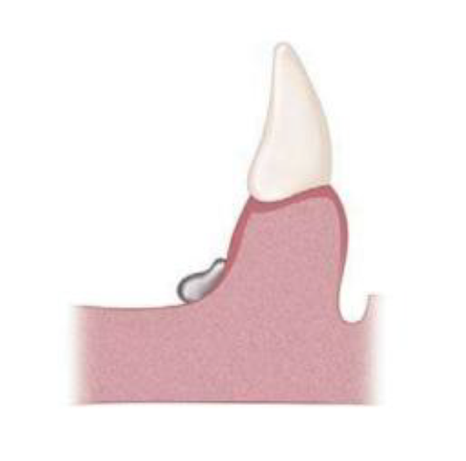
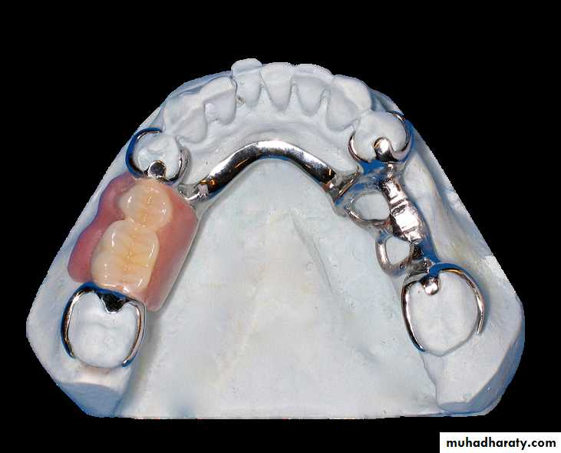
4) sublingual bar major connector.
Characteristics and location:
The sublingual bar is essentially the same half-pear shape as a lingual bar except that the bulkiest portion is located to the lingual and the tapered portion is toward the labial.
The superior border of the bar should be at least 3 mm from the free gingival margin of the teeth.
The inferior border is located at the height of the alveolar lingual sulcus when the patient's tongue is slightly elevated, lying over and parallel to the anterior floor of the mouth.

Slide 20
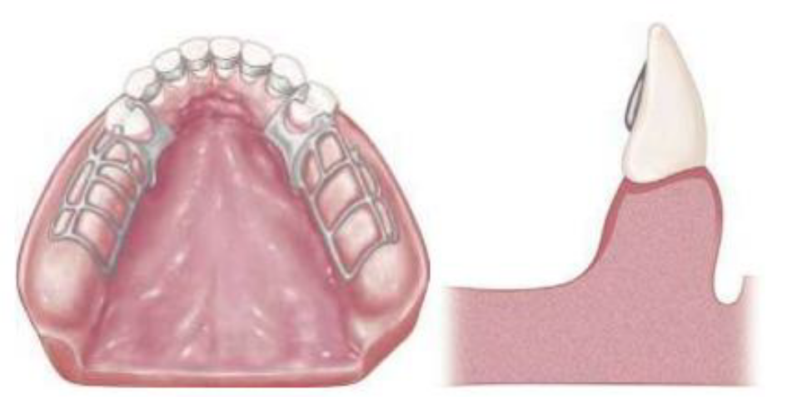
5) Cingulum bar major connector (continuous bar).
Indications :
When a linguoplate is the major connector of choice, but the axial alignment of the anterior teeth is such that excessive block out of interproximal undercuts must be made, a cingulum bar may be considered.
Height of activated lingual frenum and floor of the mouth at the same level as marginal gingiva.
Inoperable tori or exostosis at the same level as the marginal gingiva.
Severely undercut lingual alveolus.
Concern that the major connector cross the gingival sulcus will cause a periodontal problem.

Slide 21
5) Cingulum bar major connector (continuous bar).
contraindications :
Anterior teeth severely tilted to the lingual. When wide diastemas/open cervical embrasures exist between the mandibular anterior teeth and the cingulum bar would objectionably display metal in a frontal view.
Overlapped anterior teeth.
Advantages:
Does not cross the marginal gingiva or overlay the lingual alveolus.
Easy to add prosthetic teeth to framework.
Disadvantges:
Must be bulky to have sufficient rigidity and thus may be objectionable to the patient.

Slide 22
5) Cingulum bar major connector (continuous bar).
Characteristics and location:
Thin, narrow (3 mm) metal strap located on cingula of anterior teeth, scalloped to follow interproximal embrasures with inferior and superior borders tapered to tooth surfaces.
Originates bilaterally from incisal, lingual, or occlusal rests of adjacent principal abutments.

Slide 23
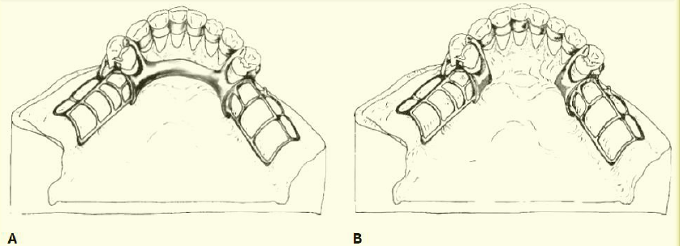
Lingual bar and cingulum bar (continuous bar) major connector. this major connector is located on cingula of anterior teeth. Requirement of positive support by rest seats, at least as far anteriorly as the canines, is critical. Note that superior border of lingual bar portion is often placed objectionably close to gingival margins if sufficient bulk for rigidity is to be obtained. This type of major connector easily traps food and is often more objectionable to patients than a linguoplate.
The Cingulum bar (continuous bar) major connector although this design may reduce possibility of food entrapment, it may not provide adequate rigidity.

Slide 24
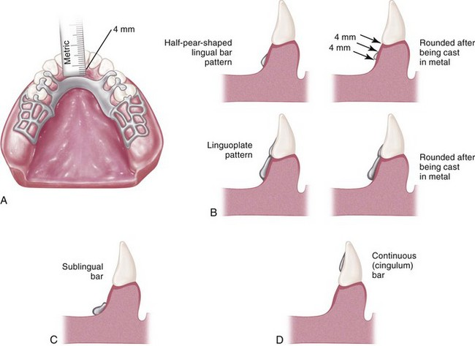

Slide 25
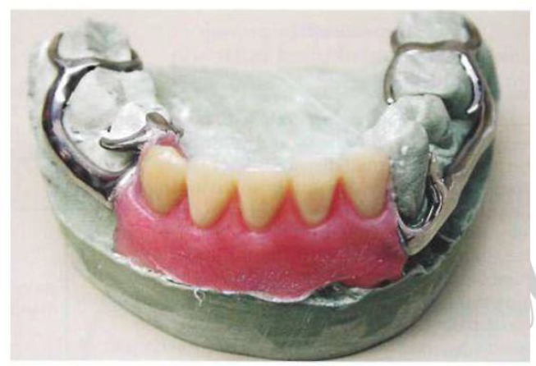
6) Labial bar major connector
Indications:
When lingual inclinations of remaining mandibular premolar and incisor teeth cannot be corrected, thus prevents the placement of conventional lingual bar connectors.
When severe lingual tori cannot be removed and prevent the use of a lingual bar or lingual plate major connector.
When severe and abrupt lingual tissue undercuts make it impractical to use a lingual bar or lingual plate major connector. Diastemas, open cervical embrasures, and overlapped anterior teeth may contraindicate a linguoplate.
Contraindications:
Lingual major connectors can be used.
Facial tori or exostoses.
Facial alveolar ridge undercuts.
High facial muscle attachments which would result in less than 3 mm of space between the superior edge of the labial bar and the marginal gingiva of the teeth.

Slide 26
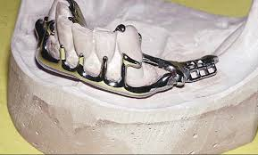
6) Labial bar major connector
Advantages:
It can be used where other types of lingual major connectors cannot.
Disadvantages:
The labial major connector is longer than a lingual major connector and therefore, must be wider and/or thicker to provide the necessary rigidity.
The labial major connector may be visible when the patient smiles.
May distort lip contour resulting in poor esthetic.
Difficult to add prosthetic teeth to the framework.

Slide 27
6) Labial bar major connector
Characteristics and locations:
Half-pear shaped with bulkiest portion inferiorly located on the labial and buccal aspects of the mandible.
Superior border tapered to soft tissue.
Superior border located at least 4 mm inferior to labial and buccal gingival margins and more if possible.
Inferior border located in the labial-buccal vestibule at the juncture of attached (immobile) and unattached (mobile) mucosa.

Slide 28
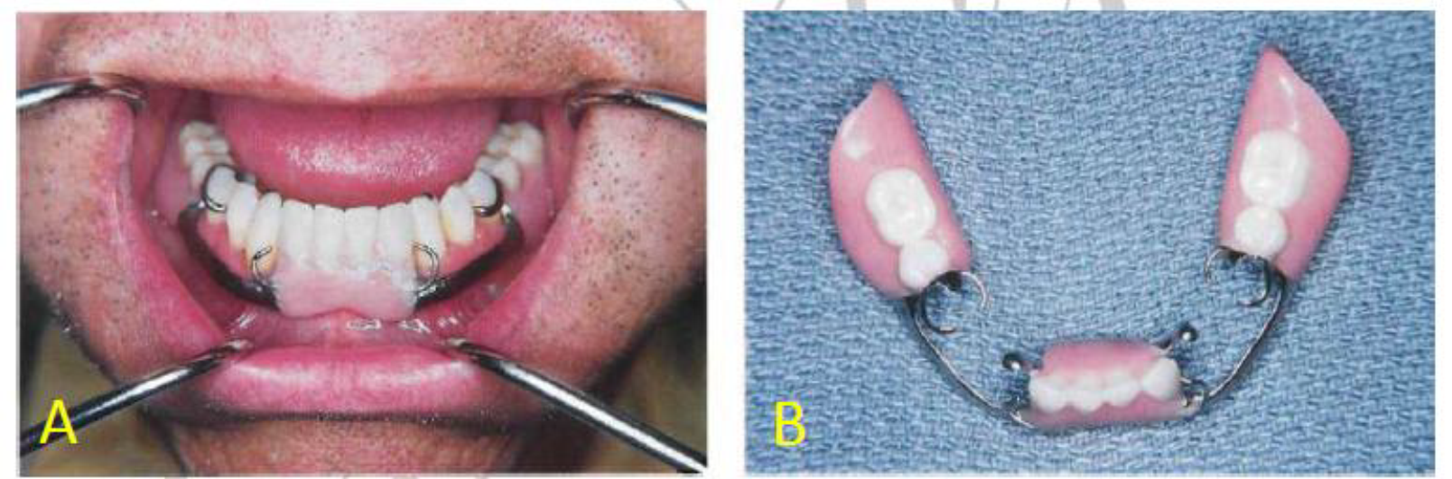
Lingual inclination of patient's canines and premolars precludes use of lingual bar.
Labial bar major connector was used in treatment. Retention was obtained on terminal abutments. Support and stabilization were gained by using rests, minor connectors arising from labial bar, and well-fitting denture bases.

Slide 29
Design of mandibular major connector
The following systematic approach to designing a mandibular lingual bar and linguoplate major connectors:
Step 1: Outline the basal seat areas on the diagnostic cast.
Step 2: Outline the inferior border of the major connector.
Step 3: Outline the superior border of the major connector.
Step 4: Connect the basal seat area to the inferior and superior borders of the major connector, and add minor connectors to retain the acrylic resin denture base material.

Slide 30
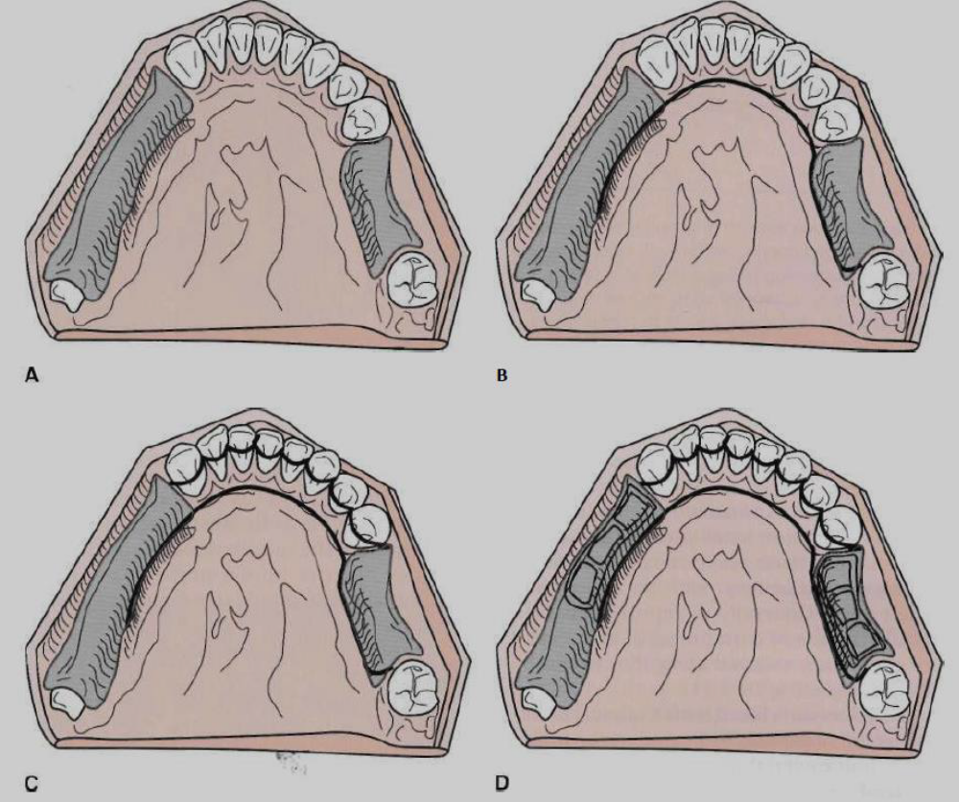

Slide 31


