Slide 1
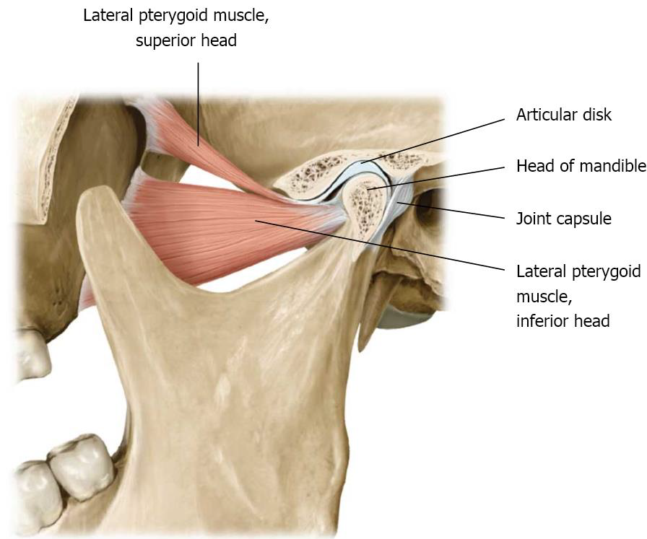
anatomy and physiology of temporomandibular joint
Bushra Mohammed Ali Al-Ameen
B,D,S,. M,Sc.(Pros)

Slide 2
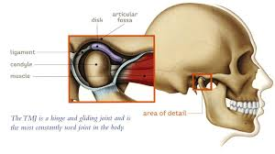
Temporomandibular joint (TMJ):
It is the articulation of the condyle of the mandible, and the inter-articular disc; with the mandibular fossa (glenoid fossa) of the temporal bone.
The joint has a capsule and an articulating disc.
It is considered as a compound joint (a compound joint is one with more than two bones articulating); in TMJ, the articular disc acts like the third bone.

Slide 3
TMJ consists of the following parts:
The mandibular fossa (glenoid fossa) of temporal bone.
The condyle or head of the mandible.
Synovial cavity.
The articular disc or (meniscus).
Meniscus is found between the condyle and the glenoid fossa. It divides the synovial joint or TMJ into upper and lower (superior and inferior) compartments.

Slide 5
The muscles that control the movement of the mandible:
There are three groups of muscles:
Closing muscles.
Gliding muscles.
Opening muscles.

Slide 6
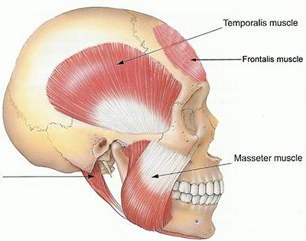
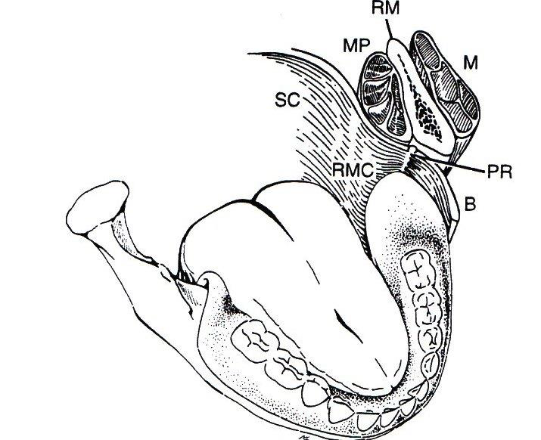
Closing muscles:
The temporalis muscles.
Masseter muscles.
Medial pterygoid muscles.
(elevating and closing the mandible).

Slide 7
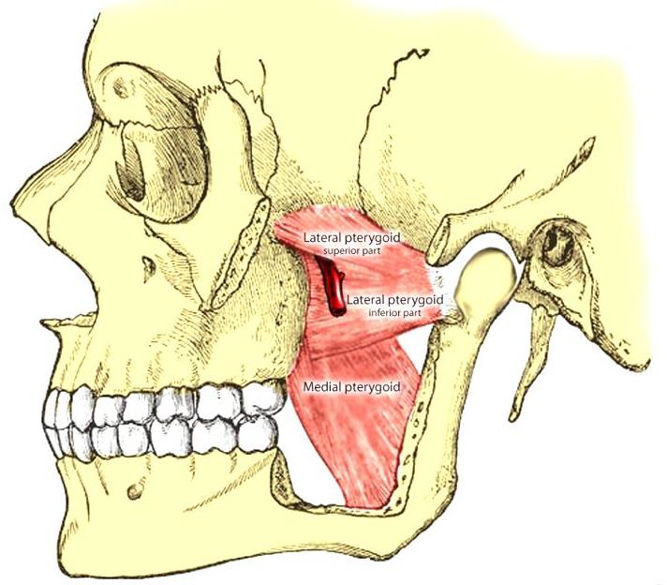
Gliding muscles:
The lateral pterygoid muscle
(protrude the jaw or to move it laterally).

Slide 8
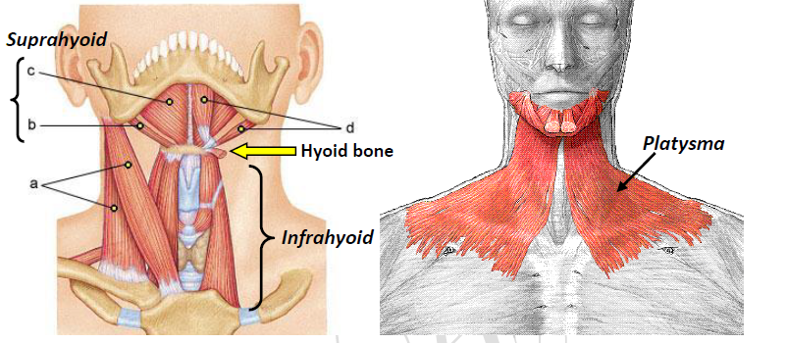
Opining muscles:
Suprahyoid muscles.
Infrahyoid muscles.
Platysma.
(depress (open) mandible)

Slide 9
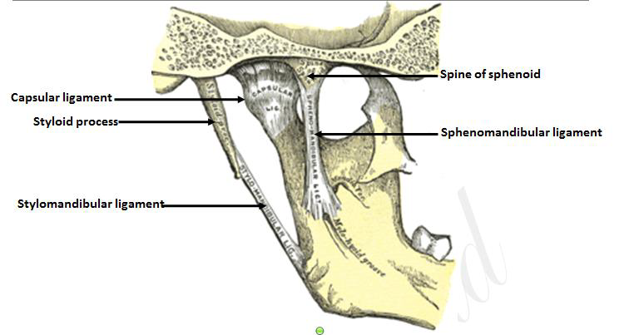
Ligaments affect the movement of mandible consist of:
Temporomandibular and capsular ligaments.
Sphenomandibular ligament.
Stylomandibulalar ligament.

Slide 10
Mandibular axes and Mandibular movements

Slide 11
The temporomandibular joints affect the dentures and likewise the dentures affect health and function of the joints.
The mandible is connected to the cranium at the two temporomandibular joint by the temporomandibular and capsular ligaments.
The sphenomandibular and stylomandibular ligaments also connect the bones in such a way as to limit some motions of the mandible.

Slide 12
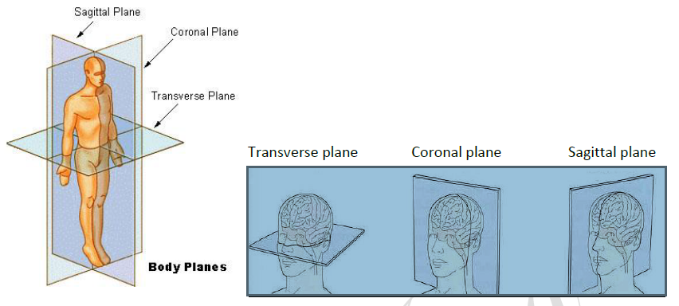

Slide 13
Mandibular axes
There are three axes around which the mandibular movements take place, the mandibular movements are related to three planes of skull (sagittal, transverse (horizontal), and coronal (frontal)).

Slide 14
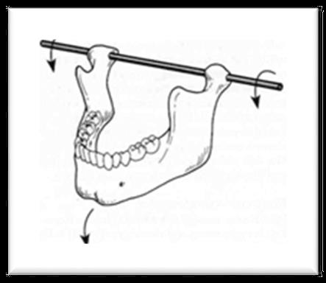
1- Hinge axis or transverse axis
It is an imaginary line around which the mandible may rotate within the sagittal plane (during opening and closing movement

Slide 15
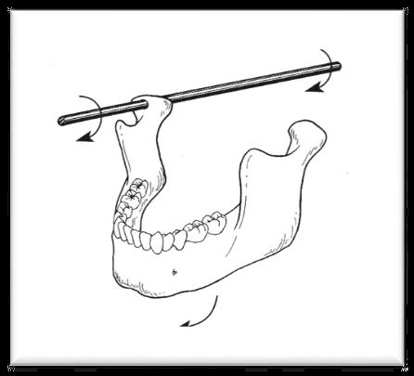
2- Sagittal axis of the mandible
It is an imaginary anteroposterior line around which the mandible may rotate within the frontal plane.

Slide 16
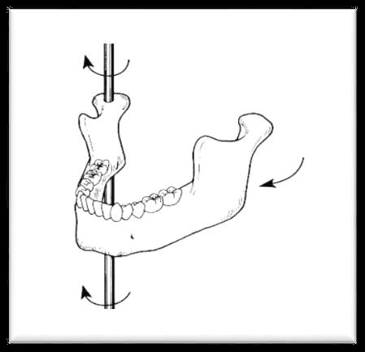
3- Vertical axis of the mandible
It is an imaginary line around which the mandible may rotate through the horizontal plane.

Slide 17
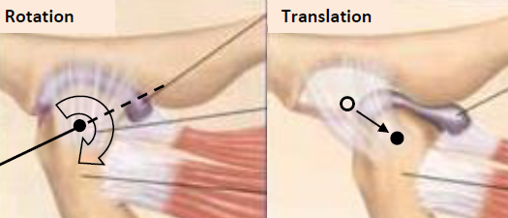
MANDIBULAR MOVMENTS
Based on the dimension involved in the movement
1- Rotational
a- Rotation around the transverse or hinge axis.
b- Rotation around the anteroposterior or sagittal axis.
c- Rotation around the vertical axis.
2- Translational or gliding
They are considered as basic movements of the mandible.

Slide 18
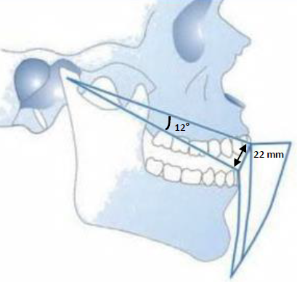
The upper compartment shows anteroposterior gliding movement, when this movement takes place, the condyle and the disc move as a single unit against the glenoid fossa.
The lower compartment shows hinge movement, during hinge movement the condyle moves against the articular disc and the glenoid fossa, which together act as a single unit. True condylar rotation is 12° with the maximum incisal separation of 22 mm.

Slide 19
MANDIBULAR MOVMENTS
Based on the type of movement:
1- Hinge movement.
2- Protrusive movement.
3- Retrusive movement.
4- Lateral movement.
a- Lateral rotation or (laterotrusion).
▪ Right.
▪ Left.
b- Lateral translation or (Bennett movement).

Slide 20
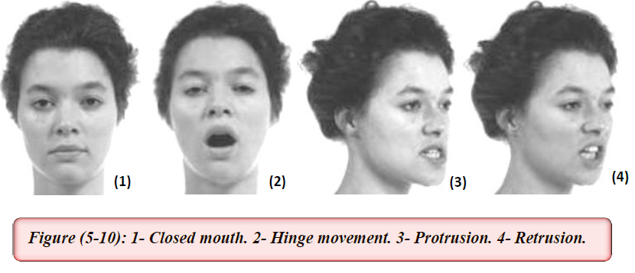
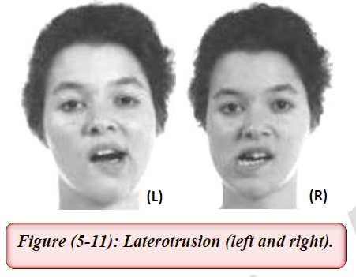

Slide 21
MANDIBULAR MOVMENTS
Based on the extent of movement:
1- Border movement
a- Extreme movement in the sagittal plane.
b- Extreme movement in the horizontal plane.
c- Extreme movement in the frontal plane.
d- Envelope of motion.
2- Intra-border movement
a- Functional movement.
▪ Chewing cycle.
▪ Swallowing.
▪ Yawning.
▪ Speech.
b- Para-functional movement
▪ Clenching.
▪ Bruxism.
▪ Other habitual movements.

Slide 22


Slide 23
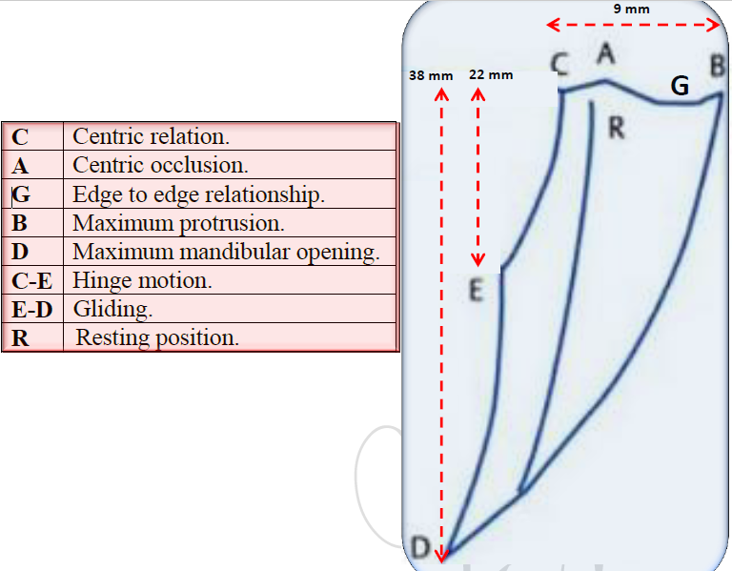
Borders movements recorded in the sagittal plane.

Slide 24
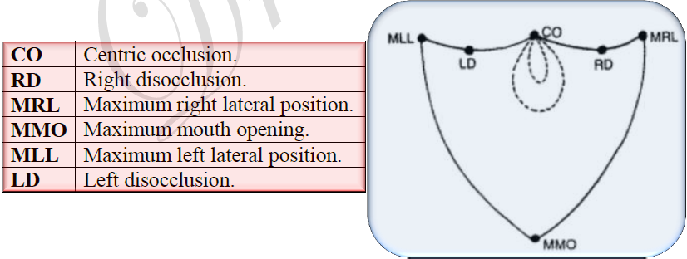
Border movements recorded in the coronal plane.

Slide 25
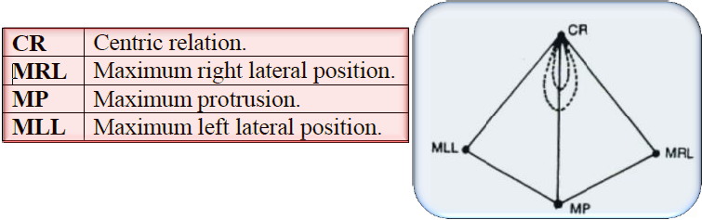
Border movements recorded in the horizontal plane.

Slide 26
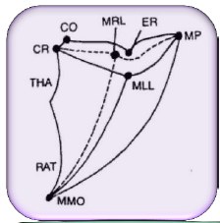
Envelope of motion
When we combine the border movements of all the three planes, we get a three dimensional space within which mandibular movements is possible, this three dimensional limiting space is called the (envelope of motion).
Envelope of motion:
(It is the combination of border movements in all three planes).

Slide 27

THANK YOU

