Slide 1
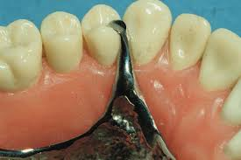
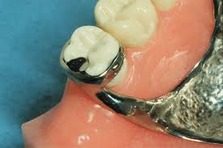
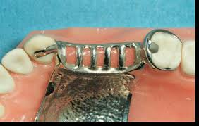
Minor Connectors
Bushra Mohammed Ali Al-Ameen
B,D,S,. M,Sc.(Pros)

Slide 2
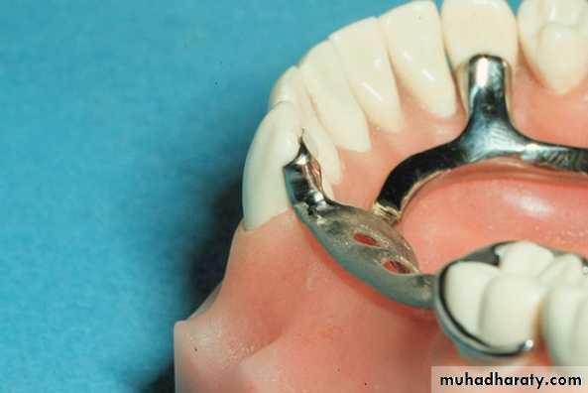
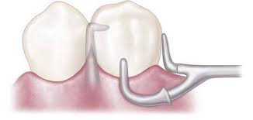
Minor Connectors
Minor connectors are those components that serve as the connecting link between the major connector or base of a removable partial denture and the other components of the prosthesis, such as the clasp assembly, indirect retainers, occlusal rests, or cingulum rests.

Slide 3
Functions of minor connectors
The primary function of a minor connector is to join the denture parts to major connector.
The minor connector serves other purposes.
1- To transfer functional stress to the abutment teeth. This is a (prosthesis-to-abutment function) of the minor connector.
Occlusal forces applied to the artificial teeth are transmitted through the base to the underlying ridge tissue if that base is primarily tissue supported.
Occlusal forces applied to the artificial teeth are also transferred to abutment teeth through occlusal rests.
The minor connectors arising from a rigid major connector make possible this transfer of functional stress throughout the dental arch.

Slide 4
Functions of minor connectors
The primary function of a minor connector is to join the denture parts to major connector.
The minor connector serves other purposes.
2- To transfer the effect of the retainers, rests, and stabilizing components throughout the prosthesis. This is an (abutment-to-prosthesis function) of the minor connector.
Thus forces applied on one portion of the denture may be resisted by other components placed elsewhere in the arch for that purpose.
A stabilizing component on one side of the arch may be placed to resist horizontal forces originating on the opposite side. This is possible only because of the transferring effect of the minor connector, which supports that stabilizing component, and the rigidity of the major connector.

Slide 5
Functions of minor connectors
The primary function of a minor connector is to join the denture parts to major connector.
The minor connector serves other purposes.
3- Provide unification and rigidity.
4- It might help in retention and stability of the prosthesis.
5- Through its connection to the guiding plane; it helps as a bracing element.
6- Share in the path of insertion and removal maintenance.

Slide 6
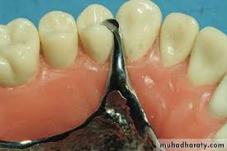
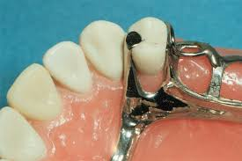
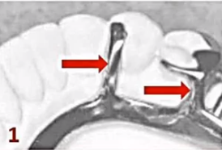
Basic types of the minor connectors
1. Type 1: Minor connectors placed into embrasures between two adjacent teeth or adjacent to an edentulous space to join clasp assembly, indirect retainer and auxiliary rest.

Slide 7
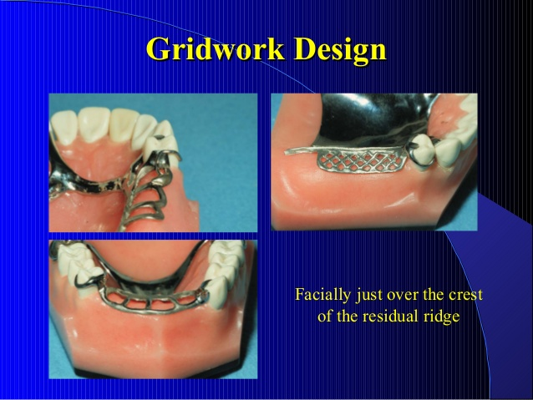
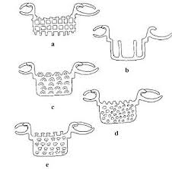

Basic types of the minor connectors
2. Type 2: Grid work minor connectors that covers the edentulous area to join denture base to major connector .
a. Retentive mesh.
b.Retentive lattice.
c. Retentive loops.
d.Retentive bead.
e. Retentive posts.

Slide 8
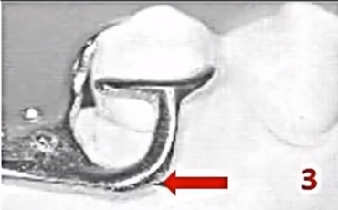
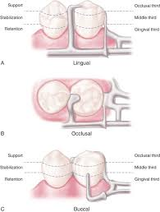
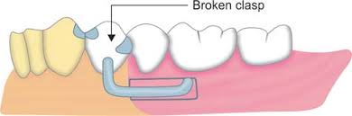
Basic types of the minor connectors
3. Type 3: minor connector that serve as approach arm for vertical projection of bar type clasp.

Slide 9
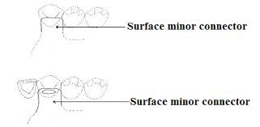
Basic types of the minor connectors
3. Type 4: Surface minor connectors are located on the lingual surface of incisors and canines. They connect lingual rests to the major connector.

Slide 10
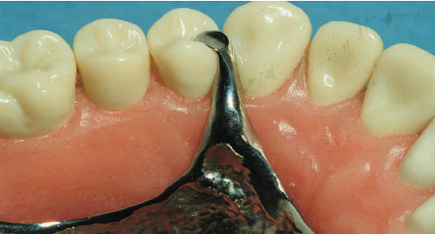

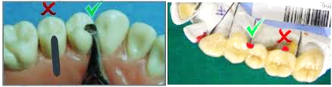
Form and location
1- The minor connector must have sufficient bulk to be rigid; otherwise the transfer of functional stresses to the supporting teeth and tissue will not be effective.
2- A minor connector contacting the axial surface of an abutment should not be located on a convex surface. Instead it should be located in an embrasure where it will be least noticeable to the tongue.

Slide 11
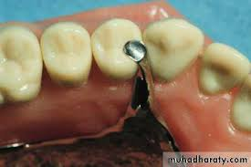

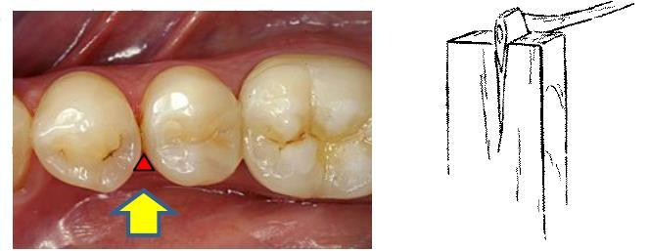
Form and location
3- It should passing vertically from the major connector and covers as little of the gingival tissue as possible.
4- The minor connector cross the free gingival area must be relieved in order not to impinge the tissue.
5- The deepest part of the interdental embrasure should have been blocked out to avoid interference during placement and removal, and to avoid any wedging effect on the contacted teeth.

Slide 12
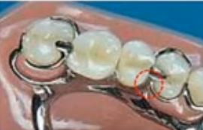
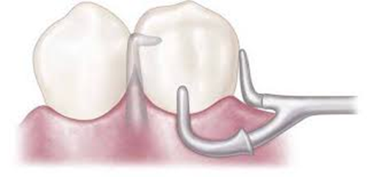
Form and location
6- It is a minor connector that contacts the guiding plane surfaces of the abutment teeth adjacent to an edentulous space. Here the minor connector must be broad buccolingually to use the guiding plane to the fullest advantage. And thin mesiodistally to place the prosthetic tooth in a natural position.
7- When an artificial tooth will be placed against a proximal minor connector, the minor connector's greatest bulk should be toward the lingual aspect of the abutment tooth. This way sufficient bulk is ensured with the least interference to placement of the artificial tooth.

Slide 13
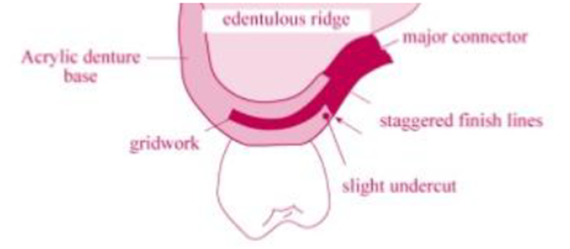
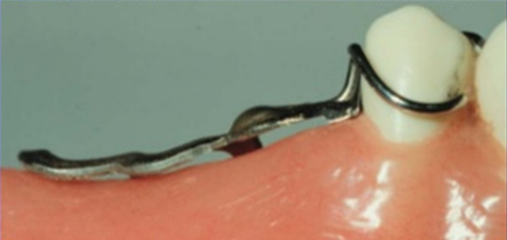
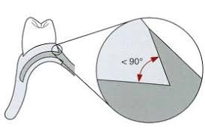
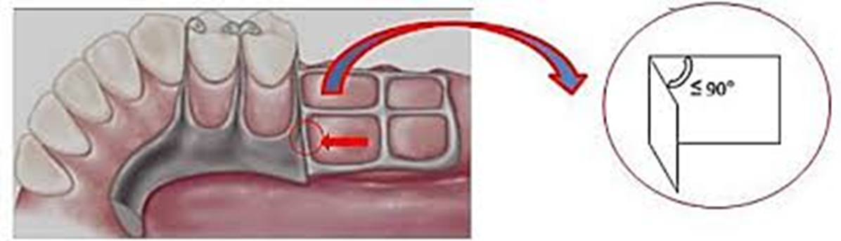
Form and location
8- Minor connector that covers the edentulous area to join denture base to major connector should be completely embedded within the denture base.
9- The junctions of these mandibular minor connectors with the major connectors should be strong butt-type joints. Angles formed at the junctions of the connectors should not be greater than 90 degrees, thus ensuring the most advantageous and strongest mechanical connection between the acrylic resin denture base and the major connector.

Slide 14
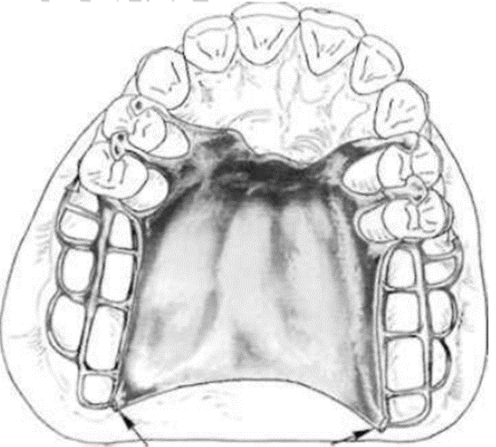
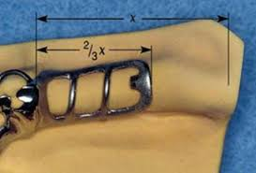
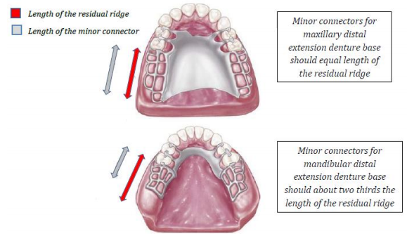
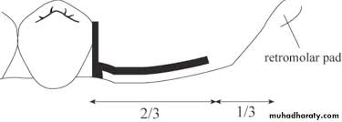
Form and location
10- The minor connector for the mandibular distal extension base should extend posteriorly about two thirds the length of the edentulous ridge and have elements on both the lingual and buccal surfaces. Such an arrangement will not only add strength to the denture base but also may minimize distortion of the cured base from its inherent strains caused by processing.
11- Minor connectors for maxillary distal extension denture bases should extend the entire length of the residual ridge and should be of a ladder-like or mesh-like.

Slide 15
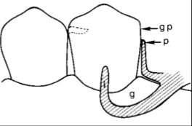
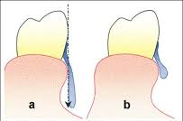
Form and location
12- The minor connector for vertical projection of bar type clasp approaches the tooth from an apical direction rather than from an occlusal direction, the approach arm should display a smooth, even taper from its origin to its terminus
13- Minor connectors for vertical projection of bar type clasp must not cross a soft tissue undercut (need parallel block out).

Slide 16
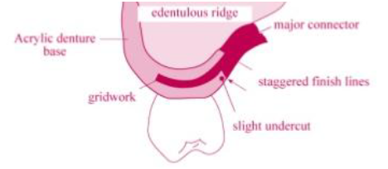
Finishing line
The finishing line junction with the major connector should take the form of an angle not greater than 90°, therefore being somewhat undercut.
Functions:
A finish line creates a definite limit to the plastic of the denture base, in this way the plastic ends in a bulk of material. Thin areas of plastic are weak and subjected to fracture.
Undercut finishing line provides mechanical retention for the plastic denture base.
Finish line provides a smooth transition from the plastic base to the removable partial denture metal framework.

Slide 17
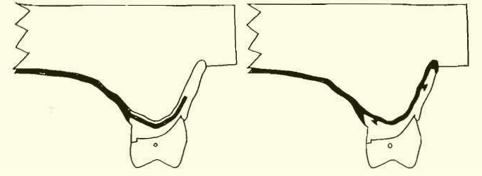
Finishing line
Frontal sections through lingual finishing lines of palatal major
connectors. Right image is through full cast metal base major connector;
left image is through resin denture base.

Slide 18
Finishing line
Of course the medial extent of the minor connector depends on the lateral extent of the major palatal connector.
If the finishing line is located too far medially, the natural contour of the palate will be altered by the thickness of the junction and the acrylic resin supporting the artificial teeth, when the palatal contours are restored, enhancing speech and contributing to a natural feeling for the patient.
If, on the other hand, the finishing line is located too far buccally, it will be most difficult to create a natural contour of the acrylic resin on the lingual surface of the artificial teeth.

Slide 19
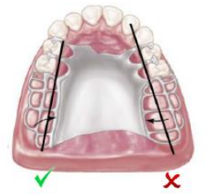
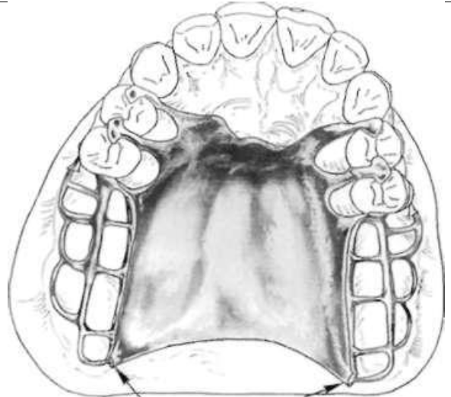
Finishing line
Junction of major connector and minor connector at palatal finishing lines should be located 2 mm medial from an imaginary line that would contact lingual surfaces of missing posterior teeth. Finish line on right is too far toward midline of palate.
Extension of finishing line to area of pterygomaxillary notch provides butt-type joint for attachment of border portion of resin base through pterygomaxillary notch (arrows).

Slide 20
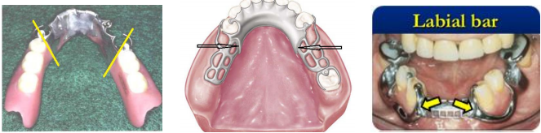
Types of finishing line
1. Vertical finish line:
It is the finishing line at the junction of ladder area and major connector in free end extension cases (class I and class II) in mandibular arch, and class IV mandibular arch with labial bar major connector. It represents the area where the acrylic resin that supporting artificial teeth ending.

Slide 21
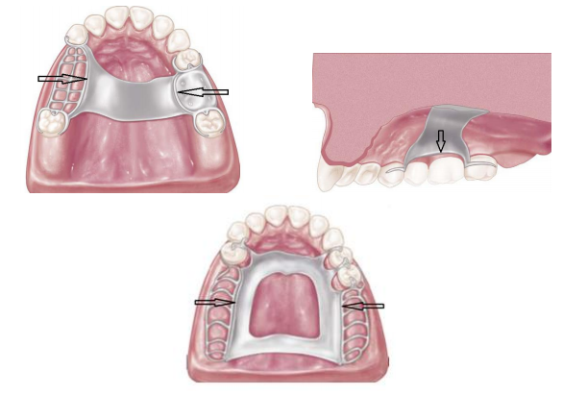
Types of finishing line
2. Horizontal finish line:
It is the junction of major connector and ladder area and it extends horizontally forming an undercut area that support acrylic resin that carrying artificial teeth, this type of finishing line is detected in all maxillary partial denture cases and in cl III mandibular cases and Class IV mandibular cases with lingually located major connector.

Slide 22

Thank you

