Slide 1
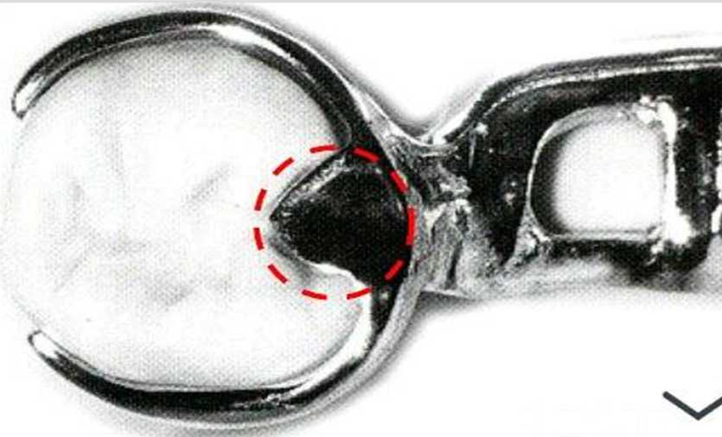
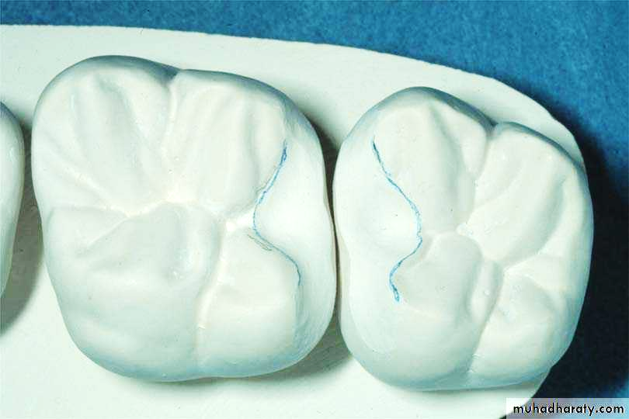
Rest And Rest Seats
Bushra Mohammed Ali Al-Ameen
B,D,S,. M,Sc.(Pros)

Slide 2
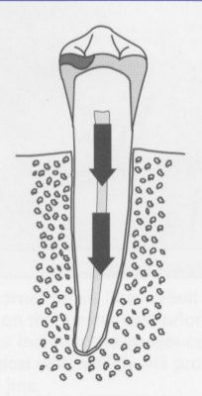
Rest And Rest Seat
Rest:
It is a rigid extension of partial denture which rest on occlusal, incisal, and lingual surface of a tooth to provide vertical support for the removable partial denture and transmit functional forces to the teeth in an atraumatic fashion (i.e. transfer forces down the long axes of the abutment teeth, in this manner the stress can be absorbed by the fibers of the PDL.

Slide 3
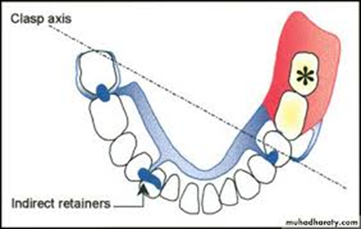
Rest And Rest Seat
Rest seat:
It is that portion of the tooth that have been selected and prepared to receive a rest.
The rest that is part of a retentive clasp assembly is called primary rest while rest that is responsible for additional support or indirect retainer is called secondary or auxiliary rest.

Slide 4
Functions of rests:
The primary purpose of the rest is to provide vertical support for the partial denture.
Directs and distributes occlusal loads to abutment teeth.
Maintains components in their planned positions.
Maintains established occlusal relationships by preventing settling of the denture.
Prevents impingement of soft tissue.

Slide 5
Functions of rests:
Serve as a reference point for evaluating the fit of the framework to the teeth.
Prevent extrusion, tipping, or migration of the abutment teeth.
Acts along with its minor connector as an indirect retainer for a tooth-tissue supported removable partial denture.
Deflection of food by bridging the gap between two teeth.
Splints mobile teeth.

Slide 6
There are several points which should be put into consideration in determination of the site and form of the rests.
Root form.
Root length.
Inclination of the tooth.
Ratio of the length of the clinical crown to the alveolar support.

Slide 7
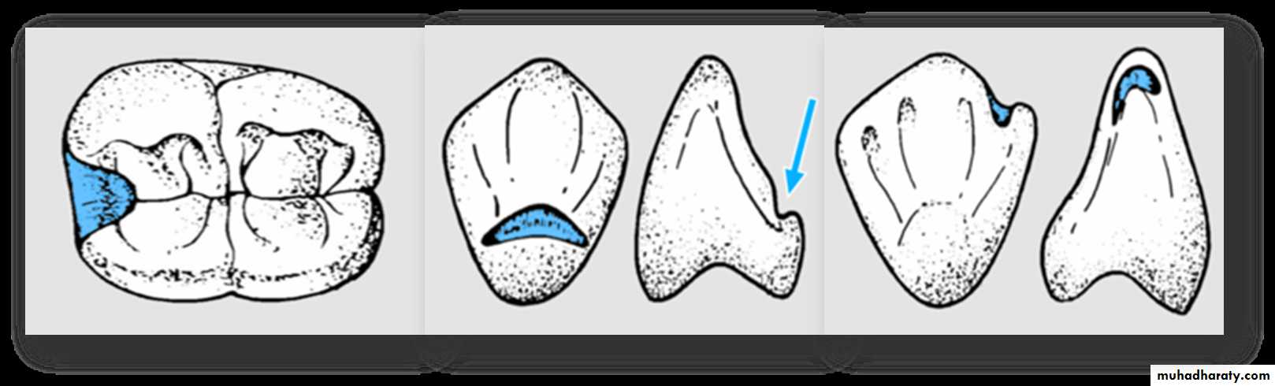
Types of rests:
Occlusal rest.
Lingual rest.
Incisal rest.

Slide 8
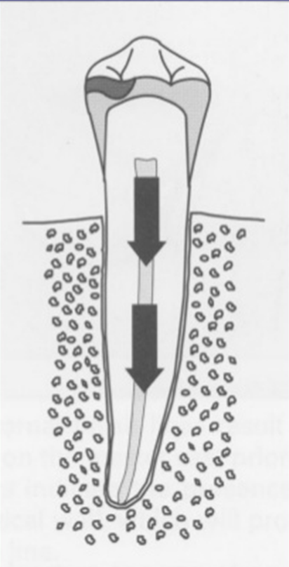
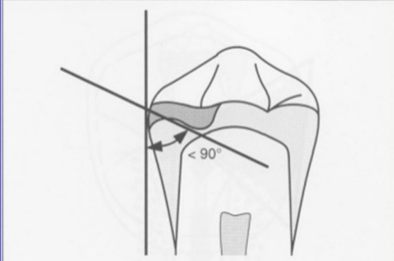
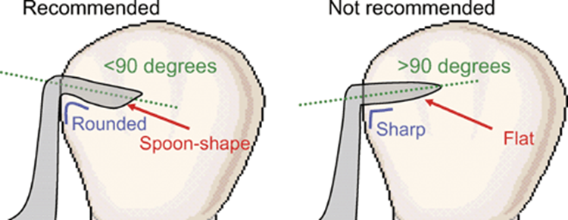
Basic requirements of rest and rest seat
Provide rigid support.
Extends to the center of the tooth in tooth supported situations, so the vertical stress will be resisted by all of the periodontal ligament fibers.
Rests should be placed in properly engineered seat, with minimal preparation in dentine of the surfaces of the teeth, ( rounded, the floor of rest seat shloud be less than 90° to the long axis of the tooth, to direct stresses axially. Also its seat should be apical to the marginal ridge with no sharp angles ( for ease of cleaning , making impressions and prevents tooth fracture).

Slide 9
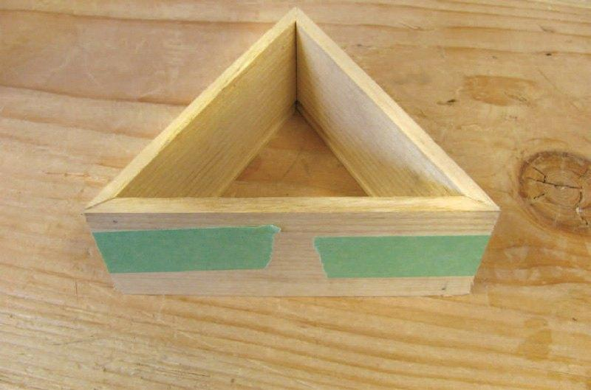
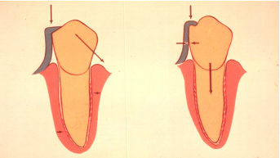
Basic requirements of rest and rest seat

Slide 10
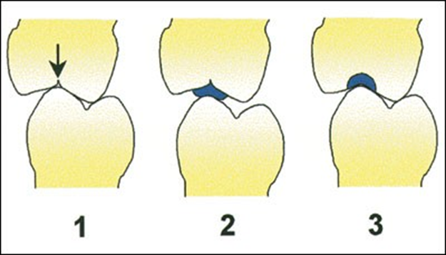
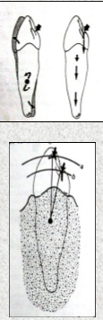
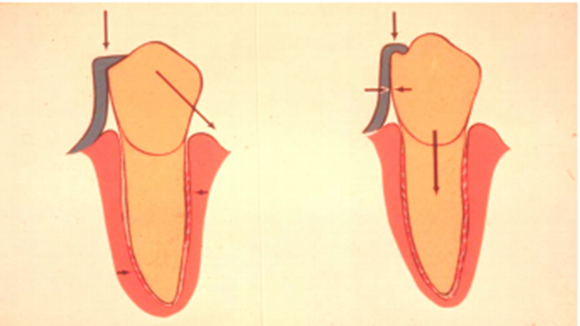
Basic requirements of rest and rest seat
No undercuts in the path of insertion.
Minimum of 1 mm thick.
Restore the occlusal plane.
Contoured so that when increased force is applied to the prosthesis the rest will engage more securely to prevent separation.
Anterior rests should be as close to the center of the tooth as possible.

Slide 11
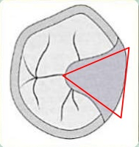
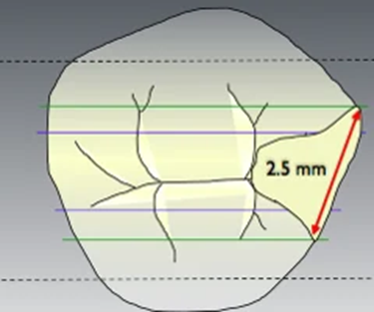
Form of the occlusal rest and rest seat
1- The outline form of an occlusal rest seat should be a rounded triangular shape with the apex toward the center of the occlusal surface.
2- It should be as long as it is wide, It should occupy 1/3 to ½ the mesiodestal diameter of the abutment and ½ the buccolingual intercuspal width. Rest seats of smaller dimensions do not provide an adequate bulk of metal for rests.

Slide 12
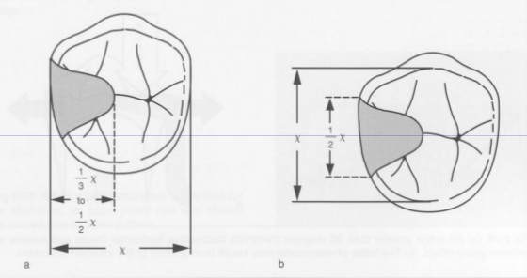

Slide 13
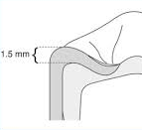
Form of the occlusal rest and rest seat
3- The marginal ridge of the abutment tooth at the site of the rest seat must be lowered to permit a sufficient bulk of metal for strength and rigidity of the rest and the minor connector. This means that a reduction of the marginal ridge of approximately 1.5 mm is usually necessary.

Slide 14
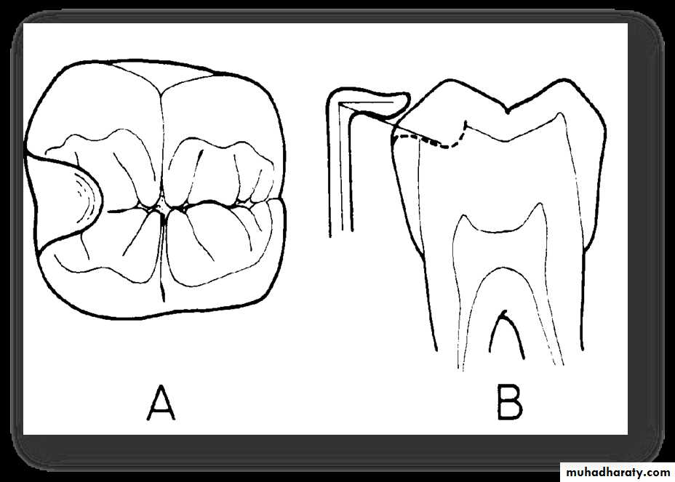
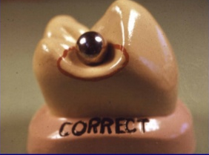
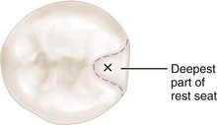
Form of the occlusal rest and rest seat
4- The floor of the occlusal rest seat should be apical to the marginal ridge and the occlusal surface and should be concave, or spoon shaped. Caution should be exercised in preparing a rest seat to avoid creating sharp edges or line angles in the preparation.
5- The angle formed by the occlusal rest and the vertical minor connector from which it originates should be less than 90°.

Slide 15

Form of the occlusal rest and rest seat
Only in this way can the occlusal forces be directed along the long axis of the abutment tooth. An angle greater than 90° fails to transmit occlusal forces along the supporting vertical axis of the abutment tooth. This also permits slippage of the prosthesis away from the abutment, which can result in orthodontic-like forces being applied to an inclined plane on the abutment, with possible tooth movement, so a secondary rest is placed on the opposite side of an abutment to prevent slippage of the rest.

Slide 16
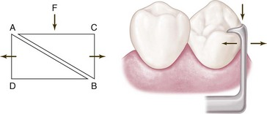
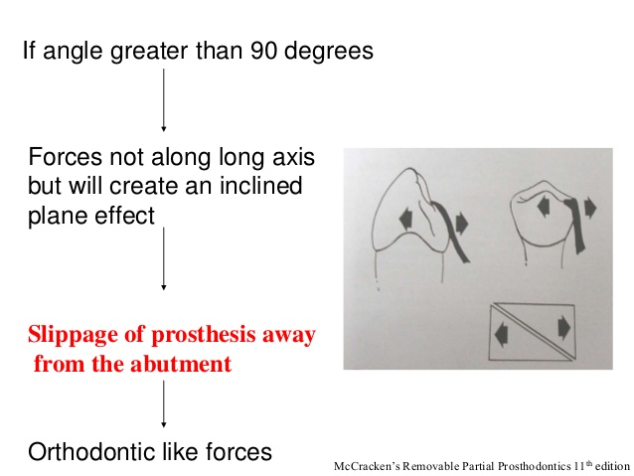

Slide 17
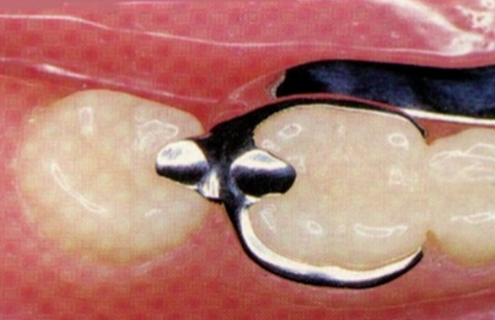

Form of the occlusal rest and rest seat
Interproximal rests (embrasure rest):
One or two occlusal rests on adjacent teeth; every seat must be prepared as an individual occlusal rest with exception that the preparation must be more lingually.

Slide 18
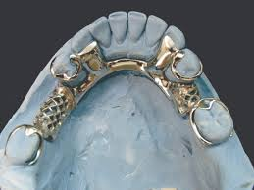
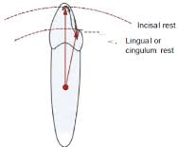
Lingual rests on canines and incisor teeth
Although the preferred site for an external rest is the occlusal surface of a molar or a premolar, also anterior teeth occasionally must be used to support an indirect retainer or an auxiliary rest.
A canine is much preferred over an incisor for this purpose.
When a canine is not present, multiple rests that are spread over several incisor teeth are preferable to the use of a single incisor.
A lingual rest is preferable to an incisal rest.

Slide 19
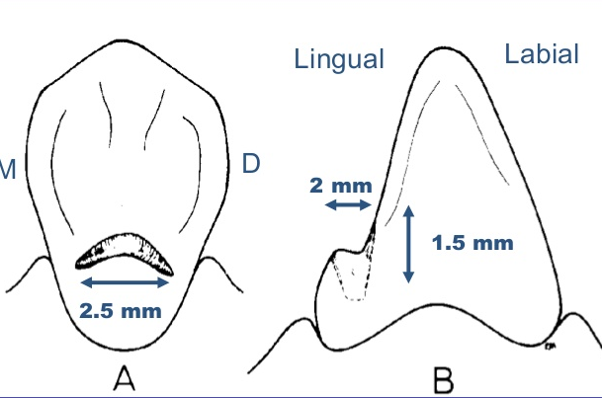
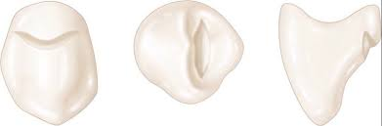
Lingual rests on canines and incisor teeth
The rest seat, from lingual aspect, form of a broad inverted V- notch form is self-centering for the rest and at the same time directs forces rather favorably in an apical direction. Looking at preparation from incisal view, it will be noted that rest seat preparation is broadest at most lingual aspect of canine. As preparation approaches proximal surfaces of tooth, it is less broad than at any other areas.
Proximal view demonstrates correct taper of floor of rest seat. It also should be noted that borders of rest seat are slightly rounded to avoid line angles in its preparation. Mesiodistal length of preparation should be a minimum of 2.5-3 mm, labiolingual width about 2 mm, and incisoapical depth a minimum of 1.5 mm.

Slide 20
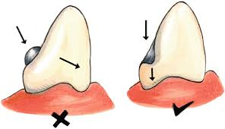
Lingual rests on canines and incisor teeth
Lingual view demonstrates a slightly rounded V prepared on the lingual surface at the junction of the gingival and the middle one third of the tooth.
The apex of the V is directed incisally.
All line angles must be eliminated, and the rest seat must be prepared within the enamel and must be highly polished.
A predetermined path of placement for the denture must be kept in mind in preparing the rest seat.

Slide 21
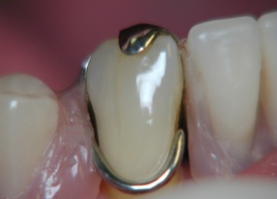
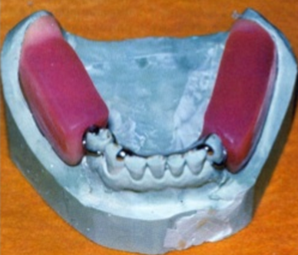
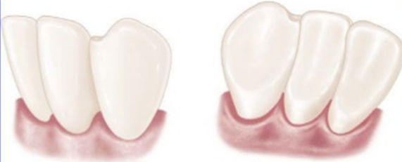
Incisal rest and rest seat
Incisal rests are placed near the incisal angles of anterior teeth and on prepared rest seats. Although this is the least desirable placement of a rest seat for reasons previously mentioned, it may be used successfully for selected patients when the abutment is sound.

Slide 22
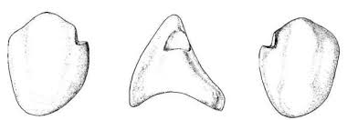
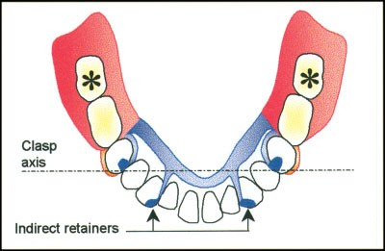
Incisal rest and rest seat
It is prepared in the form of a rounded notch at the incisal angle or on an incisal edge; the floor of rest seat has been extended slightly onto labial aspect of tooth. Lingual view shows that all borders of rest seat are rounded to avoid sharp line angles. It is especially important to avoid a line angle at junction of axial wall of preparation and floor of rest seat.
The enamel on the lingual surface should be prepared as a shallow depression to accommodate the minor connector and avoid annoying the tongue.

Slide 23

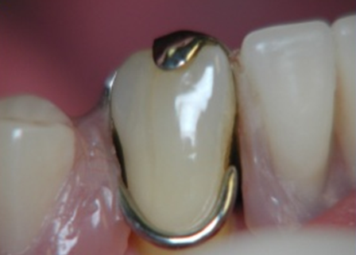

Incisal rest and rest seat
Lingual rest is preferable over the incisal rest because:
Lingual rest is more esthetic than the incisal rest because it lies on the lingual surface completely.
Lingual rest usually placed nearer to the horizontal axis of rotation of the abutment tooth (tipping axis), so it will has fewer tendencies to tip the teeth.
For mandibular teeth, they are not involved in the occlusion.

Slide 24


