Slide 1
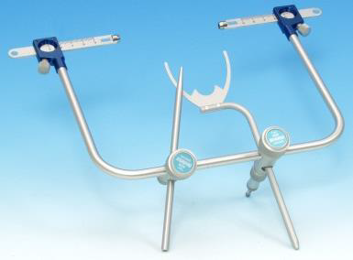
Face bow and Articulators
Bushra Mohammed Ali Al-Ameen
B,D,S,. M,Sc.(Pros)

Slide 2
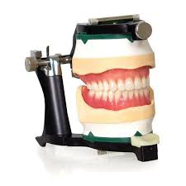
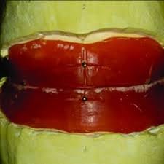
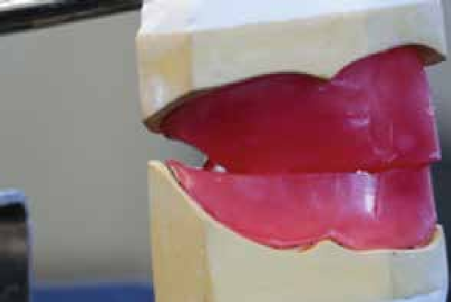
Jaw relation (Maxillomandibular relationship):
any one of the infinite spatial relationships of the mandible to the maxilla.
Jaw relation record:
It is a registration of any positional relationship of the mandible relative to the maxilla. These records may be made at any vertical, horizontal, or lateral orientation; it is also known as:Maxillomandibular record, maxillomandibular registration.

Slide 3
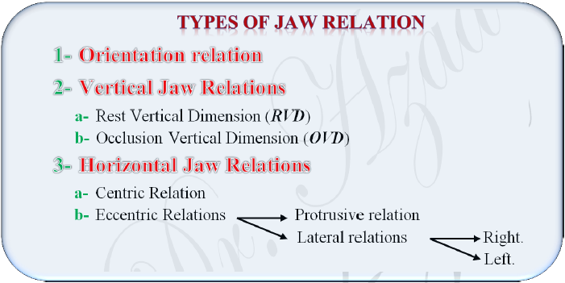

Slide 4
Orintation relation
It is defined as the jaw relation when the mandible is kept in its most posterior position, it can rotate in the sagittal plane around an imaginary transverse axis passing through or near the condyles.
This record gives the position of the maxilla in relation to the base of the skull.
It is necessary to do orientation jaw relation before carrying out other jaw relation.
The casts on the articulator must relate to the hinge axis of the instrument.
This relation can be recorded by mean of the face-bow.

Slide 5
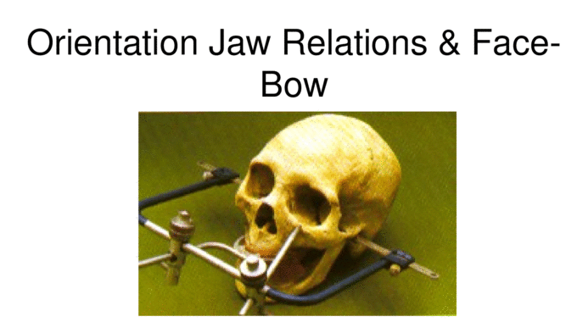

Slide 6
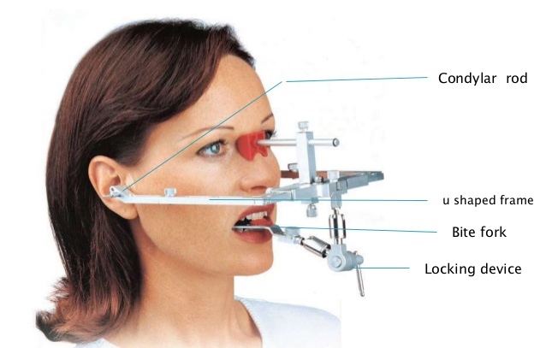
Face bow
It is a caliper-like device used to record the relationship of the maxillary arch to the temporomandibular joints (base of the skull) or the opening axis of the jaws, and then transfer this relationship to the opening axis of the articulator.

Slide 7
Parts of the face bow
The face-bow basically contains three sections:
1- U-frame: it represents the plane of the cranium. It is the main frame of the face-bow; all other components are attached to the frame. It should be large and wide enough to avoid contact with the sides of the face.
2- Bite fork: it represents the plane of the maxilla. It is a U-shaped plate, which is attached to the occlusal rims.
3- Locking device: it locks the first two sections without altering their plane.

Slide 8
Also the face-bow contains
Condyle rods: These are two small rods on either side of the free end of the frame that contacts the skin over the TMJ, over the hinge axis and transverse the hinge axis of TMJ by attaching to the condylar shaft in the articulator.
Orbital pointer with clamp: It is designed to mark the anterior reference point (infraorbital notch) and can be locked in position with a clamp. It is present only in the arbitrary face- bow.

Slide 9
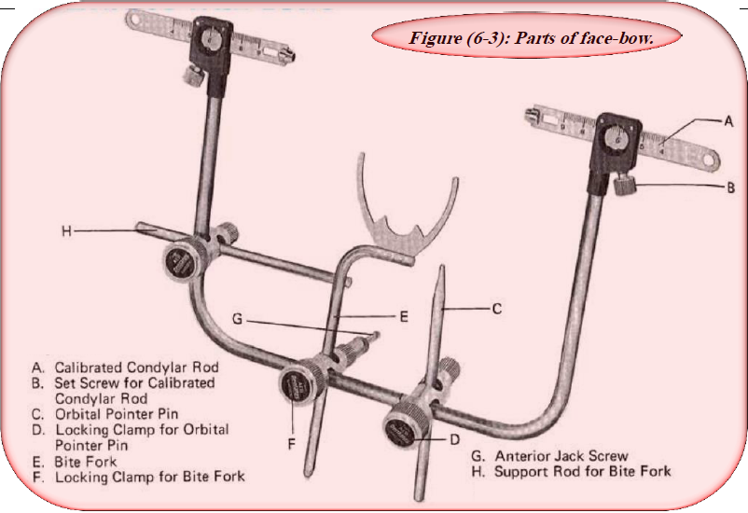

Slide 10
Types of the Face-Bow
Arbitrary face-bow:
It is the most commonly used face-bow in complete denture construction.
The hinge axis is approximately located, it orients the maxilla to an arbitrary hinge axis and transverse it to the articulator and it does not exactly match the articulator axis to the actual hinge axis.
It is simplistic, less accurate, requires less complicated equipment and time.
It is used with semiadjustable articulators.

Slide 12
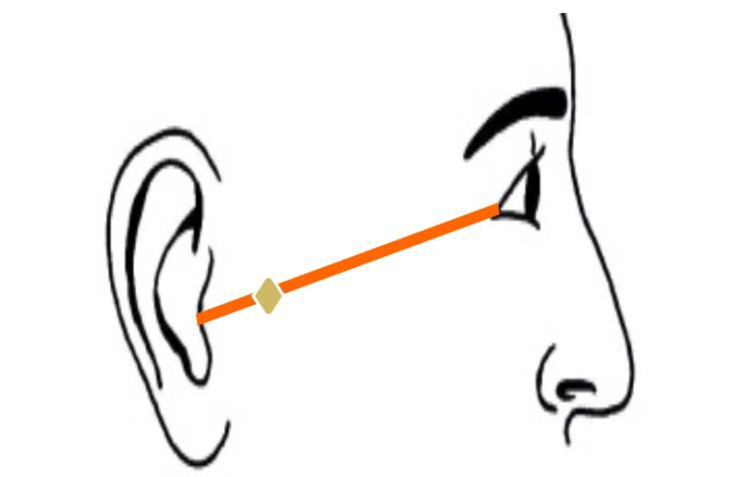
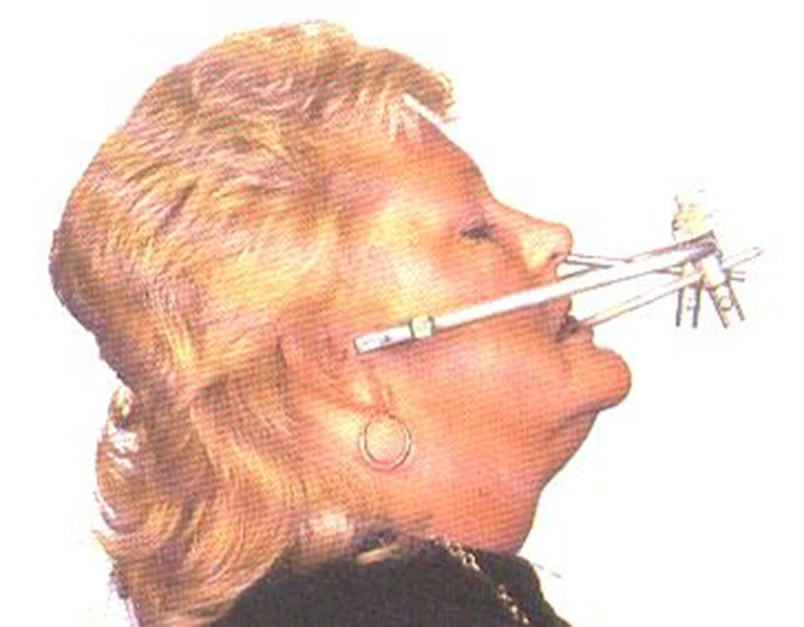
The hing axis of Arbitrary Face Bow can be designed:
EITHER arbitrarily, the condylar rods are positioned approximately13 mm anterior to the posterior margin of the tragus of ear along a line drawn from the outer canthus of the eye to the center of the tragus (cantho-tragus line) this point called (Beyron's point).

Slide 13
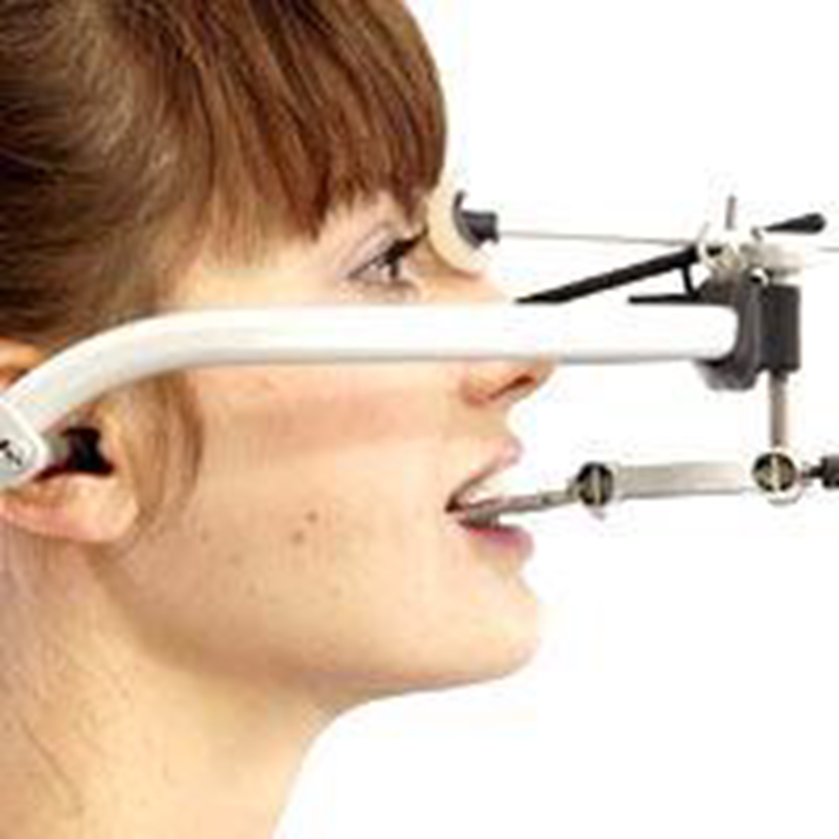
The hing axis of Arbitrary Face Bow can be designed:
OR by the position of the earpieces in the external auditory meatus.The difference in the position of the earpiece position is accommodated by the design of the articulator and its earpiece receiver points (auditory pin).

Slide 14
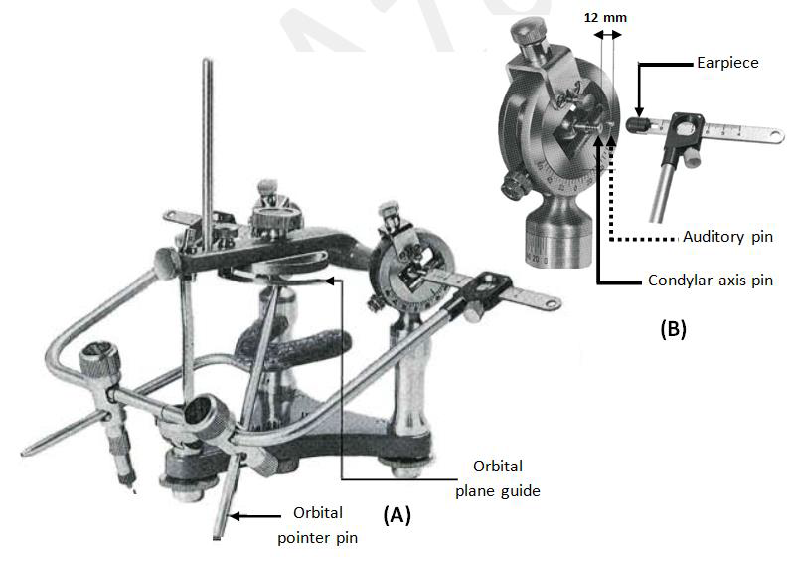
Figure : Attachment of the arbitrary face bow to the semiadjustable articulator (A):condylar rod. (B): earpiece.

Slide 15
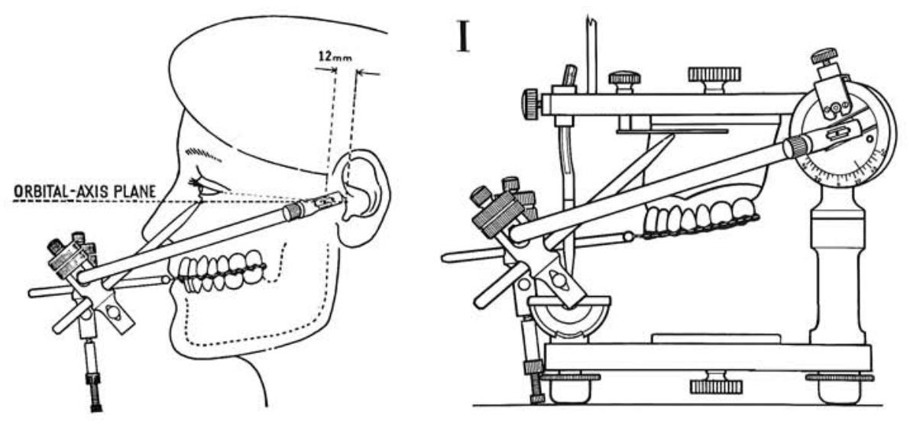

Slide 16
Types of the Face-Bow
2. Kinematic face-bow:
A face-bow attached to the mandible with caliper ends (condyle rods) that can be adjusted to permit the accurate location of the true axis of rotation of the mandible.
It is generally used for the fabrication of fixed partial denture and full mouth rehabilitation.
It is generally not used for complete denture fabrication because it requires a long and complex procedure to record the orientation jaw relation.
It orients the maxilla to the actual hinge axis and transverse it to the articulator.
It is most sophisticated, most accurate, required more elaborate equipment and time.
It is used with fully-adjustable articulators.

Slide 17
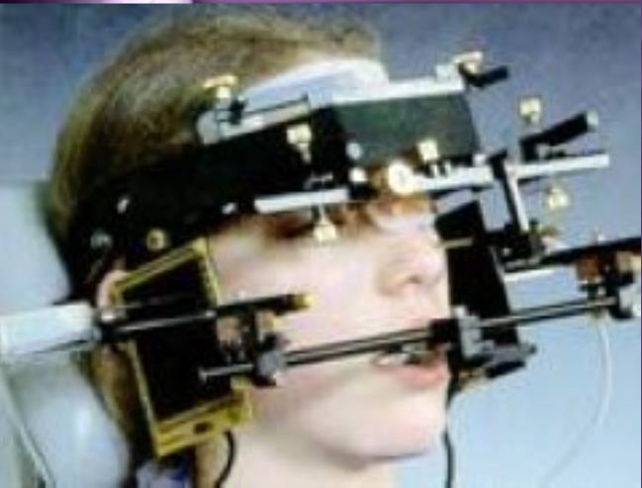

Slide 18
The axis of kinematic Face Bow can be designed:
The first step involves the fabrication of clutch (it is occlusal rim made of impression compound with a bite fork tightly attached to it).
Once the clutch has been attached to the mandible and hinge bow attached to it, guide the patient in making only hinge opening and closing movement.
Left and right styli are attached via a face-bow to a clutch.

Slide 19
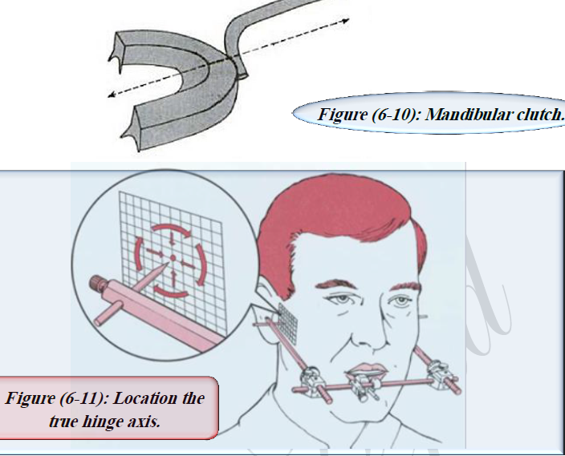

Slide 20
Importance of the Facebow
The mounting of maxillary cast without face-bow transfer can produce errors in the occlusion of the finished denture.
A face-bow transfer allows minor changes in the occlusal vertical dimension on the articulator without having to make new maxillomandibular records.
It is helpful in supporting maxillary cast while it is being mounted on the articulator.

Slide 21
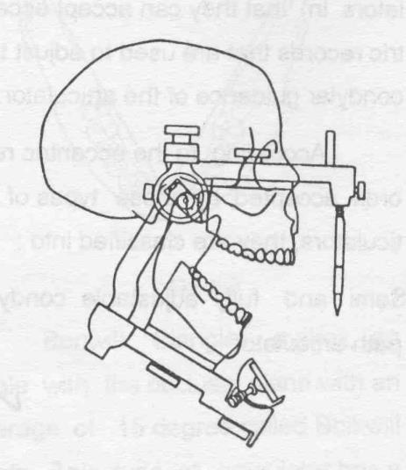
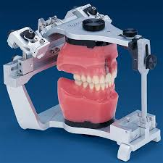
Articulator
It is a mechanical instrument that represents the temporomandibular joints and jaws, to which maxillary and mandibular casts may be attached to simulate some or all mandibular movements.

Slide 22
Uses of Articulators
To diagnose the state of occlusion in both the natural and artificial dentitions.
To plan dental procedures based on the relationship between opposing natural and artificial teeth.
To aid in the fabrication of restorations and prosthodontic replacements.
To maintain the jaw relation record during arrangement of artificial teeth.
To correct and modify completed restorations (remounting the dentures after processing for correction of occlusal disharmony).

Slide 23
Requirments of an articulator
It should hold casts in the correct horizontal relationship.
It should hold casts in the correct vertical relationship.
The casts should be easily removable and re-attachable.
It should provide a positive anterior vertical stop (incisal pin).
It should accept face-bow transfer record.
It should open and close in a hinge movement.
It should be made of non-corrosive and rigid materials.
It should not be bulky or heavy.
There should be adequate space between the upper and lower members.
The moving parts should move freely without any friction.

Slide 24
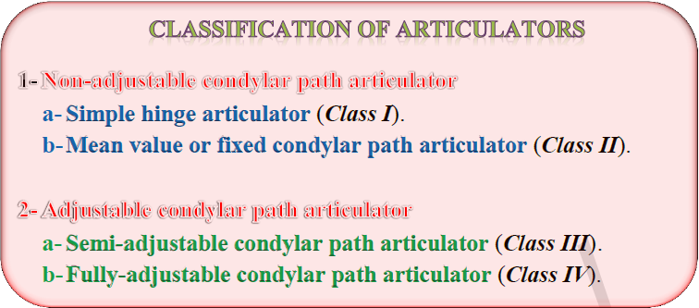

Slide 25
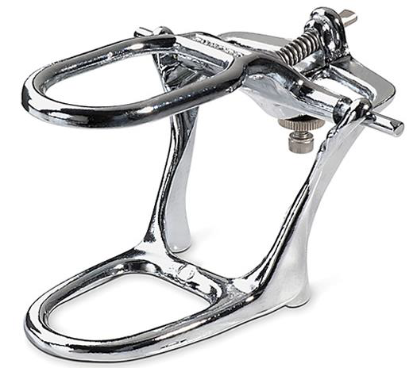
Simple hinge Articulator
These are simple holding instruments capable of accepting a single static registration.
Only vertical motion is possible.
They orient the opposing casts to each other without reference to anatomical landmarks.

Slide 26
Simple hinge Articulator
DESIGN: It consists of upper and lower members held apart at certain distance by a screw which acts at the back. The screw can increase or decrease the distance between the two members, and permits only a hinge like movement.
Possible movement: This type of articulators gives only hinge opening and closing movement.

Slide 27
Simple hinge Articulator
Records required for programming this type:
1- Vertical dimension of occlusion.
2- Centric relation records.
Disadvantages:
These articulators do not represent the temporomandibular joint and the dynamic mandibular movements.

Slide 28
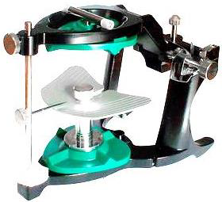
Mean value (fixed condyler path articulator)
These are an instrument that permits horizontal as well as vertical motion but does not orient the motion to the temporomandibular joints.

Slide 29
Mean value (fixed condyler path articulator)
DESIGN: The two members of this type of articulators are joined together by two joints that represent the temporomandibular joints.
The horizontal condylar path is fixed at certain angle that ranges from 30° which is the average (mean) of the most patients.
The incisal guide table is also fixed at a certain angle from horizontal.
The distance between the condylar and incisal guide is derived from the average (mean) distance of the population.
In the most fixed condylar path articulators, the upper member is movable and the lower member is stationary.

Slide 30
Mean value (fixed condyler path articulator)
Possible movements:
Opening and closing.
Protrusive movement at a fixed condylar path angle.
Records required for programming this type:
Vertical dimension of occlusion.
Centric relation record.
Face-bow record.

Slide 31
Mean value (fixed condyler path articulator)
Disadvantages:
Most of these articulators do not accept face-bow record.
The condylar path moves to a fixed angle and it is successful only in patients whose condylar angle approximates that of the articulator.
No lateral movements.

Slide 32
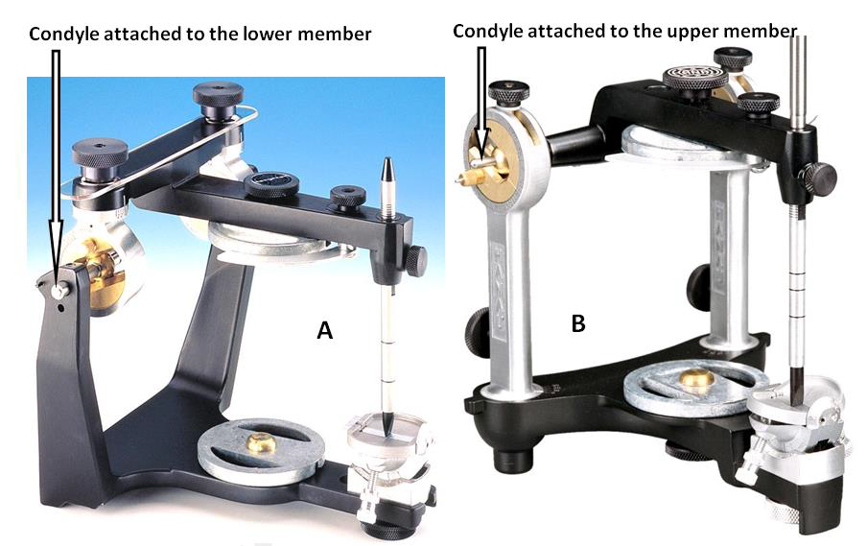
Semi adjustable condyler path articulator.
An articulator that allows adjustment to replicate average mandibular movements and it may be arcon or nonarcon instruments.

Slide 33
Semi adjustable condyler path articulator.
In these articulators, the horizontal condylar path is adjusted by a protrusive record obtained from the patient, and the lateral condylar path inclination is adjusted according to the Hanau's formula when use Hanau type of semi-adjustable articulator.

Slide 34
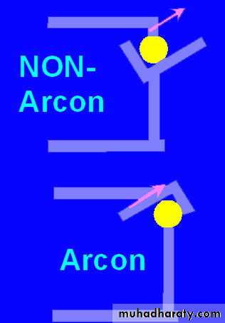
Semi adjustable condyler path articulator.
They are classified as:
Arcon semi-adjustable articulator.
Non-arcon semi-adjustable articulator.
The term arcon comes from (mandibular condyle). It is commonly used to indicate an articulator that has its condyles on the lower member and the condylar guide on the upper member.

Slide 36
Semi adjustable condyler path articulator.
Possible movements:
Opening and closing.
Protrusive movement according to the horizontal condylar path angle determined from the patient.
Lateral movement according to the lateral condylar path inclination determined from the Hanau's formula.
Some types have Bennett movement (immediate side shift).

Slide 37
Semi adjustable condyler path articulator.
Records required for programming this type:
A maxillary face-bow record to mount the upper cast.
Centric occluding relation record to mount the lower cast.
Protrusive record to adjust the horizontal condylar path inclination of the articulator, and to find the lateral condylar path inclination from Hanau's formula.

Slide 38
Semi adjustable condyler path articulator.
Disadvantages:
The lateral condylar path angle is determined from a formula, not from the patient directly.
The condyles travel on a flat path cannot be used to reproduced eccentric movements exactly.
Most of these articulators have no Bennett movement

Slide 39
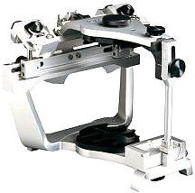
Fully adjustable condyler path articulator.
An articulator that will accept three dimensional dynamic registrations; these instruments allow for orientation of the casts to the temporomandibular joints and simulation of mandibular movements.
They differ from the semi-adjustable articulators in that the lateral condylar path inclination is adjusted according to records taken from the patient.

Slide 40
Fully adjustable condyler path articulator.
Possible movements:
Opening and closing.
Protrusive movement according to the horizontal condylar path angle determined from the patient.
Lateral movement according to the lateral condylar path inclination determined from the patient.
Bennett movement.

Slide 41
Fully adjustable condyler path articulator.
Records required to program this type:
A maxillary face-bow record to mount the upper cast.
Centric occluding relation record to mount the lower cast.
Protrusive record to adjust the horizontal condylar path inclination of the articulator.
Right lateral record to adjust the left condylar path inclination.
Left lateral record to adjust the right condylar path inclination.
Disadvantages:
Multiple records are required with the possibility of errors.

Slide 42


