Slide 1
Children’s management techniqueS
Pedodontic Dentistry \ 5th-grade
Lec.5
Dr. Mukhalled alasady
Oral & Maxillofacial surgeon
B.D.S. – C.A.B.M.F.S
College of dentistry\University
ofAl- Muthanna

Slide 2

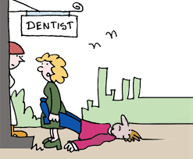
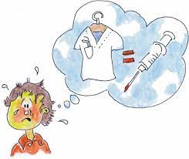
Children’s management techniqueS

Slide 3
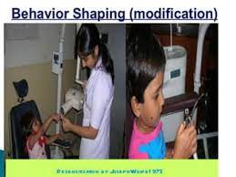
Behavior Shaping
it is that procedure which very slowly develops behavior by reinforcing successive approximations of the desired behavior until the desired behavior occurs.
Most behavior is learned and that learning is the establishment of a connection between a stimulus and a response. For this reason, it is sometimes called stimulus-response (S-R) theory.

Slide 4
The following is an outline for a behavior-shaping model:
1. State the general goal or task to the child at the outset.
2. Explain the necessity for the procedure.
3. Divide the explanation for the procedure

Slide 5
The following is an outline for a behavior-shaping model:
.
6. Reinforce appropriate behavior and Disregard minor inappropriate behavior
4. Give all explanations at a child’s level of understanding
5. Use successive approximations

Slide 6
Behavior shaping may include
Desensitization
Tell-Show-DO
Modelling
Contingency
Distraction

Slide 7
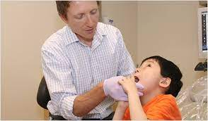
Desensitization
It is also called as reciprocal inhibition. It is a training procedure or steps taken to reduce the sensitivity of the patient to a particular anxiety producing situation or object.
The technique involves 3 stages
1. Training the patient to relax
2. Constructing a hierarchy of fear producing stimuli .
3. Introducing each stimulus in the hierarchy

Slide 8

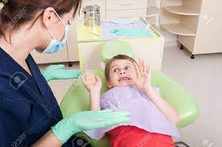
First Visit
Subsequent visits when introducing new dental procedure
Fearful Child
Apprehensive Child because of information received from parents.
Indications:

Slide 9
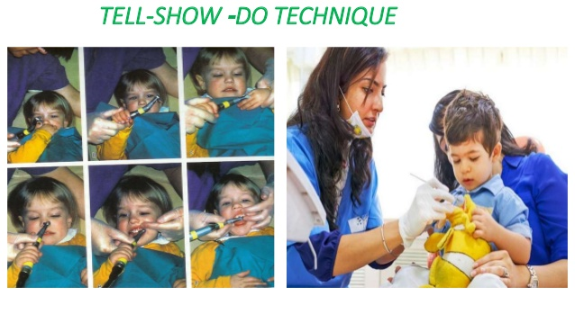
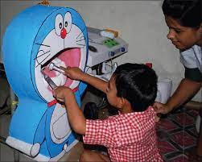
Tell-Show-Do (TSD)
(Tell) The dentist tells the child what is going to be done in words the child can understand
( Show ) demonstration for the patient of different aspects of the procedure in a non- threatening setting
(Do) then proceed to complete the procedure

Slide 10
objectives
1- To teach the patient aspects of dental visit and to familiarize him with the dental setting.
2. To shape patients response to various procedures through desensitization and well described expectations.
Note: With Tell-Show-Do we don’t ask permission

Slide 11
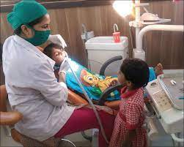
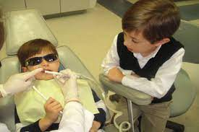
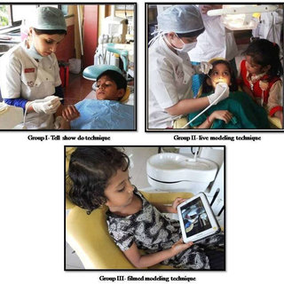
Modeling
It involves allowing the patient to observe one or more model who demonstrate appropriate behavior in a particular situation.
Modeling will encourage the appropriate behavior when the patient see the dentist is happy with other child.
Types of modeling
1. Audio-visual 2. Live modeling by sibling or parent

Slide 12
Advantages
1. Obtain the patient attention.
2. Designed behavior is modelled.
3. Physical guidance of the desired behavior.
4. Reinforcement of the guided behavior.
Objectives
1. Stimulate acquisition of new behavior.
2. Facilitating the behavior already in the patients in a more appropriate manner.
3. Elimination of avoidance behavior.
4. Extinction of fear

Slide 13
Contingency
Contingency management is the term used for presentation or withdrawal of reinforcers in behavior management. Reinforcers can be:
I. Positive reinforcers- presentation of which increases the frequency of desired behavior.
II. Negative reinforcers- withdrawal of which increases the frequency of desired behavior.
Example :- (Exclusion of the parents once the child shows an inappropriate reaction at the dental clinic)

Slide 14
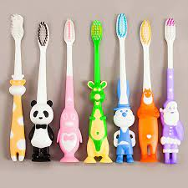
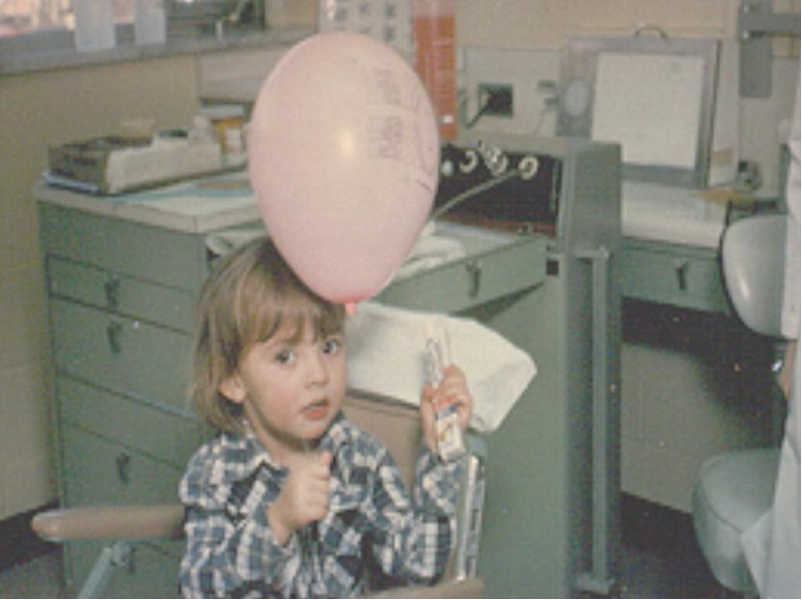
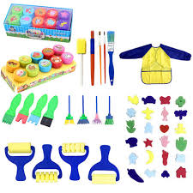


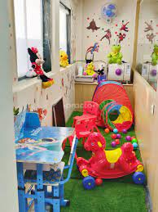
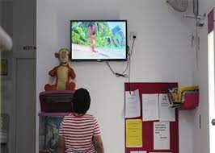
Reinforcers can of the following types
1. Materials reinforcers
2. Social reinforcers
3. Activity reinforcers

Slide 15
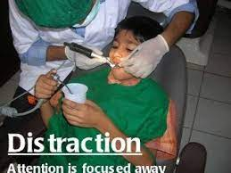
Distraction
Distraction is stealing the attention of the child either from the whole dental clinic like make them feel somewhere else (in different environment) or from something specific unpleasant the dentist want to do at the clinic such as giving local anesthesia
(This is a newer method of behavior management in which the patient is distracted from the sounds and / or sight of dental treatment thereby reducing the anxiety.)
The aim of it is to decrease the perception of unpleasantness experienced by the target patient, which will then facilitate our clinical work.

Slide 16
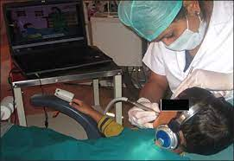
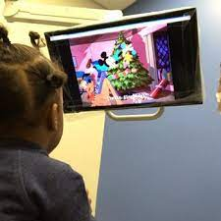
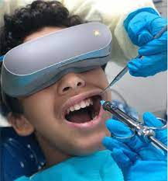
Types of Distraction:
I. Audio Distraction:
II. Audio-visual distraction:
III. A combination of both visual and auditory

Slide 17
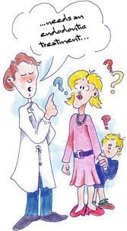
THANKS

