Slide 1
Classification of Children’s Behavior
Pedodontic Dentistry \ 5th-grade
Lec.4
Dr. Mukhalled alasady
Oral & Maxillofacial surgeon
B.D.S. – C.A.B.M.F.S
College of dentistry\University
ofAl- Muthanna

Slide 2
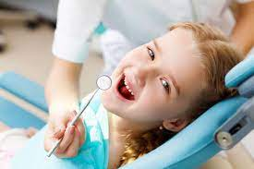
Classification of Children’s Behavior

Slide 3
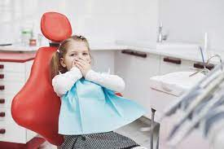
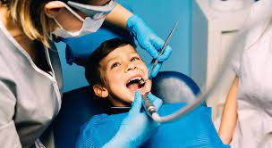
I) according to age
Pre-cooperative stage-less than 2 years
Cooperative stage-above 2 years

Slide 4
Factors influencing child behavior:
At 2 years ( precooperative stage) the children vary greatly in their ability to communicate.
At 3 years the child can communicate more easily than 2 years old, but they need their parents to remain with them in clinic to feel more security.
At 4 years the child usual listens with response and interest to dentist explanation and verbal direction.
At 5 years the child has no fear of new experience if he is properly prepared by the parents.
At 6 years (school age) the child need proper introduction of dental treatment so he will respond in satisfactory manner

Slide 5
II) According to Clinical classification of behavior patterns
Wright’s clinical classification places children in one of three categories:
Cooperative
Lacking cooperative ability
Potentially cooperative

Slide 6
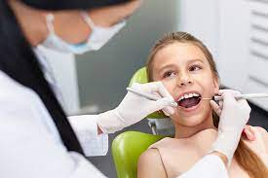
Child's behavior in the dental office:
:
Cooperative child:
Cooperative children are relaxed with little apprehension
Can be treated by straight forward behavior shaping approach
They have minimal apprehension and may even be enthusiastic

Slide 7
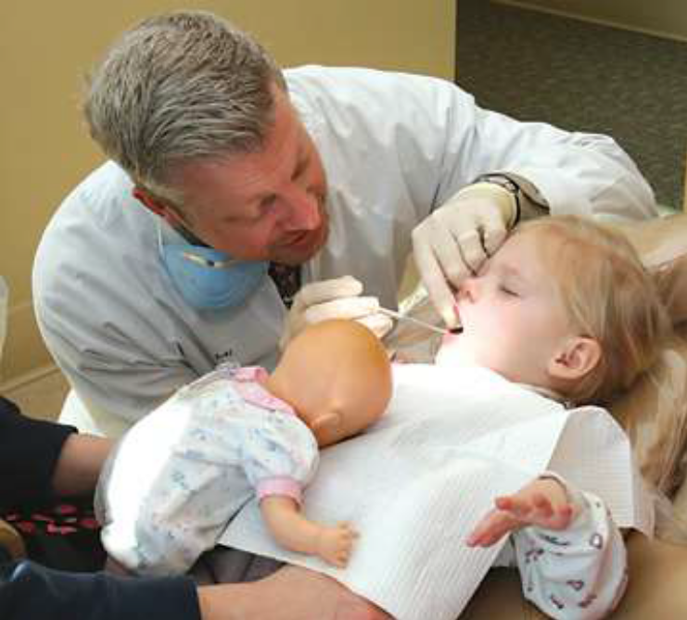
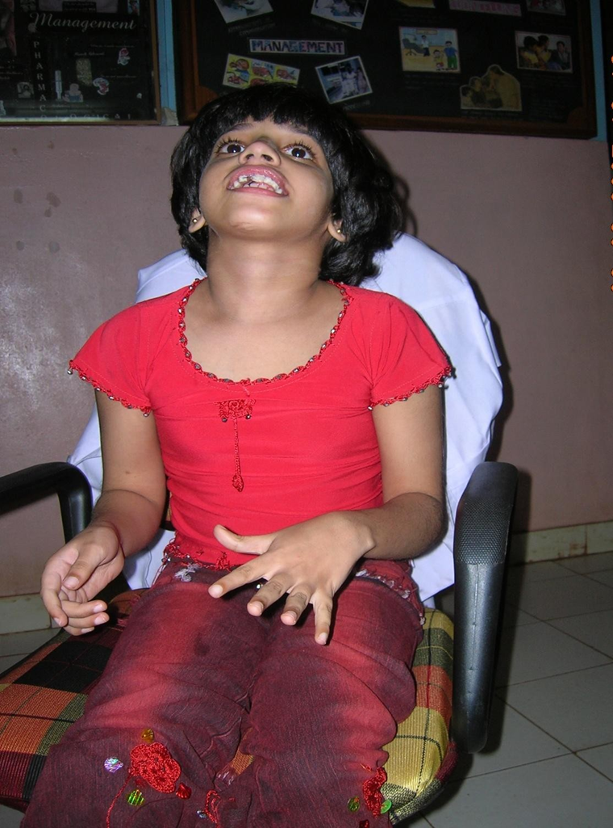
Lacking in cooperative ability:
This category includes 2 types of children:
Very young children who are uncooperative because of their age.
Children with specific handicapping conditions and these need special behavior management technique but changing in their behavior cannot be expected.

Slide 8
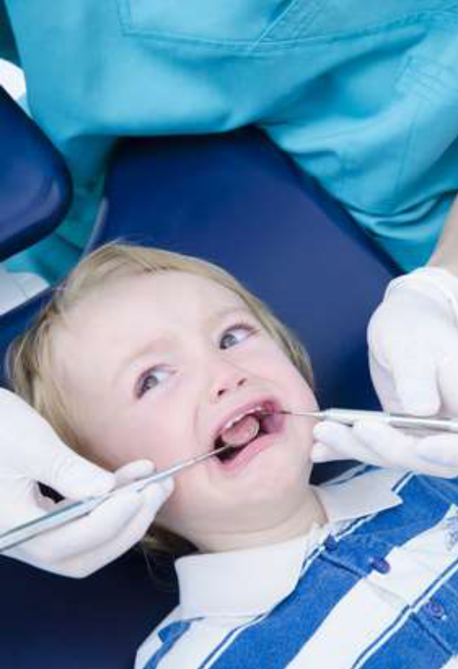

Potentially cooperative:
This called behavior problem because clinically that child’s behavior can be modified and become cooperative, this behavior include the following:
Uncontrolled behavior :
This behavior seen in young are between 3-6 years,
The reaction can start in the reception room or even before entering
In the clinic also patient characterized by tears, loud crying, and flailing of the hands and legs.
This behavior is also called as ‘incorrigible’

Slide 9
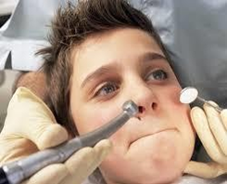
B- Defiant behavior (challenging one)
Can be found in all ages, more typical in the elementary school group.
Distinguished by “I don’t want to” or “I don’t have to” or “I won’t”.
They protest when they are brought to the dental clinic against their will, as they do at home.
Once won over, these children frequently become highly cooperative

Slide 10

Timid behavior :
Those children range between positive negative behavior and if managed incorrectly they become uncontrolled behavior,
Those children hesitate in their behavior and see shield themselves behind their parent
Cry without tears.
Those children need to gain confidence in themselves and need understanding from dentist because they are anxious.

Slide 11
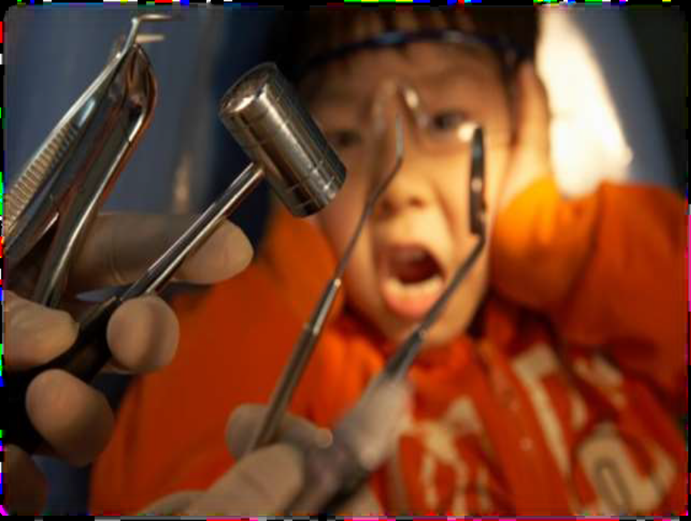
Tense - cooperative behavior:
those children in border line positive negative they accept treatment as it is provided with very tense reaction ,
> 7 years, very anxious, we call them white knuckles, they hold something with their hand(s) in a constant position, their knuckles become white.
Tremor may be heard, when they speak

Slide 12
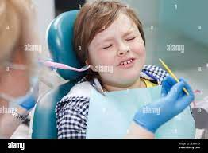
E-Whining behavior
No pain, no tears, just ''naaaaaa'' Usually continuous, it's annoying.
They do not prevent treatment, but whine throughout the procedure
Cry is controlled, constant and not loud
Seldom are there tears

Slide 13
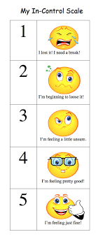
Frankle behavior rating scale:
It is the second system, which used widely in behavior science, it include:
Rating 1: Definitely negative refusal of treatment ,crying forcefully , very fearful.
Rating 2: Negative reluctant to accept treatment, then cooperates with Some evidence of negative attitude.
Rating 3: Positive accepts treatment with cautions .
Rating 4: Definitely positive, good report with the dentist, interested in dental procedure.

Slide 14
Fundamentals of Behavior Guidance
Behavior guidance is the means by which the dental health team effectively and efficiently performs treatment for a child and, at the same time, instills a positive dental attitude, and high-quality dental care
Dental office and dental personnel must have the following quality:
1. The positive approach:
2. The team attitude:
3. Organization:
4. Truthfulness:
5. Tolerance:

Slide 15
Techniques of behavior management
Non pharmacotheraputic approaches: without using drugs.
Pharmacotheraputic approaches: this by using drug in management of child but should be conscious when taking drugs and complete treatment.

Slide 16

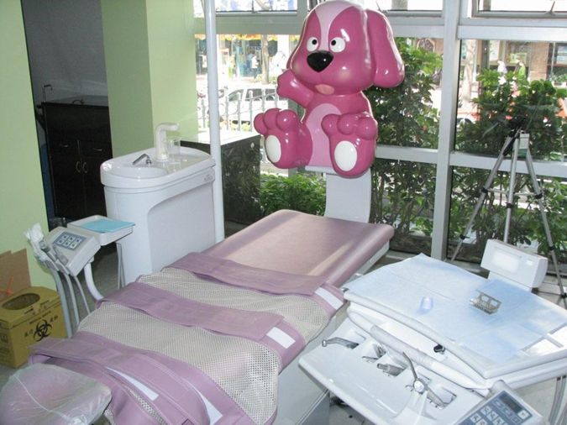
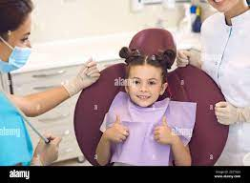
Communicating with Children in dental clinic:
The three most important facets of communication are source, medium and receiver.
In reference to dentistry, dentist is the source, dental clinic is medium and child is the receiver.

Slide 17
Objectives of communication
1. Establishment of communication:
verbal communication with younger children is best initiated with complimentary comments, followed by questions that elicit an answer other than “yes” or “no.”
2. Establishment of the communicator:
The receptionist who welcomes the child and the parent with the smile provides initial communication. This initial communication
3. Message clarity:
Message should be simple and easy to understand by a young child. For Example — “Do not move” is avoided and replaced by “I can’t fix your teeth until you sit still”
To improve the clarity of messages to young patients, dentists use euphemisms to explain procedures.

Slide 18
Dental Terminology and Word Substitutes
Rubber dam Rubber raincoat
Rubber dam clamp Tooth button
Sealant Tooth paint
Fluoride varnish Tooth vitamins
Water syringe Water gun
High speed Whistle
Low speed Motorcycle

Slide 19
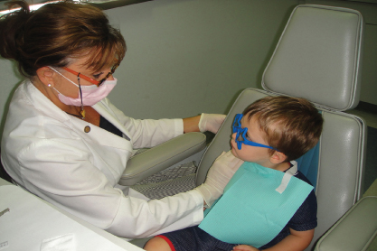
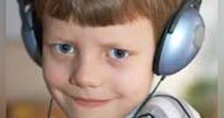
Voice Control (Verbal - Spoken language)
Sudden and firm commands that are used to get the child's attention and stop the child from his current activity.
Soft, monotonous soothing conversation can also be used.
The tone of voice and the facial expression of the dentist are also important as they function like a mirror.
Objectives
• To gain the patient attention and compliance
• To avoid negative or avoidance behavior
Contraindications
• Children who due to age, disability, mental or emotional immaturity are unable to understand.

Slide 20

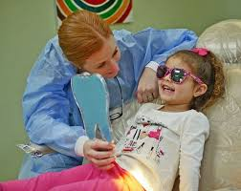
Non-verbal communication (Nonverbal - Expression without words)
Non-verbal communication is the reinforcement and guiding behavior through contact, posture, and facial expression.
Body contact
Eye contact
Objectives
1. To enhance the effectiveness of communicative management techniques.
2. To gain or maintain the patient's attention and compliance.

Slide 21
Active Listening
Children express their feelings by word and by action.
Listening to the spoken words may be more important in establishing rapport with the older child, whereas attention to nonverbal behavior is often more crucial in guiding the behavior of a younger child. Active listening mirrors the communicated emotion.

Slide 22
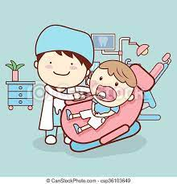
THANKS

