Slide 1


Slide 2

Before starting……
please switch off your mobile

Slide 3
SECOND STAGE Lec.No.1
Dr.Mukhalled.Al-Asady
(Oral & maxillofacial surgeon)
B.D.S-C.A.B.M.F.S
Al-MuthNAa University
C0llege of dentistry
2024-2025

Slide 4
GENERAL ANATOMY

Slide 5
HUMAN SCALP-1

Slide 6
SCALP
The area bordered by the forehead, superior part of the cranium, and occipital area immediately superior to the superior nuchal line. The lateral portion of the scalp blends with the temporal area because it extends inferiorly to the zygomatic arch. Anatomy of the scalp is important because of frequent trauma in this region.

Slide 7
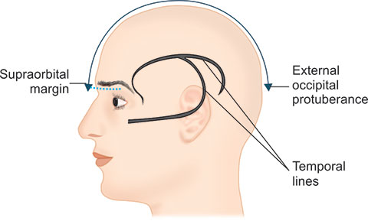

Slide 8
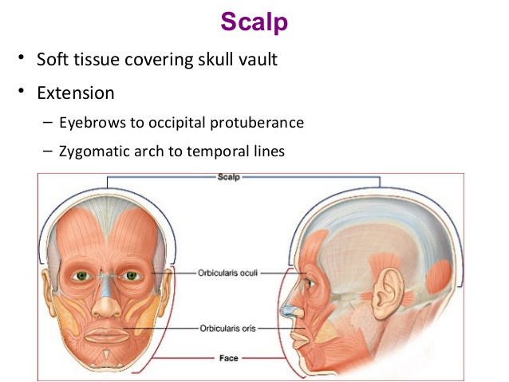

Slide 9
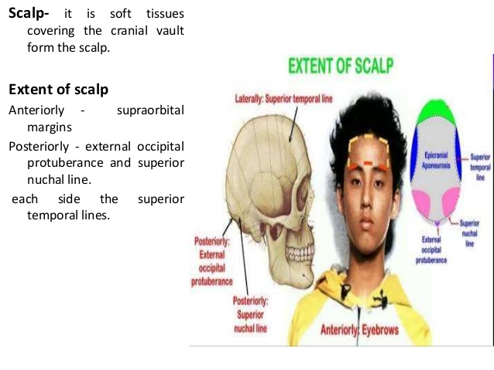

Slide 10
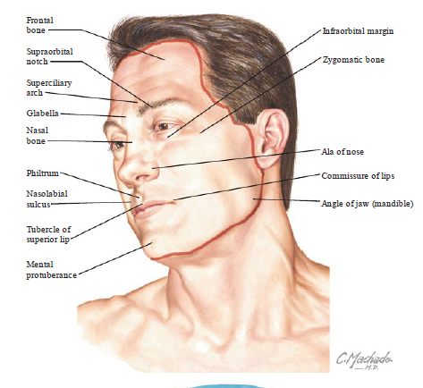

Slide 11
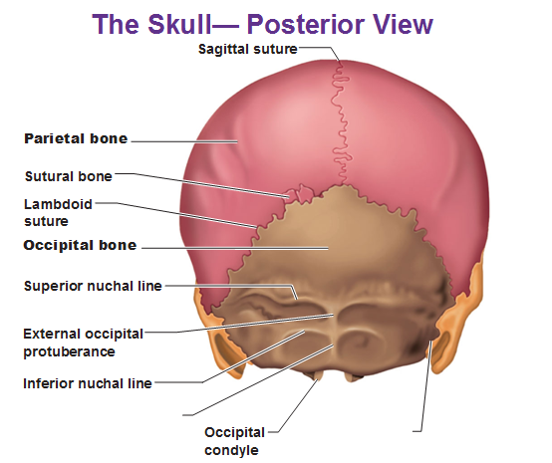

Slide 12
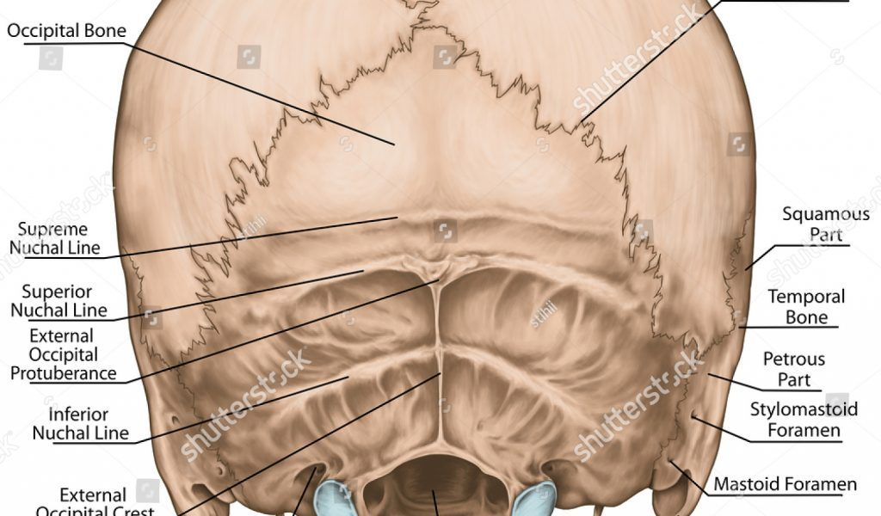

Slide 13
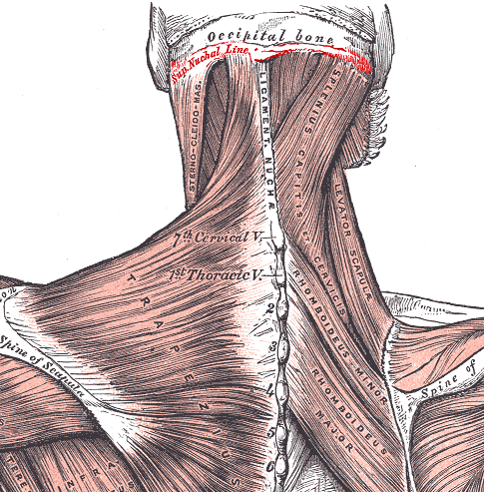

Slide 14
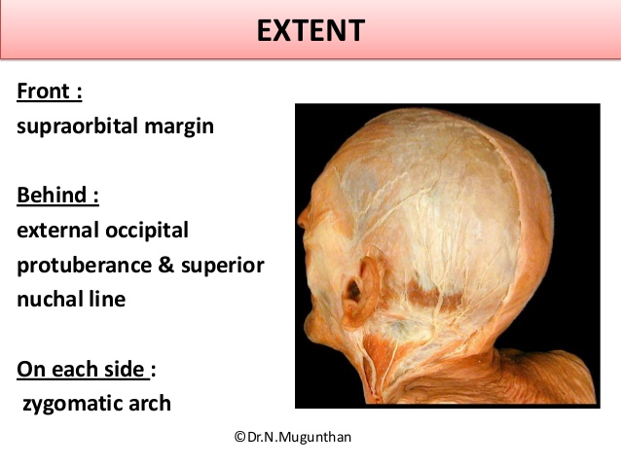

Slide 15
FUNCTION OF SCALP
The scalp is the same as skin on other parts of our body, and has lipid glands and sweat glands. Like other parts of skin, the scalp's stratum corneum (skin's outer layer) is only 0.02mm thick, but it plays an important role in protecting our body against external irritation.

Slide 16
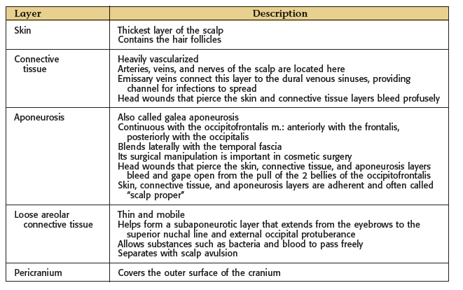

Slide 17
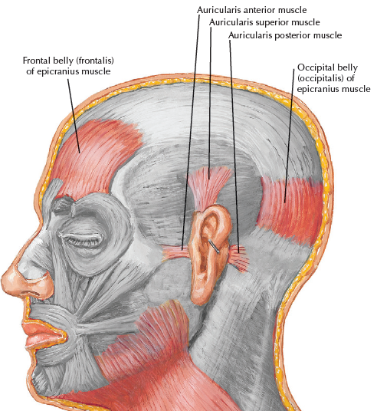

Slide 18
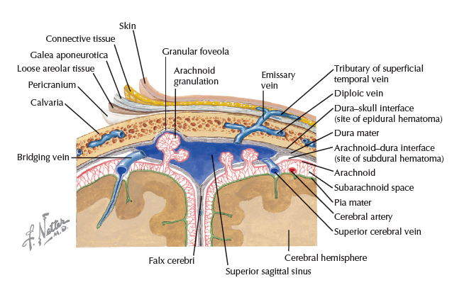

Slide 19
Muscles of SCALP
Note that when this muscle contracts, the first three layers of the scalp move forward or backward, the loose areolar tissue of the fourth layer of the scalp allowing the aponeuros is to move on the pericranium. The frontal bellies of the occipitofrontalis can raise the eyebrows in expressions of surprise or horror.

Slide 20
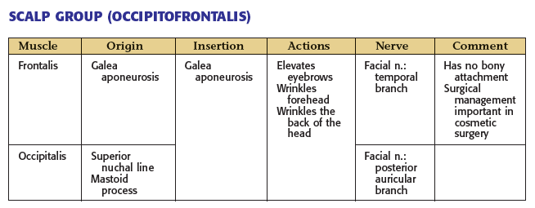

Slide 22
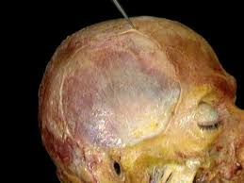

Slide 23
Sensory Supply of SCALP
The main trunks of the sensory nerves lie in the superficial fascia. Moving laterally from the midline anteriorly, Sensory supply is derived from all 3 divisions of the trigeminal nerve, branches of the cervical plexus, and upper cervical dorsal rami. These nerves travel in the scalp’s connective tissue layer. The following nerves are present:

Slide 24
The supratrochlear nerve, a branch of the ophthalmic division of the trigeminal nerve, winds around the superior orbital margin and supplies the scalp. It passes backward close to the median plane and reaches nearly as far as the vertex of the skull.
The supraorbital nerve, a branch of the ophthalmic division of the trigeminal nerve, winds around the superior orbital margin and ascends over the forehead. It supplies the scalp as far backward as the vertex.

Slide 25
The zygomaticotemporal nerve, a branch of the maxillary division of the trigeminal nerve, supplies the scalp over the temple.
The auriculotemporal nerve, a branch of the mandibular division of the trigeminal nerve, ascends over the side of the head from in front of the auricle. Its terminal branches supply the skin over the temporal region.

Slide 26
The lesser occipital nerve, a branch of the cervical plexus (C2), supplies the scalp over the lateral part of the occipital region and the skin over the medial surface of the auricle.
The greater occipital nerve, a branch of the posterior ramus of the 2nd cervical nerve, ascends over the back of the scalp and supplies the skin as far forward as the vertex of the skull.

Slide 27
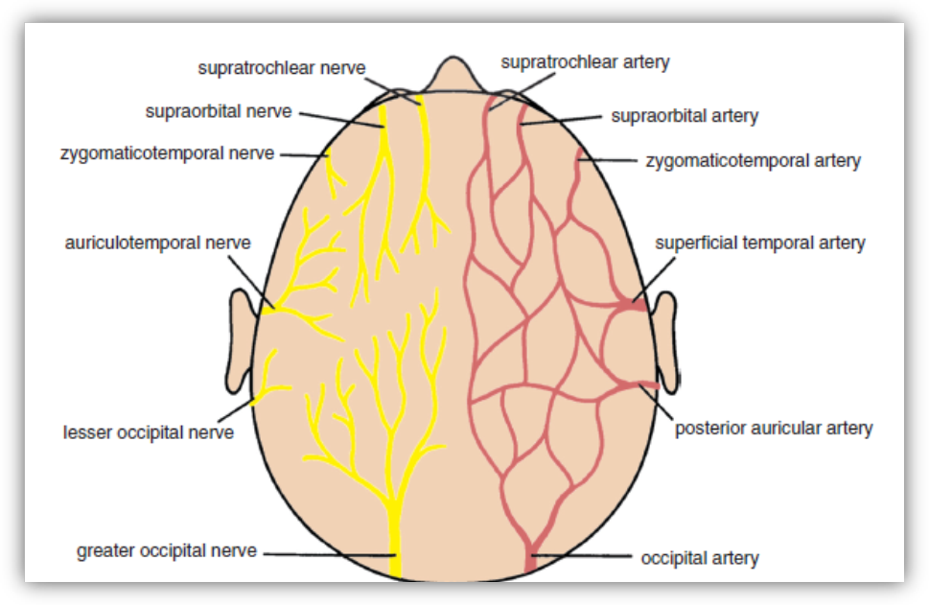

Slide 28
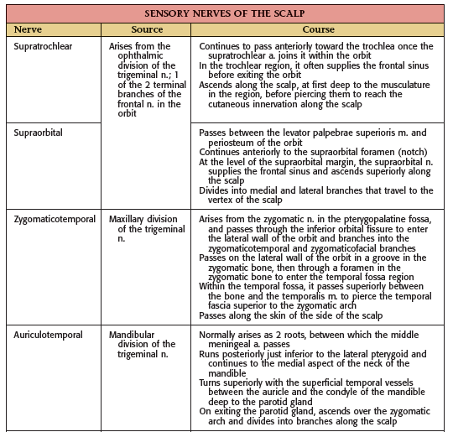

Slide 29
