Slide 1


Slide 2

Before starting……
please switch off your mobile

Slide 3
SECOND STAGE Lec.No.2
Dr.Mukhalled.Al-Asady
(Oral & maxillofacial surgeon)
B.D.S-C.A.B.M.F.S
Al-MuthANAa University
C0llege of dentistry
2024-2025

Slide 4
GENERAL ANATOMY

Slide 5
HUMAN SCALP-2

Slide 6
Arterial Supply of SCALP
The scalp has a rich supply of blood to nourish the hair follicles, and, for this reason, the smallest cut bleeds profusely.
The arteries lie in the superficial fascia.
Moving laterally from the midline anteriorly.
Highly vascularized; the vessels anastomose freely on the scalp.

Slide 7
Arteries are derived from the external and the internal carotid arteries .
The neurovascular supply arises from the anterior, lateral, and posterior scalp regions.
The following arteries are present:

Slide 8
In front of the ear
The supratrochlear and the supraorbital arteries, branches of the ophthalmic artery, ascend over the forehead in company with the supratrochlear and supraorbital nerves.
The superficial temporal artery, the smaller terminal branch of the external carotid artery, ascends in front of the auricle in company with the auriculotemporal nerve. It divides into anterior and posterior branches, which supply the skin over the frontal and temporal regions.

Slide 9
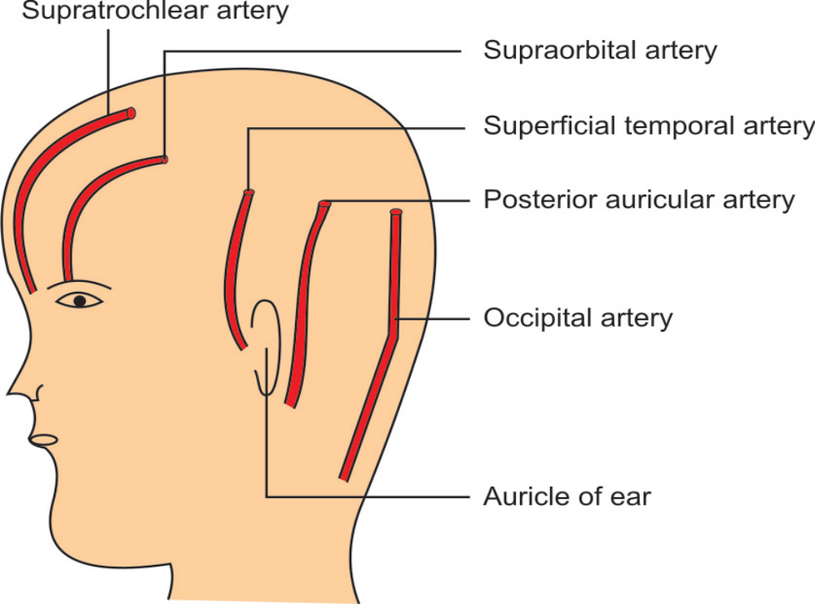

Slide 10
Behind the ear
The posterior auricular artery, a branch of the external carotid artery, ascends behind the auricle to supply the scalp above and behind the auricle.
The occipital artery, a branch of the external carotid artery,ascends from the apex of the posterior triangle, in company with the greater occipital nerve. It supplies the skin over the back of the scalp and reaches as high as the vertex of the skull.

Slide 11
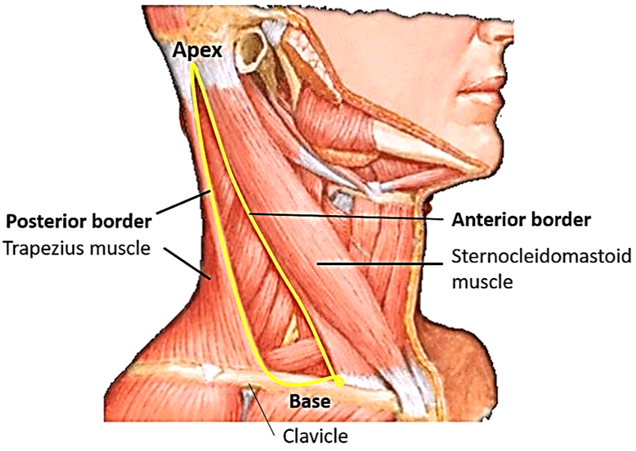

Slide 12
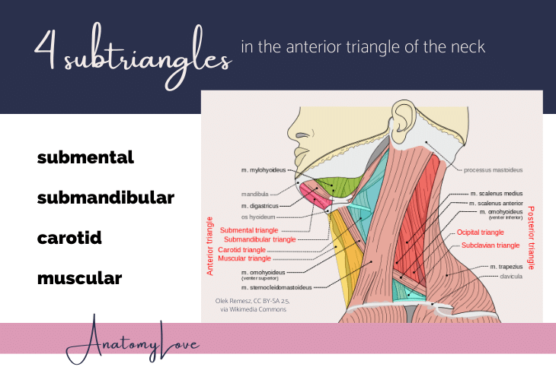

Slide 13
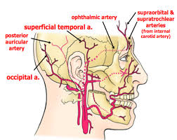

Slide 14
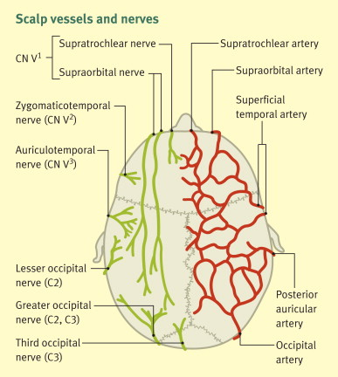

Slide 15
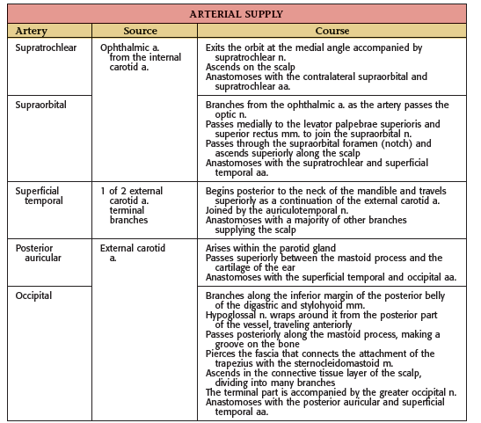

Slide 16
Venous Drainage of SCALP:
1. The supratrochlear and supraorbital veins unite at the medial margin of the orbit to form the angular vein and further continue as the facial vein.
2. The superficial temporal vein unites with the maxillary vein in the substance of the parotid gland to form the retromandibular vein.

Slide 17
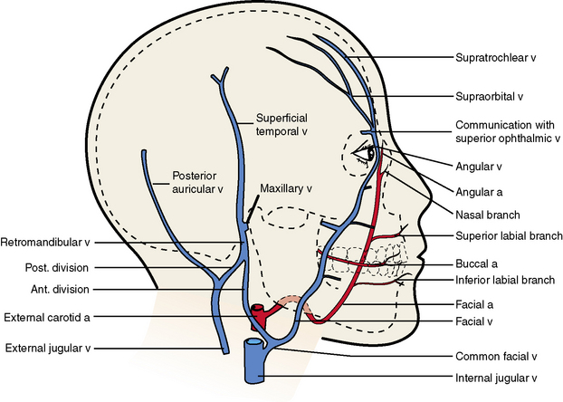

Slide 18
3. The posterior auricular vein unites with the posterior division of the retromandibular vein, just below the parotid gland, to form the external jugular vein.
4. The occipital vein drains into the suboccipital venous plexus, which lies beneath the floor of the upper part of the posterior triangle; the plexus in turn drains into the vertebral veins or the internal jugular vein.
The veins of the scalp freely anastomose with one another and are connected to the diploic veins of the skull bones and the intracranial venous sinuses by the valveless emissary veins.

Slide 19
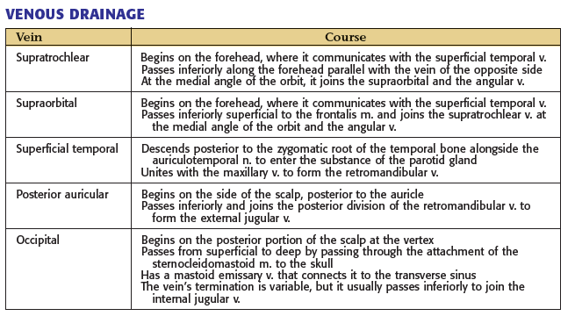

Slide 20
Lymphatic Drainage of SCALP
Lymph vessels in the anterior part of the scalp and forehead drain into the submandibular lymph nodes.
Drainage from the lateral part of the scalp above the ear is into the superficial parotid (preauricular) nodes.

Slide 21
Lymph vessels in the part of the scalp above and behind the ear drain into the mastoid nodes.
Vessels in the back of the scalp drain into the occipital nodes.

Slide 22
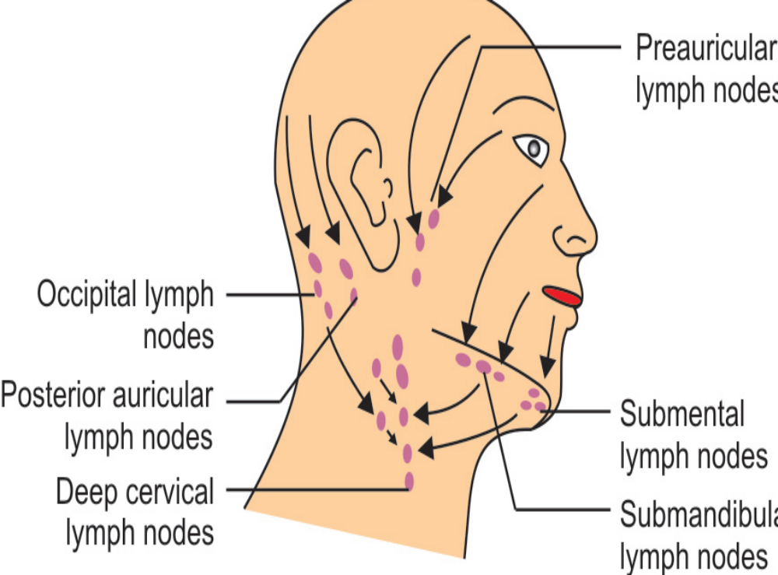

Slide 23
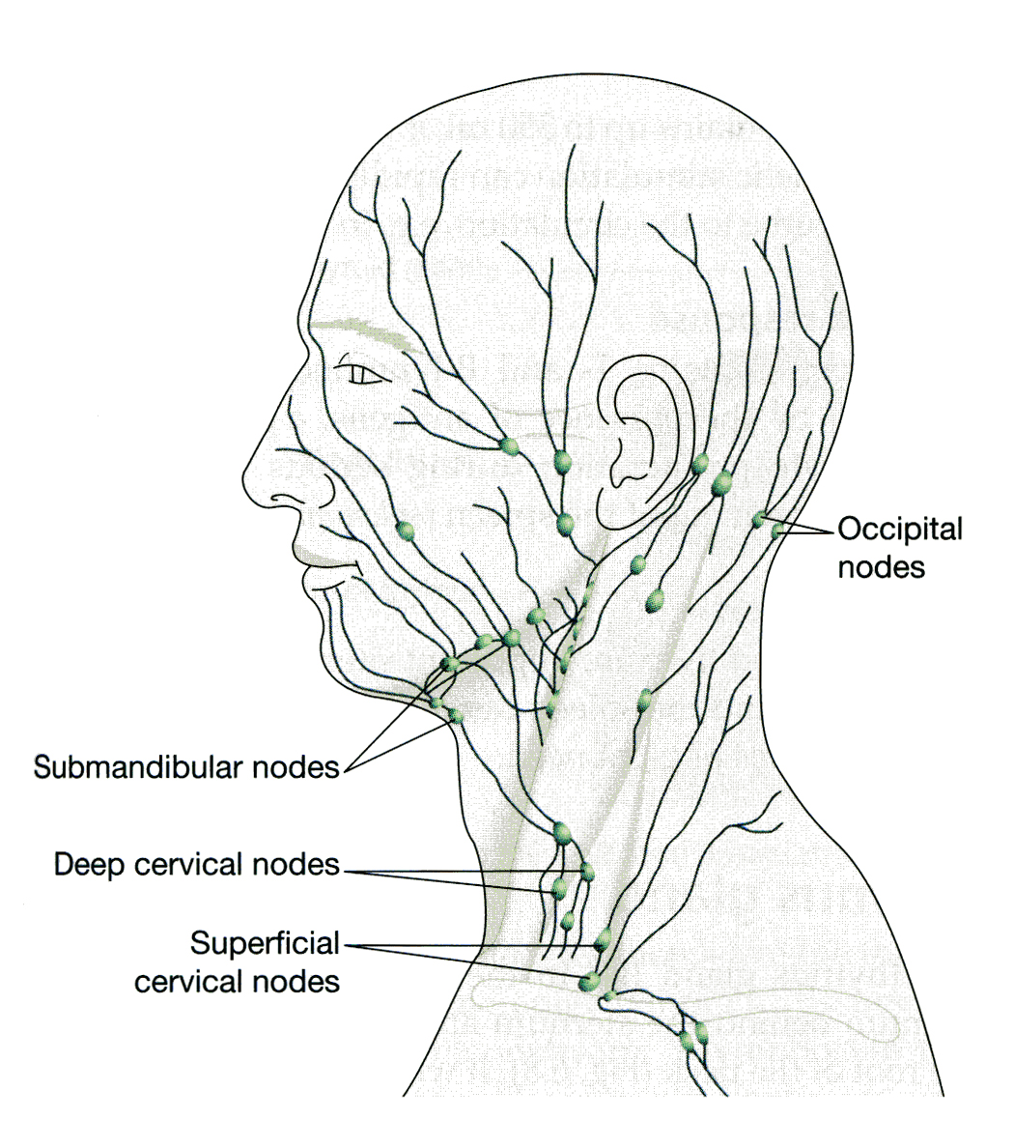

Slide 24
Clinical Significance of the Scalp Structure

Slide 25
It is important to realize that the skin, the subcutaneous tissue, and the epicranial aponeurosis are closely united to one another and are separated from the periosteum by loose areolar tissue.
The skin of the scalp possesses numerous sebaceous glands, the ducts of which are prone to infected and damage by combs. For this reason, sebaceous cysts of the scalp are common.

Slide 26
Lacerations of the Scalp
The scalp has a profuse blood supply to nourish the hair follicles. Even a small laceration of the scalp can cause severe blood loss.
It is often difficult to stop the bleeding of a scalp wound because the arterial walls are attached to fibrous septa in the subcutaneous tissue and are unable to contract or retract to allow blood clotting to take place.
Local pressure applied to the scalp is the only satisfactory method of stopping the bleeding.

Slide 27
Head injury
resulting in soft tissue damage can cause collection of blood in the loose subaponeurotic layer of scalp which is continuous with the upper eye lid.
The blood easily tracks down anteriorly over the eyelids leading to discoloration of the eye known as black eye.
The spread of this collection is limited posteriorly and laterally due to attachment of the aponeurosis to the supranuchal lines and to the zygomatic arches at these points.

Slide 28
Infections of the scalp
tend to remain localized and are usually painful because of the abundant fibrous tissue in the subcutaneous layer.
Occasionally, an infection of the scalp spreads by the emissary veins, which are valveless, to the skull bones, causing osteomyelitis.

Slide 29
Cephalhaematoma:
It is the collection of blood below the periosteal layer of scalp due to an injury.
The swelling due to the haematoma is localized over the particular bone involved as the periosteum is adherent to the underlying bone at the sutures which limits its spread.
In a new born, this has to be differentiated from caput formation.

Slide 30
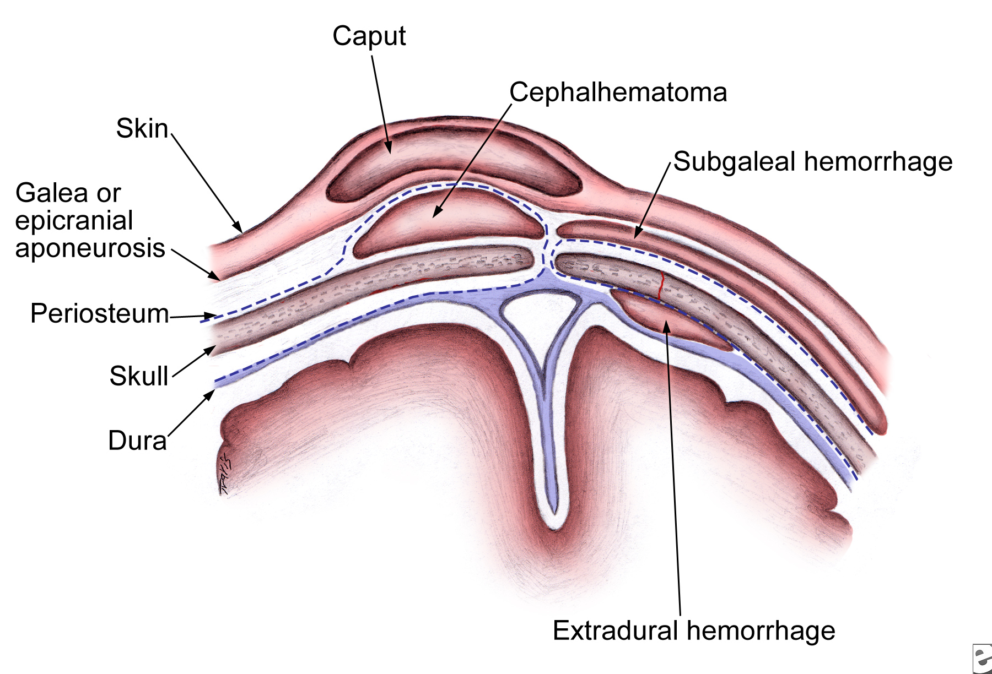

Slide 31
Caput
is the collection of fluid in the loose areolar tissue of scalp due to forces of labour.
The swelling due to caput is generally diffuse and more on the dependant areas instead of a particular bone.
The collection of caput crosses the sutures and the midline as it is not limited by sutures.
Caput disappears in 24 to 48 hours of birth while cephalhaematoma may take upto 4 to 7 days to disappear.

Slide 32
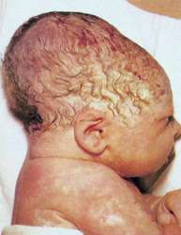

Slide 33
Dangerous layer of the scalp
The layer of loose areolar tissue is often called as dangerous layer of the scalp because it lodges the emissary veins.
These veins do not have any valves, hence, if there is any infection of scalp it can travel along the emissary veins into the intracranial dural venous sinuses leading to thrombosis of the sinuses.

