Slide 1

Before starting……
please switch off your mobile

Slide 2
GENERAL ANATOMY

Slide 3
SECOND STAGE Lec.No.3
Dr.Mukhalled.Al-Asady
(Oral & maxillofacial surgeon)
B.D.S-C.A.B.M.F.S
Al-MuthNAa University
C0llege of dentistry
2024-2025

Slide 4
1-HUMAN FACE

Slide 5


Slide 6
’’FACE’’
The area bordered within the hairline, anterior border of the auricles, and the chin.
Major contents: eyes, nose, mouth, muscles of facial expression, muscles of mastication, parotid gland, trigeminal nerve, and facial nerve.
There is no deep fascia along the face.

Slide 7
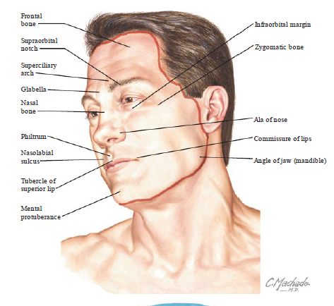

Slide 8
Facial layers
The entire face is similar to the scalp in being composed of five basic layers:
(1)the skin,
(2) the subcutaneous layer,
(3) the musculoaponeurotic layer,
(4) loose areolar tissue (ie, spaces and retaining ligaments), and
(5) the fixed periosteum and deep fascia.

Slide 9
Facial layers
The skin, superficial fascia, and SMAS form an anatomic structure similar to the scalp proper.
The superficial muscular aponeurotic system (SMAS) is deep to the superficial fascia and provides a surgical plane for surgery of the face.

Slide 10
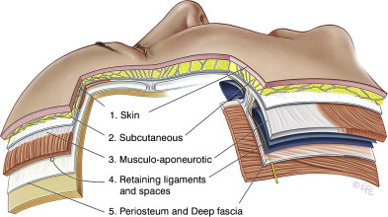

Slide 11
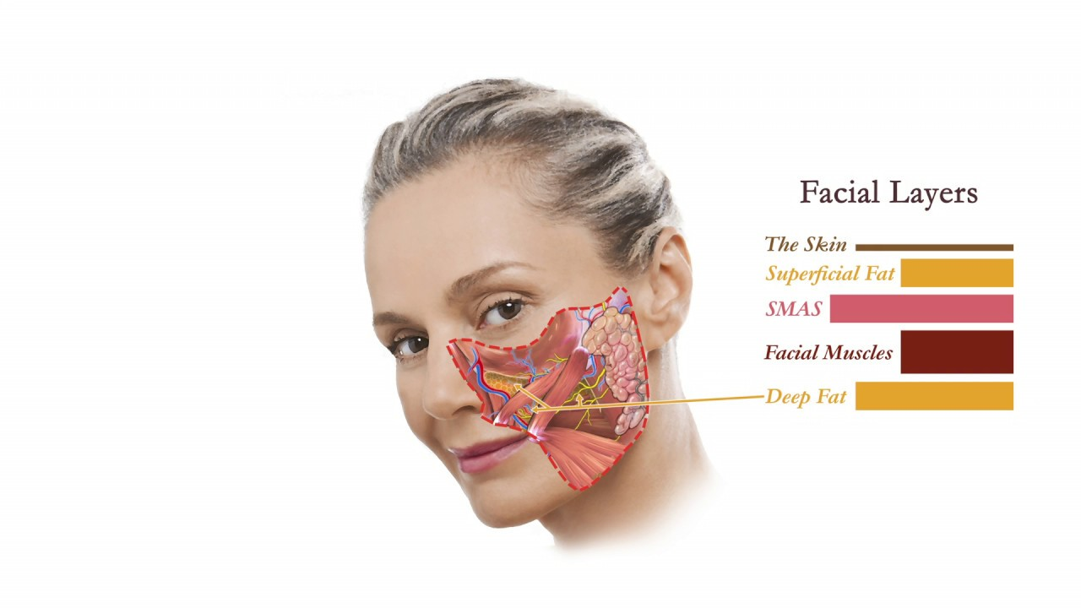

Slide 12
Skin of the Face
The skin of the face possesses numerous sweat and sebaceous glands.
It is connected to the underlying bones by loose connective tissue, in which are embedded the muscles of facial expression.
No deep fascia is present in the face.

Slide 13
Superficial Musculoaponeurotic System (SMAS)
is the continuous layer, or sheet, of firm tissue that lies beneath the skin and runs from the collar bone to the forehead.
Unlike the skin, which is a stretchy layer, the SMAS is a strong fibromuscular web; it is intricately connected to the skin, as well as the various muscles, tissues and fat pads in the face and neck.
When the SMAS is surgically modified and lifted, it will also reposition the skin and make it look tighter, creating a more youthful appearance.

Slide 14
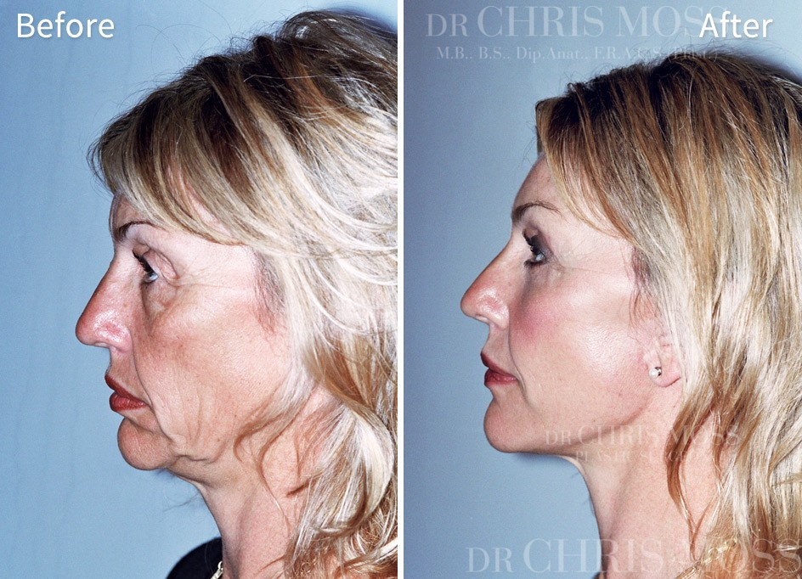

Slide 15
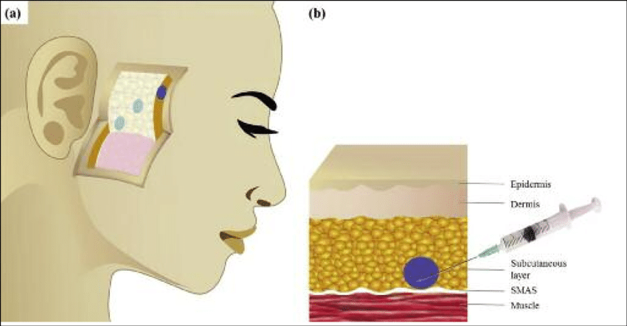

Slide 16
GENERAL INFORMATION:
Sensory Nerves of the Face

Slide 17
Many motor and sensory nerves supply the face.
All motor nerves are from the facial nerve and supply the muscles of facial expression.
Sensory nerves of the face are derived:
Mainly from the 3 divisions of the trigeminal nerve (V1, V2, V3).
Small area by the branches of cervical plexus (C2&C3).

Slide 18
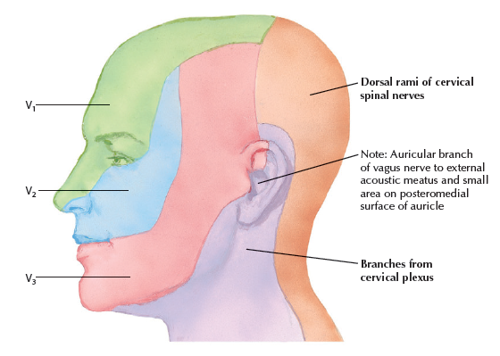

Slide 19
The skin of the face is supplied by branches of the three divisions of the trigeminal nerve, except for the small area over the angle of the mandible and the parotid gland which is supplied by the great auricular nerve (C2 and 3).

Slide 20
These nerves not only supply the skin of the face, but also supply proprioceptive fibers to the underlying muscles of facial expression.
They are, in addition, the sensory nerve supply to the mouth, teeth, nasal cavities, and paranasal air sinuses.

Slide 21
(Ophthalmic Nerve (V1
The ophthalmic nerve supplies the skin of the forehead, the upper eyelid, the conjunctiva, and the side of the nose down to and including the tip. Five branches of the nerve pass to the skin:
The lacrimal nerve supplies the skin and conjunctiva of the lateral part of the upper eyelid.
The supraorbital nerve : It divides into branches that supply the skin and conjunctiva on the central part of the upper eyelid; it also supplies the skin of the forehead.

Slide 22
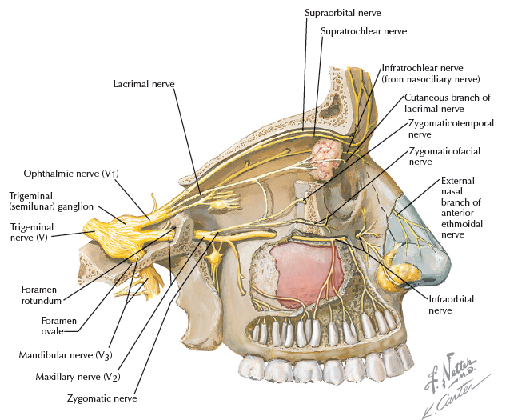

Slide 23
The supratrochlear nerve: It divides into branches that supply the skin and conjunctiva on the medial part of the upper eyelid and the skin over the lower part of the forehead, close to the median plane.
The infratrochlear nerve: It supplies the skin and conjunctiva on the medial part of the upper eyelid and the adjoining part of the side of the nose.

Slide 24
The external nasal nerve leaves the nose by emerging between the nasal bone and the upper nasal cartilage.
It supplies the skin on the side of the nose down as far as the tip.

Slide 25
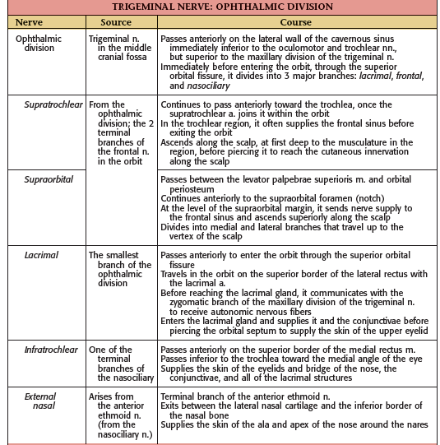

Slide 26
Maxillary Nerve (V2)

Slide 27
The maxillary nerve supplies the skin on the posterior part of the side of the nose, the lower eyelid, the cheek, the upper lip, and the lateral side of the orbital opening.
Three branches of the nerve pass to the skin.

Slide 28
The infraorbital nerve is a direct continuation of the maxillary nerve. It enters the orbit and appears on the face through the infraorbital foramen.
It immediately divides into numerous small branches, which radiate out from the foramen and supply the skin of the lower eyelid and cheek, the side of the nose, and the upper lip.

Slide 29
The zygomaticofacial nerve passes onto the face through a small foramen on the lateral side of the Zygomatic bone. It supplies the skin over the prominence of the cheek.
The zygomaticotemporal nerve emerges in the temporal fossa through a small foramen on the posterior surface of the zygomatic bone. It supplies the skin over the temple

Slide 30
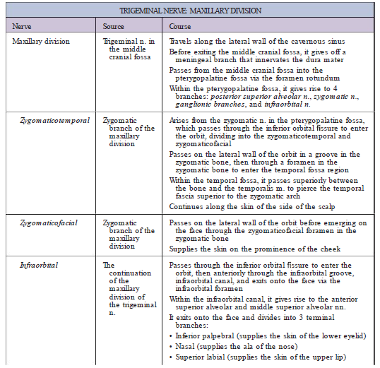

Slide 31
3.Mandibular Nerve (V3)

Slide 32
The mandibular nerve supplies the skin of the lower lip, the lower part of the face, the temporal region, and part of the auricle.
It then passes upward to the side of the scalp.
Three branches of the nerve pass to the skin.

Slide 33
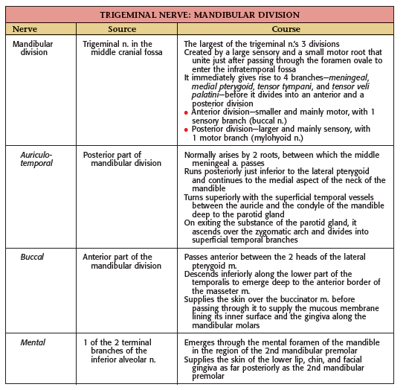

Slide 34
The mental nerve emerges from the mental foramen of the mandible and supplies the skin of the lower lip and Chin.
The buccal nerve emerges from beneath the anterior border of the masseter muscle and supplies the skin over a small area of the cheek.

Slide 35
The auriculotemporal nerve ascends from the upper border of the parotid gland between the superficial temporal vessels and the auricle.
It supplies the skin of the auricle, the external auditory meatus, the outer surface of the tympanic membrane, and the skin of the scalp above the auricle.

Slide 36
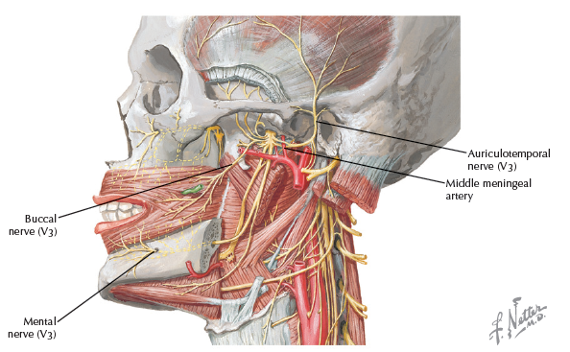

Slide 37
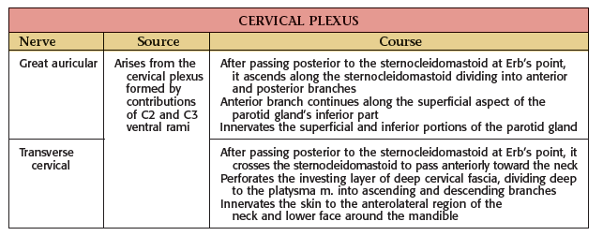

Slide 38
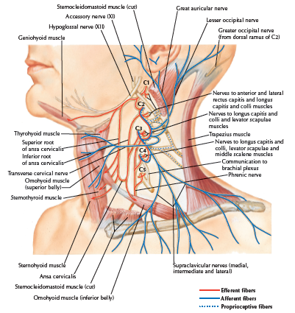

Slide 39
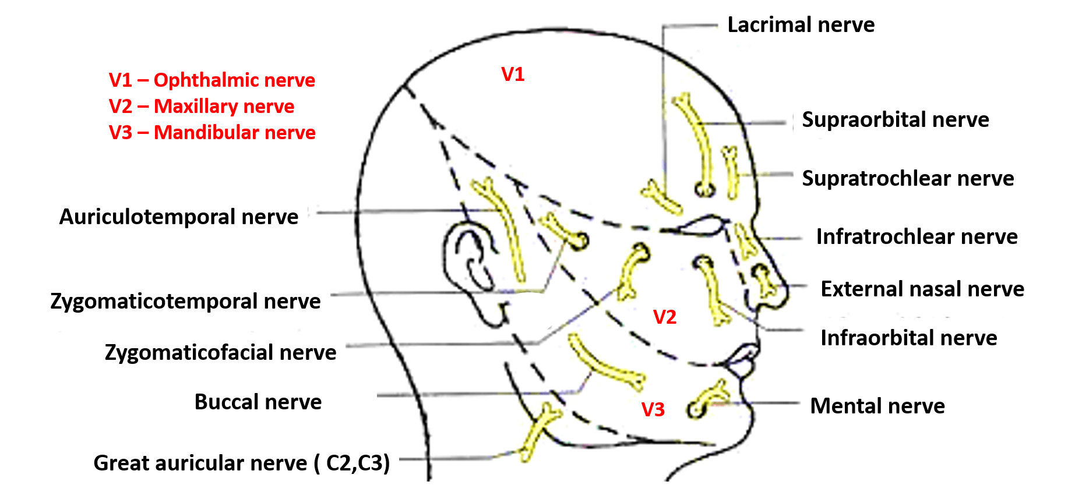

Slide 40
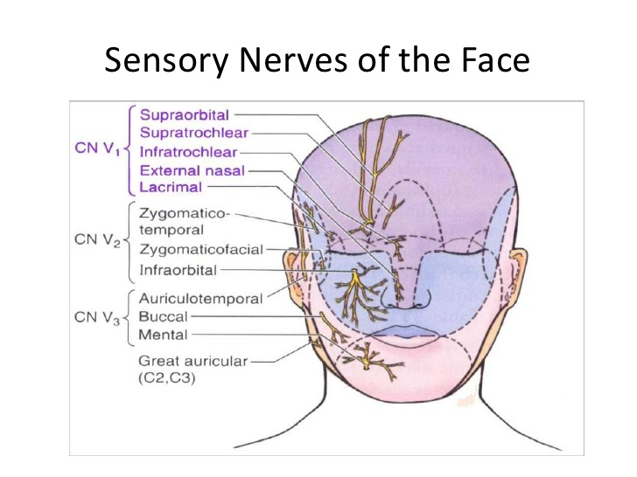

Slide 41
Lymphatic Drainage of the Face (Introduction)

Slide 42
The lymphatic system functions to drain tissue fluid, plasma proteins and other cellular debris back into the blood stream, and is also involved in immune defense.
Once this collection of substances enters the lymphatic vessels, it is known as lymph.
Lymph is subsequently filtered by lymph nodes and directed into the venous system.
The lymphatic vessels of the head and neck can be divided into two major groups; superficial vessels and deep vessels.

Slide 43
Superficial Vessels :
drain lymph from the scalp, face and neck into the superficial ring of lymph nodes at the junction of the neck and head.
Deep Vessels:
The deep lymphatic vessels arise from the deep cervical lymph nodes. They converge to form the left and right jugular lymphatic trunks:
• Left jugular lymphatic trunk – joins the thoracic duct at the root of the neck.
• Right jugular lymphatic trunk empties into the right lymphatic duct at the root of the neck.

Slide 44
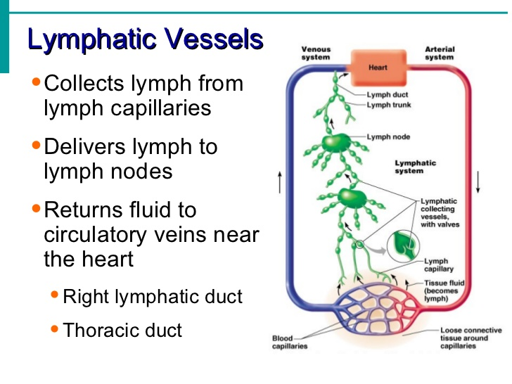

Slide 45
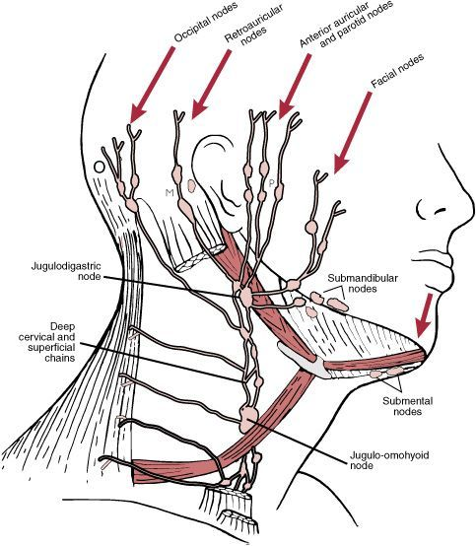

Slide 46
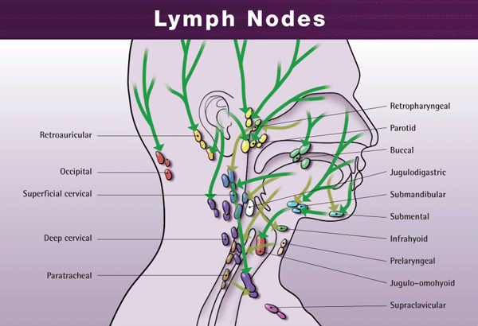

Slide 47
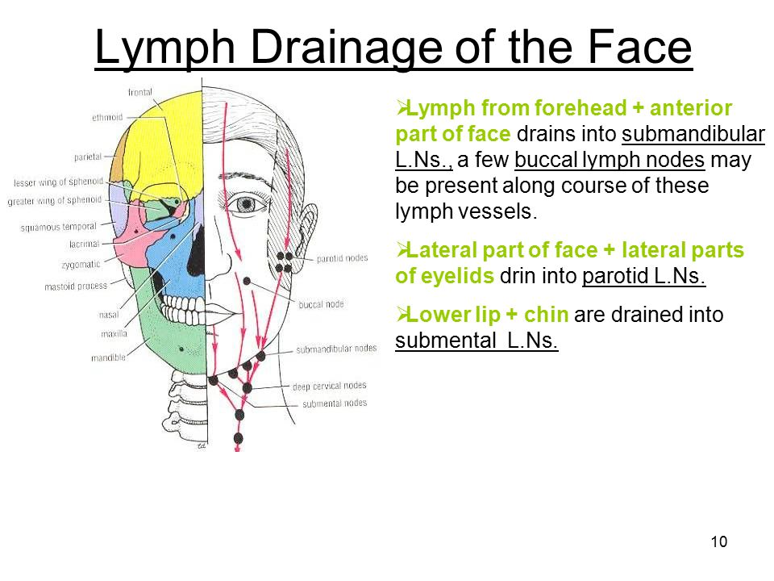

Slide 48
Clinical Significance-1

Slide 49
Sensory Innervation and Trigeminal Neuralgia
The facial skin receives its sensory nerve supply from the three divisions of the trigeminal nerve.
Remember that a small area of skin over the angle of the jaw is supplied by the great auricular nerve (C2 and 3).

Slide 50
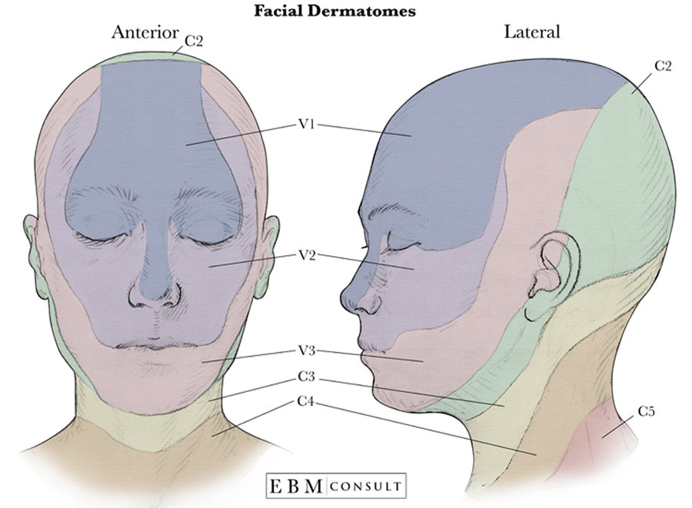

Slide 51
Trigeminal neuralgia (TN or TGN)
is a chronic pain disorder that affects the trigeminal nerve.
There are two main types: typical and atypical trigeminal neuralgia.
The typical form results in episodes of severe, sudden, shock-like pain in one side of the face that lasts for seconds to a few minutes.

Slide 52
Groups of these episodes can occur over a few hours.
The atypical form results in a constant burning pain that is less severe.
Episodes may be triggered by any touch to the face.
Both forms may occur in the same person. It is one of the most painful conditions, and can result in depression.

Slide 53
Trigeminal neuralgia
is a relatively common condition in which the patient experiences excruciating pain in the distribution of the mandibular or maxillary division, with the ophthalmic division usually escaping.
A physician should be able to map out accurately on a patient’s face the distribution of each of the divisions of the trigeminal nerve.

Slide 54
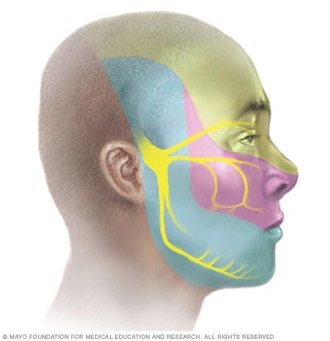

Slide 55
Facial Scar
Wrinkle lines of the face result from the repeated folding of the skin perpendicular to the long axis of the underlying contracting muscles, coupled with the loss of youthful skin elasticity.
Surgical scars of the face are less conspicuous if they follow the wrinkle lines.

Slide 56
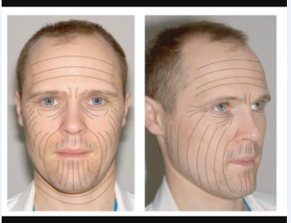

Slide 57
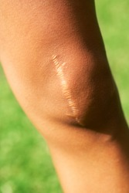
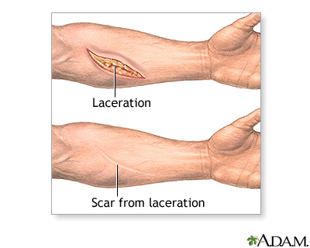

Slide 58
Face lift Surgery
clinically known as rhytidectomy, is a procedure used to reduce the appearance of facial wrinkles and other signs of aging, with the goal of improving the overall appearance of the face and jaw.

Slide 59
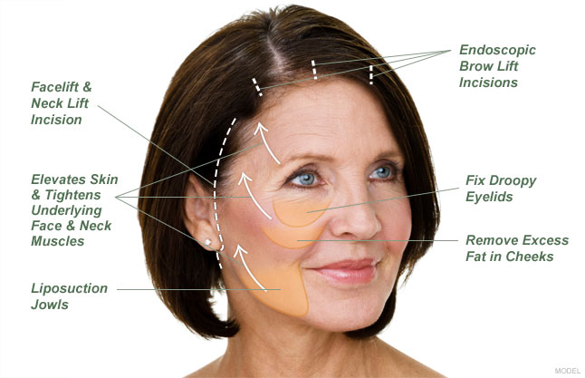

Slide 60
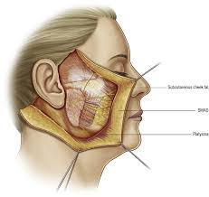

Slide 61
