Slide 1

Before starting……
please switch off your mobile

Slide 2
GENERAL ANATOMY

Slide 3
SECOND STAGE Lec.No.4
Dr.Mukhalled.Al-Asady
(Oral & maxillofacial surgeon)
B.D.S-C.A.B.M.F.S
Al-MuthNNa University
C0llege of dentistry
2024-2025

Slide 4
2-HUMAN FACE

Slide 5
Arterial Supply of the Face
GENERAL INFORMATION:

Slide 6
Most of the arterial supply to the face arises from the superficial temporal artery and facial branches of the external carotid artery.
The face receives a rich blood supply from two main vessels: the facial and superficial temporal arteries, which are supplemented by several small arteries that accompany the sensory nerves of the face.

Slide 7
Arterial Supply of the Face:
1)Some branches of ECA
(FACIAL.A, MAXILLARY.A & SUPERFICIALTEMPORAL.A).
2)OPHALMIC BRANCH OF ICA.

Slide 8
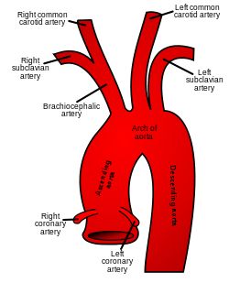

Slide 9
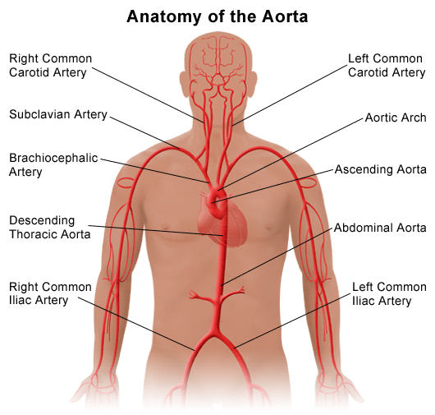

Slide 10
Braanches of (ECA):
S: superior thyroid artery.
A: ascending pharyngeal artery.
L: lingual artery.
F: facial artery.
O: occipital artery.
P: posterior auricular artery.
M: maxillary artery.
S: superficial temporal artery

Slide 11
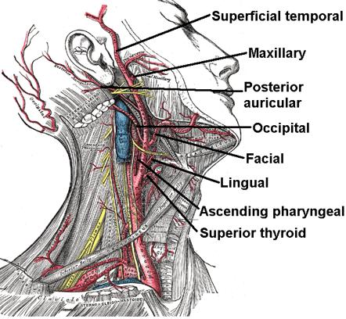

Slide 12
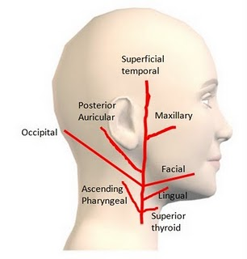

Slide 13
The internal carotid artery supplies the anterior portion of the forehead and dorsal surface of the nose via ophthalmic artery branches.
The arteries of the face anastomose freely.

Slide 14
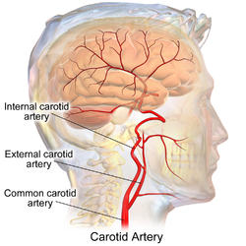

Slide 15
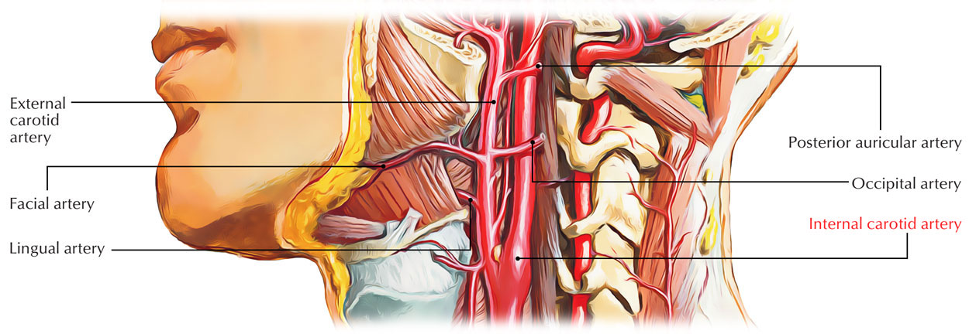

Slide 16
BRANCHES OF ophthalmic artery

Slide 17
Orbital group
The orbital group, distributing vessels to the orbit and surrounding parts, includes:
Lacrimal artery
Supraorbital artery
Posterior ethmoidal artery
Anterior ethmoidal artery (by external nasal branch)
Medial palpebral artery.
Frontal artery, also called the Supratrochlear artery
Dorsal nasal artery

Slide 18
Ocular group
The ocular group, distributing vessels to the eye and its muscles, includes:
Long posterior ciliary arteries
Short posterior ciliary arteries
Anterior ciliary artery
Central retinal artery
Superior muscular artery
Inferior muscular artery

Slide 19
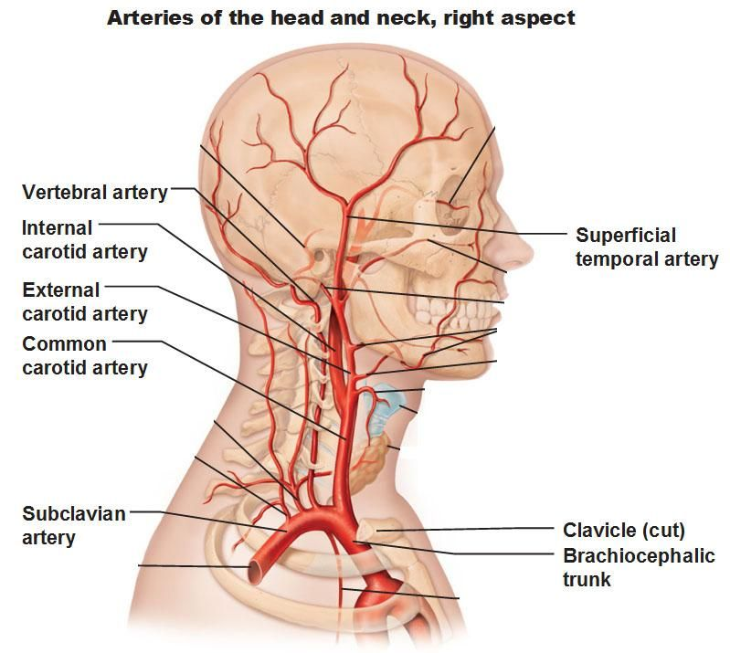

Slide 20
Arterial supply for human face :

Slide 21
I)FACIAL ARTERY:
The facial artery (external maxillary artery in older texts) is a branch of the external carotid artery that supplies structures of the superficial face.
Having arched upward and over the submandibular salivary gland, it curves around the inferior margin of the body of the mandible at the anterior border of the masseter muscle.

Slide 22
It runs upward in a tortuous course toward the angle of the mouth and is covered by the platysma and the risorius muscles.
It then ascends deep to the zygomaticus muscles and the levator labii superioris muscle and runs along the side of the nose to the medial angle of the eye, where it anastomoses with the terminal branches of the ophthalmic artery.

Slide 23
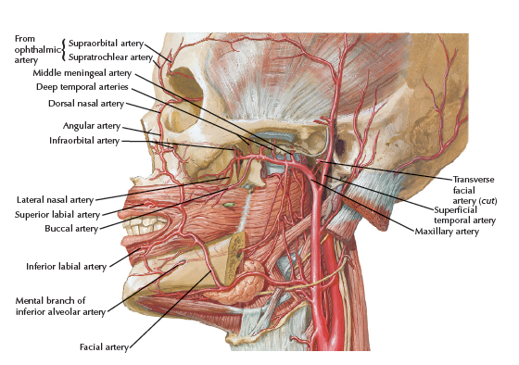

Slide 24
Cervical & facial
BRANCHES:

Slide 25
A)Cervical
1}Ascending palatine artery : arises close to the origin of the facial artery and passes up between the styloglossus and stylopharyngeus to the side of the pharynx, supplies the soft palate, palatine glands, palatine tonsil and auditory tube.
2}Tonsillar branch : ascends between the pterygoideus internus and styloglossus muscles, and then along the side of the pharynx,supplies palatine tonsil.

Slide 26
3}Submental artery :
It supplies the surrounding muscles(mylohyoid and diagastric),submandibular gland,chin & lower lip, runs on the underside of the chin.
4}Glandular branches : (Submaxillary branches)
supply the submandibular gland, some being prolonged to the neighboring muscles, lymph glands, and integument.

Slide 27
B)Facial
1}Inferior labial artery : Supplies the lower lip, arises near the angle of the mouth.
2}Superior labial artery : supplies the upper lip, and gives off in its course two or three vessels which ascend to the nose; a septal branch ramifies on the nasal septum as far as the point of the nose, and an alar branch supplies the ala of the nose.

Slide 28
3}Lateral nasal branch to nasalis muscle: Supplies the ala and dorsum nose, vessel ascends along the side of the nose.
4}Angular artery - the terminal branch: is the terminal part of the facial artery; it ascends to the medial angle of the eye's orbit, supplying the lacrimal sac and Orbicularis oculi.

Slide 29
II)The superficial temporal artery
the smaller terminal branch of the external carotid artery, commences in the parotid gland.
It ascends in front of the auricle to supply the scalp.
The transverse facial artery, a branch of the superficial temporal artery, arises within the parotid gland.
It runs forward across the cheek just above the parotid duct.

Slide 30
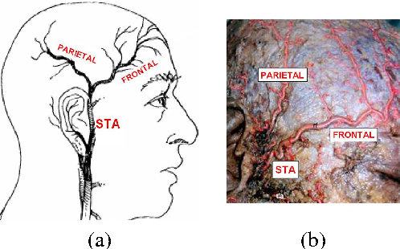

Slide 31
Branches of (STA):
1)parietal branch of superficial temporal artery (posterior temporal): supplying temple region.(out side of parotid gland)
2)frontal branch of superficial temporal artery (anterior temporal): supplying the muscles, integument, and pericranium in this region. (out side of parotid gland)
3)transverse facial artery: supply the parotid gland and parotid duct, the masseter muscle& the integument.( inside parotid gland)

Slide 32
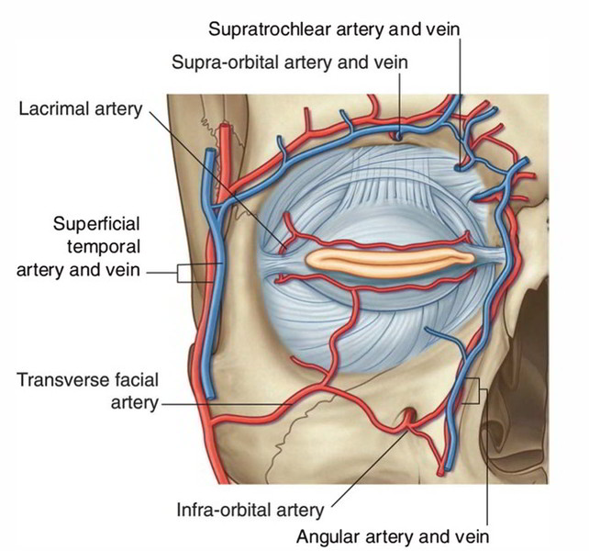

Slide 33
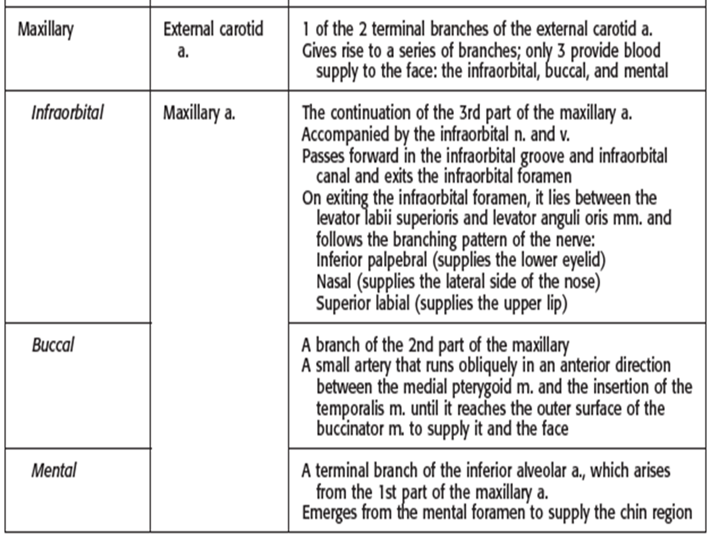
III)Some branches of maxillary artery.

Slide 34
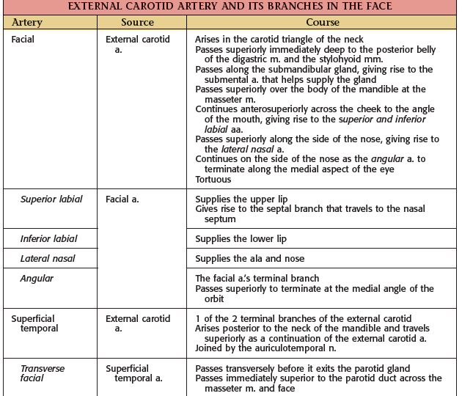

Slide 35
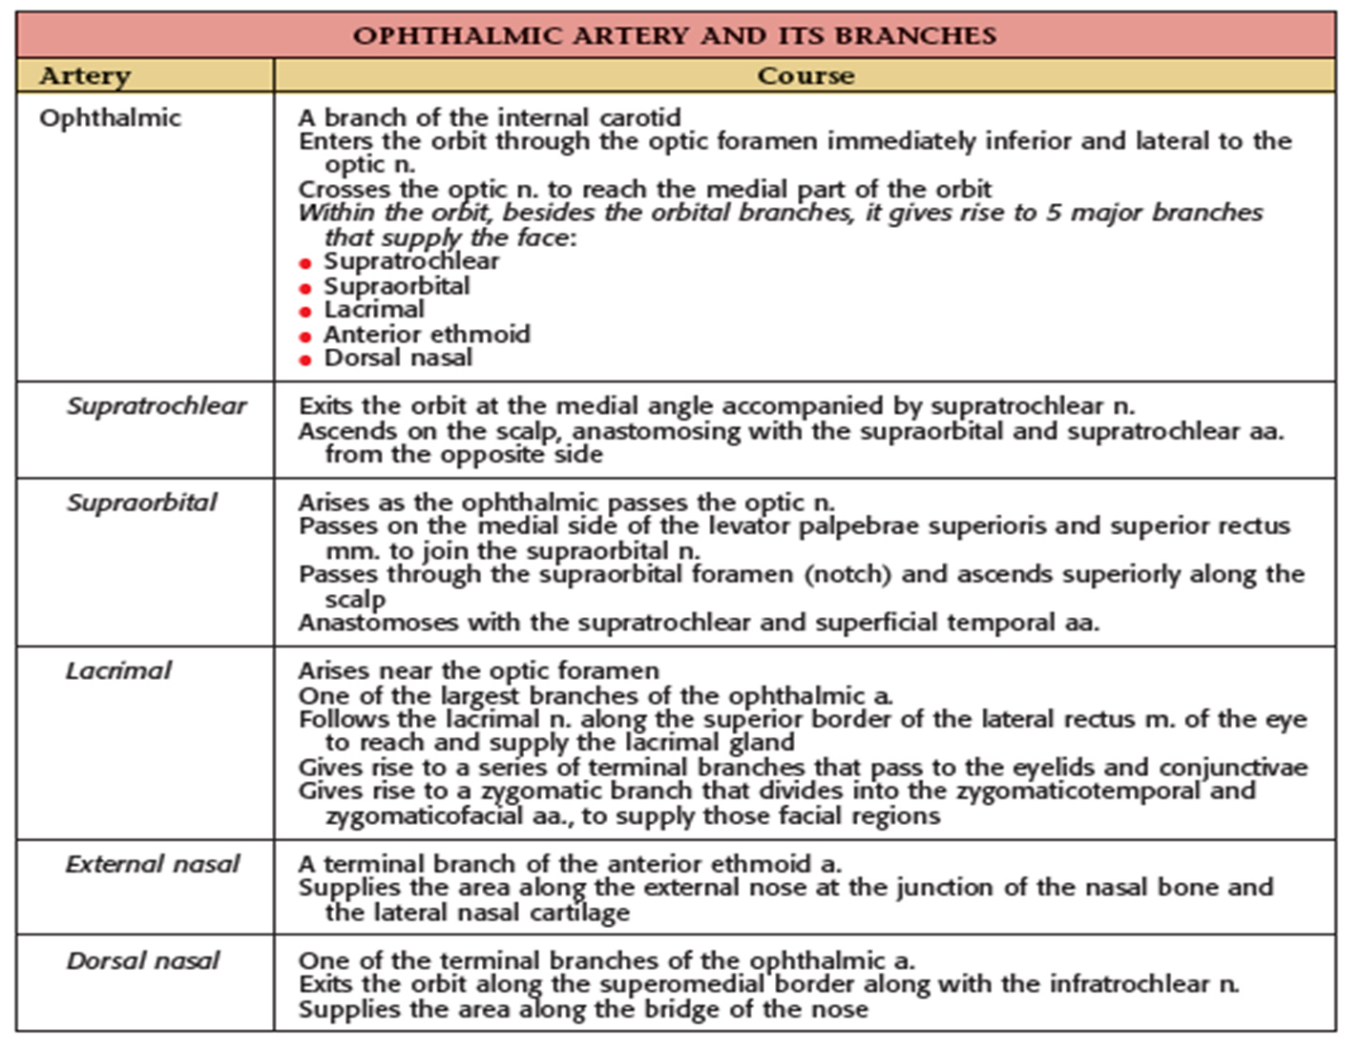
IV) : branches of the ophthalmic artery, supply the skin of the forehead.

Slide 36
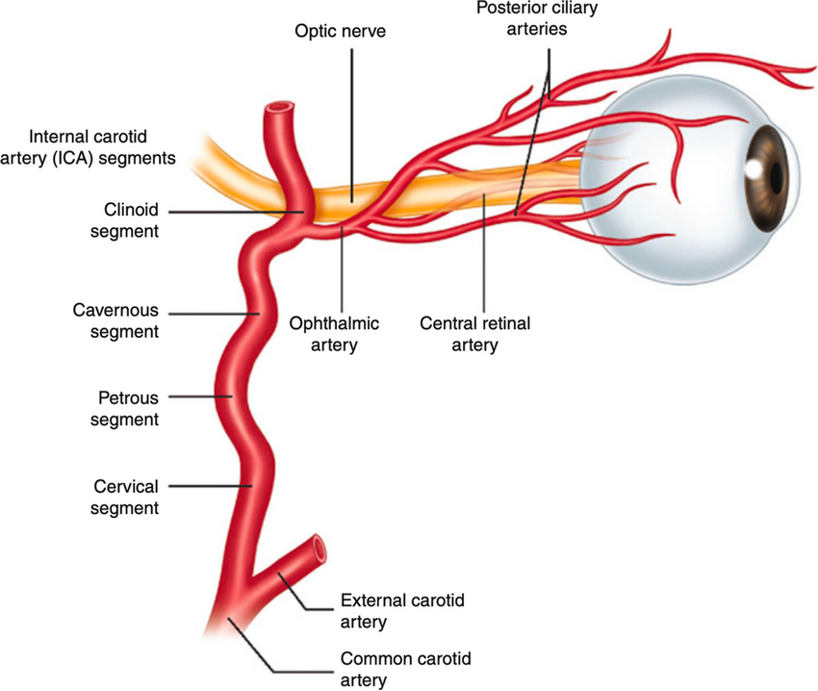

Slide 37
Facial vein:
Venous Drainage of the Face

Slide 38
The facial vein=(Anterior Facial Vein) is formed at the medial angle of the eye by the union of the supraorbital and supratrochlear veins.
It is connected to the superior ophthalmic vein directly through the supraorbital vein. By means of the superior ophthalmic vein.

Slide 39
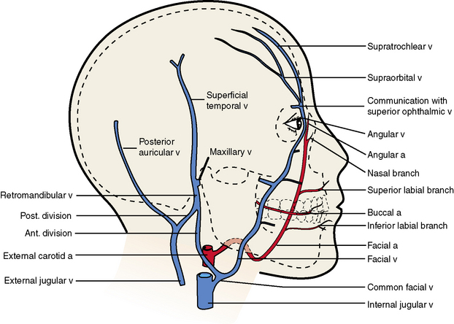

Slide 40
facial vein is connected to the cavernous sinus ; this connection is of great clinical importance because it provides a pathway for the spread of infection from the face to the cavernous sinus.
The facial vein descends behind the facial artery to the lower margin of the body of the mandible.
It crosses superficial to the submandibular gland and is joined by the anterior division of the retromandibular vein forming common facial vein.
The facial vein ends by draining into the internal jugular vein.

Slide 41
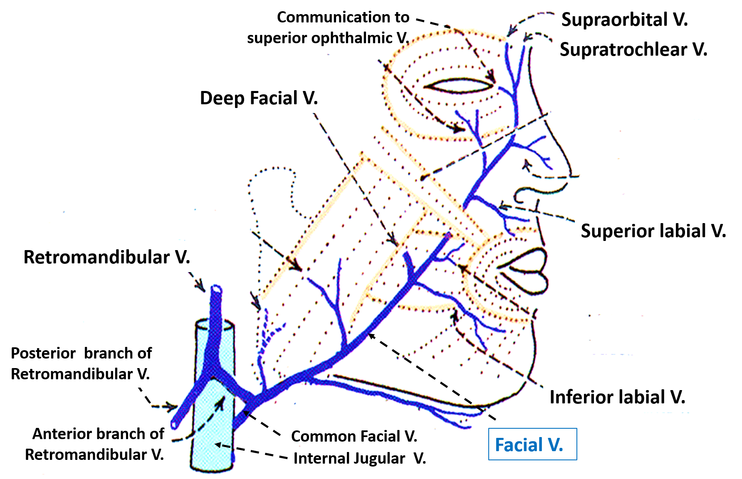

Slide 42
Tributaries
The facial vein receives tributaries that correspond to the branches of the facial artery.
It is joined to the pterygoid venous plexus by the deep facial vein and to the cavernous sinus by the superior ophthalmic vein.
The transverse facial vein joins the superficial temporal vein within the parotid gland.

Slide 43
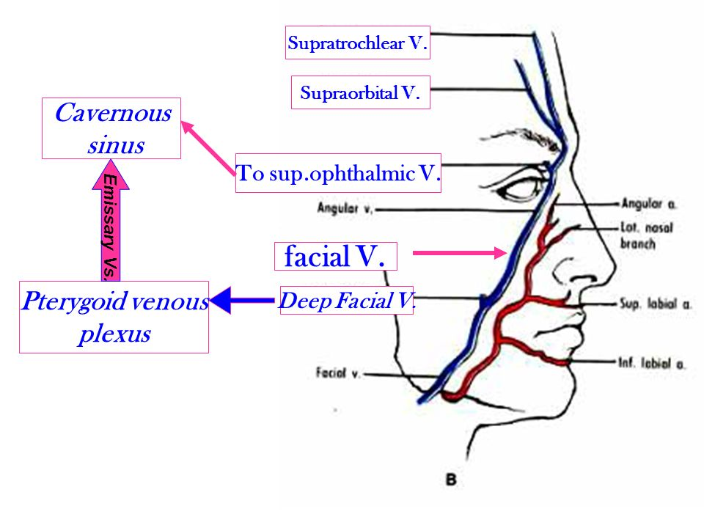

Slide 44
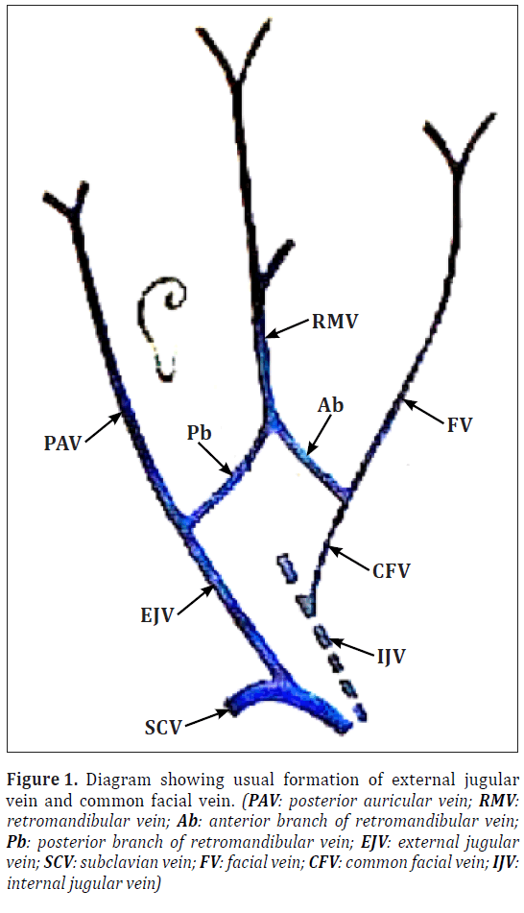

Slide 45
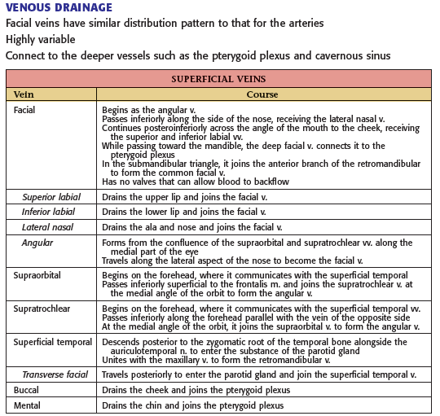

Slide 46
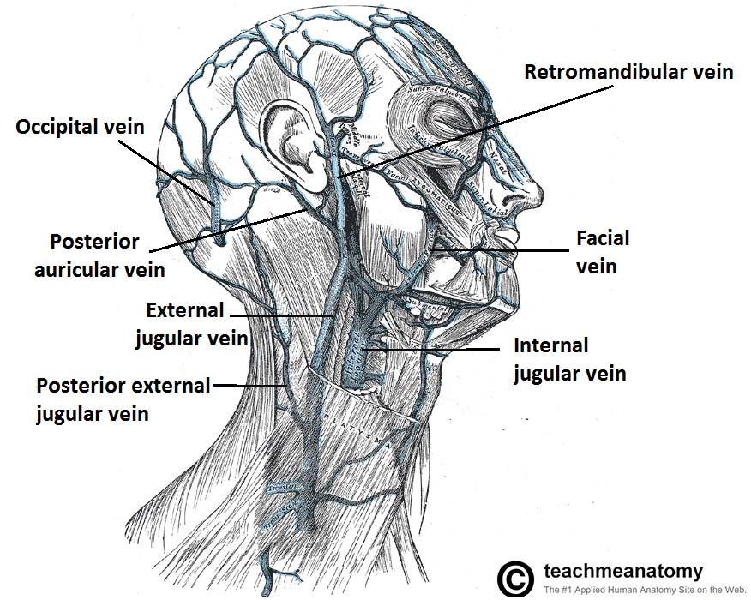

Slide 47
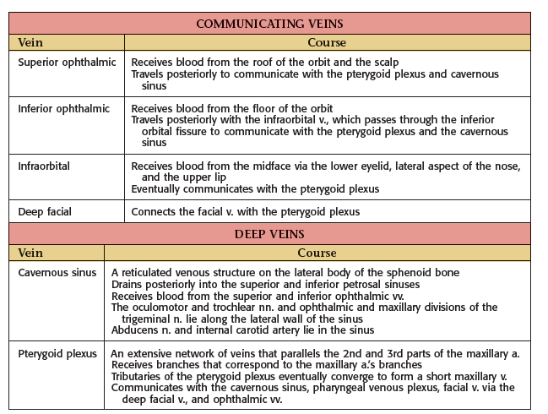

Slide 48
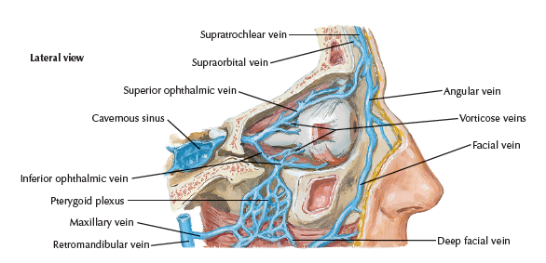

Slide 49
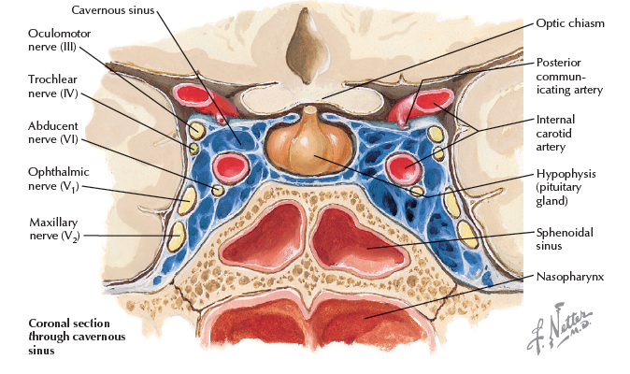

Slide 50
Facial nerve, CN VII:
MOTOR INNERVATION OF THE FACE

Slide 51
Is the seventh paired cranial nerve.
Motor: Innervates the muscles of facial expression, the posterior belly of the digastric, the stylohyoid and the stapedius muscles.
Sensory: A small area around the concha of the auricle.
Special Sensory: Provides special taste sensation to the anterior 2/3 of the tongue.

Slide 52
Parasympathetic: Supplies many of the glands of the head and neck, including:
Submandibular and sublingual salivary glands.
Nasal, palatine and pharyngeal mucous glands.
Lacrimal glands.

Slide 53
The course of the facial nerve:
Anatomically, the course of the facial nerve can be divided into two parts:
Intracranial – the course of the nerve through the cranial cavity, and the cranium itself.
Extracranial – the course of the nerve outside the cranium, through the face and neck.

Slide 54
Intracranial:
The nerve arises in the pons, an area of the brainstem.
It begins as two roots; a large motor root, and a small sensory root (the part of the facial nerve that arises from the sensory root is sometimes known as the intermediate nerve).
The two roots travel through the internal acoustic meatus, a 1cm long opening in the petrous part of the temporal bone.

Slide 55
Here, they are in very close proximity to the inner ear.
Still within the temporal bone, the roots leave the internal acoustic meatus, and enter into the facial canal.
The canal is a ‘Z’ shaped structure. Within the facial canal, three important events occur:

Slide 56
Firstly the two roots fuse to form the facial nerve.
Next, the nerve forms the geniculate ganglion (a ganglion is a collection of nerve cell bodies).
Lastly, the nerve gives rise to:
Greater petrosal nerve – parasympathetic fibres to mucous glands and lacrimal gland.
Nerve to stapedius – motor fibres to stapedius muscle of the middle ear.
Chorda tympani – special sensory fibres to the anterior 2/3 tongue and parasympathetic fibres to the submandibular and sublingual glands.

Slide 57
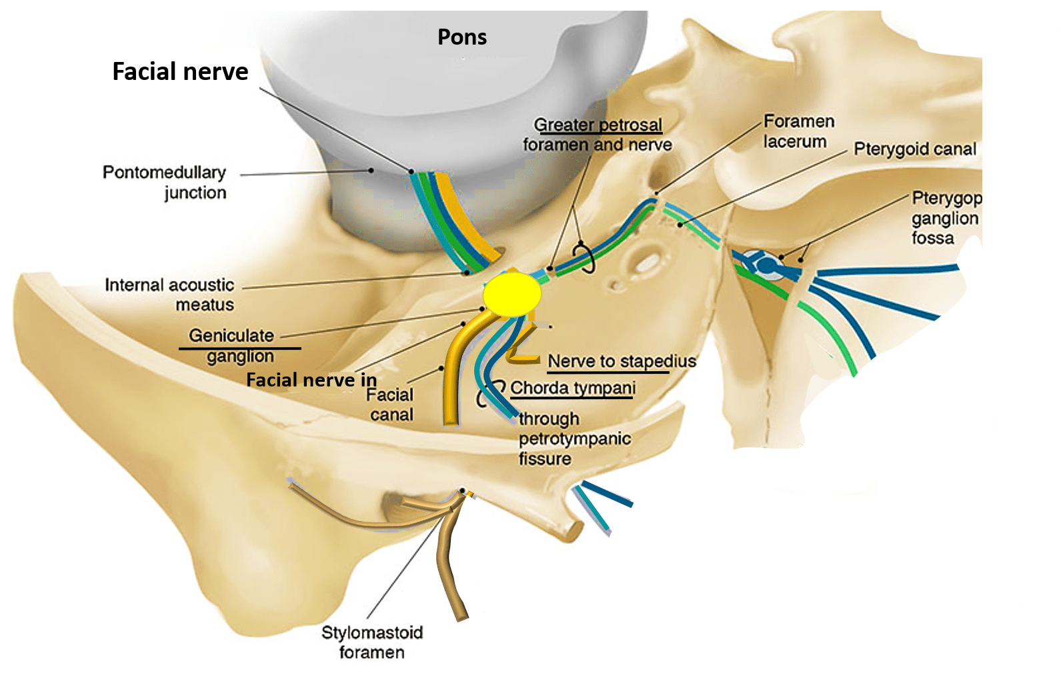

Slide 58
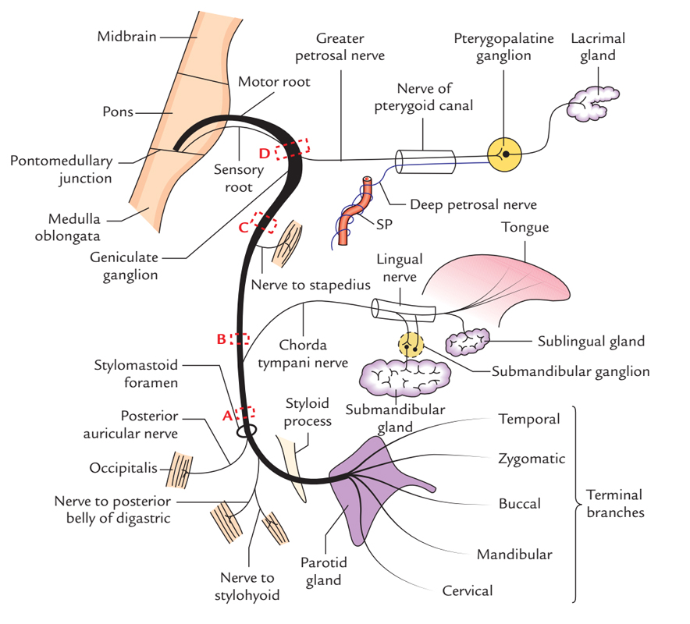

Slide 59
Intracranial branches:
1.Greater petrosal nerve : It arises at the geniculate ganglion and provides parasympathetic innervation to several glands, including the nasal glands, the palatine glands, the lacrimal gland, and the pharyngeal gland.
It also provides parasympathetic innervation to the sphenoid sinus, frontal sinus, maxillary sinus, ethmoid sinus and nasal cavity.
This nerve also includes taste fibers for palate via lesser palatine nerve and greater palatine nerve.

Slide 60
2.Communicating branch : to the otic ganglion – It arises at the geniculate ganglion and joins the lesser petrosal nerve to reach the otic ganglion.
3.Nerve to stapedius : provides motor innervation for stapedius muscle in middle ear
4.Chorda tympani:
  Parasympathetic innervation to submandibular gland
  Parasympathetic innervation to sublingual gland
  Special sensory taste fibers for the anterior 2/3 of the tongue

Slide 61
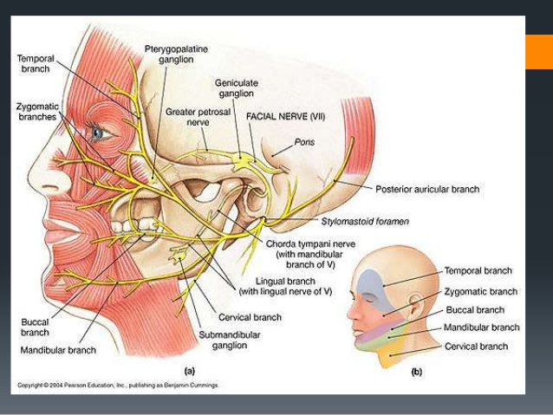

Slide 62
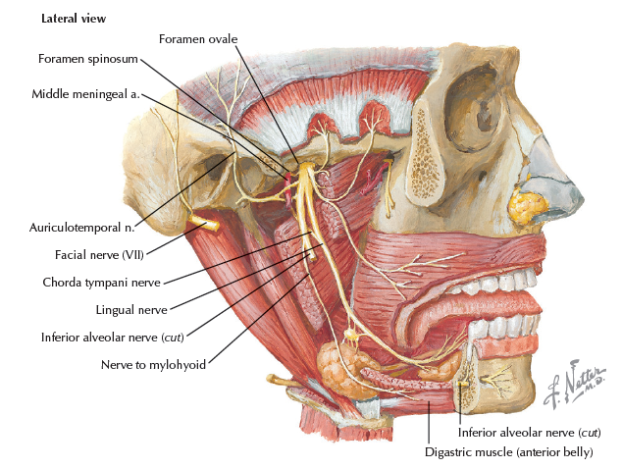

Slide 63
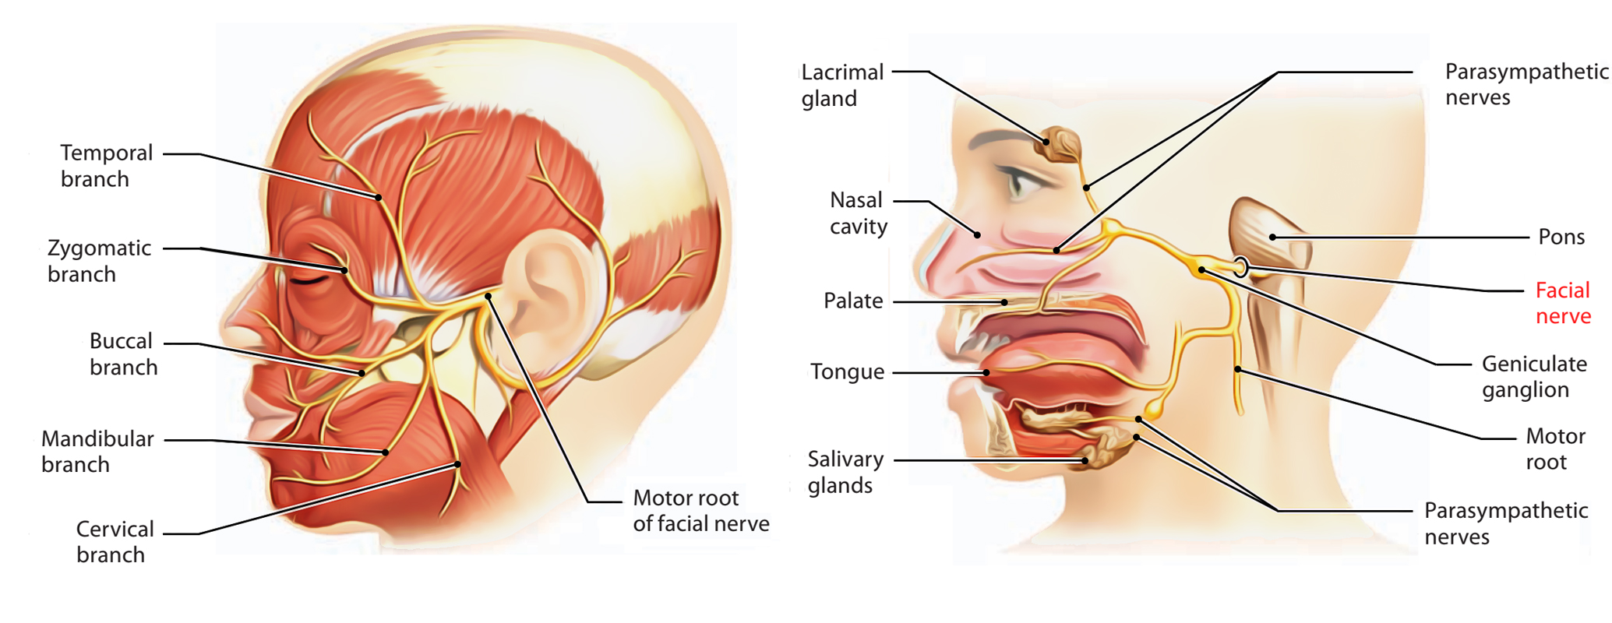

Slide 64
Extracranial:
After exiting the skull, the facial nerve turns superiorly to run just anterior to the outer ear. The first extracranial branch to arise is the posterior auricular nerve.
It provides motor innervation to the some of the muscles around the ear.
Immediately distal to this, motor branches are sent to the posterior belly of the digastric muscle and to the stylohyoid muscle.
The main trunk of the nerve, now termed the motor root of the facial nerve, continues anteriorly and inferiorly into the parotid gland.

Slide 65
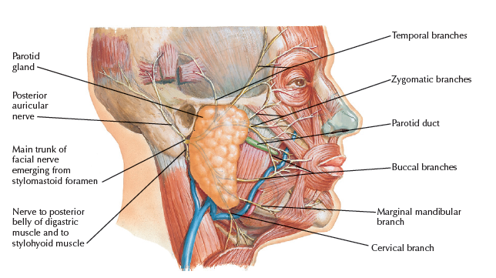

Slide 66
Extracranial branches:
Distal to stylomastoid foramen, the following nerves branch off the facial nerve:
1.Posterior auricular nerve : controls movements of some of the scalp muscles around the ear
2.Branch to Posterior belly of Digastric muscle as well as the Stylohyoid muscle
3.Five major facial branches (in parotid gland) – from top to bottom:
  Temporal branch (Frontal branch)
  Zygomatic branch
  Buccal branch
  Marginal mandibular branch
  Cervical branch

Slide 67
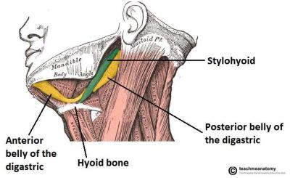

Slide 68
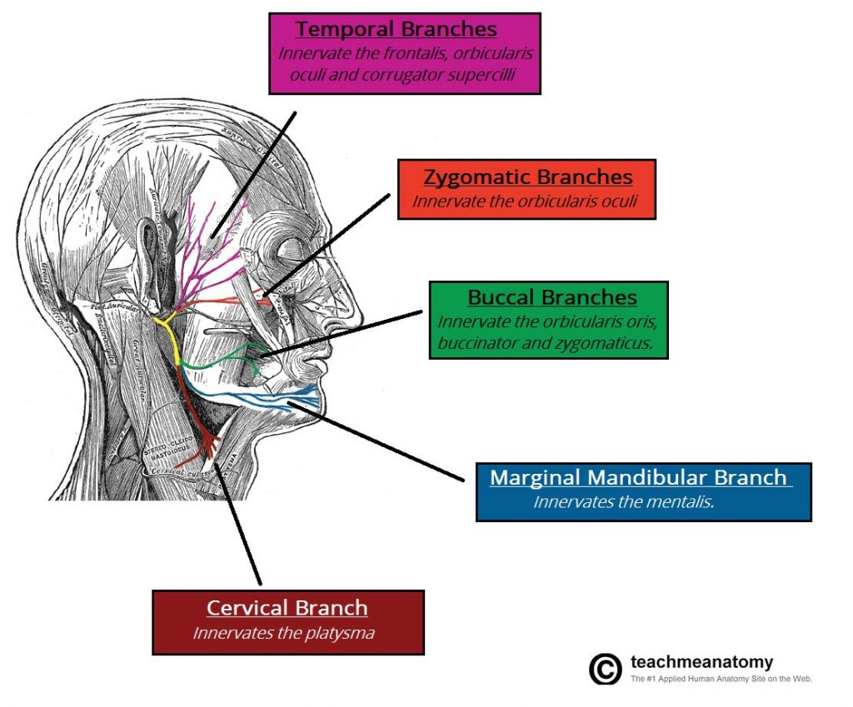

Slide 69
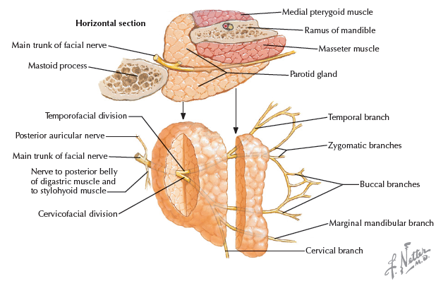

Slide 70
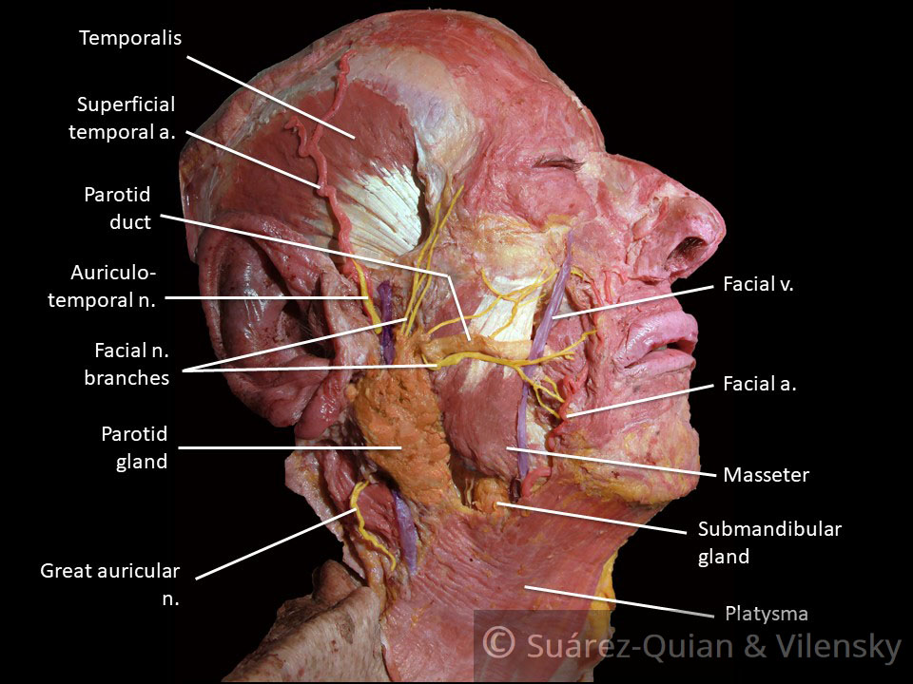

Slide 71
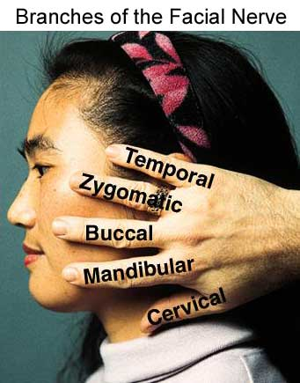

Slide 72
Muscles of the Face (Muscles of Facial Expression)

Slide 73
The muscles of the face are embedded in the superficial fascia, and most arise from the bones of the skull and are inserted into the skin.
The orifices of the face, namely, the orbit, nose, and mouth, are guarded by the eyelids, nostrils, and lips, respectively.

Slide 74
It is the function of the facial muscles to serve as sphincters or dilators of these structures.
A secondary function of the facial muscles is to modify the expression of the face.
All the muscles of the face are developed from the second pharyngeal arch and are supplied by the facial nerve.

Slide 75
Muscles of the Eyelids
The sphincter muscle of the eyelids is the orbicularis oculi which is innervated by temporal& zygomatic branch of facial nerve, and the dilator muscles are the levator palpebrae superioris (which is innervated by 3rd cranial nerve) and the occipitofrontalis.

Slide 76
Muscles of the Nostrils (Nasalis muscle)
The sphincter muscle is the compressor naris and the dilator muscle is the dilator naris & are innervated by buccal branch of facial nerve.

Slide 77
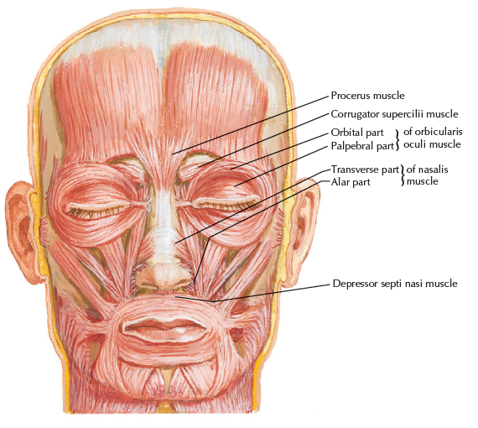

Slide 78
Muscles of the Lips and Cheeks
The sphincter muscle is the orbicularis oris ( which is innervated by buccal&mandibular branches of facial nerve).
The dilator muscles consist of a series of small muscles that radiate out from the lips which are innervated by (buccal,zygomatic&mandibular branches of facial nerve).

Slide 79
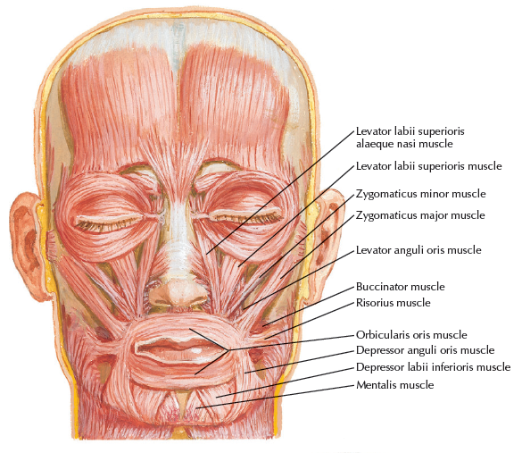

Slide 80
Muscle of the Cheek
Buccinator
Nerve supply: Buccal branch of the facial nerve
Action: Compresses the cheeks and lips against the teeth.

Slide 81
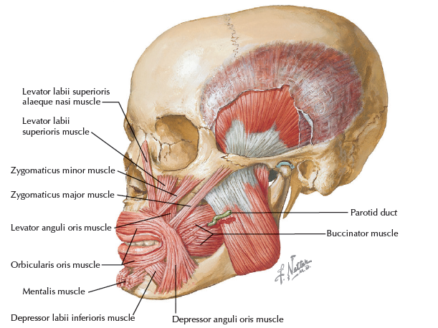

Slide 82
Clinical Significance-2

Slide 83
Blood Supply of the Facial Skin
Facial Arteries and Taking the Patient’s Pulse

Slide 84
Facial Infections and Cavernous Sinus Thrombosis
The area of facial skin bounded by the nose, the eye, and the upper lip is a potentially dangerous zone to have an infection. For example, a boil in this region can cause thrombosis of the facial vein, with spread of organisms through the inferior ophthalmic veins to the cavernous sinus. The resulting cavernous sinus thrombosis may be fatal unless adequately treated with antibiotics.

Slide 85
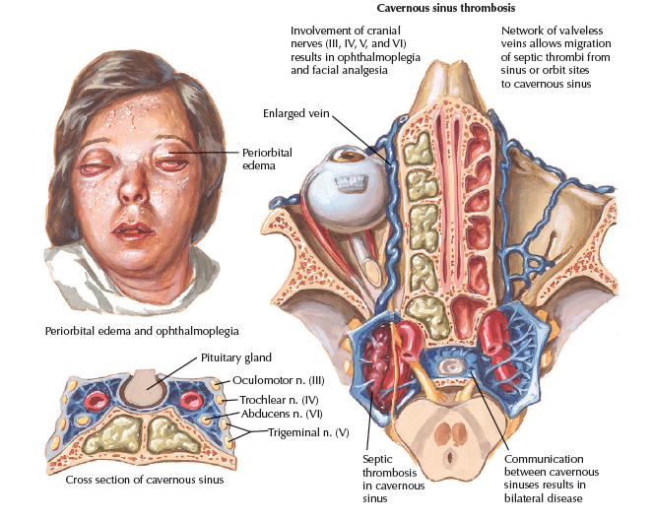

Slide 86
Before the advent of antibiotics, death was the normal outcome from the sepsis
It affects the contents of the cavernous sinus, including:
● Internal carotid artery with sympathetics
● Cranial nerve III
● Cranial nerve V1
● Cranial nerve V2

Slide 87
Common clinical manifestations include:
● Ophthalmoplegia with diminished pupillary light reflexes
● Venous congestion leading to periorbital edema
● Exophthalmos

Slide 88


Slide 89
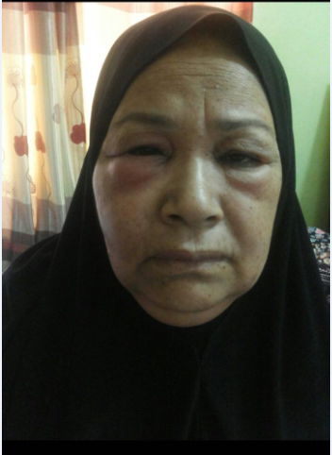

Slide 90


Slide 91
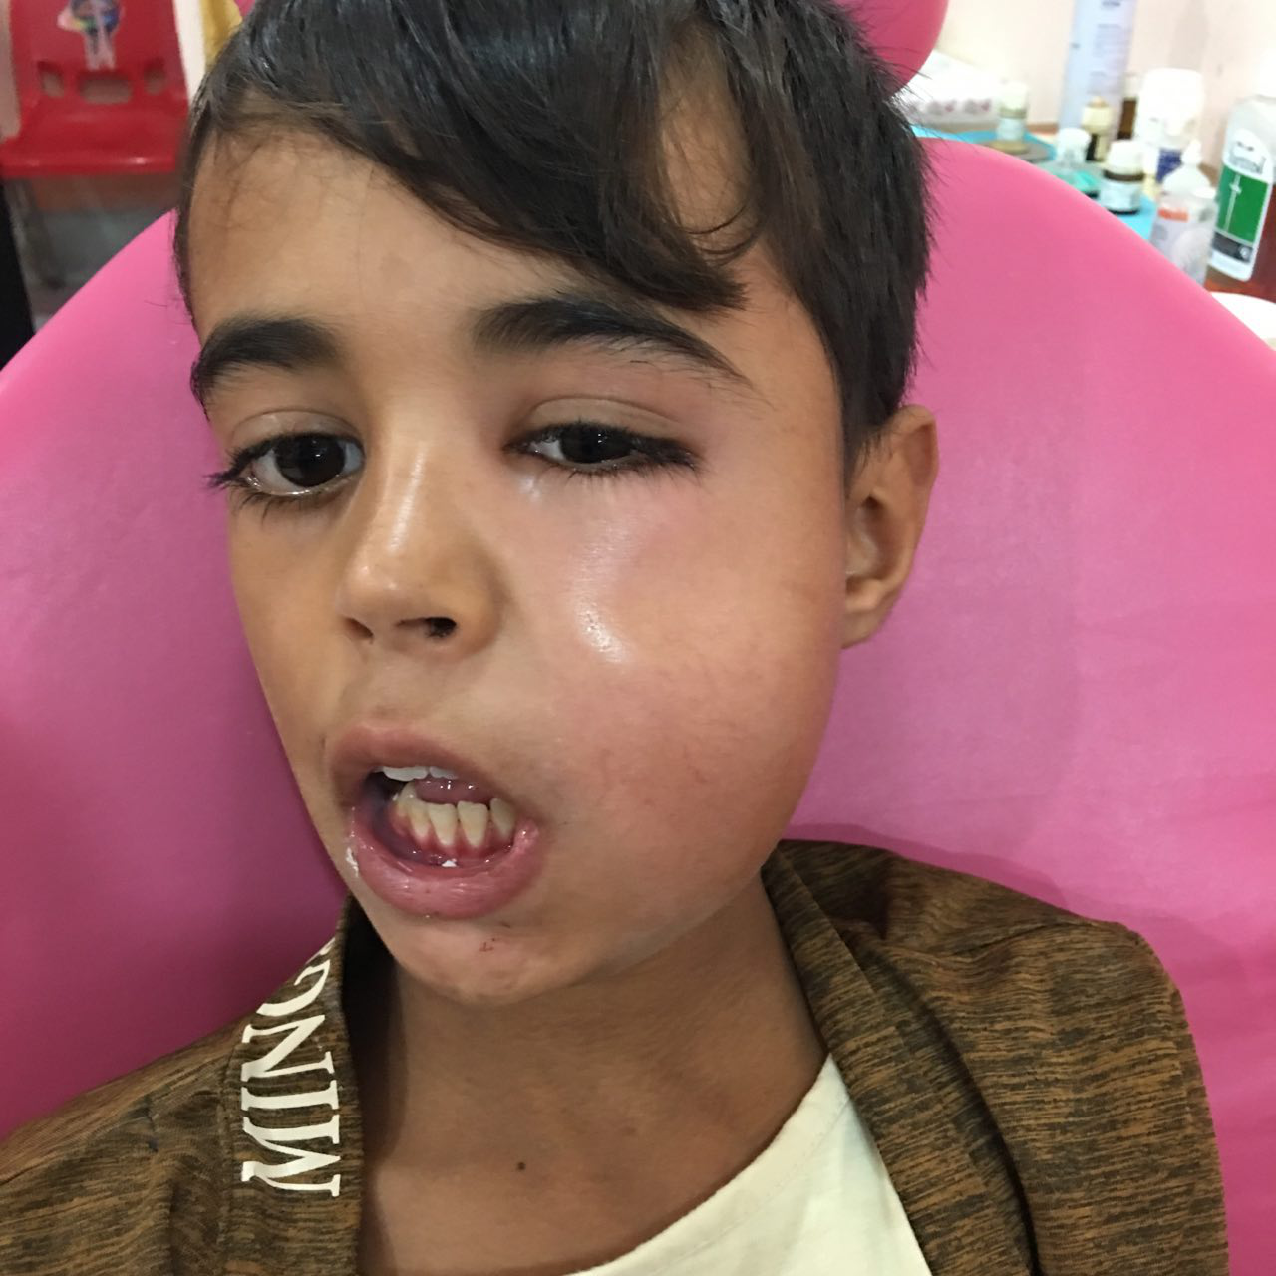

Slide 92
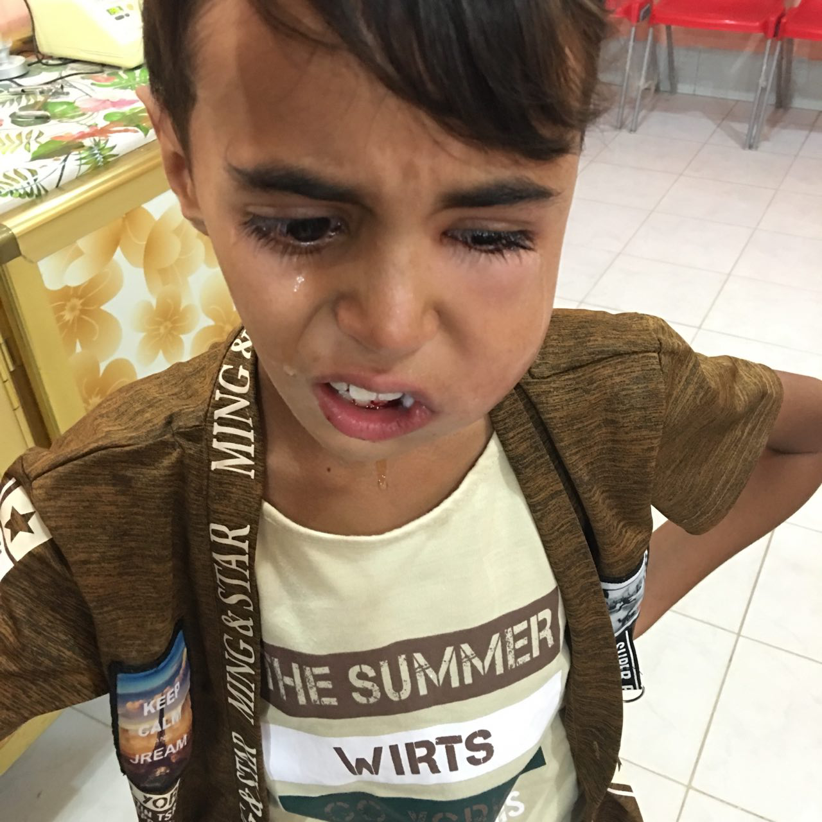

Slide 93
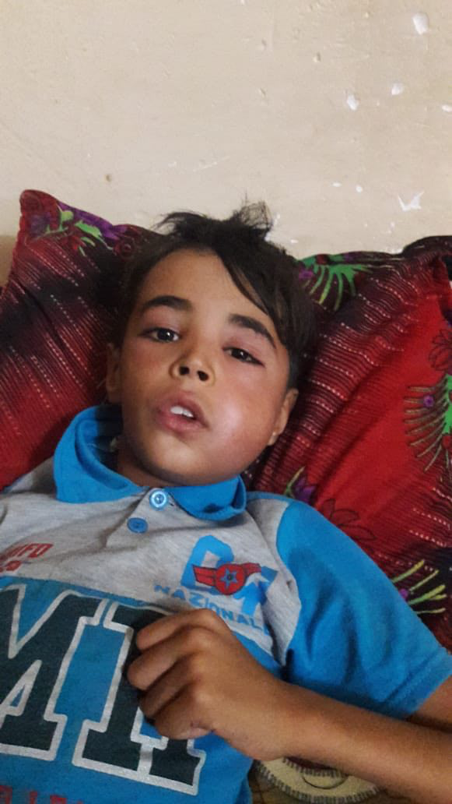

Slide 94
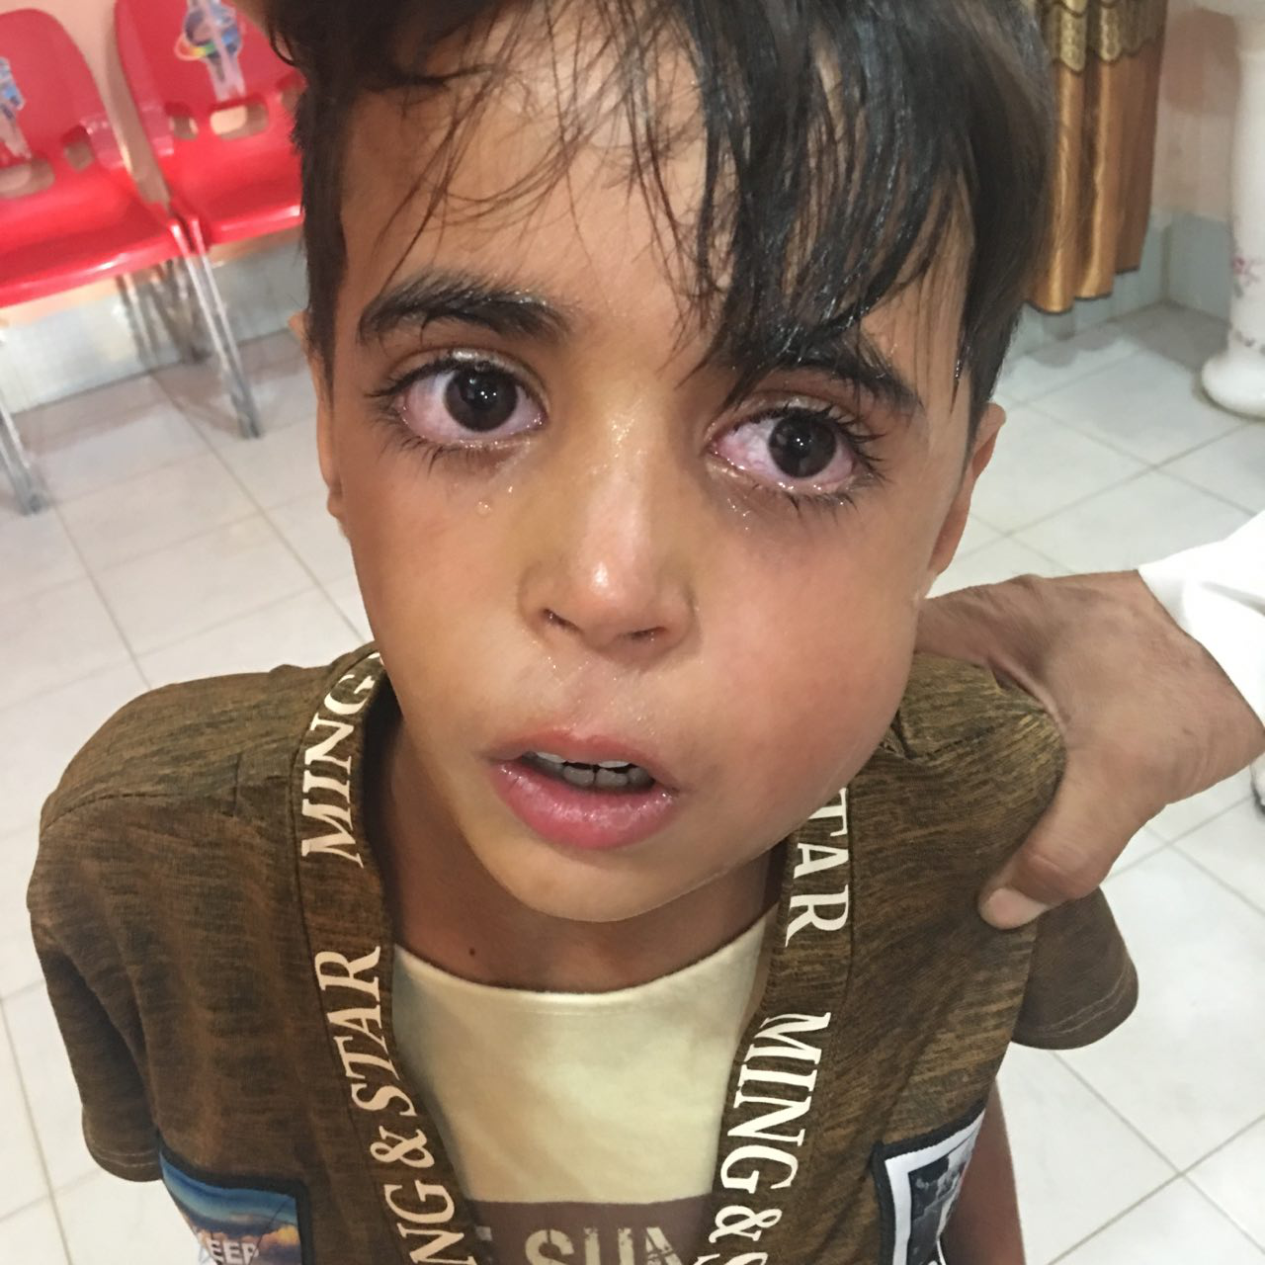

Slide 95


