Slide 1

Before starting……
please switch off your mobile

Slide 2
SECOND STAGE Lec.No.5
Dr.Mukhalled.Al-Asady
(Oral & maxillofacial surgeon)
B.D.S-C.A.B.M.F.S
Al-MuthNNa University
C0llege of dentistry
2024-2025

Slide 3
GENERAL ANATOMY

Slide 4
PAROTID REGION \Part one

Slide 5
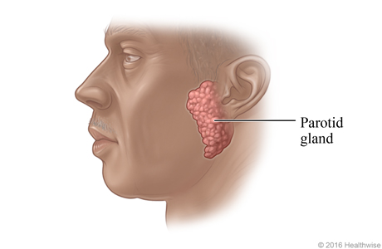

Slide 6
OVERVIEW:
The parotid region is the region that located in the posterolateral part of the facial region.

Slide 7
BOUNDERIES

Slide 8
Zygomatic arch superiorly.
External ear and anterior border of the sternocleidomastoid muscle posteriorly.
Ramus of the mandible medially.
Anterior border of the masseter muscle anteriorly.
Angle and inferior border of the mandible inferiorly.

Slide 9
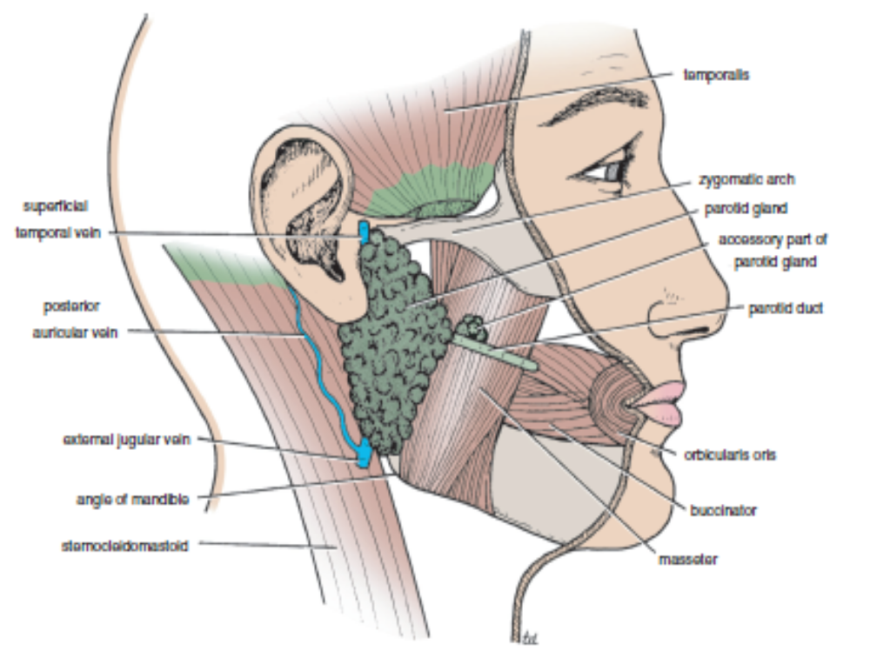

Slide 10
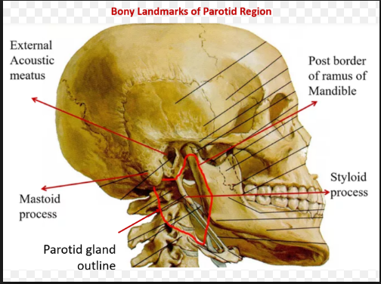

Slide 11
The parotid region includes:
Parotid gland
Parotid duct.
Facial nerve (CN VII).
Retromandibular vein.
External carotid artery.
Masseter muscle.

Slide 12
Overview and Topographic Anatomy
PAROTID GLAND

Slide 13
GENERAL INFORMATION
The largest of all the major salivary glands.
Entirely serous in secretion.
Pyramidal in shape, with up to 5 processes (or extensions)
The gland’s capsule is from the deep cervical fascia.

Slide 14
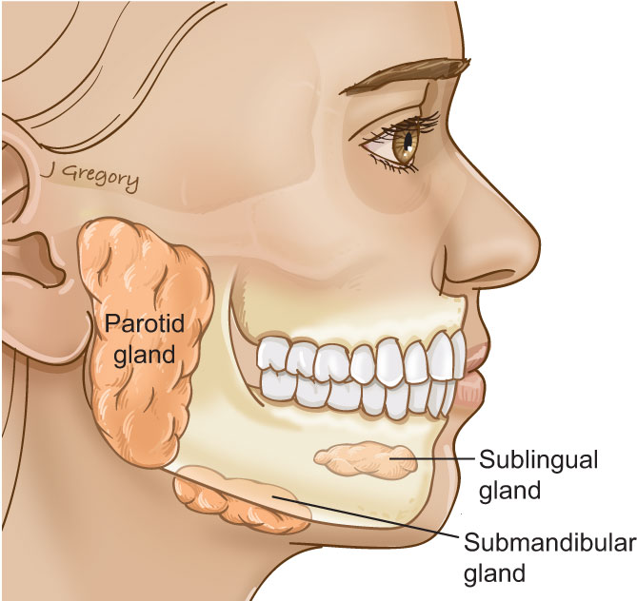

Slide 15
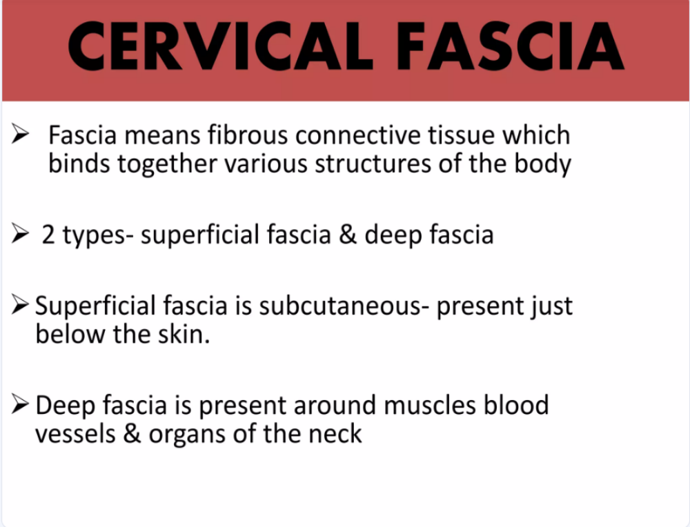

Slide 16
Deep Cervical Fascia
The deep cervical fascia lies, as its name suggests, 'deep' to the superficial fascia and platysma muscle.
This fascia is organized into several layers.
These layers act like a shirt collar, supporting the structures and vessels of the neck.

Slide 17
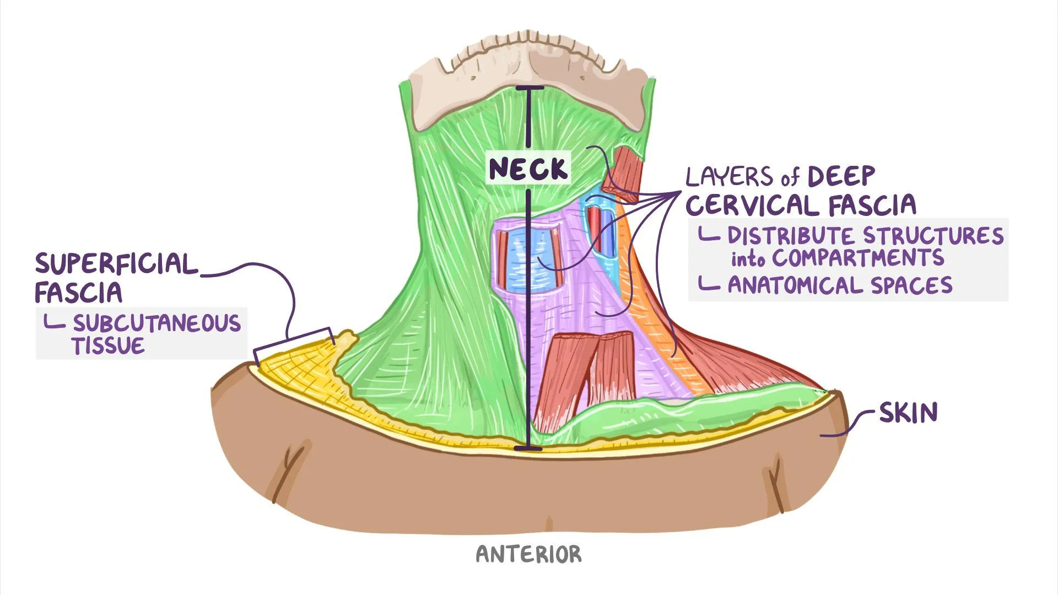

Slide 18
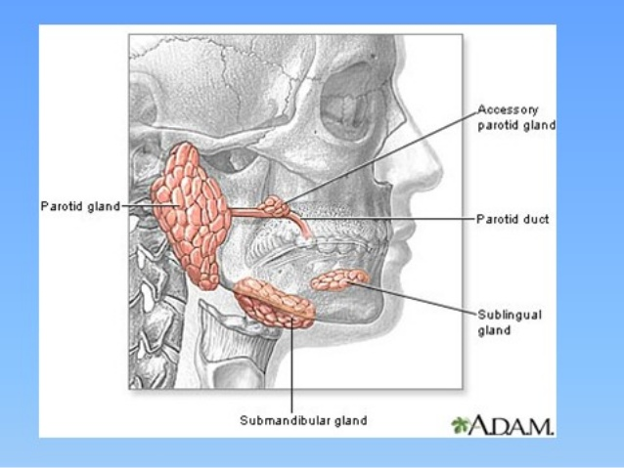

Slide 19
The gland is an irregular lobulated mass, sends ‘processes’ in various directions. These include:
1. Glenoid process that extends upward behind the temporo-mandibular joint, in front of external auditory meatus
2. Facial process that extends anteriorly onto the masseter muscle
3. Accessory process (part), small part of facial process lying along the parotid duct
4. Pterygoid process that extends forward from the deeper part, lies between the medial pterygoid muscle & the ramus of mandible
5. Carotid process that lies posterior to the external carotid artery

Slide 20
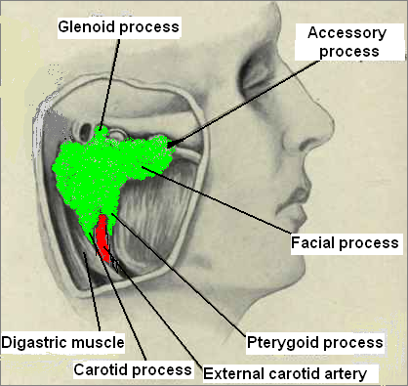

Slide 21
ANATOMIC LANDMARKS

Slide 22
1.Approximately 75% or more of the parotid gland overlies the masseter muscle; the rest is retromandibular.
2.Facial nerve enters the parotid fossa by passing between the stylohyoid muscle and the posterior belly of the digastric muscle, then splits the gland into a superficial lobe and a deep lobe that are connected by an isthmus.

Slide 23
3.Deep lobe lies adjacent to the lateral pharyngeal space.
4.Transverse facial artery parallels the parotid duct slightly superior to the duct.
5.Buccal and zygomatic branches of the facial nerve form an anastomosing loop superficial to the parotid duct.

Slide 24
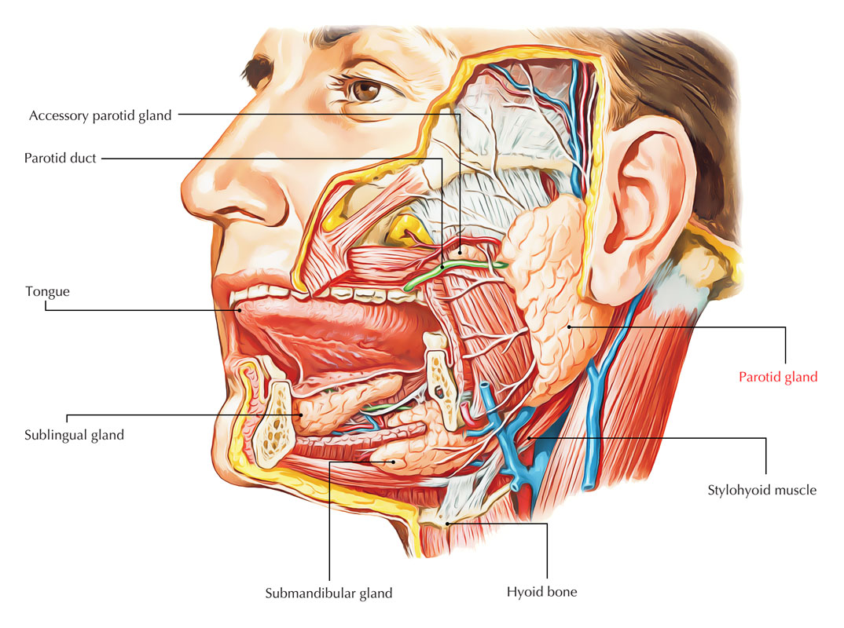

Slide 25
6.The parotid gland is the largest of three paired salivary glands.
7.It composed mostly of serous acini.
8.Although the facial nerve (CN VII) is embedded within the parotid gland, the branches extending from the gland to innervate the muscles of facial expression are encountered during the dissection of the face.

Slide 26
9. The facial nerve divides the gland into superficial and deep lobes.

Slide 27
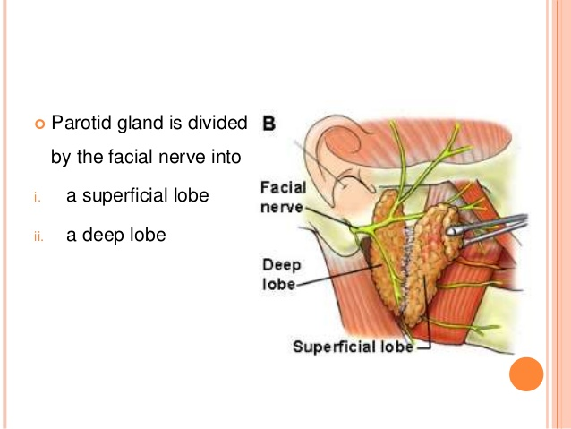

Slide 28
10.The parotid gland is enclosed within a tough, unyielding, fascial capsule, the parotid sheath (capsule), derived from the investing layer of deep cervical fascia.
The parotid gland has an irregular shape because the area occupied by the gland, the parotid bed, is anteroinferior to the external acoustic meatus, where it is wedged between the ramus of the mandible and the mastoid process.

Slide 29
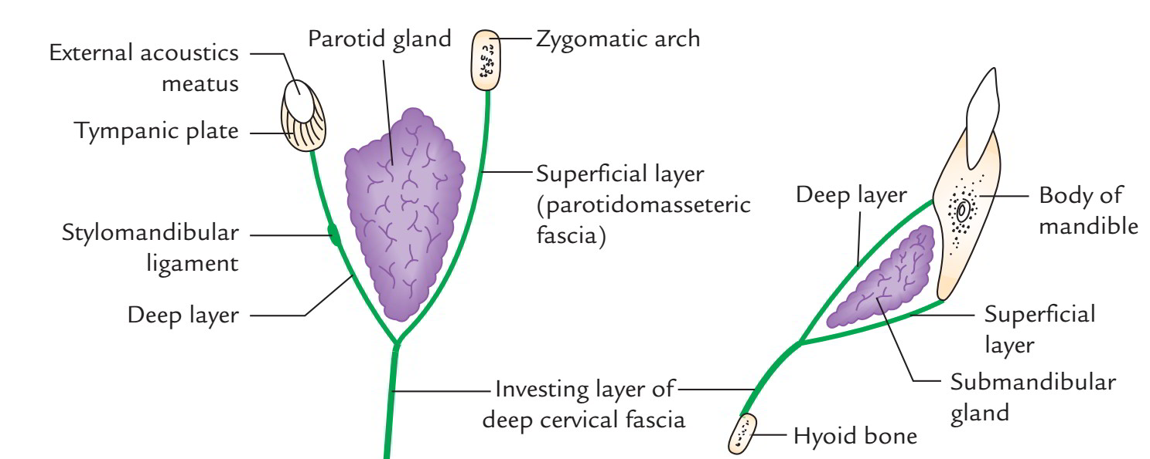

Slide 30
11.The apex of the parotid gland is posterior to the angle of the mandible, and its base is related to the Zygomatic arch.

Slide 31
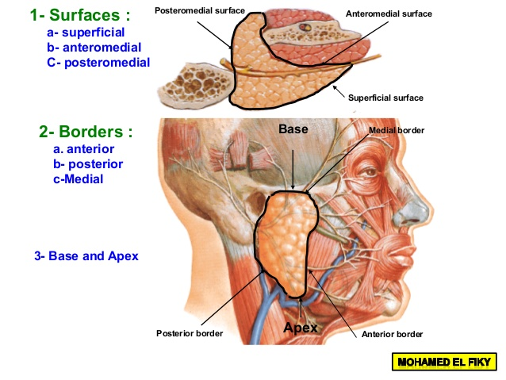

Slide 32
12.The parotid duct passes horizontally from the anterior edge of the gland.
At the anterior border of the masseter, the duct turns medially, pierces (Buccal pad of fat, the buccinator muscle, Buccopharyngeal fascia and Buccal mucosa and enters the oral cavity through a small orifice opposite the 2nd maxillary molar tooth).

Slide 33
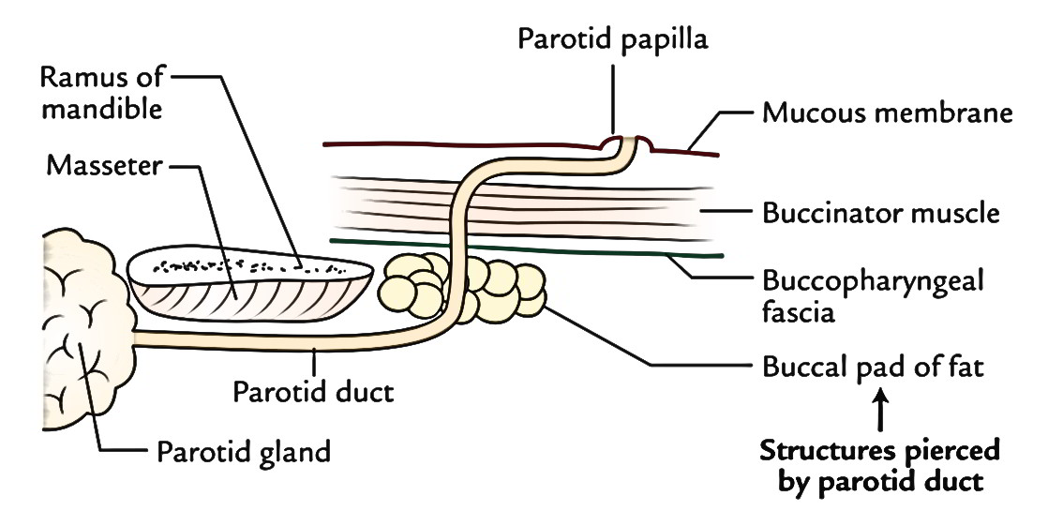

Slide 34
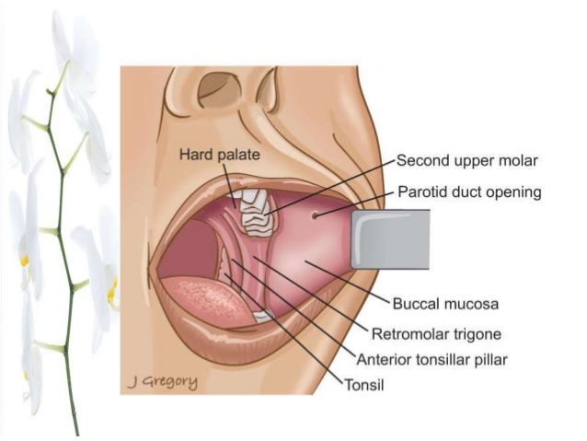

Slide 35
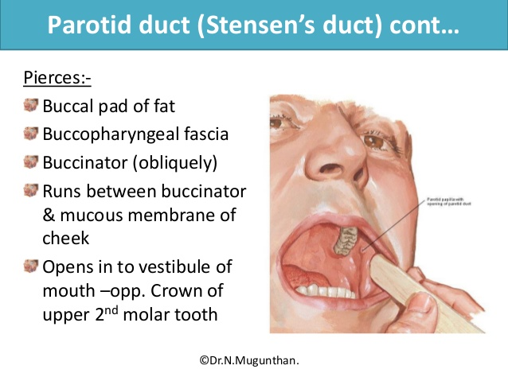

Slide 36
13.The oblique passage of the duct in the buccinator muscle acts as a valve-like mechanism & prevents inflation of the duct during blowing.
About a finger breadth below the zygomatic arch, the duct accompanied by the: transverse facial vessels above and buccal branch of facial nerve below.

Slide 37
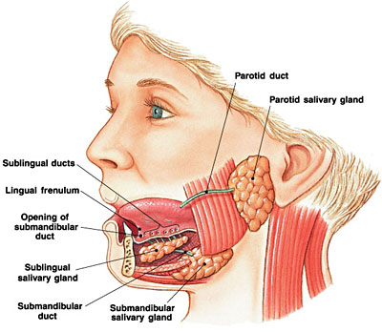

Slide 38
14.The duct is represented by the middle 1/3 of a line extending from the tragus of the auricle to a point midway between the ala of nose & upper lip.

Slide 39
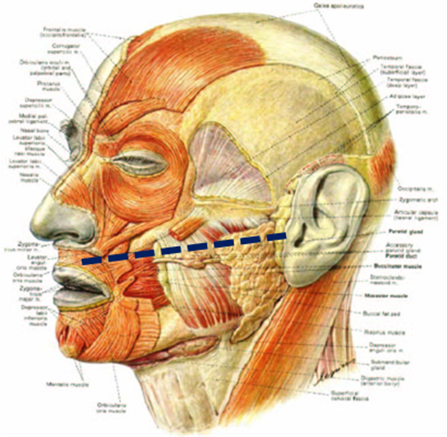

Slide 40
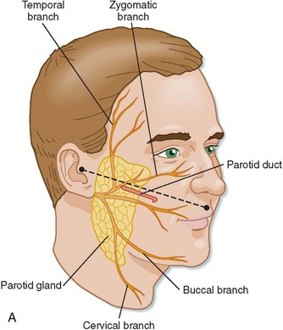

Slide 41
from superficial to deep
Structures Present Within the Parotid Gland

Slide 42
1. Facial nerve and its branches.
2. Retromandibular vein: It is formed within the substance of parotid gland by union of superficial temporal and maxillary veins, and lies below the facial nerve.
3. External carotid artery: It occupies the deep part of gland.
4. Deep parotid lymph nodes.

Slide 43
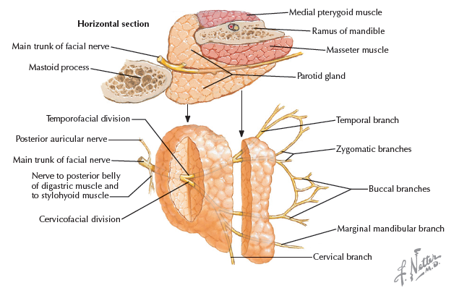

Slide 44
INNERVATION OF PAROTID GLAND AND RELATED STRUCTURES:

Slide 45
Sensory innervation
Although the CN VII is embedded within the gland the CN VII does not provide innervation to the gland.
The auriculotemporal nerve and the great auricular nerve (a branch of the cervical plexus composed of fibers from C2 and C3 spinal nerves), innervates the parotid sheath as well as the overlying skin.

Slide 46
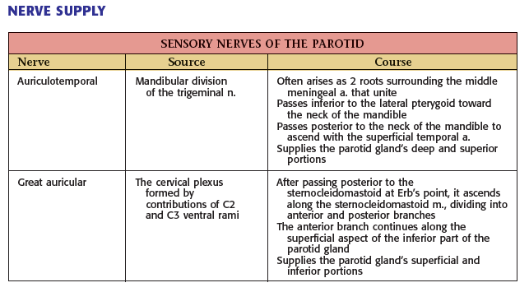

Slide 47
Arterial supply: External carotid artery & its terminal branches.
Venous drainage: Into the retro-mandibular vein.
Lymph Drainage: Into the parotid & then into the deep cervical lymph nodes.
Sensory innervations: Auriculotemporal & Great auricular nerves.

