Slide 1

Before starting……
please switch off your mobile

Slide 2
SECOND STAGE Lec.No.7
Dr.Mukhalled.Al-Asady
(Oral & maxillofacial surgeon)
B.D.S-C.A.B.M.F.S
Al-MuthNNa University
C0llege of dentistry
2024-2025

Slide 3
GENERAL ANATOMY

Slide 4
MANDIBULAR NERVE/1

Slide 5
Trigeminal nerve [V]
The trigeminal nerve [V] is the major general sensory nerve of the head and also innervates muscles that move the lower jaw.
It carries general somatic afferent (GSA) and branchial efferent (BE) fibers:

Slide 6
The GSA fibers:
provide sensory input from the face, anterior one-half of the scalp, mucous membranes of the oral and nasal cavities and the paranasal sinuses , the nasopharynx, part of the ear and external acoustic meatus, part of the tympanic membrane, the orbital contents and conjunctiva, and the dura mater in the anterior and middle cranial fossae.

Slide 7
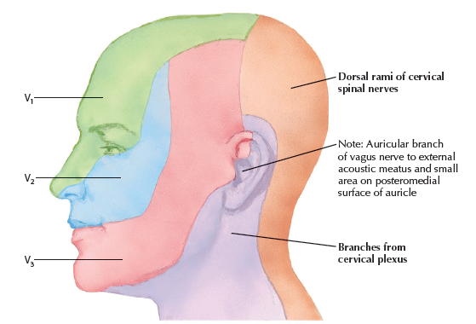

Slide 8
The BE fibers:
innervate the muscles of mastication; the tensor tympani, tensor veli palatini, and mylohyoid muscles; and the anterior belly of the digastric muscle.

Slide 9
COURSE OF TRIGEMINAL NERVE
The trigeminal nerve exits from the anterolateral surface of the pons as a large sensory root and a small motor root
These roots continue forward out of the posterior cranial fossa and into the middle cranial fossa by passing over the medial tip of the petrous part of the temporal bone.

Slide 10
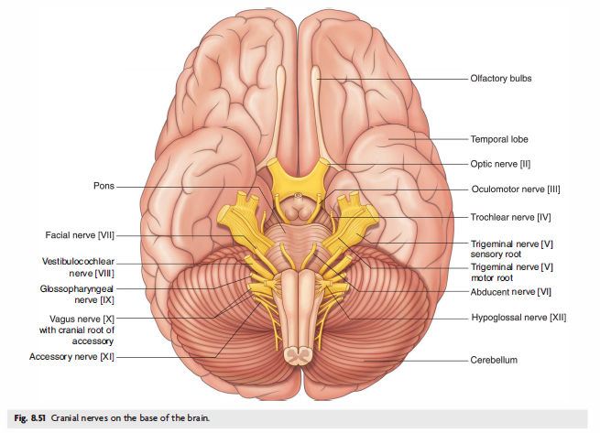

Slide 11
I n the middle cranial fossa the sensory root expands into the trigeminal ganglion , which contains cell bodies for the sensory.
The ganglion is in a neurons in the trigeminal nerve and depression (the trigeminal depression) on the anterior surface of the petrous part of the temporal bone, in a dural cave (the trigeminal cave)
The motor root is below and completely separate from the sensory root at this point.

Slide 12
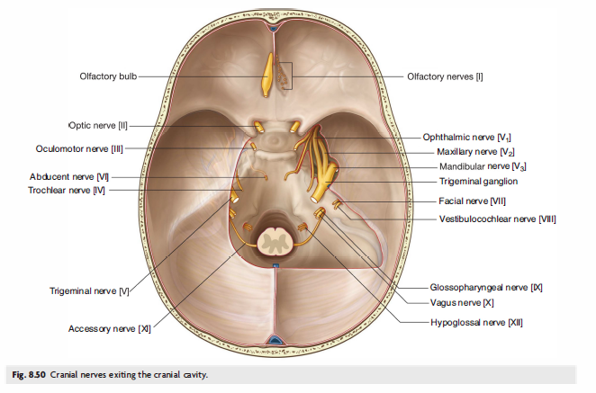

Slide 13
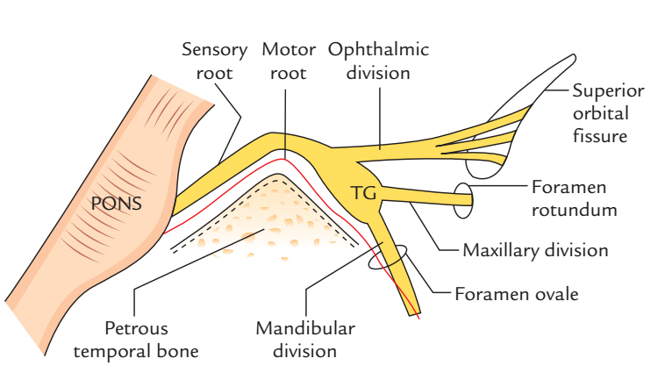

Slide 14
Arising from the anterior border of the trigeminal ganglion are the three terminal divisions of the trigeminal nerve, which in descending order are:
• the ophthalmic nerve (ophthalmic division [VI ] ) .
• the maxillary nerve (maxillary division [V2]), and
• the mandibular nerve (mandibular division [V 3]).

Slide 15
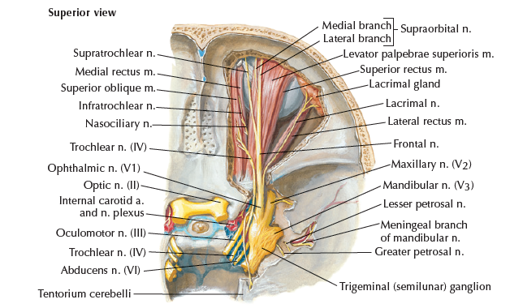

Slide 16
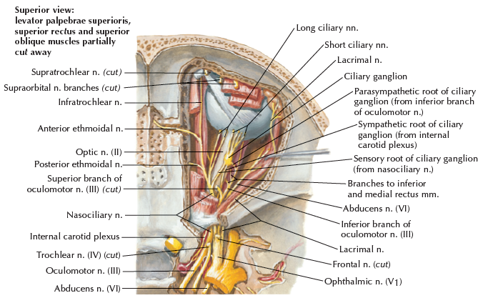

Slide 17
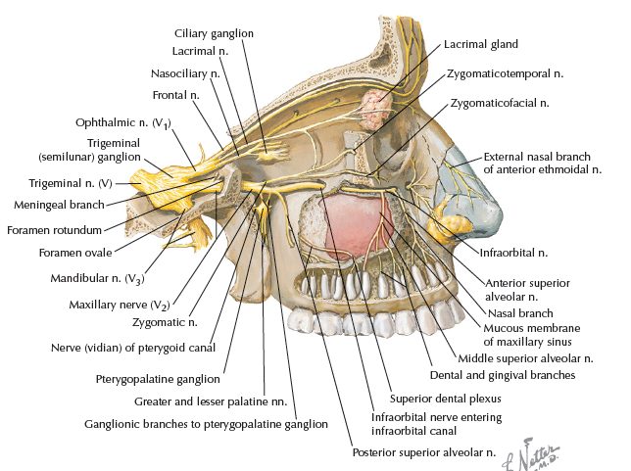

Slide 18
Mandibular nerve [V3]

Slide 19
This is the largest division of the trigeminal nerve and is the only one to contain motor as well as sensory fibers.
Developmentally, it is the nerve of the first branchial arch and is thus responsible for supplying structures derived from it.

Slide 20
The mandibular nerve [V3] leaves the inferior margin of the trigeminal ganglion and leaves the skull through the foramen ovale.
The motor root o f the trigeminal nerve also passes through the foramen ovale and unites with the sensory component of the mandibular nerve [V 3] outside the skull.

Slide 22
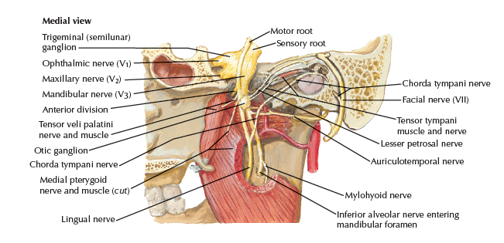

Slide 23
Thus the mandibular nerve
[V 3] is the only division of the trigeminal nerve that contains a motor component.

Slide 24
Outside the skull the motor fibers innervate the four muscles of mastication (temporalis, masseter, and medial and lateral pterygoids) , as well as the tensor tympani muscle, the tensor veli palatini muscle, the anterior belly of the digastric muscle, and the mylohyoid muscle.

Slide 25
The mandibular nerve [V 3] also receives sensory branches from the skin of the lower face, cheek, lower lip, anterior part of the external ear, part of the external acoustic meatus and the temporal region, the anterior two thirds of the tongue, the teeth of the lower
jaw, the mastoid air cells, the mucous membranes of the cheek, the mandible, and dura in the middle cranial fossa.

Slide 26
Its Sensory fibers supply :
the mandibular teeth and their supporting structures,
the mucosa of the anterior two-thirds of the tongue and the floor of the mouth.
the skin of the lower part of the face (including the lower lip) and parts of the temporal region and auricle.

Slide 27
Its motor fibers supply :
the four muscles of mastication
the mylohyoid, anterior belly of digastric,
tensor veli palatini and tensor tympani muscles.

Slide 28
The mandibular nerve is formed in the infratemporal fossa by the union of the sensory and motor roots immediately after they leave the skull at the foramen ovale.
Within the foramen ovale, the motor root (or roots) lie posteromedially to the sensory root and these roots are accompanied by emissary veins, the lesser petrosal nerve and the accessory meningeal artery.
As the mandibular nerve leaves the foramen ovale, it lies on the tensor veli palatini muscle and is covered laterally by the upper head of the lateral pterygoid muscle (slightly anterior to the neck of the mandible).

Slide 30
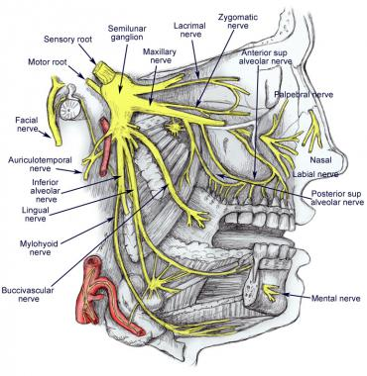

Slide 31
BRANCHES:

Slide 32
Main trunk
Sensory:
Meningeal branch (nervus spinosus)
Motor branches:
Nerve to medial pterygoid
Tensor veli
Tensor tympani

Slide 33
Anterior division:
Masseteric nerve
Deep temporal nerves
Nerve to lateral pterygoid
Long buccal nerve

Slide 34
Posterior division:
Auriculotemporal nerve
Lingual nerve
Inferior alveolar nerve:(Mental, Incisive & mylohyoid nerves)

Slide 35
The meningeal branch (nervus spinosus):
It is a ‘recurrent nerve’ as it runs back into the middle cranial fossa through the foramen spinosum.
It supplies the dura mater lining the middle and anterior cranial fossae and the mucosa of the mastoid antrum and mastoid air cells.

Slide 36
The nerve to the medial pterygoid muscle:
This enters the deep surface of the muscle and also gives slender branches that pass uninterrupted through the otic ganglion to supply the tensor tympani and tensor veli palatini muscles.

Slide 37
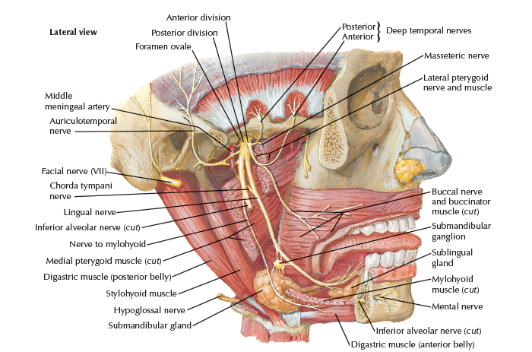

Slide 38
