Slide 1
Pharmacological Management of Child Behavior
Part one
Pedodontic Dentistry \ 5th-grade
Lec.6
Dr. Mukhalled alasady
Oral & Maxillofacial surgeon
B.D.S. – C.A.B.M.F.S
College of dentistry\University
of Al- Muthanna

Slide 2
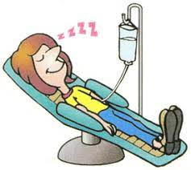
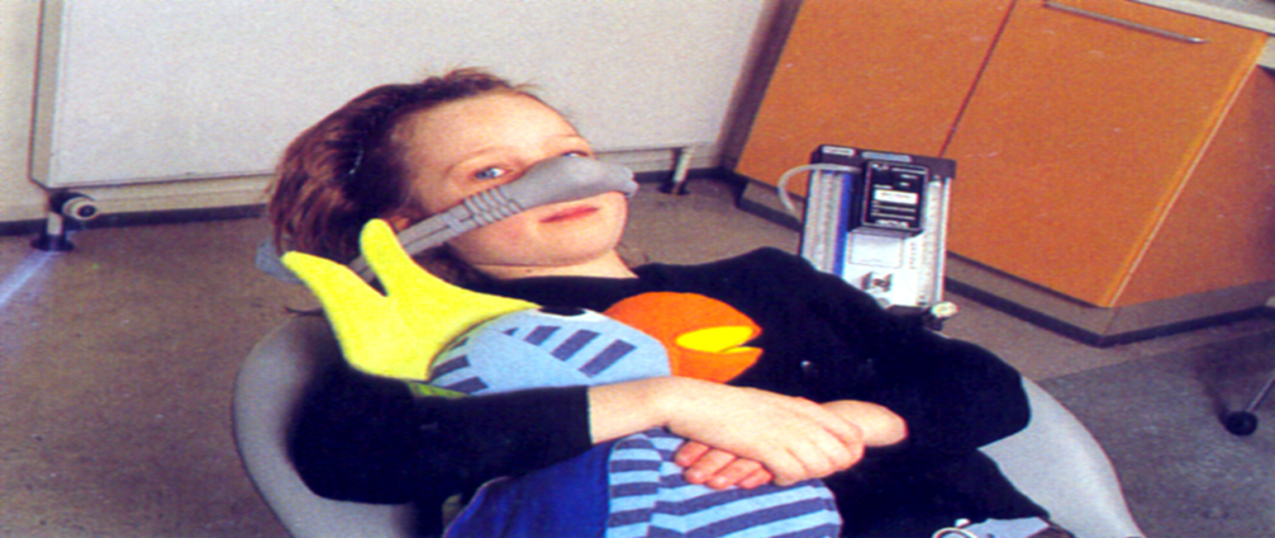
Pharmacological Management of Child Behavior

Slide 3
Pharmacologic management:
Pharmacologic management is a broad term that describes the drugs to manage the behavior of pediatric patients undergoing dental procedures.
The types of drugs used include:
inhaled gases
oral medications,
drugs administered via intravenous infusion,
intramuscular injection, and other routes of administration.
Pharmacologic management is further divided into two subcategories:
sedation and general anesthesia

Slide 4
DEGREE OF SEDATION
Minimal degree:(anxiolysis)
Minimally depressed level of consciousness produced by a pharmacologic method
The patient's ability to maintain an airway independently
The patient responds normally to tactile stimulation and verbal commands.
Although cognitive function and coordination may be modestly impaired.
ventilator and cardiovascular are unaffected.

Slide 5
DEGREE OF SEDATION
Moderate degree: (Conscious Sedation)
a drug-induced depression of consciousness
patients respond purposefully to verbal commands, either alone or accompanied by light tactile stimulation.
No interventions are required to maintain a patent airway, and spontaneous ventilation is adequate.
Cardiovascular function is usually maintained.

Slide 6
DEGREE OF SEDATION
Deep sedation (Analgesia) :
a drug-induced depression of consciousness
patients cannot be easily aroused but respond purposefully following repeated or painful stimulation.
The ability to maintain ventilatory function independently may be imparied
Patients may require assistance in maintaining a patent airway, and spontaneous ventilation may be inadequate.
Cardiovascular function is usually maintained.

Slide 7
DEGREE OF SEDATION
General anesthesia:
drug-induced loss of consciousness during which
patients are not arousable, even by painful stimulation.
The ability to maintain ventilatory function independently is often impaired.
Patients often require assistance in maintaining patent airway,
and positive pressure ventilation may be required because of depressed
spontaneous ventilation or drug-induced depression of neuromuscular function.
Cardiovascular function may be impaired.

Slide 8
The goals of sedation for pediatric child:
(1) to guard the patient's safety and welfare;
(2) to minimize physical discomfort and pain.
(3) to control anxiety, minimize psychological trauma, and maximize the potential for amnesia
(4) to control behavior or movement so that the procedure can be completed safely;
(5) to return the patient to a physiologic state in which safe discharge, as determined according to recognized criteria, is possible

Slide 9
Indications for pharmacological behavior management:
1. very young child
2. Children with reduced emotional maturity or those with (cognitive, physical or mental disabilit)
3. Children who are intensely fearful and anxious
4. Children who require extensive dental care and would benefit from prolonged dental visit
5. Children who have allergy to local anesthesia.

Slide 10
Documentation
1.The reason for the need for sedation or G.A
2. Informed consent: each patient, parents is entitled to be informed regarding (benefits, risks, alternatives to sedation or G.A.) and the patient record should document that appropriate informed consent was obtained.
3. Instructions to parents : The dental surgeon should provide verbal and written instructions ( pre and post anesthesia precautions , potential or anticipated behavior, and limitation of activities)
4. Dietary instructions: food and liquids intake should be limited prior to treatment

Slide 11
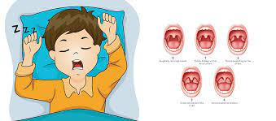
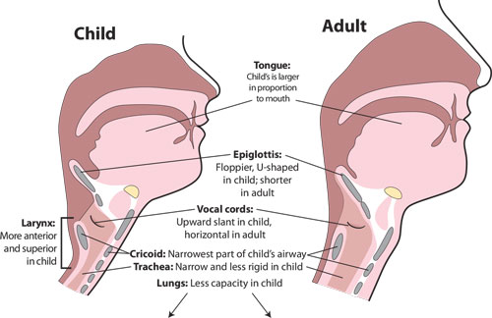
Anatomically differences in pediatric airways
The vocal cords positioned higher and more anterior.
The smallest portion of pediatric airway is at the level of the subglottis (below cords)
Children have relatively larger tongue and epiglottis.
large tonsillar/adenoid mass.
Larger head to body size ratio in children
The mandible is less developed and retrognathic in younger children and infants.
Children have smaller lung capacity and higher metabolic rate resulting in a smaller oxygen reserve. Hence, children desaturate more quickly than adults do.

Slide 12
Patient preoperative assessment
Medical and dental history:
1- Allergies or adverse drug reaction that might increase the potential for airway obstruction ( history of snoring or obstructive sleep apnea )
2- Current medications (if any including the dose, time, rout and site of
dministration)
3. Previous hospitalization and past operations (date and purpose)
4. History of previous treatment under general anesthesia or sedation and any
associated complications.

Slide 13
Patient preoperative assessment
5. Family history of diseases or disorders especially those might affect sedation and
general anesthesia
6. Patient medical status (diseases, disorders or physical abnormalities):
• History of recent respiratory illness or current infections.
• Assessment of the airway to determine suitability for conscious sedation or general anesthesia (GA).
• Fasting requirements and the ability of the career to comply with instructions.
• Proposed procedures being performed.
• Patient's weight and vital signs.

Slide 14
Patient preoperative assessment
7. Review of body systems.
8. Age (in years and months) and weight
9. Name, address, and contact information of the child's home.

Slide 15
Patient preoperative assessment
The physical evaluation
1. Height and weight
2. Vital signs, including heart and respiratory rates and blood pressure. If determination of baseline vital signs is prevented by the patient's physical resistance or emotional condition, the reasons should be documented
3. Evaluation of airway patency, to include tonsillar size and anatomic abnormalities any increase the risk of airway obstruction (e.g, mandibular hypoplasia, large. short neck, limited mandibular range of motion).
4. Physical abnormalities or conditions that may affect routine intraoperative
monitory (eg. recent orthopedic injuries to arms or legs, active skin rashes)

Slide 16
5. ASA classification
American Society of Anesthesiologists' Physical Status (ASA)
P1 A normal healthy patient
P2 A patient with mild systemic disease
P3 A patient with severe systemic disease
P4 A patient with severe systemic disease that is a constant threat to life
P5 A moribund patient who is not expected to survive without the operation
P6 A declared brain-dead patient whose organs are being removed for donor purposes
So according to ASA, generally, patients categorized into classes III and IV are
better managed in a hospital setting.

Slide 17
PRE-OPERATIVE DIATARY INSTRUCTION:
I. No milk or solid foods for 6 hours for children 6 to 36 months. and for 6 to 8 hours for children 36 months and older
2. Clear liquids up to 3 hours before the procedure for cite aged 6 months and older.
3. Let everyone in the home know the above information, because siblings or others
living in the home often unknowingly feed the child

Slide 18
Routs of drug administrations
Inhalation route
Rectal route
Intramuscular route
Submucosal route
Subcutaneous route
Intravenous route

Slide 19
Onset of action
Peak clinical effect
oral 30 min
Inhalation 3 min
IM 5-10 min
IV 20 to 40 seconds
Oral 60 min
Inhalation 3-5 min
IM 30min
IV 1-I0min

Slide 20
Titration
Ability to administer small increments of a drug to achieve a desire clinical effect
Oral Titration not possible
Inhalation Titration possible
IM Titration not possible
IV Titration posssible

Slide 21
Recovery
Need for an escort (somebody) to leave the office
Oral recovery not complete even after 2-3hrs
Inhalation recovery almost always complete, may discharged alone
IM not complete need escort

Slide 22
Enteral Route
Enteral sedation is achieved by drugs that are swallowed and absorbed through the digestive or enteric system.
The practice of having parents administer oral medications to children prior to arrival at the office should be avoided,the onset approximately 30 minutes after administration, with peak effect noted by 60 minutes.
The taste may be quite objectionable, especially to very young children, this can usually be overcome when the drug is mixed with a palatable liquid.

Slide 23
Enteral Route
Advantages | Dis advantage
Accepted | Reliance
Ease to administration | Prolonged latent period (recovery)
Decreased incidence and severity of adverse reaction | Incomplete absorption of drugs from GIT
No picks (needle) | Inability to titrate
No special training | Prolong duration of action
 | Inability to lighted or deepened the level of sedation

Slide 24
Rectal route
Drugs administered through this route are absorbed through two
different vascular systems, one of which delivers agents to the liver while the second by passes the liver result wide variations of bioavailability are seen after rectal administration.
Absorption is often irregular and incomplete, and because of the tendency toward mucosa! irritation from drugs delivered via this route, rectal administration is not recommended for pediatric sedation

Slide 25
complications
Indications
complications:
rectal mucosal irritation
Initiation of bowel movement
Risk of over sedation
Unwilling to take orally
• Nausea & vomiting
• Patient objecting injection
• Post-op control of pain

Slide 26
Rectal Route
Advantages | Dis advantage
Low cost | Inconvenience to the administration
Ease to administration | Variable absorption
No picks | Inability to reverse
Absorbed directly to circulation system (rapid onset of action) | Inability to titrate
By passing enterohepatic circulation | Intestinal irritation
 | Prolong recovry

Slide 27
Intramuscular route
Relies on the high vascularity of muscle tissue to achieve a moderate rapid onset of action (5-10 min).
More Rapid onset and offset compared with enteral technique
Indications
Other controllable routes are unavailable or have proved ineffective.
Prior to IV sedation or general anesthesia.

Slide 28
complications
Nerve injury
Intravascular injection
Air embolism
Periostitis
Hematoma
Abscess
Cyst
Necrosis

Slide 29
Intravenous route
The most effective method of ensuring predictable and adequate sedation in virtually all patients.
Effective blood levels of drugs are achieved quite rapidly (rapid onset of action)
The use of intravenous conscious sedation in pediatric dentistry is somewhat restricted to certain types and ages of patients. Venipuncture is difficult to accomplish in the very young or the combatant child because smaller vein size and with the need to restrain the patient.
Because of this the technique is often more suitable for the apprehensive preteen and adolescent patient.

Slide 30
Intravenous
Advantage | Disadvantage
Rapid onset of action | Venipuncture is required
Easily titrated | More monitoring necessary
Rapid recovery | Hematoma at the site of injection
Minimal side effects | Most agents cannot be reversed by antagonistic agents
Emergency IV access available

Slide 31
Inhalation
The inhalational route is a highly effective route of administration, allowing nonirritating gases and volatile drugs to be inhaled and absorbed directly through the pulmonary ..
The almost instantaneous absorption of agents delivered through this route is due to the large surface area of the lung.
Equilibrium is quickly established among the partial pressure of the drug in the alveolar gas space, serum, and target tissues in the brain

Slide 32
Inhalation
Advantage
Rapid onset of action
Maximum clinical effect within 30min
More reliable absorption than oral or rectal routs
Cooperation is not require
Disadvantage
Inability to titrate
Inability to reverse the drug action
Prolonged duration of drug effect
Injection injuiries

Slide 33
Inhalation
Indication
Anxiety
• Medically compromised patients
• Gagging
Contraindication
Severe behavioral problems
Acute respiratory conditions
Inability to communicate and Learning difficulties
Very young children
Fear of the mask

Slide 34
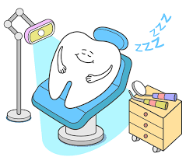
Thank you

