Slide 1
Pharmacological Management of Child Behavior
Part TWO
Pedodontic Dentistry \ 5th-grade
Lec.7
Dr. Mukhalled alasady
Oral & Maxillofacial surgeon
B.D.S. – C.A.B.M.F.S
College of dentistry\University
of Al- Muthanna

Slide 2
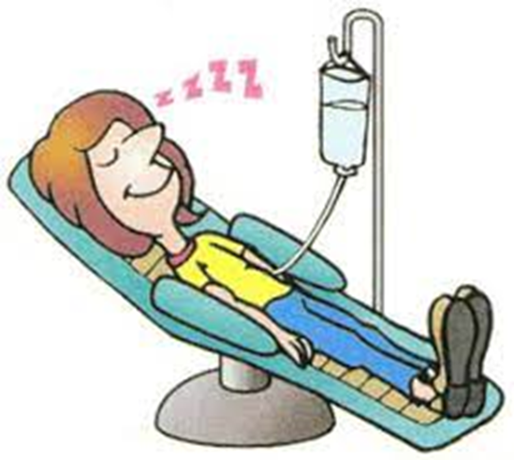
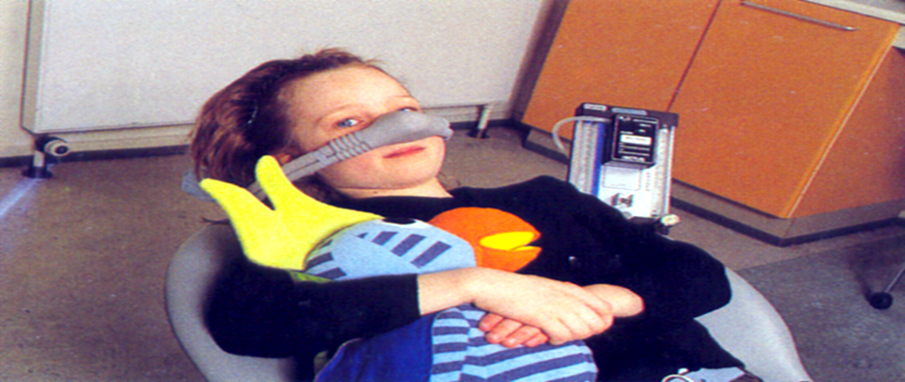
Pharmacologic Management of Patient Behavior (2)

Slide 3
DRUGS AND AGENTS USED FOR SEDATION
Pharmacologic alternatives in patient sedation for pediatric dentistry fall into one of four categories
Nitrous oxide / oxygen
sedative-hypnotics
Phenothiazine and phenothiazine like drugs
narcotics

Slide 4
Nitrous oxide
N2O It is the most frequently inhalation agent used in pediatric sedation .
Nitrous oxide is a slightly sweet-smelling, colorless, heavier than air, and inert gas.
It is compressed in metal cylinders as a liquid that vaporizes on release.
The gas is nonflammable but will support combustion.
Very potent analgesic but weak anesthetic.
It is absorbed quickly from the alveoli of the lungs and is physically dissolved in the serum blood
It is excreted through the lungs without any biotransformation, small amount may be found in the body fluids and intestinal gas.

Slide 5
The objectives of nitrous oxide sedation, as stated by the American Academy of Pediatric Dentistry
Reducing or eliminating anxiety
Reducing untoward movement and reaction to dental treatment
Enhancing communication and patient cooperation
Raising the pain threshold
Increasing tolerance for longer appointments
Aiding in the treatment of a patient with mental and/or physical disabilities
Reducing gagging

Slide 6
Disadvantages of nitrous oxide–oxygen inhalation may include:
Lack of potency
Dependence on psychological reassurance
Interference of the nasal hood with injection to the anterior maxillary region
Need for the patient to be able to breathe through the nose
Nitrous oxide pollution and potential occupational exposure health hazards

Slide 7
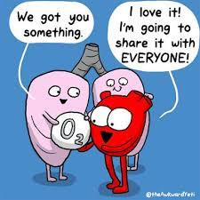
Action (Pharmacodynamics) of N2O
Create an altered state of awareness without impairment to the motor function and it is a CNS depressant.
Increase the respiratory rate and decrease the tidal volumes (the volume of gas inhaled and exhaled with each breath. With quiet breathing at rest, it is approximately 500 mL per breath for a 70-kg).
Cardiac output is decreased and peripheral vascular resistance is increased (important in the cardiac patients).
Rapid induction and reversal may induce vomiting.

Slide 8
Onset:
Anywhere from a few seconds up to 3-5 minutes Crosses the blood-brain barrier rapidly
Enter the blood by crossing the pulmonary epithelium and depends upon the
concentration gradient.
During early phases of administration, the brain, heart, liver and kidney absorbs the major portion of N2O from blood

Slide 9
Elimination
Rapid elimination
Unchanged with exhalation from the lungs
No significant metabolism by the liver or kidneys
Not stored in the tissues

Slide 10
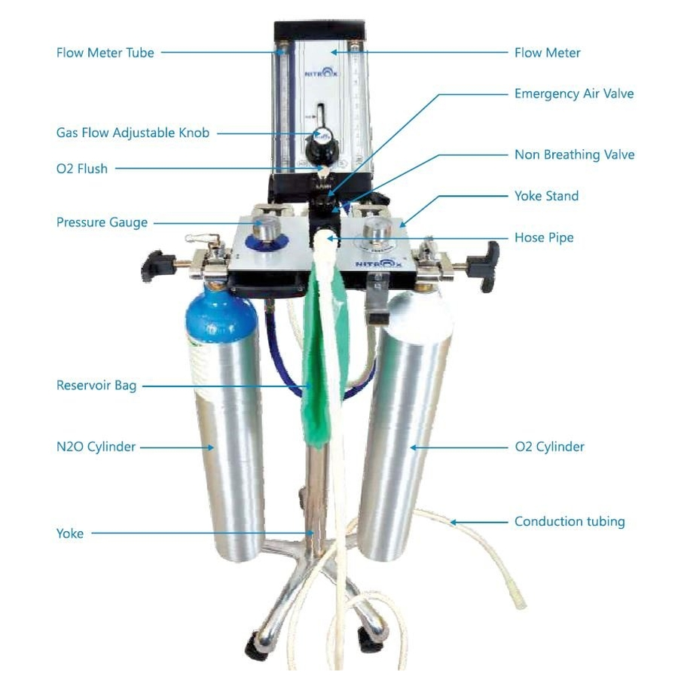
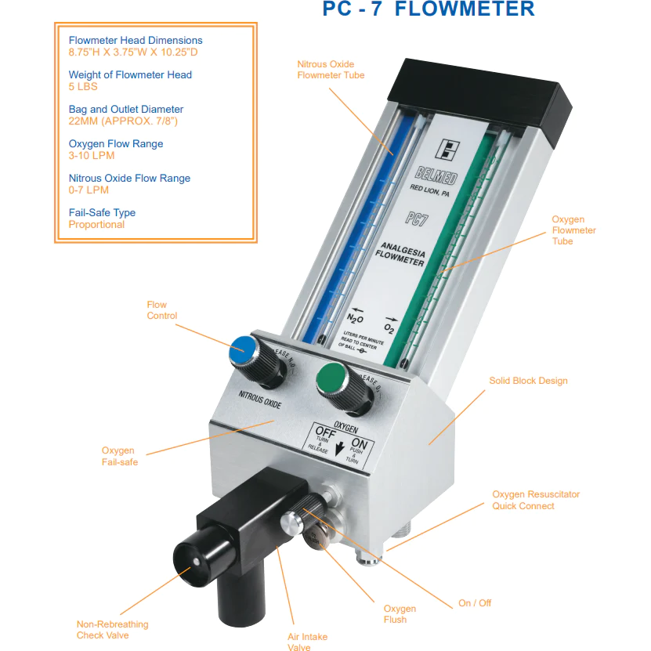
Requirements of the equipment used for the induction of N2O
1. Should have a continuous flow design with flow meters capable of accurate regulation.
2. Automatic shut down if the O2 level falls < 20 %.
3. Flush level for easy and immediate flushing of the system with 100% O2.

Slide 11
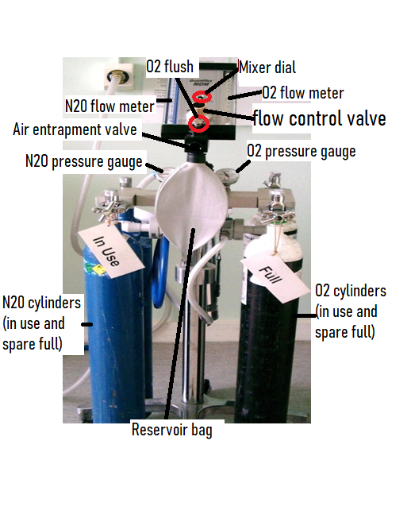
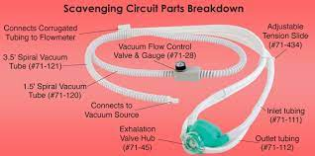
Requirements of the equipment used for the induction of N2O
4. Can be either mobile units or operating from a central supply to a wall mounted with mobile head.
5. Good and efficient scavenger system.
6. Nasal hood should be of adequate size for adults and children.

Slide 12
Types of Inhalation
2- Continuous flow:
continuous flow of gases (more safe and accurate).
1- Intermittent (demand flow) gase
delivered according to the patient, respiratory demand and requirements.

Slide 13
Components of the continuous flow unit
1- Compressed gas cylinders and pressure gauge.
2- Reducing valve (regulator)
3- Flow meter
4- Reservoir bag
5- Conducting tubing
6- Nasal hood, full face mask or nasal cannula

Slide 14
Describe sensations in advance Four Plateaus of Analgesia with N2O (Stages of Sedation)
1. Tingling sensation (Paresthesia - tingling of hands, feet).
2. Followed by a warm feeling (Vasomotor - warm sensations).
3. Feeling of well-being, hearing may dissolve into electronic throbbing. (Drift -euphoria, pupils centrally fixed, sensation of floating).
4. Sleepiness, Nausea sets in, dream can occur (Dream - eyes closed but will open in response to questions, difficulty in speaking, jaw sags open).

Slide 15
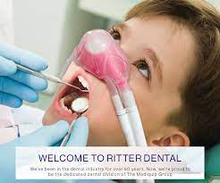
Techniques
The acceptance of the nosepiece by the patient is very important in the procedure for effective conscious sedation.
If the patient exhibits resistance then this method is not advisable for such a child

Slide 16
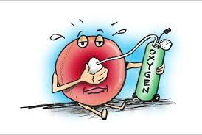
1- Slow induction technique
The bag is filled with 100% oxygen and delivered to the patient for 1 or 2 minutes at an appropriate flow rate, typically between 4 and 6 L/min.
With an appropriate flow rate, movement covering one quarter to one half of the breathing bag should be observed with each inhalation and exhalation.

Slide 17
1- Slow induction technique
With too high a flow rate:
The bag will be overinflated,
Movement will not be seen with each breath,
leakage will occur from around the mask. In this instance, the flow rate should be adjusted downward.
Too low a flow rate will deplete the bag of mixed gases

Slide 18
1- Slow induction technique
Once the proper flow rate is achieved, the nitrous oxide can be introduced by slowly increasing the concentration in increments of 10% to 20% until the desired level is achieved.
After stabilization of the nose piece, 100% O2 is delivered for 3-5 min , then N2O level is increased slowly to 30-35% for 3-5 min (induction period) during this period the dentist should continuously communicates with the child to promote relaxation and reinforce cooperative behavior.
If the child is older, he can be asked for the physical changes like tingling sensation in the fingers and toes

Slide 19
1- Slow induction technique
Most of the dentists prefer to increase the level of N2O to 50% for 3-5 min to provide the maximum effect for the administration of L.A.
Concentration more than 50% is contraindicated in dental practice, after administration of L.A. the concentration can be brought down to 30-35 %.
After the treatment:
Inhalation of 100% O2 for not less than 5 min should be continued to allow diffusion of nitrogen from the venous blood into the alveoli, which will be then exhaled as N2O through the respiratory tract
and also allow the patient to return to the pretreatment activities, with any incident
inadequate oxygenation may produce: nausea, headedness or dizziness

Slide 20
1- Slow induction technique
The child should be kept in supine position or in his side to maintain air way patency.
Upon arriving home, the child should be placed on his side and observed carefully for the first hour and if he wishes to sleep, he can be allowed to do so.

Slide 21
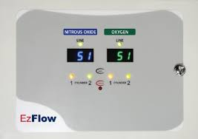
2- Rapid induction technique Initiation
Administration of equal parts of N2O and O2 for 10-15 min
This is followed by maintenance phase where N2O is reduced by half for 40 min,
The withdrawal is done by administration of O2 only which is used to prevent anoxia that may result when N2O is used alone

Slide 22
Common problems associated with N2O
1- Sleep Patient may go into sleep during the procedure and frequent arousal or communication is required.
2- Air way obstruction Frequent repositioning of the head is needed to hyper extend the mandible so that the tongue is brought forward.

Slide 23
Common problems associated with N2O
3- Vomiting: It could be due to:
Over dose of N2O
Prolonged administration of N2O
Pre-existing GIT infection or influenza
History of motion sickness or vomiting (use antiemetic drugs) Impurities during delivery (rare)
This (vomiting) can be prevented by:
(1)Using min. effective concentration.
(2)Avoid prolong procedure.
(3)Empty stomach inhalation.
(4)Slow return to upright position.
(5)Aspiration is unlikely.

Slide 24
Common problems associated with N2O
4- Diffusion Hypoxia to avoid this 100% O2 for 10 min.
5- Increased N2O concentration This should be avoided otherwise pressure will be created in the air filled body cavities especially in the middle ear.
6- Hallucinations This can occur when we give high concentration of N2O (> 60 %) so reduce the dosage of N2O.

Slide 25
Chronic Exposure to N2O
Can produce irreversible toxic changes, and should be a concern for dental
personnel working in environments in which nitrous oxide is administered to patients.”
Chronic exposure may cause disorders in the:
➢ Respiratory system
➢ Hematological
➢Immunological
➢ Liver
➢ Kidney
➢ Neurological such as loss of concentration, numbness and paresthesia, ataxia, loss of bladder control, loss of bowel sphincter control.

Slide 26
Controlling N2O in the operatory:
To minimize the risk of chronic exposure:
✓ Good scavenging system
✓ Adequate circulation of the room air
✓ Limiting of speech and mouth breathing by the patient
✓ Chose the proper size of the nasal hood
Note:
Nitrous oxide is not a substitute for the traditional behavior management technique and it should be considered an adjunct to aid in the management of mild to moderate anxious child who is capable to cooperate in the dental chair

Slide 27
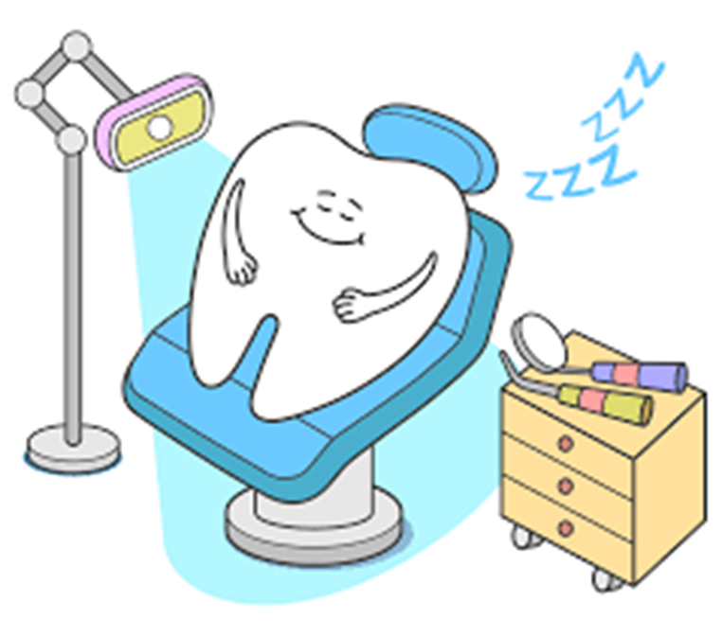
THANK YOU

