Slide 1
Pharmacological Management of Child Behavior
Part Three
Pedodontic Dentistry \ 5th-grade
Lec.8
Dr. Mukhalled alasady
Oral & Maxillofacial surgeon
B.D.S. – C.A.B.M.F.S
College of dentistry\University
of Al- Muthanna

Slide 2
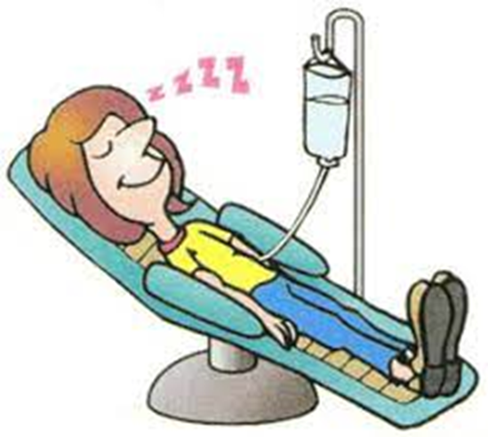
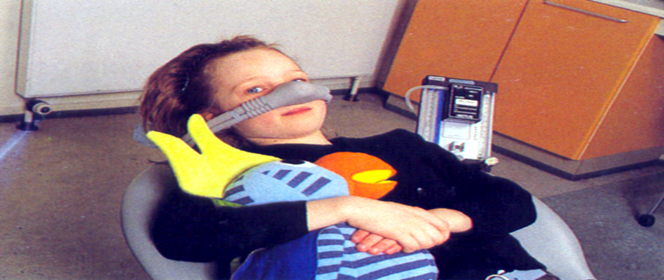
Pharmacologic Management of Patient Behavior (3)

Slide 3
DRUGS AND AGENTS USED FOR SEDATION
Hydroxyzine (Atarax, Vistaril) :
Antihistamine with weak sedative, anticholinergic, and antiemetic properties.
In normal doses, it has no cardiovascular or respiratory depressant effects.
Absorption through the gastrointestinal tract is relatively rapid
with the onset of action occurring in 15 to 30 minutes.
Peak levels occur at 2 hours
Recovery is slow, reflected by the mean half-life of 3 hours.
able in two forms, hydroxyzine hydrochloride (Atarax) and hydroxyzine pamoate (Vistaril)

Slide 4
DRUGS AND AGENTS USED FOR SEDATION
Hydroxyzine (Atarax, Vistaril) :
Administration is preferably by the oral route, intramuscular injection must be deep in a large muscle mass.
The drug should not be injected subcutaneously or intravenously because of potential tissue necrosis and hemolysis.
Dosage: 0.5 to 1.0 mg/kg
Side effects: prolonged drowsiness, ataxia, dry mouth. In children, paradoxical reactions may occur at sedative doses.

Slide 5
BENZODIAZEPINE AGONISTS AND ANTAGONISTS:
Midazolam (Versed)
It is a water soluble type of benzodiazepine.
The clinical potency of midazolam is estimated to be 2 to 5 times the potency of diazepam.
Onset of action 3-5 minutes after IV
administration and recovery take place in 2-6 hrs.
The elimination half-time of midazolam is significantly shorter than that of diazepam.
Cognitive testing in adults shows return of normal mental function within 4 hours.
Adverse drug reaction
Respiratory depression dose, defendant risk of apnea, more often when used with narcotics, Hypertension

Slide 6
Sedative- hypnotics
Barbiturate:
Can produce all levels of CNS depression, ranging from mild sedation to general anesthesia and deep coma.
Their use are of very limited value for pediatric patients.
Chloral Hydrate
After oral administration, the drug was characterized by a slow onset time (30 to 60 minutes) and had a duration of action of 4 to 8 hours, with an elimination half-life of 8 to 11 hours.
Children given chloral hydrate would often enter a period of disinhibition before reaching a level of clinically useful sedation.

Slide 7
Sedative- hypnotics
Chloral Hydrate:
The drug causes prolonged drowsiness or sleep and respiratory depression.
In large dose it produces general anesthesia.
should be avoided in patients with cardiac disease.
The lethal dose of chloral hydrate is stated to be 10 g in adults, yet ingestion of 4 g
has been associated with a fatal outcome
Because the drug dose not reliably produce sedation of a degree to permit operative procedures at lower doses, there is tendency to push the dosage higher to achieve the necessary sedation.
With such a wide range of reported toxicity, this drug may be an unwise choice for many pediatric patients.
It is recommended that young children receive not more than 1 g as a total dose
Risks are increased when it is accompanied with nitrous oxide, narcotics or local
anesthetic agents

Slide 8
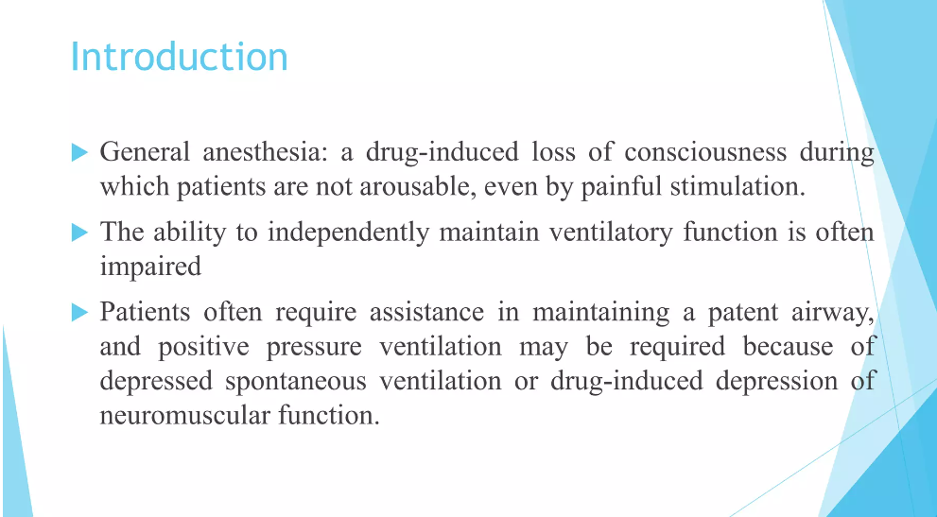

Slide 9
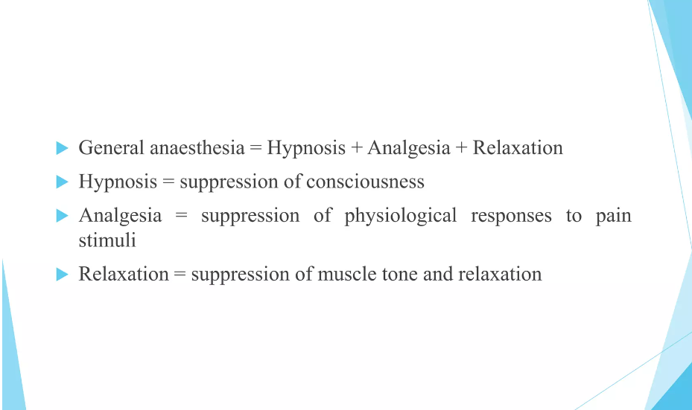

Slide 10
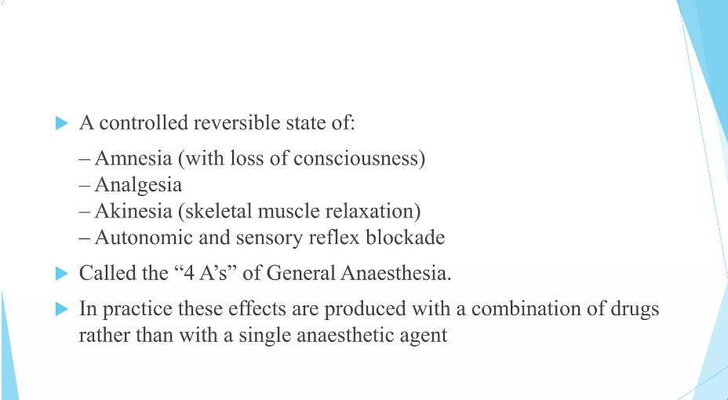

Slide 11
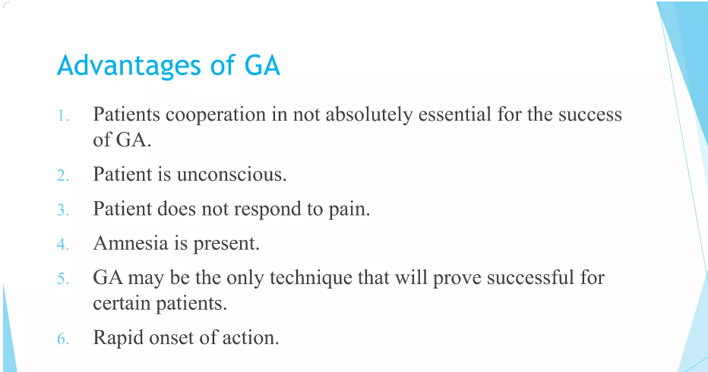

Slide 12
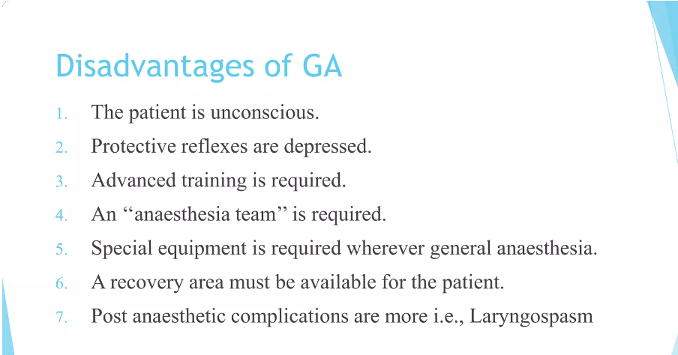

Slide 13
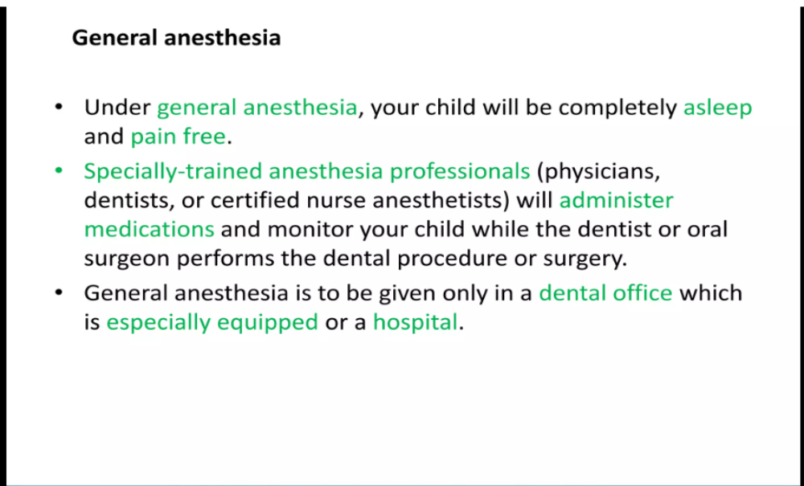

Slide 14
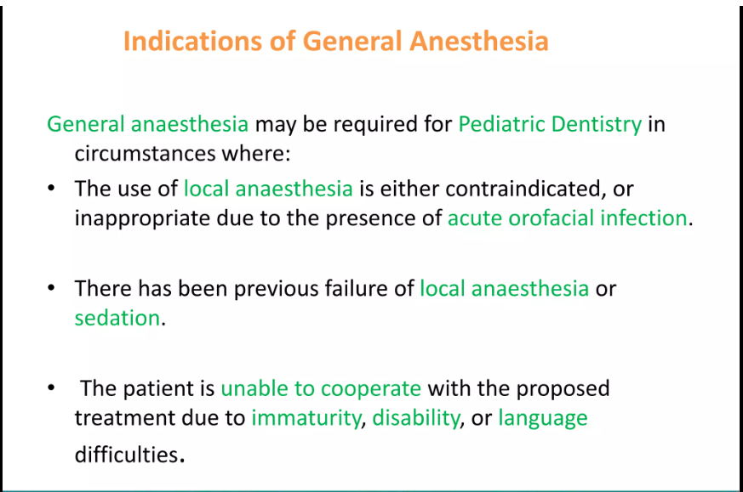

Slide 15
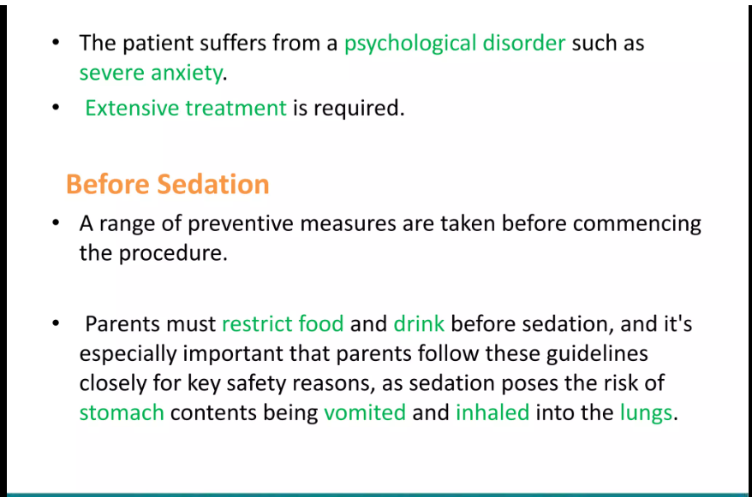

Slide 16
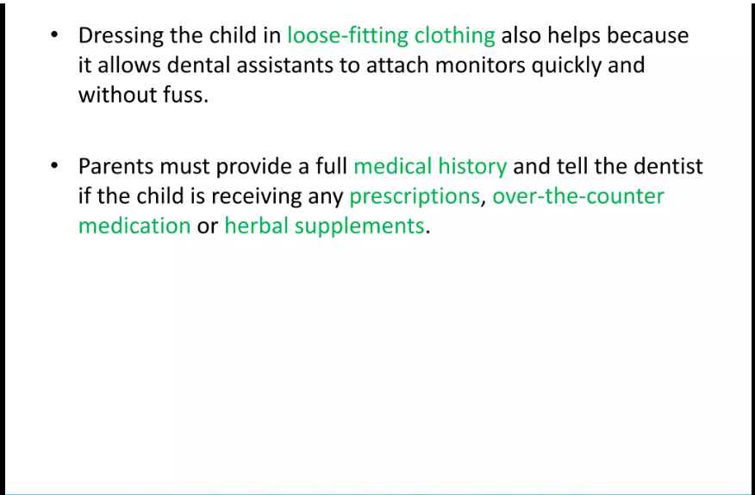

Slide 17
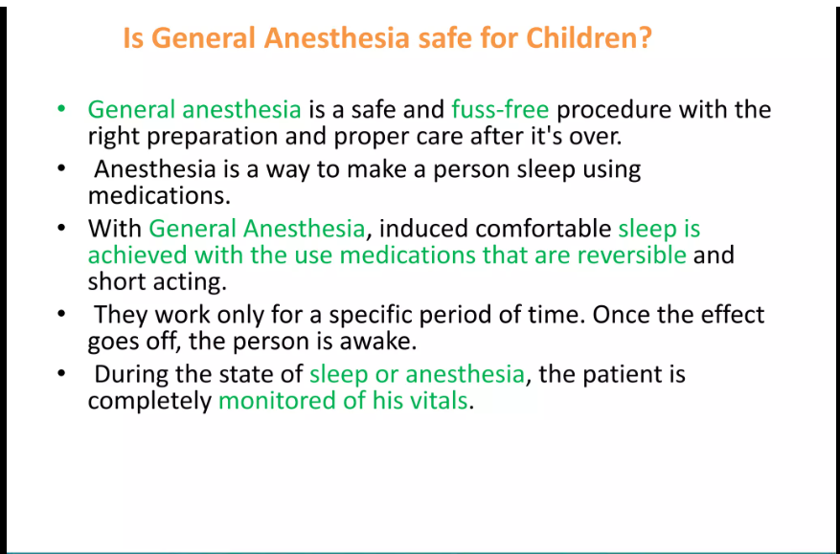

Slide 18
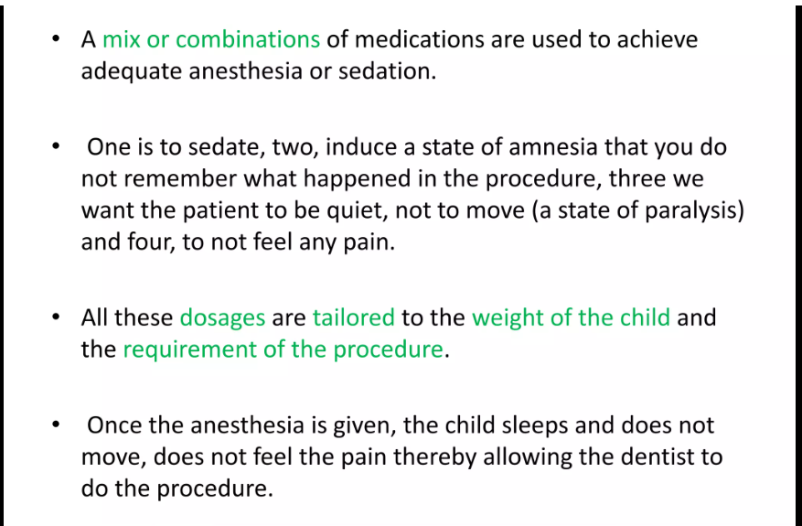

Slide 19
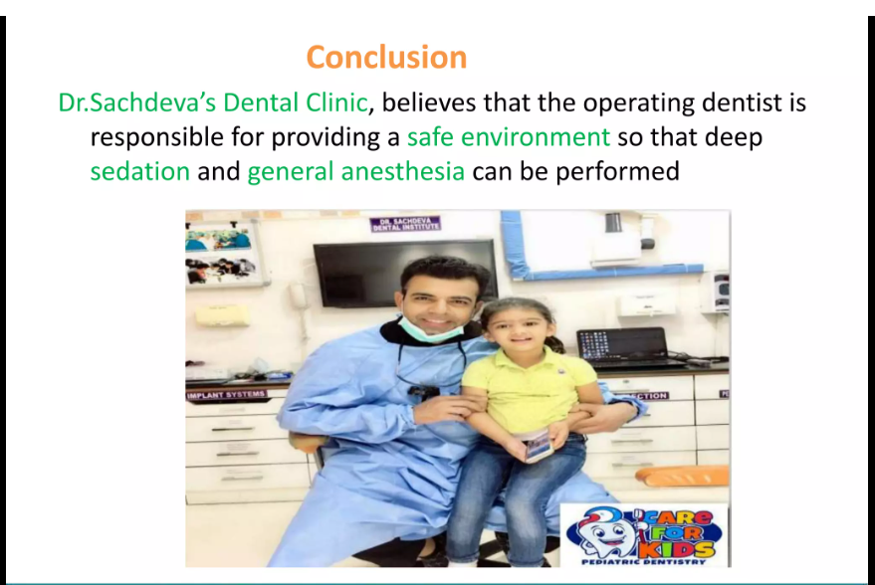

Slide 20
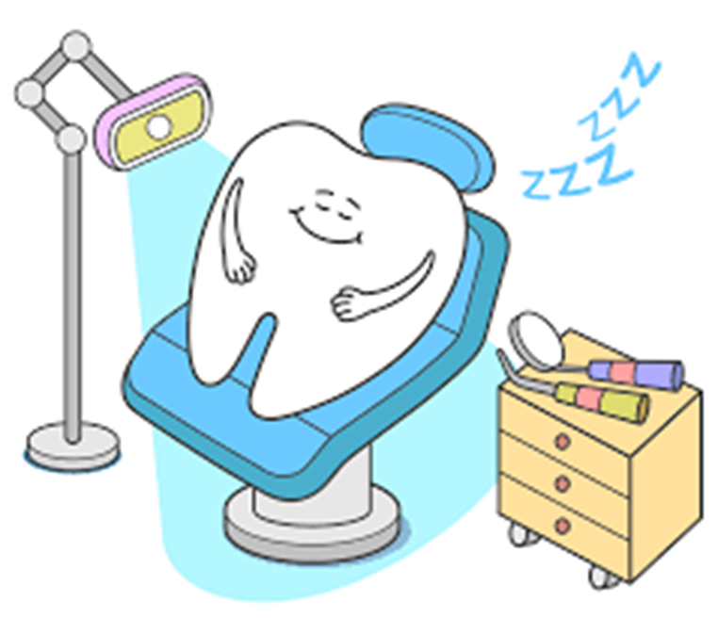
THANK YOU

