Slide 1
Dental Problems of Children with Special Health Care Needs
Pedodontic Dentistry \ 5th-grade
Lec.9
Dr. Mukhalled alasady
Oral & Maxillofacial surgeon
B.D.S. – C.A.B.M.F.S
College of dentistry\University
of Al- Muthanna

Slide 2
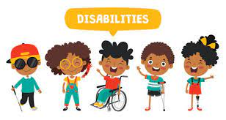
Dental Problems of Children with Special Health Care Needs

Slide 3
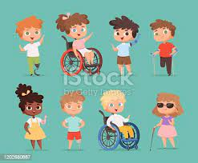
According to the American Academy of Pediatric Dentistry, individuals with special health care needs (SHCN) are:
those with "any physical, developmental, mental, sensory, behavioral, cognitive, or emotional impairment or limiting condition that requires medical management, health care intervention, and/or use of specialized services or programs."
Individuals with SHCN are at increased risk for oral disease.

Slide 4
Children with SHCN may present challenges:
Require special preparation before the dentist and office staff can provide acceptable care.
Parental anxiety concerning the problems associated with a child with SHCN frequently delays dental care until significant oral disease has developed.
In addition, some dentists feel uncomfortable providing treatment for children with SHCN, which results in a loss of greatly needed services.

Slide 5
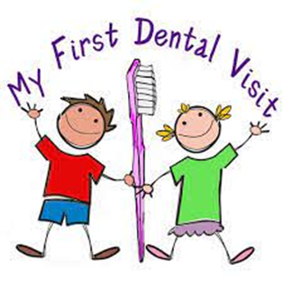
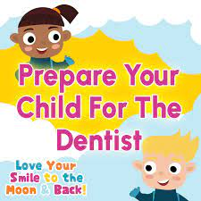
FIRST DENTAL VISIT
The initial dental examination for a child with SHCN is as that for the initial examination described for normal children.
Special attention should be given to obtaining a thorough medical and dental history. The names and addresses of medical or dental Personnel who have previously treated the patient are necessary for consultation purposes.
Consultation with these specialists is common; this helps provide management and planning and avoids unwanted outcomes.
Health Insurance Portability and Accountability Act compliance is mandatory throughout this process.

Slide 6
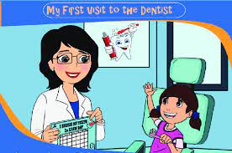
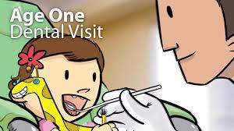
The first dental appointment is very important and can set the stage for subsequent appointments,
In many situations, parents or guardians do not realize the importance of this visit and desire treatment immediately
By scheduling the patient at a designated time (early in the day) and allowing sufficient time to talk with the parents and the patient before dental care, a practitioner can establish an excellent relationship with them.

Slide 7
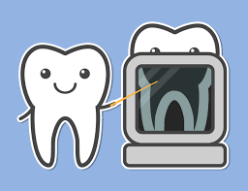
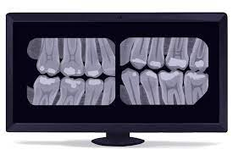
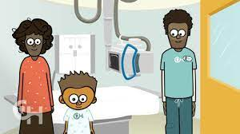
RADIOGRAPHIC EXAMINATION
Adequate radiographic records are often necessary in planning dental treatment for the child with SHCN.
Through appropriate behavior management of the child, a dentist can usually perform a complete radiographic examination of the teeth when indicated.
Assistance from the parent and dental auxiliaries and the use of immobilization devices may be necessary to obtain the films.
Better cooperation may be elicited from some children by delaying radiographs until the second visit,

Slide 8
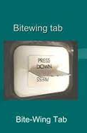
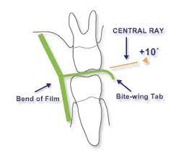
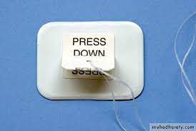
For patients with limited ability to control film position, intraoral films with bitewing tabs are used for all bitewing and periapical radiographs.
An 18-inch ( 46cm) length of floss is attached through a hole made in the tab to facilitate retrieval of the film if it falls toward the pharynx.
The patient should wear a lead apron with a thyroid shield, and anyone who helps hold the patient

Slide 9
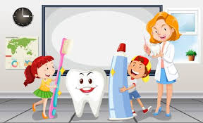
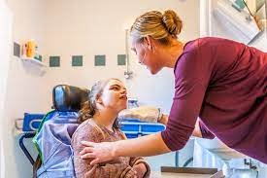
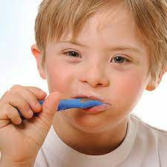
PREVENTIVE DENTISTRY
An effective preventive dental program is important for a child with SHCN because of the predisposing factors that make restorative dental care harder to obtain when it is necessary.
After the diagnosis, the dentist should determine the patient's needs, assume an individual program for the child, and communicate to the parents and patient how such a program can be affected.

Slide 10
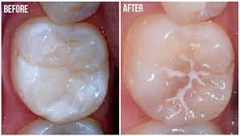
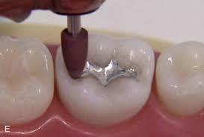
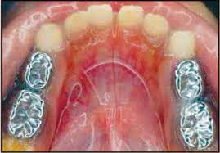
Pit-and-fissure sealants have been shown to reduce occlusal caries effectively.
For a patient who requires dental work under general anesthesia, deep occlusal pits and fissures should be restored with amalgam or composites to prevent further decay.
Patients with severe bruxism and interproximal decay may need their teeth restored with stainless steel crowns to increase the longevity of the restorations.

Slide 11
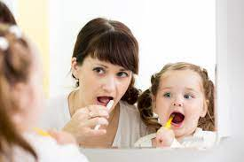
HOME DENTAL CARE
Dental education of parents/guardians/caregivers is important to children with SHCN.
The parents (or the guardian) are responsible for establishing good oral hygiene in the home.
Reinforcement of good home dental care is provided through mass media , communication with other people, and school activities (e.g., health classes, parent-teacher association meetings.
The dentist or the hygienist is responsible for consulting with the caregiver of the child with SHCN when oral hygiene problems occur
Regular follow-up supervision at home and in the dental office is essential

Slide 12
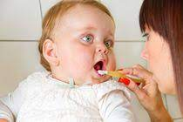
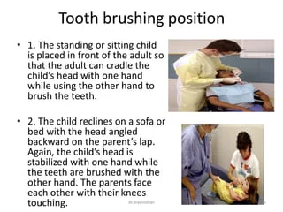
Home dental care should begin in infancy; the dentist should teach the parents to gently cleanse the incisors daily with a soft cloth or an infant toothbrush
Several positions for tooth brushing that permit firm control and support of the child, adequate visibility.
Positions most commonly used for children requiring oral care assistance are as follows:
The standing or sitting child is placed in front of the adult so that the adult can cradle the child's head with one hand while using the other hand to brush the teeth.

Slide 13
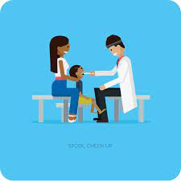
The child reclines on a sofa or bed with the head angled backward on the parent's lap,the child's head is stabilized with one hand while the teeth are brushed with the other hand.
The parents face each other with their knees touching. The child's buttocks are placed on one parent's lap, with the child facing that parent while the child's head and shoulders lie on the other parent's knees; this allows the first parent to brush the teeth.

Slide 14
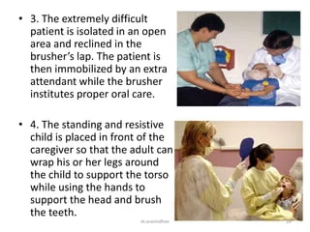
The extremely difficult patient is isolated in an open area and reclined in the brusher's lap. the patient is immobilized by extra attendant while the brusher institute proper oral care.
The standing and resistive child is placed in front of the caregiver so that the adult can wrap his or her legs around the child while using the hands to support the head and brush the teeth.

Slide 15
DIET AND NUTRITION
A proper non-cariogenic diet is essential to a good preventive program for a child with SHCN.
The dentist should assess the diet by reviewing answers on a diet survey with the parent, realizing that allowances must be made for certain conditions for which dietary modifications are required.
For example, conditions associated with difficulty in swallowing, such as severe cerebral palsy, may require that the patient be on a puree diet.
Patients with certain metabolic disturbances or syndromes, such as phenylketonuria, diabetes, or Prader-Willi syndrome, have diets that restrict specific foods or total caloric consumption
The oral side effects of the child's medications should be reviewed with the parents or guardians at each visit, for example, of increased caries or gingival overgrowth, to prevent these problems.
Particular emphasis should be placed on discontinuation of the nursing bottle by 12 months of age and cessation of at-will breast-feeding after teeth begin to erupt,

Slide 16
Below is a list of specific medication groups that can cause tooth decay due to dry mouth over time:
Antihistamines (e.g., Benadryl)
Decongestants (e.g., pseudoephedrine)
Opioid pain medications, like hydrocodone/acetaminophen (Norco)
High blood pressure medications (e.g., propranolol)
Antidepressants (e.g., selective serotonin reuptake inhibitors like fluoxetine)
Muscle relaxants (e.g., cyclobenzaprine)

Slide 17
Parkinson’s disease medications (e.g., benztropine)
Some medications are sweetened with sugar, which can also cause tooth decay. People who take these medications for a long time are at the greatest risk. Examples include:
Children’s syrup-based medications (e.g., Children’s Tylenol)
Chewable antacid tablets (e.g., Tums)
Some antifungal medications (e.g., nystatin liquid suspension)

Slide 18
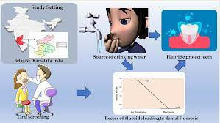
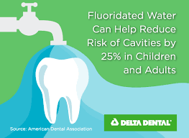
FLUORIDE EXPOSURE
Systemic fluoride for patients with SHCN is necessary. The dentist should first determine the concentration of fluoride in the patient's daily water supply.
If the level of fluoride is between 0.7 and I ppm, no supplementation is normally required.
If the dentist is not sure of the fluoride level of the patient's drinking water ,an analysis is indicated. Once the level has been documented, a determination of the need for fluoride supplementation can be made.
The amount of systemic fluoride supplementation necessary, along with the various forms available (i.e., drops, tablets, and rinses).

Slide 19
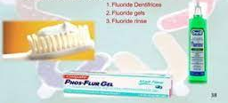
FLUORIDE EXPOSURE
Whether the patient lives in an area with a fluoridated or non-fluoridated water supply, a topical fluoride should be applied after a regularly scheduled professional prophylaxis.
5% neutral sodium fluoride varnishes
Dentifrice containing a therapeutic fluoride compound should also be used daily.
Daily regimen of rinsing with 0.05% sodium fluoride solution.
Nightly application of a 0.4% stannous fluoride or 1,1 % sodium fluoride brush-on gel has also been successfully used to decrease caries in children.

Slide 20
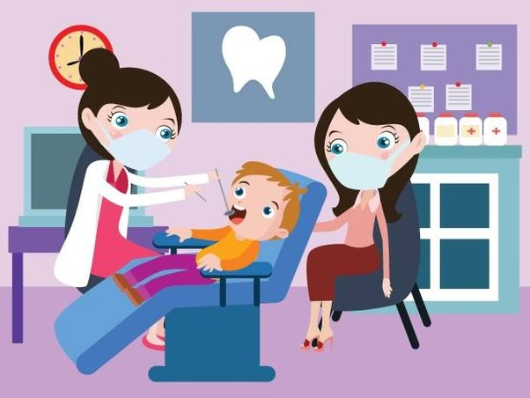
REGULAR PROFESSIONAL SUPERVISION
Regular dental examinations are important in the treatment of patients with SHCN. Although most patients are seen
Certain patients can benefit from recall examinations every 2, 3, or 4 months

Slide 21
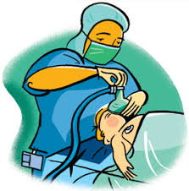
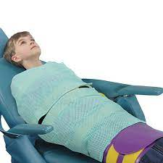
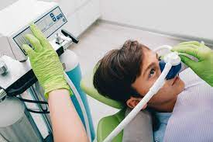
MANAGEMENT OF A CHILD WITH SPECIAL HEALTH CARE NEEDS DURING DENTAL TREATMENT
If patient cooperation cannot be obtained, the dentist must consider alternatives such as protective stabilization, conscious sedation, or general anesthesia to allow the necessary dental procedures to be performed.

Slide 22
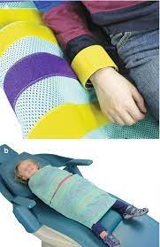
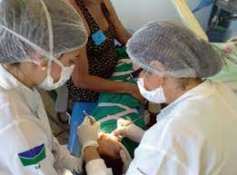
PROTECTIVE STABILIZATION
Partial or complete protective stabilization of the patient is necessary and effective way to diagnose and deliver dental care to patients who need help controlling their extremities, such as infants or patients with certain neuromuscular disorders.
Protective stabilization is also useful for managing combative, resistant patients so that the patient, and/or dental staff may be protected from injury
The consent must be documented before protective stabilization is used.
These individuals should have a clear understanding of the type of stabilization to be used, the rationale, and the duration of use

Slide 23
The use of protective stabilization is indicated in the following situations
A patient requires immediate diagnosis and/or limited treatment and cannot
cooperate because of lack of maturity or mental or physical disability.
(A patient requires diagnosis or treatment and does not cooperate after other behavior management techniques have failed.
The safety of the patient, staff, parent, or practitioner would be at risk without the use of protective stabilization.

Slide 24
The use of stabilization is contraindicated in the following situations:
A cooperative non-sedated patient.
Patients who cannot be safely stabilized due to medical or physical conditions.
Patients who have experienced previous physical or psychological trauma from
protective stabilization
Non- sedated patients with non emergent treatment requiring lengthy appointments.

Slide 25

Note:
Protective stabilization should not be used as punishment and should not be used solely for the convenience of the staff
The tightness and duration of stabilization must be monitored and reassessed at regular intervals; stabilization around the extremities or chest must not actively restrict circulation or respiration
Stabilization should be terminated as soon as possible in a patient who is experiencing severe stress or hysterics to prevent possible physical or psychological trauma

Slide 26
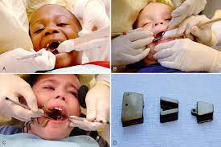
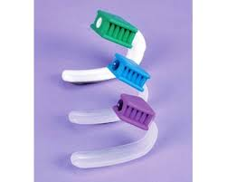
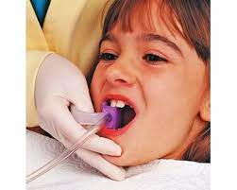
Common mechanical aids for maintaining the mouth in an open position are:
1. Padded and wrapped tongue blades are easy to use, disposable, and inexpensive.
2- Open wide disposable mouth props It has a durable foam core on the end of a tongue depressor. It is also easy to use, disposable, and available in two sizes

Slide 27
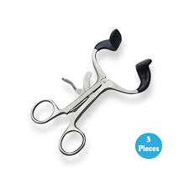
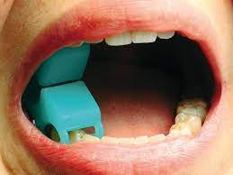
Common mechanical aids for maintaining the mouth in an open position are:
3.Molt Mouth Prop can be very helpful to manage a difficult patient for a prolonged period. It is made in both adult and child sizes
4. Rubber bite blocks can be purchased in various sizes to fit on the occlusal surfaces of the teeth and stabilize the mouth in an open position

Slide 28
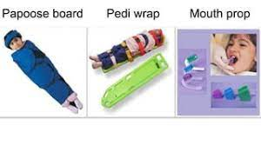
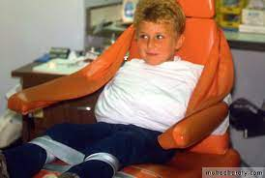
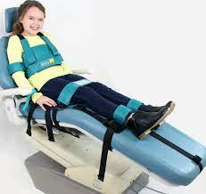
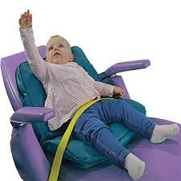
The following are commonly used for protective stabilization
Body
Papoose Board
Triangular sheet
Pedi-Wrap
Beanbag dental chair insert
Safety belt
Extra assistant
Safety belt
Beanbag dental chair insert

Slide 29
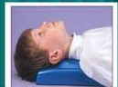
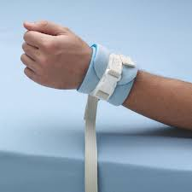
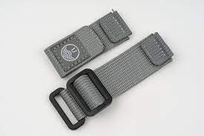
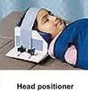
The following are commonly used for protective stabilization
Extremities
Posey straps
Velcro straps
Towel and tape
Head
Forearm-body support
Head positioner
Plastic bowl
Extra assistant
Velcro straps
Posey straps

Slide 30

Thank you

